Slide 1
Research Infrastructures in Horizon 2020
Bernhard Fabianek
European Commission – DG Research & Innovation Research Infrastructures
"The views expressed in this presentation are those of the author and
do not necessarily reflect the views of the European Commission"

Slide 2
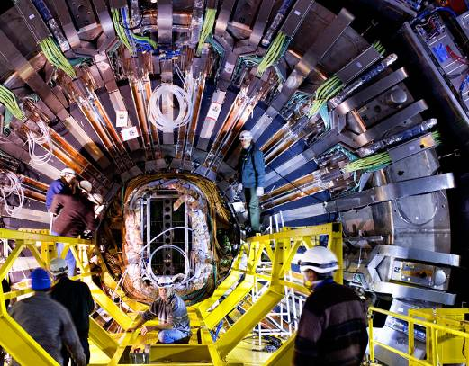
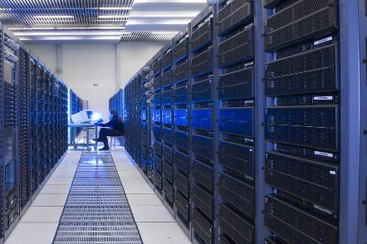
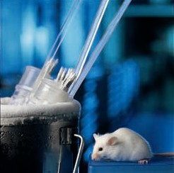
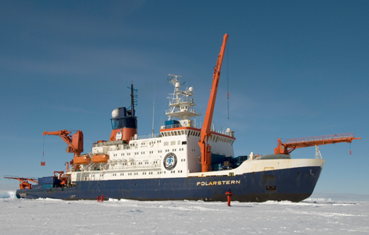
Research Infrastructures
Facilities, resources, organisational systems and services that are used by the research communities to conduct research and innovation in their fields

Slide 3
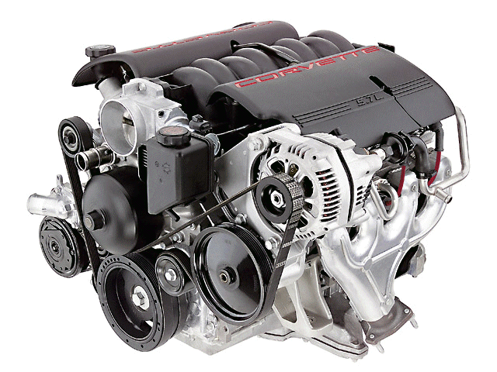
The Knowledge Triangle at Work
To be a genuinely competitive in the knowledge economy, one must be better:
in producing knowledge through research
in diffusing it through education
in applying it through innovation
Research-Infrastructures
research
education
innovation

Slide 4
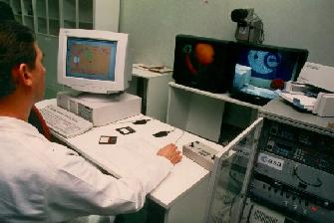
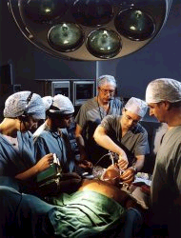
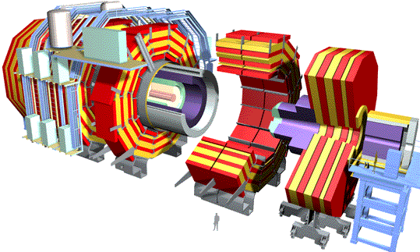
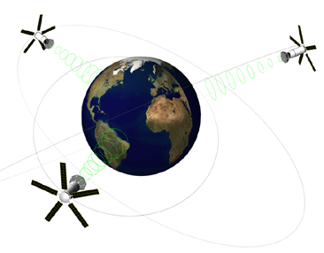

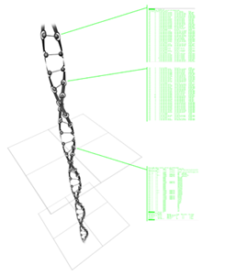
Global Virtual Research Community
e-Science
e-Health
e-Learning
e-Business
aeronautics
genomics
environment
astronomy
Infrastructure
security
semantic web.
broadband
automatic
management
Grid
mobility

Slide 5
Why an EU Approach for
Research Infrastructures?
To open access to the research infrastructures existing in the individual Member State to all European researchers
To avoid duplication of efforts and to coordinate and rationalise the use of these research infrastructures
To trigger the exchange of best practice, develop interoperability of facilities and resources, develop the training of the next generation of researchers
To connect national research communities and increase the overall quality of the research and innovation
To help pooling resources so that the Union can also acquire and operate research infrastructures globally

Slide 6
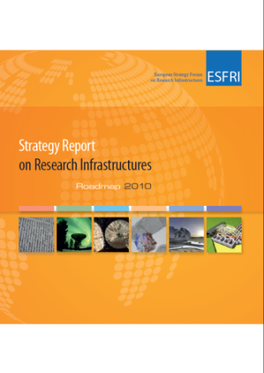
European Strategy Forum on Research Infrastructures - The Process
ESFRI Road-map
RI proposal by Member State
ESFRI
TWG1
TWG2
TWG3
Recommended
projects
and analysis of
landscape
Pan-European
Science case
Technical case
Business case
Overall maturity

Slide 7
ESFRI Roadmap 2010
Social Sc. & Hum. ( 5 ) | Life Sciences ( 13 ) |  | Environmental Sciences ( 9 ) |  | Energy ( 7 ) | Material and Analytical Facilities ( 6 ) | Physics and Astronomy ( 10 ) |  | e-Infra- structures (1)
SHARE | BBMRI | ELIXIR | ICOS | EURO-ARGO | ECCSEL | EUROFEL | ELI | TIARA | PRACE
European Social Survey | ECRIN | INFRA FRONTIER | LIFEWATCH | IAGOS | Windscanner | EMFL | SPIRAL2 | CTA
CESSDA | INSTRUCT | EATRIS | EMS | EPOS | EU-SOLARIS | European XFEL | E-ELT | SKA
CLARIN | EU-OPENSCREEN | EMBRC | SIAEOS | EISCAT_3D | JHR | ESRF Upgrade | KM3NeT | FAIR
DARIAH | Euro BioImaging | ERINHA BSL4 Lab |  | COPAL | IFMIF | NEUTRON ESS | SLHC-PP | ILC-HIGRADE
 | ISBE | MIRRI |  |  | HiPER | ILL20/20 Upgrade
 | ANAEE |  |  |  | MYRRHA
 | Distributed research infrastructures
 | Single sited research infrastructures

Slide 8
Implementation of ESFRI projects
  «A combination of resources from national budgets, Community programmes, EIB instruments and structural funds should lead to the development of excellent research infrastructures throughout Europe»
  EU Council of Research Ministers March 2009
Notes:
8

Slide 9
The ESFRI Process cont.
ESFRI
Incubator Role
ESFRI Road-map
EC
Funding of Preparatory Phase
Member States
Funding of Implementation
Phase and Operation
Finalise concept
and design
RI Organisation
Legal framework
Business plan
Finance model
Support from EC
Structural Funds
Support from EC
Horizon2020

Slide 10
Innovation vs. Economic Output
Source: Mikel Navarro et al, Basque Competitiveness Institute, 2010

Slide 11
Status of implementation
  Social Science and Humanities (SSH): SHARE (ERIC); CLARIN (ERIC); ESSurvey (ERIC application)
  Environmental Sciences (ENV): EURO-ARGO (ERIC application)
  Biological and Medical Sciences (BMS): EATRIS (ERIC application); ECRIN (ERIC application); INSTRUCT (ICA, Ltd); ELIXIR (ICA, EMBL special project)
  Energy: JHR (ICA)
  Engineering, Physical Sciences, Materials and Analytical Facilities (EPS): ESRF upgrade (EIRO, société civile); European XFEL (EIRO, GmbH); ILL 20/20 upgrade (EIRO, société civile); FAIR (GmbH); SPIRAL2 (CNRS/CEA)
  e-Infrastructures: PRACE (AISBL)

Slide 12
ESFRI Research
Infrastructures
under construction

Slide 13
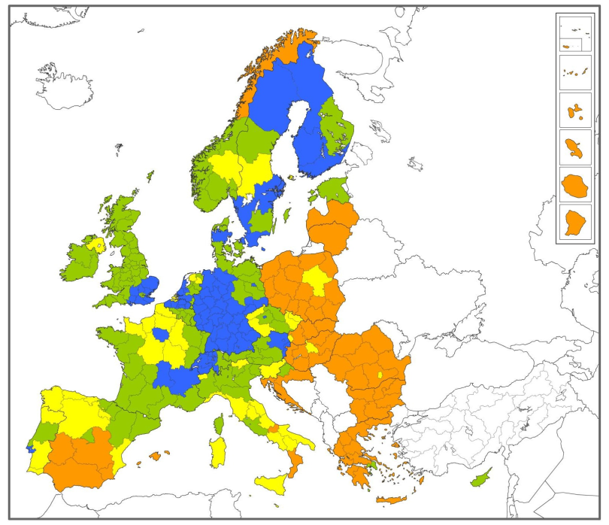

Regional Innovation
Scoreboard 2012
ESFRI Research
Infrastructures
under construction

Slide 14

Hosted ESFRI Research
Infrastructures
Participating in ESFRI
Research Infrastructures

Slide 15
National Support ESFRI Roadmap 2010
Social Sc. & Hum. ( 5 ) | Life Sciences ( 13 ) |  | Environmental Sciences ( 9 ) |  | Energy ( 7 ) | Material and Analytical Facilities ( 6 ) | Physics and Astronomy ( 10 ) |  | e-Infra- structures (1)
SHARE | BBMRI | ELIXIR | ICOS | EURO-ARGO | ECCSEL | EUROFEL | ELI | TIARA | PRACE
European Social Survey | ECRIN | INFRA FRONTIER | LIFEWATCH | IAGOS | Windscanner | EMFL | SPIRAL2 | CTA
CESSDA | INSTRUCT | EATRIS | EMSO | EPOS | EU-SOLARIS | European XFEL | E-ELT | SKA
CLARIN | EU-OPENSCREEN | EMBRC | SIOS | EISCAT_3D | JHR | ESRF Upgrade | KM3NeT | FAIR
DARIAH | Euro BioImaging | ERINHA BSL4 Lab |  | COPAL | IFMIF | NEUTRON ESS | SLHC-PP | ILC-HIGRADE
 | ISBE | MIRRI |  |  | HiPER | ILL20/20 Upgrade
 | ANAEE |  |  |  | MYRRHA
NFFA
C-ERIC
 | Distributed research infrastructures
 | Single sited research infrastructures
Hosting countries
Participating countries

Slide 16
Commitments within the Innovation Union
By 2015 (…) have completed or launched the construction of 60% of the priority European research infrastructures currently identified by ESFRI (…).
… opening of Member State operated research infrastructures to the full European user community …
The European Union should step up its cooperation on the roll-out of the
global research infrastructures…

Slide 17
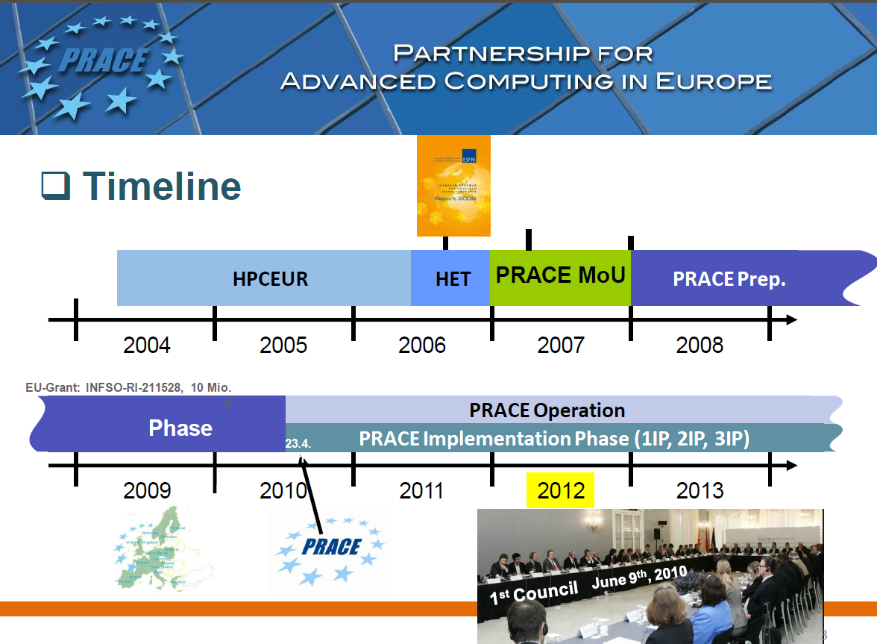
Framework Programme
Framework Programme
ESFRI
Framework Programme
ESFRI
Framework Programme - ESFRI
Structural Funds

Slide 18









e-Infrastructures
Structural
Funds
Horizon2020
Open
AIRE
EUDAT
IMPACT
METAFOR
EuroVO-AIDA
GENESI-DR
neuGRID
EUFORIA
D4SCIENCE
ETSF
PRACE
EGI
network computing data
FEDERICA
EVALSO
AUGERaccess
GÉANT
generic e-Infrastructure… user communities involvement

Slide 19

ERIC: European Research Infrastructure Consortium
  A new legal framework, at EU level, to facilitate the joint establishment and operation of Research Infrastructures of European interest among several countries
  A legal personality recognised in all EU Member States
  Current status:
    First ERIC status awarded to SHARE on
    17 March 2011, hosted by NL
    Second ERIC status awarded to CLARIN on
    29 February 2012, hosted by NL

Slide 20


National
Roadmaps
for Research
Infrastructures
Roadmap in place
Roadmap under preparation
National funding reserved for new/updated RIs

Slide 21

Cohesion policy 2014-2020 & EU 2020
Commission adopted its proposals 6 October 2011:
  Cohesion policy (ERDF, CF & ESF) will focus on Europe 2020 objectives for smart, sustainable and inclusive growth, along with rural development policy (EAFRD) and maritime and fisheries policy (EMFF),
  List of thematic objectives developed around the Europe 2020 headline targets and flagship initiatives
  Thematic concentration for maximising impact: minimum shares for research and innovation through ERDF
  Ex-ante conditionality, e.g. existence of a Research and Innovation Strategy for Smart Specialisation (RIS3).
  Commission has adopted “Elements for a Common Strategic Framework 2014 to 2020” for cohesion. Linkages have been clarified with Horizon 2020.

Slide 22
Smart Specialisation
Research & Innovation Strategies for Smart Specialisation (RIS³) will lead to an economic transformation based on 4Cs:
(Tough) Choices: select few priorities on the basis of international specialisation integration on international value chains
Competitive (Constructed) Advantage: mobilize talent by matching Research & Innovation with business needs & capacities
Critical Mass: provide arenas for cross-cutting links between sectors which drive specialised technological diversification; address generic technologies, based on cutting edge research, as well as their exploitation and adaptation to specific sectors
Collaborative Leadership: efficient innovation systems as a collective endeavour based on public-private partnership (quadruple helix) and synergies between funding instruments from the EU, national and regional policies

Slide 23
Research Infrastructures in Horizon 2020
Developing the European RIs for 2020 and beyond
  Developing new world-class RIs – ESFRI+
  Integrating and opening national RIs
  of pan-European interest – Integrating Activities
  Development, deployment and operation of ICT based e-Infrastructures
Fostering the innovation potential of RIs and their human capital
Reinforcing European RI policy and
international cooperation

Slide 24
Specific Implementation Aspects
Development, Deployment & Operation of e-Infrastructures
Integrating and Operating national RIs of pan- European Interest
Developing new world-class RI
Fostering the Innovation Potential of Research Infrastructures and
their Human Capital
Reinforcing European Research Infrastructure Policy and
International Cooperation

Slide 25
Integrating and Opening existing National RIs of pan-European Interest
To open up key national research infrastructures to
all European researchers and to ensure their optimal use and joint development
Support to “European Research Infrastructures Networks” bringing together infrastructures
in a given field
Continuation of the FP7 Integrating Activities and I3s
Activities will cover: Transnational and virtual access;
Networking to foster a culture of cooperation; Joint research to improve the services provided by the infrastructures

Slide 26
Exploiting the innovation potential of research infrastructures
R&D partnerships with industry to develop Union capacities and industrial supply in high-tech areas such as scientific instrumentation or ICT;
Stimulate the use of research infrastructures by industry, e.g. as experimental test facilities, innovation hubs, knowledge-based centres;
Encourage the integration of research infrastructures into local, regional and global innovation systems;
Pre-commercial procurement by research infrastructure actors to drive forward innovation and act as early adopters of technologies.

Slide 27
Priorities and Vision for Horizon 2020
Adopt adequate organizational and
governance models
Pool and reinforce regional capacities
Consolidate RIs as a multi-disciplinary platform for regional/global collaborations
Support international collaborations that are strategic for European scientific partnerships

Slide 28

Thank you for your Attention!
Find out more:
www.ec.europa.eu/research/horizon2020

