Slide 1

Report to ECFA, November 22nd 2012
Dave Barney, Michael Kobel: IPPOG Co-chairs

Slide 2
IPPOG 2012 - Overview
IPPOG Membership
International Masterclasses
  Driving the public use of LHC data!
Education & Outreach Collection
IPPOG @ International Conferences
IPPOG chairs 2013-2016
Summary/Resources…..
Discovering Particle Physics Together

Slide 3
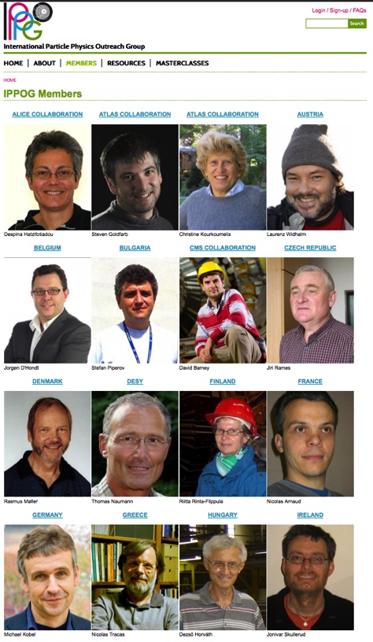
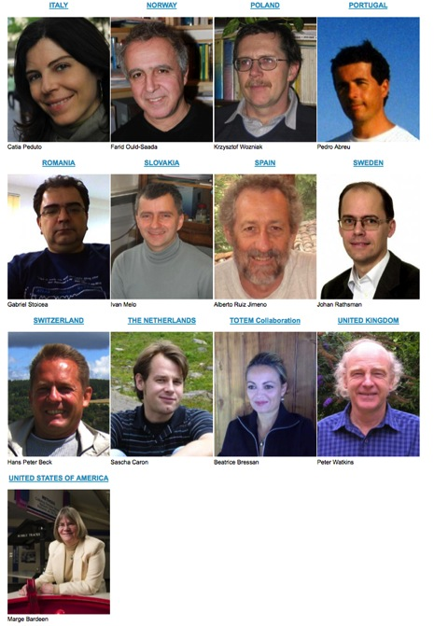
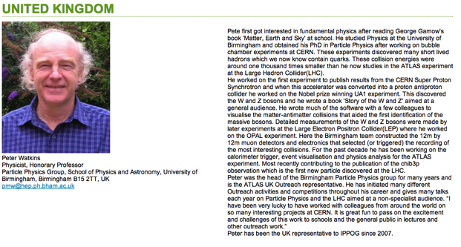
IPPOG Membership (1)
New IPPOG Website includes
members page with profiles

Slide 4
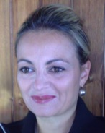
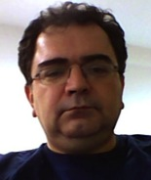
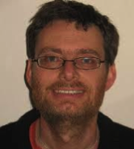
IPPOG Membership (2)
In 2012 we have invited TOTEM, Romania, Ireland, Israel, India
  TOTEM: Beatrice Bressan
  Romania: Gabriel Stoicea
  Ireland: Jonivar Skullerud
  Both Israel and India seeking appropriate member

Slide 5

International Masterclasses (1)
High school students become “scientists for a day” at a local University/Institute
“enquiry-based learning exercise” on real data from LHC
Discussion of results via video conference with other participants & CERN – just like we do!
Interest expressed for 2013:
India
China
Australia
Georgia
Romania
Cyprus
Palestine
Turkey

Slide 6
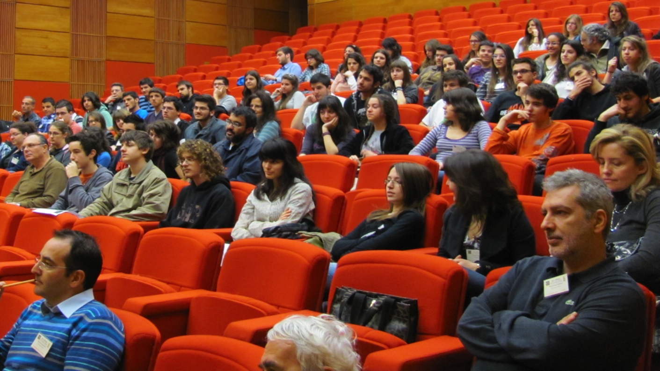
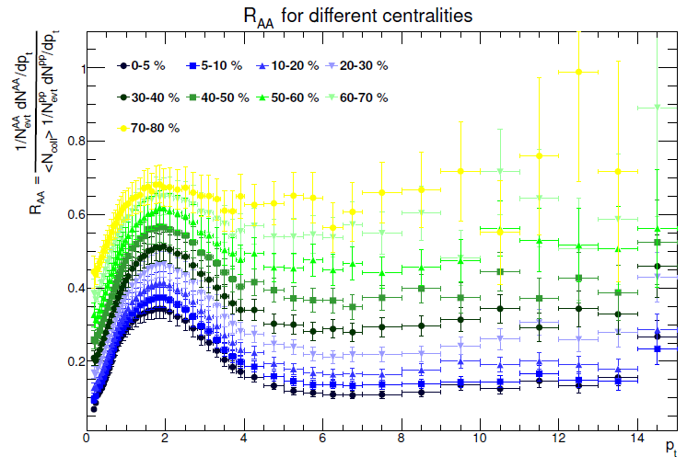
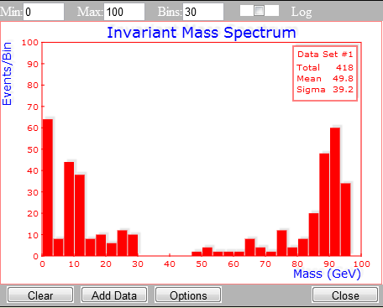


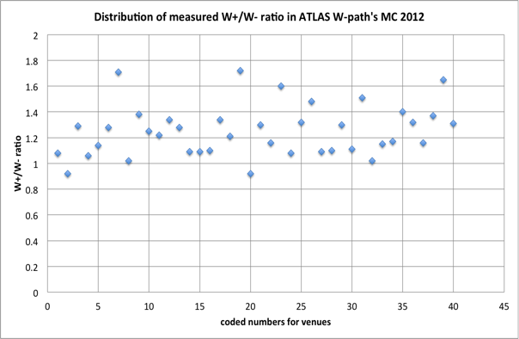

International Masterclasses (2)
Real LHC data from ALICE, ATLAS, CMS:
In 2013 we will also have real Higgs events!

Slide 7
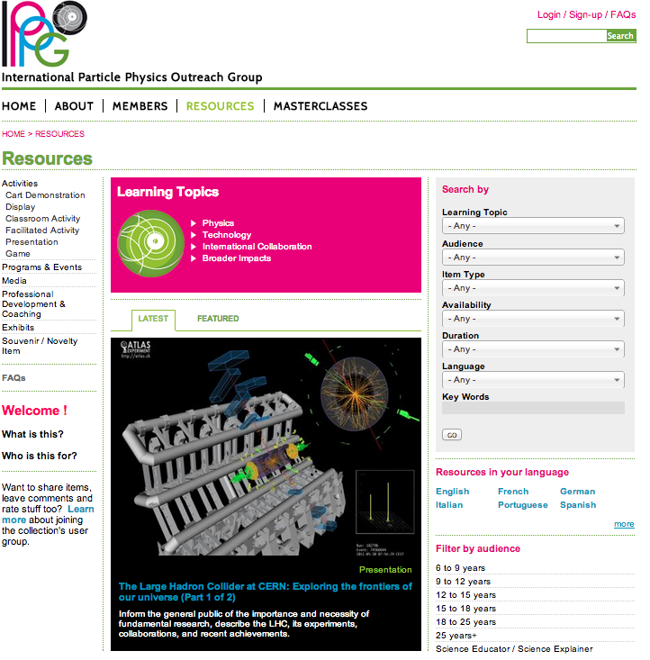
IPPOG E&O Resource Collection
First-ever global collection of materials for particle physics E&O
  Provides materials and ideas for public talks, exhibitions and informal education activities
  Hundreds of items
  Videos, photos, presentations, descriptions of physics goals of LHC etc., ideas for educational activities
  Multiple languages
  All items carefully tagged to facilitate finding the “right stuff”
  Growing number of external contributors
  Does require maintenance

Slide 8
IPPOG @ Conferences (1)
Reminder from IPPOG presentation to ECFA 2011
Proposal to get increased visibility of IPPOG (and E&O in general) at other International Conferences, such as ICHEP 2012 (Melbourne, Australia, July 2012) and 1st World Conference on Physics Education (Istanbul, Turkey, July 2012)
Achieved:
ICHEP: IPPOG-organized parallel session, masterclass, museum exhibit, TV/radio…
WCPE: Oral presentation on masterclasses + hands-on workshop
ESOF: 90-minute IPPOG session

Slide 9
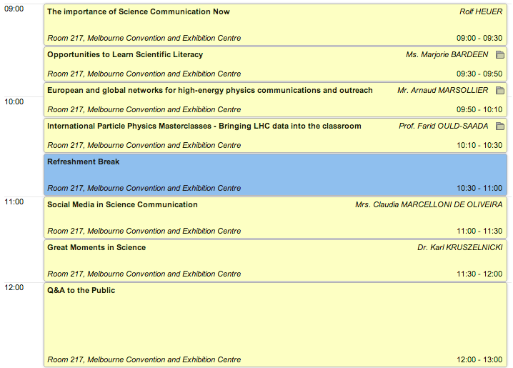
IPPOG @ ICHEP (Melbourne)
4-hour parallel session
About 30 attendees (in parallel to Higgs!)
“Hangout on air” video conference with the public very well attended
- included audience participation
(“Hangouts on air” now held every week from CERN to worldwide audience)
All-Star Cast!!!

Slide 10
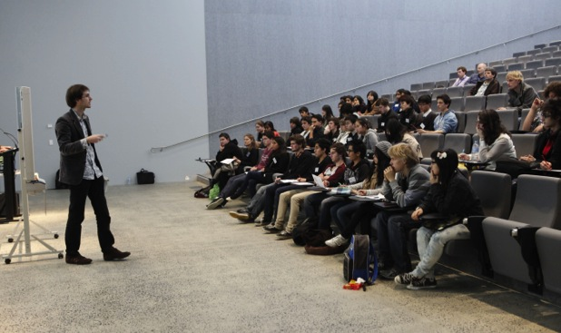
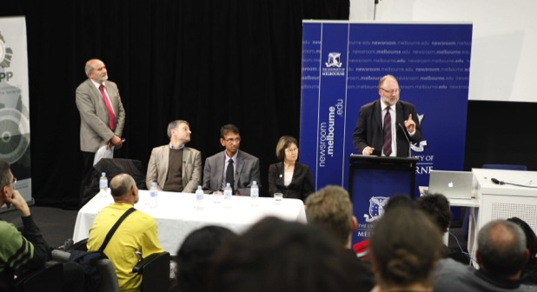
IPPOG @ ICHEP (cont.)
Masterclass
Panel Discussion

Slide 11
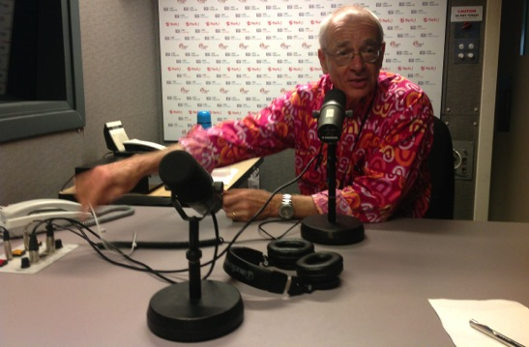
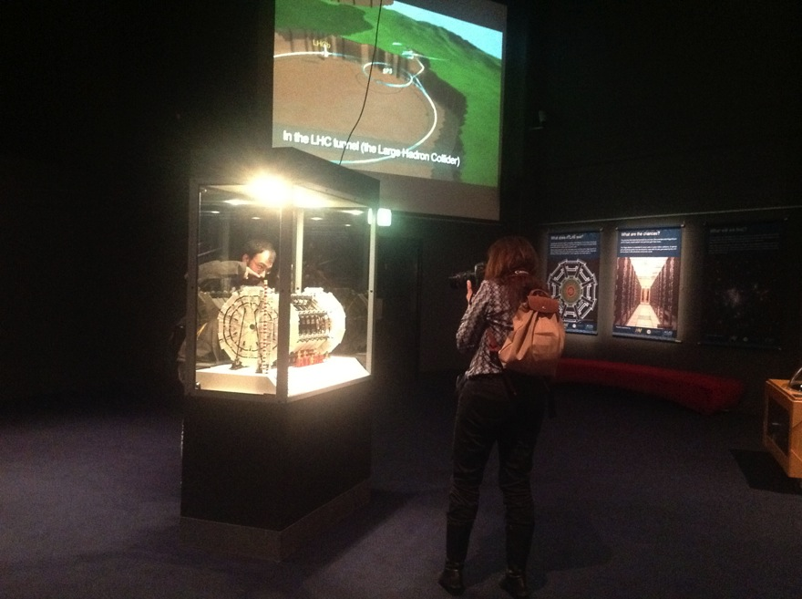
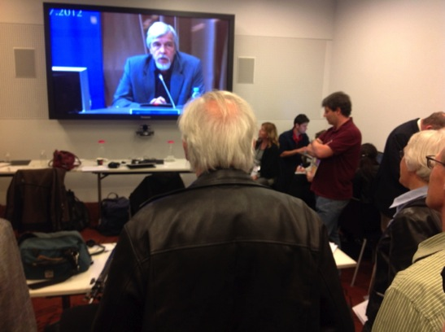
IPPOG @ ICHEP (cont.)
Radio
Press Room
Museum Exhibit

Slide 12
IPPOG @ WCPE (Istanbul)
Theme: The Role of Context, Culture and Representation in Physics Teaching and Learning
500 physics educators, teachers, researchers, policy makers
IPPOG Workshop (Experiencing data analysis from the world‘s largest science experiment):
ATLAS W-path measurement (90 min)
Attendees from India, Iran, Czech Republic, China, Japan, Turkey, Portugal
Reception:
Fascinated by the idea of LHC data analysis in the classroom or at home
Website seen as a pleasant (and useful) environment

Slide 13
IPPOG @ ESOF (Dublin)
Europe’s largest general science meeting (5000 attendees)
IPPOG 90min panel discussion:
  Best practice in sharing the research process with the public
    Paul Hix, German Museum Munich: established Open Research Laboratory on Nanoscience in the museum
    Marianne Fokkens, Dutch National Natural History Museum: Museum opened up more of its collection and research to the public, interactive exhibitions and activities, e.g. crowdsourcing
    Tom McCauley, QuarkNet / I2U2 / CMS
    Michael Kobel, IPPOG
  100 participants, lively discussion

Slide 14
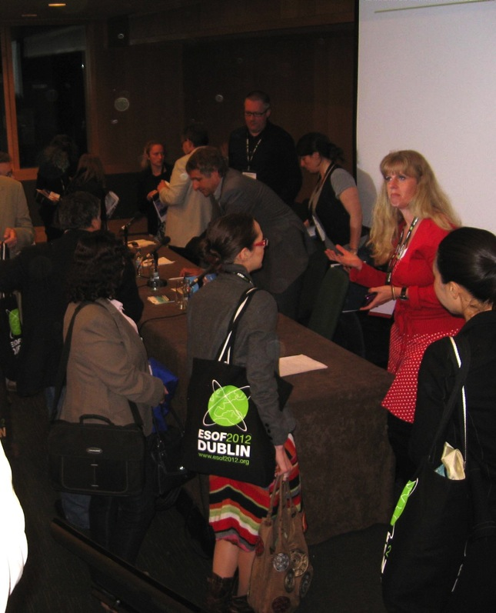
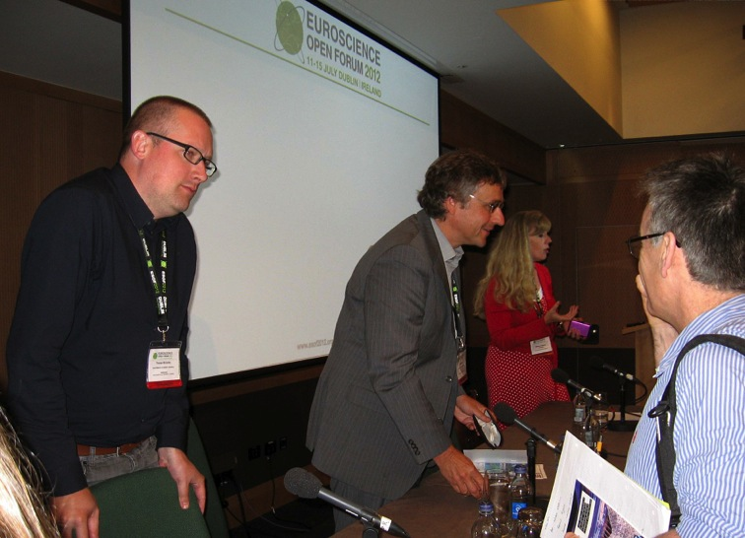
IPPOG @ ESOF (cont.)

Slide 15
IPPOG @ Conferences
International conferences are receptive to E&O sessions
  Plenary talks very well attended
  Parallel talks less well attended – especially when in parallel to sessions on new Higgs results!
Perhaps try for EPS or Lepton/Photon in 2013…

Slide 16
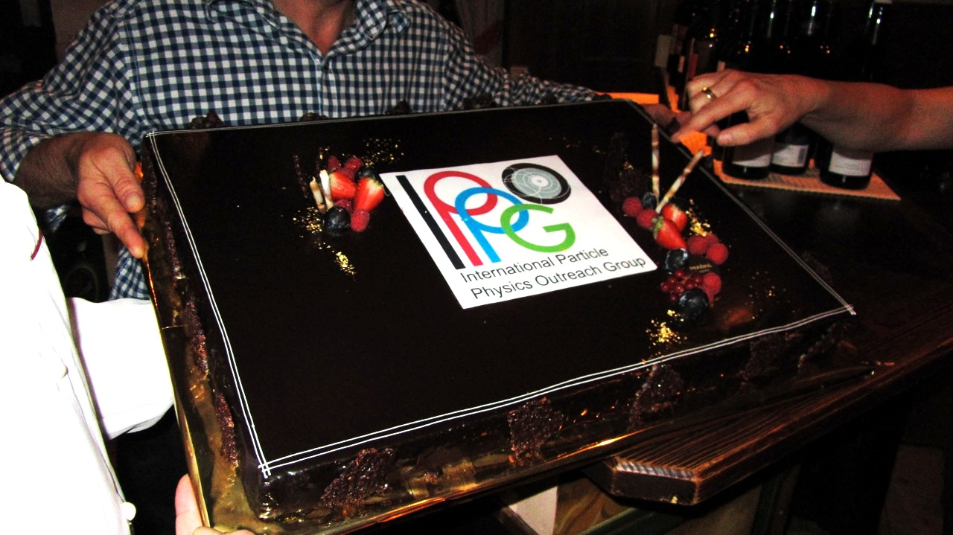
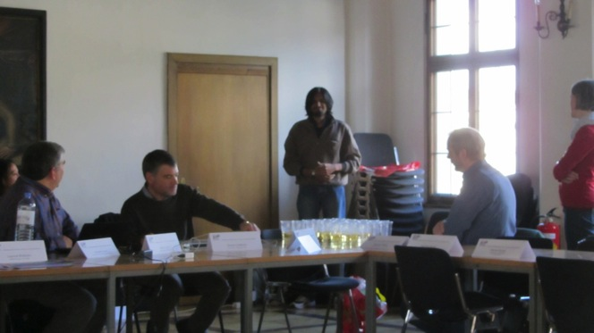
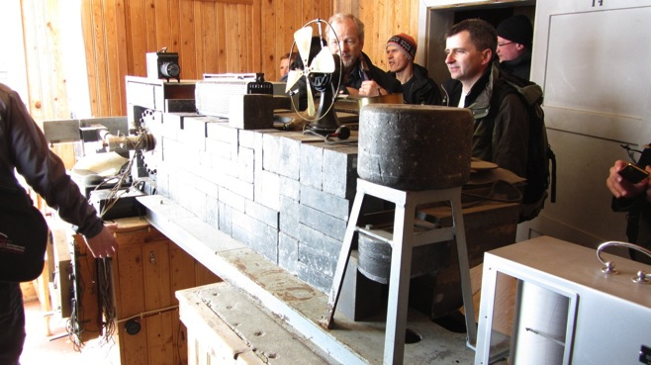
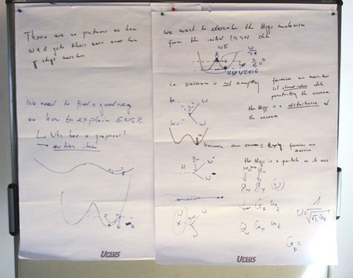
IPPOG Meeting @ Innsbruck
Spring Meeting in Innsbruck, Austria, including visit to Hess’ lab.

Slide 17
IPPOG Co-chairs
Michael Kobel & Dave Barney reach the end of their 3-year mandate at the end of 2012
Two co-chairs, rather than 1 chair, deemed most efficient, with increased IPPOG activities
3 candidates for next co-chairs:
  Marge Bardeen (USA)
  Hans Peter Beck (Switzerland)
  Steven Goldfarb (ATLAS)
Election to take place at IPPOG meeting 30th Nov.

Slide 18
IPPOG: Summary (1)
Much progress and additional activities in 2012
Working Groups active between meetings
  Especially group to develop simple – but correct – Higgs mechanism/boson explanations
Expansion underway, with much interest
Plans for 2013:
  Continued expansion of IPPOG
  Organization of International Masterclasses & help with spin-off programmes
  Continued participation in International Conferences (already invited to MRS conference in San Francisco, spring 2013)
  Further development of web-site and database to “package” materials for teaching purposes – but manpower needed

Slide 19
IPPOG: Summary (2)
Funding (at a relatively modest level) is invaluable for many of our activities. Currently we are extremely thankful to:
  Helmholz Alliance (“Physics at the Terascale”), TU Dresden, EPS-HEPP, QuarkNet, I2U2, FNAL for Masterclasses
    funding from Germany ends at the end of 2012
      Lost 80% funding of the DVDs distributed to all Masterclass participants (about 10k CHF)
    CERN DG has agreed to take over funding of Masterclass central coordinator Uta Bilow (50% FTE) from January 2013 – thank you!
  60% FTE @ CERN for database, organization: CERN DG (funding assured until end 2012)
    But Lisa McCarthy has now left; need to find a replacement for 2013-

