Slide 1
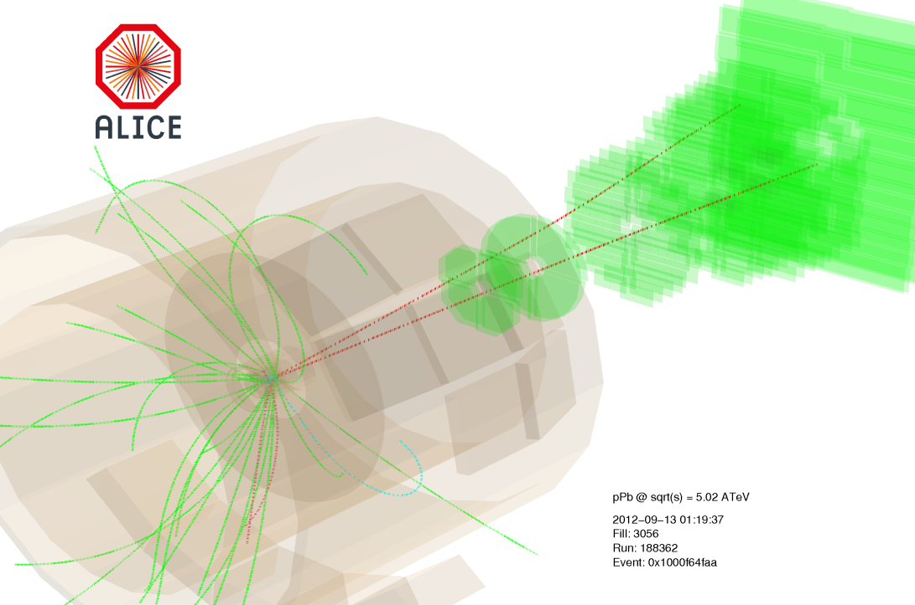

ALICE results on quarkonium production in p-Pb collisions
Roberta Arnaldi
INFN Torino (Italy)
for the ALICE Collaboration
Workshop on proton-nucleus collisions at the LHC
ECT* Trento, 6-10 May 2013

Slide 2
ALICE results on quarkonium production in p-Pb collisions
First ALICE results on J/ψ production from the 2013 p-Pb run:
J/ψ nuclear modification factor R_{pA} in the range 2.5<y_{LAB}<4 and -4<y_{LAB}<-2.5
J/ψ forward to backward ratio R_{FB} in the range 2.96<y_{CMS}<3.53
Differential J/ψ R_{pA} versus y and R_{FB} versus y and p_{T}
Comparison with theoretical models

Slide 3

Quarkonium production in p-A
Several aspects on quarkonium production can be addressed studying its behaviour in p-A collisions:
Production models:
the study of the interaction of the cc pair with the nuclei provides constraints to the production models
→ the strength of this interaction may depend on the cc quantum states and
kinematics (R.Vogt, Nucl.Phys. A700,539 (2002), B.Z. Kopeliovich et al, Phys. Rev.D44, 3466 (1991))
Initial/final state nuclear effects:
J/ψ behaviour in cold nuclear matter (CNM) can be investigated
→ complicated issue, interplay of many competing mechanisms
Initial state
shadowing, saturation,
initial state energy loss,
intrinsic charm
Final state
cc in-medium dissociation
final state energy loss
Reference for understanding dissociation in a hot medium
knowledge of J/ψ behaviour in p-A is fundamental to disentangle genuine QGP effects in A-A collisions
→ approach followed at SPS (p-A) and similarly at RHIC (d-Au data)

Slide 4
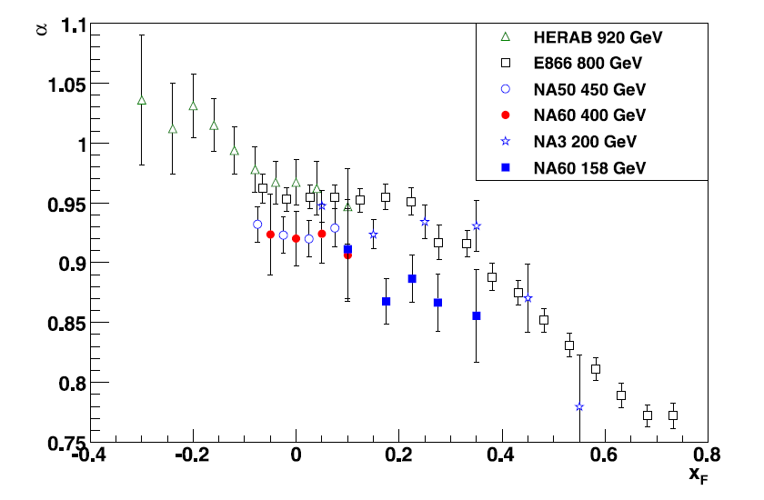
Cold nuclear matter effects
Crossing of the nuclear matter by the cc pair can be investigated, under different conditions, varying √s, colliding nuclei, kinematics…
constraints can be provided to theoretical models in order to disentangle the different CNM mechanisms
From a compilation of fixed target results of J/ψ α vs x_{F}:
J/ψ yield in p-A is suppressed with respect to pp collisions
suppression increases with x_{F} (forward y)
CNM effects are more important at low √s
NA60 Coll., Phys. Lett. B 706 (2012) 263-367
Notes:
(at x_{F}~0 clear hierarchy between
HERA-B, E866, NA50 and NA60)

Slide 5
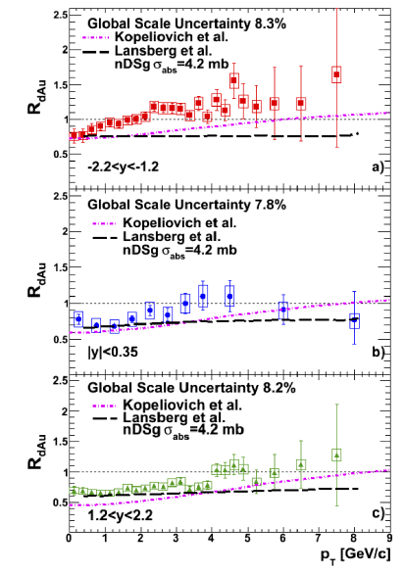
Cold nuclear matter effects
RHIC: the nuclear modification factor R_{dAu} is studied versus centrality, y and p_{T}
disentangling CNM mechanisms is challenging
theoretical description still meets difficulties!
LHC data should help to clarify this scenario:
short crossing time of the cc pair in the nuclear matter → final state effects might be negligible (in particular at forward y)
dominant effects should be shadowing and/or energy loss
low-x probed region → parton saturation effects can also be investigated
A. Frawley (PHENIX Collab.) arXiv:1209.1159

Slide 6
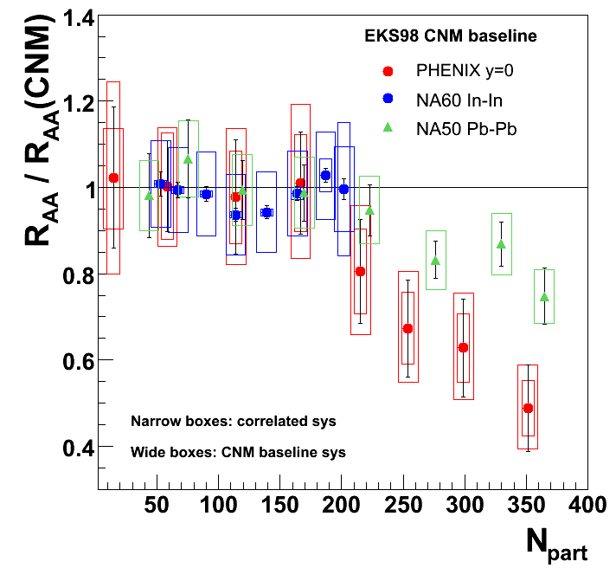
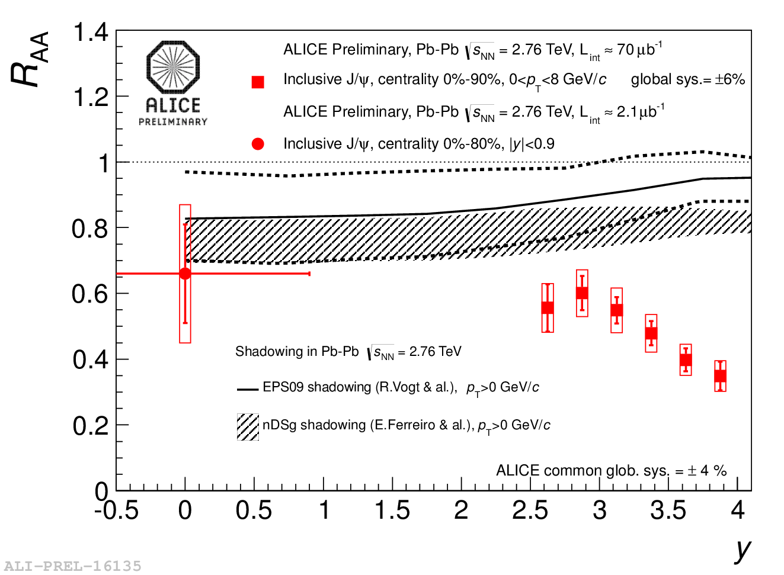
p-A as a reference for A-A
Charmonium suppression is predicted to be a signature for QGP formation as indeed observed at SPS, RHIC and LHC
N. Brambilla et al., arXiv:1010.5827
Lower energy experiments:
p-A (d-A) data collected in the same kinematic domain as A-A turned out to be crucial to interpret A-A results
LHC energies:
sizeable CNM effects (shadowing)
p-A results will help to quantify J/ψ dissociation in the hot matter

Slide 7
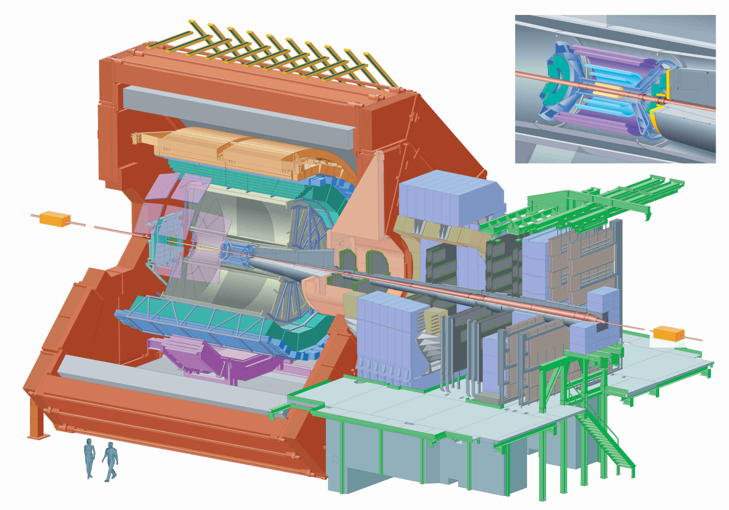
Quarkonium measurement in ALICE
Quarkonium in ALICE can be measured in two ways:
Central Barrel J/ψ →e⁺e⁻
(|y_{LAB}|<0.9)
Electrons tracked using ITS and TPC
Particle identification: TPC, TOF, TRD
Forward muon arm J/ψ →μ⁺μ⁻
(2.5<y_{LAB}<4)
Muons identified and tracked in the muon spectrometer
Acceptance coverage in both y regions down to zero p_{T}
ALICE results presented in this talk refer to inclusive J/ψ production in the μ⁺μ⁻ decay channel
µ⁺
e⁺
e⁻
µ⁻

Slide 8

p-A collisions at √s_{NN} = 5.02 TeV
Results from data collected in January/February 2013
Beam energy: √s_{NN} = 5.02 TeV
Energy asymmetry of the LHC beams (E_{p} = 4 TeV, E_{Pb}= 1.58 A⋅TeV)
→ rapidity shift Δy= 0.465 in the proton direction
Beam configurations:
Data collected with two beam configurations: p-Pb and Pb-p in the range 2.5<y_{LAB}<4
p
Pb
Pb
p
2.03<y_{CMS}<3.53
-4.46<y_{CMS}<-2.96
Integrated luminosity used for this analysis:
p-Pb (2.03<y_{CMS}<3.53) ~ 4.9 nb⁻¹
p-Pb (-4.46<y_{CMS}<-2.96) ~ 5.5 nb⁻¹
Notes:
to improve the purity of the
muon sample, both muons
reconstructed in the tracking
and trigger chambers should
satisfy the trigger algorithm
→ reduction of hadronic
background and fake tracks

Slide 9
Physics observables
Nuclear effects on J/ψ production can be parameterized via:
Nuclear modification factor R_{pA}:
Pros:
The full coverage of the ALICE muon spectrometer 2.5<y_{LAB}<4 can be exploited
Cons:
Rely on an estimate of the σ^{J/ψ}_{pp} reference at √s_{NN}=5.02TeV
Forward to backward ratio R_{FB}:
Pros:
Does not depend on the estimate of the σ^{J/ψ}_{pp} reference at √s_{NN}=5.02TeV
Cons:
The forward and backward yields have to be computed in the common (restricted) y_{CMS} range 2.96< |y_{CMS}|< 3.53

Slide 10
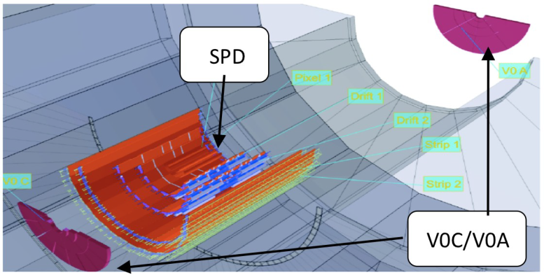
Event selection
Event selection:
Rejection of beam gas and electromagnetic interactions (VZERO and ZDC)
SPD used for vertex determination
µ⁺
µ⁻
VZERO
Muon track selection:
Muon trigger matching
-4<η_{μ}<‐2.5
17.6<R_{abs}<89 cm
(R_{abs}= track radial position at
the absorber end)
2.5<y^{μμ}_{LAB}<4
Trigger:
Dimuon trigger: coincidence of a minimum bias (MB) interaction with two opposite sign muon tracks detected in the trigger chambers of the Muon Spectrometer.
MB trigger efficiency ~99% for NSD events
Notes:
to improve the purity of the
muon sample, both muons
reconstructed in the tracking
and trigger chambers should
satisfy the trigger algorithm
→ reduction of hadronic
background and fake tracks

Slide 11
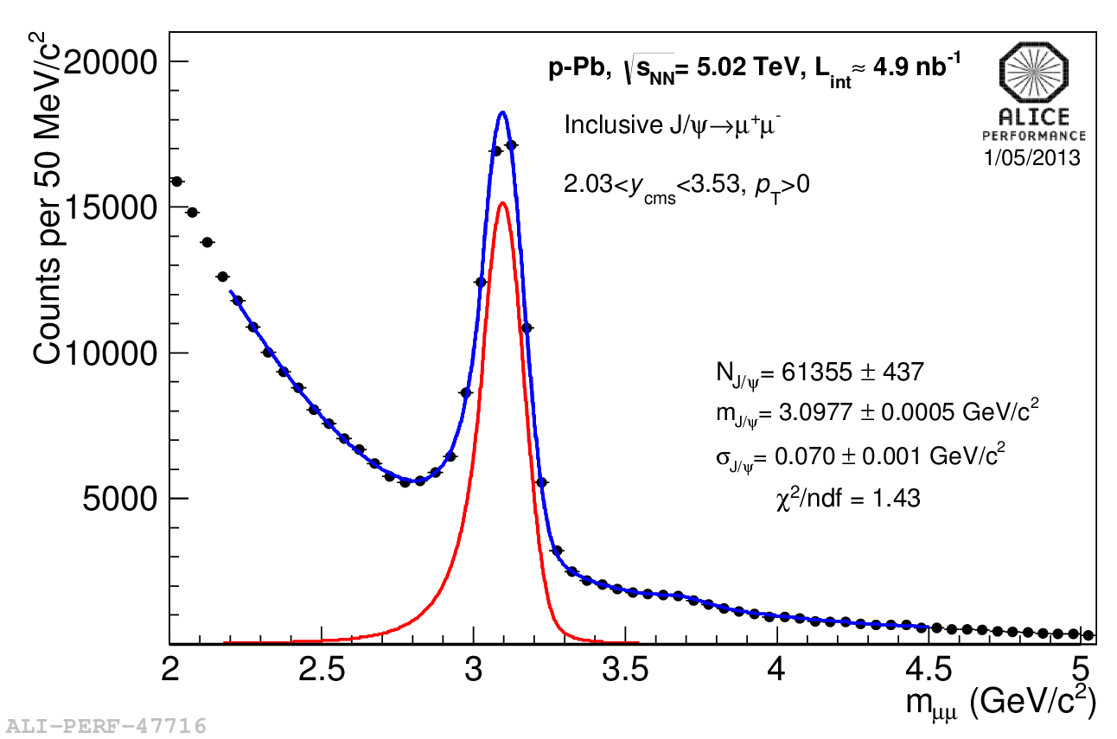
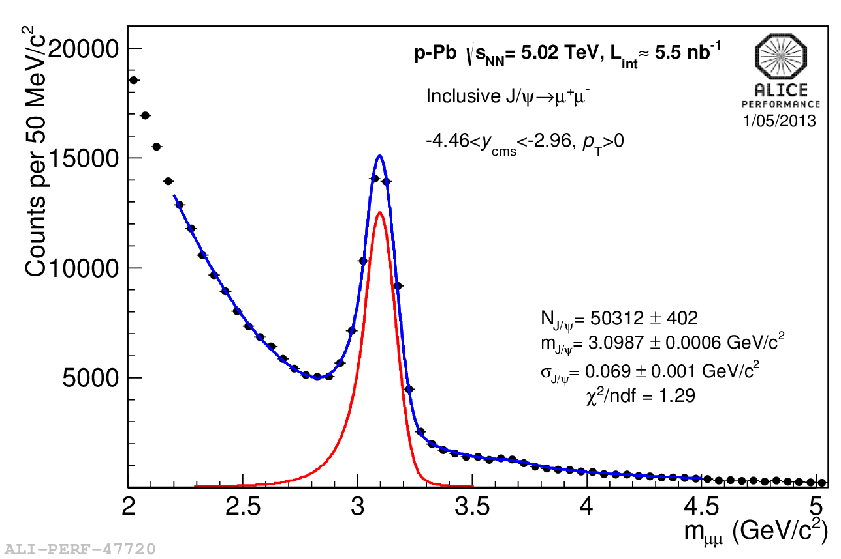
J/ψ → μ⁺μ⁻ signal
  J/ψ yield extracted fitting the opposite sign dimuon invariant mass spectrum with a superposition of signal and background shapes:
Signal: shape described by
an extended Crystal Ball function or other pseudo-gaussian phenomenological shapes
Background: several functions tested, as a variable width gaussian or combinations of exponential x polynomial functions
Notes:
More details in the backup slides

Slide 12
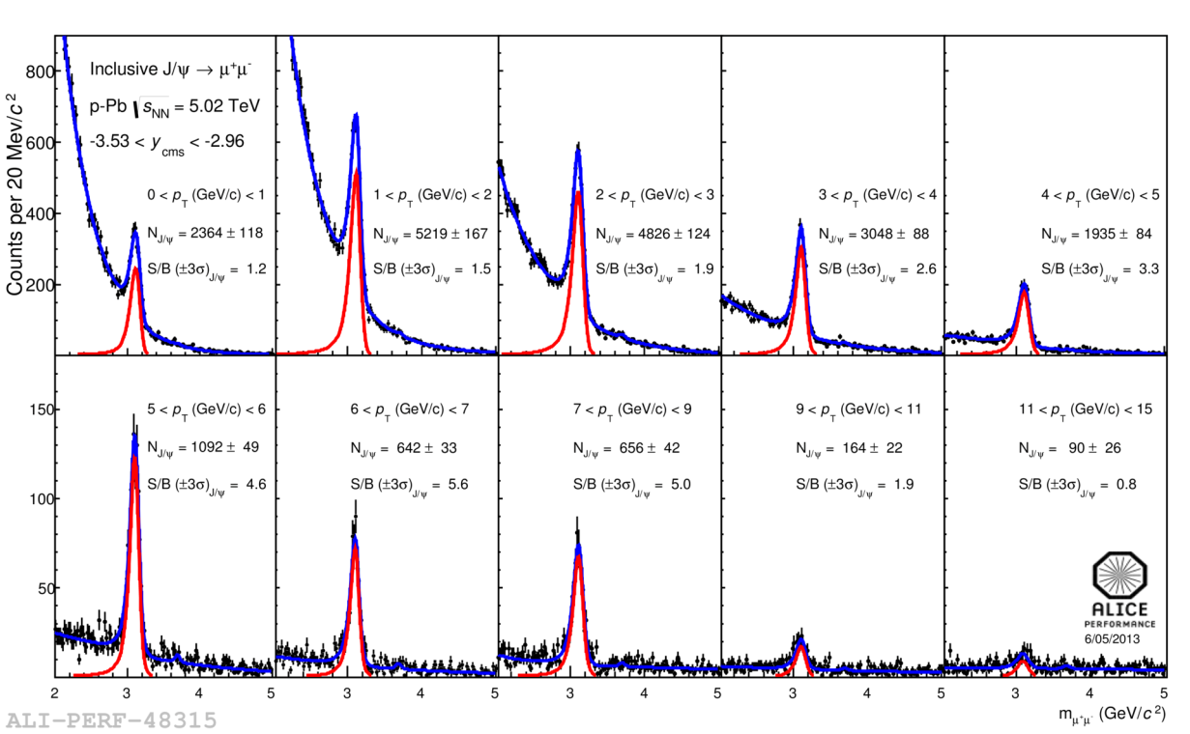
J/ψ → μ⁺μ⁻ signal
  J/ψ yield extracted fitting the opposite sign dimuon invariant mass spectrum with a superposition of signal and background shapes:
Signal: shape described by
an extended Crystal Ball function or other pseudo-gaussian phenomenological shapes
Background: several functions tested, as a variable width gaussian or combinations of exponential x polynomial functions
Thanks to the large collected statistics, J/ψ yields can be extracted also in kinematic bins (y, p_{T})
Notes:
More details in the backup slides

Slide 13
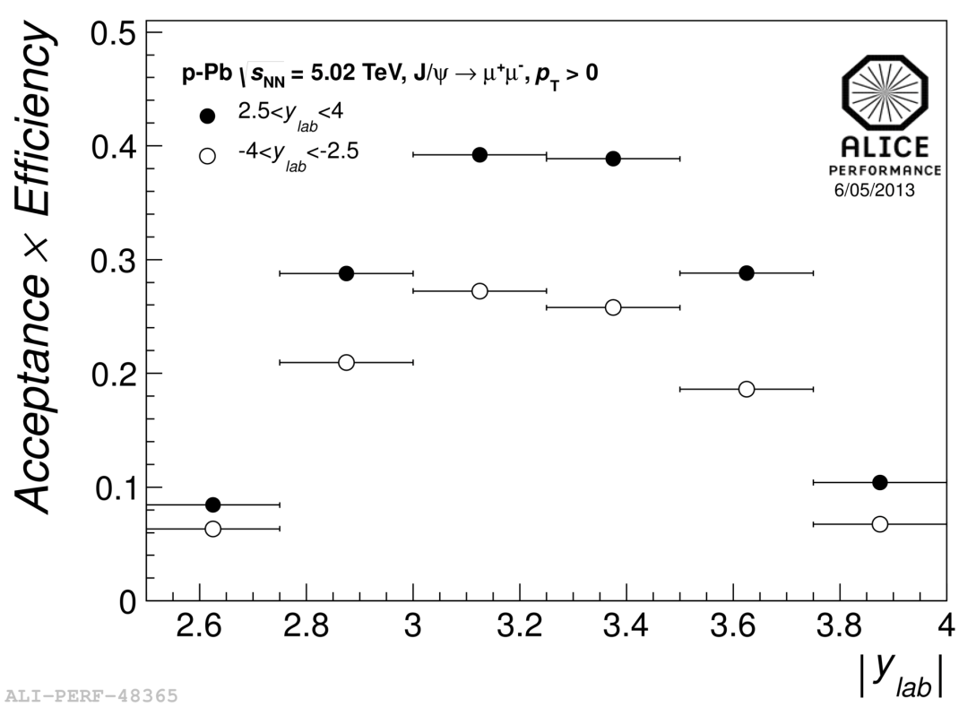
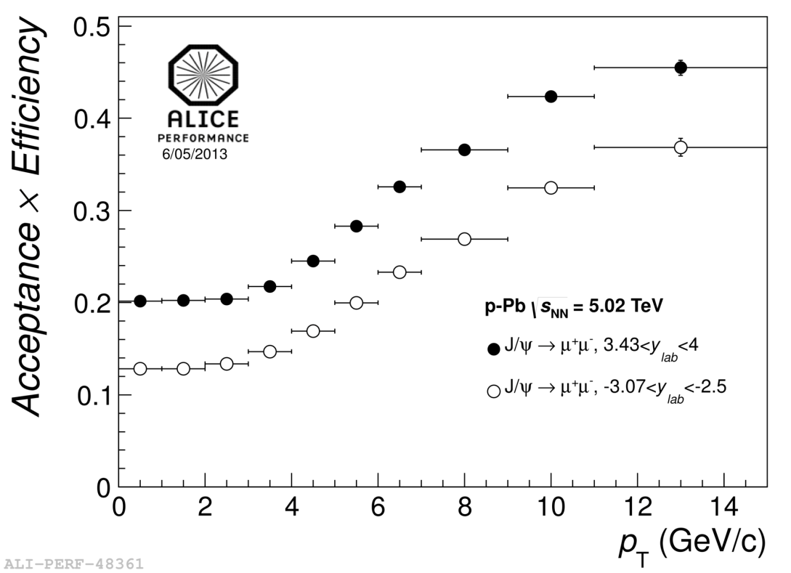
J/ψ acceptance x efficiency
Acceptance x efficiency computed with pure signal simulations, using as input J/ψ y and p_{T} kinematical distributions tuned on p-Pb data
Average J/ψ Acc. x Eff (dominated by geometrical acceptance):
~25% in 2.03<y_{CMS}<3.53
~17% in -4.46<y_{CMS}<-2.96
(the lower acceptance x efficiency value for -4.46<y_{CMS}<-2.96 is due to a time-dependent detector efficiency)
Notes:
Dominated by geo acceptance (80%) vs 30%

Slide 14
Systematic uncertainties
Summary of the systematic uncertainties for R_{pA} (or R_{FB})
Source of systematic uncertainty
Signal extraction | 1-4%
Acceptance inputs | 1-3.5%
Trigger efficiency | 3%
Tracking efficiency | 4-6%
Matching efficiency | 1%
Normalization dimuon-MB trigger | 1%
Nuclear overlap function T_{pA} | 3.5%
pp reference @ y=0, √s_{NN} = 5.02TeV | 10-15%
y-dependence of pp reference @ √s_{NN} = 5.02TeV | 10-20%
Total syst. uncertainty (excluding pp ref) | ~7-12 %
(ranges correspond to values obtained in y or p_{T} bins)

Slide 15
The pp reference at √s = 5.02 TeV
pp data at √s = 5.02 TeV are not available
reference cross section obtained through an interpolation procedure (based on F. Bossu’ et al., arXiv:1103.2394)
energy and rapidity dependence interpolated from CDF
(√s = 1.96 TeV), RHIC (√s = 200 GeV) and LHC (√s = 2.76 and 7TeV) data
Energy dependence: pp cross section ad mid-rapidity
Interpolation based on a phenomenological shape (power-law) gives, at √s = 5.02 TeV
Systematic uncertainties evaluated fitting test distributions obtained moving data points according to a Gaussian distribution with a width corresponding to 2.5 × their systematic uncertainties (randomly for uncorrelated ones, same direction for correlated ones)
Results are in agreement with FONLL and LO CEM calculations

Slide 16
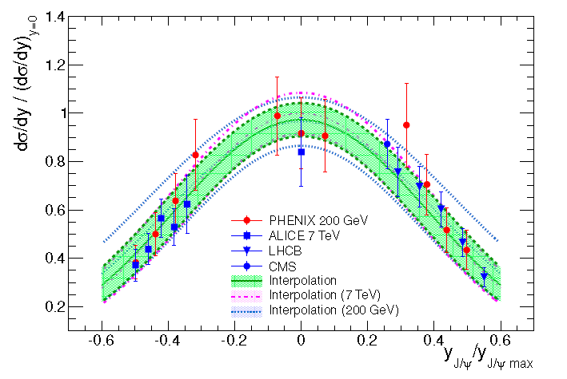
The pp reference at √s = 5.02 TeV
Rapidity dependence
phenomenological approach, based on the observation that PHENIX, ALICE and LHCb results on (dσ^{pp}/dy)/dσ^{pp}/dy|_{y=0} vs y_{J/ψ}/y_{J/ψ,max} are independent on √s
The distribution is fitted with a gaussian shape
Systematic uncertainties obtained with the same procedure adopted for the mid-y result. The chosen 2.5 sigma cut accommodate results based in FONLL and LO CEM calculations
Notes:
(y_{max} is the maximum y for J/ψ production at a given √s)

Slide 17
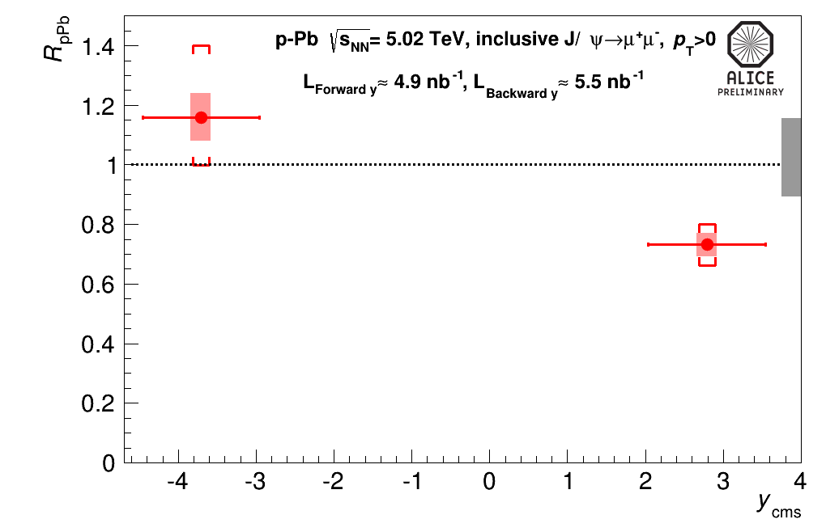
Nuclear modification factor:R_{pA}
R_{pA} decreases towards forward y
Uncertainties:
uncorrelated (box around points)
partially correlated ([])
100% correlated (grey box)
dominant error source is due to the normalization to pp collisions
R_{pA} (2.03<y_{CMS}<3.53)=
0.732 ± 0.005(stat) ± 0.059(syst) + 0.131(syst. ref) – 0.101(syst.ref)
R_{pA} (-4.46<y_{CMS}<-2.96)=
1.160 ± 0.010 (stat) ± 0.096(syst) + 0.296(syst. ref) – 0.198(syst.ref)

Slide 18
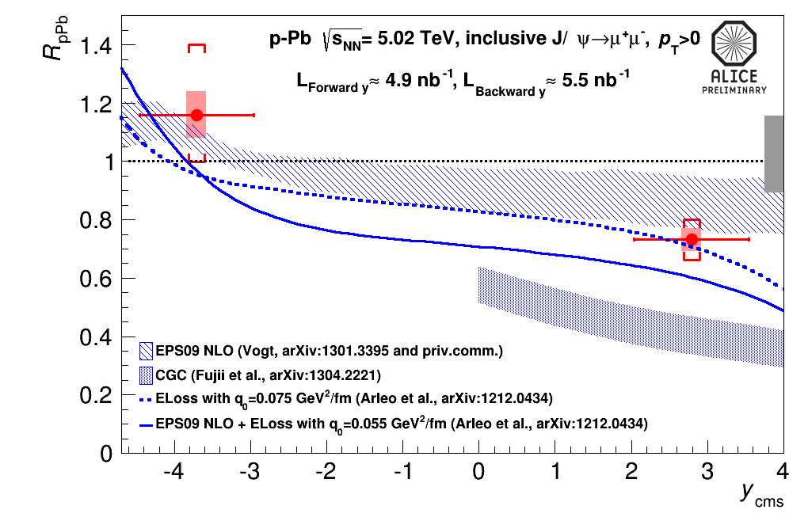
Nuclear modification factor:R_{pA}
R_{pA} decreases towards forward y
Uncertainties:
uncorrelated (box around points)
partially correlated ([])
100% correlated (grey box)
dominant error source is due to the normalization to pp collisions
Comparison with theoretical predictions shows reasonable agreement with:
shadowing EPS09 NLO calculations (R. Vogt)
models including coherent parton energy loss contribution (F. Arleo et al)
while CGC description (Q²_{S0,A} = 0.7-1.2 GeV/c², H. Fujii et al) seems not to be favoured

Slide 19
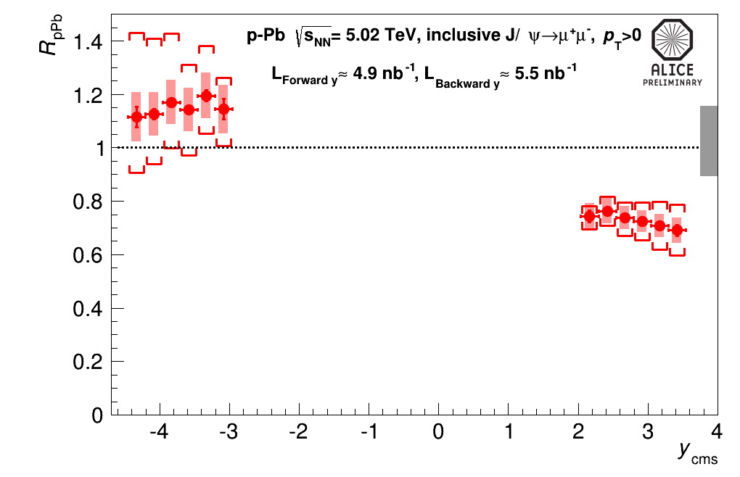
R_{pA} and R_{Ap} vs rapidity
Due to the large collected statistics, we can study the y dependence of R_{pA}
Uncertainties:
uncorrelated (box around points)
partially correlated ([])
100% correlated (grey box)

Slide 20
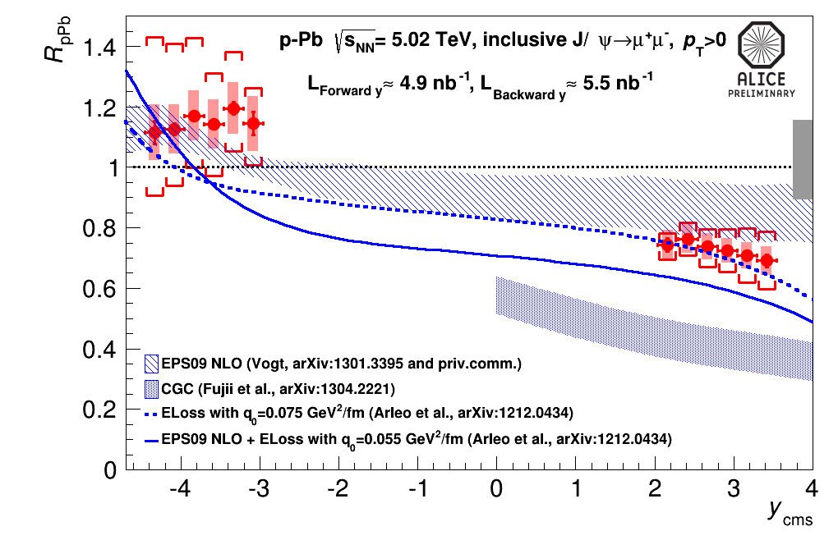
R_{pA} and R_{Ap} vs rapidity
Due to the large collected statistics, we can study the y dependence of R_{pA}
Uncertainties:
uncorrelated (box around points)
partially correlated ([])
100% correlated (grey box)
At backward y, models including coherent parton energy loss show a slightly steeper pattern than the one observed in data
Results are dominated by uncertainties on the pp reference

Slide 21
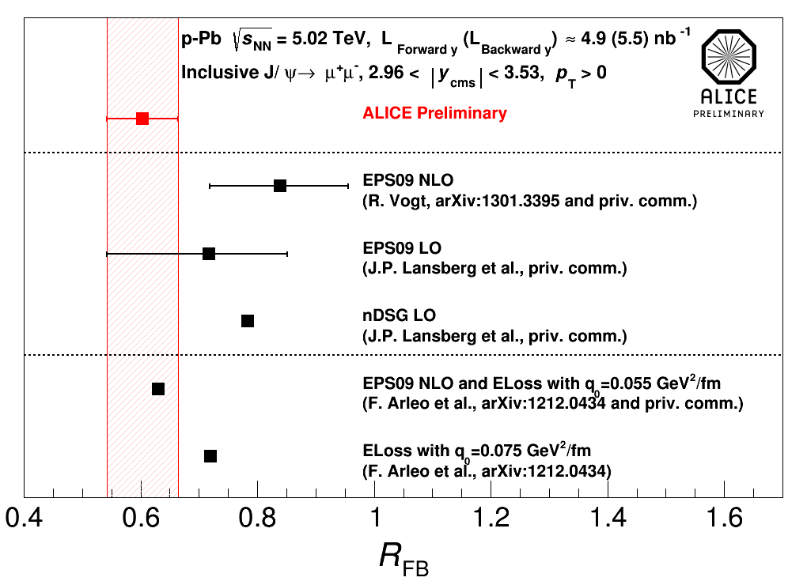
Forward to backward ratio: R_{FB}
To be free of the uncertainty on the pp reference the forward to backward ratio of the nuclear modification factors (R_{FB}) is studied in the range 2.96<|y_{CMS}|<3.53
R_{FB} = 0.60 ± 0.01 (stat) ± 0.06 (syst)
limiting the y range implies a reduction of the J/ψ statistics → compensated by a sizable decrease of the systematic uncertainty wrt R_{pA} (from 20-25% to 10%)
Agreement between data and model including energy loss contribution is rather good, while pure shadowing R_{FB} seems to slightly overestimate the data

Slide 22
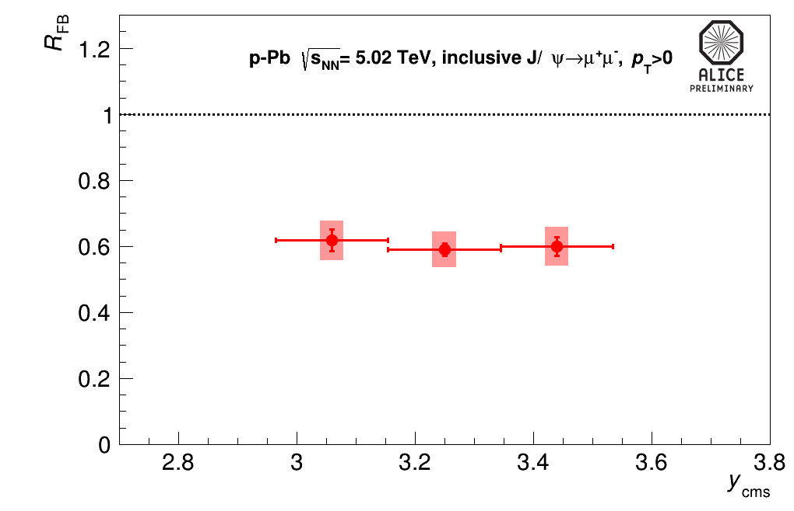
R_{FB} versus rapidity
The R_{FB} rapidity dependence has also been investigated

Slide 23
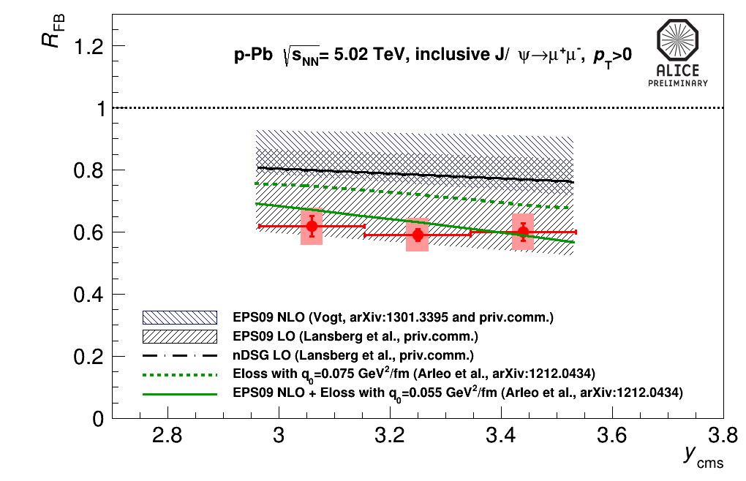
R_{FB} versus rapidity
The R_{FB} rapidity dependence has also been investigated
comparison with theoretical models confirms previous observations done on the y-integrated results
Calculations including both shadowing and energy loss seems consistent with the data

Slide 24
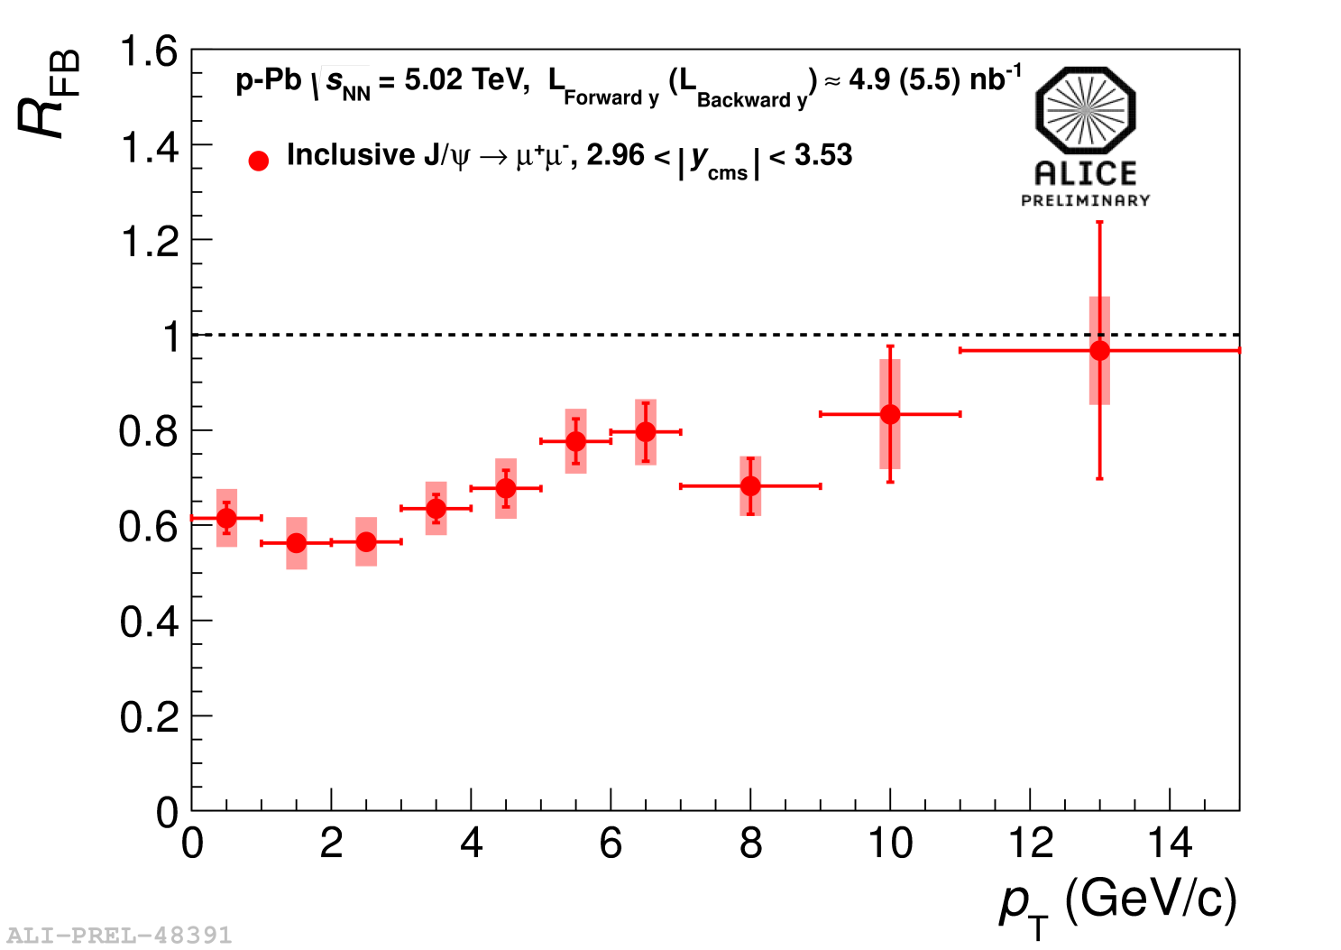
R_{FB} versus p_{T}
The R_{FB} p_{T} dependence is studied in the range 0<p_{T}<15 GeV/c
The R_{FB} ratio shows a p_{T} dependence with a stronger suppression at low p_{T}

Slide 25
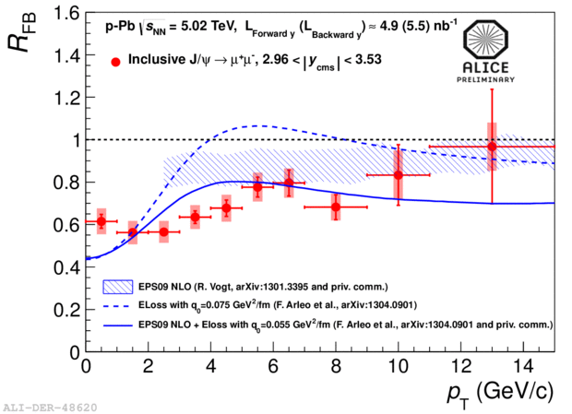
R_{FB} versus p_{T}
The R_{FB} p_{T} dependence is studied in the range 0<p_{T}<15 GeV/c
The R_{FB} ratio shows a p_{T} dependence with a stronger suppression at low p_{T}
theoretical predictions including energy loss show strong nuclear effects at low p_{T,} in fair agreement with the data
the observed p_{T} dependence is smoother than the one expected in coherent energy loss models

Slide 26
Conclusions…
First ALICE results on J/ψ production from p-Pb collisions at √s=5.02 TeV have been presented
R_{pA} result shows an increasing suppression of the J/ψ yield towards forward y
the R_{FB} ratio decreases at low p_{T} in fair agreement with models including coherent energy loss contribution
pure nuclear shadowing and/or energy loss seem to reasonably describe the data, indicating that final state absorption may indeed be negligible at LHC energies
Notes:
p-A data provide informations on several aspects of quarkonium production and behaviour in cold nuclear matter

Slide 27
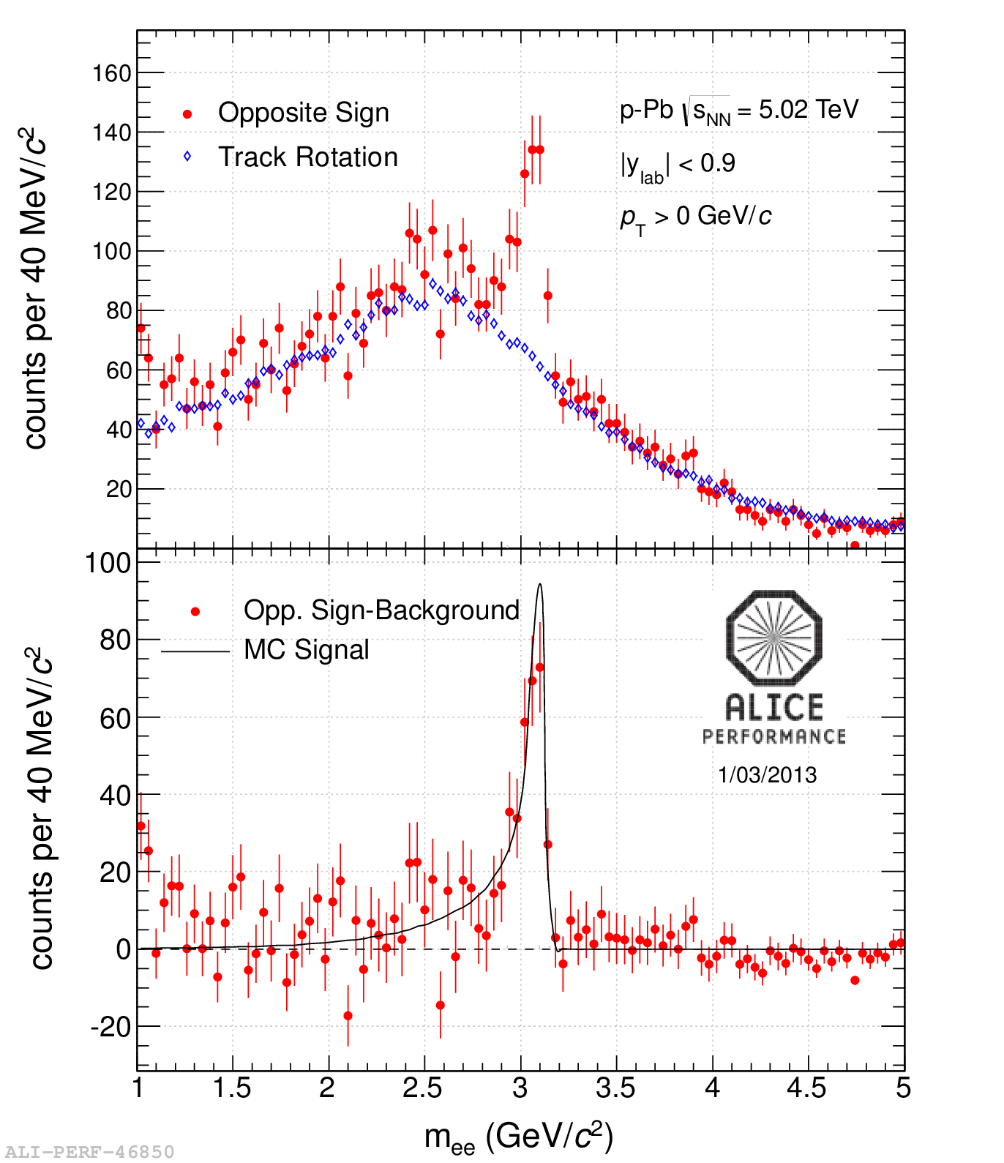
…and prospects
Many more results still to be extracted from the 2013 p-A data!
J/ψ→e⁺e⁻
Centrality and p_{T} dependence of the J/ψ nuclear modification factor and R_{FB}
ψ(2S) production in p-Pb
J/ψ studies at mid-rapidity in the e⁺e⁻ channel and lots more…
…stay tuned!

