Slide 1

OUTCOME OF FIRST CAVITY TESTS
SPL Seminar 2012 at CERN
With help of T. Junginger, N. Schwerg, K. Liao, P. Maesen, M. Gourragne, A. Benoit, O. Brunner

Slide 2
OUTLINE
Cavity Preparation for RF test
  - Antenna adjustment
  - Hydrogen desorption
  - Electro polishing and rinsing
  RF facilities at SM18
  - 2K RF test stand
  - Cavity and diagnostic system mounting on the insert
  - RF test control room
  - Automatic measurement program development
  RF measurement setup
  RF tests on Saclay (β=0.65) and SPL (β=1) 704MHz mono-cell cavities
  Integration of the 5 cells on the new vertical RF test stand
  Outlook

Slide 3
Cavity Preparation for RF test

Slide 4
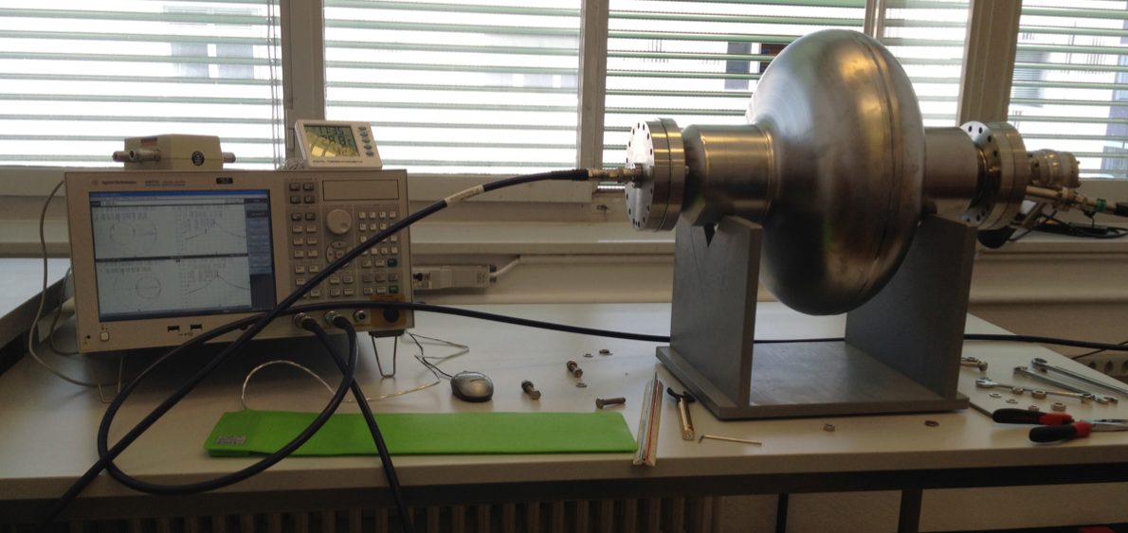
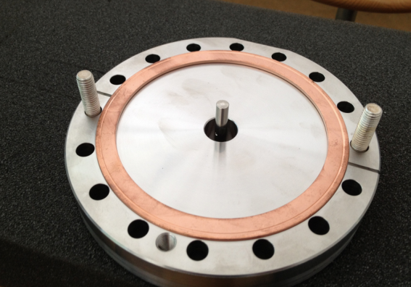
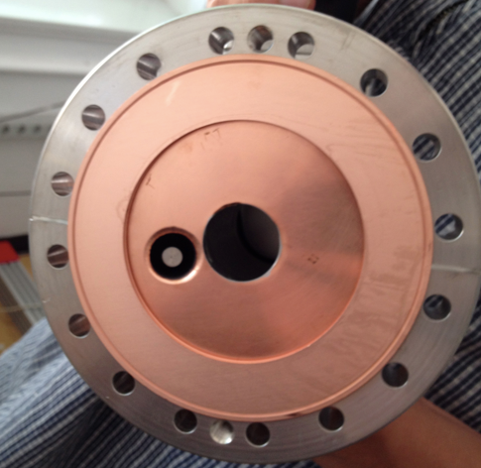
SPL MONO CELL ANTENNA ADJUSTEMENT
f_{res} = 704.1972MHz
Measurement setup
• Input Antenna:
L_{input} = 17 mm
Q_{ExtInput} = 3.75E+9
• Pick-up Antenna:
L_{pick-up} = 86 mm
Q_{ExtPick-up} = 2.11E+11
REF: SPL Mono-Cell Antenna Adjustment, N. Schwerg, T.Junginger BE/RF, EDMS 1240961

Slide 5
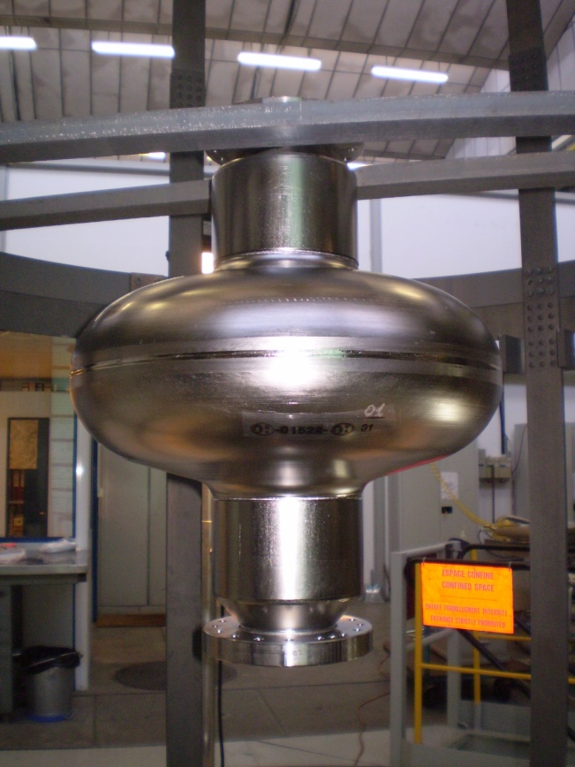
HYDROGEN DESORPTION TREATMENT
Bake out under Vacuum
24 h at T = 650°C after reach the maximum outgasing of hydrogen
p = 1.1 E⁻⁷ mbar at the end of the process
Ref: A. Mongeluzzo TE/VSC

Slide 6
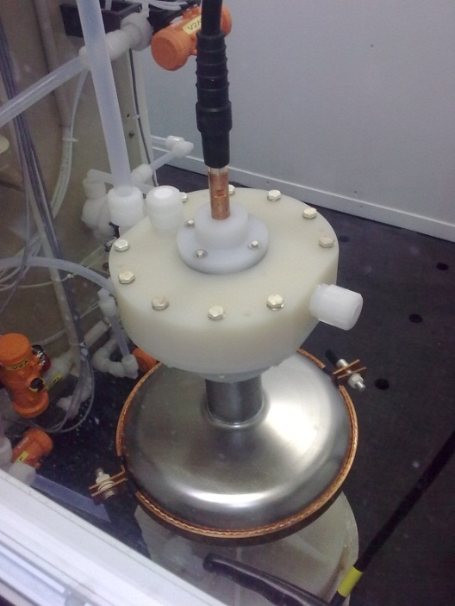
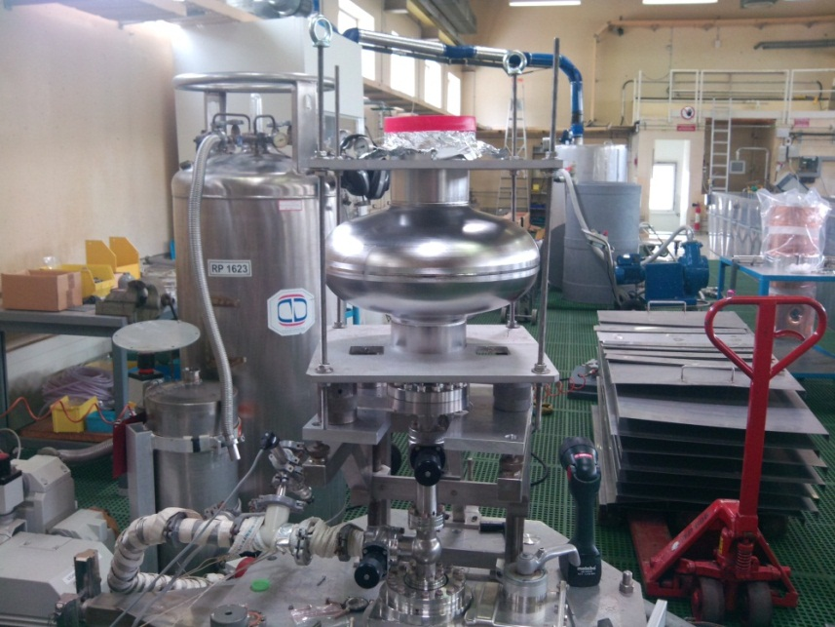
ELECTRO-POLISHING AND HPWR RINSING
Electro polishing setup
Rinsing setup
1st : 31 μm
T_{inlet} 11.6C T_{outlet} 12.5C
Time 7h
Potential 12.2V I= 29 to 50A
2nd : 32 μm
T_{inlet} 9.5C T_{outlet} 10C
Time 7h17
Potential 12.2V I = 18 to 45A
3nd : 22 μm
T_{inlet} 10.5C T_{outlet} 11.5C
Time 5h
Potential 12.2V I = 20 to 45A
TOC > 40ppb
Resistivity 18MOhm.cm
P_{cav} = 1.4e-2 mbar
Nb removed ≈100 μm (Spec 200 μm)
Rmq: Observation of cracks after electropolishing (J. Chambrillon, O. Capatina)
Ref: L. Ferreira TE/VSC

Slide 7
  RF facilities at SM18

Slide 8
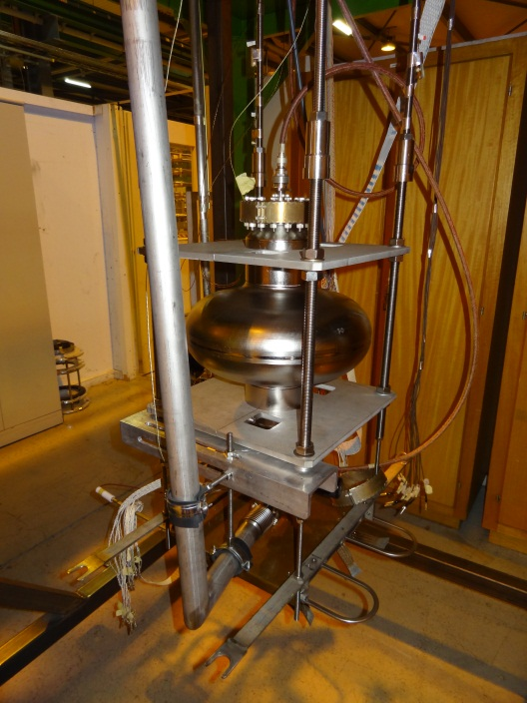
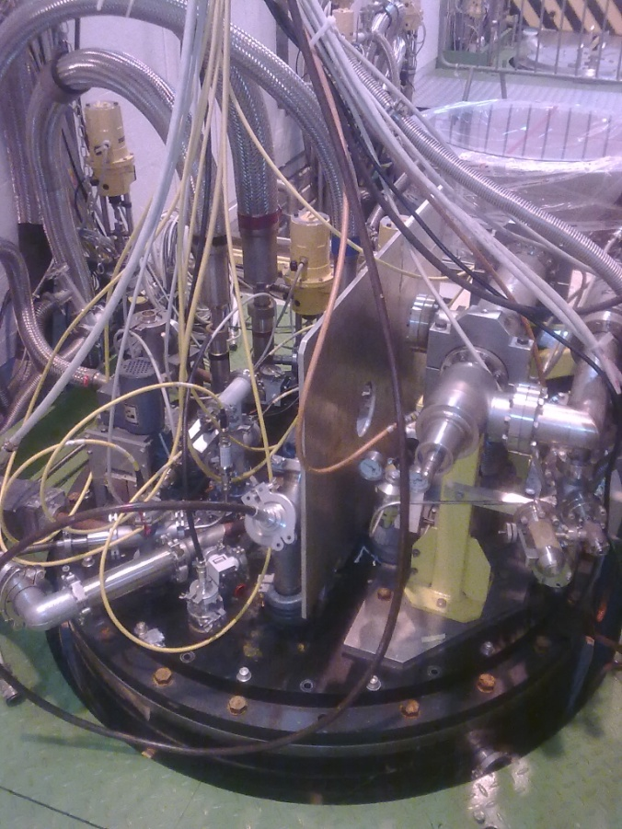
2K VERTICAL TEST STAND AT SM18
β = 1 mono-cell mounted on the insert
Cryostat (Height: 2.4m) cover with RF and cryogenics connections
New cryostat 4m next year

Slide 9
CRYOGENIC INSTRUMENTATION
Thermal sensors
1- TT850
2- TT851
3- TT852
4- TT816 (520mm from the first screen)
5- TT813 (370mm from the first screen)
6- TT810 (1340mm from the first screen)
7- TT811 (700mm from the first screen)
8- TT814 (430mm from the first screen)
9- TT815 (270mm from the first screen)
Heaters
10- Heater DN100 EH817 (connection AB (2-6)) (R=90Ω)
11- Heater EH818 (connection CD (5-6)) (R=100Ω)
Thermocouples
12- TC818 (thermocouple CD, 5-6 connectors)
13- TC817 (thermocouple AB)
He Level
14- LT 810 (L=1150 mm)
15- LT811 (L=1150 mm)
1
1080
2
30
14
3
210
670
9
5
690
4
8
12
1420
7
10
10
15
6
13
LT811 = 760mm in order to cover the cavity
11

Slide 10
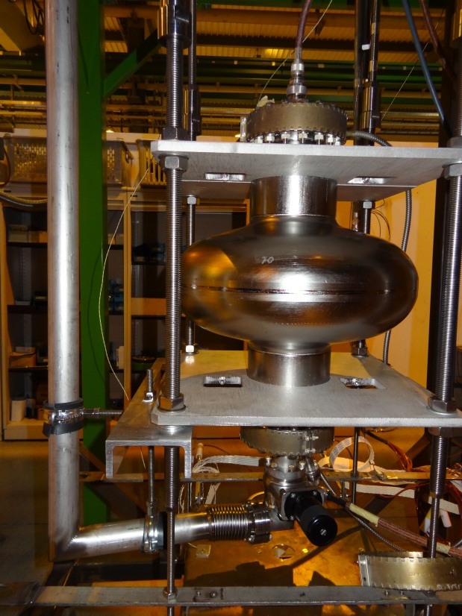
CAVITY MOUNTING FOR RF TEST
We found a Leak with a rate of 10⁻⁶ mbar l/s
We opened the cavity in the clean room ISO 5
Pb Copper Gasket
No time for a new HPWR (due to the cryo shutdown in SM18)
We lost the benefit of the HPWR for the RF test
leak
Second mounting
Parameters checked before cool down:
Leak detection: 1.10⁻⁸ mbar l/s
P_{cav}= 2.10⁻⁷ mbar at 25°C
f_{res} = 704.1972 MHz at 25°C

Slide 11
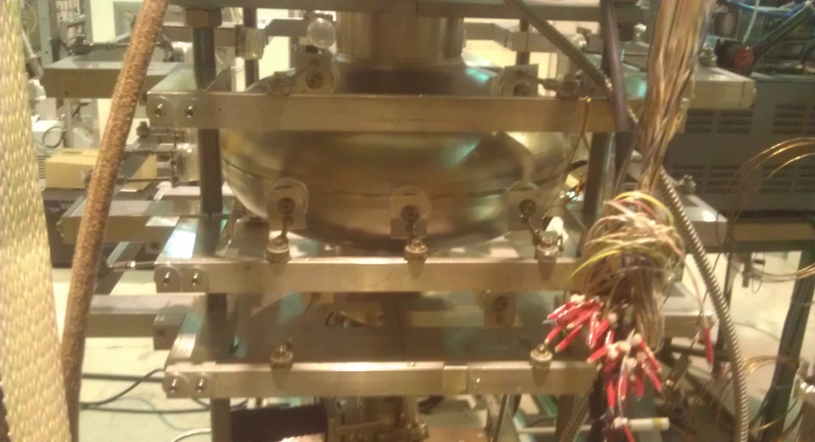
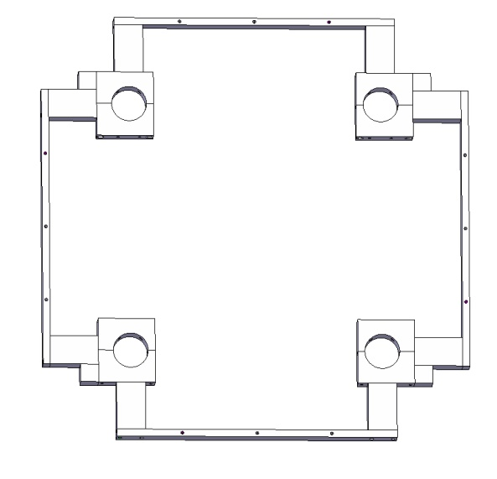
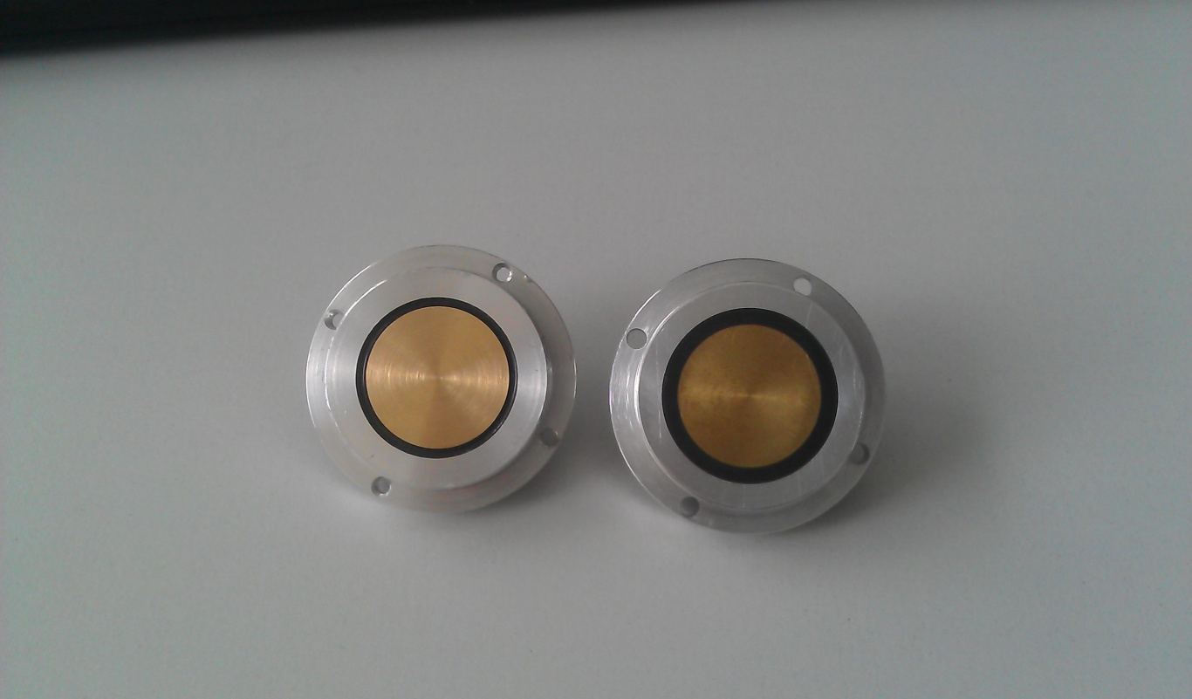
OSCILLATING SUPERLEAK TRANSDUCER
Localized hot spot (default) with 2nd sound propagation in He superfluid method
20 OSTs were installed to the equator and the Iris
No cavity quench during the mono-cell RF measurement
Ref: K. Liao BE/RF

Slide 12
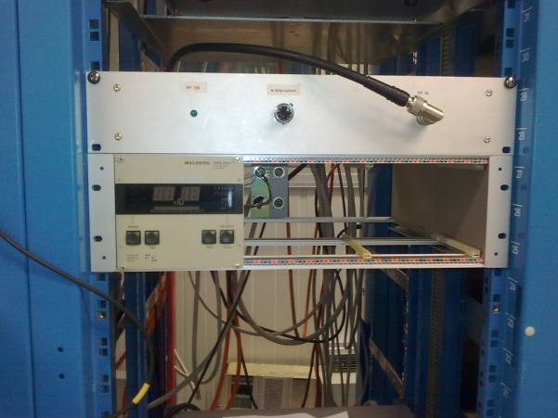
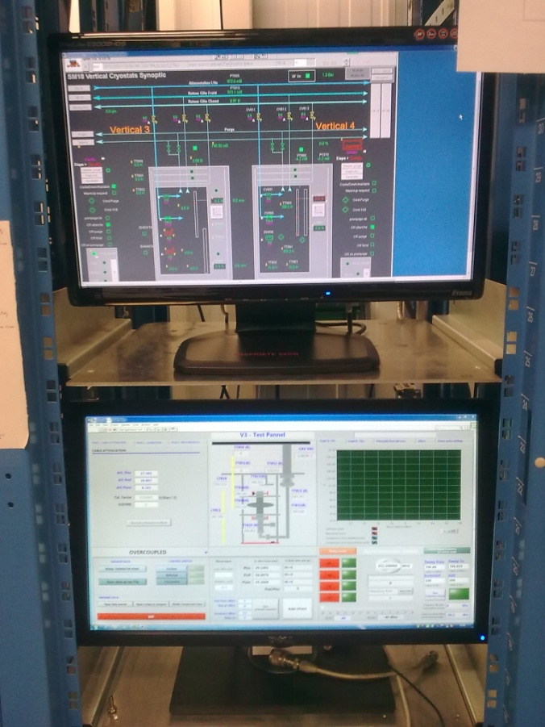
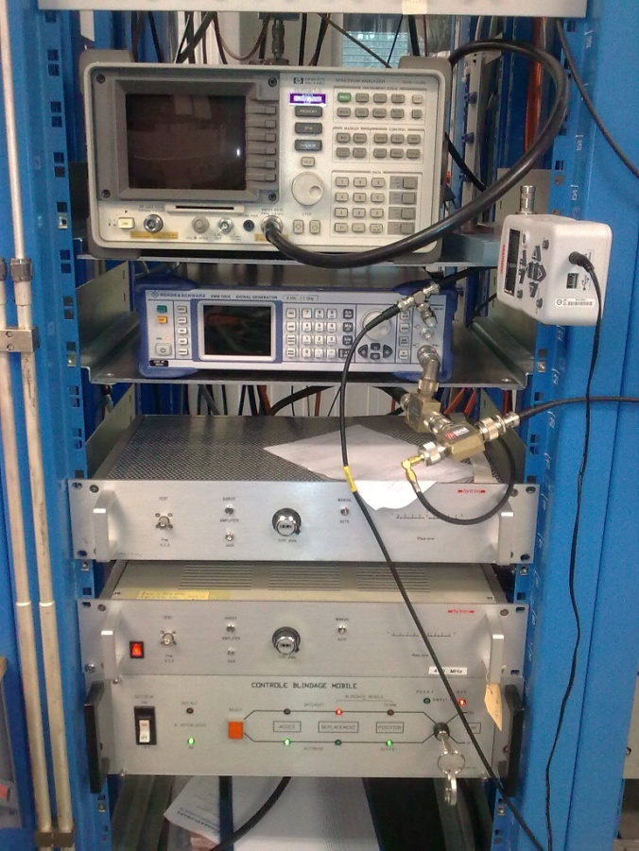
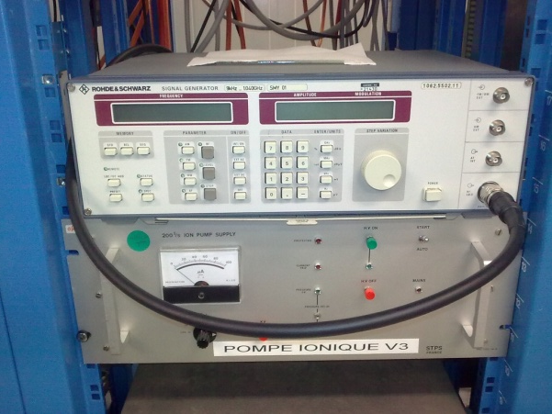
RF TEST FACILITY CONTROL ROOM

Slide 13
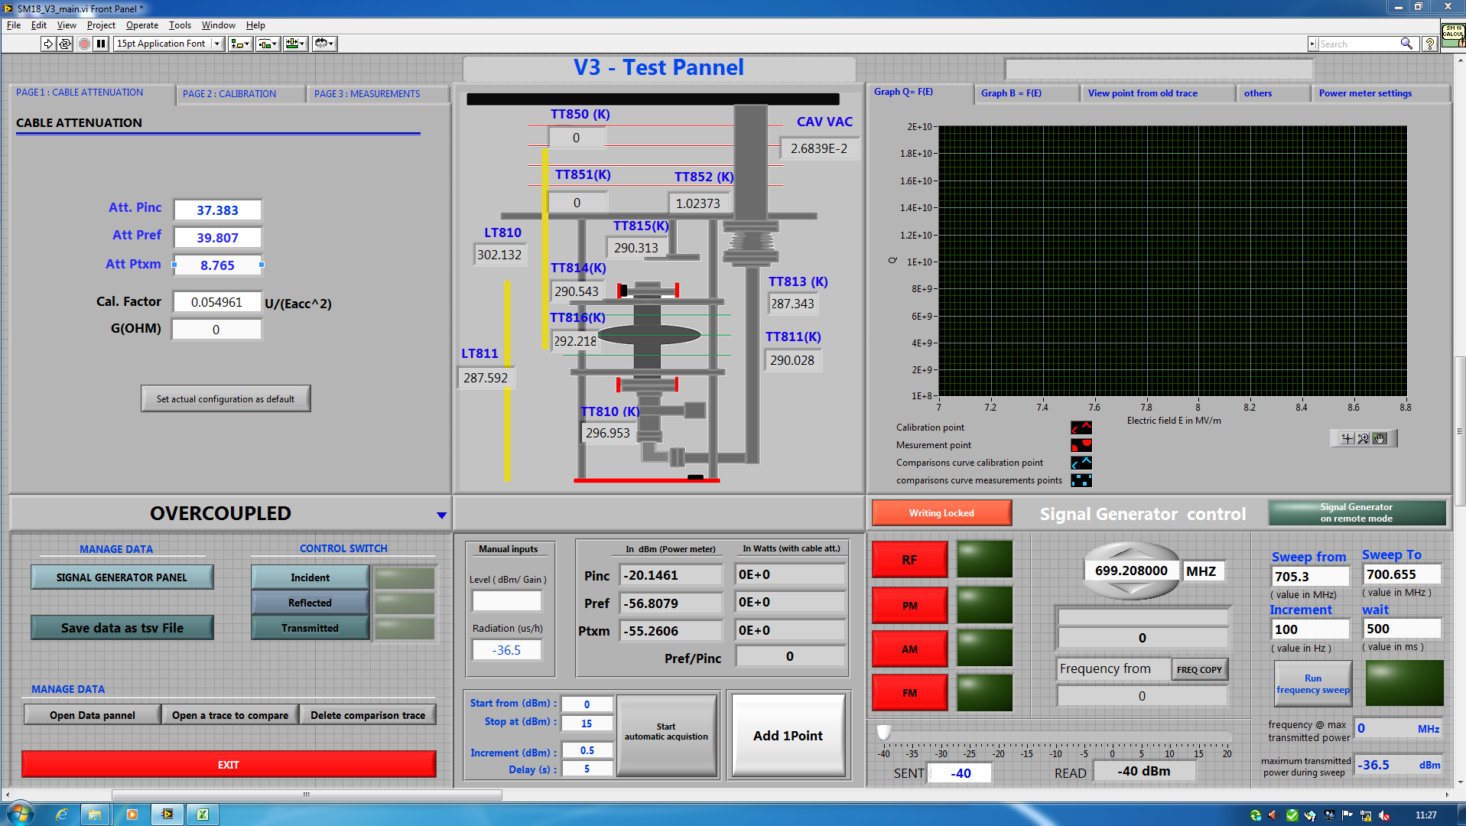
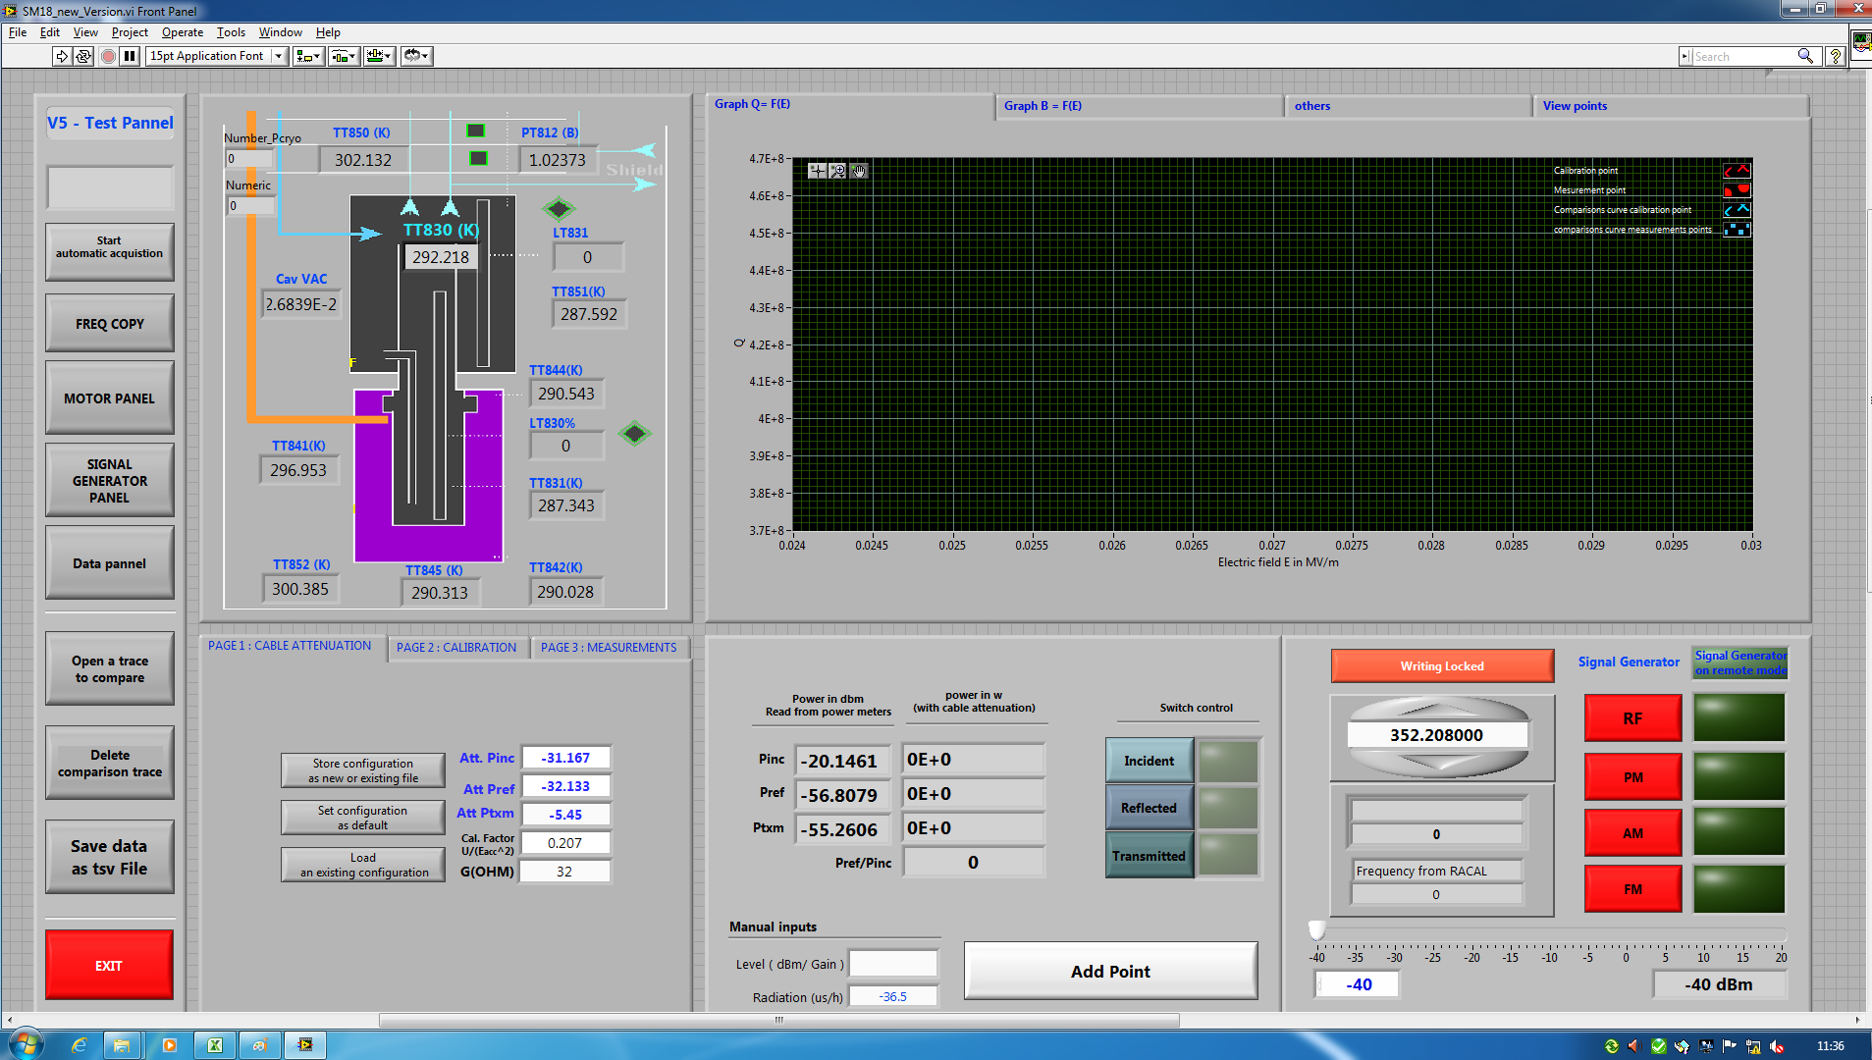
TEST CONTROL PANEL PROGRAM
Improvement: automatic control of the PLL, τ measurement
Program was done by A. Benoit BE/RF

Slide 14
  RF measurement setup

Slide 15
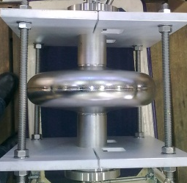
RF MEASUREMENT SETUP
Frequency meter
Signal
Generator
F.M.
Attenuator
Amplifier
Directional Coupler
PIN Switch/Att
Cavity
A
D.C.
Coupler
FM Modulation
P_{FWD}
P_{RFL}
D.C.
P_{TXM}
P.M.
Power Meter
RF Box
Phase Shifter
In high Q system it is necessary to have a feedback system to power the cavity at his resonance frequency.

Slide 16
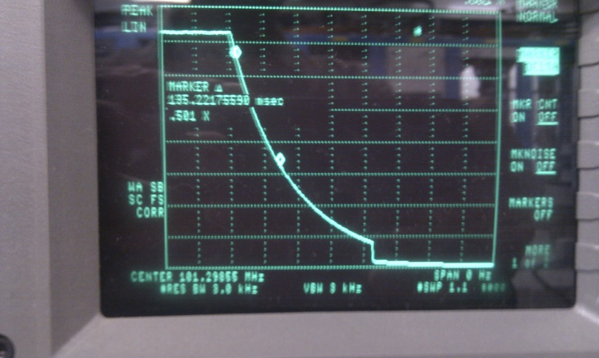
CALCULATION OF Q₀ AND E_{ACC}
Calibration point measurements
Time decay τ of the P_{trans}
Q₀ calculation
with
and
Pinc, Pref, Ptrans measured with power meters
E_{acc} calculation
and
E_{acc}

Slide 17
  RF tests on Saclay (β=0.65) and SPL (β=1) 704MHz mono-cell cavities

Slide 18
704 MHz SACLAY CAVITY β=0.65 AT 2K
Test parameters:
P_{cav} = 1.3E^⁻¹⁰ mbar
P_{He}= 28 mbar
T= 2K
f_{res=} 700,65549 MHz
Strongly overcoupled big error (uncertainty) ≈ 30%
Min E_{acc} ≈ 18MV/m from different method
Validation of the electro polishing , rinsing, mounting, RF test stand…

Slide 19
SPL β=1 MONO-CELL CAVITY TEST AT 2K
Specifications:
Q₀=10^¹⁰ at 25 MV/m
Test parameters:
P_{cav} = 10E^⁻¹⁰ mbar
P_{He}= 24 mbar
T= 2K
f_{res=} 705,3152 MHz
- Calibration points were taken at 4 and 10 MV/m and agree better than 2 %.
- The cavity was strongly over coupled (Q_{ext}=6*10^8). This results in the rather big error bars, especially for Q₀
- For E_{acc} a lower estimate can be made from an emitted power measurement. This technique yields a value agreeing with the lower limit of the horizontal error bars given in the graph
- Residual resistance is about 20 nΩ, which is a decent value for this frequency
- Only mild medium Q-slope, no sign of Q-disease.
- Field emission starting at 13 MV/m, clearly identified from x-ray measurements (higher fields up to 2 mSv/h)
- He processing was done unfortunately the RF Input connector has been burnt (too much power)

Slide 20
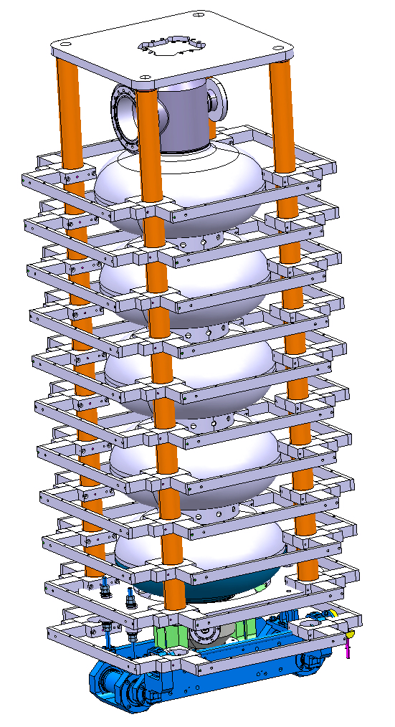
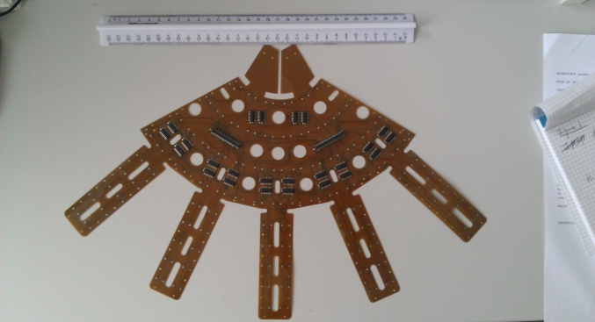
INTEGRATION OF THE 5 CELLS ON THE NEW VERTICAL RF TEST STAND
New support for the cavity and for diagnostic system (OST)
Temperature mapping : octopus using Allen-Bradley resistors temperature sensor (K.Liao)
New cryostat Height = 4m and New cryo line at SM18 (P. Measen)

Slide 21
OUTLOOK
Refurbishment and development of the cavity preparation, diagnostic system, RF test facilities:
Electro polishing, Rinsing, RF test stand, New automatic measurement program, 2nd sound Measurement, Temperature mapping, optical diagnostic
Result of the First test of the SPL mono cell cavity :
  Q₀= 10E^¹⁰ until 13 MV/m and field emission appears at E_{acc}> 13MV/m with X-Ray (maybe due to the fact that we opened the cavity due the leak)
Next steps:
Integration of the mono-cell and 5 cells cavities in the new cryostat
New RF test on the SPL mono-cell cavity β=1
5 cells RF test
Thanks for your attention

Slide 23
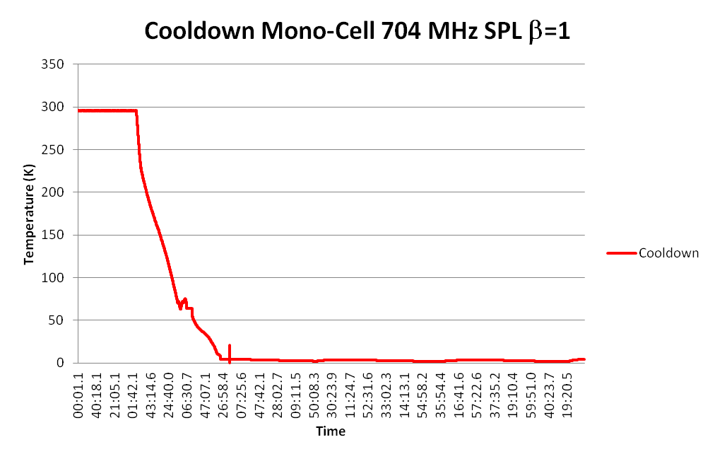
CAVITY COOLDOWN

