Slide 1
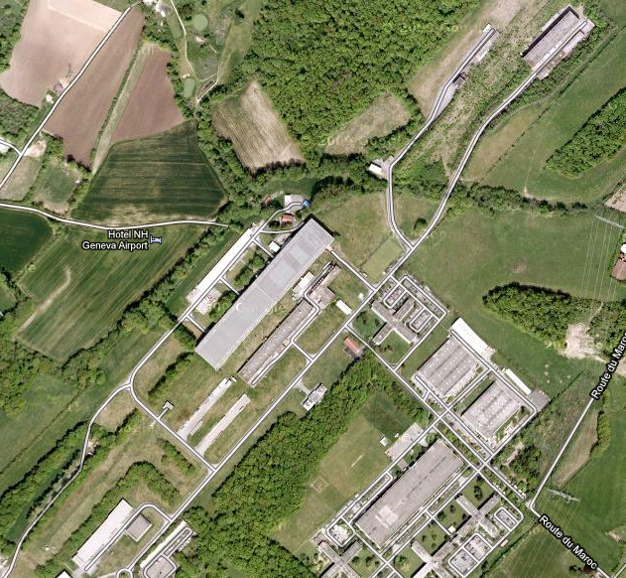
North Area Consolidation
Mats Wilhelmsson
EATM 6 Novembre 2012

Slide 2
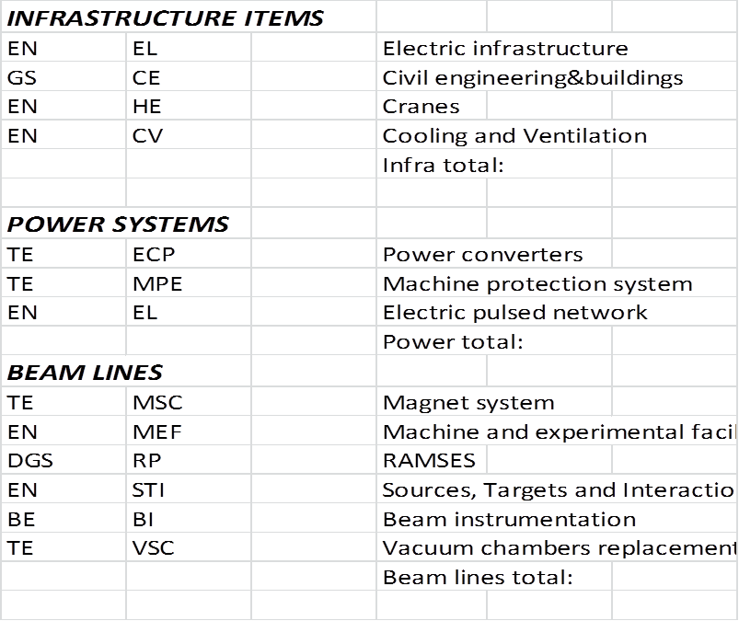
Three main chapters:

Slide 3
With their work units…

Slide 4
And a total cost estimate, per group: ..

Slide 5
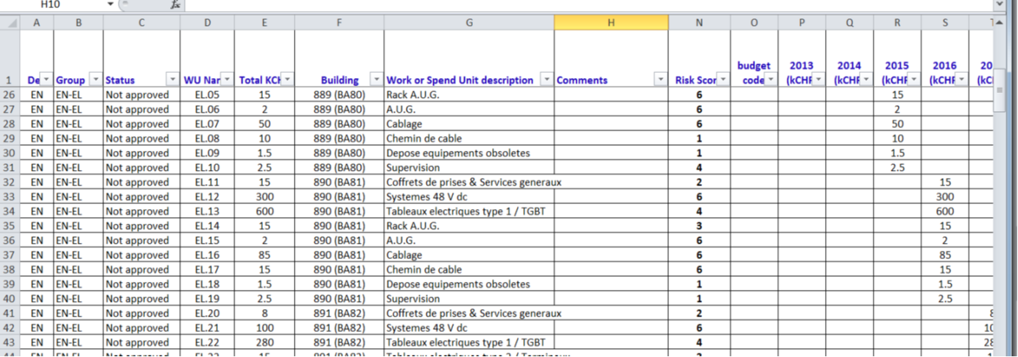

Cost plan (what to do which year)
Risk score=failure probability x impact

Slide 6
Cost plan per group: ..

Slide 7
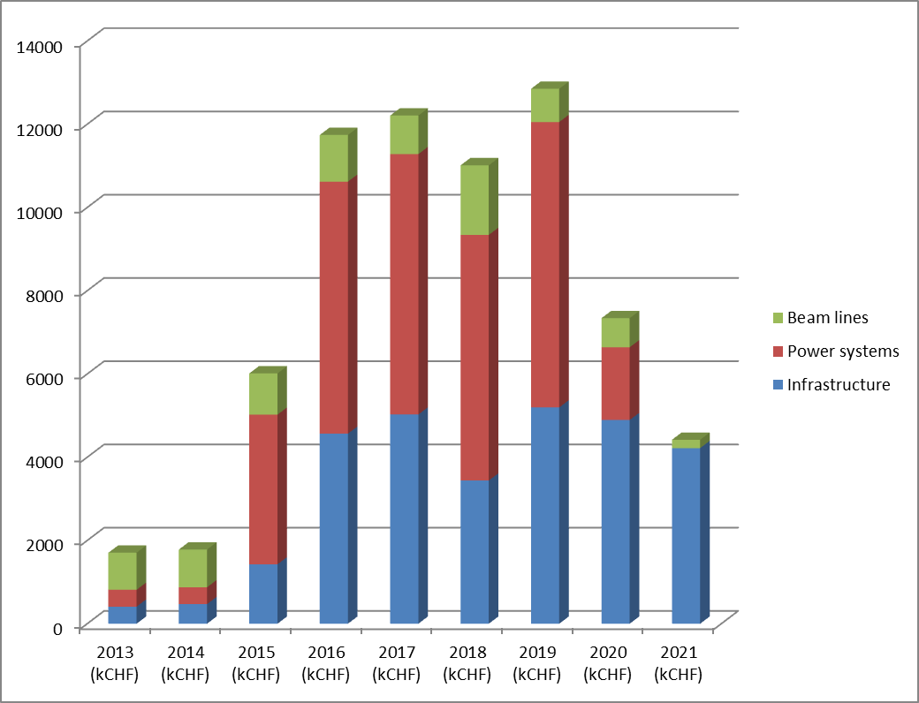
Cost profile (kCHF) :

Slide 8
Comments:
2013-2014 is booked with the renovation work in TCC2/TDC2
Electric networks
A big work package has been included for the pulsed network (EMD, ERD and transformers)
Machine protection
Markus Zerlaut proposes a machine protection system standardized as with the other machines (750kCHF )
Radioprotection
A full transformation to RAMSES (from ARCOR)
Improved work areas for users OUTSIDE the radiation supervised areas work places, meeting room, toilets, rest- and coffee rooms.

Slide 9
After 2021, the North Experimantal area is a reliable, attractive
and modern research facility for the CERN users

