Slide 1

EATM 12-10 – East Area
Lau Gatignon / EN-MEF

Slide 2
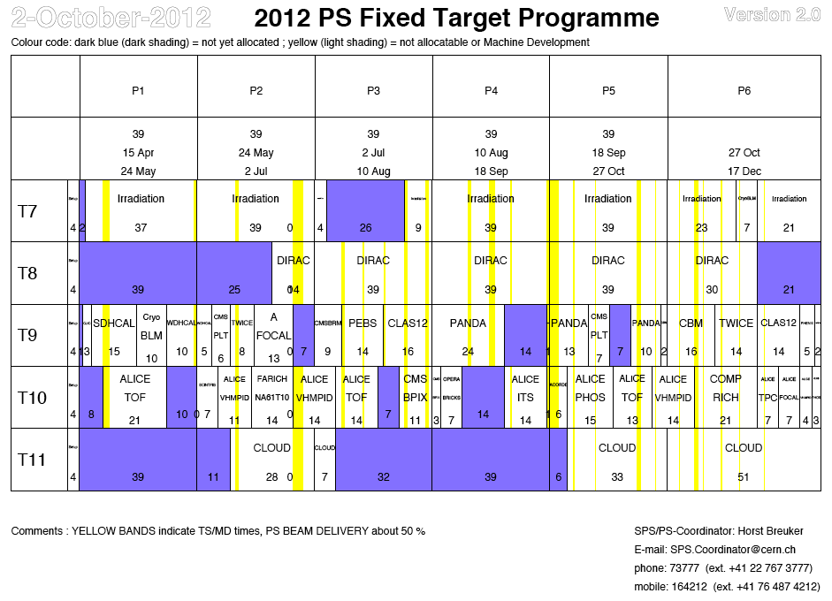

Slide 3
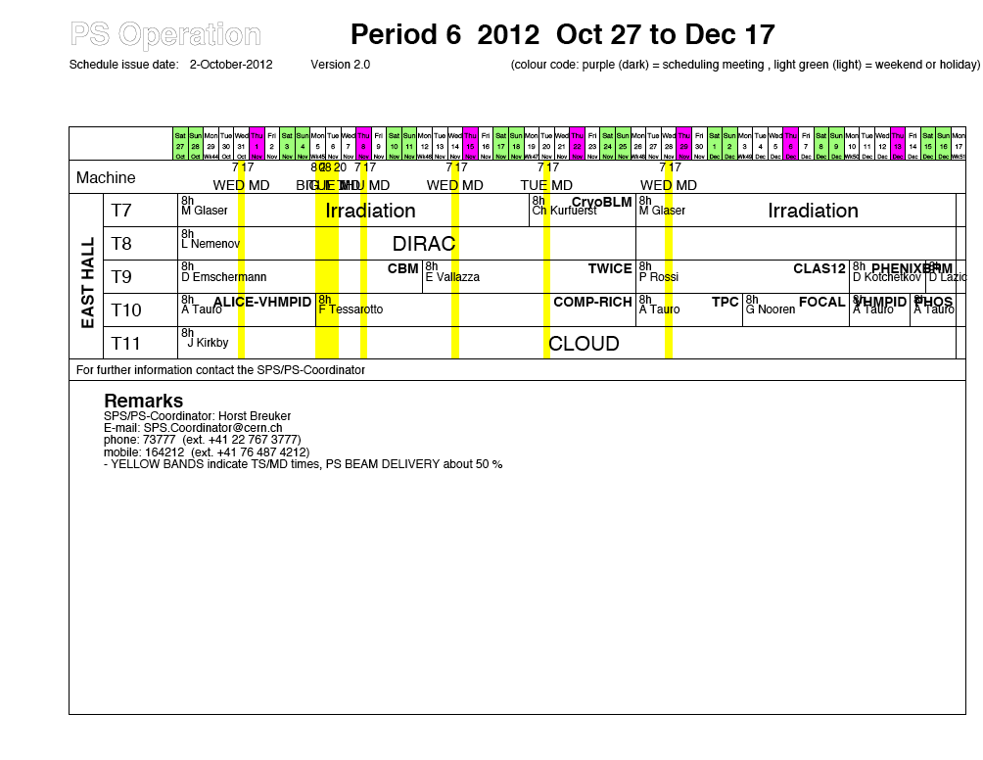

Slide 4
P6
The crane consolidation starts on Monday 5th of October. For a two-week period,
ad-hoc solutions must be found for equipment handling.
T7 IRRAD continuse. During the technical stop installation of the CryoBLM cryostat. All works have been discussed and prepared beforehand. It will only be removed after a long cool-down period, i.e. in the shutdown.
T8 DIRAC continues, no changes. DIRAC stops their physics program on the 26th.
T9 CBM continues, no changes. On Monday 12th change to TWICE.
Same conditions as last time. Need a DESY table. On Monday 26th of November change to CLAS12. They need N₂ for their RICH and a 70/30
Ar/CO₂ mix for their GEMs. On Monday 10th of December change to PHENIX (tbc). No final input yet. The last weekend is given to CMS-BRM,
a pixel lumi telescope. This is a small set-up, no changes.

Slide 5
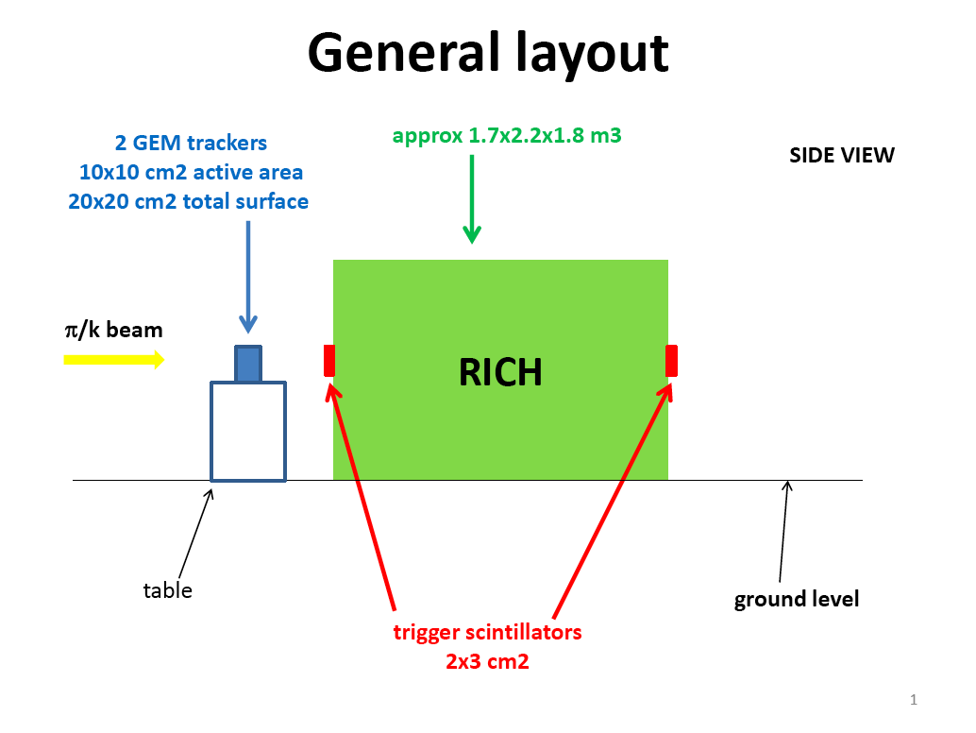
CLAS12

Slide 6
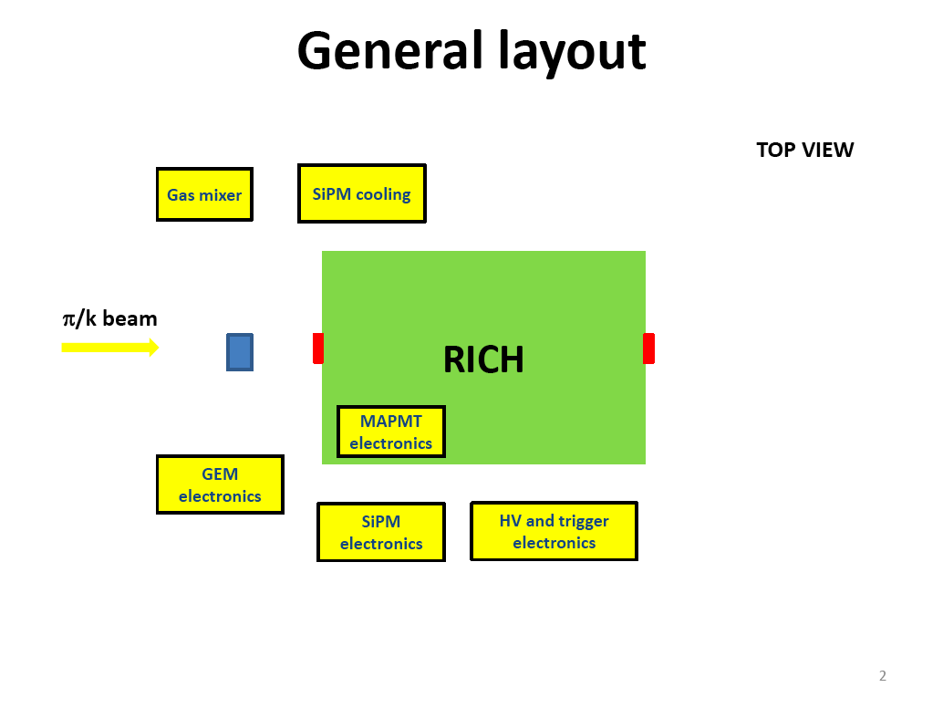
CLAS12

Slide 7
P6 cont’d
T10 Start with COMPASS-RICH. This is a THGEM-based photon detector prototype of 30x30 cm² active area, total weight 120 kg. No special requirements, but use a 50/50 Ar-CH₄ mix. On Monday 26th change to
ALICE/TPC, followed by FOCAL, VHMPID and PHOS. No changes.
T11 CLOUD continues, no changes

Slide 8
PHENIX
PHENIX requested 2 weeks but is scheduled for 5 days only It is a test of a hadronic
calorimeter (1.6 tons) of 2 m long. The whole set-up has to be installed on a 7 m long
and 2 m wide concrete platform of 95 cm height.
The whole set-up has to be covered in a tent to ensure light tightness.
They request 3 scintillators for triggering (we have only one).

Slide 9
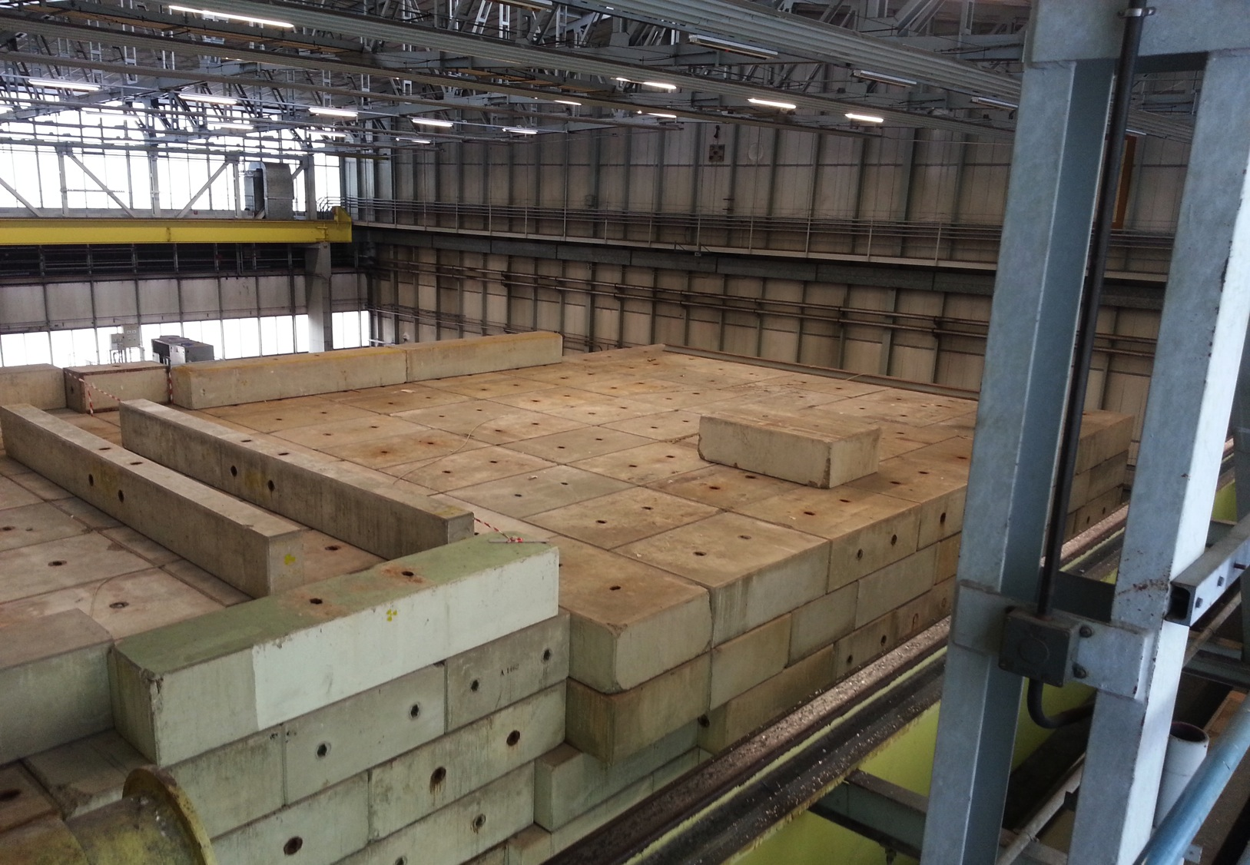

Slide 10
