Slide 1

EATM 12-10 – NA62
Lau Gatignon / EN-MEF

Slide 2
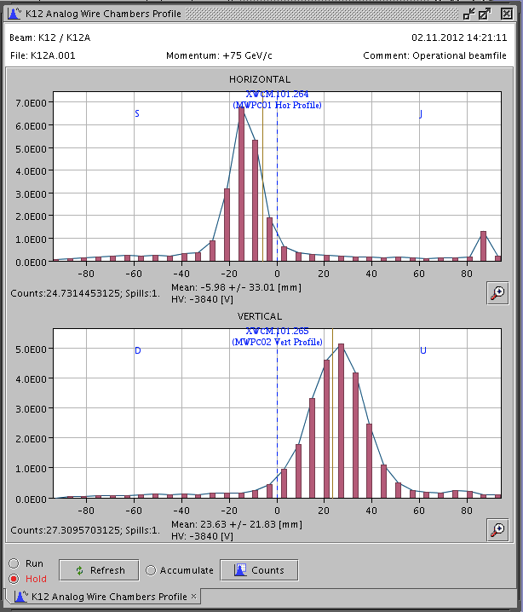
Thanks to the tremendous efforts of all of you (and many others) the patrol of ECN3 and TCC8
was done last Wednesday afternoon and the beam permit signed.
After a machine stop on Thursday morning we could start at 14 PM and immediately some beam
was seen on the T10 monitor. A first steered pencil beam of 10¹¹ ppp hit the T10 target at 19 PM!
Then the experiment took access till 14 PM on
Friday. We switched on the K12 beam (pencil beam
with 1% of nominal acceptance) and saw
immediately the beam profile at the beam dump
and with roughly the expected intensity!
Now the detailed beam tuning has started and this
will be a lengthy process (in particular the
optimisation of backgrounds, which needs detailed
feedback from the experiment and many FISC
profiles).
Many thanks and
congratulations
to all of you!

Slide 3
The vacuum pressure in the blue tank (with one cryo pump) was last Friday at the expected
level for this configuration (1.3 10⁻⁵ mbar) and in the large vessel in the dump tunnel the pressure
was also good (5 10⁻⁴ mbar). Therefore nothing prevents NA62 to switch on all detectors!
The cooling and ventilation is working as expected, for access to ECN3 (including to the
CEDAR) a 15 minutes waiting time is requested before accessing, as long as we stay at intensities
below 10¹² ppp on T10.
So far we relied mostly on EXPT scalers and in particular on the XION chamber.
A detailed look at the other instrumentation and e.g. at the XCON radiator will
come over the next days and weeks.
On the short term the tolerances in P0-SURVEY need to be defined correctly.

Slide 4
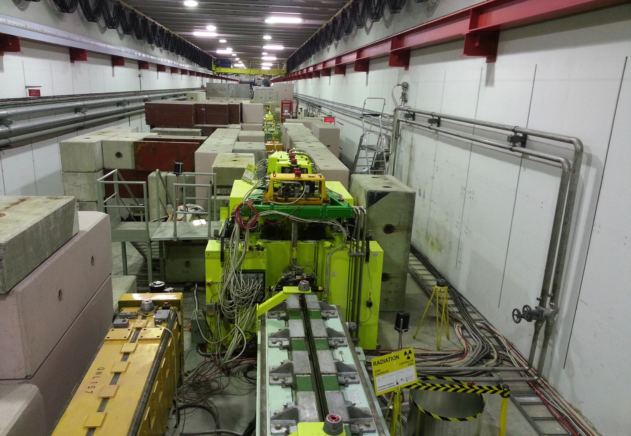
NOW COMPLETE INCLUDING ROOF

Slide 5
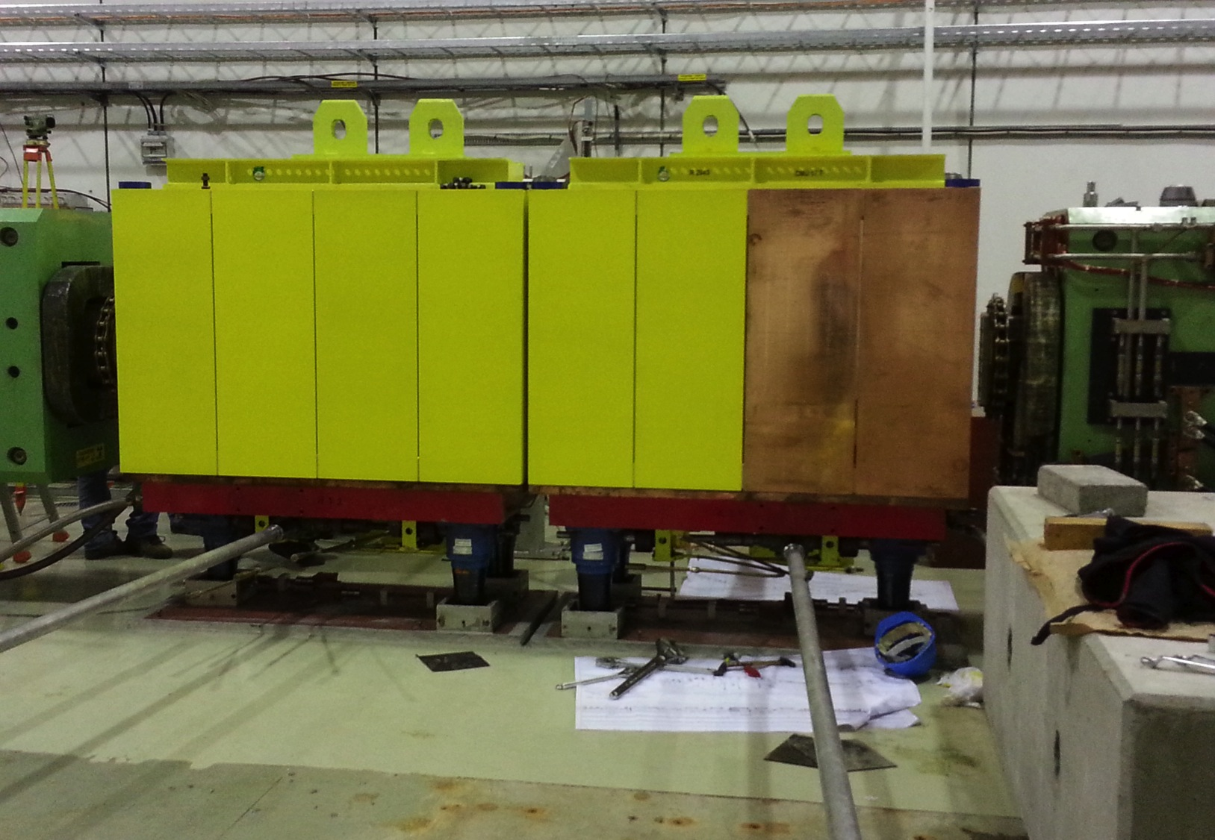

Slide 6
