Slide 1

EATM 12-10 – SPSC107
Lau Gatignon / EN-MEF

Slide 2
Accelerator restart after LS1
Recommendation about the Accelerators and the restart after LS1:
The committee supports (is pleased with) the efforts to aim for a restart of the injector accelerators for a first period of proton beam to the experimental areas at the end of 2014. The Committee recommends that during this period the highest possible beam intensity for the COMPASS experiment should be delivered.
The SPSC also recommends to aim for a period of Argon ion running before the start of the 2015 proton run and supports the optimisation of the replacement work of the irradiated cables in the SPS splitter area to allow the 2015 proton run to start as early as possible. Recommendation about the

Slide 3
NA63
The SPSC notes with satisfaction the progress achieved by the NA63 experiment andcongratulates the collaboration for the prompt publication of the results obtained from the 2011 data.
The Committee is looking forward to the final analysis of the data recorded in 2012 to study the Landau-Pomeranchuk-Migdal effect and structured target resonances.
The Committee acknowledges the plans of the collaboration for the near future and is looking forward for the detailed proposal for the continuation of the data taking beyond 2013.

Slide 4
UA9
The SPSC congratulates the UA9 Collaboration for the good progress made in crystal-assisted collimation at the SPS, both with proton and lead ion beams, and for the timely publication of results.
The Committee encourages the Collaboration to proceed with detailed planning and hardware preparations for the LHC test.

Slide 5
NA61
The Committee notes with satisfaction that NA61 has made good progress on the publication of the results of the 2007 data.
The Committee notes with satisfaction that preliminary results have been presented on the analysis on cosmic-ray related data and on multiplicity fluctuations in proton-on-proton data which serves as reference for future ion-on-ion measurements and is looking forward to further results.
The SPSC congratulates the NA61 Collaboration for the efficient data taking of the Beryllium-on-Beryllium data in 2011 and encourages a timely analysis of the data.
The Committee also encourages the experiment and CERN to explore all options to consolidate the magnets of the experiments to ensure that no beam time allocated to NA61 is lost due to technical problems.
The SPSC welcomes the interest of American groups for measurements relevant to the US neutrino programmes and is looking forward to a proposal.

Slide 6
CNGS PROGRAM
ICARUS
The SPSC congratulates the Collaboration for the publication of physics results on the time-of-flight measurement, sterile neutrino search and on the new approach of 3D event reconstruction for the LAr TPC.
OPERA
The SPSC congratulates the OPERA collaboration on the announcement of the second tau neutrino candidate event.
The Committee is looking forward to completion of the analysis of the 2010 and 2011 data and to the publication of the results.
The Committee acknowledges the effort and successful collaboration between CERN, LNGS, OPERA, ICARUS, LVD and Borexino to bring the neutrino time-of-flight measurement to a conclusion. The SPSC is looking forward to the publication of the final results.

Slide 7
SBL AND LBL NEUTRINOS
SBL
The SPSC acknowledges the formation of a joint working group between the collaboration and the CERN beam and infrastructure divisions.
The SPSC is looking forward to the SBL beam and infrastructure design in the North Area.
LBL
The Committee acknowledges the reception of first answers to referee questions and will continue to review the LBNO Expression of Interest.
Neutrino strategy
The SPSC is starting to prepare an overall recommendation for the neutrino program, inside an overall context including the
SPC and the European Strategy Group. A synergy and collaboration between the SBL and LBL projects is an important element in this strategy.

Slide 8
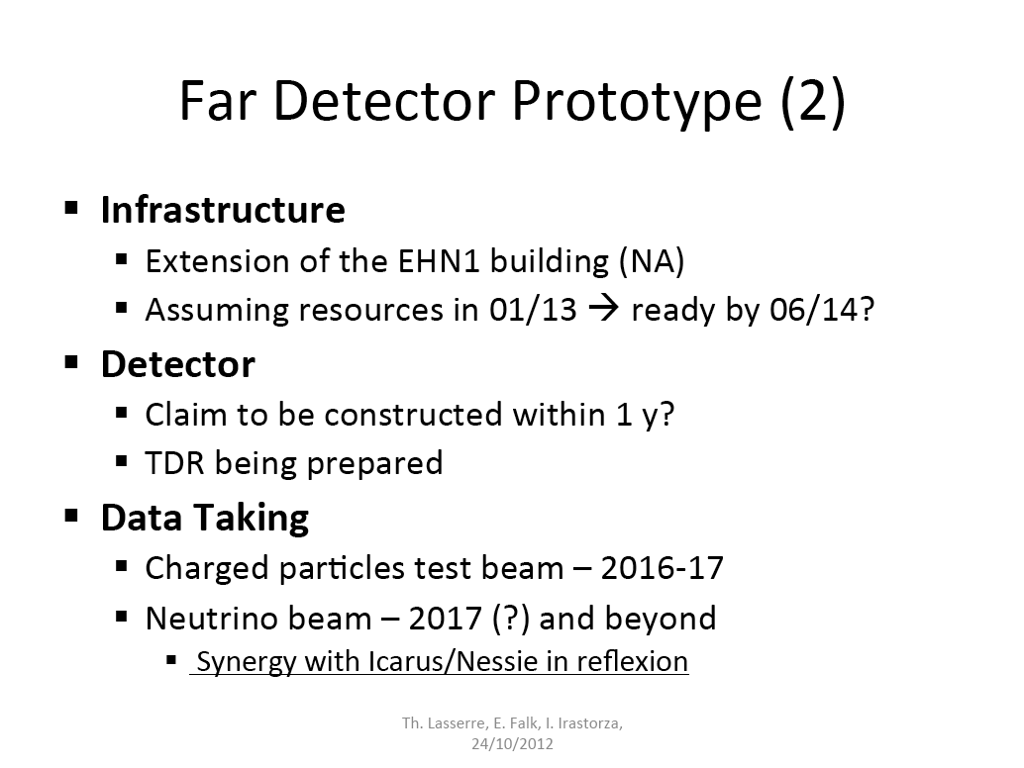

Slide 9
OTHER ISSUES
The SPSC received an Expression of Interest for an experiment to study charm production with proton and heavy ion beams, SPSC-E-008. The Committee will further review the project.

Slide 10
NEW ACTION ITEMS
Meeting | Experiment | Action item | Comments
SPSC107 | COMPASS | Can enough intensity be delivered in 2014? | Hadron beams (tbc)
SPSC107 | NA61 | Investigate consolidation needs | e.g. VTX magnets
SPSC107 | NA61 | Finalize planning for Argon run in 2015
SPSC107 | NA63 | Is the Pb beam sufficiently de-bunched?
SPSC107 | OPERA | Running in 2014?
SPSC107 | AD, CLOUD | Running in LS1 without beam
SPSC107 | OSQAR, CAST | Running during LS1 | Cryo?

