Slide 1
Perspectives for UPC at the LHC Run 2
E. Scapparone
June 4, 2014
• The present: measurements performed so far in p-p, p-Pb, Pb-Pb
• What can we learn on UPC at the LHC Run 2 ?
• Is Run 2 enough for a comprehensive UPC study ?
Thanks to P.Collins(LHCb), J. Hollar(CMS), I. Katkov(CMS), V. Podzniakov(ATLAS) for their inputs

Slide 2
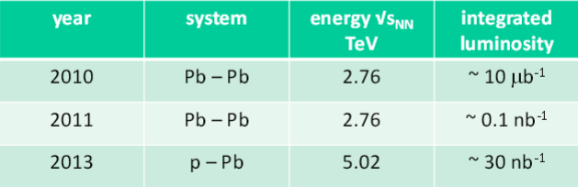
Run 1:
Year system energy √s integrated
TeV luminosity
2010 p-p 7 45 pb⁻¹
p-p 7 6 fb⁻¹
p-p 8 23 fb⁻¹
~0.15 nb⁻¹
Run 2 assumptions:
pp: √s = 13 TeV (later may be higher), 75-100 fb⁻¹ → factor 3000 ...but pileup has to be tamed
Pb-Pb: √s = 5.1 TeV, 1 nb⁻¹ → factor 7 (may be 10)
p-Pb: ~ 50 nb⁻¹ , √s under discussion.... ( 5.1 or ~8 TeV ?) → factor 2

Slide 3
J.P. Wessel, at ECFA High Luminosity LHC Experiments Workshop - 2013

Slide 4
Trigger:
General comment: UPC triggering not trivial:
HW/technology:
• Few tracks (2 to 4) → requires low noise detectors;
• Low p_{T} (low mass mesons challenging with ~ 1 T field)
• relatively small cross section → background rejection
Sociology:
Often considered an «out of stream» physics, competition to get bandwidth
ALICE advantages: low material budget, low B, low p_{T} threshold
→ barrel: silicon detector (low background), but background from the huge e⁺e⁻ cross section
gas detectors far from IP ( noise to be tamed for few hits trigger, physics background from late particles)
hadronic background, easier to reject
→ life harder at Run2 with shorter bunch spacing (easier for pilup)
CMS,ATLAS advantages:
Large acceptance, excellent calorimetry, thr may be high for low mass mesons, but should be OK for ϒ
Workaround: triggering with the Zero Degree Calorimeters. But:
Only a part of the cross section can be taken;
Event generator do not include neutron production in the final state. Bias ?

Slide 5
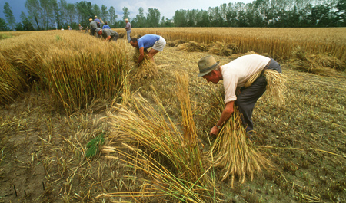
The Run1 harvest:

Slide 6
p-p

Slide 7
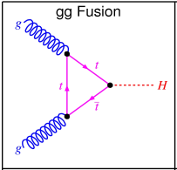
CMS
Exclusive two-photon production of lepton pairs, 40 pb⁻¹ ,
Central exclusive γγ production
Two-photon production of W pairs and limits on anomalous quartic gauge couplings
JHEP 01 (2012) 052
No candidates;
CMS calorimetry (em + hadronic) at work.
Powerful search for γ ( E_{T} > 5 GeV).
Related to
Higgs
production
JHEP 1211 (2012) 080
JHEP 1307 (2013) 116
- ϒ coming soon ?

Slide 8
LHCb
Exclusive J/Ψ and Ψ(2S) vector meson production has been
studied in the dimuon channel using the LHCb detector.
arXiv: 1401.3288
J/Ψ
Run1: Luminosity: 930 pb⁻¹
J/Ψ statistics ok ( 1/3 of the sys error); could be improved for Ψ(2S) in Run 2
(factor 2 larger than sys error).
With L = 930 pb⁻¹ → ~30 000 J/Ψ collected (“purity included”). If we consider
σ_{ϒ} ∼ 1/200 ∗ σ _{J/ Ψ} , different branching to μμ, few events should be already there..
R. McNulty, Central exclusive quarkonium production at LHCb
CERN-LHC Seminar, Feb 2013

Slide 9
p-Pb

Slide 10
ALICE:
J/Ψ study in p-Pb collisions ~ (300 + 100 events) at two different range of γp centre of mass energies W;
at the moment results available at forward rapidities.
Semi-central (one muon in the forward spectrometer and one muon
In the barrel), mid-rapidity (barrel) in progress.
CMS:
γγ study in p-Pb collisions (talk by I. Katkov) L=35 nb⁻¹, good agreement to LO QED.
− ϒ(1s,2s,3s) study in p-Pb collisions (ongoing, see proc. DAE Symp. on Nucl. Phys. 58 (2013));

Slide 11
Pb-Pb

Slide 12
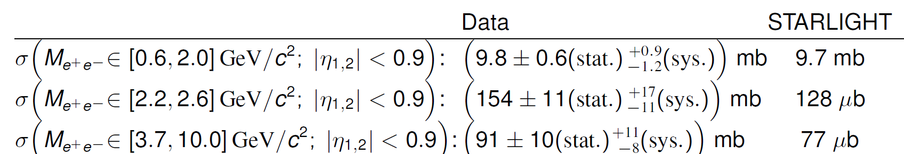
ALICE
QED studies
γγ ◊ ee ~ 280 events (2.3 < M_{γγ} < 10) GeV/c²
~ 300 events (0.6 < M_{γγ} < 2.0) GeV/c² (C. Mayer talk)
EPJ C73 (2013) 2017
(Preliminary)

Slide 13
ALICE
Vector meson production
ρ (*) ~10⁴ √ stat error < < sys err
J/Ψ ~ 500 (midrapidity)+ ~ (stat error < sys)
~ 100 (forward)
Ψ(2s) (***) ~50 X stat error ~25% (a factor 3 larger
than sys error)
(*) 2010 Run, 0.26 μb⁻¹ luminosity collected for this trigger
(**) 2011 Run, 22 μb⁻¹ luminosity collected for this trigger
(***) 2011 Run, 55 μb⁻¹ luminosity collected for this trigger

Slide 14

.. and Run2 sowing

Slide 15
CMS TOTEM- Proton Precision Spectrometer

Slide 16
ADA/ADD
VZEROA
A new entry in ALICE @ run 2
ADA, ADD detectors can be used to make the veto to non UPC
event stronger (now VZERO detectors used).
Two scintillators (two layers each, in coincidence).
ADA: 5.5 ≤ η ≤ 7.5
ADD: 7.5 ≤ η ≤ 5.5

Slide 17
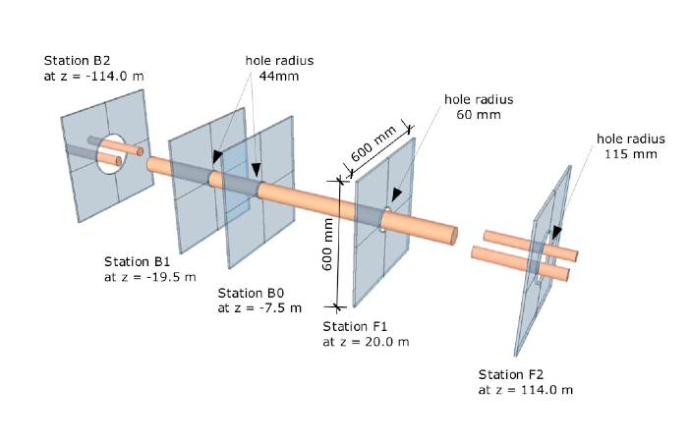
High Rapidity Shower Counters for LHCb:
The HeRSCheL Project
Detectors consist of 4 plastic scintillator plates, 20 mm thick, glued to “fishtail” light guides

Slide 18
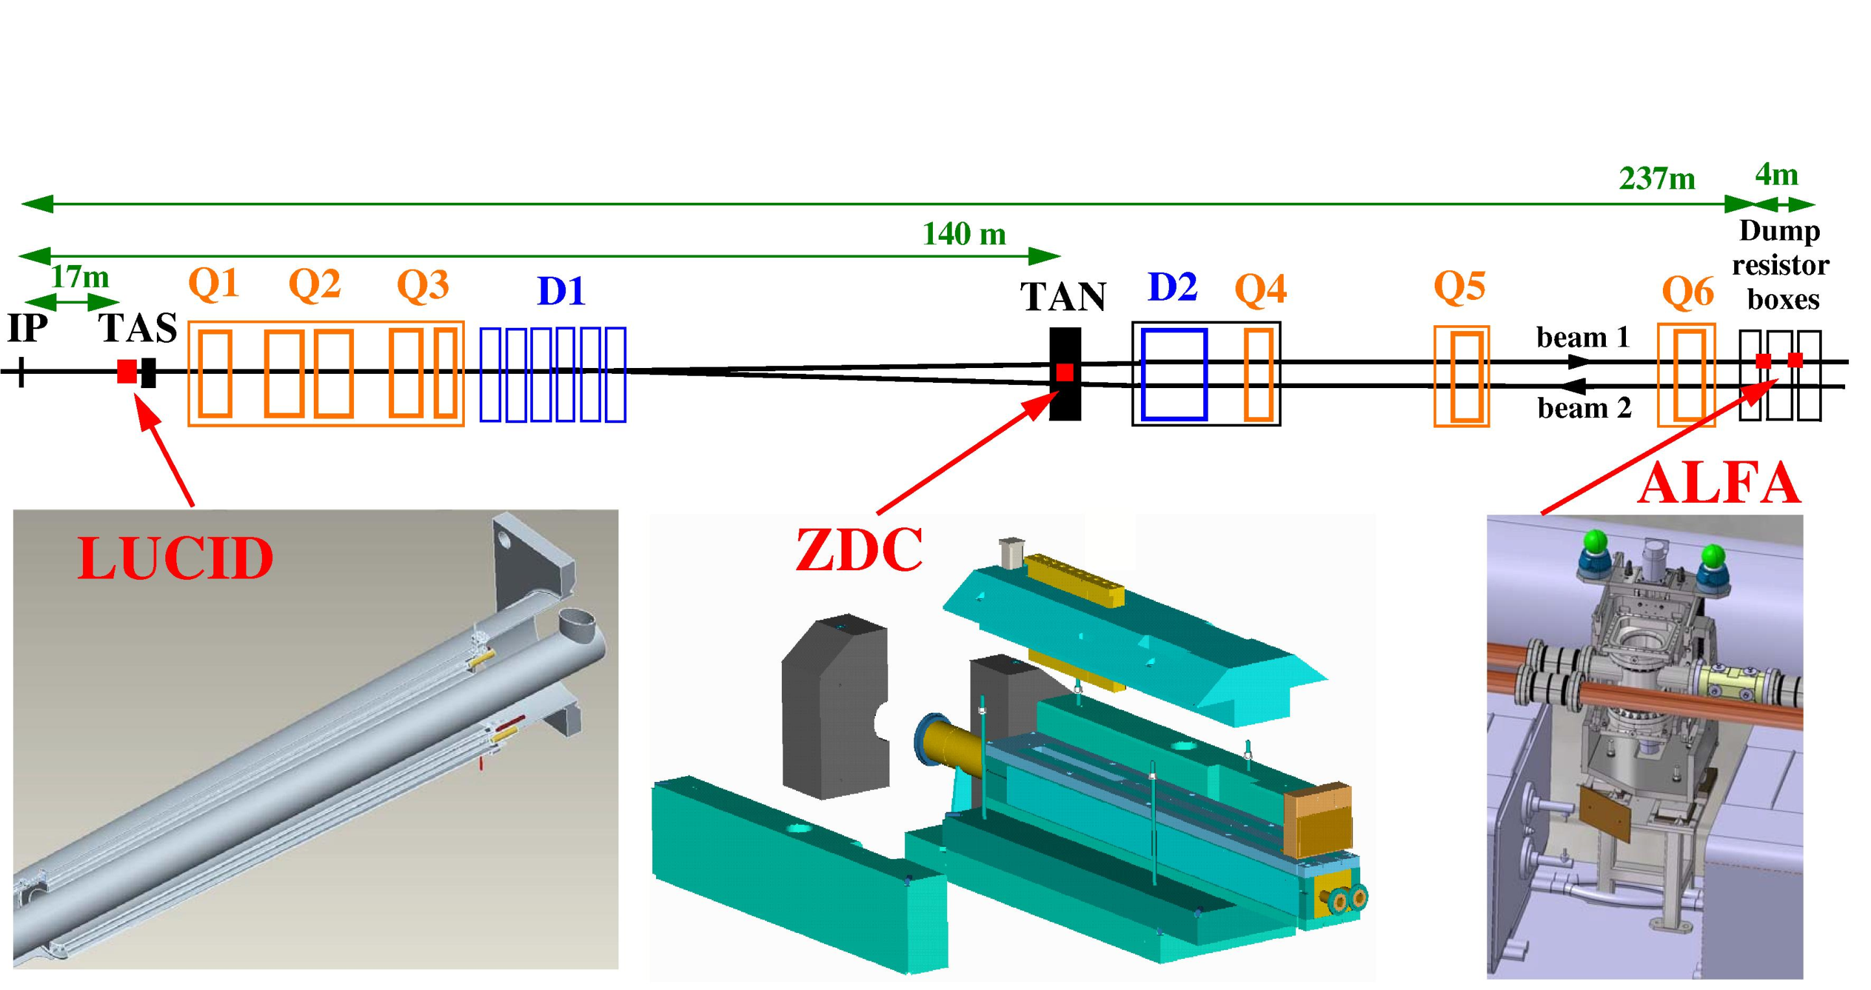
ATLAS Forward Detectors Project

Slide 19
p-p

Slide 20
CMS:
• Central exclusive γγ production
No diphoton event found with
σ ( E_{T}(γ ) > 5.5 GeV, |η(γ)| < 2.5 ) < 1.18 pb using 37 pb⁻¹
CDF observed 43 events: σ(E_{T}>2.5 GeV, |η|<1) =(2.48 (stat) (sys)) pb
+0.4
-0.35
+0.4
-0.51
Run2: L ~100 fb-1 → factor 3000 higher statistics (if pileup under control)
• Access to high statistics ϒ production
• CMS &TOTEM: PPS ( Proton Precision Spectrometer)
Mainly diffraction but UPC can be studied too:
Central exclusive production pp→ pp+X (X= WW, ZZ, γγ, di-jets,...)
W, Z, γ pair production search for anomalous coupling

Slide 21
LHCb
Run 2: with L = 5 fb^{-1 →} ϒ fully accessible
(different mass scale, DGLAP evolution test).
Other questions:
Can X(3872) (arXiv:1302.6269) be produced
exclusively ?
ALICE
Interest in pp collisions from ALICE too. Dedicated trigger already collected data in run 1.
J/Ψ in pp could be used to compare with Pb-Pb results.

Slide 22
p-Pb

Slide 23
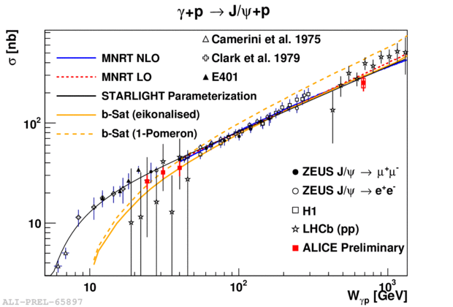
Strong interest in ALICE UPC group to run at the highest possible energy in the next p-Pb run → up to W ~ 1.5 TeV

Slide 24
Pb-Pb

Slide 25
J/Ψ
12, 000 J/Ψ midrapidity dN/dy, dN/dt (see A. Stasto talk )
2,500 J/Ψ at forward rapidity
→ at forward rapidity we have contributions both from x ~10⁻² and 10⁻⁵.
How low in Bjorken x can we go at the moment ?
• Barrel → x ~10⁻³
At forward rapidity we have contributions both from x ~10⁻² (95%) and 10⁻⁴ (5%), depending on the Pb nucleus emitting the photon.
→ tagging by using ZDC activity, see arXiv:1109.0737
Now: 5% of the UPC forward J/Ψ from low x. 20% of them with neutron emission.
With the present statistics (55 μb⁻¹) → 80 * 0.05 * 0.2 ~ 1 event
→ Run2: 2,500 J/Ψ * 5 % * 20 % ~ 30 tagged J/Ψ at x ~10⁻⁴ (1 nb⁻¹)
→ Gluon shadowing at 10⁻⁴ feasible !
Run 3 required for a good statistics, but results may come also at Run 2

Slide 26
ϒ study:
Important to measure gluon shadowing at similar x but different mass scale. Caveat: HERA constrain to the γ-p cross section could be poor (see yesterday Joakim talk)
ALICE: ~ 50 ϒ (σ_{J/Ψ} / σ_{ϒ} ~ 180 ; Γ^{l+l-}_{J/Ψ} ~2*Γ^{l+l-}_{ϒ} )
I. Yeletskikh
(jinr.ru/img_sections/Scient_Sess/SC111/7.1_Yeletskikh.pdf)
Run 2 UPC program being defined
ATLAS: so far no published results, but it has full capabilities to measure UPC J/Ψ ....
ALICE, ATLAS and CMS can study ϒ at Run 2; statistics may be low....
...a joint effort is required to keep statistical uncertainties at a reasonable level.

Slide 27
Dark photon
Particles of light, photons, interact with visible matter and its building blocks—protons, neutrons and electrons.
Perhaps the same is true for dark matter. In other words, does the visible photon have a counterpart, a dark photon, that interacts with the components of dark matter?
Search for heavy (dark) photon A’ (sometimes U ) is an importan part of the scientifc program at JLAB: HPS dedicated experiment
A’ couples very weakly to electrons.
Fine structure constants α = e²/4π ; α’ = g’²/4π; ε² = α’ / α
X⁻
X⁺

Slide 28
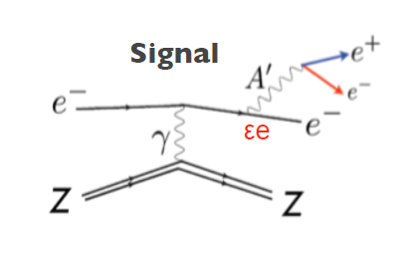
Example: HPS at JLAB

Slide 29
Can UPC help ?
Pb
Pb
e
At LHC nice preliminary results from ALICE in π⁰ decay
( but limited to M < 100 MeV/c2).
UPC can go up to few GeV:
γ
e
Pb
Pb
A large statistics is required...
→ Collected 300 ee events with M< 2 GeV/c² ( L=0.2 μb⁻¹ ). Factor 5000 larger statistics at Run 2

Slide 30
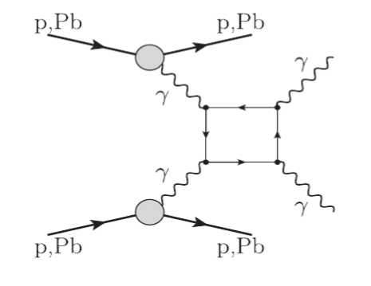
γγ → γγ
A very important measurement ...UPC hunting for physics beyond SM
So far, no direct observation of this process.
In the SM the above box diagram involves quarks, W, etc,
→ Extra contributions from new heavy charged particles and/or super symmetric partners
of SM particles ?
See PRL 111, 080405 (2013)
depends on the M_{γγ} threshold. M_{γγ} > 5 GeV → σ ∼ 30−40 nb
In ALICE a lower threshold could be used (but background expected, see yesterday David talk).
a) γ conversion in/before the TPC
b) γ conversion in ECAL/DCAL
CMS/ATLAS: 50% (Acc x eff)
ALICE: Acceptance, efficiency to be evaluated; assuming a conservative 20%
N ~20 events in CMS/ATLAS, 5-10 events in ALICE ( depending on the threshold ).
With 1 nb⁻¹ , √s_{NN}=5.5 TeV → N~ 30-40 events ( threshold M_{γγ} > 5 GeV)
Run3 is required for a large statistics , but we can start at Run2

Slide 31
Is Run 2 enough ?
In Pb-Pb collisions, most of the analysis can start at Run 2, but need Run 3 for a reasonable statistics

Slide 32


Conclusion
UP-Cinderella..
...became a princess
LHC Run 1: UP-Cinderella became a princess (thanks also to the previous effort at RHIC (STAR, PHENIX), Tevatron +
theoreticians working at this field).
Abstracts at several important conferences on UPC now always accepted and sometimes required.
~10 experimental papers published/being submitted at the LHC by ALICE,LHCb,CMS; > 100 Proceedings.
But «they lived happily ever after» does not apply....Run2 will be exciting but hard...

Slide 33
Summary (+ personal considerations)
Run2 will be a great step forward in UPC for pp, P-Pb and Pb-Pb collisions
Luminosity is important but it is just a required ingredient: UPC results need a proper, sometimes not
straightforward, interpretation
(several processes at work): a tight collaboration with theoreticians is mandatory.
Few analysis are at the statistical limit at Run2: a joint effort between LHC experiments would be a great help.
Hope we will quote this workshop not as «the workshop on photon-induced collisions» but
« the first workshop on photon-induced collisions»......

