Slide 1
Consolidation of the SMIT quadrupole magnets in the Booster Injection Line
A. Aloev
8th November 2012

Slide 2
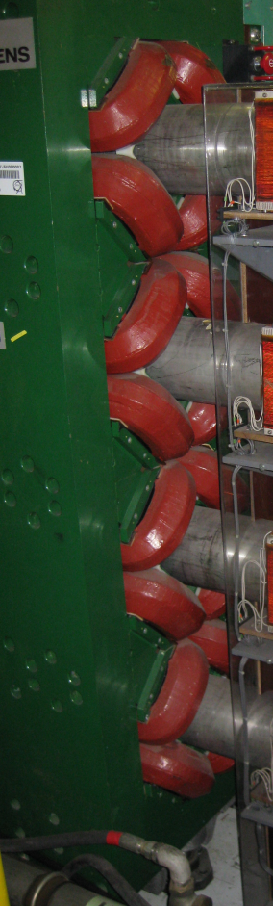
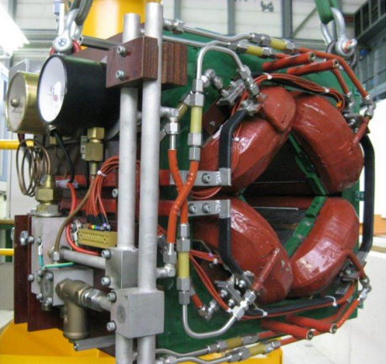
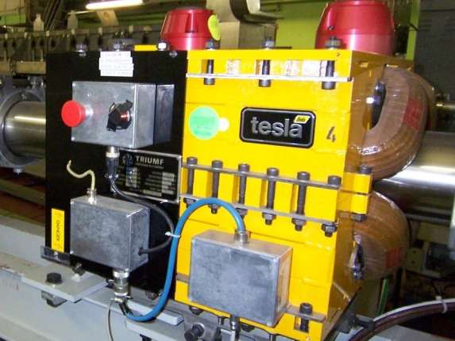
Introduction
The booster injection quadrupoles are to be consolidated due to mechanical degradation of the coils. We consider here a scenario for replacing the SMIT-type magnets (1969) with the TRIUMF-type magnets(1990’s). An alternative scenario based on new, more compact magnets, is still to be completed and will not be presented here.
There are two families of magnets to be considered
  single SMIT
  four-in-one SMIT
We will show that:
  the single SMIT can be replaced by the single TRIUMF
  in case of the four-in-one units the TRIUMF version
    produces a small asymmetrical field which must
    be considered.
SMIT
TRIUMF
SMIT
stack of four units

Slide 3
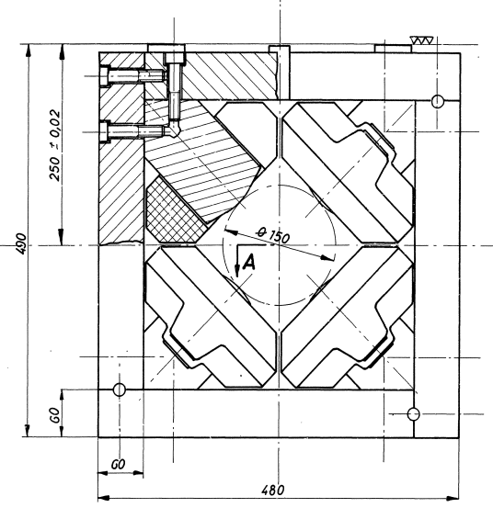
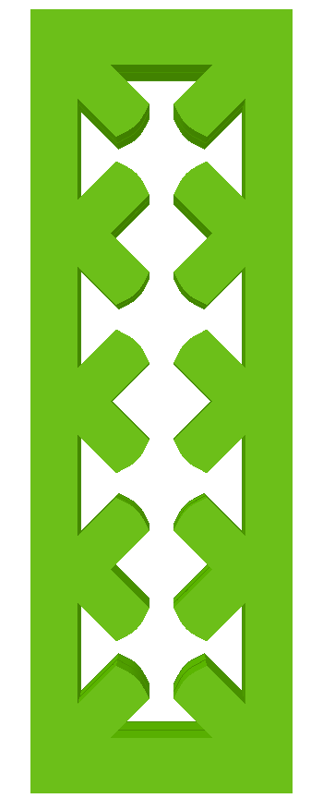
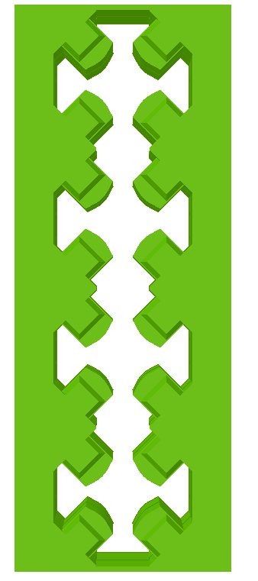
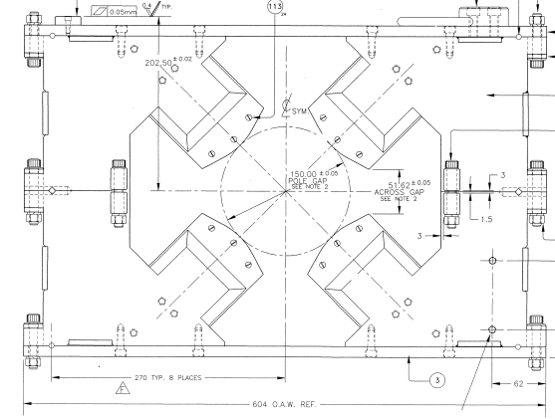
Stack of four units design
SMIT-1
No space for plates between quadrupoles
TRIUMF-1
TRIUMF-4
SMIT-4

Slide 4
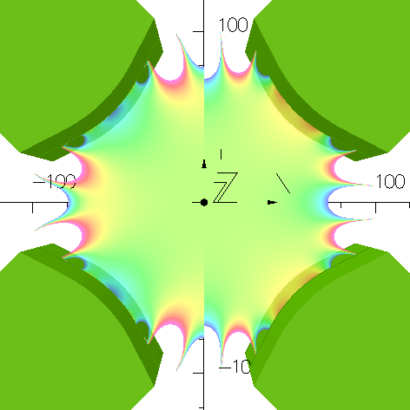
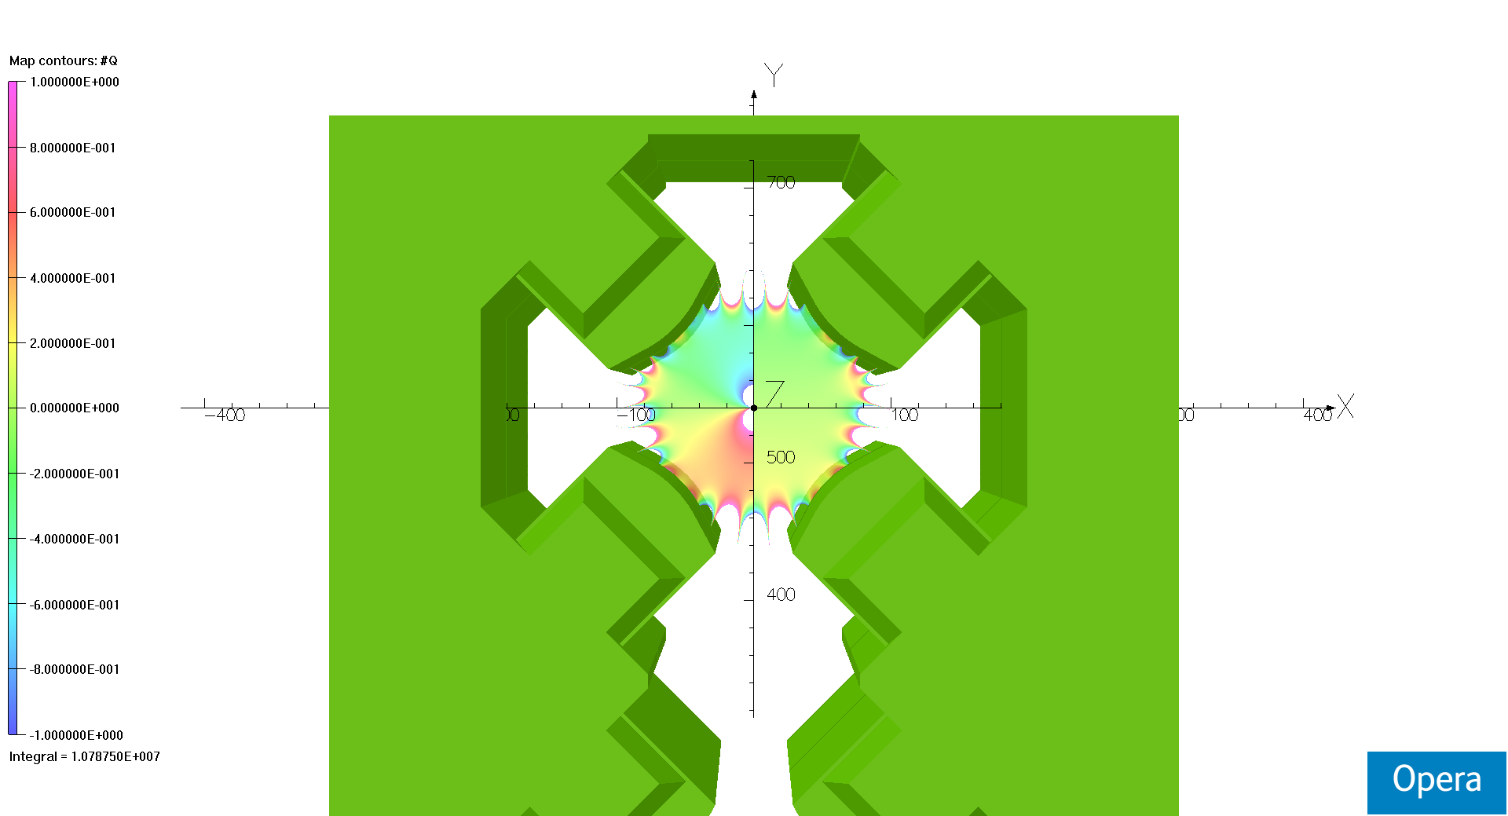
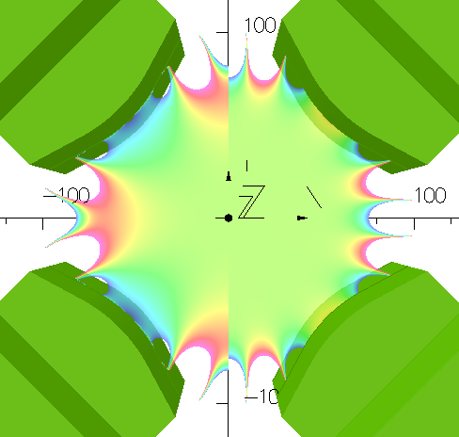
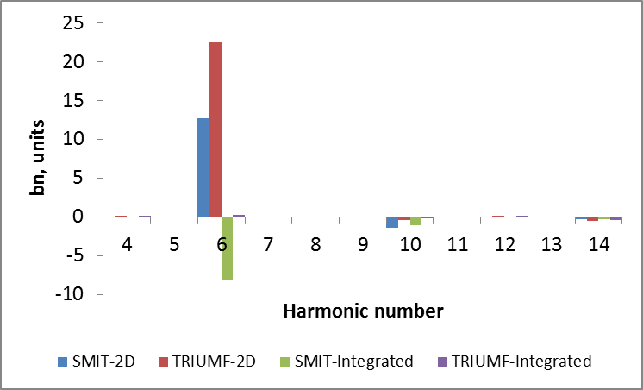
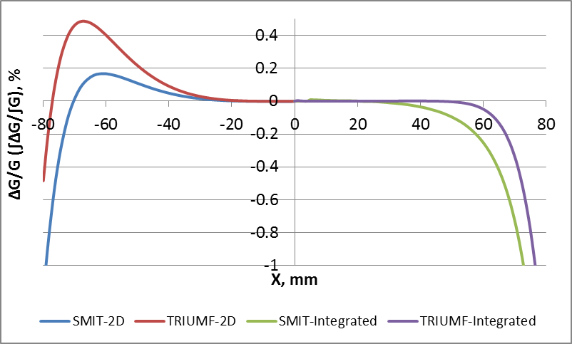








Single unit comparison
(Integrated) gradient homogeneity
SMIT-1
1%
TRIUMF-1
$$\frac{∆G}{G}$$
$$\frac{∫∆G}{∫G}$$
$$\frac{∆G}{G}$$
$$\frac{∫∆G}{∫G}$$
0%
$$G=1.96 T/m$$
$$∫Gdz=0.911 T$$
-1%
$$G=1.96 T/m$$
$$∫Gdz=0.919 T$$
Relative harmonics at r₀=50 mm
(Integrated) gradient homogeneity along X

Slide 5
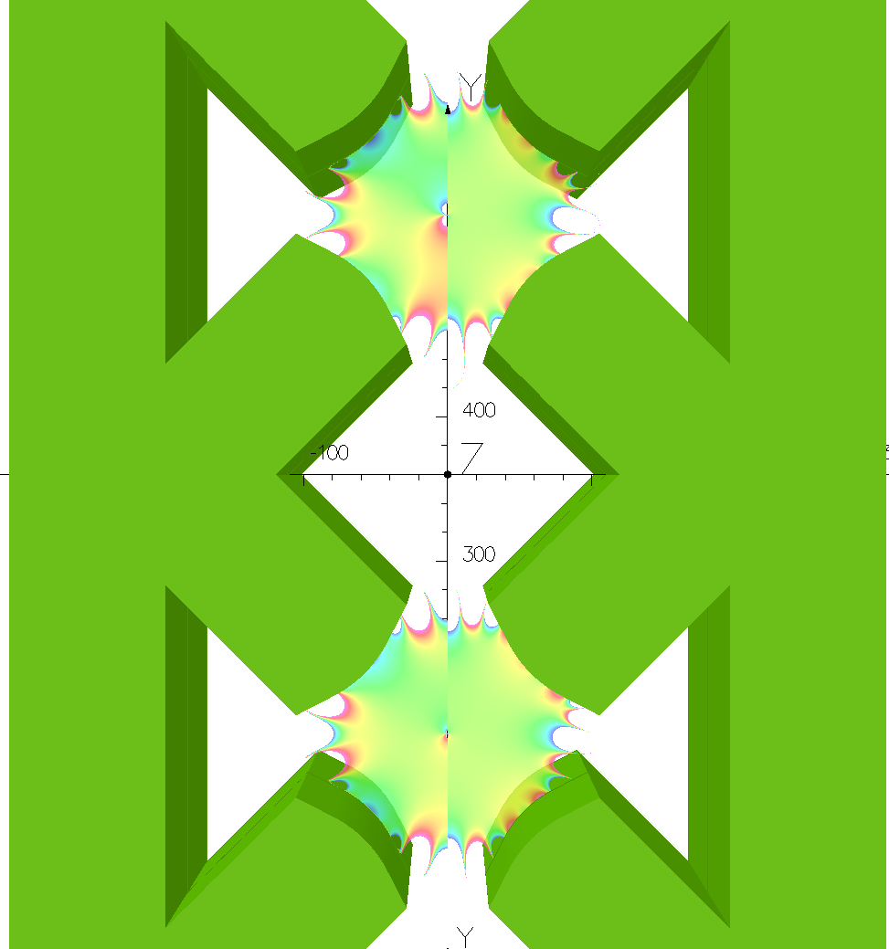
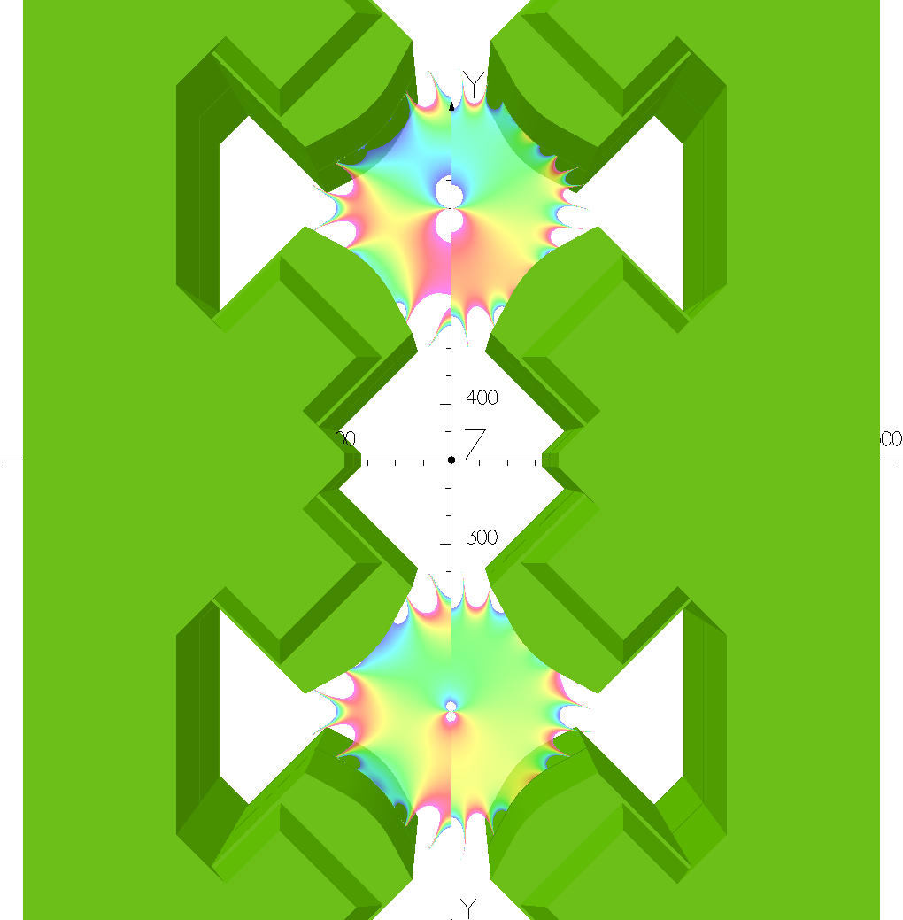







Stack of four units comparison
(Integrated) gradient homogeneity
(with the thin top plate)
SMIT-4
TRIUMF-4
1%
$$\frac{∆G}{G}$$
$$\frac{∫∆G}{∫G}$$
$$\frac{∆G}{G}$$
$$\frac{∫∆G}{∫G}$$
0%
$$\frac{∆G}{G}$$
$$\frac{∫∆G}{∫G}$$
$$\frac{∆G}{G}$$
$$\frac{∫∆G}{∫G}$$
-1%
$$G=1.96 T/m$$
$$∫Gdz=0.911 T$$
$$G=1.96 T/m$$
$$∫Gdz=0.919 T$$
When four quadrupoles are joined in a stack with a common yoke the magnetic field is not zero on the central axis of the quadrupoles:
B_{x} ≠ 0 ∫B_{x}dz ≠ 0

Slide 6
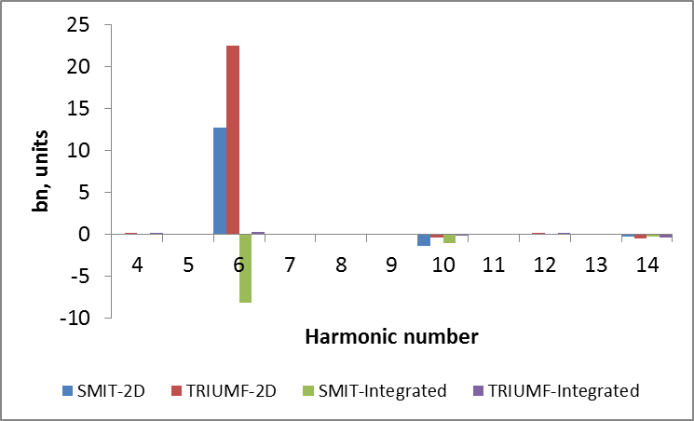
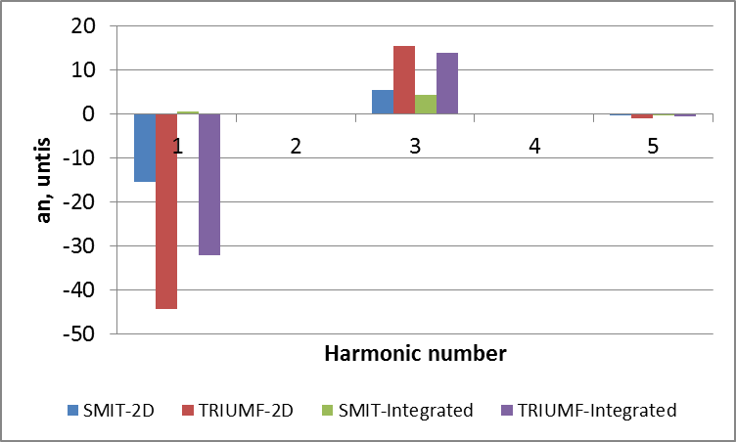
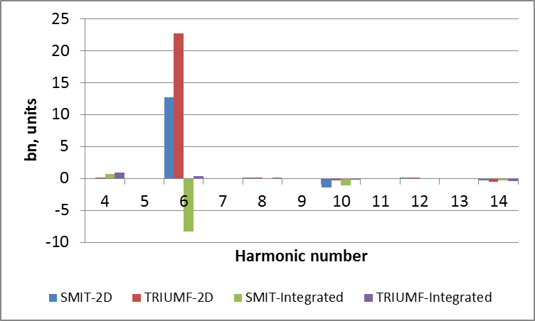
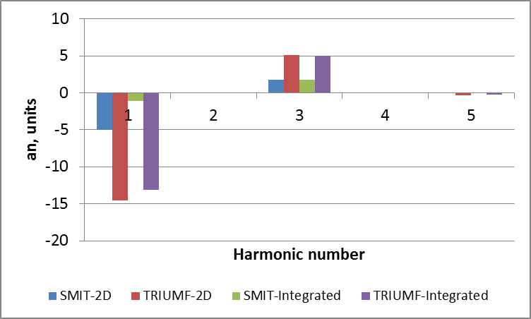
Harmonic analysis of the stacks of four units
Normal and skew relatives harmonics of the outer quadrupoles at r₀ = 50 mm
Normal and skew relatives harmonics of the inner quadrupoles at r₀ = 50 mm
The harmonic analysis indicate that the magnetic field on the central axis of the quadrupoles is not zero:
B_{x} =A₁
∫B_{x}dz = ∫ A₁ dz
where A₁ is the absolute skew dipole harmonic of the field.

Slide 7
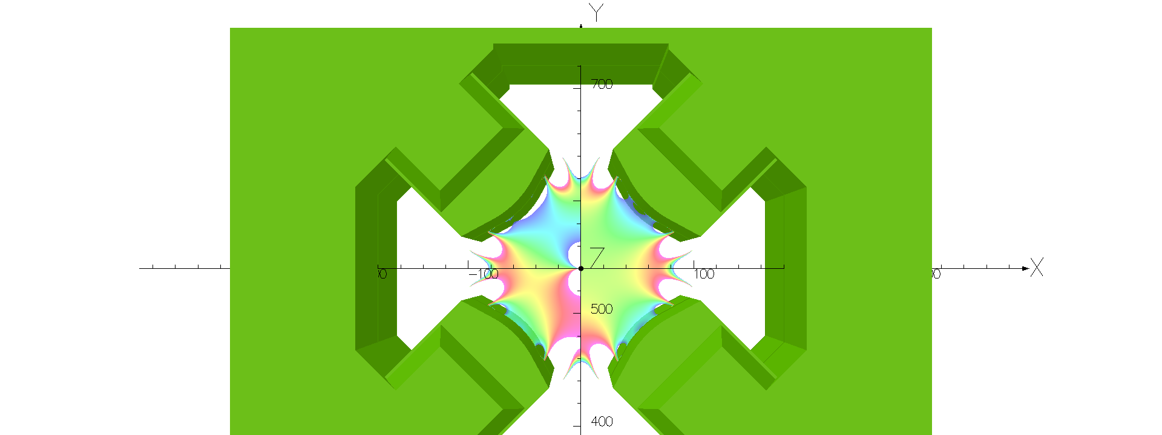
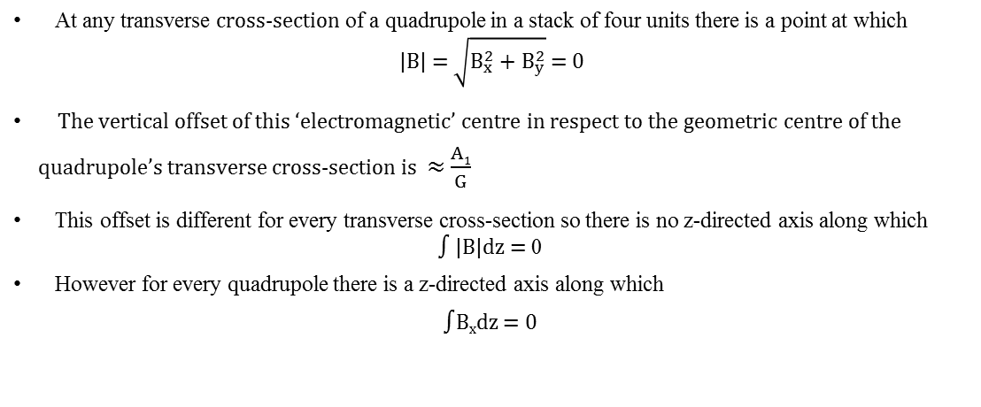
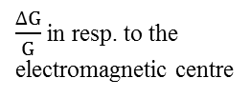
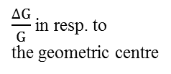
Electromagnetic centre offset in the stacks of four units
At any transverse cross-section of a quadrupole in a stack of four units there is a point at which
|B| = $\sqrt{B_{x}^{2}+B_{y}^{2}}$ = 0
The vertical offset of this ‘electromagnetic’ centre in respect to the geometric centre of the quadrupole’s transverse cross-section is ≈ $\frac{A1}{G}$
This offset is different for every transverse cross-section so there is no z-directed axis along which
∫ |B|dz = 0
However for every quadrupole there is a z-directed axis along which
∫B_{x}dz = 0
TRIUMF-4 gradient homogeneity at Z = 0
(outer quad with a thin top plate)
1%
$\frac{∆G}{G}$ in resp. to
the geometric centre
$\frac{∆G}{G}$ in resp. to the
electromagnetic centre
0%
|B(0,0,0,)| = 4.4 Gauss
Offset = 222 μm
-1%

Slide 8
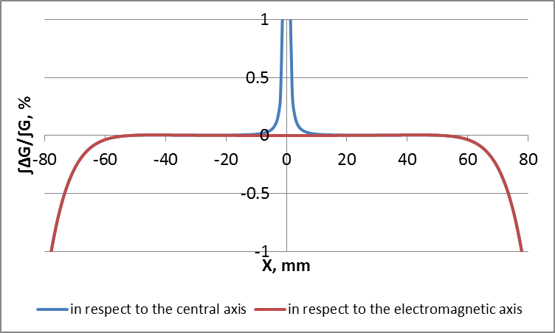
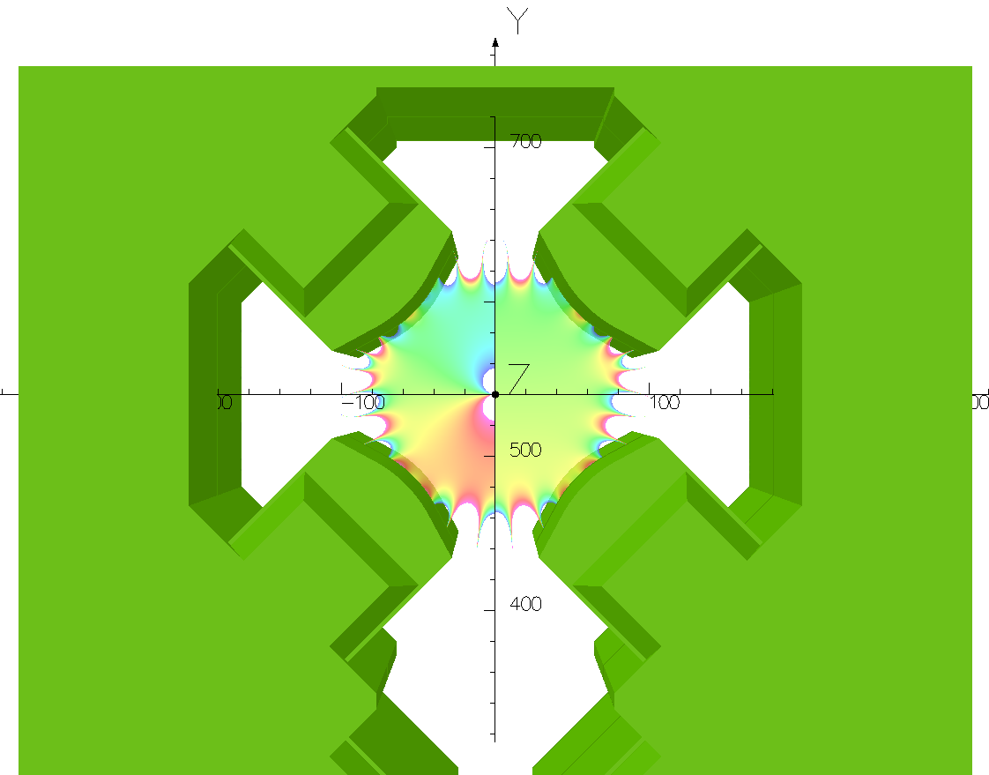
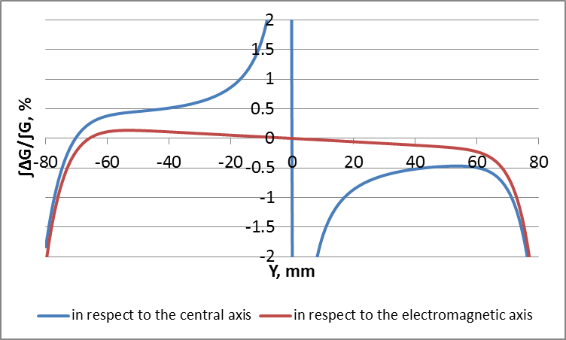
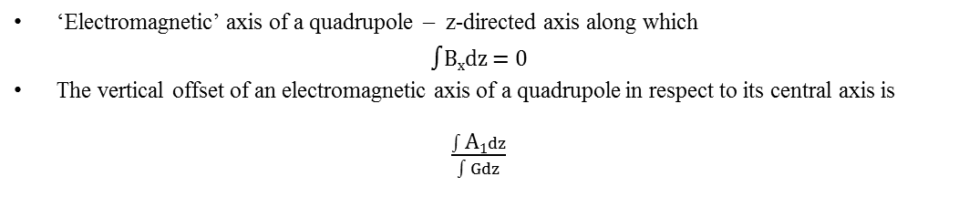
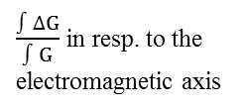
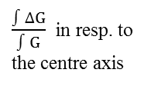
Electromagnetic axis offset in the stacks of four units
‘Electromagnetic’ axis of a quadrupole – z-directed axis along which
∫B_{x}dz = 0
The vertical offset of an electromagnetic axis of a quadrupole in respect to its central axis is
$\frac{∫\text{A}\text{1}dz}{∫Gdz}$
≈
TRIUMF-4 integrated gradient homogeneity
(outer quad with the thin top plate)
1%
$\frac{∫∆G}{∫G}$ in resp. to
the centre axis
$\frac{∫∆G}{∫G}$in resp. to the
electromagnetic axis
Offset = 161 μm
0%
-1%

Slide 9
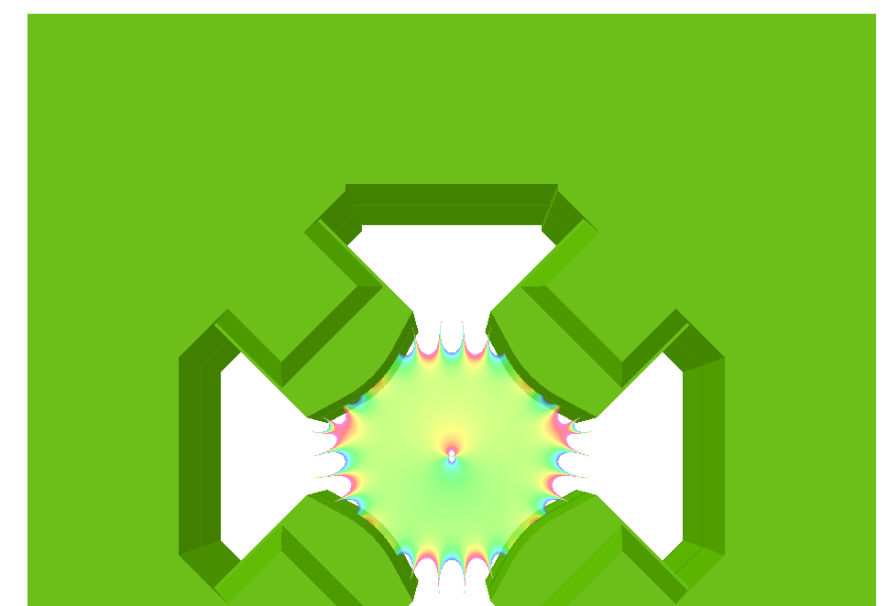
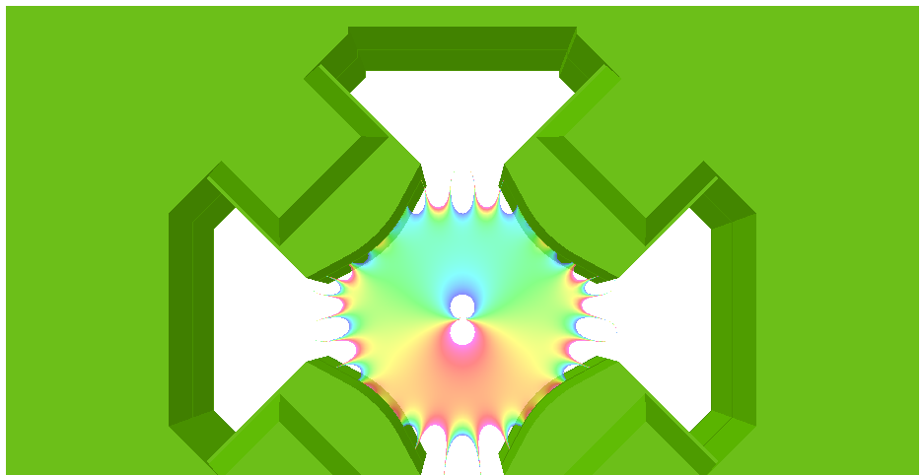
Electromagnetic axis offset in the stacks of four units
Field on the central axis
 | in resp. to the central axis |  |  |  | in resp. to the electromagnetic axis
 | B_{x} max, ×10⁻⁵ T | ∫B_{x}dz, ×10⁻⁷ Tm | ∫|B|dz, ×10⁻⁴ Tm | Offset, μm | B_{x} max, ×10⁻⁵ T | ∫B_{x}dz, ×10⁻⁷ Tm | ∫|B|dz, ×10⁻⁴ Tm
SMIT (outer quad) | 15.3 | 35.3 | 1.4 | -3.2 | 15.9 | 6.1 | 1.4
TRIUMF (outer quad) | 43.6 | 1473.9 | 2.8 | 161.1 | 11.9 | 6.4 | 1.3
SMIT (inner quad) | 4.9 | 46.8 | 0.4 | 5.7 | 3.8 | 4.8 | 0.4
TRIUMF (inner quad) | 14.3 | 598.6 | 0.9 | 65.7 | 3.4 | 4.6 | 0.3
The offset can be adjusted by varying the thickness of the top plate.
TRIUMF-4 outer quad with 12.5 mm top plate
TRIUMF-4 outer quad with 112.5 mm top plate
Offset = 161 μm
∫B_{x}dz =1.4×10⁻⁴ Tm
(along the central axis)
Offset = − 40 μm
∫B_{x}dz = 0.4×10⁻⁴ Tm
(along the central axis)

Slide 10
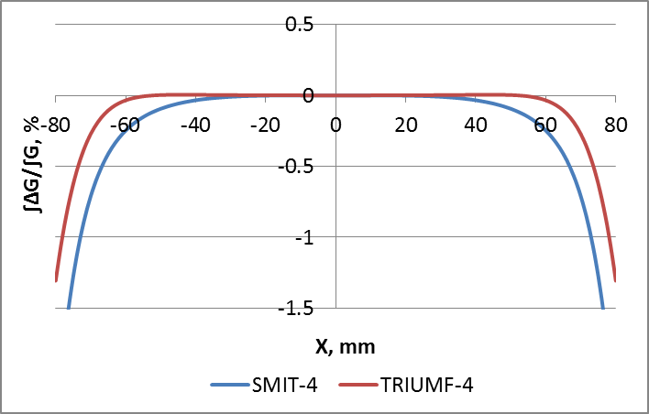
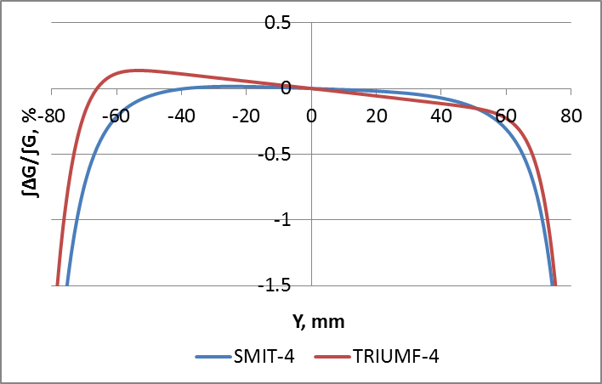
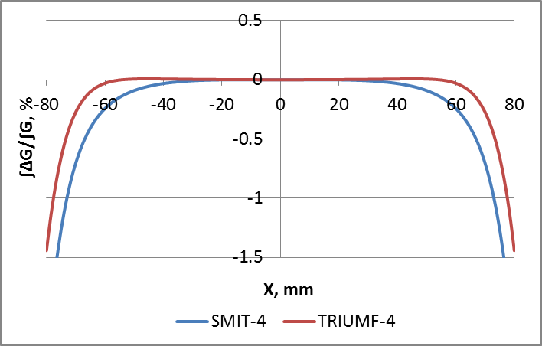
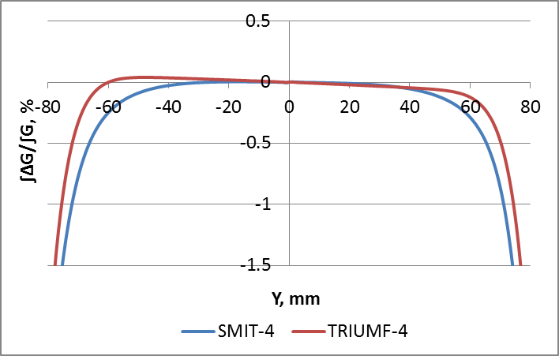
Integrated gradient homogeneity of SMIT-4 and TRIUMF-4
along Y = 0 and X = 0 in resp. to the electromagnetic axis
Outer quadrupoles
Inner quadrupoles

Slide 11
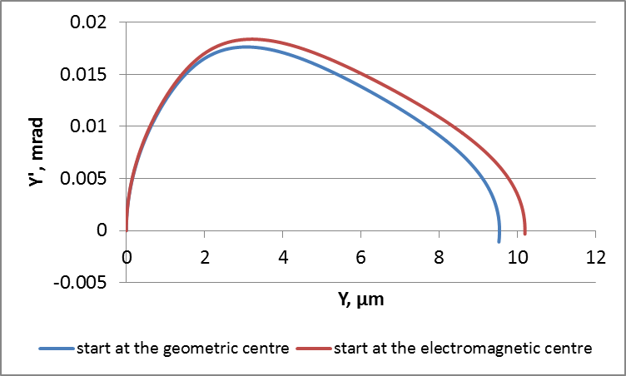
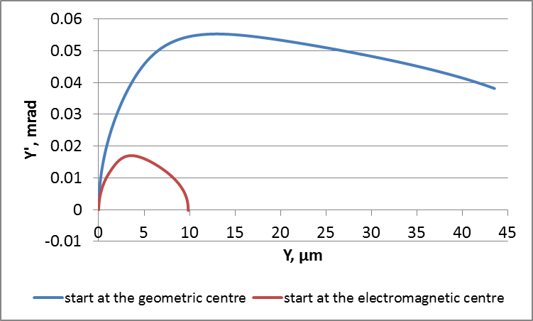
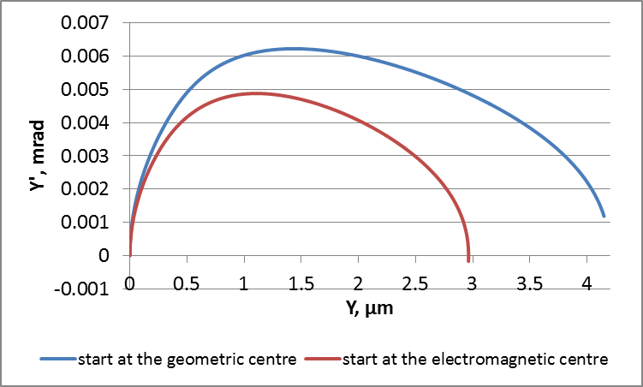
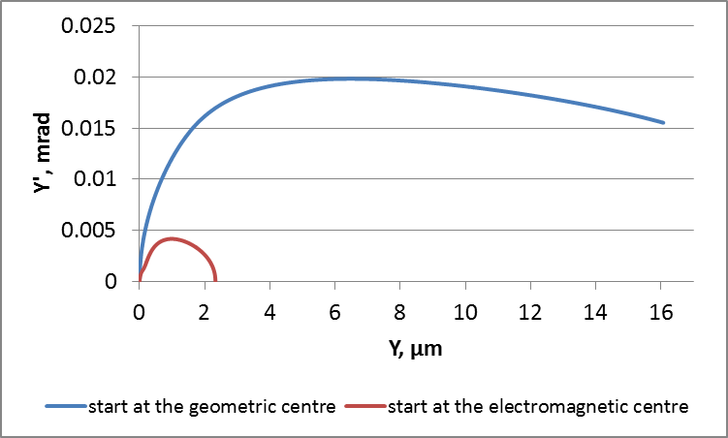
160 MeV H⁻ particle in SMIT-4 and TRIUMF-4
SMIT-4 outer quadrupole
TRIUMF-4 outer quadrupole
SMIT-4 inner quadrupole
TRIUMF-4 inner quadrupole

Slide 12
Conclusion
SMIT single units can be replaced with TRIUMF single units.
SMIT stack of four units can be replaced with TRIUMF stack of four units if the offset of the ‘electromagnetic’ axis of its quadrupoles is acceptable from the beam optics point of view.
If not, TRIUMF stack of four units could be modified to reduce the offset of the ‘electromagnetic’ axis of its quadrupoles.
However, considering that it is no longer necessary to purchase TRIUMF magnets for the LT-LBE line (we can fit the Linac 4 TL quadrupoles), we propose to explore a new more compact design for the consolidation project.

Slide 13
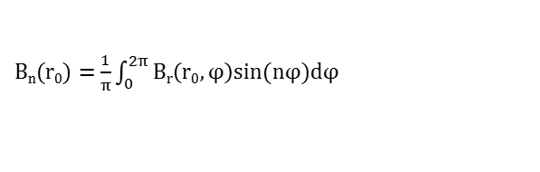
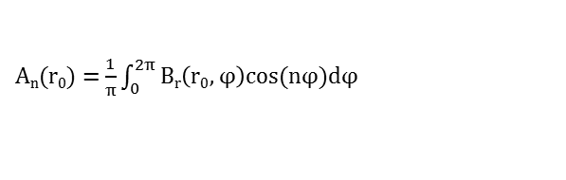
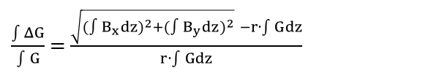


Used formulas
Absolute harmonics:
A_{n}(r₀) = $\frac{1}{π}\int_{0}^{2π}{Br\left(r0,φ\right)cos⁡(nφ)dφ}$
B_{n}(r₀) = $\frac{1}{π}\int_{0}^{2π}{Br\left(r0,φ\right)sin⁡(nφ)dφ}$
n = 1,2,3, … r₀ – reference radius of harmonic analysis
Relative harmonics:
a_{n} = A_{n}/B₂ b_{n} = B_{n}/B₂
Gradient
G = $\frac{B2}{r0}$
Gradient error
$$\frac{ΔG}{G}= \frac{\sqrt{B_{x}^{2}+B_{y}^{2}}−G∙r}{G∙r}$$
Integrated gradient error
$\frac{\int{ΔG}}{\int{G}}$ = $\frac{\sqrt{{({∫B}_{x}dz)}^{2}+{({∫B}_{y}dz)}^{2}} −r∙\int{G}dz}{r∙\int{G}dz}$

