Slide 1
User support and requirements capturing processes
Geant4 Collaboration organization, management and communication review
November 9th, 2012
Marc Verderi
LLR, Ecole polytechnique

Slide 2
Introduction
User support and requirements capturing processes are the most important communication aspects with users.
  User support:
    Response to bugs & questions, announcements, tutorials, etc.
  Requirements capturing:
    Response to missing functionalities
This communication has to deal with challenges:
  Users’ community is large
    And keeps growing
  Users’ community is diverse
    High energy, nuclear, accelerator, medical, space…
    With a diversity which is itself growing
      with a trend on simulating more media response: relaxation, phonon, electron-hole drifting, activation, etc.
The Collaboration has set up various communication channels and tools, presented here, to help with communication with users.

Slide 3
Overview of user support and requirements capturing channels
User support and requirements capturing rely on various channels:
  Fora:
    Technical Forum
    HyperNews forum
  Tools:
    Announcement mailing list
    Bug reporting system
    Requirements tracking system
  Workshops and tutorials:
    Users workshops and meetings
    Geant4 tutorials
  Liaisons
  Daily communications

Slide 4
Channels for User support and requirements capturing

Slide 5
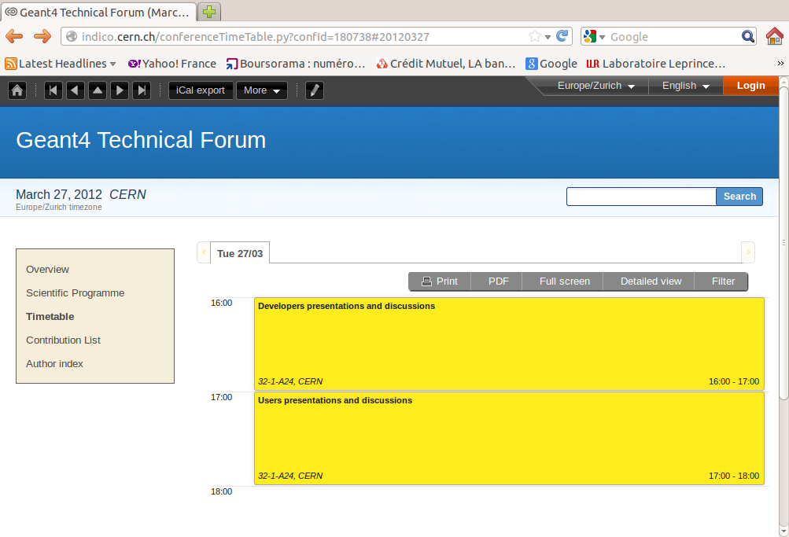
Technical Forum
One of the most important and efficient ways of communication between users and Geant4 developers.
Allows for detailed discussions on problem findings and on requirements.
Typical agenda is:
  Geant4 collaborators presentations:
    Release and/or patch announcements
    Update on requirements
    Possibly, detailed responses to problems
  Users presentations
Items (requirements or problems) are discussed during the meetings
  To understand first if a solution is currently available
  If not, item is taken on board to be further examined by Geant4
    If needed, liaison is created between requesters and Geant4
  Requirements are addressed, depending on criticality and resources

Slide 6
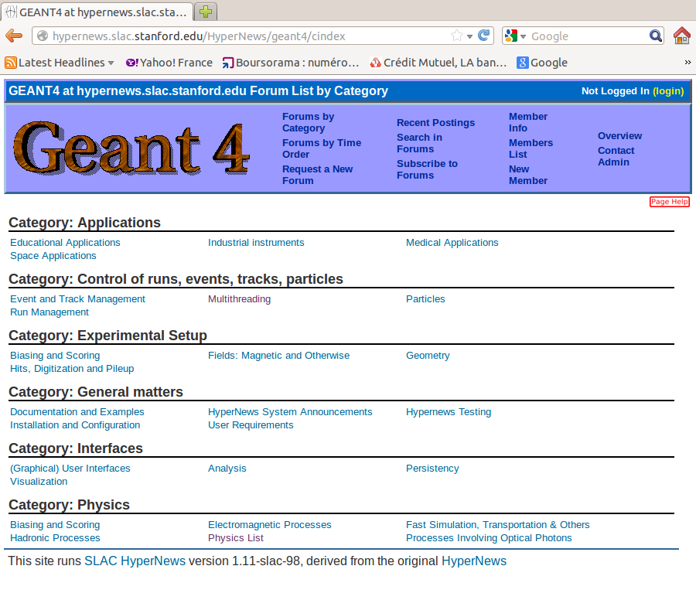
HyperNews Forum
A copious open exchange medium, on a continuous communication mode basis.
Web-based discussion forum:
  http://hypernews.slac.stanford. edu/HyperNews/geant4/cindex
Currently has 27 discussion threads corresponding to either Geant4 modules or application domains.
Access:
  Reading is public
  Posting and receiving emails require minimal registration
    name, email address and institution
  At present, 2540 such registrants
Moderation is minimal
  Only 2 problems in 10 years
Experienced users are encouraged to answering to novice/trivial questions.
Often a place to initiate bug reports.

Slide 7
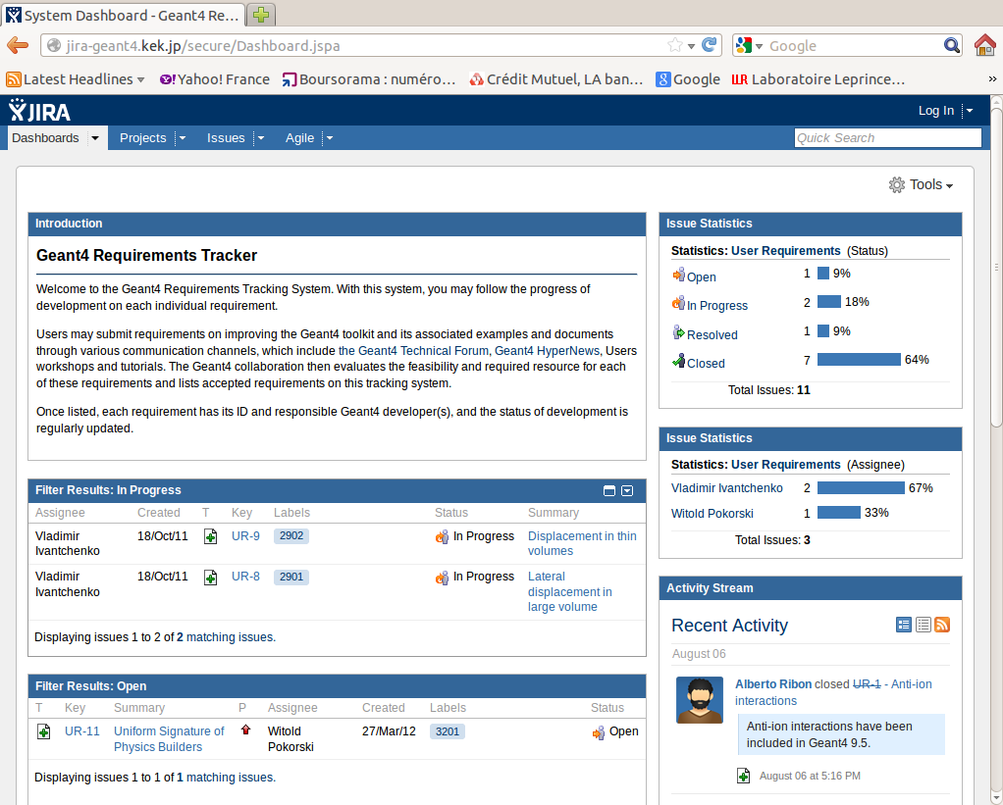
Communication Tools
Requirements tracking system
  JIRA-based system to track major requirements
    http://jira-geant4.kek.jp/secure/Dashboard.jspa
    JIRA system for Geant4 launched about two years ago
  Agreed major requirements are entered to JIRA
  Read access is public
    To allow users to follow progress on requirements.
Bug reporting system
  Bugzilla-based bug report tracking system.
    http://bugzillageant4.kek.jp/buglist.cgi?bug_status=__all__&list_id=659&product=Geant4&query_format=specific&order=bug_id%20DESC&query_based_on=
  When a user identifies a problem, he/she creates a bug report.
  Status of each ticket tracked and recorded on the Bugzilla system
    and made visible to the public
Announcement mailing list
  Registered users receive announcement e-mails
  Inform on patch or Beta releases, user workshops and tutorials
  Currently 550 registrants on the mailing list.
  Past announcements can be consulted for users having a CERN afs account.

Slide 8
Users Workshop and Meetings
Collaboration committed to user workshops and meetings
For example:
  Geant4 Space Users workshop
    http://ec2-204-236-247-226.compute-1.amazonaws.com/
    This 9th G4SUW pages are still under construction
  G4NAMU (Geant4 North American Medical Users organization)
    http://geant4.slac.stanford.edu/g4namu/news.html
Past events of relevance for Geant4 can be found at:
  http://geant4.cern.ch/pastevents.shtml

Slide 9
Geant4 tutorials
Geant4 tutorials held several times each year at many different locations and/or targeted audiences.
  Tutorials are at the initiatives of Geant4 Collaborators, or of users’ communities, etc.
  Last tutorial organized last week, in Korea, by KISTI and NCC.
  5 tutorials in 2012, 8 in 2011, 4 in 2009, etc.
Tutorial opportunities are announced on the Geant4 announcement mailing list and posted on the Collaboration web page.
Past tutorials and training material are available at:
  http://geant4.cern.ch/support/training.shtml
Tutorial presentations and material remain publicly available for some time, so that new users who could not attend at a tutorial may also benefit.

Slide 10
Liaison and daily communications
Liaisons
  Liaisons appointed to major user groups.
  Participate to user groups meeting, capture their requirements and inform our developments.
  Existing current liaisons to ATLAS, CMS, LHCb, ALICE and GATE.
  Past liaisons to BaBar and HARP.
  Collaboration has also direct contacts with several other experiments: CALICE, ILC, Mu2e, CDMS, Belle-2, GERDA, etc.
Daily communications
  Each collaborator has also local communications with their local users for day-to-day assistance and private email communications with users.

Slide 11
Processes for User support and requirements capturing

Slide 12
Processes for Bug Reports and Requirements
Previous channels help in capturing Bug Reports and Requirements.
Once captured, they have to be confirmed first:
  This is done after further examination of the related WG coordinator(s)
  This is done under the legitimacy hat of the Steering Board
Confirmed Bug reports are then:
  Signaled as such in Bugzilla
  Assigned to a developer, who becomes responsible for fixing the problem
  Weekly reminder is sent to related developers
  Open bug report progress are examined at each Steering Board meeting
Confirmed User Requirements
  They may not always be addressed, if resources do not permit
    In such a case, attempt to obtain expertise or resources are made
  In other case, requirements are:
    Simply assigned to a WG, if scope is limited to it
    Or to several WGs, with coordination of the Steering Board and Architecture Team if needed
  Progress on open requirements are examined at each Steering Board

