Slide 1
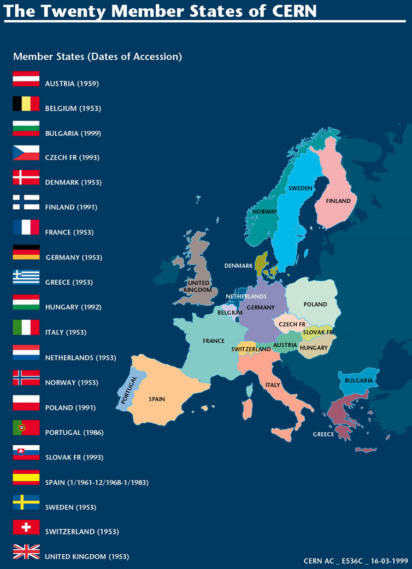
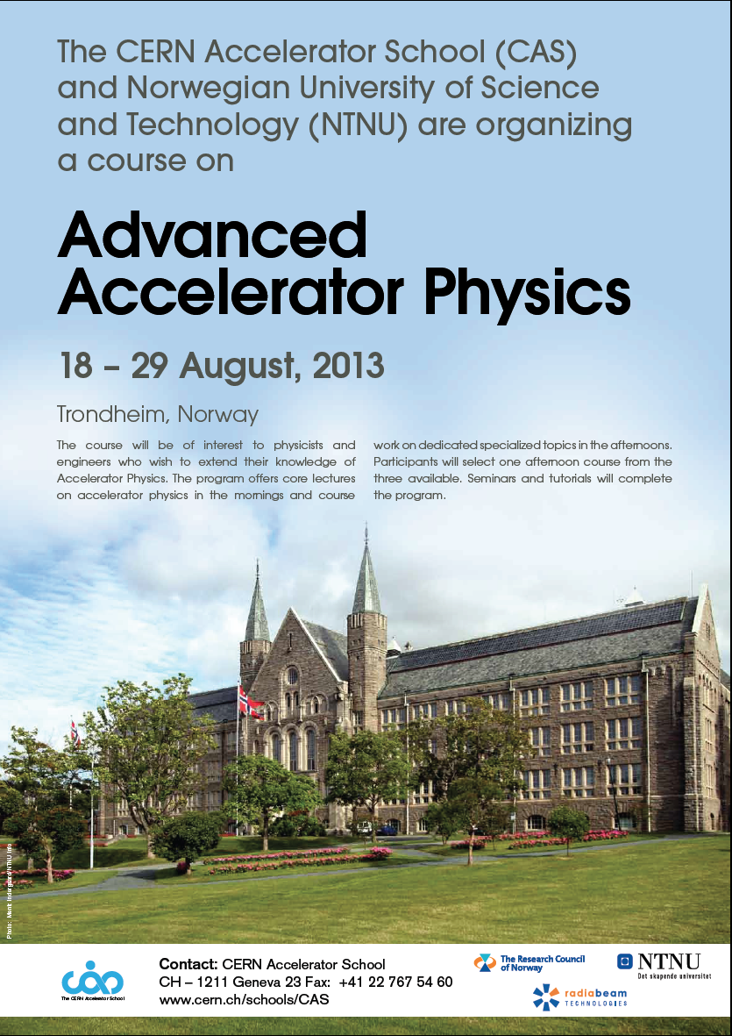
The CERN Accelerator School holds courses in all of the member states of CERN
2013, Trondheim
Norway

Slide 2
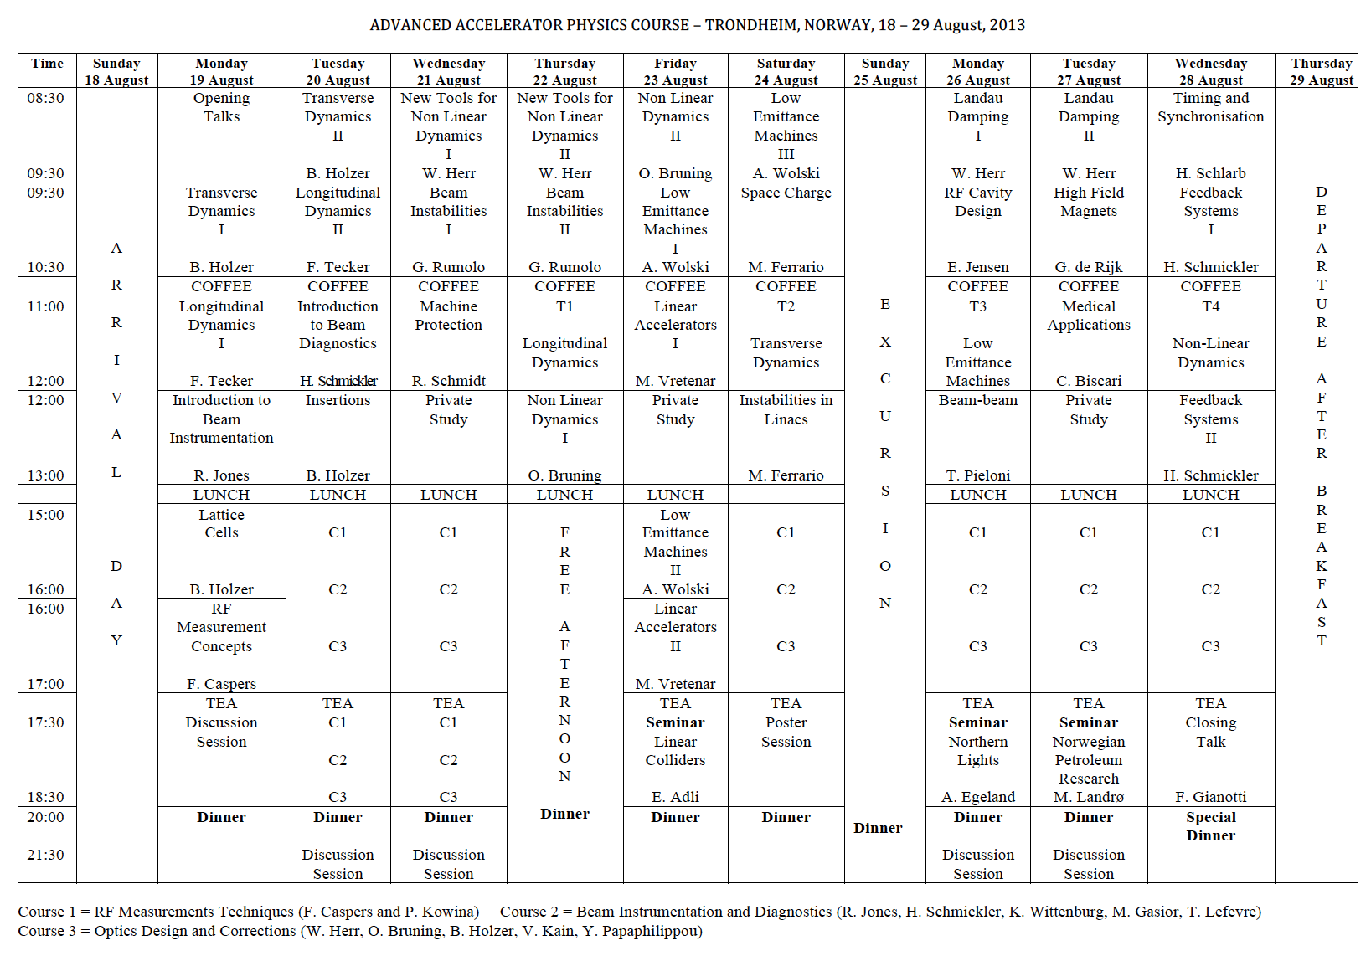

Slide 3
Generalities
80 selected out of 93 applicants
  10 unable to come, so 70
All lectures in Britannia Hall
  Except last day, Meeting room 5
All afternoon courses at NTNU
Coffee breaks in the Britannia
  outside Britannia Hall
Tea breaks in the University
  cafeteria near to course room
Secretariat, Barbara Strasser
  Britannia, Meeting room 7
  University, R30
Breakfast Lunch and Dinner all at the Britannia Hotel
  Lunch in Palmehaven
  Dinner in Speilshalen (except Saturday, in Britannia hall)
Handouts provided each morning

Slide 4
Afternoon Courses

Slide 5
Afternoon Courses
Chance to try something new!
14 hours ++ of practical training
Sign up for the course of preference (~equal numbers)
  At the secretariat absolute latest by coffee on Tuesday AM
Course | Location | Coordinator | Tutors week 1 | Tutors week 2
C1 RF | Høgskoleringen | F.Caspers | P.Kowina | P.Kowina
C2 BI | Natural Science D1 - 102 | H.Schmickler | K.Wittenberg, R.Jones, M.Gasior | K.Wittenberg, T.Lefevre
C3 Optics | Natural Science D1 - 185 | W.Herr | B.Holzer, V.Kain, O.Bruning | B.Holzer, V.Kain, Y.Papaphilippou

Slide 6
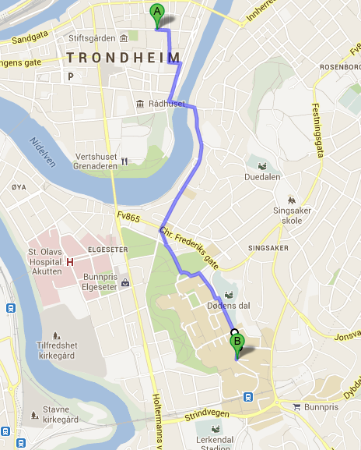
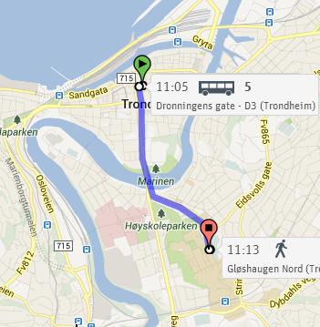
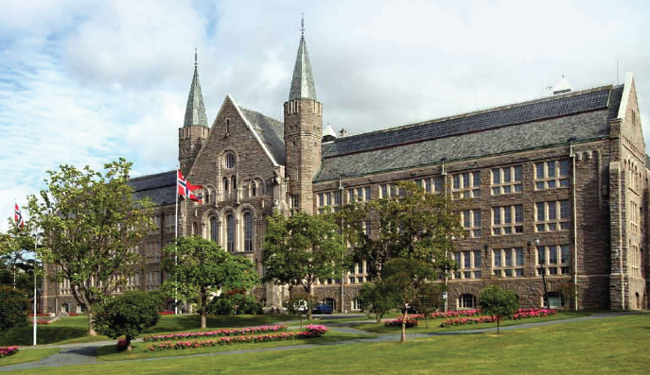
Walking
How to get from Britannia Hotel to the afternoon courses at NTNU
come rain or shine
By bus

Slide 7
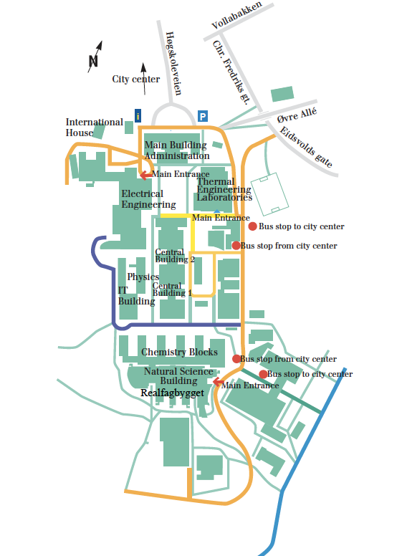
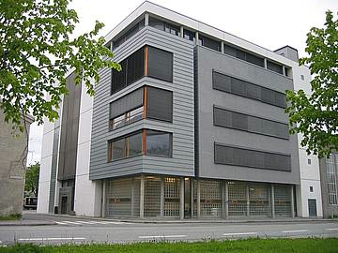
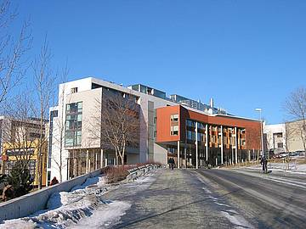
RF course
BI course
Optics course

Slide 8
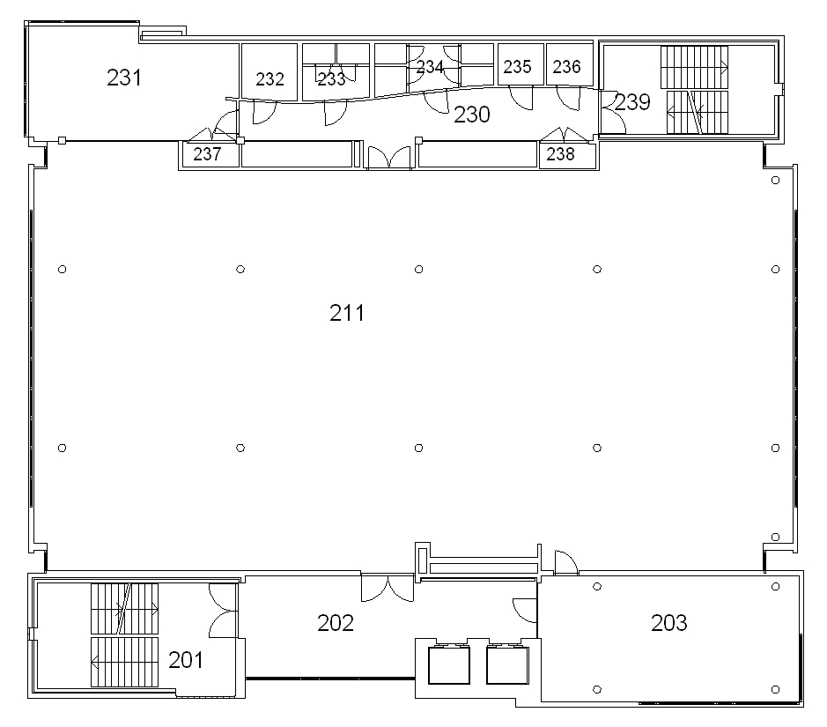
RF course on the second floor

Slide 9
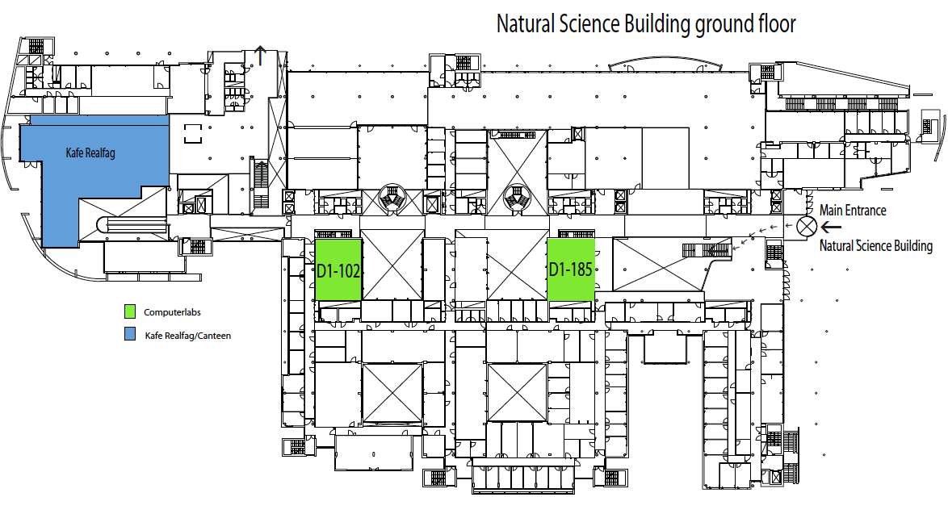
BI course
Optics course

Slide 10
Tutorials

Slide 11
Tutorials
Exercises set by the 4 lecturers mentioned
  Tutorials for each in 3 roughly equal groups
    TG1 Surnames A to H Britannia Hall
    TG2 Surnames I to P Meeting room 10, Britannia
    TG3 Surnames Q to Z Meeting room 11, Britannia
Tutorial | TG1 (A to H) | TG2 (I to P) | TG3 (Q to Z)
 | Britannia Hall | Meeting room 10 | Meeting room 11
T1 Longitudinal Dynamics | W.Herr | B.Holzer | O.Bruning
T2 Transverse Dynamics | B.Holzer | V.Kain | W.Herr
T3 Low Emittance Machines | A.Wolski | W.Herr | Y.Papaphilippou
T4 Non-Linear Dynamics | W.Herr | Y.Papaphilippou | T.Pieloni

Slide 13
No-lecture periods
Private Study
  To work on exercises, wherever you like
Discussion sessions
  First one is here
  Others are in the hotel bar
  Discuss with lecturers outside the amphitheater
  Go into detail which is maybe not of interest to all
Poster session
  At the university in AU 1-6
  Mount from Thursday, take down Tuesday
Seminars in the second week
  At the university in Auditorium R2
Free Afternoon
  Is exactly that
  If you decide not to take dinner at the hotel (after the free afternoon or otherwise) please let Barbara know the day before so that we can inform the hotel
School photo
  Afternoon tea break on Wednesday 21st

Slide 14
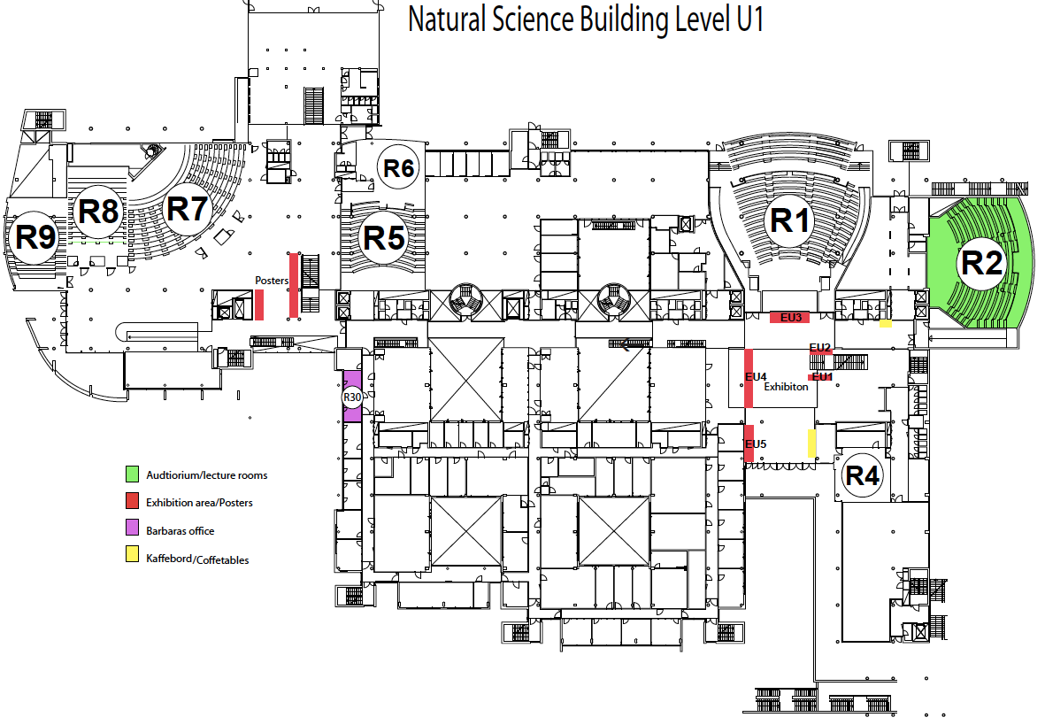

Slide 15
Exhibition and HR stand
CERN exhibition
  Already installed in the University
  Will remain throughout and beyond the school
CERN HR stand
  Will be installed tomorrow
  Will be manned Tuesday and Wednesday

Slide 16
Excursion
Sunday August 25, all day
  Løkken verk http://en.oi.no/
  Depart by bus at 09.00
  Trip on old train to the mine
  Guided tour of mine
  Lunch at the mine
  Return to Trondheim by bus
  We have reserved for everyone !
  We need to know if you will come or not
  Please tell Barbara YES or NO by coffee Wednesday AM

Slide 17
WiFi
WiFi in the hotel
  Username and password provided by the front desk
  You will need one for each device
WiFi in the university
  Eduroam if you have it
  NTNU guest
    The NTNU guest network is for visitors who cannot use Eduroam
    Note that NTNU guest only gives you limited access to the Internet
    To connect to NTNU guest
      Click on the wireless icon on your taskbar
      Select ntnuguest and click connect (koble til)

Slide 18
Feedback
Please, please, please, please
Give us your feedback on the lectures
For each lecture (series)
  Level 1 to 5, 3 is ideal, 4,5 too high, 1,2 too low
  Content 1 to 5, higher is better
  Presentation 1 to 5, higher is better

Slide 19
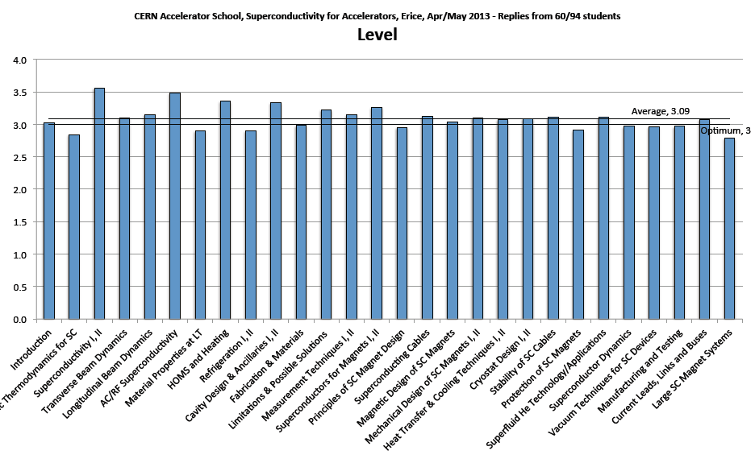
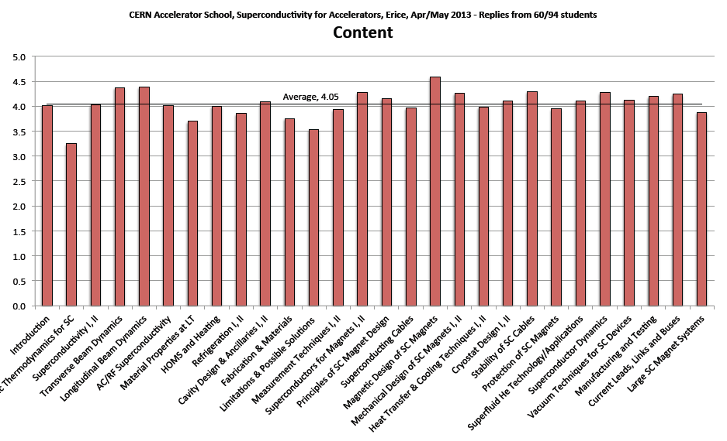
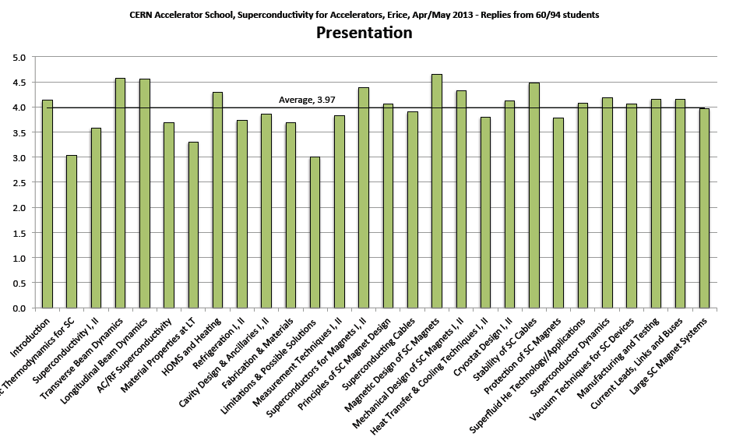
Feedback from last school

Slide 20
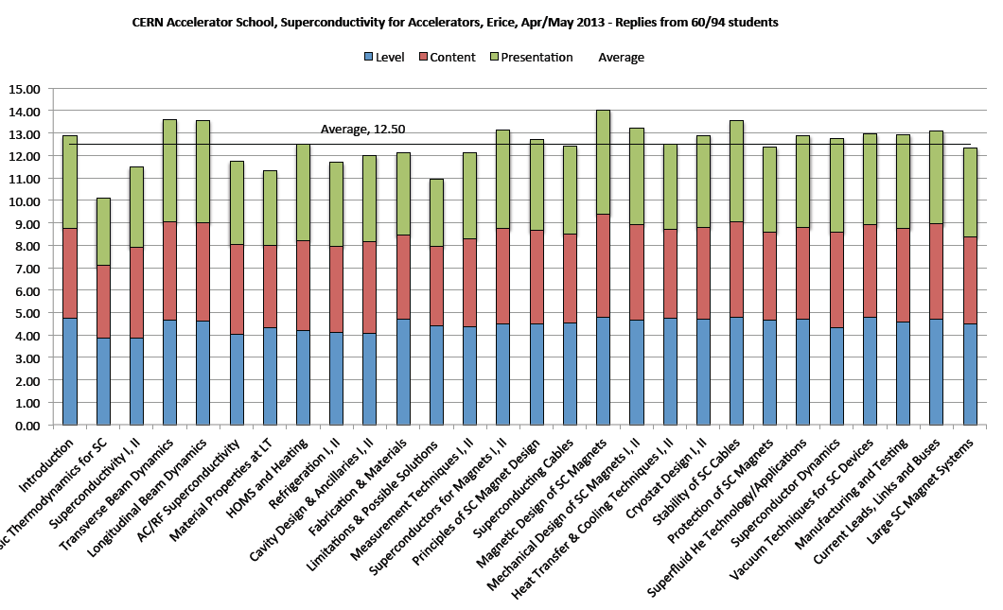
LCP combined (Level is 5, 3 or 1)

