Slide 1
X-Box 1 commissioning status
- First T24 results -
Jan Kovermann
CERN

Slide 2
Status of X-box1
Hardware installation finished
Development of control and DAQ software on-going
Control software now tunes and stabilizes PC power output
Waveguide network including pulse compressor conditioned up to 20MW av., 1.5us, 50Hz into compressor, 170ns, 30MW, 50Hz out of compressor into structure. Pulse compressor needed about 200h of rf cleaning to reduce outgassing (chem. cleaning/baking not possible)
SC solid state modulator is running without major problems, pulse-to-pulse stability is excellent (10^-4)
Klystron runs without any problems (after being resurrected twice a year ago!)
Experience from X-Box1 triggered new developments for X-Box2, especially in the LLRF part
24/7 operation only limited by CTF2 access and software changes!

Slide 3
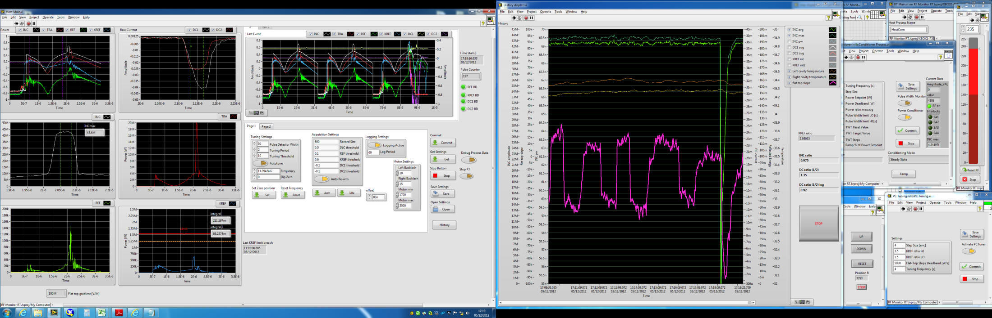

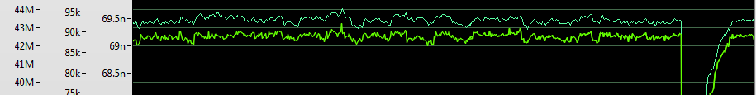
Screenshot of X-Box controls (Mid Dec 2012)
Last interlock event display (plus two previous pulses)
50dB log detector into 14bit 250MSps/s ADC for controls
Controls for tuning, power, motors etc.
Interlock levels, calibration etc.
Configurable history plot
Real-time gradient display
Power history plot (peak and average)

Slide 4
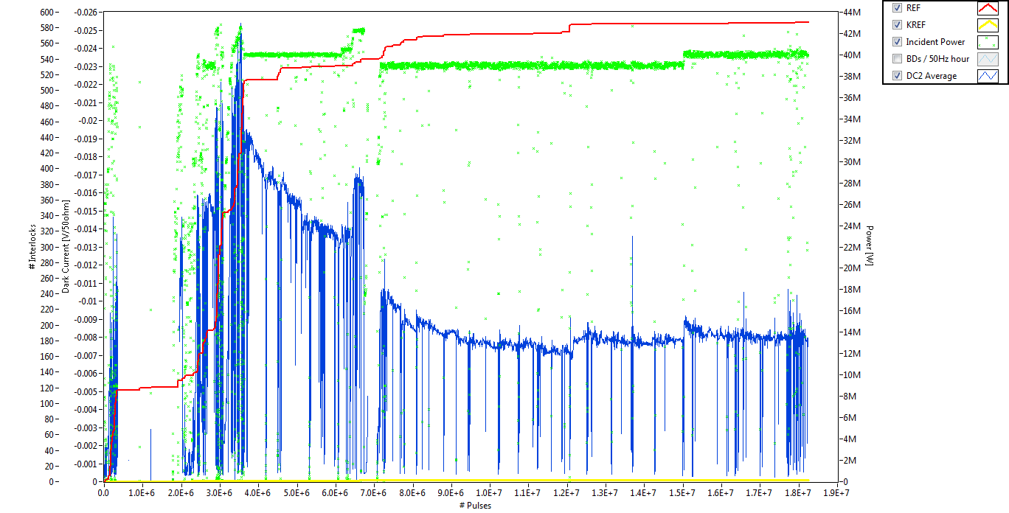
Status of the first CLIC T24 structure tested at CERN
100MV/m !
Run 7.12.2012 to 10.12.2012
Stable pulse compressor output power due to constant automatic tuning and gain control
Reached 100MV/m stable operation for ~1.5h
Observed decreasing dark current for the first time

Slide 5
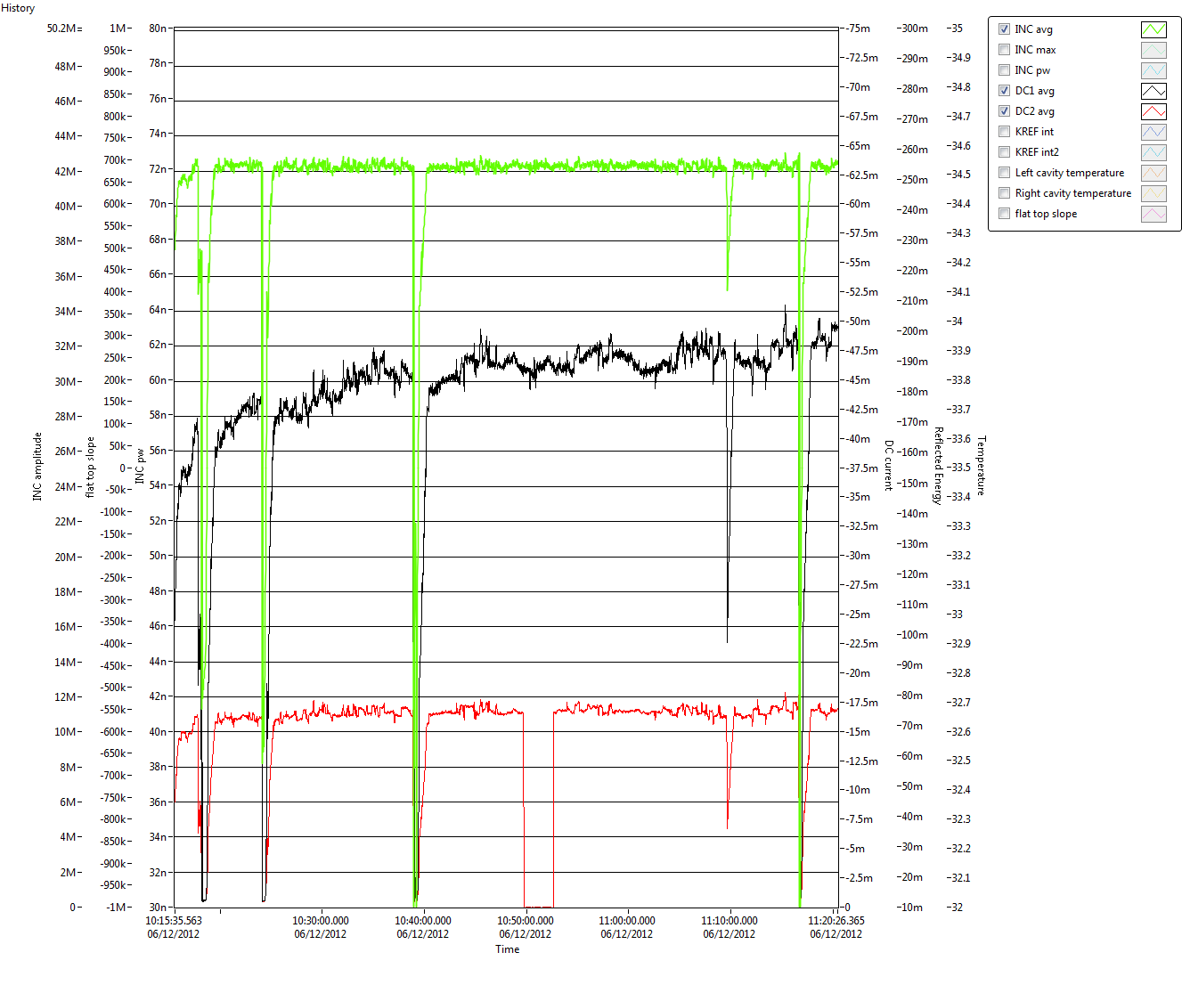
The first 100MV/m at 50ns in detail (operator display)
42.2MW
Decreasing dark current (e⁻!)
(upstream)

Slide 6
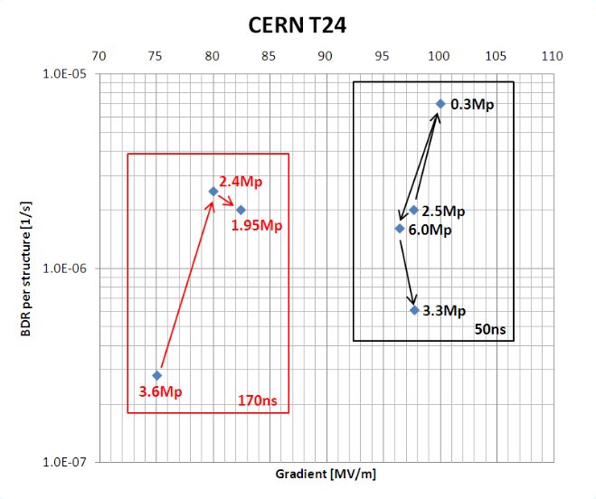
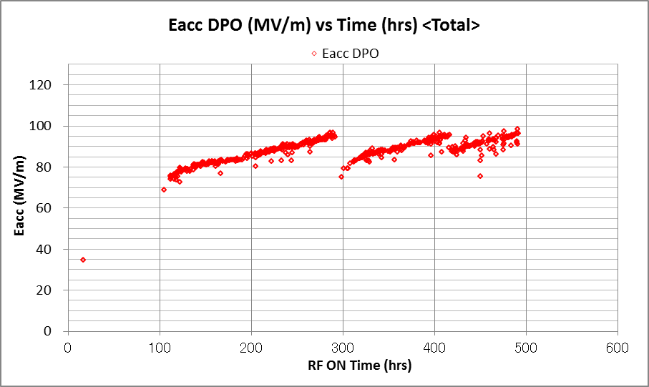
Status of the first CLIC T24 structure tested at CERN
51ns
91ns
132ns
TD24R05 initial processing at KEK
Total conditioning time at 50ns ~ 300hrs

Slide 7
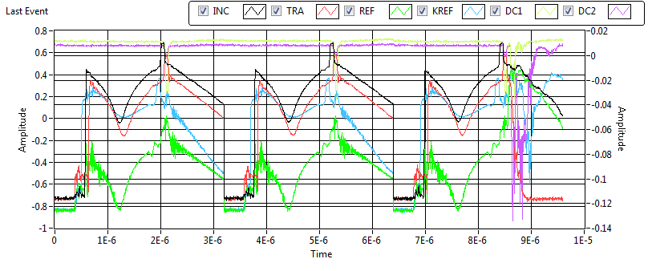
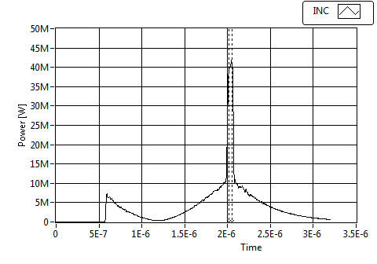
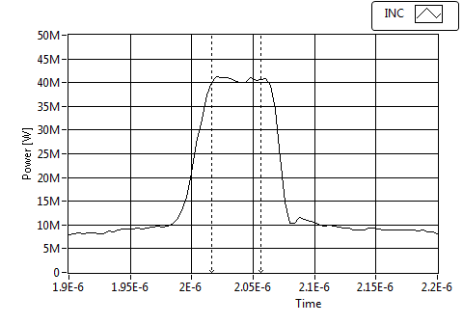
Some example waveforms at 50ns
Log detector!
Compressed INC pulse into structure
50ns flat top pulse into structure

Slide 8
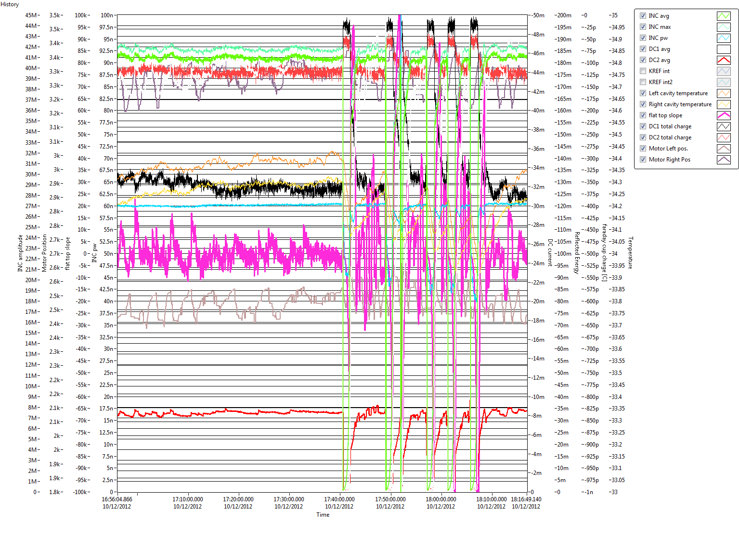
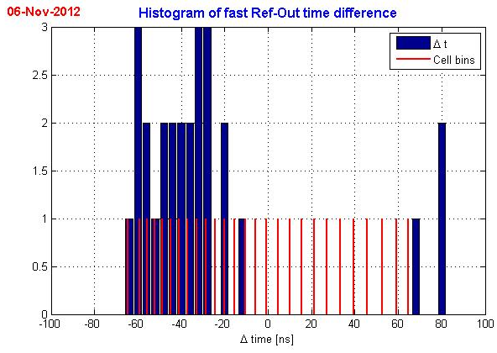
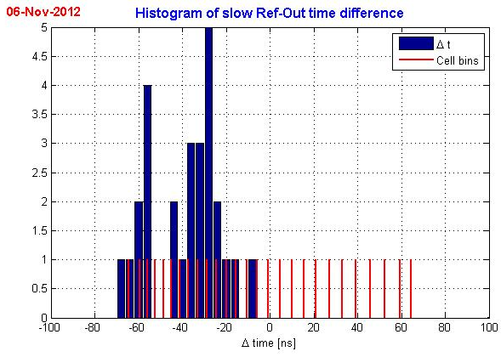
Started data analysis on 170ns data (Wilfrid Farabolini)
Same data taken with diode detectors @ 1GSPS/s (left) and with log detectors @ 250MSPS/s (right)
Good input for developing new LLRF hardware for X-Box2
Raw data and calibration factors stored in event (Logging or BD) based files
All parameters stored in a 60s interval
Everybody is welcome to request data for analysis!
Most data treatment already done in the X-Box1 DAQ system

Slide 9
Conclusion
Still quite some work to be done, but we are testing a structure right now!
You are welcome to visit the test stand!
Thank you!

