Slide 1
CLIC Re-baselining
Project Meeting, December 2012
D. Schulte for the CLIC team

Slide 2
Strategy
Optimise the first energy stage
  Focus has been on 3TeV
  Alternative options should also be studied, most importantly a klystron-drive first stage
  Include upgrade considerations
Split design into relatively independent pieces
  Including all cost, in particular also civil engineering
  Make a simple cost model for each area for overall optimisation
  Identify internal cost saving potential in each area and associated R&D, e.g. main linac module length
  Study the cost saving and required R&D
Form a discussion group for each area
  Main beam sources: Yannis Papaphilippou
  Drive beam generation: Roberto Corsini
  Two-beam acceleration: Alexej Grudiev
  Klystron-based first stage: Igor Syratchev
  Please contact them with any good idea
Full optimisation in common working group
  A number of studies can directly report to this group, e.g. klystrons and modulators

Slide 3
Simplified Diagram
Parameter Routine
Luminosity, …
Variable | Meaning | Current value
I_{drive} | Drive beam current | 101A
E_{drive} | Drive beam energy | 2.37GeV
τ_{RF} | Main lianc RF pulse length | 244ns
N_{sector} | Number of drive beam sectors per linac | 4
N_{combine} | Combination number | 24
f_{r} | Repetition rate | 50Hz
N | Main beam bunch charge in linac | 3.72e9
n_{b} | MB bunches per pulse | 312
n_{cycle} | Spacing between MB bunches | 6 cycles
E₀ | MB energy at linac entrance | 9GeV
E_{cms} | Centre-of-mass energy | 500GeV
G | Main linac gradient | 100MV/m
I_{drive}
E_{drive}
τ_{RF}
N_{sector}
N_{combine}
f_{r}
N
n_{b}
n_{cycle}
E₀
f_{r}
E_{cms,} G, L_{structure}
Two-Beam Acceleration Complex
L_{module}, Δ_{structure}, …
Drive Beam Generation Complex
P_{klystron}, N_{klystron}, L_{DBA}, …
Main Beam Generation Complex
P_{klystron}, …

Slide 4
Cost vs. Structure Length

Slide 5
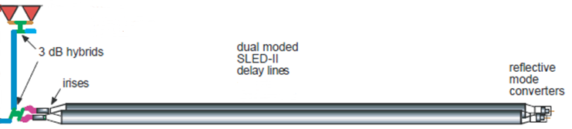
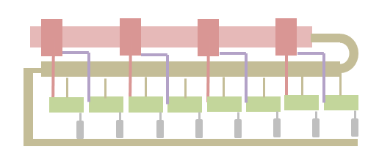
Klystron-driven First Stage: RF Unit Layout
The alternative PC schemes certainly must be considered (especially for the low energy machine), but for our evaluation we will keep DM SLED II as a base line option, as its performance was confirmed through the high RF power testing.
2-pack solid state modulator
PPM klystrons
460 kV, 2 μs flat top
59 MW
1.95 μs
118 MW
1.95 μs
x 4.64
~17.7 m, ∅16.3 cm
TE01 transfer line (? m)
TE01 90⁰ bend
Inline RF distribution network
492 MW
244 ns
Common vacuum network
x 8 accelerating structures,
100 MV/m loaded gradient
2 m, 1.83 active
Compared to NLC, the energy gain per unit in CLIC’k case is 26% lower (need more klystrons per meter), but the unit length is ~ 3 time shorter.

Slide 6
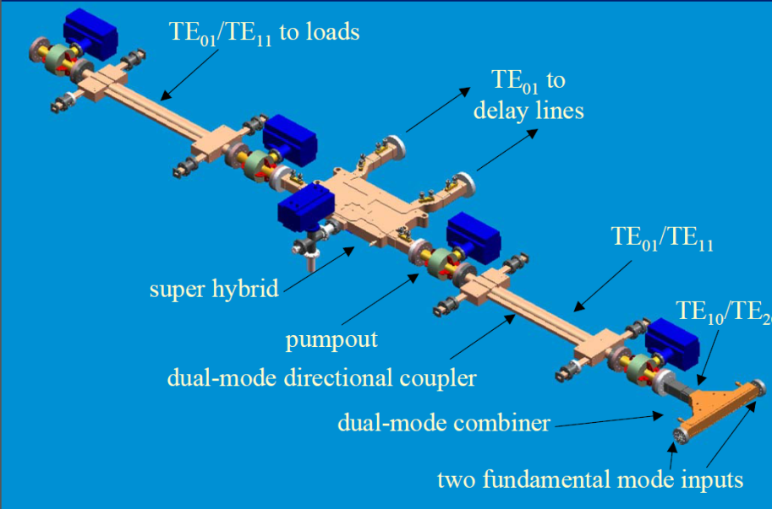
RF Pulse Compressor and Distribution System
Distribution system will be new design
Pulse compressor will be based on SLED-II design, removing parts that were needed for the tests only
Other options appear possible and remain to be studied
1/4
1/3
1/2
1/1

Slide 7
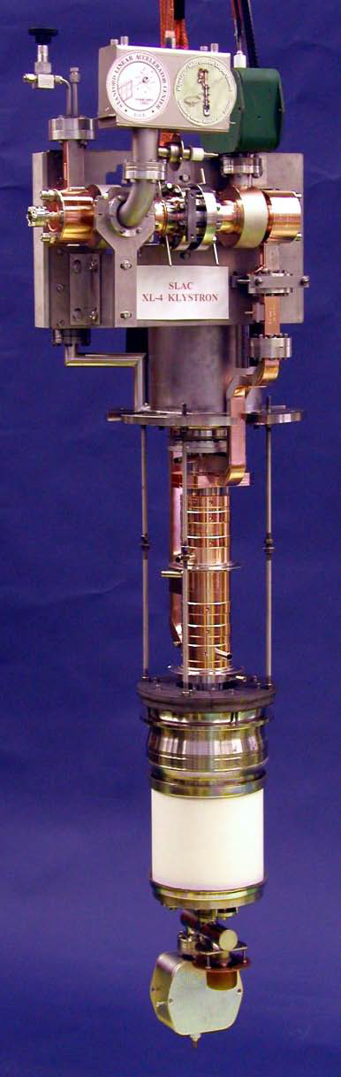
Klystrons
Klystrons are an important challenge
  Using less ambitious parameters (60MW, 2μs pulses, 50Hz)
  Focusing is critical
    Can use permanent magnet focusing for highest efficiency
    Or use superconducting solenoid, which is easier but slightly less efficient and more costly
Klystrons are a large part of the cost
  Started cost estimate based on the components of the klystron: Gun, body, collector, RF window/ RF network, assembly/ brazing, solenoid, vendor profit
  In reasonable agreement with price of klystrons
    Assuming reasonable higher profit to cover risk of prototype
  Relevant is cost reduction as function of number of klystrons, i.e. learning factor

Slide 8
Main Beam Generation
Injectors
Damping rings
RTML
Significant cost is in the different linacs
cost optimisation for each linac, respecting RF and beam dynamics limits
  note: scenario A uses about 100% more RF than scenario B but needs only 40%
review choice of RF frequency for each linac
review of 1 vs. 2GHz in the damping ring and impact on cost
review cost of long pulses for low energy operation
Can we remove the electron pre-damping ring?

Slide 9
Main Beam Generation (cont.)
2.86 GeV
0.2 GeV
PDR
Injector Linac
DC gun
e⁺ DR
BC1
target
e⁻ DR
gun
Booster Linac
2 GHz
6 GeV
Could re-use a linac for other beam
e.g. booster linac to produce electron beam for positron production
the drive beam accelerator could be used for the same purpose
…
Could power the booster linac with the drive beam
Need to carefully evaluate the consequences

Slide 10
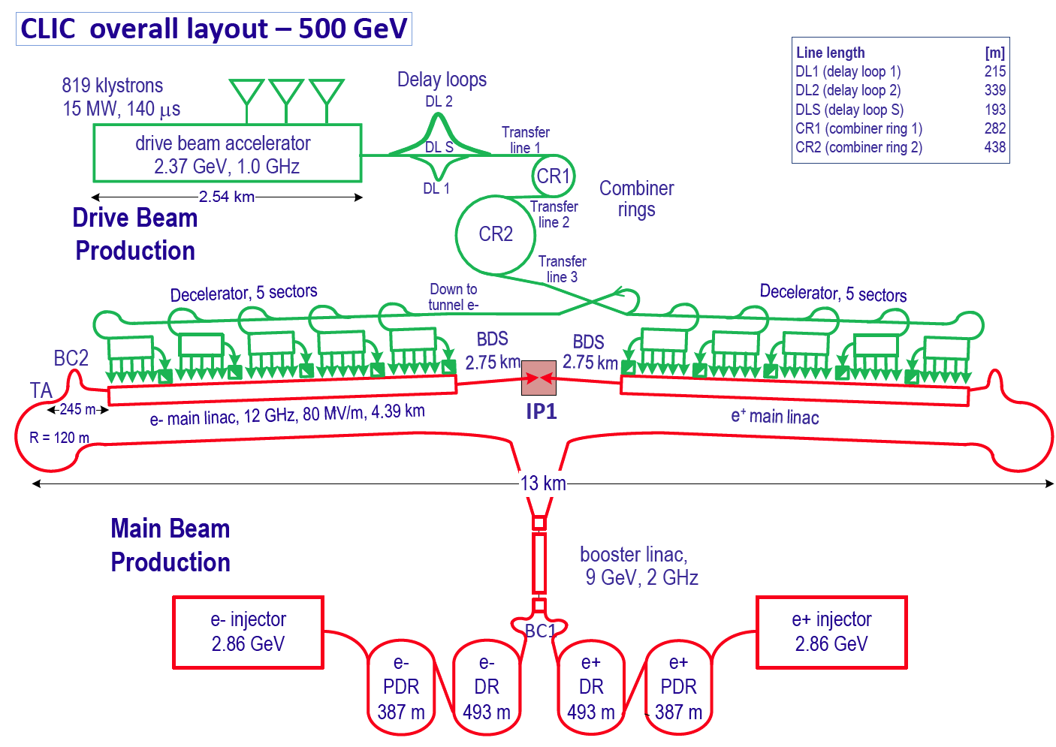
Drive Beam Generation
Scope
375
819 klystrons
15 MW , 58 μs
Have a good understanding of the functional dependence of the cost
Most important are drive beam accelerator klystrons and modulators
Need to verify the optimisation of these systems, e.g. klystron peak power
strong dependence on learning factor
Combination of two klystrons into one accelerating structure is possible
RF and beam dynamics constrains are respected (Avni Aksoy and Rolf Wegner)
reduces structure number by 50%, reduces linac length to 70%
cost impact to be confirmed
Cost of the buildings needs to be determined and integrated in the model
4
4

Slide 11
Conclusion
The work has started
  Impressive progress on a klystron-based alternative
  Technical results on drive beam accelerator
  Important questions raised for klystrons and modulators
  Cost models are progressing
  But much more work
More results at the CLIC workshop

Slide 12
Reserve

Slide 13
Some Examples of Saving Options for Current Design
Cost
  Alternative main linac structure fabrication
  Longer main linac modules
  Maybe do not need electron pre-damping ring
  CVS overdesigned for 500GeV
  Main beam sources RF power quite high
  Shorter drive beam pulses in first stage can reduce cost of modulator (modular design)
  Combining pairs of drive beam accelerator klystrons
  Using cheaper copper type in drive beam accelerator structure
  Cost impact of 1GHz damping ring RF
  Cost impact of long main beam pulses for low energy operation
  …
Power
  Permanent drive beam turn-around magnets
  …
For many items need R&D since choices were made for a reason

