Slide 1
Secondary Electron Yield (SEY):
Pulsed Mode Development
M. Mensi, H. Neupert, M. Taborelli

Slide 2
Outline
Secondary Electron Emission (SEE)
Physics of the SEE: Overview
Pulsed Mode SEY
Motivations
General Principle
System’s Development: Flowchart & Interface
Results
System’s Characterization: StSt as Benchmark
Insulating Samples: Continuous vs Pulsed SEY
Outlook and Conclusion

Slide 3
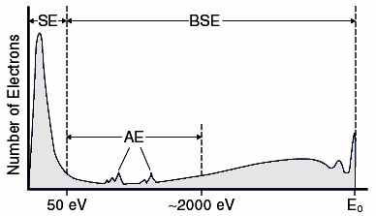
SEE measurement: Physics of SEE
Secondary Electron Emission
SEE Energy Spectrum
Primary Electron Beam
Secondary e⁻
Cathodo-luminescence
Backscattered e⁻
X-rays
Figure after Goldstein et al. 1981
Secondary Electron Yield
SE escape depth
Sample
δ_{max}
Excitation
Volume
SEY
Secondary e-
SEY =
Secondary e⁻ escape depth: typ. 1nm
Primary e-
Primary e⁻ Energy [eV]

Slide 4
Pulsed Mode SEY: Motivations
Two major effects to be considered
Electron conditioning
Charge accumulation
Electron Stimulated Desorption: sample cleaning
From time to time: C increase on the sample’s surface
Insulator sample = capacitor: V=Q/C: charging effect
ΔV =
Q
ε₀ε_{R}S / d
LOW DOSE
LOW DOSE
Electron Beam
Electron Beam
SEY
Electron conditioning of StSt
SEY
δ > 1
1
1
Backscattered e⁻
δ < 1
PE Energy [eV]
PE Energy [eV]
- - - -
Secondary e⁻
++++
SE escape depth
SE escape depth
Insulator
Sample
Insulator
Sample
Excitation
Volume
Excitation
Volume
- - - -
⁺⁺⁺⁺

Slide 5
Pulsed Mode SEY: Working Principle
Pulse Gen.
Pulsed Measurement
Continuous Measurement
e-gun controller
Oscilloscope
e⁻gun
Bias Networks
I_{coll}
I/U preamp
+ -
DC+AC
AC
I/U
+
I_{sample}
Prim. e⁻
Sec. e⁻
-
DC+AC
- +
AC
I/U
-
+
Sample
SE
SE
C_{coll}
I_{coll}
SEY
=
SEY =
=
SEY =
PE
PE
C_{coll}+C_{sample}
I_{coll}+I_{sample}
PE Energy [eV]

Slide 6
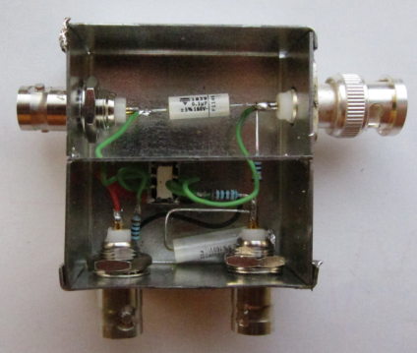
Pulsed Mode SEY: Bias Network
Techniques commonly used for continuous SEY measurements cannot be transposed to Pulsed mode SEY
What is a Bias Network
Bias Networks decouple the AC component of the signal from the AC + DC
No batteries in the signal path
Bias Networks should not affect the SEY since their theoretical behavior is linear with the charge
0 V
AC + DC
C
AC
R
+
V
-
Discrete electronics components contain parasitic elements, i.e.:
R_{real} = R_{th} + L_{th} + C_{th} …

Slide 7
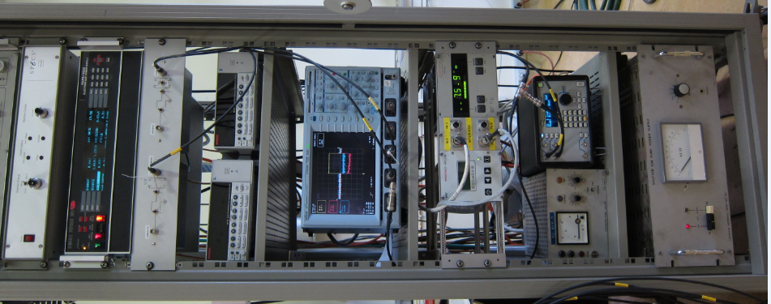
Pulsed Mode SEY: Flowchart
Initialize instruments
Next E Step
Set Instruments
Pulse and Acquisition
Data Processing
Save data
Reset instruments

Slide 8
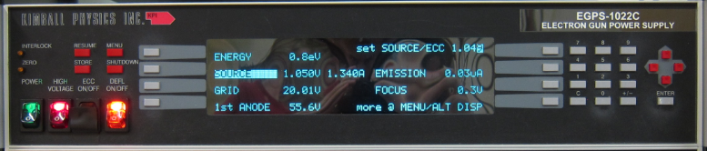
Pulsed Mode SEY: Flowchart
Initialize instruments
Next E Step
δ
SEY
Set Instruments
PE Energy [eV]
Pulse and Acquisition
Data Processing
Set the e-gun parameters:
Energy 0 – 2000 eV
Focus = f(Energy)
First Anode = f(Energy)
Typ. Spot area 1mm²
Save data
Reset instruments

Slide 9
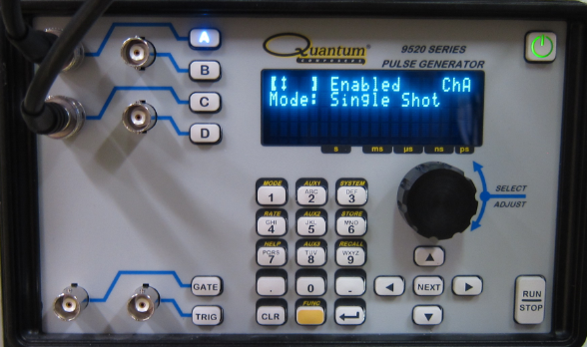
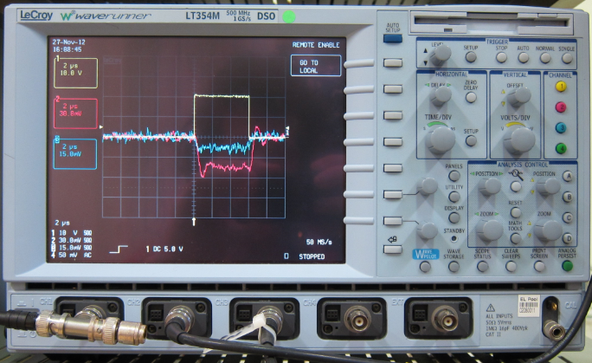
Pulsed Mode SEY: Flowchart
Arm oscilloscope trigger
Pulse (single): typ. 1 – 10μs
Initialize instruments
Next E Step
Set Instruments
Pulse and Acquisition
Data Processing
Get waveforms from scope
Save data
Reset instruments

Slide 10
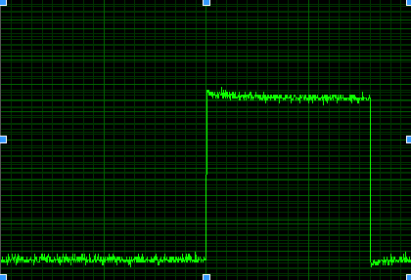
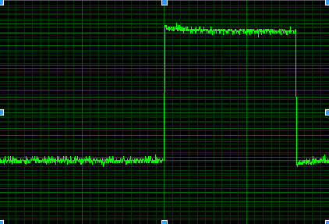
Pulsed Mode SEY: Flowchart
Initialize instruments
Average the DC base level
Subtract offset to data points
Integrate Pulse
Next E Step
Set Instruments
1 – 10μs
Pulse and Acquisition
Charge
0 V
Data Processing
Sample and collector charge
Save data
Primary and Secondary C
SE
C_{coll}
SEY =
=
Reset instruments
PE
C_{coll}+C_{sample}

Slide 11
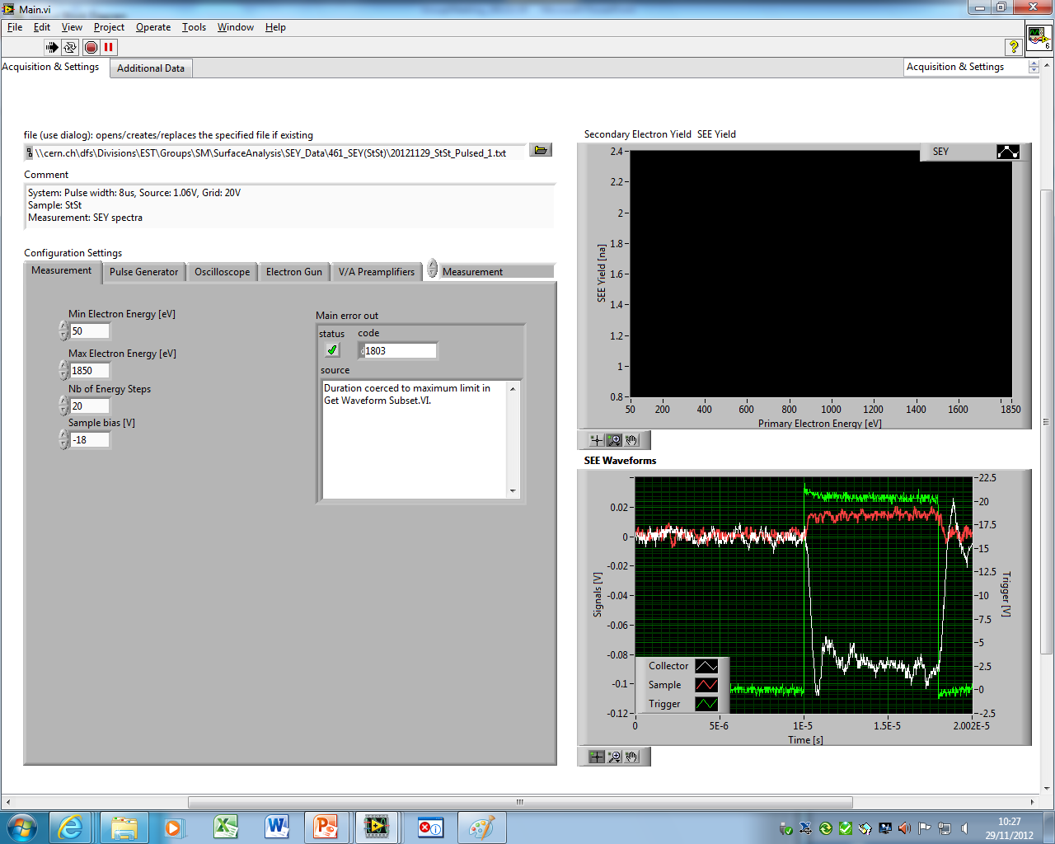
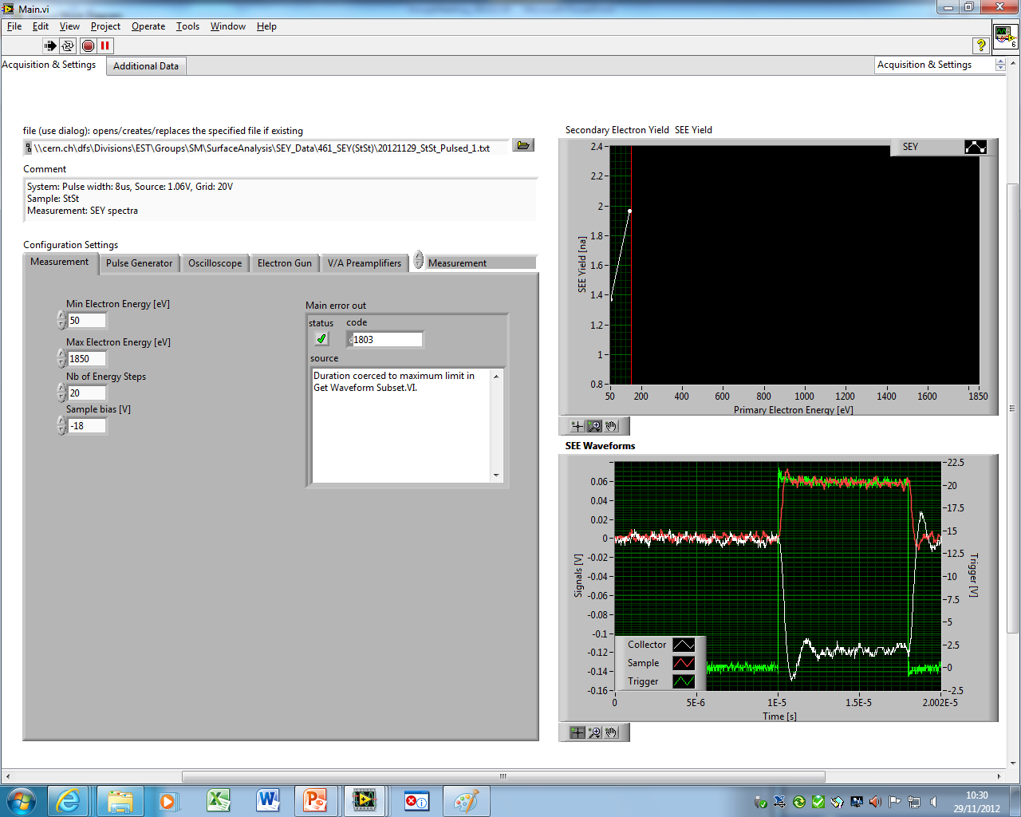
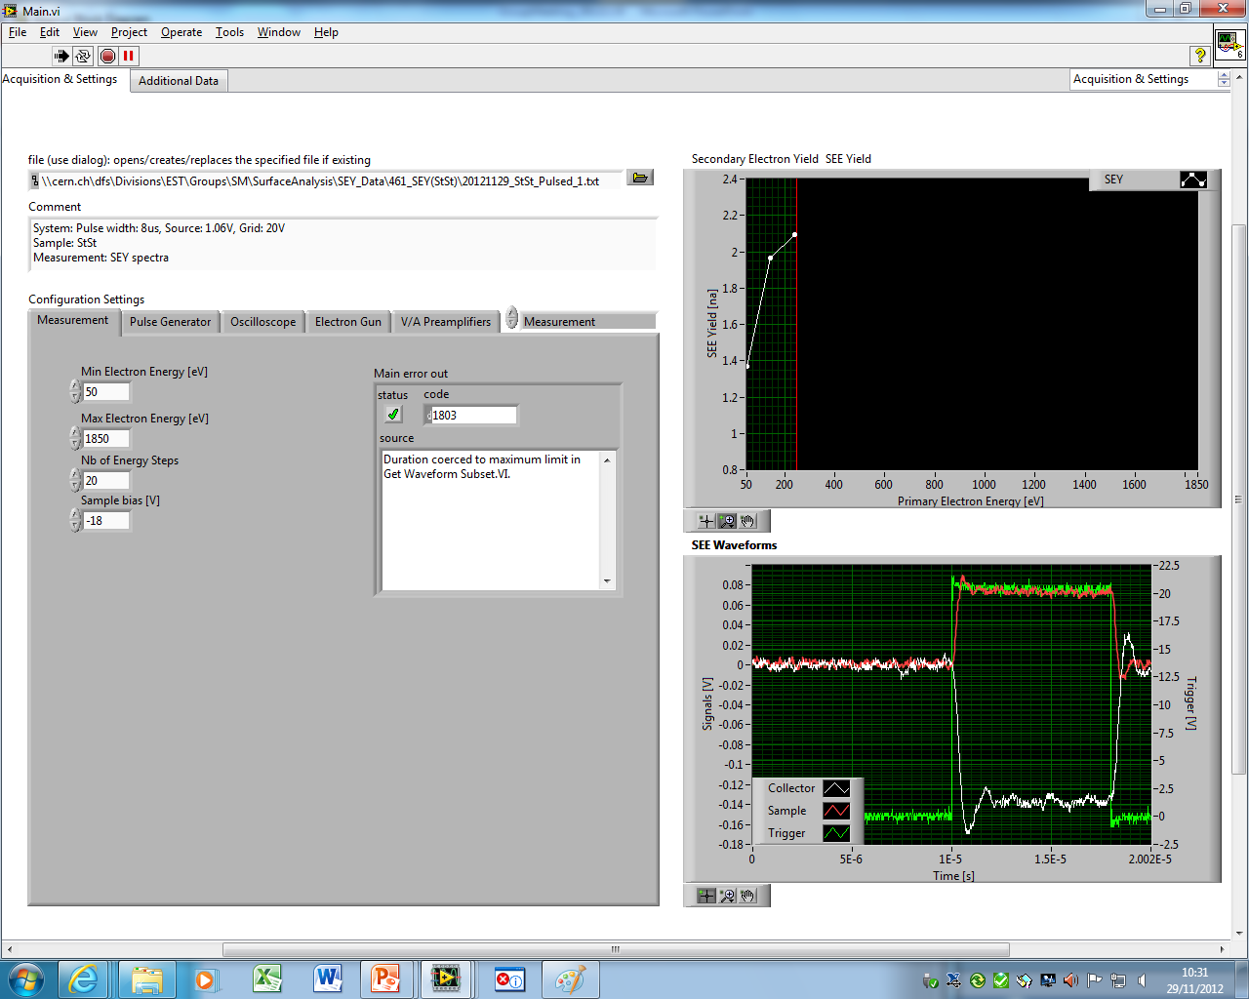
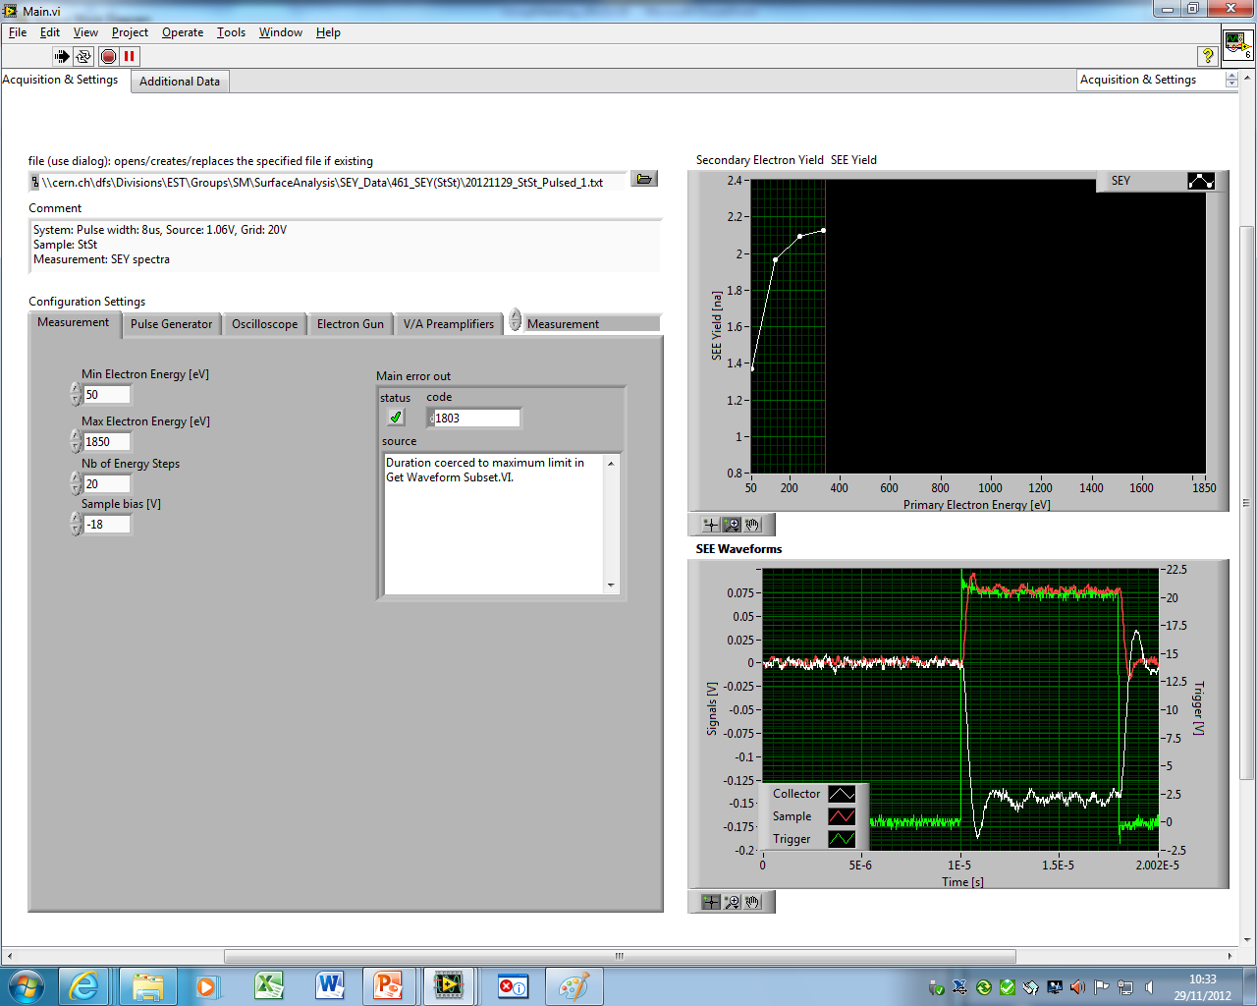


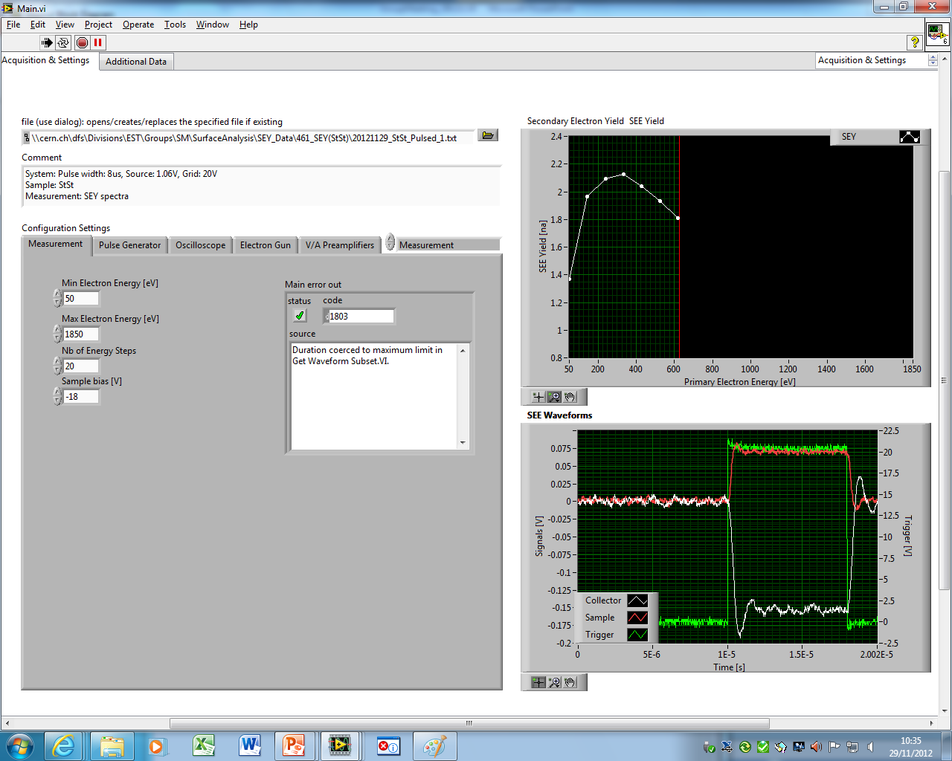





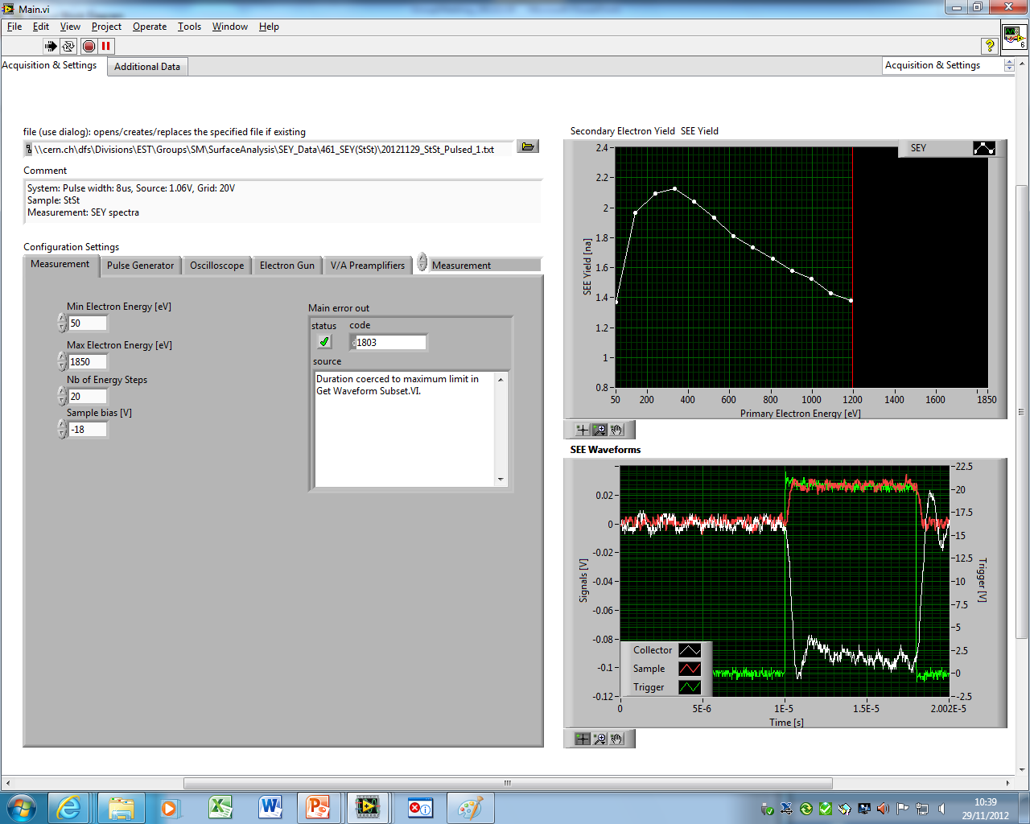
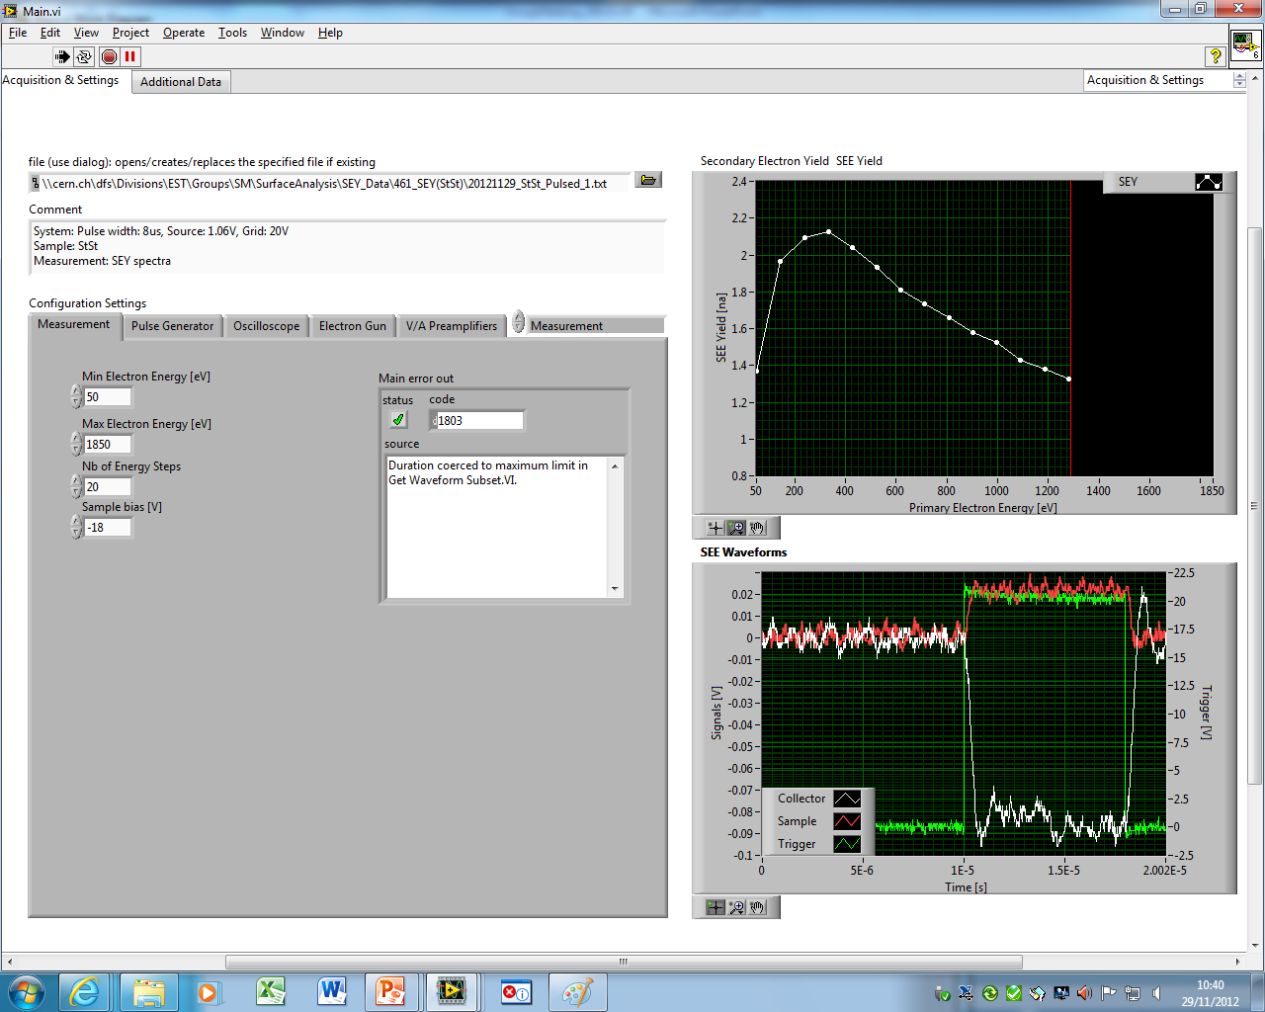




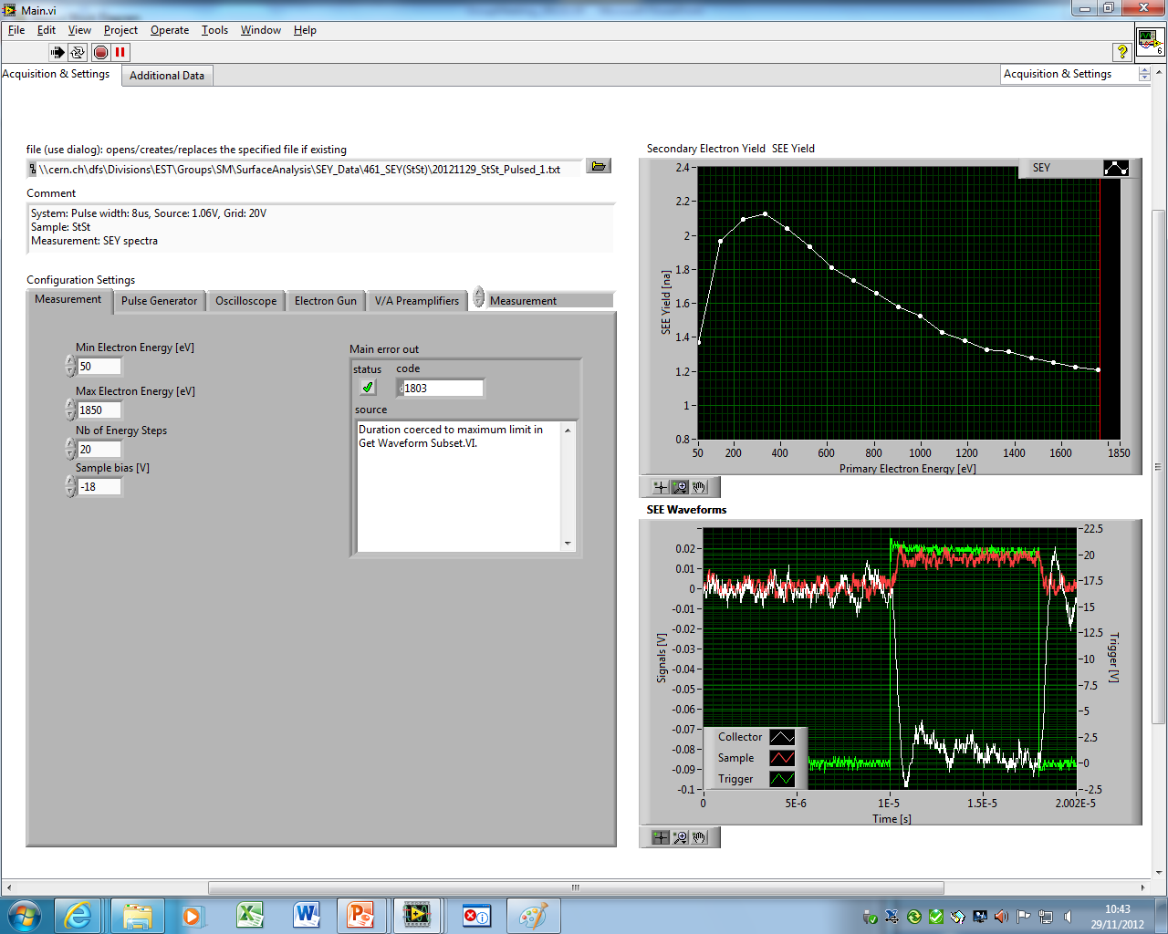
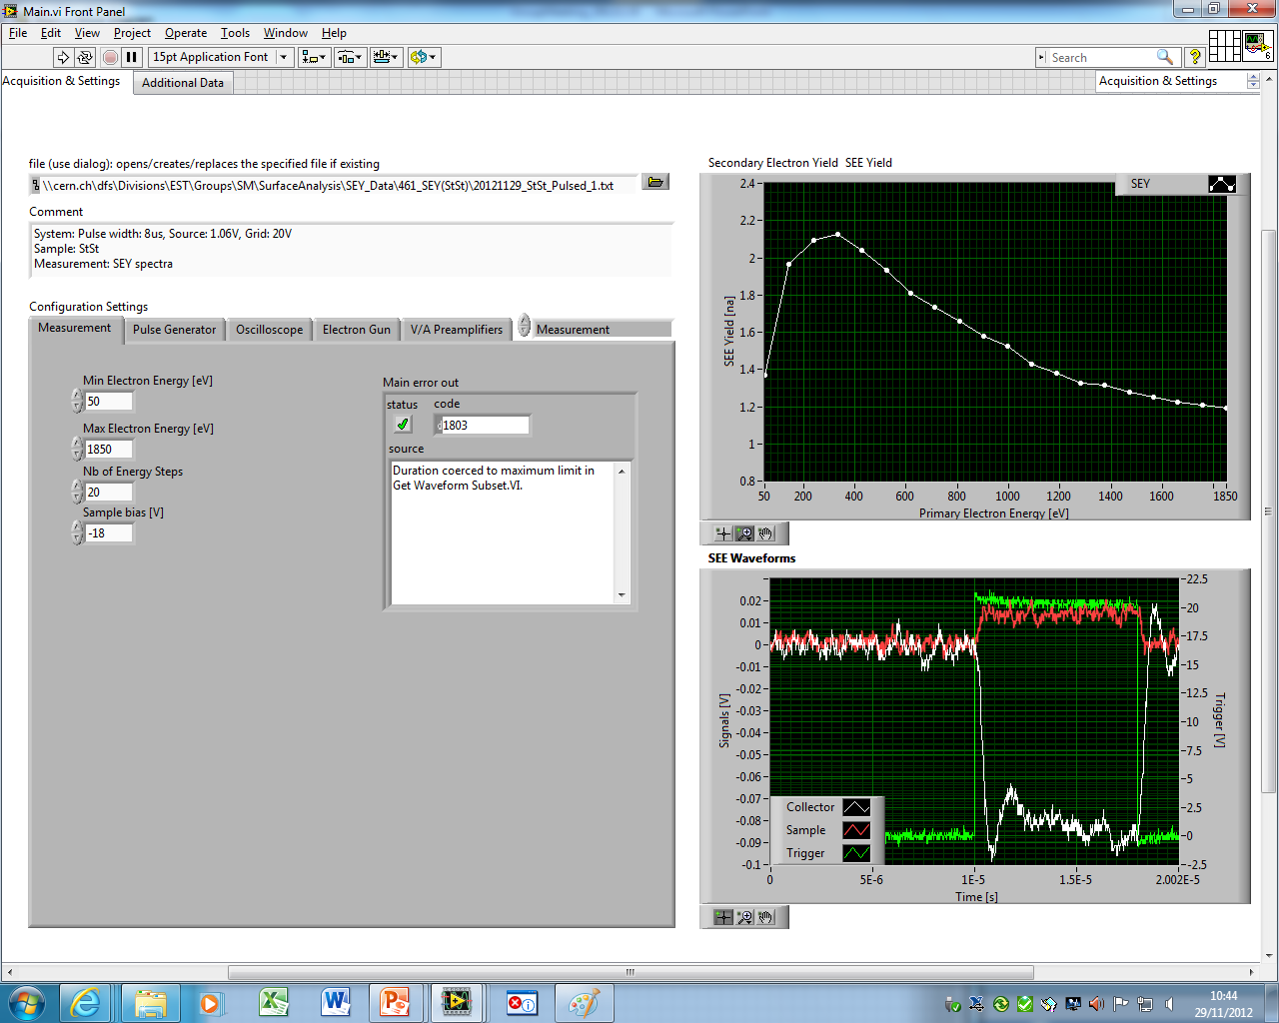
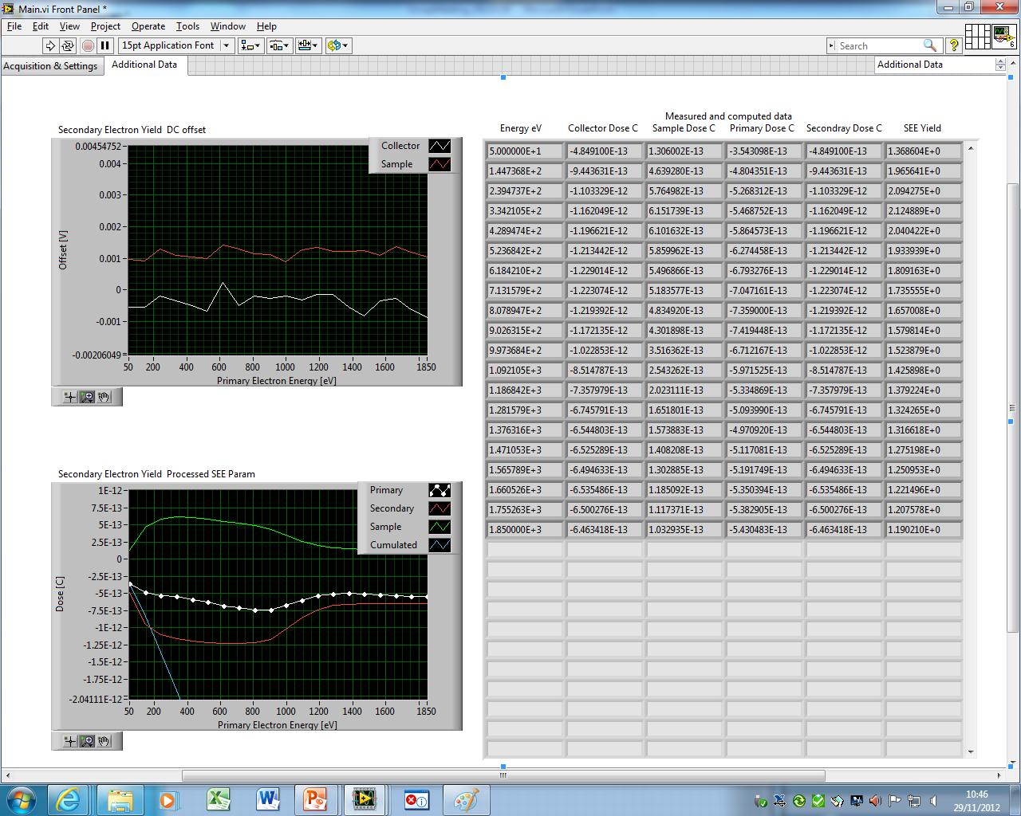
Pulsed Mode SEY: LabVIEW Interface
Graphical User Interface: Main window and additional data

Slide 12
Results: System’s Characterization
StSt as benchmark sample
Measurement characteristics
Pulse width: 1 - 10μs
PE current: 10 - 100nA
Dose/pulse: -10⁻¹² – -10⁻¹⁴ C/pulse
Cum.dose : -3 x 10⁻¹¹ – -3 x 10⁻¹³ C
Continuous vs Pulsed Cum.Dose: 10⁴-10⁶
Signal Noise : 10nA p-p @500MHz BW
SEY Noise @ δ_{max} : 0.15 p-p
SEY StDev @ δ_{max}: 0.021
Continuous vs Pulse offset @ δ_{max} : 0.06
Repetitions @300eV, Pulsed
Repetitions @300eV, continuous

Slide 13
Results: Insulators
Continuous vs Pulsed-mode SEY on Insulators
PC#17: H plasma contamination a-C coating
SEM Morphology
500x
5000x
Ar bleed pressure : 4.7e⁻² [Torr], H signal current @ RGA: 1.6e⁻⁹ [A] (at/or close to chemical regime), Power: 600 [W]
More insulating samples are actually not measurable, work in progress…

Slide 14
Outlook and Conclusion
Outlook
Decrease sample’s charge density by e-beam defocusing
Understand e-gun behavior
Better characterization of the measurements
Find optimal parameters, i.e. pulse width, dose, U/I gain
Add the possibility to save all data, i.e. every pulses
Conclusion
Hardware and Software for a pulsed-mode SEY setup were implemented
Preliminary characterization and limitations of the system were assessed

Slide 15
Thank you for your attention

