Slide 1


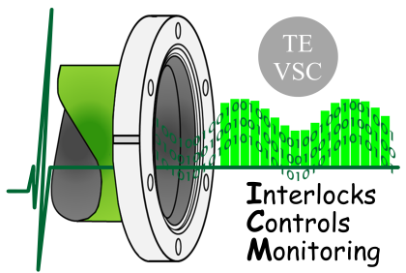

Vacuum Controls
Quality Management
Fabien ANTONIOTTI
TE-VSC-ICM
2012-11-30

Slide 2
Outline
Quality Management
Quality Needs and Guidelines
ICM Naming Convention
Vacuum-controls Tracking Log
MTF & EDMS
Layout DB
Examples
VAC PVSS & DB
What else?

Slide 3



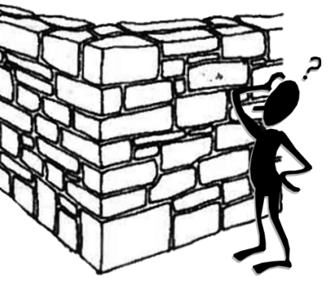

Quality Management
Target:
  to ensure that a work/product/service is consistent with expectation
  to provide the means to achieve it
How:
  Homogenization: Naming Convention, methods & tools
  Centralization of information: actions, documentation, devices settings
  Preservation of knowledge
  Simple but efficient to maintain system up-to-date
And then… we will be able to improve the quality…

Slide 4
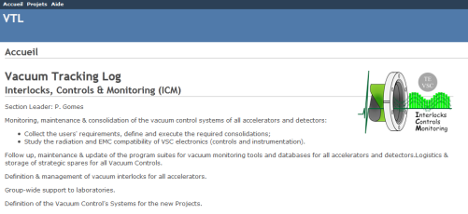
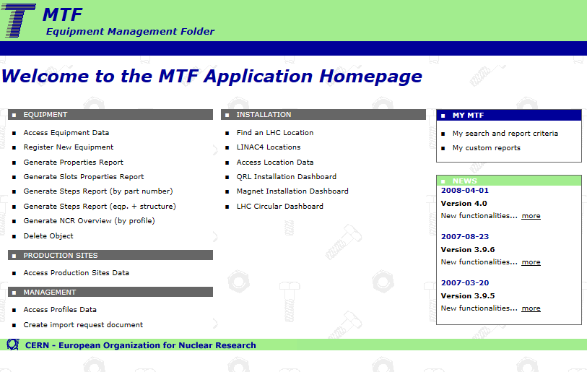
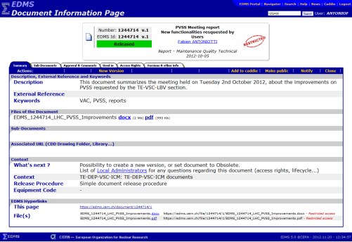
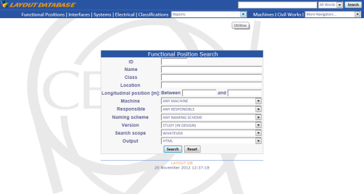
ICM Needs
Tracking of
Actions
Tracking of
Objects/Assets
Tracking of
Documentation
Tracking of
System Layout
  target:
Requests
Reports
Examples:
Cabling
Installation
Repairs
  target:
ID (serial #)
Behavior
Lifetime
Examples:
Manufacturing steps
Measurements
RP
Changed location
  target:
Technical knowledge
Examples:
Procedures
Activity Reports
Various information
  target:
Location
Function
Configuration
  Examples:
Position
Settings
  Interlock Levels
  Cables
  Profibus Addresses
VTL
MTF
EDMS
LAYOUT
DB

Slide 5
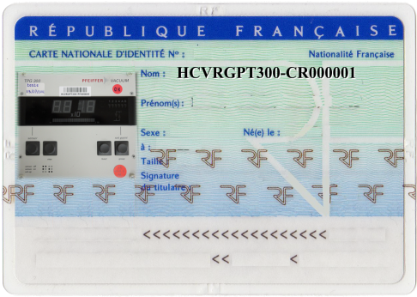

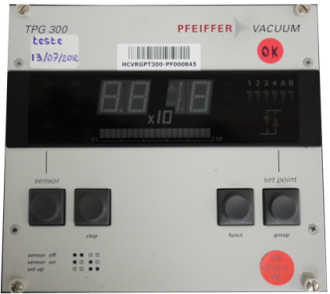
Guidelines
Actions
VTL
Assets
MTF
Documentation
EDMS
Layout / Function
LAYOUT DB
Identity
of
Asset
Place available for a given type of object
=
Functional Position

Slide 6
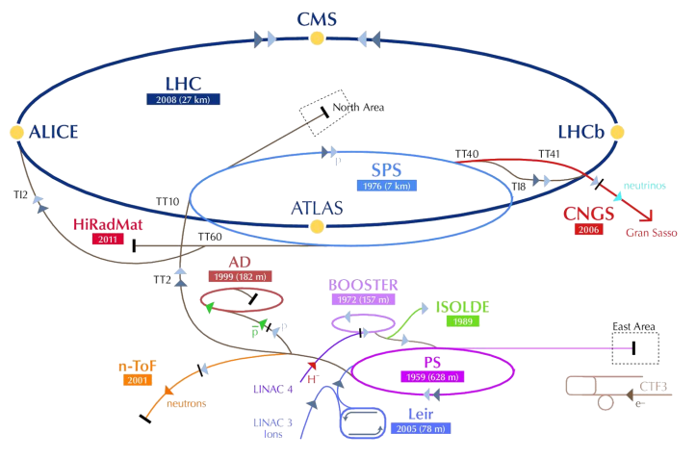
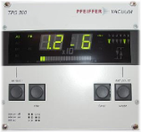
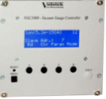
ICM Naming Convention
Essential for VTL, MTF, EDMS, Layout DB
Is the 1st step towards homogenization:
  Each machine had a ≠ naming convention…
  But objects are interchangeable between machines
275 new codes (names) created: mostly inspired from VAC LHC usage
Now integrated in Accelerators Naming Portal (EDMS1149103)
For coherent/uniform use in:
  MTF (using LHC Quality Assurance Definition)
  Layout DB
  Documents
  VAC_DB
Controller | CPS | SPS | LHC | VAC_DB | NEW
TPG300 | VGC | VRGC | VRGP | VRCG | VRGPT300
Volotek | VGCD | - | VRGA | VGHC | VRGPK
HCVRGPT300-PF000001
HCVRGPT300-PF000001
VRGPT300
VRGPT300
VRGPT300

Slide 7
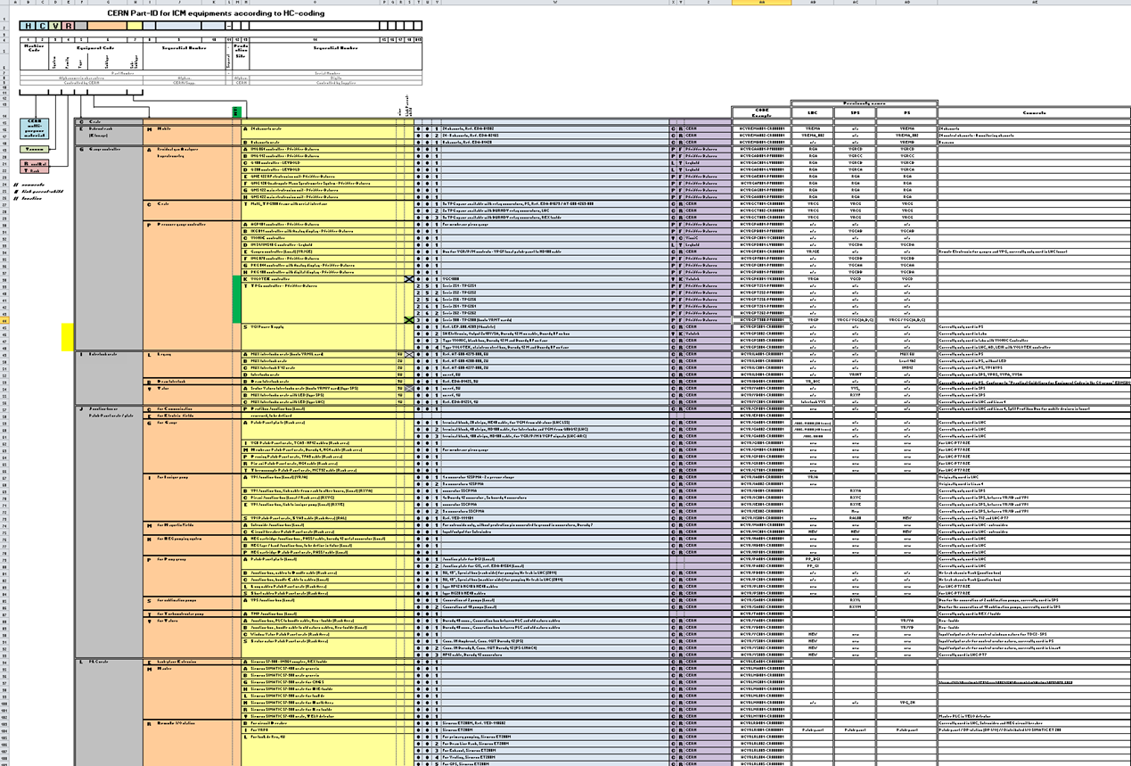
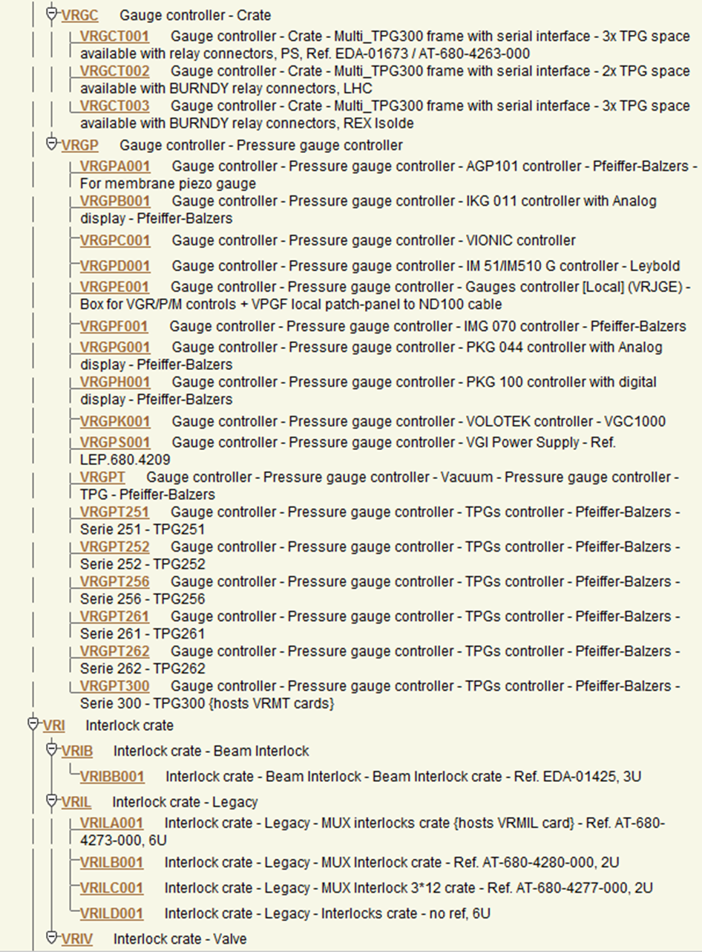
ICM Naming Convention

Slide 8
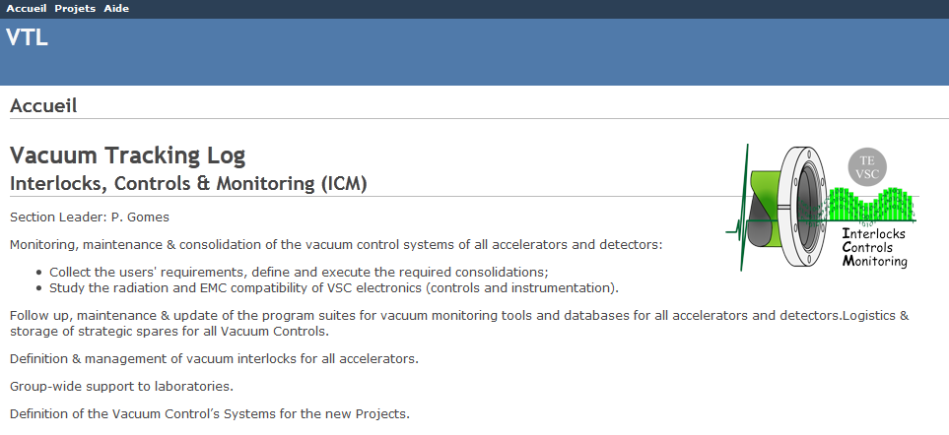
VTL
Vacuum-controls Tracking Log
cern.ch/VTL using Nice Login
Stores all requests, managed by tickets
To avoid spamming phone-calls/mails
Implemented using REDMINE application:
  Based on programming language RUBY
  is a Web interface to a MYSQL Database
  Robust & modifiable
  Widely used by Universities
  cost Free
This is not a document/file repository (use rather EDMS, MTF, etc.)
Prototype version finished & under test
What about SharePoint and JIRA?

Slide 9
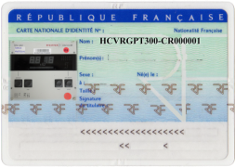





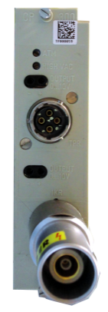

MTF
Manufacturing and Test Folder
Campaigns started January 2012:
Labeling:
  Using specific/technical labels from BradyTM
    1D: Code 128 (38.10 x 12.70 mm)
    2D: Datamatrix (9 x 9 mm)
  Done in LHC, Labs, Storage: ~10 000 labels (~50% of total ~23 000)
Chain verification: Measurements, Calibrations & Updates
  TPG300: 1 515 items tested & identified (2 704 labels)
MTF Processing:
  Definition of proprieties & steps for each device type
  Imported information/data for ~4 500 items
    (~30% of total ~15 000)

Slide 10
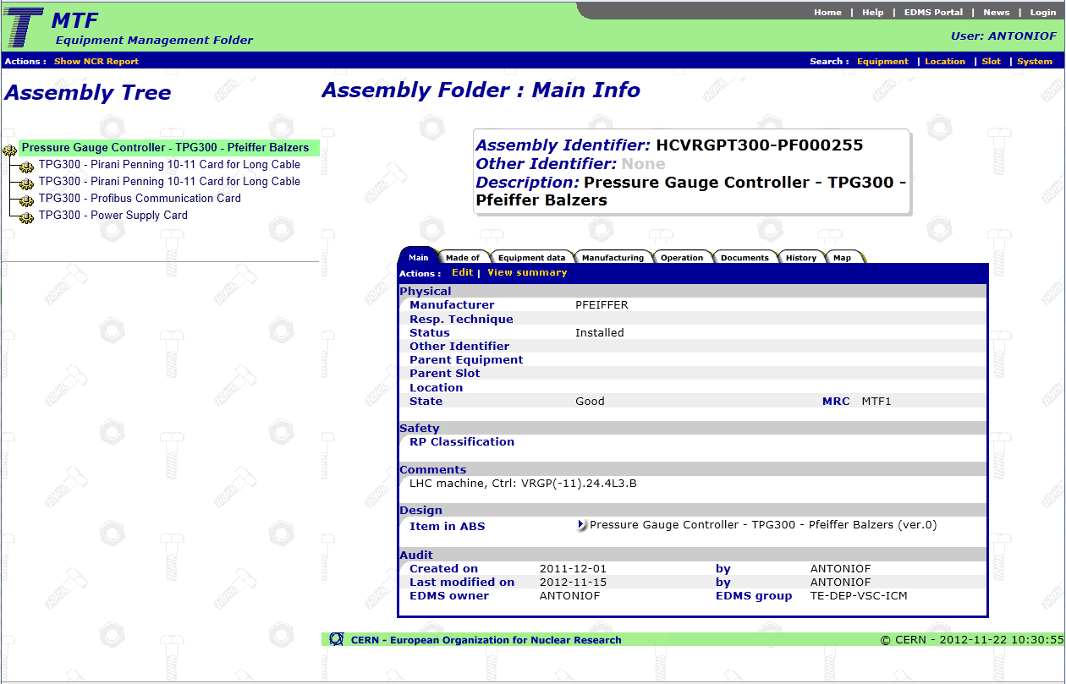
MTF

Slide 11
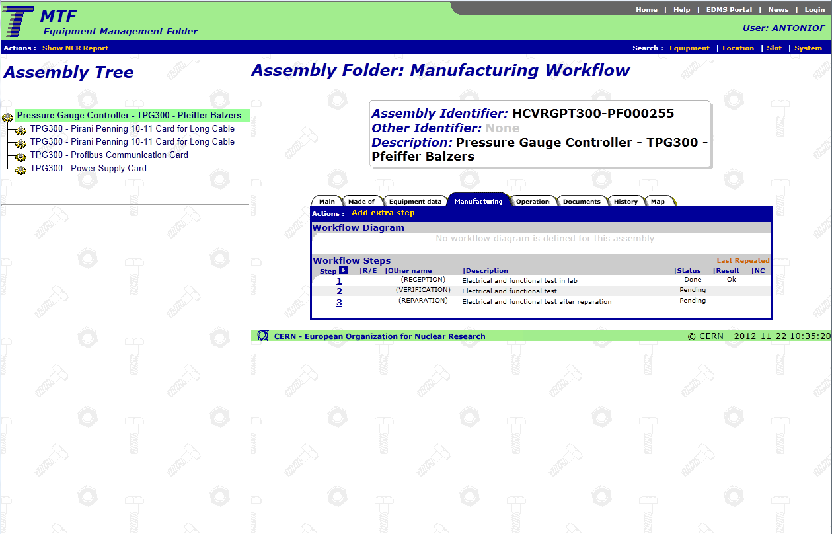
MTF

Slide 12
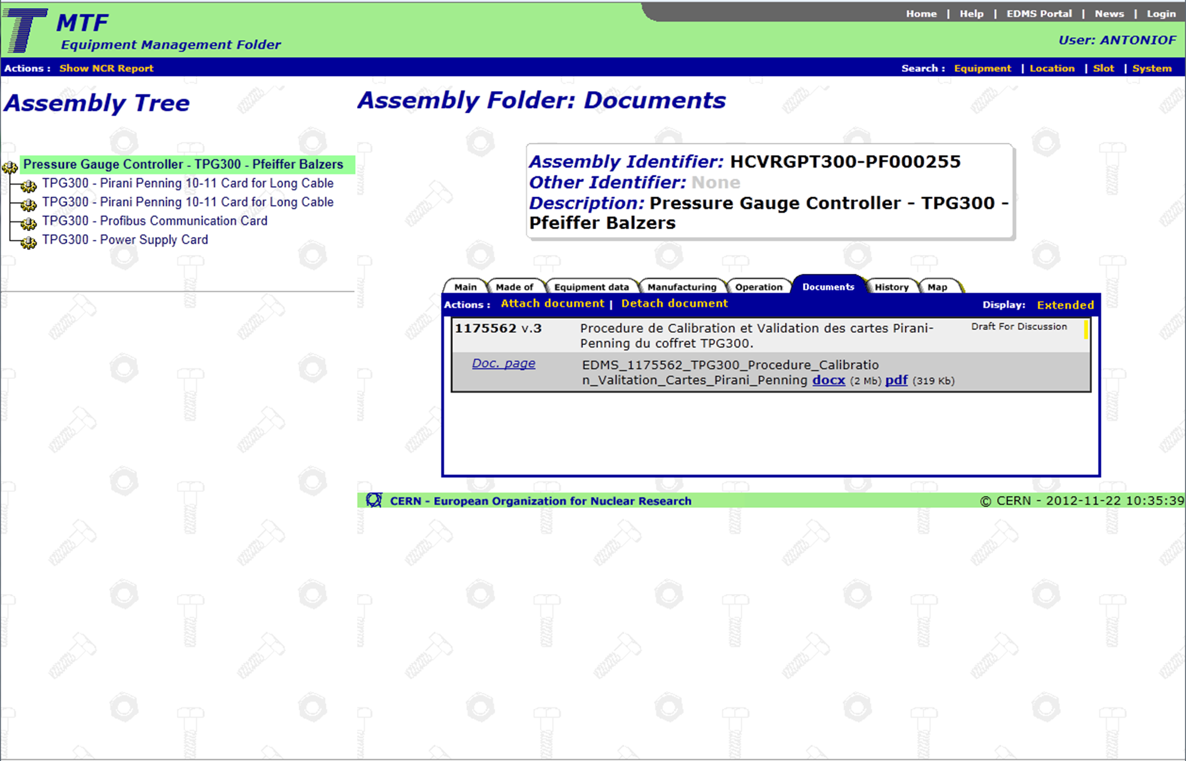
MTF

Slide 13
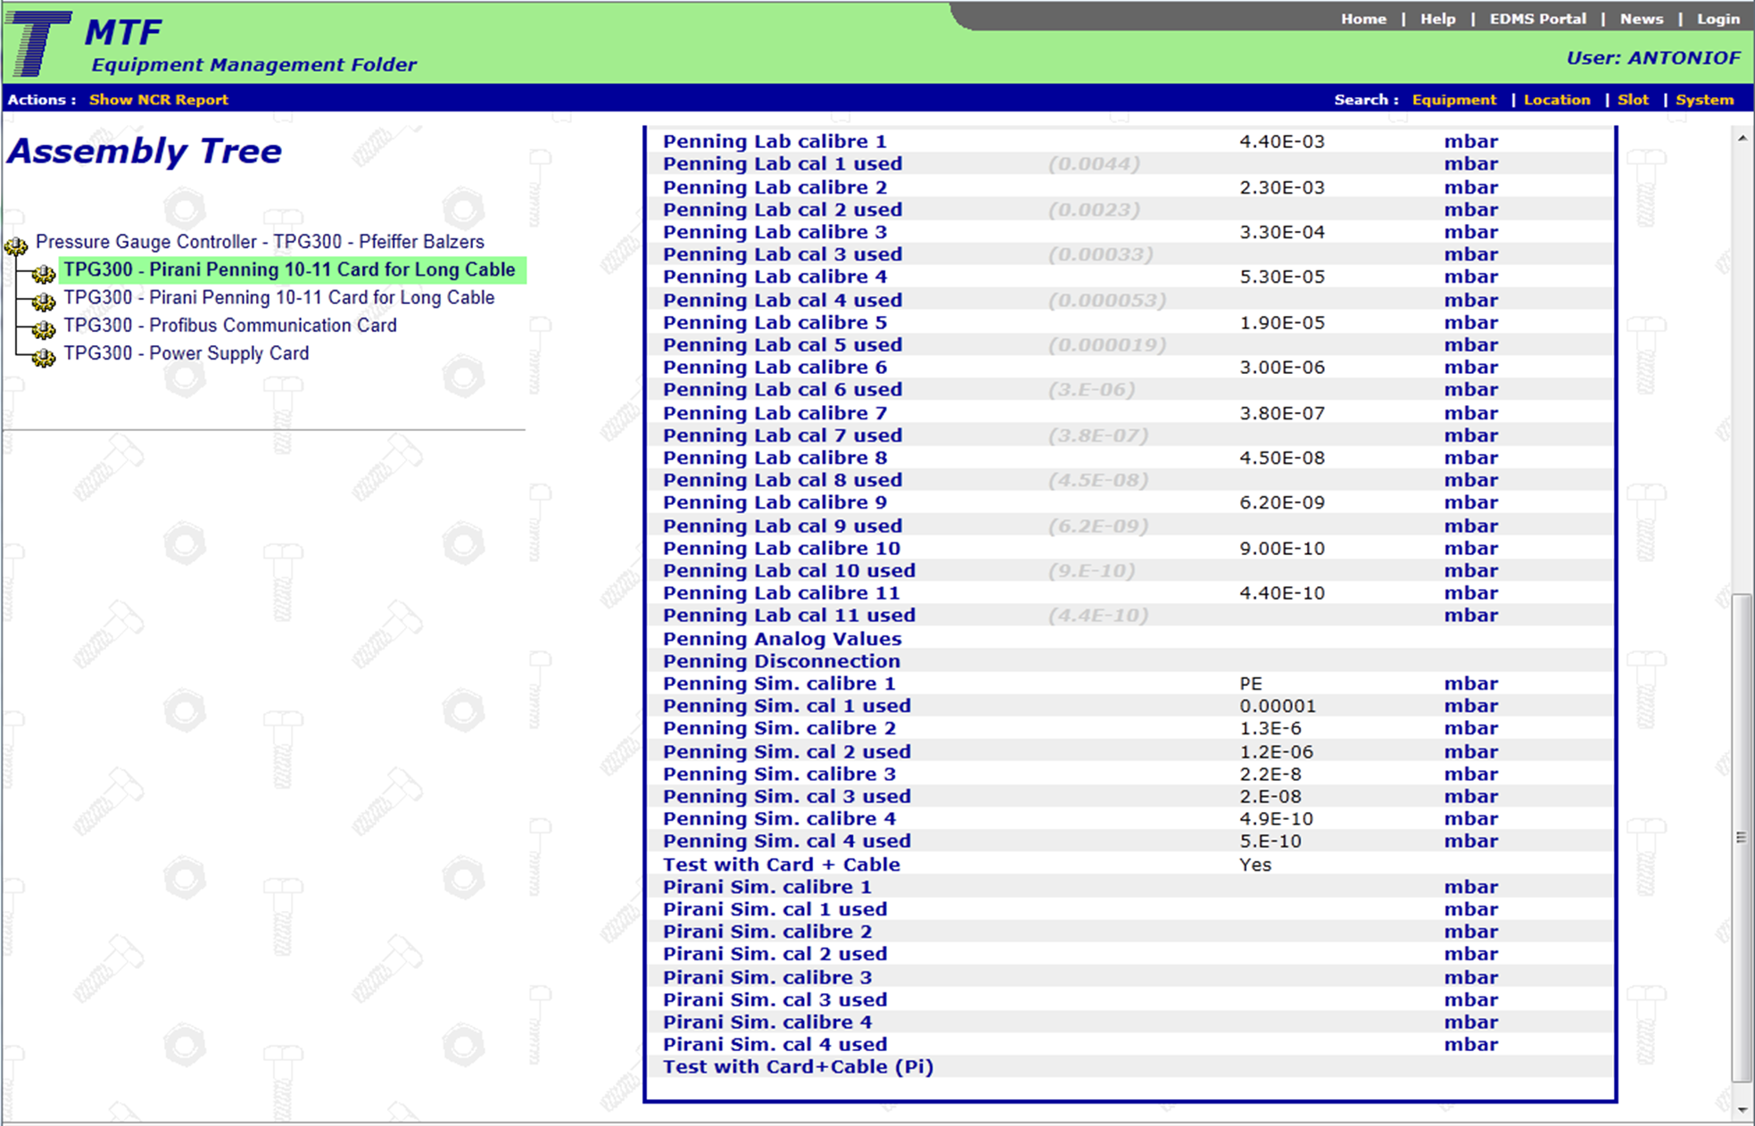
MTF

Slide 14
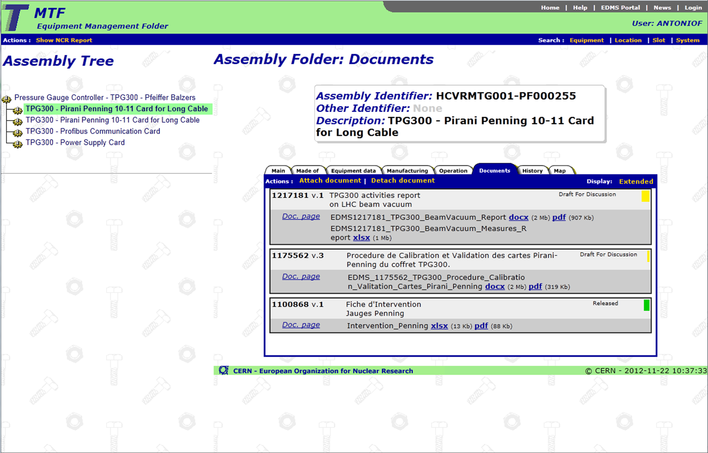
MTF

Slide 15
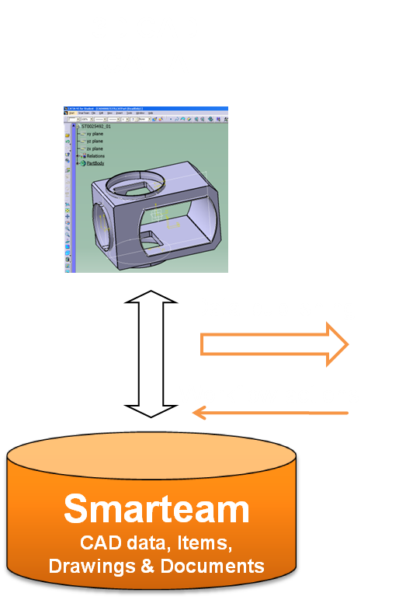
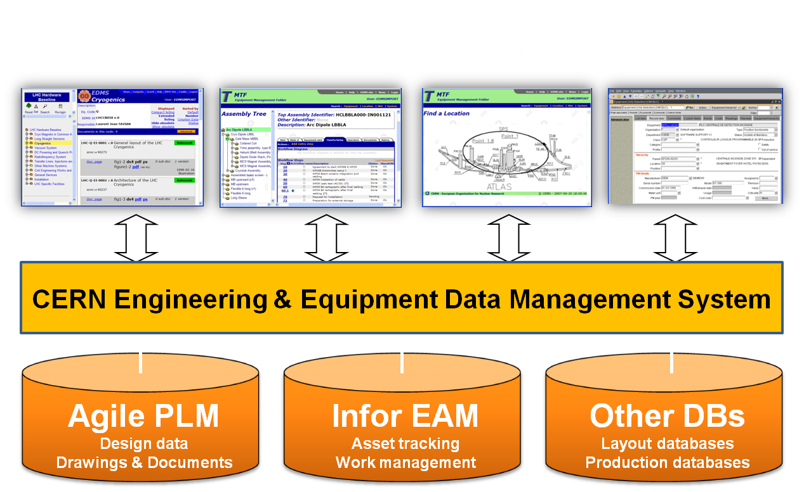
EDMS
Engineering & Equipment Data Management Service
Is a Product Lifecycle Management platform
Based on two commercial products: Agile PLM (Oracle) & Infor EAM (Infor)
Engineering / equipment data and documentation (drawings, CAD, procedures, NCR…) are:
  Safeguarded & Organized
    Access Rights & Visibility : collaborative, sharing & protecting work
  Verified
  Approval Processes & Versioning
  Retrievable on the long-term
  Knowledge transfer between generations
Since 2011: ICM large effort to collect/produce docs & store them in EDMS
Design
Manufacturing
Installation
Maintenance
Dismantling
Commissioning
CERN
EDMS

Slide 16

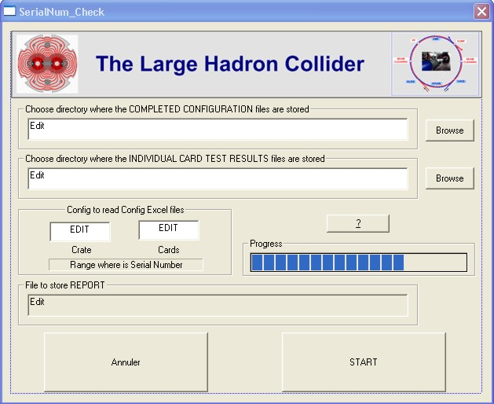
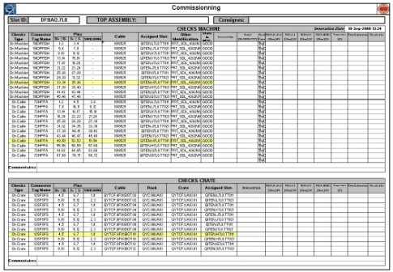
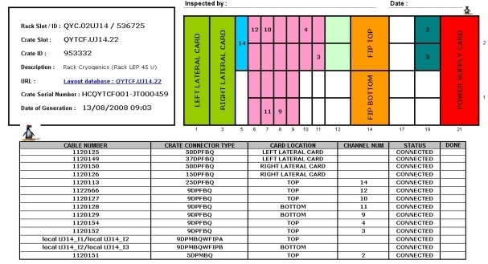
LAYOUT DB
We have to define:
  Functional positions: eg. “VRGPT.UA87.18” or “VGPB.A4R8.R”
  Relationships/connections/hierarchies between Functional positions
  Level of details in the control chain
In practice:
  In LHC, tables/views are directly used in VAC DB
    to produce the configuration files for PLCs & PVSS
  UNICOS specifications can be produced
  for the future control systems
  Applications to extract and format the information will be available
Penning gauge
TFA3
Cable
Penning card
TGP300
(interlocks)
Profibus card
(address)
PLC
Interlock cables

Slide 17
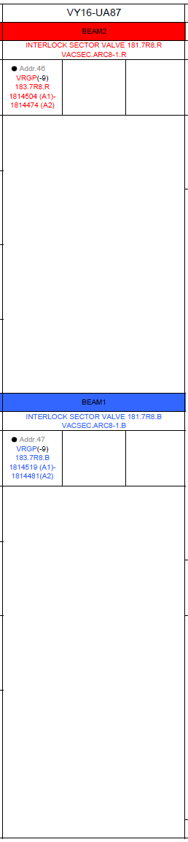
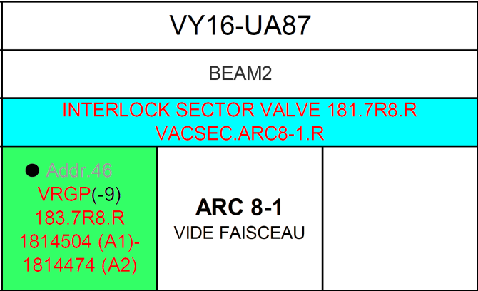
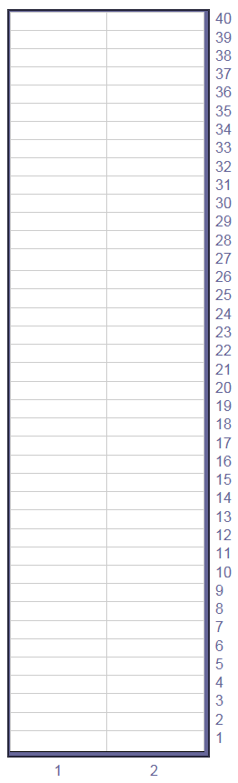
LAYOUT DB (Simulation)
Rack: VY.16UA87
VRIVC.UA87.162
VRGCT.UA87.162
VRGPT.UA87.162
VRIVC.UA87.161
VRGCT.UA87.161
VRGPT.UA87.161
Once data in Layout DB, tables or chart formats will be available online

Slide 18
Example
Manual Actions
Links
Actions
VTL
Assets
MTF
Documentation
EDMS
Layout / Function
LAYOUT DB
LINKED
LINKED
Repair request
for a TPG300
Identity, History
HCVRGPT300-CR000001
Documents?
NCR, procedures?
Chain?
Hierarchy, Settings?
Actions
ex: measurements
Worksheets generated
Problem found
TPG300 replaced
Request RP check on
HCVRGPT300-CR000001
MTF link
updated
LINKED
HCVRGPT300-CR000001
replaced by
HCVRGPT300-CR000002
VAC DB synchronization
Comment “NCR#9999999 initiated”
Status “For repair”
HCVRGPT300-CR000001
NCR#9999999
created and linked
Close the case
Repaired (Jobs)
Status “Stored”
NCR#9999999
closed
PLC
files
PVSS files

Slide 19
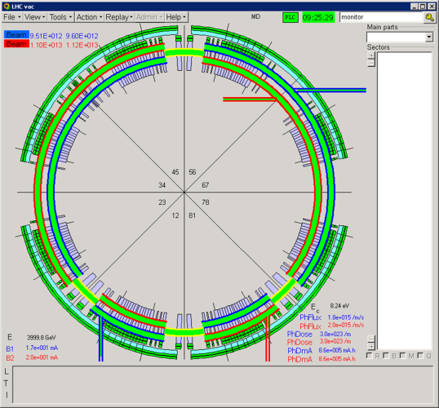
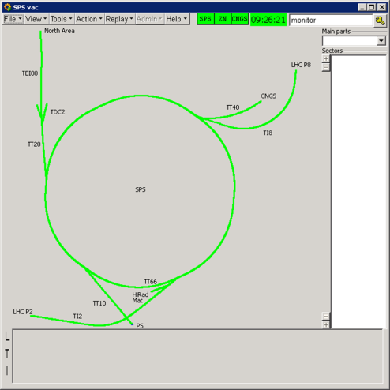
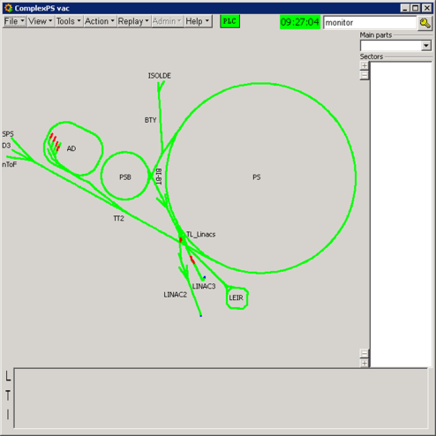
VAC PVSS & DB
VAC PVSS:
  Improvements/changes are now listed and sent to users (soon on EDMS)
  SVN server implemented to follow software versions within the team
  Important changes are described and stored in EDMS (eg. SMS notifications, archiving rules)
  Being defined: procedure to test new software releases
VAC DB:
  New procedure to synchronize with Layout DB
  Tracking of changes
  Parameters of PVSS archiving can now be set according
  to equipment type, or individually
In tight collaboration with:
  EN-ICE (PVSS support)
  BE-CO (Data Servers support)
In 2012, PVSS Data Servers migration:
  Windows to Linux operating system (VAC PVSS now fully operational in the CCC)
  PVSS 3.6 to 3.8 with improvements and new functionalities
  Physically moved the DS to the CCR building
  Integrated in MOON (ICE monitoring tool)

Slide 20



Conclusion
Well advanced:
  Homogenization: Naming Convention, methods & tools
  Centralization of information: actions, documentation, devices settings
  Preservation of knowledge
  Simple but efficient to maintain system up-to-date
Still to be done:
  Labeling (~55 %)
  Data importation into MTF (~70 %)
  Definition of templates with keywords (NCRs, Jobs)
  Definition in Layout DB
Final comments:
  Common/standard applications already widely used/supported at CERN
  Information availability, openness, transparency
  According/Conforming to the MMP recommendations
  All ICM people is somehow involved
  in aspects contributing to the improvement of QA

