Slide 1
Last results on Higgs searches from HCP2012
C.Guyot 15/11/2012

Slide 2
ICHEP: 7 TeV ~5fb-1, 8 TeV ~5fb-1
NEW : 13fb-1 (ATLAS), 12fb-1(CMS)
Channel
γγ
ZZ
WW
ττ
bbar
ATLAS CMS
ICHEP ICHEP
ICHEP NEW
NEW NEW
NEW NEW
NEW NEW

Slide 3
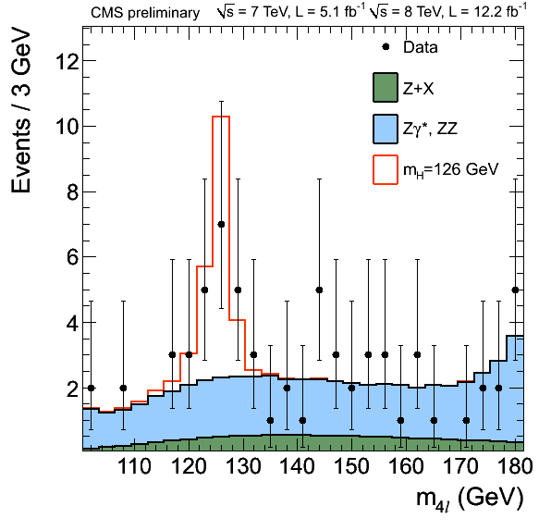
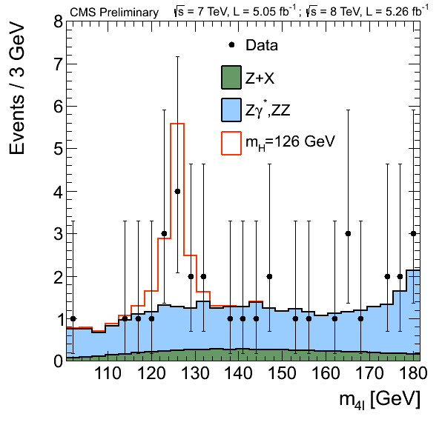
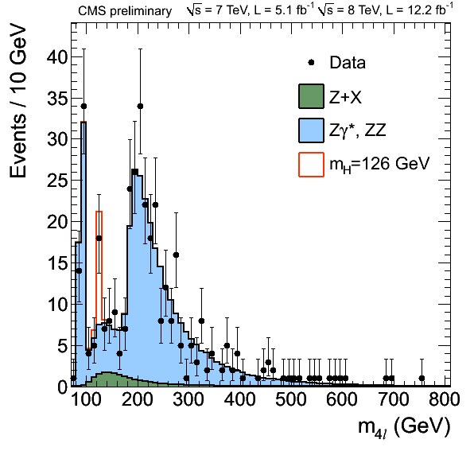
H->ZZ from CMS
ICHEP

Slide 4
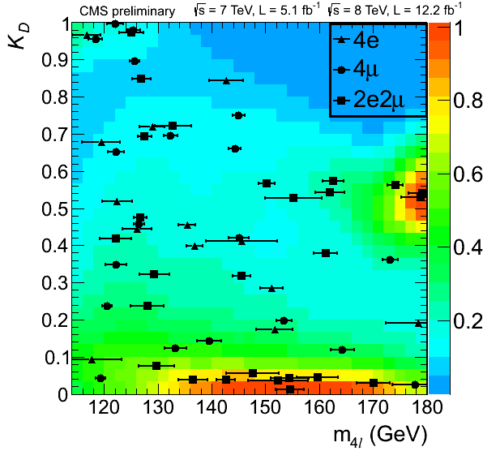
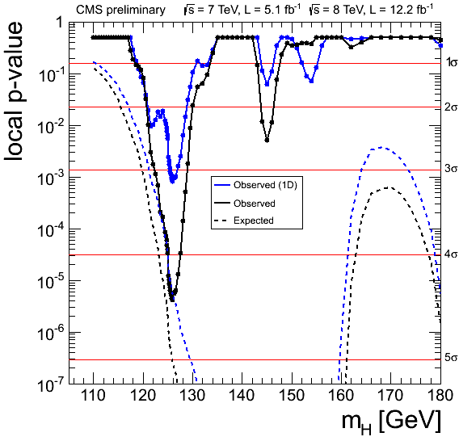
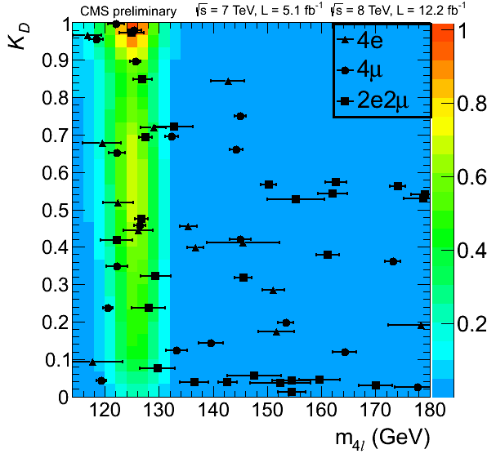
H->ZZ from CMS
P‑value corresponds to 4.5 sigma.
(ICHEP was: 3.2 sigma)

Slide 5
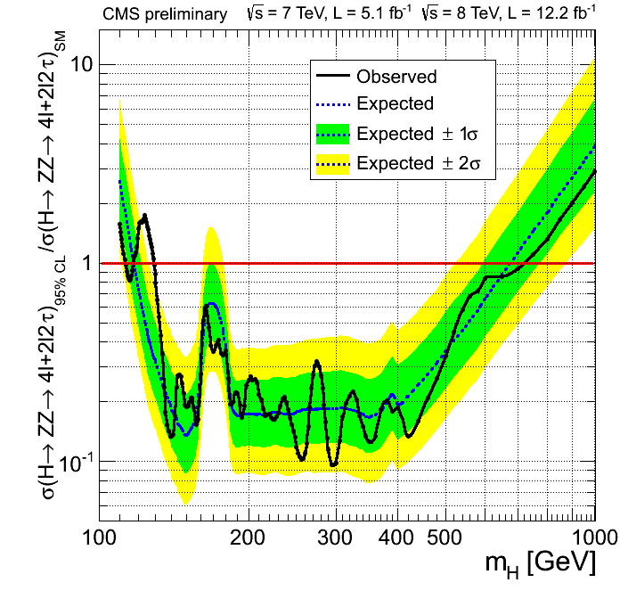
CMS: HZZ(4l+2l2tau) exclusion limits

Slide 6
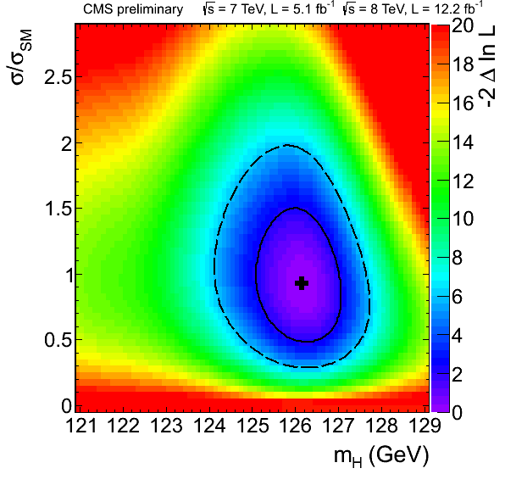
Measured mass:
126.2+-­0.6(stat.)+-­0.2(syst.) GeV
CMS: Masse vs strength

Slide 7
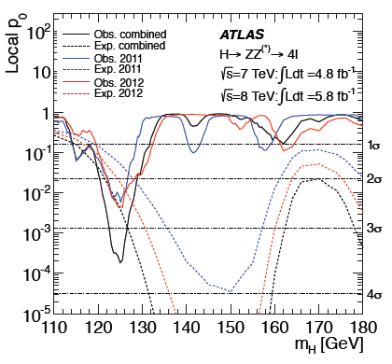
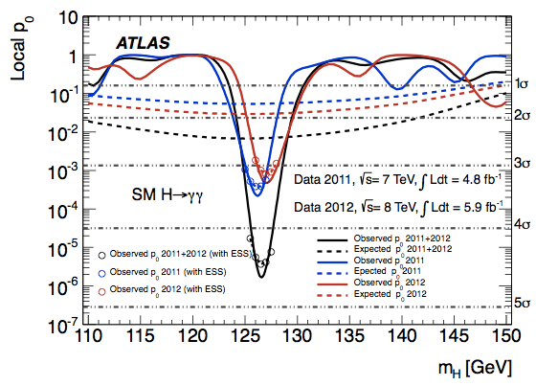
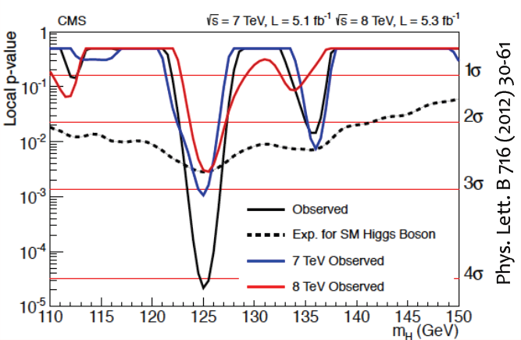
ICHEP results not updated
H->ZZ->4l
H->γγ
HCP2012

Slide 8
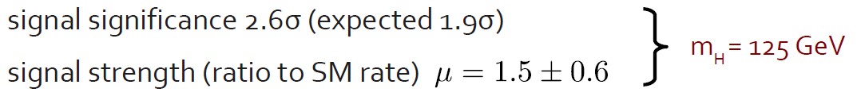
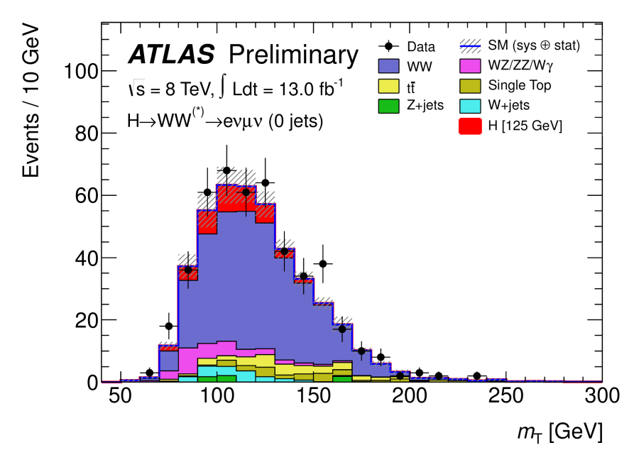
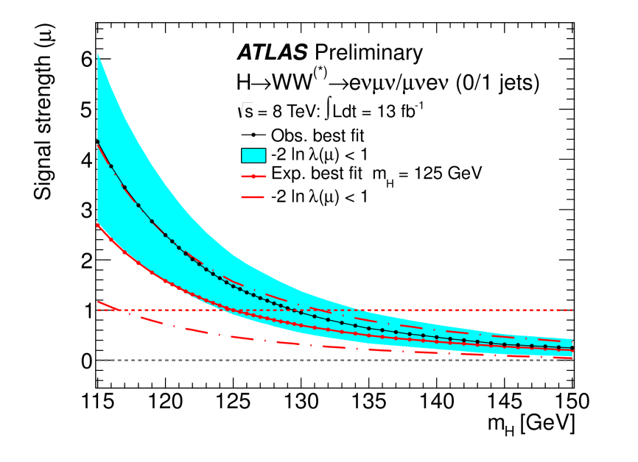
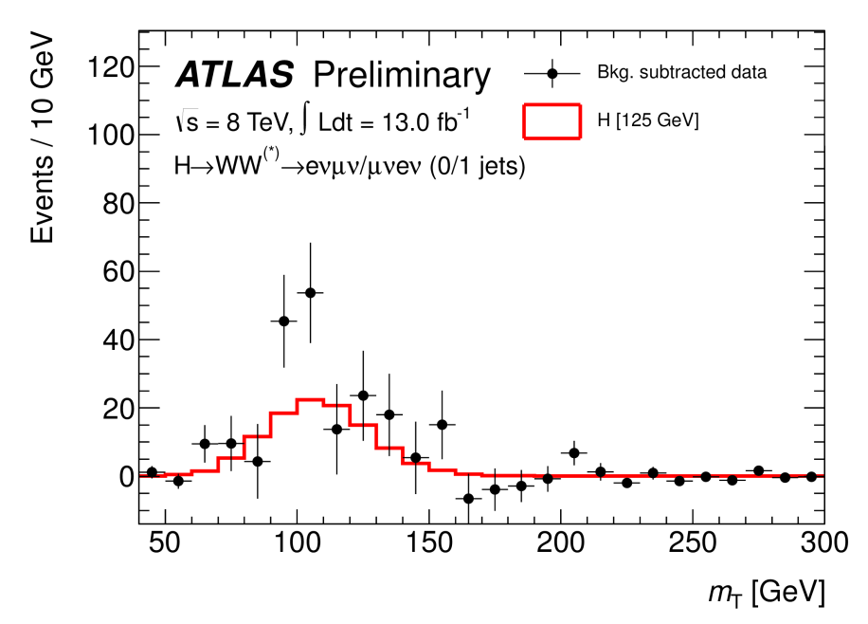
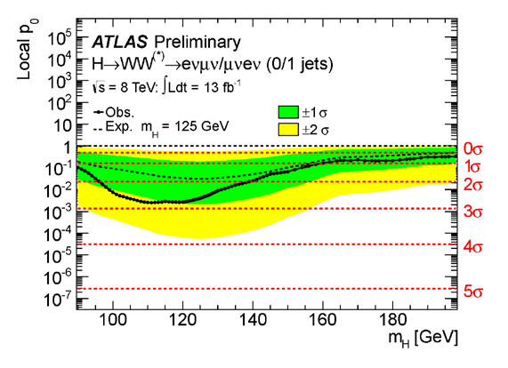
ATLAS: H->WW->2l2ν

Slide 9
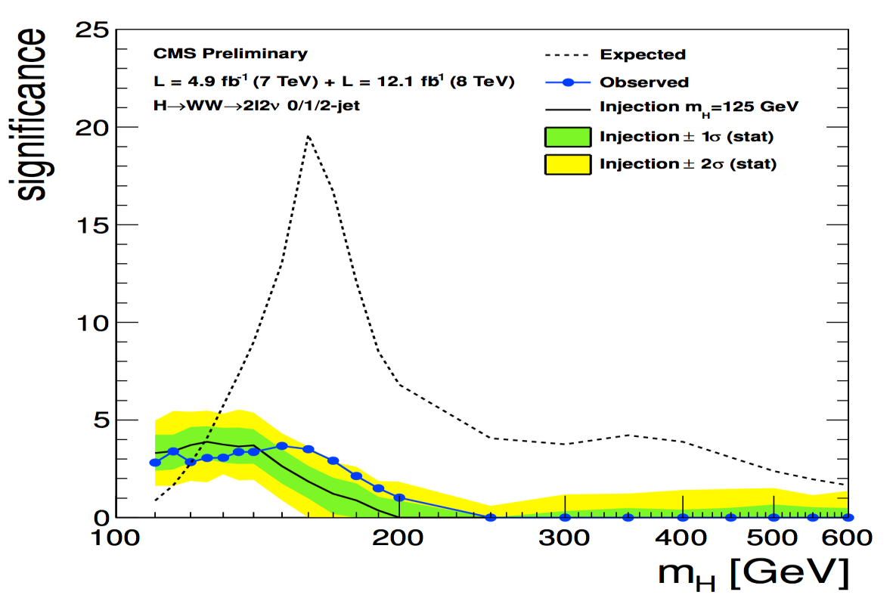
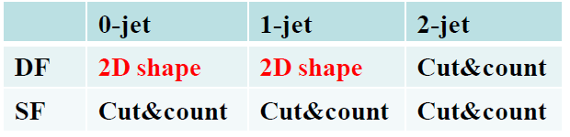
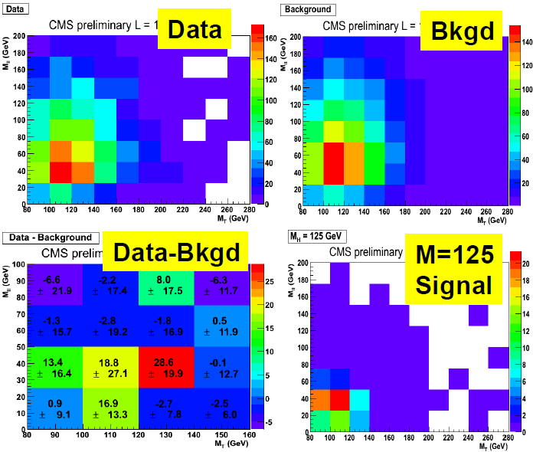
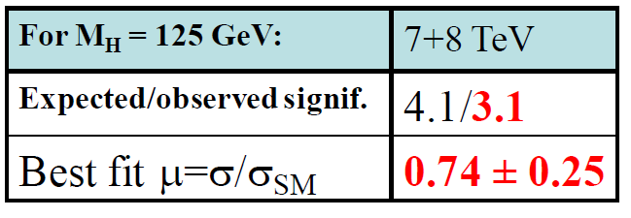
CMS: H->WW->2l2ν

Slide 10
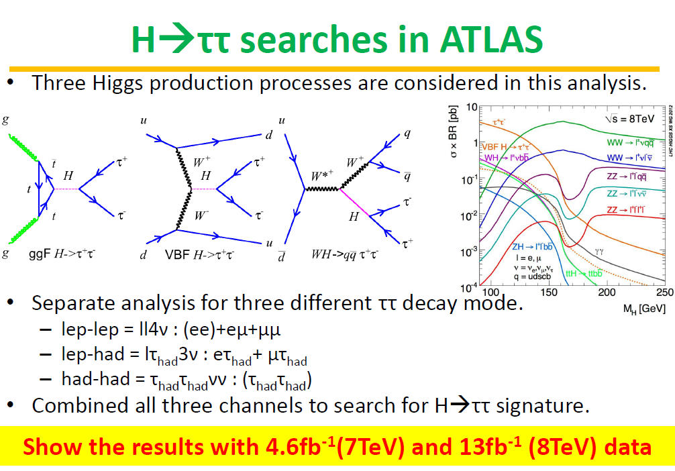

Slide 11
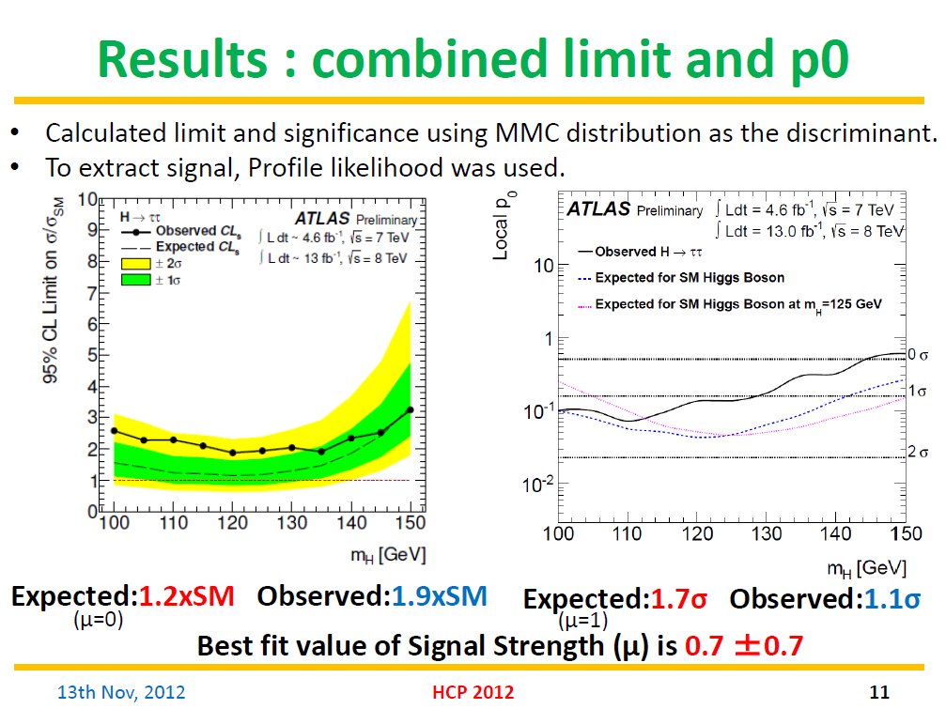

Slide 12
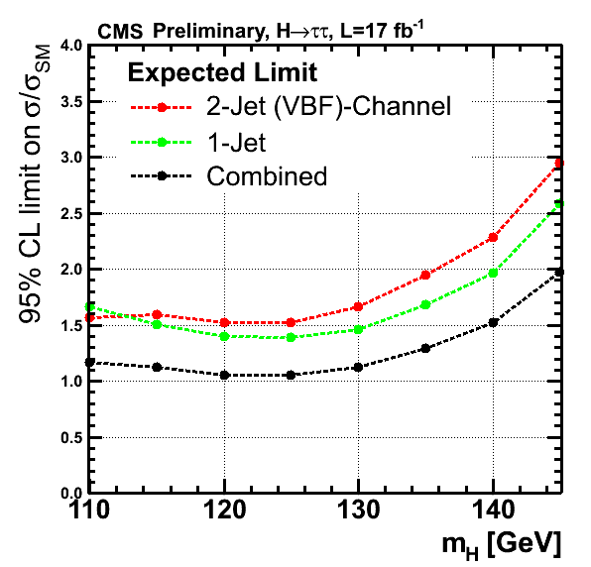
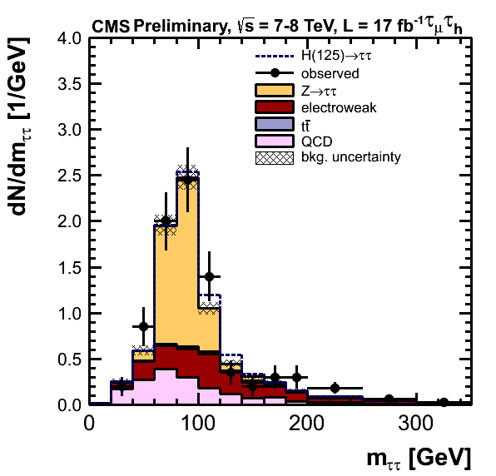
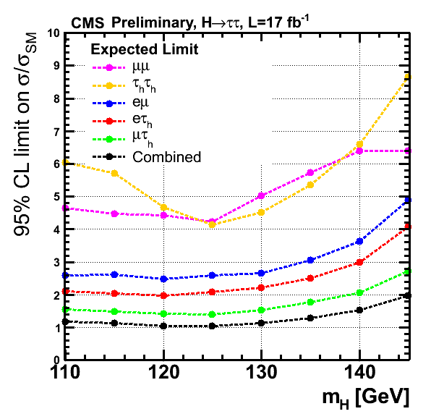
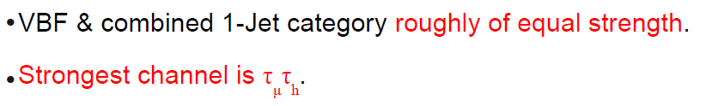
CMS: H->ττ

Slide 13
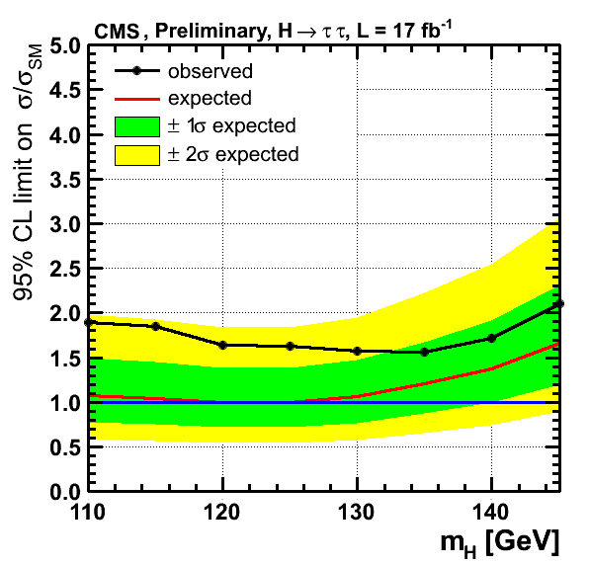

Slide 14
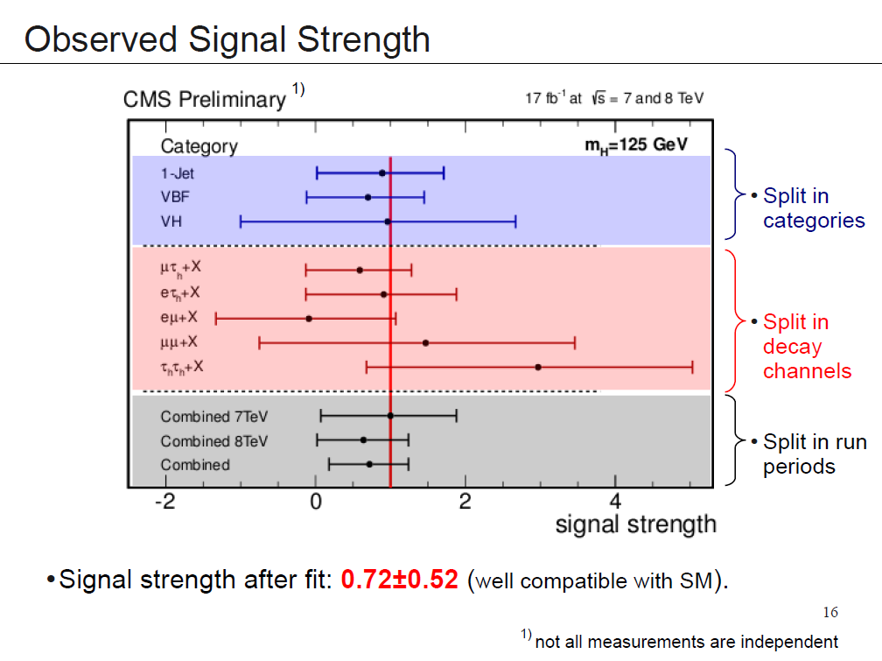
CMS: H->ττ

Slide 15
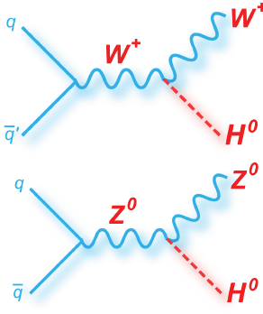
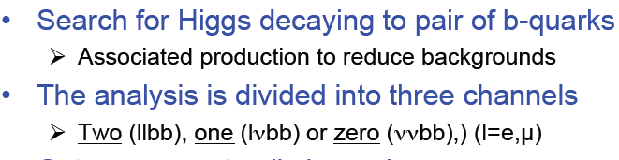
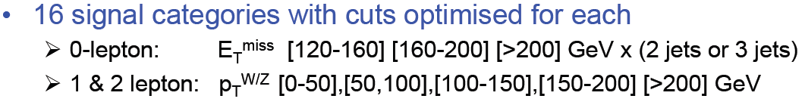
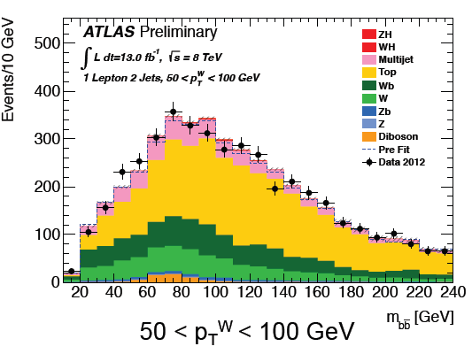
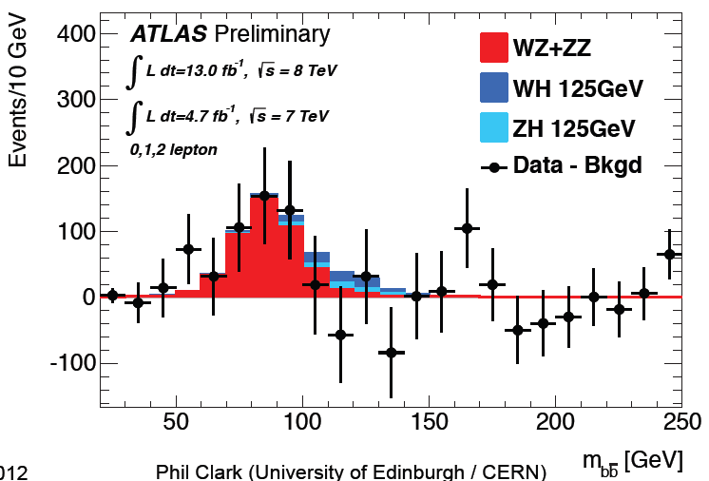
ATLAS: H->bb
Diboson production

Slide 16
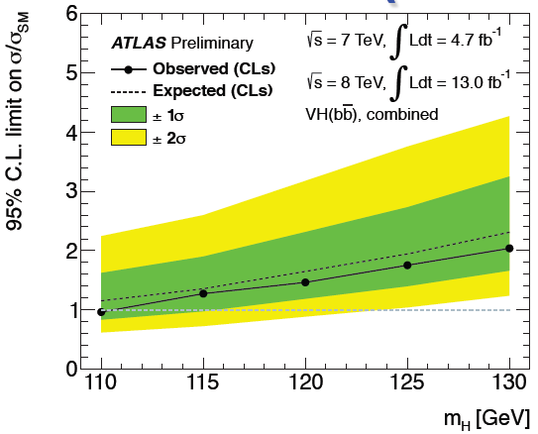
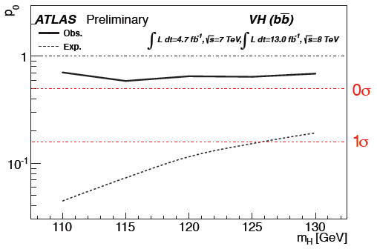
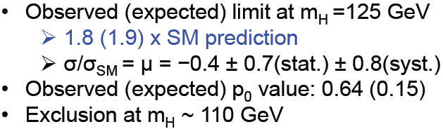
ATLAS: H->bb

Slide 17
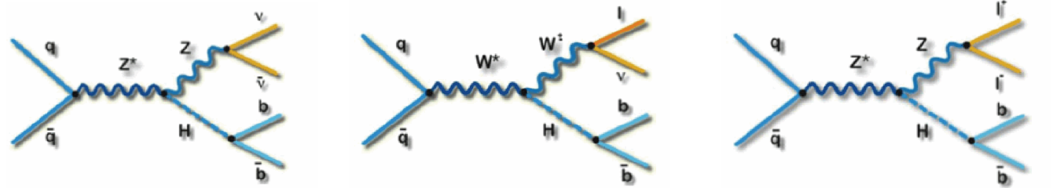
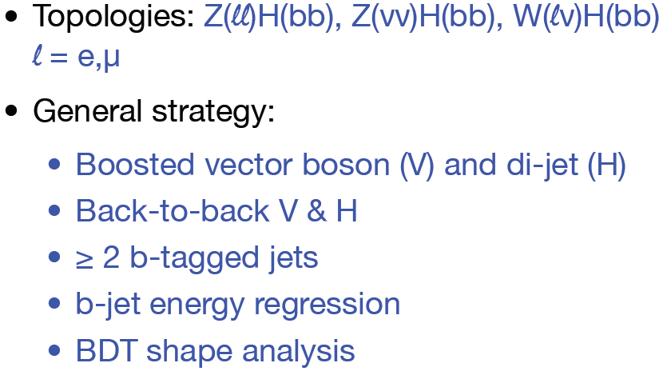
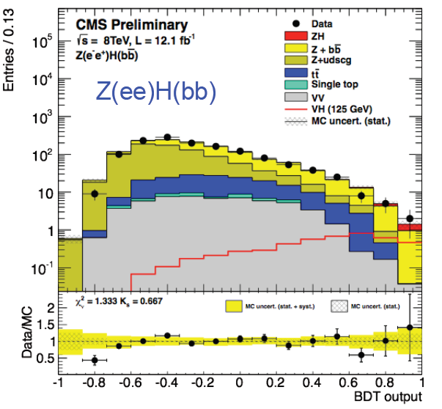
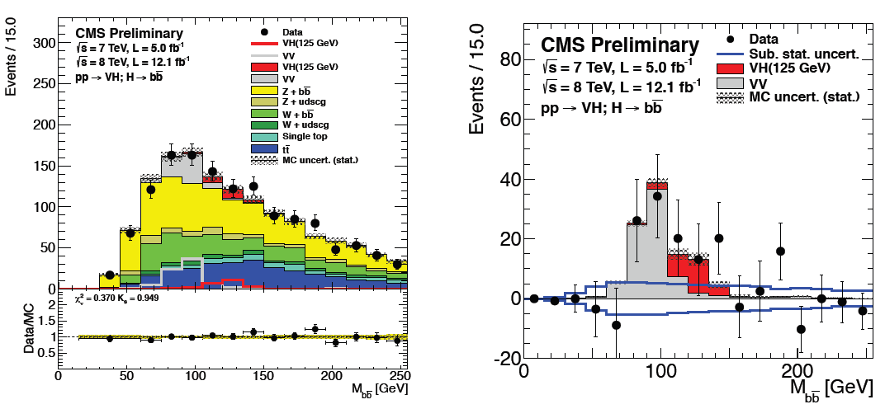

CMS: H->bb

Slide 18
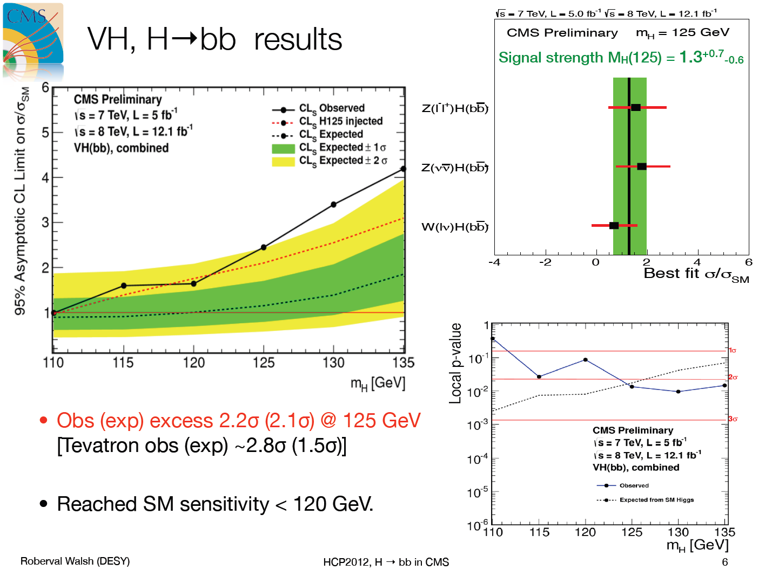

Slide 19
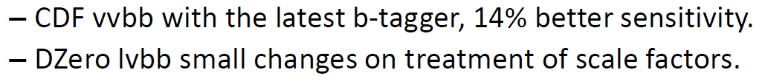
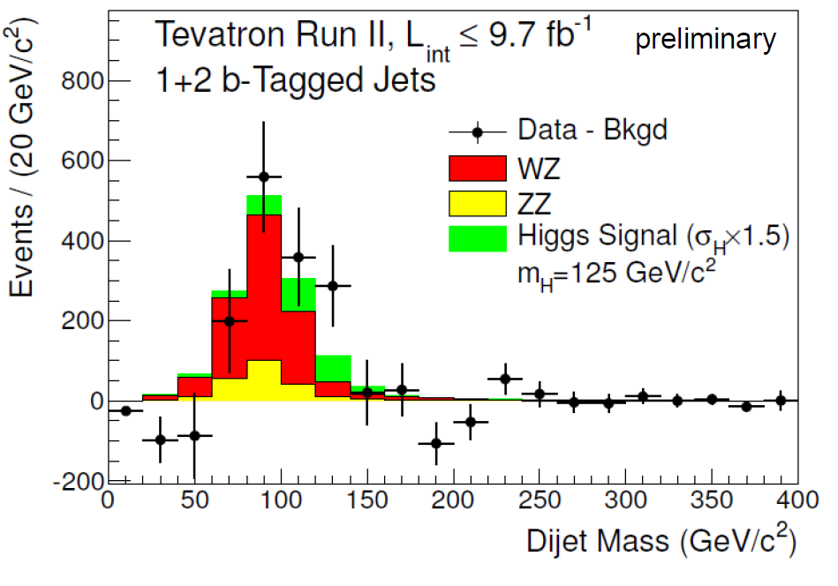

Slide 20
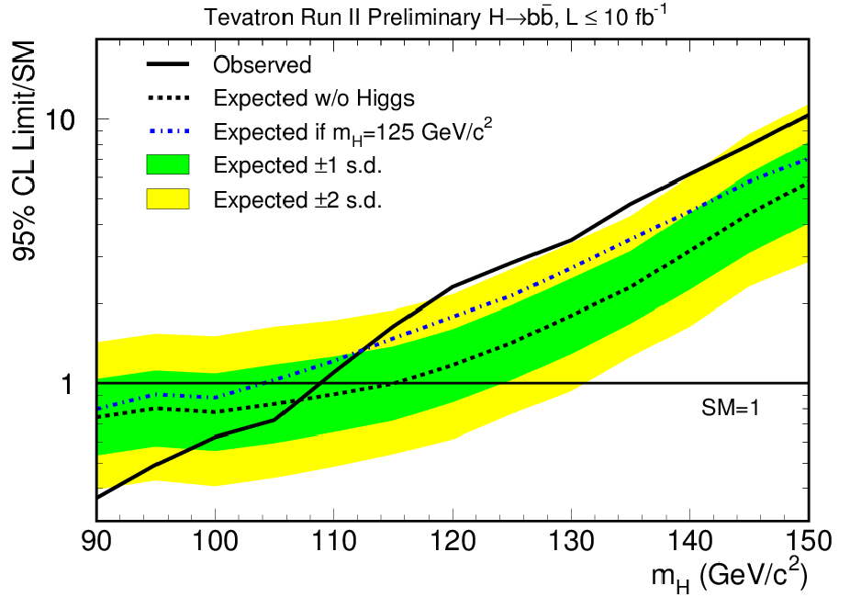
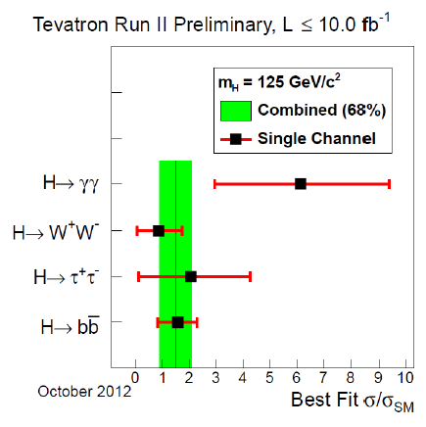


Slide 21
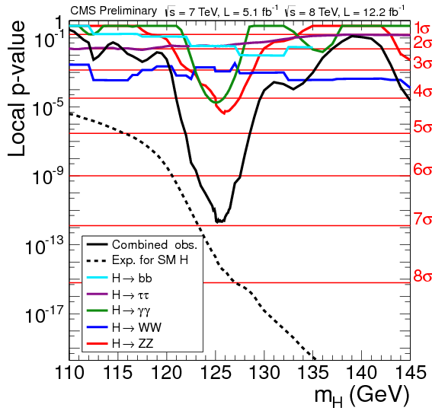
Combination of Higgs Results (CMS)

Slide 22
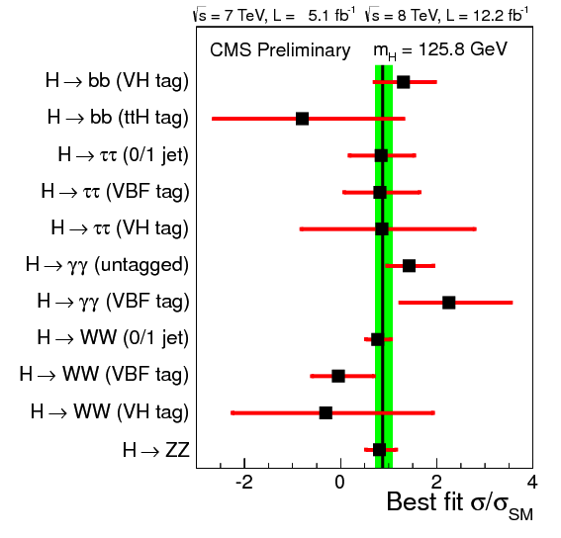
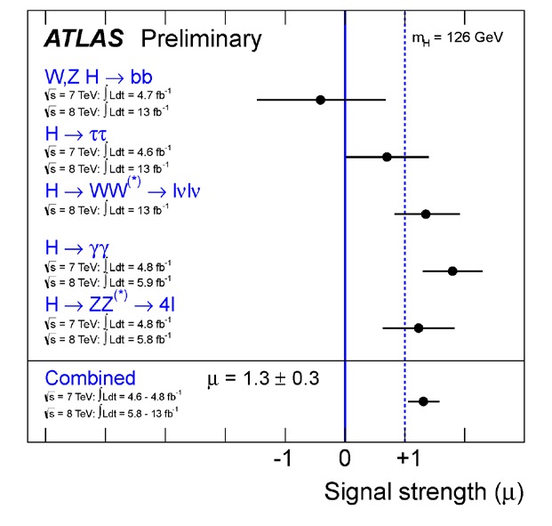
Combination of Higgs Results
July paper: μ = 1.4 ± 0.3
signal strength: 0.88 +- 0.21

Slide 23
Higgs properties

Slide 24
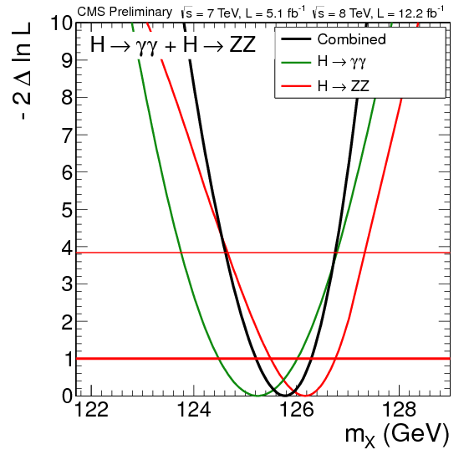

Mass measurement (CMS)
ATLAS (July):

Slide 25
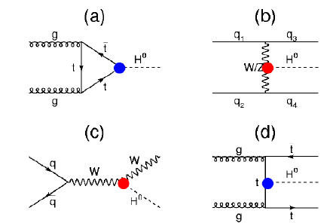

Couplings strength

Slide 26


Couplings strength
New particles can
  -Hide in the loop-mediated couplings
  -Contribute to the total width
Parameterize the photon and the gluon loops with effective scale factors (κ_{γ},κ_{g})
Fermiophobic scenario excluded at >4σ level

Slide 27

Individual couplings (CMS)
Assess individual couplings assuming only custodial symmetry and without resolving the loops structure
End up with 6 scale factors:
  κV, κt, κb, κτ, κg, κγ
Fit individually each of those, while profiling the others

Slide 28

CP measurement (CMS)
Couplings to photons => spin 0 or 2
Leptons kinematics distribution in the ZZ->4l decay used to discriminate J^{PC} = 0⁻ and 2⁺ hypotheses from 0⁻.
CP, 0- vs 0+:
  1.94σ expected separation
  0⁻ consistent with observation at 2.5σ level (<3% using CLs)
Preliminary results on spin non sensitive enough

