Slide 1
Review of PS2 injection/extraction and requirements for HP-PS
W.Bartmann, B.Goddard, A.Parfenova

Slide 2
Recall of PS2 functionalities

Slide 3
Recall of PS2 functionalities
For HP-PS, assume that we only need H- injection and fast extraction
Parameters to revise: assume for now
- extraction only at 50 GeV (30 – 70 GeV???)
- spill length ~3 us
- injection length ~1 ms
- kicker rise time crucial!! 150 ns was very demanding...

Slide 4
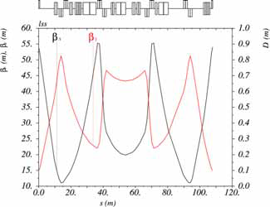
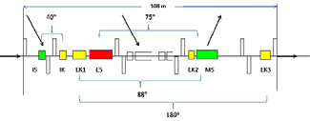
PS2 injection/extraction straight
108 m long, symmetric doublet lattice
4 doublet pairs
H- injection in central drift
Fast extraction across central doublets (88°)

Slide 5
Recall - Lorentz stripping
Losses per m of dipole – field limited to about 0.10 - 0.13 T at 4 GeV

Slide 6
Injection: H- multi-turn, 4.0 GeV
H- injection for beam from SPL
  Injection chicane with foil (and possible laser stripping section)
  Fast orbit bumps (horizontal and vertical) for phase space painting during injection process (≤300 turns i.e. ~1 ms).
  Septa, beamline and dumps for the partially or unstripped H0 and H- beams are needed.
  Low dispersion (<20 cm) to decouple longitudinal and transverse effects
This is a difficult system at 4 GeV!
  Limit on maximum dipole field H- beam can traverse, to avoid magnetic stripping and beam loss
  2 – 5 % of unstripped H- needs dedicated extraction septum and dump
  Foil physics and beamloss control…
  Dumping of stripped electrons….
  Accommodation of laser stripping

Slide 7
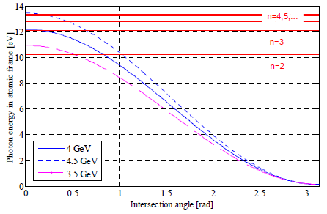
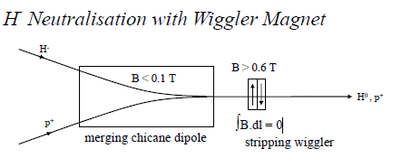
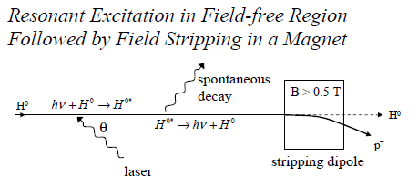
Laser stripping?
Should maintain compatibility for laser stripping insertion
Needs low beta_xy, and also large DPx at the exit of the transfer line
Separate presentation sometime on this topic…!

Slide 8
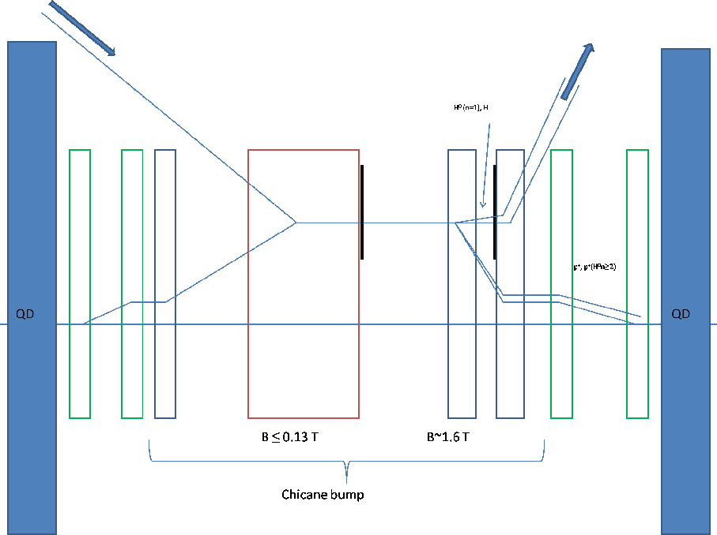
H- injection layout
H- -> p+
H0 -> p+
H-
22-24 m

Slide 9
Constraints (adapted from PS2)
Minimum drift for H⁻: ~24 m
μ_{x} between extr. kicker and MS: ~90° + k*180°
17 T/m maximum quadrupole gradient (K < 0.1)
β_{xy} ‘reasonable’ - below ~60 m
Two injection optics versions:
  Foil inj. with β_{xy} ca. 25 m and α_{xy} ~0 at foil
  Laser inj. with β_{y} as low as possible and α_{xy} ~0 at IR
Path from Laser inj. to extr. optics with LSS μ_{x} constant !

Slide 10
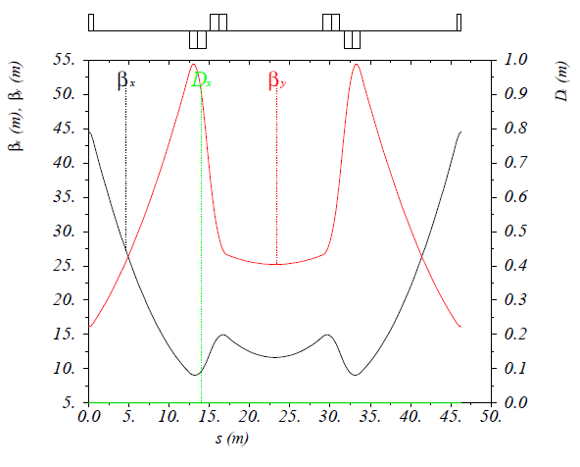
Requirements for HP-PS
4 GeV H- injection over 1 ms
Needs about 22-24 m free central drift
  Present optics has 12.0 m: by far not enough!

Slide 11
Doublet concept of LSS (from PS2)
2 pairs of doublets arranged symmetrically around the LSS centre
Doublet spacing arranged to give similar β_{xy} to arc
Generous quad lengths (2.4 m) with low gradients (maximum ~0.06 m⁻²)
Assume quads are ~1.3m wide

Slide 12
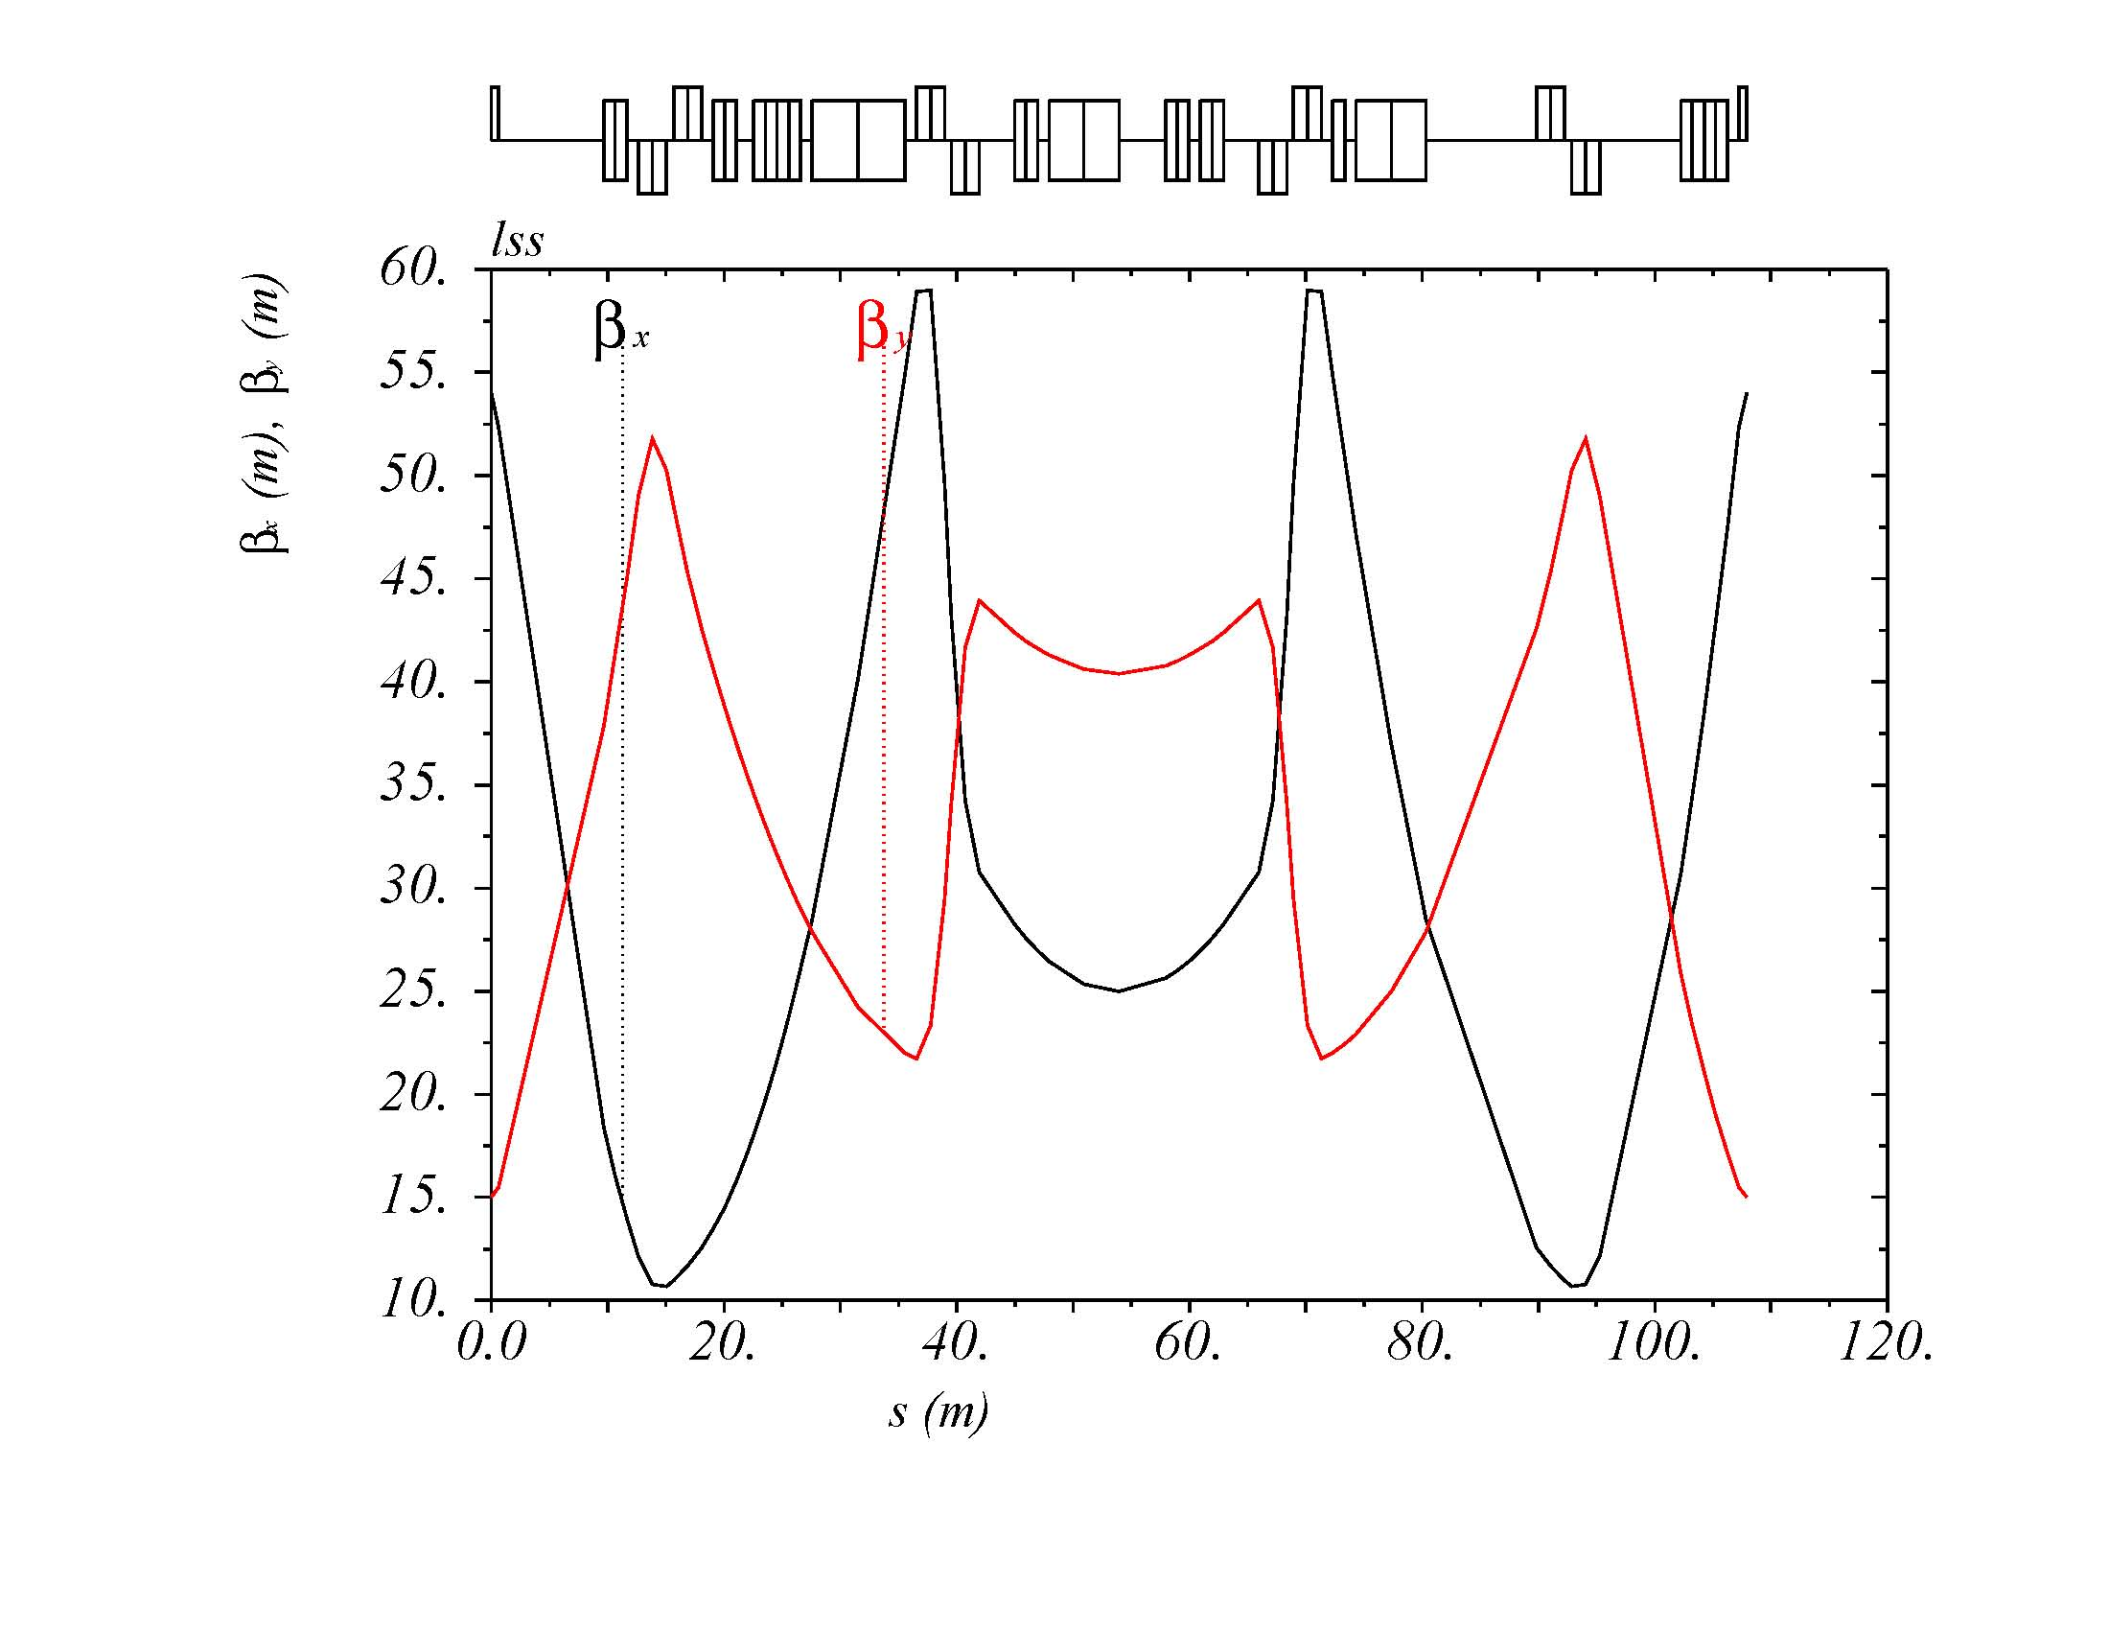
Optics – Foil inj. and extraction
Using last arc QF between DS and LSS for matching
Change over values: β_{x}=54 m, β_{y}=15 m
IS
IK
EK
ES
D1-D4
EK
MS
EK

Slide 13
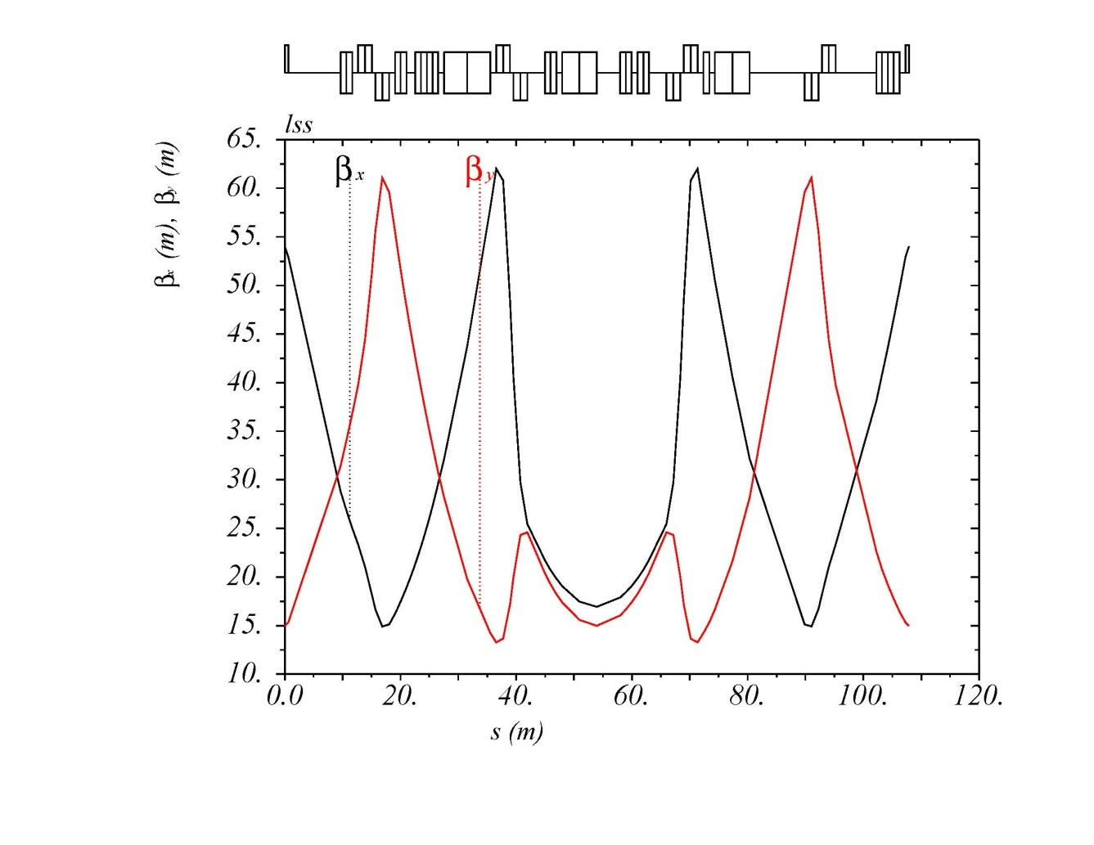
Optics - Laser
15m β_{y} in the centre
62m β_{max}

Slide 14
LSS schematically
Element | Magnetic length [m] | Strength [mrad]
IS | 0.8 | 60
IK | 0.9 | 6.8
EK1 | 3.1 | 1.2
ES | 3.8 | 0.8
EK2 | - | -
MS | 7.5 | 53.1
EK3 | 1.7 | 0.65
108 m
40°
75°
IS
IK
EK1
ES
EK2
MS
EK3
88°
180°

Slide 15
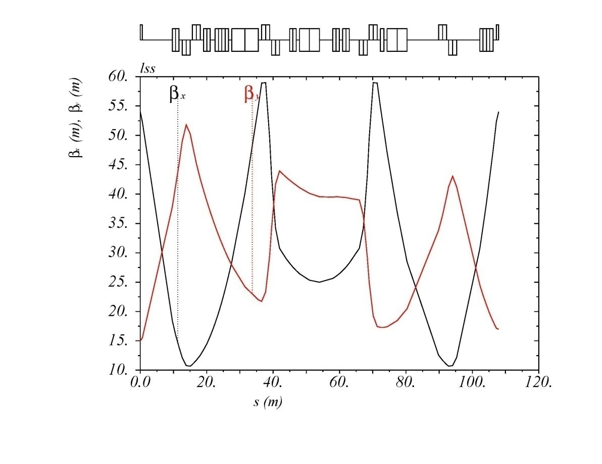
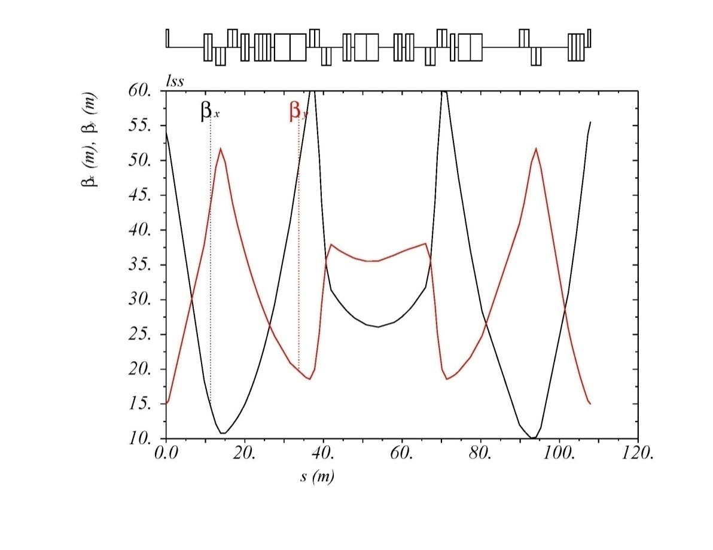
Optics perturbation by H- chicane
Effect of the vertical focussing from the chicane
Compensation by separate L/R powering of the quadrupoles (presently use all 10 quads). Fall time???

Slide 16
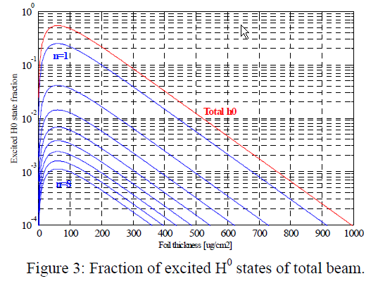
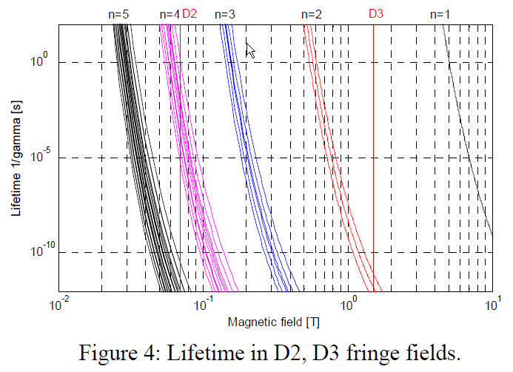
Dipole Field choices - beamloss
D1 is a septum
D2 field < 0.13 T to avoid Lorentz stripping
D3 around 1.5 T to ensure H- and excited H⁰ states n=2 and above are field stripped (n=1 stripped in 2nd foil)
  Issue of D3 fringe field, which needs to be very ‘sharp’ edged

Slide 17
“Uncontrolled” loss from n=2 state
Stripping deep in fringe field of D3 magnet
Leads to angular errors of 1-3 mrad!
  Possibly needs local collimation
  Work on fringe field shape – as ‘hard edged’ as possible

Slide 18
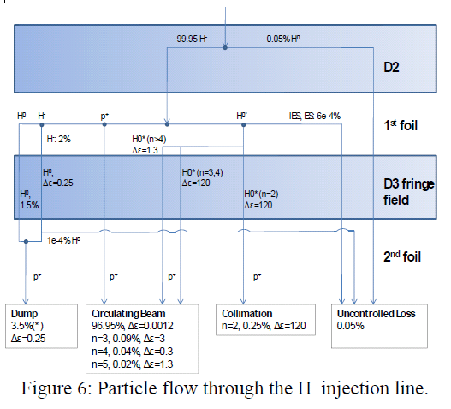
Foil thickness and stripping efficiency
Reach about 97% efficiency for 400 ug/cm2 foil
Can assume 1% H- missing the foil
Maybe 4% total waste beam to dispose of – 6 kW

Slide 19
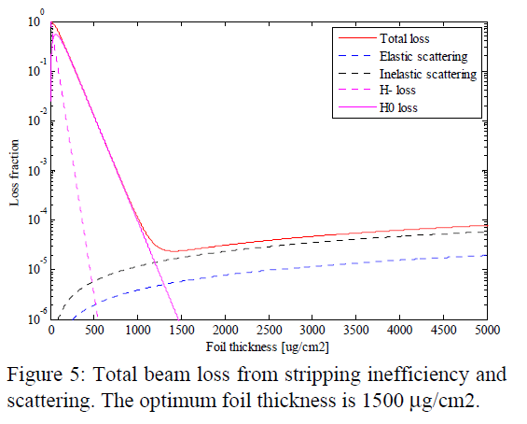
2nd foil foil thickness optimisation
Should strip all H⁰ to p+ - about 1500 ug/cm2

Slide 20
Fast extraction
Not enough phase advance to decouple completely from H- injection
Need to kick horizontally (or vertically?) across the doublet
Kicker for PS2 gave 1.2 mrad at 50 GeV in 3.1 m (magnetic) with 150 ns rise time
Opening at septum needs about 30-35 mm (for 20 m beta function), so will need kick of about 1.8-2.0 mrad.
  Any possibility to increase βx at kicker and septum, keeping Δμx around 90 deg??
Septum 7.5 m long, plus drift needed to next quadrupole
  Fixes length of 2nd straight section to about 12 m
PS2 version worked out for 12 pi.mm.mrad emittance…

Slide 21
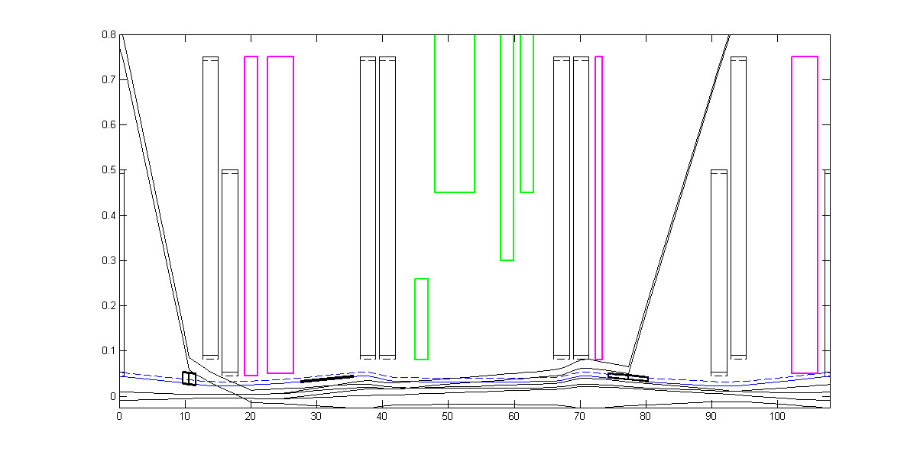
Apertures
Apertures of quadrupoles – probably need to have an ‘enlarged’ type in the LSS

Slide 22
Overall LSS concept for HP-PS
Total length needed is about 53 m (maybe possible to reduce by 4-5 m eventually – tbc)
Should at this stage add an extra 12 m per LSS, by making the central drift 24 m long.
Could look at vertical fast extraction, but maybe limits from injection chicane dipole gaps…
(2x12+24+5.2) = 53.2 m
12 m
24 m
12 m
EK
MS
~90° kicker centre to septum entrance

Slide 23
Conclusions
Should be easier than PS2 injection/extraction LSS
  Fewer beam transfer requirements
  Extract only at 50 GeV
The well-worked out H- injection system designed for PS2 at 4 GeV can basically be plugged into HP-PS
  24 m central drift
  1 m space for laser stripping elements
Fast extraction in the same LSS possible
  12 m for the outer drifts
  Imposes large aperture doublet quadrupoles
Can we already start working with basic parameter set
  4 GeV, 1 ms injection; 50 GeV extraction, rise time?
  Target emittances??

Slide 24
Next steps
24 m central drift in the injection straight and matching of overall lattice with this new LSS (YP et al.)
Generate an LSS sequence with the various injection and extraction elements (BG/AP)
Definition of envelopes, apertures, kicker and septum strengths etc. (BG/AP)

