Slide 1

Different energy options for HP-PS
Yannis PAPAPHILIPPOU, CERN
`
LAGUNA-LBNO HP-PS Meeting
20/11/2012

Slide 2
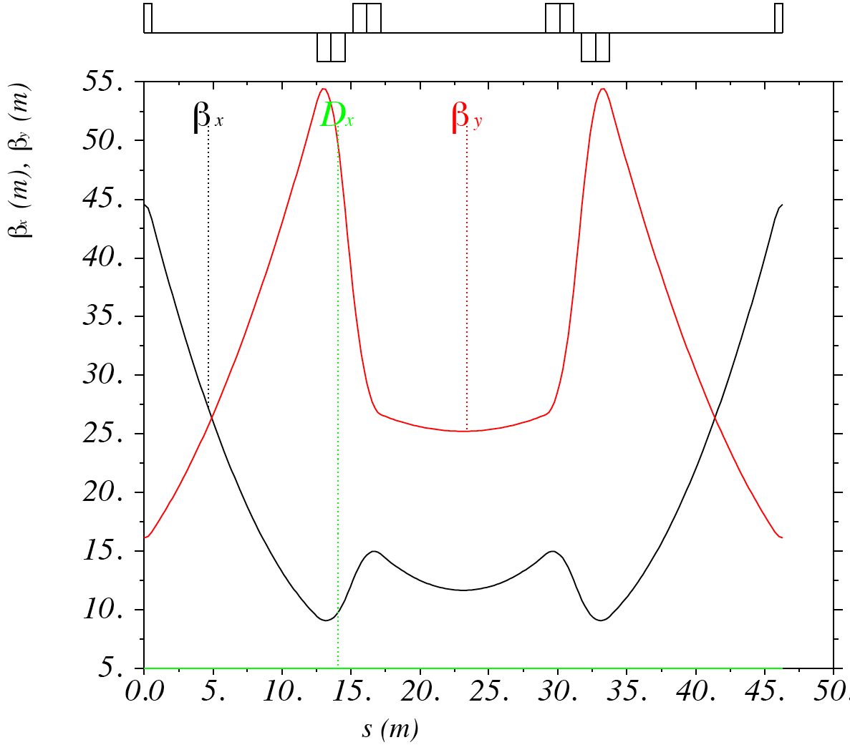
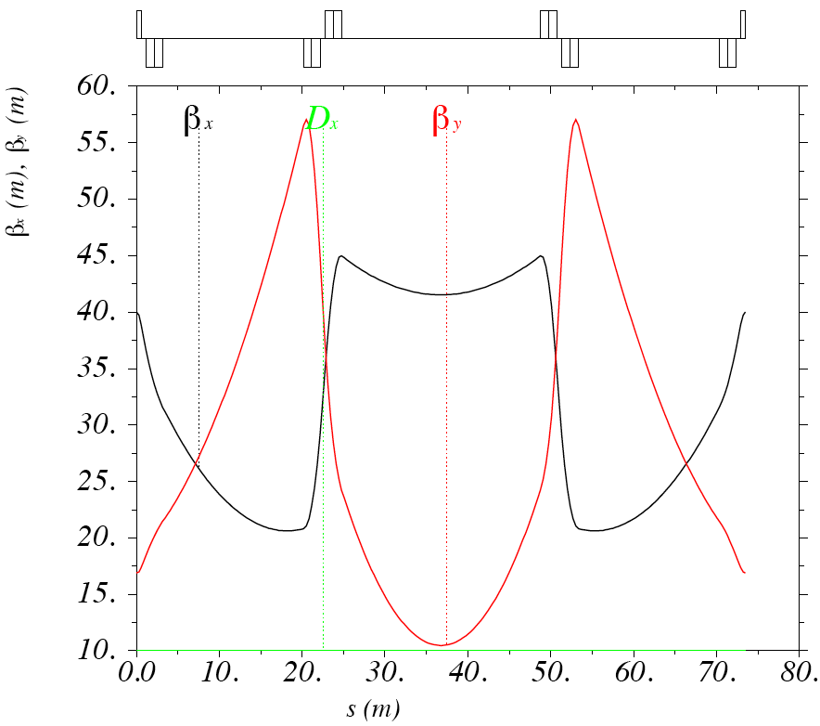
Interlude:
LSS optics modification
V1
V2
Necessity to double space in the center of the LSS, especially for injection
Difficult to match without adding extra drift space in the two side cells
Add an extra defocusing quadrupole for matching flexibility and keeping beta functions below 60m
Reduce slightly horizontal beta in the arc cell
Length increased from 46.3m to 73.5m
H/V phase advances of 0.397/0.526
Maximum H/V beta of 45/56.5m

Slide 3
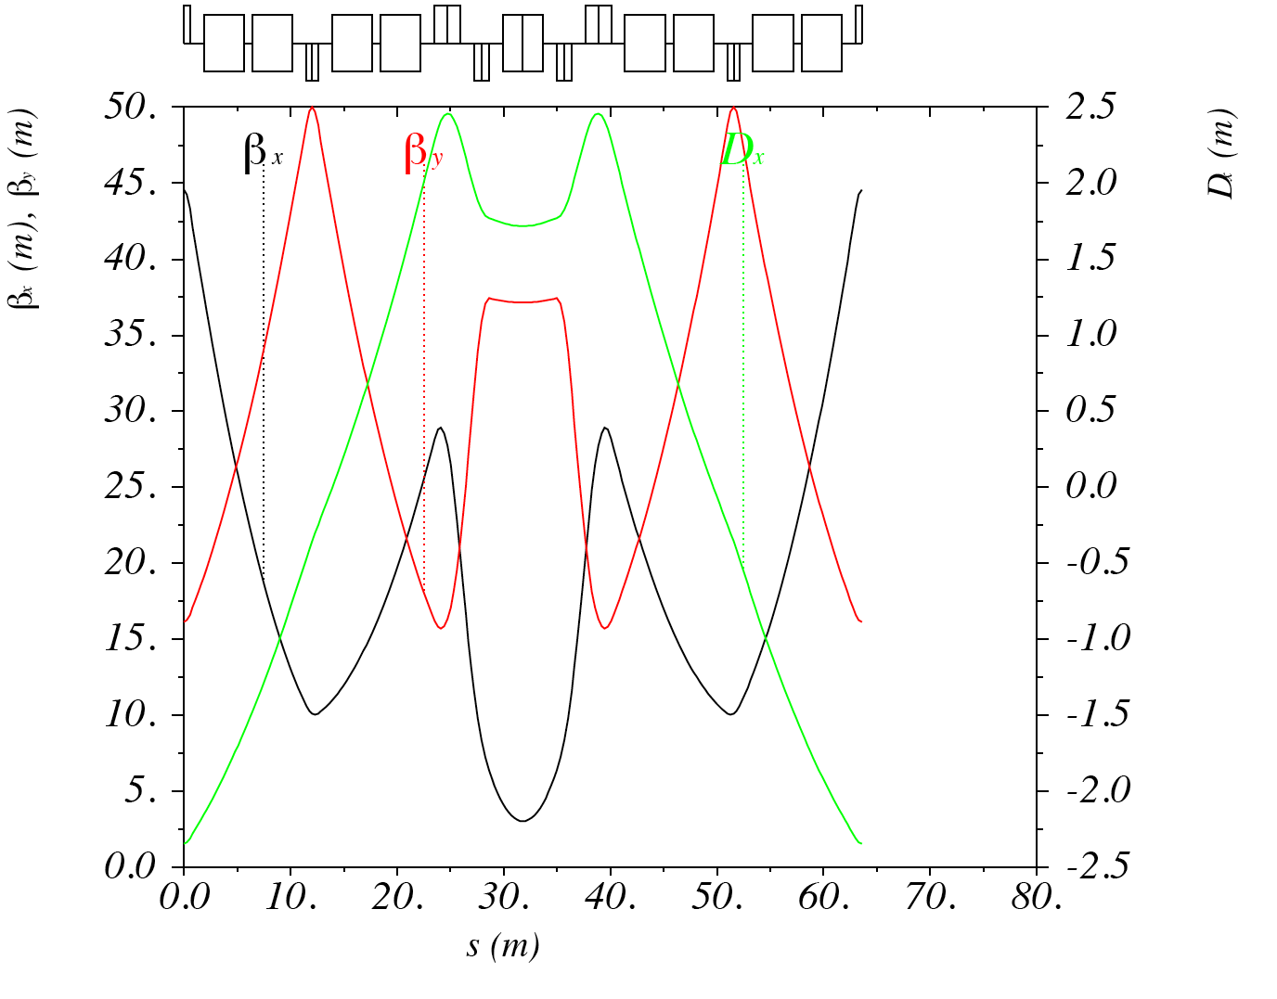
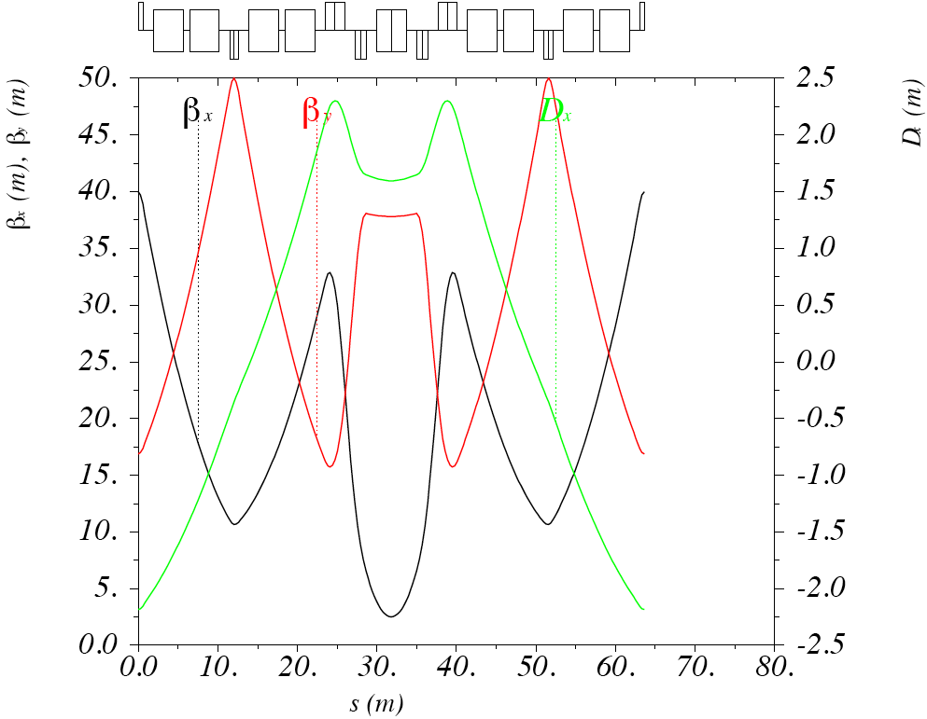
Interlude:
NMC optics modification
V1
V2
Identical cells, changing slightly horizontal beta (and peak dispersion)

Slide 4
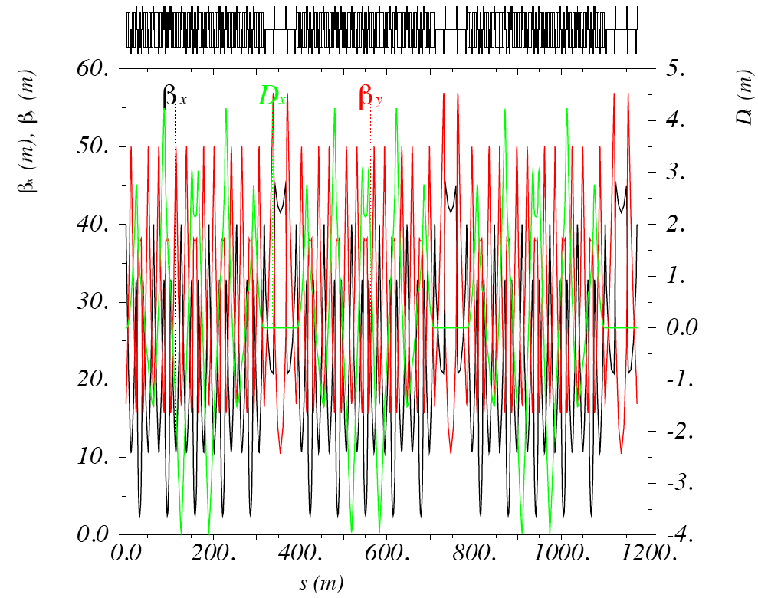
New HP-PS ring
Total length increased to 1174.3m (from 1092.7m)
Transition gamma of 45.1i (instead of 46.5i)
Tunes to be optimized (including tunability study)
Chromaticities slightly increased to (-17.5,-12.1)
Aperture to be refined (but unchanged)

Slide 5
Getting 2MW @ different energies
Parameters | PS2 | LP-SPL reach | HE HP-PS | SF HP-PS | LE HP-PS
Repetition rate [Hz] | 0.42 | 2 | 1.0
Number of protons [10¹⁴] | 1.1 | 1.1 | 1.9 | 2.5 | 4.2
Linac pulse length [ms] | 0.9 | 0.9 | 1.6 | 2.0 | 3.4
Kinetic Energy [GeV] | 50 | 4 | 65 | 50 | 30
Beam Power [MW] | 0.37 | 0.144 | 2.0 | 2.0 | 2.0
Consider three rings:
  A 50GeV ring with super-ferric magnets
  A 30GeV ring with resistive magnets
  A 65GeV ring with super-ferric magnets
The repetition rate is fixed to 1.0Hz
To get the 2MW, the intensity has to be increased from the highest to the lowest energy by more than a factor of 2
Linac pulse has to be increased by almost a factor of 4

Slide 6
Bending field
Consider the same layout and optics as for SF HP-PS
  Same circumference and filing factor
Bending field is then scaled with energy
The field in the high-energy ring is quite high for super ferric magnets.
Need to increase circumference to keep same field, as SF option (i.e. keep filling factor identical), but then ring comes even longer than PS2
Parameters | PS2 | HE HP-PSi | SF HP-PS | LE HP-PS | HE HP-PSii
Circumference [m] | 1346.4 | 1174 |  |  | 1520
Bending field @ ext. [T] | 1.7 | 2.7 | 2.1 | 1.28 | 2.1
Total Energy @ ext [GeV] | 51 | 66 | 51 | 31 | 66
Filling factor | 0.43

Slide 7
Repetition and ramp rate
Parameters | PS2 | HE HP-PS | SF HP-PS | LE HP-PS
Repetition rate [Hz] | 0.42 | 1
Injection/extraction [ms] | 100 | 1.6 | 2.0 | 3.4
Ramp up/down [ms] | 1100 | 498.4 | 498 | 496.6
Bending field @ inj/ext. [T] | 0.17/1.7 | 0.13/2.1 | 0.20/2.1 | 0.20/1.28
Kinetic Energy @ inj./ext. [GeV] | 4/50 | 4/65 | 4/50 | 4/30
Dipole ramp rate [T/s] | 1.4 | 3.95 | 3.8 | 2.2
For the 1Hz option the SF HP-PS and the HE HP-PS has a ramp rate lower than 4T/s (FAIR project SF magnet ramp rate), as the HE HP-PSii
The LE HP-PS ramp rate is reduced down to 2.2T/s, whereas the HE HP-PSi has an increased ramp rate of 5T/s

Slide 8
Space-charge and emittances
Beam considered as for PS2 with a 25ns bunch structure, although this is not necessary
Machine filled with bunches leaving a 150ns gap for kicker rise/fall time (300ns for PS2)
Assumed that bunch length is scaled with square root of harmonic number
For keeping space-charge tune-shift below -0.2, vertical emittance increased accordingly, and transverse acceptance reduced
Large increase of emittances for LE HP-PS, whereas for HE HP-PS even smaller than PS2
Parameters | PS2 | HE HP-PS | SF HP-PS | LE HP-PS
Circumference [m] | 1346.4 | 1520 | 1174
Protons/pulse [10¹⁴] | 1.1 | 1.9 | 2.5 | 4.2
Harmonic number | 180 | 202 | 156
Number of bunches | 168 | 196 | 150
Protons/bunch [10¹¹] | 6.5 | 10.4 | 18.0 | 30.2
Rel. β/γ @ inj. | 0.98/5.26
Norm. emit. H/V [μm] | 9/6 | 7.0/5.9 | 11.1/9.3 | 18.7/15.6
SC tune-shift H/V | -0.13/-0.2 | -0.2/-0.2

Slide 9
Losses control
Parameters | PS2 | HE HP-PS | LE HP-PS | SF HP-PS
Circumference [m] | 1346.4 | 1520 | 1174
Beam Power [MW] | 0.37 | 2.0
Total uncontrolled loss limit [kW] | 1.3 | 1.5 | 1.2
Fractional beam loss [10⁻⁴] | 35.1 | 7.6 | 5.9
Limit of uncontrolled losses around the ring of 1W/m
Assuming all losses occur at extraction (pessimistic), the fractional beam loss limit is set to a few 10⁻⁴, i.e. almost an order of magnitude lower than PS2
Consistent with requirements of other high-power synchrotrons (e.g. SNS accumulator ring)
Slightly more difficult for shorter rings
Similar collimation system requirements for three rings

Slide 10
Electrical power
Parameters | PS2 | HE HP-PS | SF HP-PS | LE HP-PS
Dipole ramp rate [T/s] | 1.4 | 3.95 | 3.8 | 2.2
Total dipole length [m] | 632.8 | 658.4 | 508.5 | 508.5
Gap height [mm] | 80 | 79 | 100 | 129
Rms Power [MW] | 5.2 | - |  | 11.1
Scaled linearly with ramp rate, gap height and total magnet length
Gap height scaled with square root of vertical emittance
  PS2 and HE HP-PS have same gap heights
Super-ferric option reduces drastically electrical power but extra cost/power for cryogenics
Low energy option consumption is a factor of 2 higher than for PS2

Slide 11
Concluding remarks
SF option looks has clear advantage from electrical power consumptions point of view
In addition HE option:
  Reduced intensity
  Increased circumference
  Reduced gap heights to PS2 level
LE ring
  Very big intensity for reaching 2MW
  Increased gap heights
  Much higher electrical power consumption
Next step: Optics of HE option

