Slide 1
Information and treatment of unknown correlations in BLUE combinations
Andrea Valassi (CERN IT-ES)
Roberto Chierici (IPN Lyon)
Top LHC Working Group, 29th November 2012

Slide 2
Motivation
Best Linear Unbiased Estimators (BLUE) are widely used for precision measurement combinations
  e.g. top mass @ Tevatron and @ LHC
Larger event statistics have led (and will lead more and more) to combinations dominated by systematic errors
  And by the correlations between those systematics…
In parallel, negative combination coefficients are appearing (and may appear more and more) in BLUE averages
  We should not confuse these coefficients (“weights” in BLUE weighted central values) with the statistical impact (another type of “weight”) of a measurement
Answer to typical questions
  How can we assess the “relative importance” of a measurement
  (“how much is my experiment/measurement contributing to a combination”)?
  What is the scientific interpretation of negative BLUE coefficients
  (“are we correctly estimating the correlations used as inputs to the combination”)?

Slide 3
Main messages in this talk
Absolute values of (negative) BLUE coefficients should not be used to assess the “relative importance” of measurements
  We suggest an alternative procedure based on Fisher’s information
Negative BLUE coefficients indicate a “high correlation” regime
  We show that this is true in general for N measurements of one observable
Correlation estimates in this regime are not at all “conservative” and may need to be critically reassessed
  Overestimated correlations may lead to largely underestimated combined systematics and total errors
  We propose a few tools to help in this critical review of correlations (derivatives of information, information minimization, covariance “onionization”, marginal inflow of information)
  But the ideal solution is still to measure correlations in data and MC

Slide 4
Outline
Part 1 – information in BLUE
  “Relative importance” of the measurements in the presence of correlations
Part 2 – interpretation of negative BLUE coefficients
  “Low-correlation” and “high-correlation” regimes
Part 3 – “conservative” estimates of correlations?
  The risks in overestimating correlations and a few hints to try and avoid this
Conclusions

Slide 5
Part I : information in BLUE
“Relative importance” of individual measurements with correlations
  BLUE primer
  What is the “contribution to knowledge” from various sources
    Absolute values of BLUE coefficients are used in the TOPLHCWG note
    The problem with absolute values of BLUE weights
  Fisher’s information
    A proposed new way for presenting combinations: information weights
    First look at TOP LHC WG combination

Slide 6
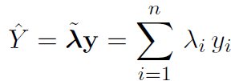
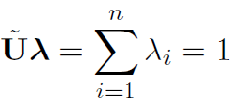
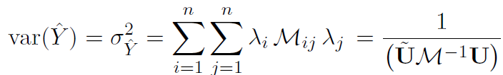
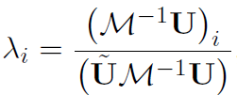
BLUE primer
Simple case [Lyons] : measurements y_{i} of a single observable Y
  A linear estimator is unbiased if
  [where U is a vector of all 1’s, i.e. contraction by U means summing all indexes]
  The square of the error on the combined estimate Ŷ is
  [where M is the (NxN) input covariance of the N measurements]
  NB Assume Gaussian pdf with M known a priori and independent of unknown parameter
  The best linear unbiased estimate is given by
  (i.e. the error is minimized for)
  The coefficients λ_{i} in the BLUE linear combination can be negative
  [a.k.a. “weights” in the BLUE weighted average]
  The combined error on the BLUE is equal to:

Slide 7
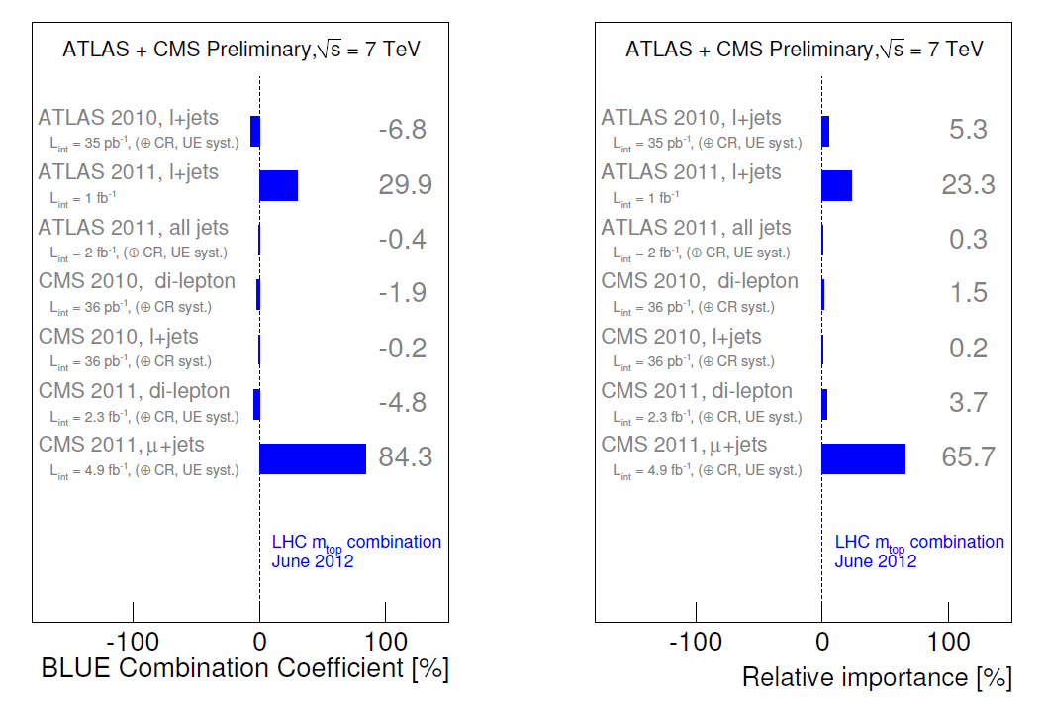

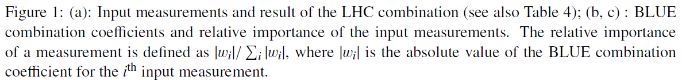
Negative weights (and absolute weights) @LHC
http://cdsweb.cern.ch/record/1460097

Slide 8
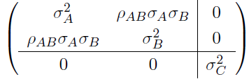

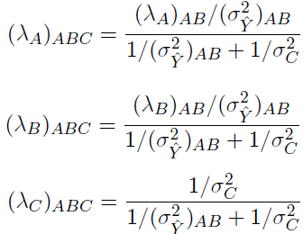

The problem with absolute values
Take A, B, C, with C uncorrelated to A or B:
Combining (A,B,C) in one go gives the same result for the combined error and for the linear coefficient of C as first combining (A,B) and then adding C:
The “relative importance” (RI) of C based on absolute values in combining (A,B,C) in one go is
It can easily be shown that there are two problems with this definition if λ_{B}<0 (which happens if ρ_{AB}>σ_{A}/σ_{B} with σ_{A}<σ_{B} – see later in this talk):
  first, RI of C is different if C is combined with A and B separately(lower) or if it is combined with the combination of A and B (higher)
  second, RI of C underestimates the contribution of C with respect to its more intuitive (and “correct”?) assessment
  the “information weight” we propose for C is exactly equal to

Slide 9

Fisher’s information primer
Given a pdf P(y,X) for the N measurements y_{i} and the n parameters X_{α}, the (nxn) information matrix I_{αβ} is defined as the covariance of ∂logP/∂X_{α}
Information has many nice properties [James]:
  Information is additive for independent measurements
  Information I_{αβ} is defined with respect to the set of parameters X_{α} to be estimated
  Information is related to precision: the greater the available information, the more precise the estimates can be – the inverse of the information matrix is a lower bound (Cramer-Rao) for the covariance of any estimates of the parameters X_{α}
  Information is positive semi-definite (for one observable it is a scalar ≥ 0)
Assuming P is multivariate Gaussian, the covariance of the BLUE estimates is equal to the inverse of the information matrix
  For a single observable (e.g. m_{top}), information is the inverse of the combined variance
For all practical purposes, in the following, “information” about one parameter is just a synonym for the inverse of its variance
  WE WILL ALWAYS BE TALKING ABOUT A SINGLE OBSERVABLE IN WHAT FOLLOWS

Slide 10


Our proposal: Information Weights
It is not only individual measurements, but also their correlation, that contribute to the information available in a combination
  The information contributed by correlations comes from the collective interplay of the measurements and cannot (in general) be attributed to any of them individually
  We propose to distinguish between the information weights from the measurements and the information weight from the ensemble of correlations
Our definition of Information Weights (IW)
  Information weight for each measurement (always > 0):
    In the absence of any correlations, this coincides with the BLUE linear coefficient λ
    Also true if one measurement is uncorrelated (e.g. C in previous A,B,C example)
  Information weight for the correlations is all the rest (may be <0):
    In the absence of any correlations, this is equal to 0
  For N measurements of 1 observable: # information weights are N (measurements) plus 1 (correlations)
One issue: not easy/obvious how to subdivide the correlation weight
  e.g. split up contributions by error source and/or by pair of measurements?
  the interplay of correlations cannot be neglected, their effect is largely a collective one
  will come back to this only at the very end

Slide 11
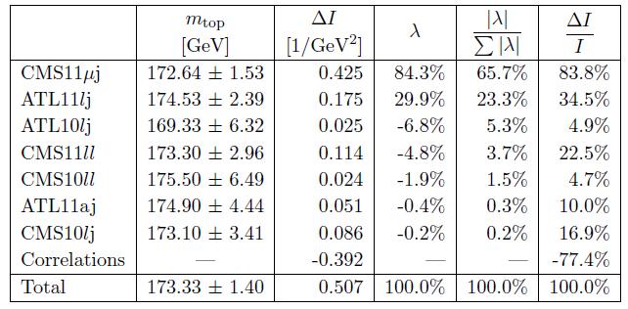
A practical example (more later): LHC m_{top}
The real challenge (and the interesting part) is splitting up the correlation contribution and understanding where it comes from!

Slide 12
Part II : negative BLUE coefficients
“Low-correlation” and “High-correlation” regimes
  The simple case of two measurements of one observable [Lyons]
    Dependencies of BLUE coefficients and combined error and IW as the correlation varies
    One linear coefficient λ goes to 0 and flips sign where the combined error is minimum
    Interpretation of information in the two regimes λ>0 and λ<0
  Generalization to the case of N measurements of one observable
    Information inflow – adding the N^{th} measurement with its N-1 correlations
    Information derivatives – analyzing Nx(N-1)/2 correlations independently
    Low-correlation regime (all λ>0) and high-correlation regime (one or more λ<0)
WE WILL ONLY DISCUSS POSITIVE CORRELATIONS IN THE FOLLOWING

Slide 13
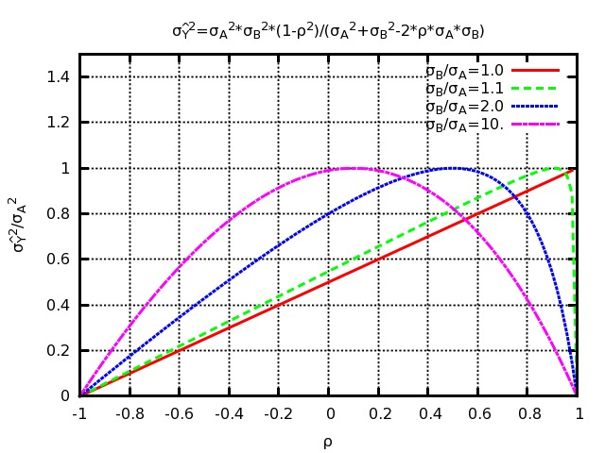

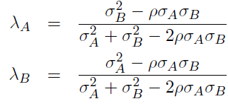
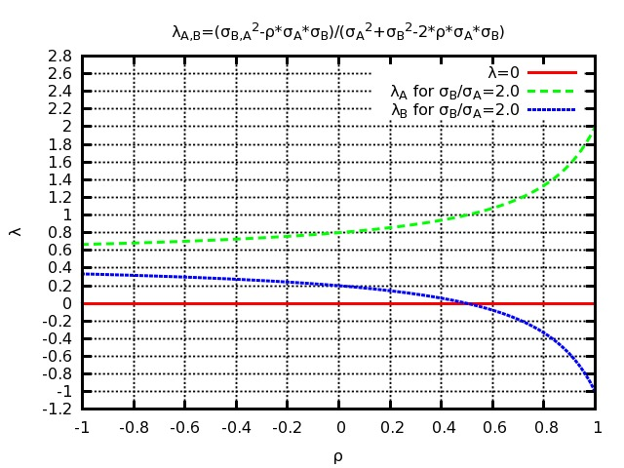

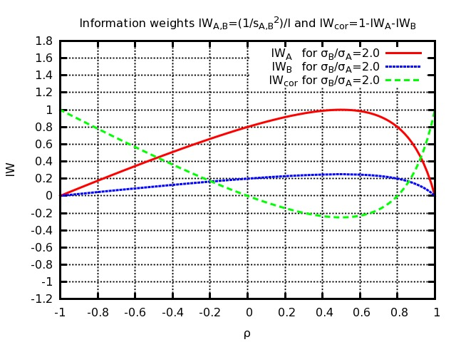
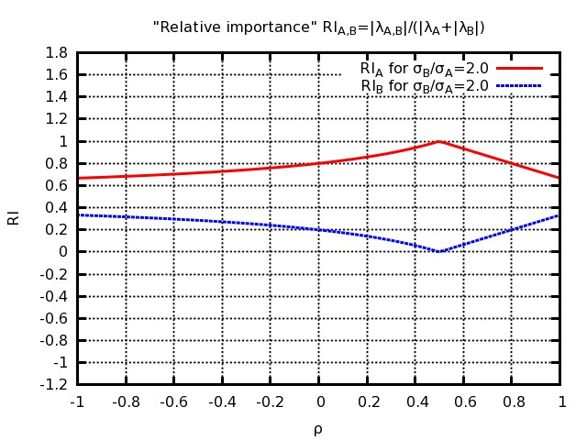
2 measurements of 1 observable
BLUE error
For two measurements A and B with errors σ_{A}< σ_{B} and correlation ρ [Lyons et al] :
Varying ρ, the combined error is maximum (equal to σ_{A}) for ρ=σ_{A}/σ_{B}, where λ_{B} flips sign
  Low correlation region – ρ<σ_{A}/σ_{B}
    Both λ_{A} and λ_{B} are > 0
    Info decreases (error increases) as ρ increases
  High correlation region – ρ>σ_{A}/σ_{B}
    One coefficient λ_{B} is < 0
    Info increases (error decreases) as ρ increases
  Boundary (most conservative corr.) – ρ=σ_{A}/σ_{B}
    One coefficient λ_{B} is = 0
    Error is maximum = σ_{A} (marginal info from B is 0)
Three information weights (A, B, correlation)
  Sum is equal to 1 by construction
  IW from ρ is minimum (largest negative) for λ_{B}=0
σ_{B}/σ_{A}=2
BLUE coefficients
σ_{B}/σ_{A}=2
Information Weight IW
LOW
CORR
HIGH
CORR
σ_{B}/σ_{A}=2
AV, RC – 13
Relative Importance RI=|λ|/Σ|λ|

Slide 14
Two measurements – interpretation
Low correlation regime, λ_{B}>0 (i.e. σ_{A}² - ρσ_{A}σ_{B} > 0)
  The covariance can be seen as the sum of a common error and an uncorrelated error
  You can combine based on the uncorrelated error (compute statistical weights from basic error propagation) and add the common error only at the end
    Remember: this happens if the off-diagonal covariance ρσ_{A}σ_{B} is smaller than the smaller of the two variances σ_{A}² (this will be used later in our “onionization” prescription proposal)
  Adding the less precise measurement B to the combination brings in additional information because B contributes independent (uncorrelated) knowledge about the unknown parameter
High correlation regime, λ_{B}<0 (i.e. σ_{A}² - ρσ_{A}σ_{B} < 0)
  The covariance can NOT be seen as the sum of a common error and an uncorrelated error
  Adding the less precise measurement B to the combination brings in additional information because B helps to constrain a correlated error on A to which it has a different sensitivity
    ρ may be overestimated or this may be perfectly legitimate: you may leverage on the different sensitivity of two measurements to a common background or a common MC parameter to reduce the uncertainty on them
    The additional information only comes from the interplay of B with A – neither can claim it as their exclusive merit
Boundary is λ_{B}=0 – where B brings no additional information
  Adding the less precise measurement B to the combination brings in NO additional information because its error has a part common with A plus an additional “uncorrelated” component
>0 (positive definite matrix)

Slide 15




Generalization to N measurements
(REMINDER: WE WILL ONLY DISCUSS POSITIVE CORRELATIONS IN THE FOLLOWING)
The previous discussion can be generalized from 2 to N measurements
  Fixing the variances on the measurements and varying only the correlations between them, any BLUE combination can fall in one of two regimes:
    EITHER Increasing any correlation decreases information and increases the combined error
    (“low” correlation regime because it includes the case where correlations are all 0)
    OR Increasing some correlations increases information and decreases the combined error
    (“high” correlation regime because you must increase a correlation beyond a threshold to enter it)
It can be shown that these regimes are defined by the BLUE coefficients:
  Low correlations (info decreases if any correlation increases) ↔ All BLUE coefficients are ≥0
  High correlations (info increases if a correlation increases) ↔ Some BLUE coefficients are <0
  In other words: if any BLUE coefficients are <0, it is because some correlations are high
Marginal info from N^{th} measurement: fix all variances, vary N-1 correlations ‘c’
General case: fix variances, vary Nx(N-1)/2 correlations and use derivatives
  Information is minimum when some coefficients are 0
  If it is impossible to properly estimate correlations, the most
  “conservative” option is to exclude some measurements…

Slide 16
Summary of part II
If any BLUE coefficients are <0, it is because some correlations are high
  The BLUE combination is in a “high correlation” regime
The contribution to information from measurements with BLUE coefficients <0 comes only from their interplay with other measurements through correlations
  They help constrain systematic uncertainties on other measurements
If any BLUE coefficients are <0, the total BLUE error is smaller than that which would be obtained if some correlations were smaller
  Are correlations really as high or are they being overestimated?
IF any BLUE coefficients are <0
AND IF correlations were “conservatively” estimated to be 100%,
THEN correlation estimates should be reassessed
  See part III for a few tools and suggestions

Slide 17
Part III :
“conservative” estimates of correlations
PRELIMINARY!
WORK IN PROGRESS!
The risks in overestimating correlations and a few hints to try and avoid this – with practical examples from m_{top} @ LHC
  “100%” is not conservative when statistical errors are low
  Using information derivatives to identify the most relevant correlations
  Minimization and “onionization” procedures
  Splitting up the correlation contribution to information using marginal inflow
  Practical recommendations
WE WILL ONLY DISCUSS POSITIVE CORRELATIONS IN THE FOLLOWING

Slide 18
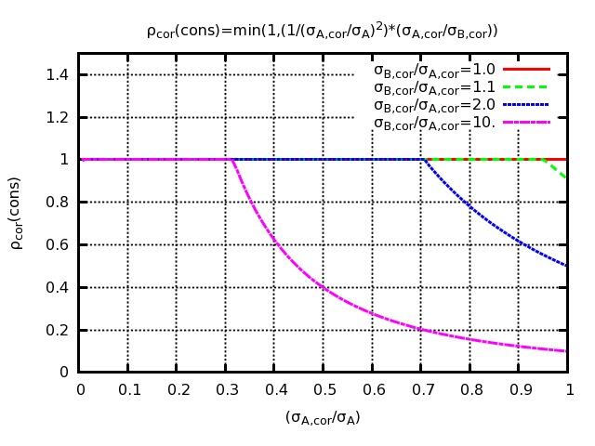


Is ρ=100% “conservative”?
Two measurements AB, each with a statistical and a systematic error
  Statistical errors are uncorrelated, systematic errors are correlated with a correlation ρ_{cor}
If ρ_{cor} is unknown, we want to look for the most “conservative” of ρ_{cor} i.e. that which makes the combined BLUE error as large as possible
  The most conservative ρ_{cor} is that which makes the total correlation ρ as large as possible, as long as ρ remains in the “region low-correlation”ρ<σ_{A}/σ_{B} (assuming σ_{A}<σ_{B})
  If measurements are statistically dominated, the most conservative ρ_{cor} is 100%
  But the most conservative ρ_{cor} is < 100% if systematic errors are not negligible
With N measurements, finding the most conservative correlations is not as easy!
SYS
NEGLIGIBLE
σ_{Bcor}/σ_{Acor}=10
SYST NOT
NEGLIGIBLE
σ_{Bcor}/σ_{Acor}=10
Most conservative ρ_{cor}

Slide 19



Prioritizing correlations to review
So, I think I overestimated my correlations: and now, where do I start?
  1 - Which correlations should I consider reassessing first?
Use information derivatives to analyze which correlations (between which 2 measurements and for which error sources) have the largest effect
  Rescale the nominal covariance using a different rescaling factor (between 0 and 1 – do not increase correlations or flip their sign) for each off-diagonal element and error source
  Will show in the following the derivatives (at nominal correlations) with respect to these scale factors
  Will normalize derivatives to total information at nominal correlations to make them a-dimensional
For the top measurement at LHC there would be 21x16 derivatives
  21 combinations (of 7 measurements) and 16 correlated error sources
  They should be studied individually, but in the following will show them summed by off-diagonal element (21) and by error source (16); the grand-total is always the derivative by a global scale factor

Slide 20
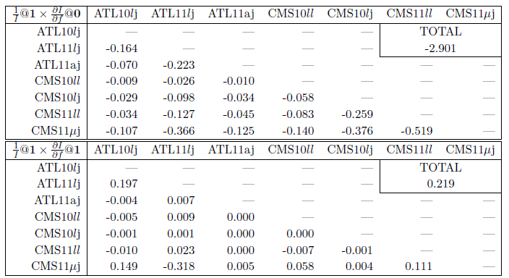

LHC m_{top} information derivatives
1st line: derivatives (all <0 !) at 0 correlations
2nd line: derivatives (most >0 !) at nominal correlations
Both normalized by info at nominal correlations
PRELIMINARY!
WORK IN PROGRESS!
The first correlations that should be reviewed (if needed) are:
  Those between ATL10lj/ATL11lj, ATL10lj/CMS11mj, CMS11mj/CMS11ll
  Those for the bJES, dJES and RAD error sources
Next slides: look at dJES and bJES for ATL10lj/ATL11lj and CMS11mj/CMS11ll

Slide 21
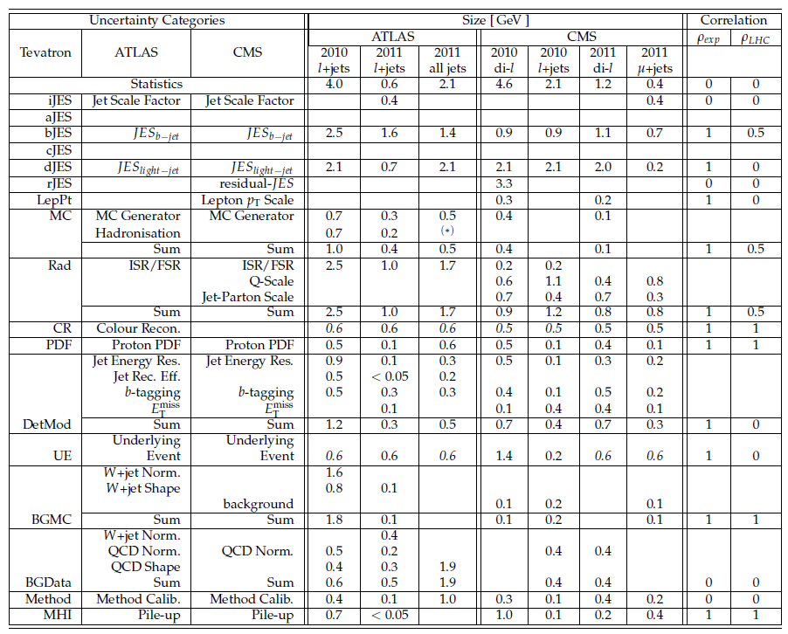
LHC m_{top} systematics
Example:
- bJES and dJES are 100% correlated between ATL11lj and ATL10lj, or CMS11mj and CMS11ll, but have very different variances in the 2 measurements in each exp.
- The larger sensitivities of ATL10lj and CMS11ll to bJES and dJES with respect to ATL11lj and CMS11mj makes the former (overall less precise) measurements contribute information and reduce the combined error by constraining the dJES and bJES systematics in the latter (overall more precise) measurements
http://cdsweb.cern.ch/record/1460097

Slide 22
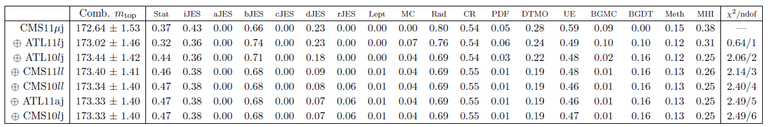
LHC m_{top} marginal combinations
The large effect of bJES and dJES correlations can also be seen by adding measurements one by one (order by decreasing λ>0 and then decreasing |λ|)
  The first 2 measurements (λ>0) bring uncorrelated information (reduce statistical errors)
  The next 2 (λ<0) reduce common systematics because of high correlations
    The third measurement (λ = -7%) has a small effect on the combined error, but it reduces systematics (bJES, dJES, RAD…) and pushes the statistical error much higher! It also shifts the central value significantly. Is this reasonable or are correlations overestimated?
  The last 3 (λ<0, |λ|<2%) have virtually no effect on the combination
Note that (in general) all measurements contribute to χ² even if λ≤0
  It is not true that a measurement with λ=0 is effectively ignored
  Why does χ² not change here for a growing number of degrees of freedom?
PRELIMINARY!
WORK IN PROGRESS!

Slide 23
Making correlations more conservative?
So, I think I overestimated my correlations: and now, where do I start?
  2 – Is there a way to (blindly) make correlations more conservative?
We tested four procedures to reduce the nominal correlations
  Minimize information by varying one scale factor per error source (16 for m_{top})
  Minimize information by varying one scale factor per measurement pair (21 for m_{top})
    This may lead into non-physical space (non positive definite covariances) – give up in that case
  Minimize information by varying one global scale factor (1 for m_{top})
  “Onionize” covariance matrices as described in the next slide
But carefully measuring correlations is much better than any rule of thumb!

Slide 24
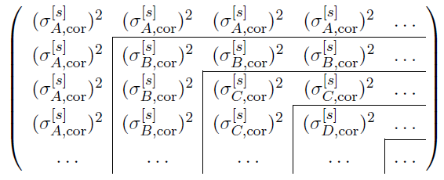

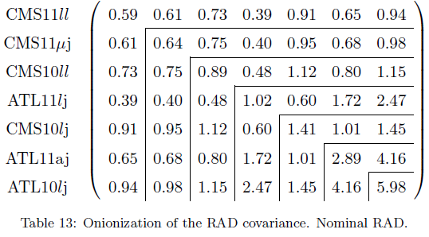
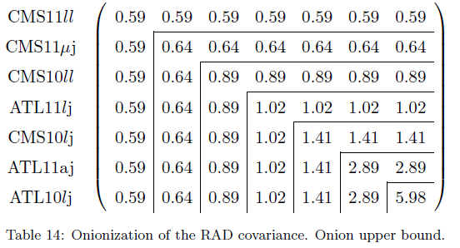
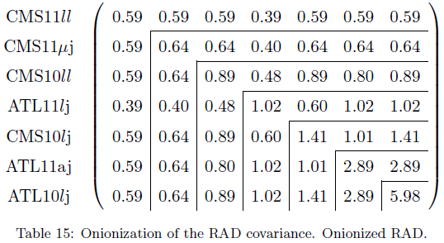
The “onionization” prescription
Generalize to N measurements an observation made for two: keep each off-diagonal covariance ρ_{ij}σ_{i}σ_{j} smaller than both variances σ_{i}² and σ_{j}²
  We do this for each error source of uncertainty [s]
  This may lead to underestimated ρ and is not even enough to ensure “conservativeness”
    But it may help avoid strange effects with highly correlated errors of very different sizes
Example: covariance for the RAD uncertainty
  e.g. reduce the covariance for ATL10lj and ATL11lj (very different variances: 2.5 and 1.0)
PRELIMINARY!
WORK IN PROGRESS!
OLD
MAX
NEW!

Slide 25
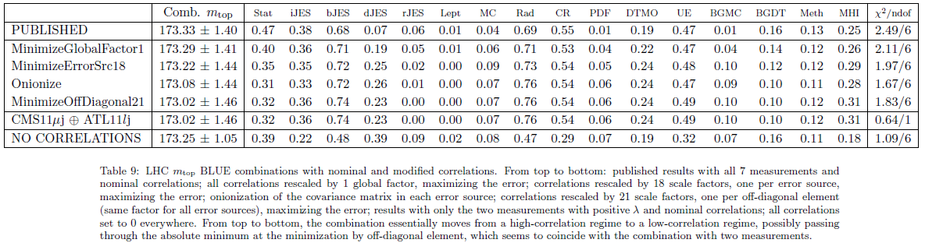
LHC m_{top} – conservative correlations?
JUNE 2012 TOP WG
Largest combined error (most “conservative” result) is found by minimizing information when rescaling correlations independently for the 21 pairs
  Result is identical (but for the χ²) with the combination of CMS11μj and ATL11jl alone
  Checked that 20 information derivatives are 0 (for all covariances but that of CMS11μj and ATL11jl)
  Two BLUE coefficients for CMS11μj and ATL11jl are > 0; five others are 0 (remember dI/dM_{ij} ~ -λ_{i}λ_{j})
  The most conservative option consists in not using the results with λ<0!
Some negative BLUE coefficients remain for the other two minimizations and (fewer) for the onionization procedure
All of these procedures change the sys/stat balance, not only the total error!
  Nominal correlations: lower total error and systematics, higher statistical error
  Modified correlations: higher total error and systematics, lower statistical error
PRELIMINARY!
WORK IN PROGRESS!

Slide 26
Recommendations?
Assume you have chosen your best estimate of correlations (“nominal”)
If all λ>0 at “nominal” correlations, you are in a low-correlation regime
  Even if correlations are high, their estimates are “conservative” enough: they do not increase the available information, they decrease it – nothing to worry about! ☺
If some λ are negative, you are in a high-correlation regime
  You should be aware that these high correlations are adding information!
    Effectively, the measurements with λ <0 are only adding information through these correlations
  We advise that all correlations should then be reviewed on a case by case basis
    There are legitimate cases where high correlations exist and may help you constrain common systematics (e.g. you varied same MC parameter or depend on a common E_{beam} measurement)
    But if you “conservatively” estimated correlations to be 100%, then you are definitely wrong!
      If correlations are overestimated, you are certainly underestimating the combined systematics, even more than you are underestimating the total combined error – and your central values are shifted, too
What can you do to provide a more realistic (or “conservative”) estimate?
  Prioritize the correlations to analyze, using information derivatives
    Then measure these correlations with your data and MC if this is possible
  For correlations you cannot measure precisely, consider some of the tools we presented
    You may try to minimize information in those correlations alone, or try the onionization procedure (if σ_{S} for A and B is correlated, and σ_{S,B} > σ_{S,A}, strip out σ²_{S’,B} = σ²_{S,B}-σ²_{S,A} as uncorrelated)
  If you have no clue, omitting the measurements with λ <0 is the most conservative option

Slide 27
Summary:
“relative importance” revisited and conclusions

Slide 28

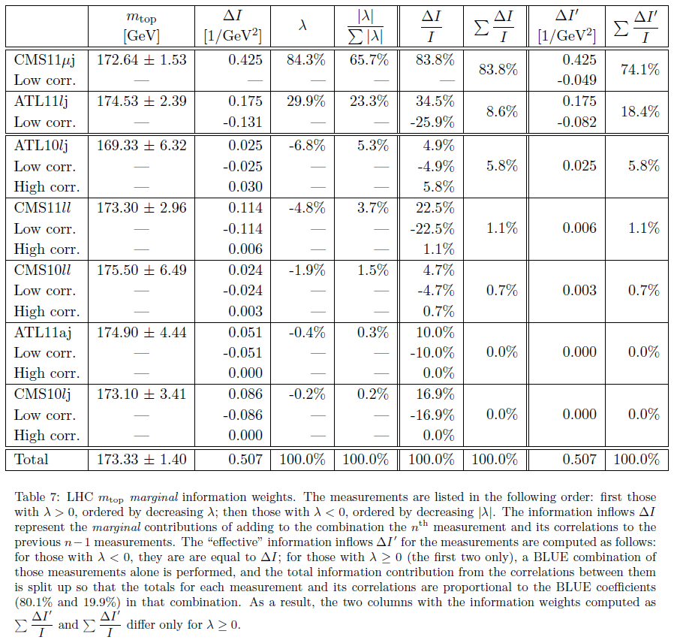

LHC m_{top} marginal information weights
I_{tot}=0.507
Split #1
Split low and high correlations by rescaling c as
For adding ATL10lj, this factor is 0.543
Split #0
“Split #0”: information weights (IW) from Part I of this talk
  One IW per measurement and one for all correlations together
“Split #1”: one possible way to split up IW for correlations
  Split it up completely amongst all measurements
  Use “marginal information inflow”
    This requires a ranking by BLUE coefficient
    Two measurements contribute 0.0% information if they are added last
More complex ways to split this up may be more satisfactory
  It would be nice to treat differently negative/positive information contributions in low/high correlation regimes
PRELIMINARY!
WORK IN PROGRESS!

Slide 29
Conclusions
We propose to use information contributions (instead of absolute BLUE coefficients) to assess the “relative importance” of measurements
  One contribution to information comes from the correlations between the measurements and cannot generally be attributed to any one of them individually
  Marginal information inflow is a possible alternative but implies a ranking
Negative BLUE coefficients indicate a “high correlation” regime
  It is crucial to properly assess correlations in this regime: overestimated correlations may lead to largely underestimated combined systematics
We propose a few tools to help a critical review of correlation estimates
  Derivatives of information may help to prioritize the most sensitive correlations
  Information minimization and covariance onionization may help be more conservative
  Understanding the marginal inflow of information from the addition of one measurement to the combination may help decide what to do with it
  Of course the ideal solution is to measure correlations in the data and MC
  High correlations have a large effect on the combination:
  as much effort should go into properly estimating correlations than individual errors

Slide 30
Some useful references
A. C. Aitken, On Least Squares and Linear Combinations of Observations, Proc. Roy. Soc. Edinburgh 55 (1935), 42
  The first published description of the BLUE technique (AFAIK)
L. Lyons, D. Gibaut, P. Clifford, How to combine correlated estimates of a single physical quantity, Nucl. Instr. Meth. A270 (1988) 110
  Extensive discussion of correlations and negative weights for two measurements of a single observable! A very useful read! ☺
A. Valassi, Combining correlated measurements of several different physical quantities, Nucl. Instr. Meth. A500 (2003) 391
  Generalization of Lyons formulas and computation of individual error contributions for many observables (e.g. LEPEWWG)
F. James, Statistical Methods in Experimental Physics (2nd Edition), World Scientific (2006)
  A very useful textbook covering information and estimation
A. van den Bos, Parameter Estimation for Scientists and Engineers, Wiley-Interscience (2007)
  Another very useful textbook covering information and estimation

Slide 31
RESERVE SLIDES

Slide 32
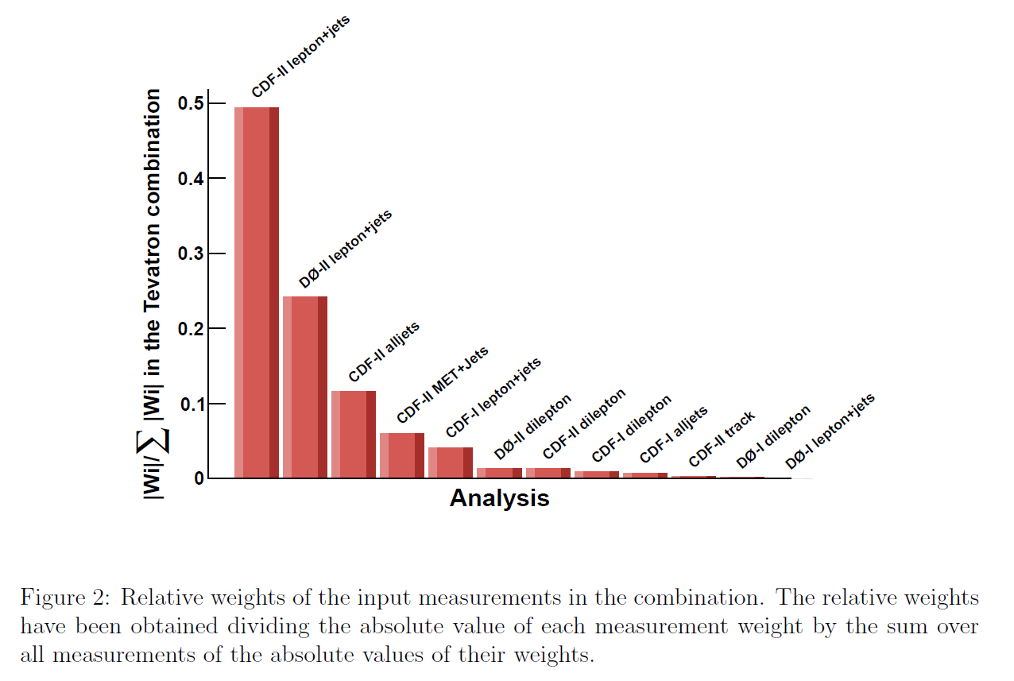
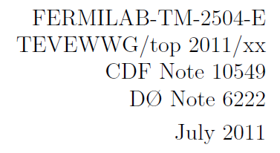
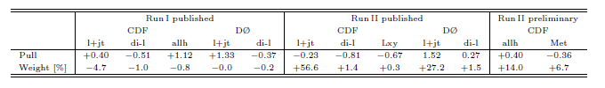
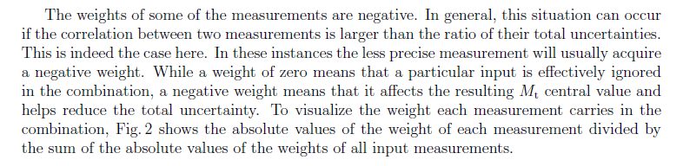
Negative weights (and absolute weights) @Tevatron
http://arxiv.org/pdf/1107.5255.pdf

Slide 33
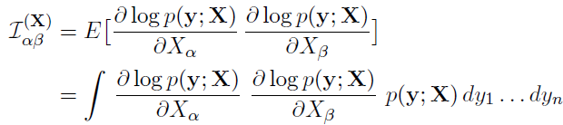




Information
General definition for many observables
For multivariate Gaussians (as in BLUE assumption) everything becomes much easier
Information becomes
related to the BLUE covariance
by
i.e. BLUE is efficient (satisfies the Cramer Rao lower bound)

Slide 34
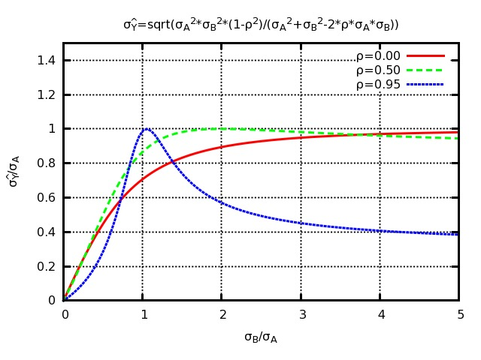
What if correlations are fixed a priori?
Fixing σ_{A} and ρ and varying σ_{B}, the result is somewhat surprising, but completely in line with the previous comments:
Once in the high-correlation regime (σ_{B}>σ_{A}/ρ), the higher is σ_{B}, the higher the total information and the lower the combined error!
  The better you measure B (as long as σ_{B}>σ_{A}/ρ), the worse the combination!
  The derivative of total information with respect to (1/σ_{B})² is negative – it is actually λ_{B}!

Slide 35
Integrals
We also considered using integrals of the dI/df information derivatives to split up the information weight of correlations
  The differential of I for a step in the multi dimensional space of rescaling factors can be easily written as the sum of contributions from each off-diagonal element in each error source, individually
  Integrate this by defining a “path” to transform 0 correlations (all scale factors = 0) to nominal correlations (all scale factors = 1)
  Use two segments of straight lines, from 0 to a minimum (e.g. minimum by off-diagonal element) and then up to nominal values, to further split up two separate contributions in the low-correlation and high-correlation regimes
Some interesting results but in the end why bother?
  Derivatives alone provide useful tool to prioritize correlations to re-analyze
  Marginal information analysis seems to be a more natural and better fit to split up “contributions to knowledge” if really needed
    series converges quite fast in high-correlation regime because we start from minimum (only λ>0) and we then add measurements in a carefully chosen order

Slide 36
λ=0 – information vs. χ²
A measurement with a zero weight λ_{i}=0 in a BLUE combination does not contribute any information…
  i.e. it does not reduce the variance of the combined estimate
… but note that it does contribute to the χ² calculation
  the χ² is essentially a weighted sum of the products of the differences to the estimate, with weights (M⁻¹)_{ij} given by the inverse of the covariance matrix
  the three sets of “weights”, BLUE coefficients, information weights and χ² weights are all equal to 1/σ_{i}² if there are no correlations
Useful to assess if correlations are correctly estimated
  similarly, measurements with λ_{i}<0 also contribute to the χ²

Slide 37
The problem with absolute values
Take A, B, C, with C uncorrelated to A or B:
Combining A, B, C gives the same result
as first combining A,B and then adding C:
Intuitively, the relative contribution of C is its “information weight”
while the “relative importance” based on absolute values is
Two issues if ρ_{AB}>σ_{A}/σ_{B} : first, RI underestimates the contribution of C;
second, RI gives different results for (A,B,C) and for (AB,C)!
=1
>1

Slide 38
Two measurements of 1 observable
For two measurements A, B with errors σ_{A}< σ_{B} and correlation ρ:
The effect of correlations was extensively discussed by Lyons et al.
  Fixing σ_{A} and σ_{B} and varying ρ, the combined error has a maximum (equal to σ_{A}) for ρ=σ_{A}/σ_{B}, which is where λ_{B} flips sign from >0 to <0
For σ_{B}/σ_{A}=2, ρ<0.5 is a
low-correlation regime
where all λ>0
BLUE error
BLUE coefficients
For σ_{B}/σ_{A}=2, ρ>0.5 is a
high-correlation regime
where λ_{B}<0

Slide 39
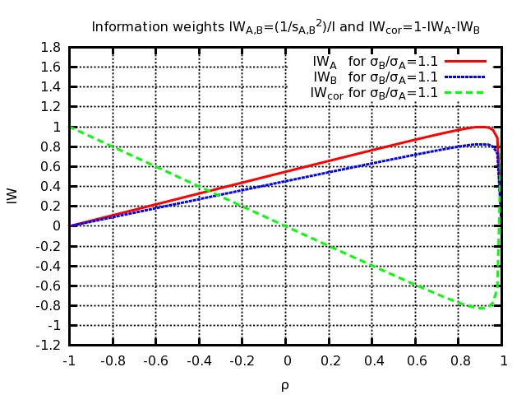
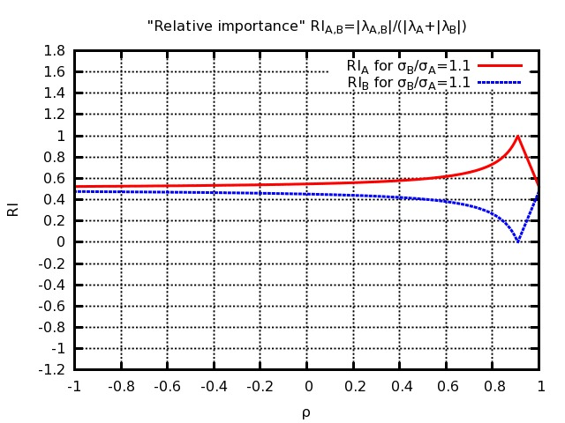
IW’s in two measurements of 1 observable
By construction the sum of all information weights (N meas. + 1 correlation) is = 1
σ_{B}/σ_{A}=2
IW
|λ|/Σ|λ|
ρ=σ_{A}/σ_{B}=0.50
σ_{B}/σ_{A}=1.1
IW
|λ|/Σ|λ|
ρ=σ_{A}/σ_{B}=0.91
Most “conservative” correlation: largest combined error,
minimum (largest negative) information weight from correlations

Slide 40
Two measurements – interpretation
Low correlation regime, λ_{B}>0 (i.e. σ_{A}² - ρσ_{A}σ_{B} > 0)
  The covariance can be seen as the sum of a common error and an uncorrelated error
  You can combine based on the uncorrelated error (compute statistical weights from basic error propagation) and add the common error only at the end
    Remember: this happens if the off-diagonal covariance ρσ_{A}σ_{B} is smaller than the smaller of the two variances σ_{A}² (this will be used later in our “onionization” prescription proposal)
  Adding the less precise measurement B to the combination brings in additional information because B contributes independent (uncorrelated) knowledge about the unknown parameter
High correlation regime, λ_{B}<0 (i.e. σ_{A}² - ρσ_{A}σ_{B} < 0)
  The covariance can NOT be seen as the sum of a common error and an uncorrelated error
    Subtracting a common error matrix ρσ_{A}σ_{B} from the covariance would give a non-positive-definite matrix
    The covariance can instead be seen as the sum of a common error and of a 100% positively correlated effect
  Adding the less precise measurement B to the combination brings in additional information because B helps to constrain a correlated error on A to which it has a different sensitivity
    There are cases where this is perfectly legitimate: you may leverage on the different sensitivity of two measurements to a common background or a common MC parameter to reduce the uncertainty on them
    But this may effectively (and incorrectly) happen also if correlations are being overestimated
Boundary is λ_{B}=0 – where B brings no additional information
  Adding the less precise measurement B to the combination brings in NO additional information because its error has a part common with A plus an additional “uncorrelated” component
>0 (positive definite matrix)

Slide 41

Two measurements – interpretation
Low correlation regime, λ_{B}>0 (i.e. σ_{A}² - ρσ_{A}σ_{B} > 0)
  The covariance can be seen as the sum of a common error and an uncorrelated error
  You can combine based on the uncorrelated error (compute statistical weights from basic error propagation) and add the common error only at the end
    Remember: this happens if the off-diagonal covariance ρσ_{A}σ_{B} is smaller than the smaller of the two variances σ_{A}² (this will be used later in our “onionization” prescription proposal)
  Adding the less precise measurement B to the combination brings in additional information because B contributes independent (uncorrelated) knowledge about the unknown parameter
High correlation regime, λ_{B}<0 (i.e. σ_{A}² - ρσ_{A}σ_{B} < 0)
  The covariance can NOT be seen as the sum of a common error and an uncorrelated error
    Subtracting a common error matrix ρσ_{A}σ_{B} from the covariance would give a non-positive-definite matrix
  The covariance can be seen as the sum of a common error and of a 100% positively correlated effect
  Adding the less precise measurement B to the combination brings in additional information because B helps to constrain a correlated error on A to which it has a different sensitivity
Boundary is λ_{B}=0 – where B brings no additional information
  Adding the less precise measurement B to the combination brings in NO additional information because its error has a part common with A plus an additional “uncorrelated” component
≥0 (positive definite matrix)
>0

Slide 42


Marginal information inflow
How much info does the N^{th} measurement add to a combination with N-1?
  Call M the NxN covariance and D the (N-1)x(N-1) covariance
  Call c the (N-1) dimensional vector of covariances of the N^{th} measurement
  Call d the variance of the N^{th} measurement
  Define u as an (N-1) dimensional vector of 1’s – contraction by this vector is a sum on N-1 indices
The marginal information from the N^{th} measurement is always ≥ 0 [van den Bos]
  The information inflow ΔI from the N^{th} measurement is minimum for
  (i.e. the N^{th} measurement brings no marginal information)
  This is a hyperplane in the N-1 dimensional space of correlations of the N^{th} to all other measurements
But the BLUE coefficient for the N^{th} measurement is
  In other words, ΔI=0 implies λ_{N}=0 and viceversa!
The hyperplane λ_{N}=0 separates the space of correlations into two half-spaces:
  Low correlation regime (including c=0), where λ_{N}>0
    Here ΔI>0 because the N^{th} measurement adds independent (uncorrelated) information
  High correlation regime (not including c=0), where λ_{N}<0
    Here ΔI>0 because the high correlations of the N^{th} measurement help reduce common systematics
    Note that rescaling all covariances downwards by a common scale factor to would effectively reduce both λ_{N} and ΔI to 0

Slide 43
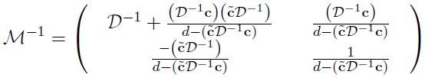

Information inflow
How much additional information does the n^{th} measurement add to the previous combination with only n-1?
The inverse of the covariance matrix
is
Defining ũ as a vector of 1’s, it can be shown [van den Bos] that the information contributed by the n^{th} measurement is
i.e. the inflow of information is always non-negative
  It is simply equal to 1/d (inverse of variance of n^{th} measurement) if all correlations are 0

Slide 44



Information inflow and correlations
The inflow ΔI is zero for
  This defines a hyperplane in the n-1 dimensional space of covariances c between the n^{th} and all other measurements
But means that
  In other words, ΔI=0 implies λ_{n}=0 and viceversa!
The hyperplane λ_{n}=0 (ΔI=0) separates the space of covariances c into two half-spaces:
  Low correlation regime (including c=0), where λ_{n}>0
    Here ΔI>0 because the n^{th} measurement adds independent information
  High correlation regime (not including c=0), where λ_{n}<0
    Here ΔI>0 because correlations help reduce common systematics!
  If one suspects that correlations are overestimated, rescaling downwards the covariance by effectively reduces both λ and ΔI to 0
This generalizes to n measurements the discussion of correlations for 2 measurements in the Lyons et al. paper
λ_{N}

Slide 45

Information sensitivity to ρ_{ij}
What is the effect on Fisher’s information (i.e. on the combined BLUE error) of a change in the correlation ρ_{ij} between two measurements y_{i} and y_{j}?
  Keep the N variances σ_{i} fixed and vary only the Nx(N-1)/2 correlations ρ_{ij}
  Using matrix derivatives [van den Bos], it is easy to show that the derivative of the information with respect to the correlation ρ_{ij} is
The Nx(N-1)/2 dimensional space of correlations is split into two regimes:
  Low correlation regime (including “ρ_{ij}=0 for all ij”), where all λ>0
    All derivatives are negative: increasing any correlation decreases the information
    (i.e. increasing any correlation increases the combined error – correlations “conservative”)
  High correlation regime (not including “ρ_{ij}=0 for all ij”), where some λ<0
    Some derivatives are positive: increasing those correlations increases the information
    (i.e. increasing those correlations decreases the combined error – correlations not “conservative”)
  The boundary between the two regimes is a hypersurface where some of the λ are = 0
    Information is locally minimized (derivatives are 0) with respect to some correlations
    We checked numerically in some examples (see next slides) that the global minimum of the information (the “most conservative choice of correlations”) requires that all λ are either > 0 or = 0: in other words, a conservative option consists in removing the measurements with λ<0

Slide 46





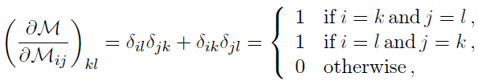
Information sensitivity to M_{ij}
Keeping in mind that [van den Bos] and , the
partial derivatives of information with respect to a vector v_{p} are:
Deriving with respect to the off-diagonal element M_{ij}=M_{ji} (i≠j) yields
because
This shows again that the n(n-1)/2 dimensional space of correlations is split into two regimes:
  Low correlation regime (including “M_{ij}=0 for all ij”), where all λ>0
    All derivatives are negative: increasing any correlation will decrease information
  High correlation regime (not including “M_{ij}=0 for all ij”), where some λ<0
    Some derivatives are positive: increasing those correlations increases information
  The boundary between the two regimes, where information is minimized as dI/dM=0 (“most conservative” correlations), requires that some λ=0
    In doubt, a conservative option consists in removing the measurements with λ<0

Slide 47


Is ρ=100% “conservative”?
Simple case of two measurements. We want:
Then:
Always true for statistically dominated
If systematic dominated, rho<1 only if:
ρ conservative
For N measurements (rather: unknown correlations) the procedure for finding the maximum error is much less defined

Slide 48





Derivatives w.r.t correlation re-scale factors
Can use derivatives to analyze which correlations (between which 2 measurements) and error sources have largest effect on information
  Rescale with
  using a different rescaling factor for each off-diagonal element and error source
  From you get that implies
In the following we will aggregate these derivatives (21x16 for m_{top}) to reduce complexity, by off-diagonal element (21 for m_{top})
and error source (16 for m_{top})
  Total is the derivative by a global scale factor
  We will normalize the derivatives to the total information at nominal correlations, so that the derivatives become a-dimensional numbers

Slide 49
Minimizations
We studied two procedures to modify the nominal covariance and reduce correlations (e.g. because they have been overestimated)
  Rescaling correlations as described before and minimizing information
  A procedure called “onionization” that we describe later on
We minimize information (i.e. maximize the error to be as “conservative” as possible) with respect to the three sets of rescaling factors described in a previous slide
  Vary one rescaling factor per error source (16 for m_{top})
    For a given error source, use the same factor for all off-diagonal elements (i.e. for the whole partial covariance for that error source)
  Vary one rescaling factor per off-diagonal element (21 for m_{top})
    For a given off-diagonal element, use the same factor for all error sources
    This may lead into non-physical space (non positive definite covariances) – give up in that case
  Vary one global rescaling factor (1 for m_{top})

Slide 50


The “onionization” prescription
How can we ensure that ? (*)
We considered:
But we prefer the “onionization”
of every source of uncertainty: remain ≤
i.e. :
However this may transform overestimates of ρ into underestimates
  It means assuming that the difference in sensitivity between measurements to a given systematic effect cannot be used to constrain or determine the actual size of that effect
    Which is generally wrong – there are legitimate cases for exploiting this leverage effect
  And with >2 measurements this condition (*) is not even enough to ensure λ>0 for each λ
Of course the only correct way forward is
  measure the correlations between measurements (from the data, the MC parameters…)
  if not possible, assess case by case whether 100% (or e.g. onionizing) is appropriate

Slide 51
Onionization example – RAD @ LHC m_{top}
PRELIMINARY!
WORK IN PROGRESS!

Slide 52
LHC m_{top} – conservative correlations?
Absolute minimum is most likely at “MinimizeOffDiagonal21”
  Checked that 20 information derivatives are 0 (for all covariances but that of CMS11μj and ATL11jl)
  Indeed (remember dI/dM_{ij} ~ -λ_{i}λ_{j} !) all 5 lambdas become 0 except for CMS11μj and ATL11jl
  Not surprisingly results coincide with the combination of CMS11μj and ATL11jl alone, but for the χ²
  A very conservative option consists in not using the results with λ<0!
Some negative BLUE coefficients remain for the other two minimizations and (less) for the onionization procedure
  Note again that all of these procedures change the sys/stat balance, not only the total error!
  Some of these procedures may also not be completely physical (covariances not positive definite?)
Carefully measuring correlations is much better than any rule of thumb!
PRELIMINARY!
WORK IN PROGRESS!

Slide 53
Recommendations?
Assume you have chosen your best estimate of correlations (“nominal”)
If all λ>0 at “nominal” correlations, you are in a low-correlation regime
  Even if correlations are high, their estimates are “conservative” enough: they do not increase the available information, they decrease it – nothing to worry about! ☺
If some λ are negative, you are in a high-correlation regime
  You should be aware that these high correlations are adding information!
    Effectively, the measurements with λ <0 are only adding information through these correlations
  We advise that all correlations should then be reviewed on a case by case basis
    There are legitimate cases where high correlations exist and may help you constrain common systematics (e.g. you varied same MC parameter or depend on a common E_{beam} measurement)
    But if you “conservatively” estimated correlations to be 100%, then you are definitely wrong!
      If correlations are overestimated, you are certainly underestimating the combined systematics, even more than you are underestimating the total combined error – and your central values are shifted, too
What can you do to provide a more realistic (or “conservative”) estimate?
  Prioritize the correlations to analyze, using information derivatives
    Then measure these correlations with your data and MC if this is possible
  For correlations you cannot measure precisely, consider some of the tools we presented
    You may try to minimize information in those correlations alone, or try the onionization procedure (if σ_{S} for A and B is correlated, and σ_{S,B} > σ_{S,A}, strip out σ²_{S’,B} = σ²_{S,B}-σ²_{S,A} as uncorrelated)
  If you have no clue, omitting the measurements with λ <0 is the most conservative option

Slide 54
LHC m_{top} marginal information weights
Split low and high correlations by rescaling c as
For adding ATL10lj, this factor is 0.543
These are two possible ways to split up the info contribution from the correlations, based on “marginal” contributions
Note that two measurements contribute 0.0% information
PRELIMINARY!
WORK IN PROGRESS!

