Slide 1
LCG+experiments with an adagio on data preservation
A.Boehlein, T. Mori, J-C Brient, C.Diaconu
June 13, 2013

Slide 2
Resources
“Flat budget” is fashionable
  Flatness with respect to what is more disputable
Pledges mechanism is not always fully transparent, there is a (non)safety margin of ~20%
  Scrutiny process to be improved (CRSG will work with WLCG MB towards a consolidated procedure to asses the needs)
Funding by (EU) projects may disrupt personnel continuity
  next H2020 not earlier tha one year
Opportunistic usage continues to occur, experiments better and better prepared to use ad-hoc environements

Slide 3
Resources 2013/2014/2015
CPU
Disk
Tape
Situation following April 2013 RRB – RSG report

Slide 4
+363 kHS06/yr
+34 PB/yr

Slide 5
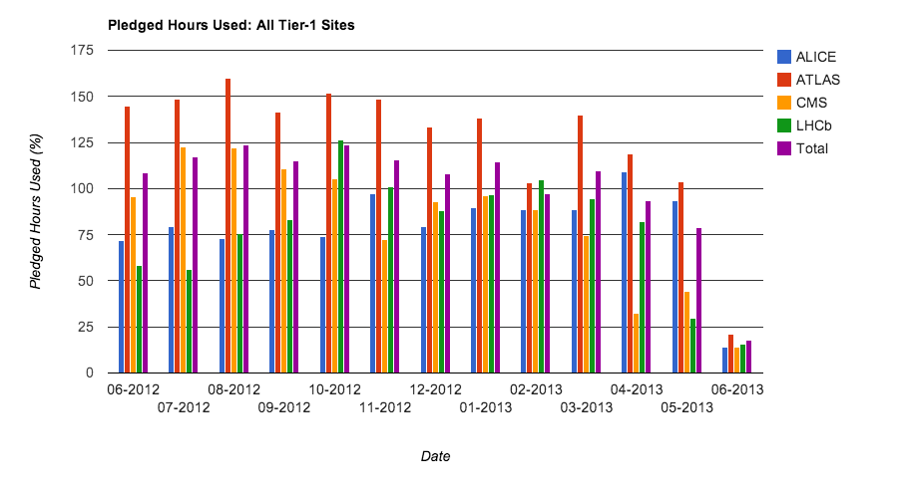
Activity
Eficient usage of ressources, no significant sign of slow down (except data processing activities, as expected)

Slide 6
CERN IT
CERN@Wigner installed
  5000 cores, few PB disk, 2x100 Gb/s
CERN-IT: EMI and EGI-Inspire ended, new organisation
  ES and GT merged, group size will decrease by 50% in the next year (Eudat, iMarine, HelixNebula)
  Three sections:
    Operations and Liaison
    Monitoring Infrastructure
    Information and Data

Slide 7
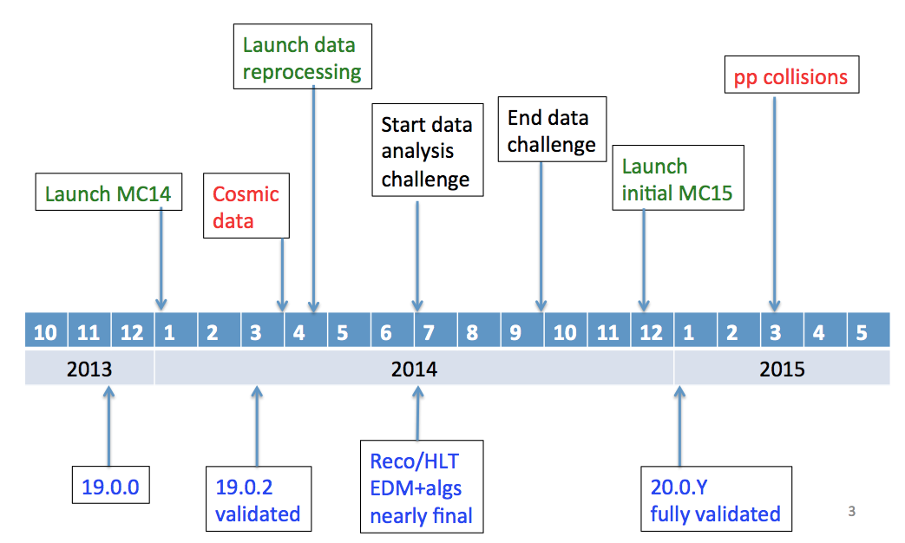
ATLAS
Plans for improvements approved

Slide 8
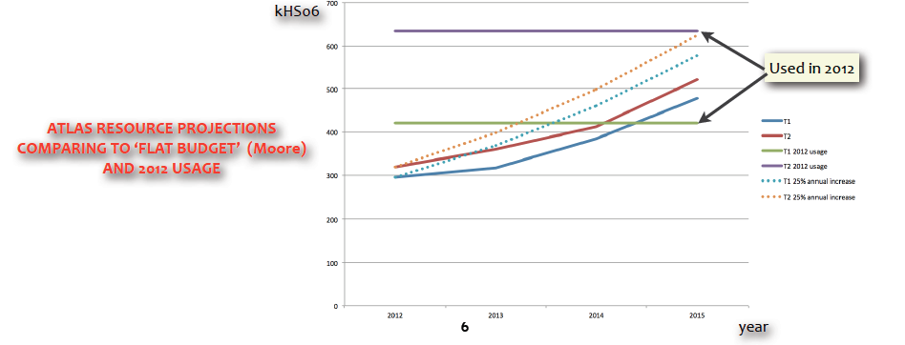
ATLAS: resources 2014/2015
To be or not to be “flat”
  Technological improvements are part of the “cash”

Slide 9
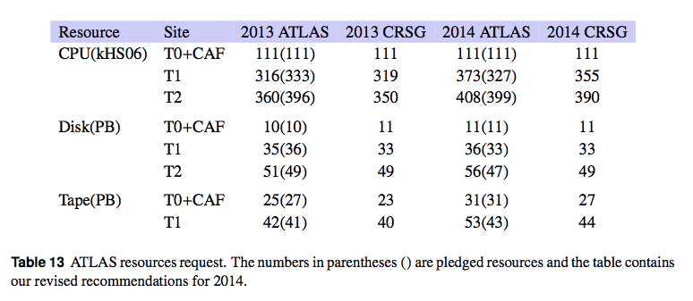
ATLAS:Resources and CRSG
CRSG recommendations
  aligned to pledges (different from the observed real usage figures)
  In particular the tape situation worries ATLAS: efforts to recover space in some T1s

Slide 10
ATLAS: opportunities and challenges
HLT commissioned, h/w to be installed then start
Opportunistic usage of “atypical” resource
  Google “pocket calculator” borrowed to ATLAS:
    4000 cores for 2 months (cloud-like environement)
Explore HPC-like resources as well
  Important source (traditional model)
  Challenges and costs should be (at some point) properly estimated

Slide 11
ALICE
Successful computing since the last meeting
  40kjobs routinely
  CPU efficiency up to 90-95% (former worry now stably solved)
Analysis 25% (12.5% in trains)
Repro proceeds according to the defined strategy
    pA (ongoing) then 2010/2011 data (pp and PbPb) – including MC – using 2012 calibration scheme

Slide 12
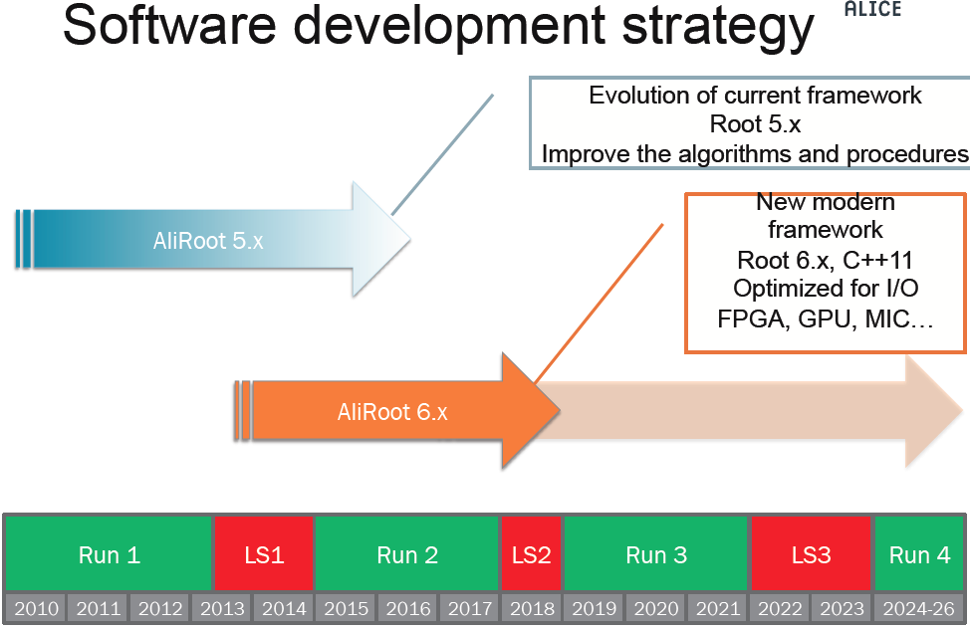
ALICE: plans for future

Slide 13
ALICE: Improvements
Targeted for Run3 (Computing TDR in October 2014)
  Will be incorporated in the existing framework if/when appropriate
Simulation: G3 => Geant 4
    Speed issues are being solved by close collaboration with G4 experts
    Plan to profit from further improvements in G4(multi-thread, GPUs etc)
Reconstruction: use TPC/HLT tracks as seeds
Analysis: reduce the turnover to 12 h, include most of the users
HLT farm: used for offline processing
    currently 2500 cores ( 108FPGA+ 64 GPGPU)
    Foresee a massive increase for RUN3 for online reconstruction
      20X reduction in event size

Slide 14
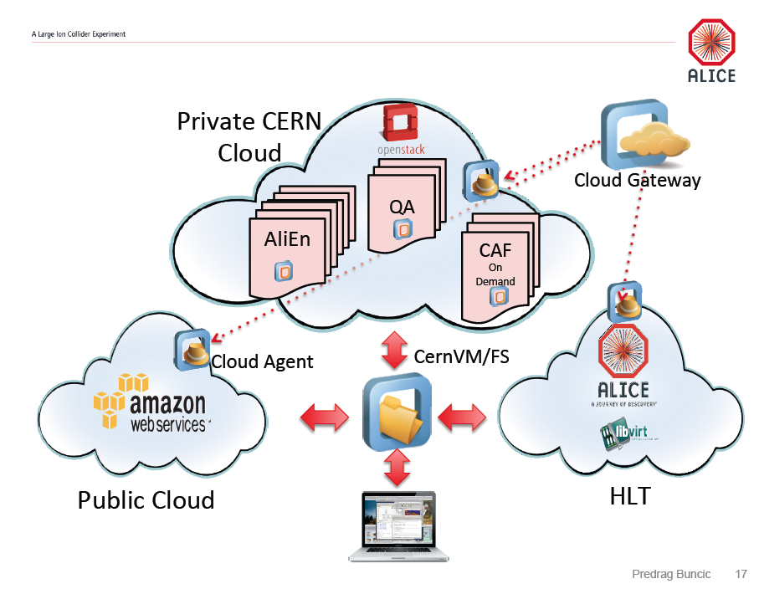
ALICE goes virtual
Use CERNVM family to enable various use-case (i.e./and/or resources)

Slide 15
CMS
Repro ended on T1’s, MC requests not yet ready
2015 preparation, LHE and upgrade studies will take significant resources and organisation in the second half of the year
Flexible usage of resources
  Move to CVMFS for s/w distribution, simplifies multiple platform usage and enable opportunistic computing
  Disk/tape separation (archive versus disk-only at T1s)
  Xrootd deployment ongoing
  Multi-core project: pilot system configured
  HLT comissioning is ongoing
  Data Management:
    work to develop common algorithms and frameworks within the effort from CMS and Operations Coordination
    Implies changements in T2 space management and in the security model (PhEDEx)
  Analysis framework: CRAB3 (with Panda back-end) preproduction in August
Data management schemes and (user) analysis workflows to be validate by mid 2014.

Slide 16
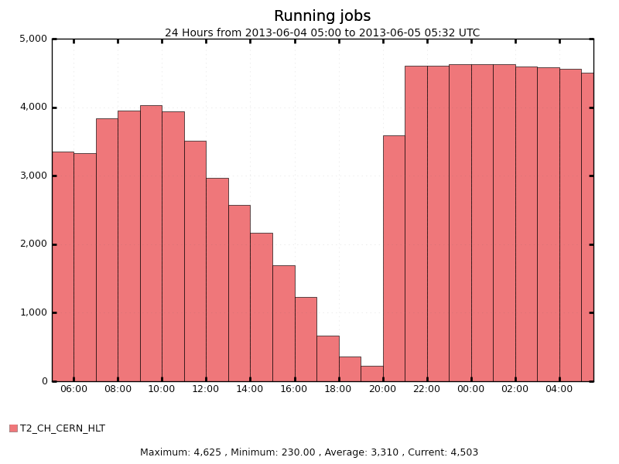
CMS: HLT comissioning
4000 jobs running, some stability issues to be solved

Slide 17
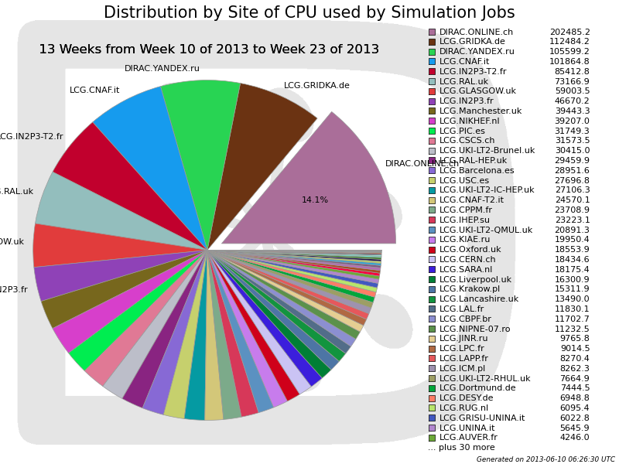
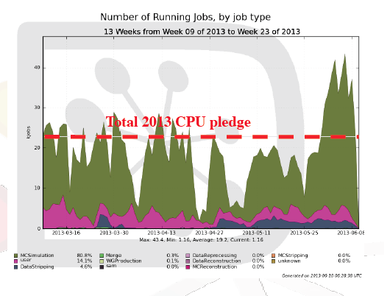
LHCb
Computing activities according to plans
  Incremental re-stripping of 2010+2011
  Processing and stripping of 2013 pA data
  Simulation for 2012 commissioned
HLT plays a significant role
HLT

Slide 18
LHCb: Disk and Tapes
Disk
  Deficit in disk in 2013 (11/15 PB)recovered due to delays
  Change in computing model:
    Allow disk (and analysis) at selected Tier2 (‘T2-D’)
    Goal is ~10 sites with >300TB per T2-D, but start with 100TB
Tapes
  Massive access (restripping 3.8 PB) problematic for some sites
  Some tapes lost, recovery procedures not fully defined

Slide 19
LHCb: software improvements
LS1 is window of opportunity for adopting latest software
  Must be in place by the early 2014, to allow validation and commissioning (in particular for HLT)
Several technical steps forward
  Compiler (gcc 48), support for C++11
  Adopt ROOT6
Internal computing reviews
  On distributed computing and new data model
  Person power is an issue

Slide 20
Data Preservation
DPHEP ICFA Study Group formed in 2009
  Major labs and collider experiments
LHC experiments joined in 2011
  Local/CERN-LHC task force on data preservation and access
  Contact persons/working groups in all experiments
DPHEP Blueprint published in mai 2012
October: CERN appoints a DPHEP Project Manager (Jamie Shiers)
Feb. 2013 ICFA Statement => DPHEP Collaboration

Slide 21
ICFA Statement – March 15, 2013
The International Committee for Future Accelerators (ICFA) supports the efforts of the Data Preservation in High Energy Physics (DPHEP) study group on long-term data preservation and welcomes its transition to an active international collaboration with a full-time project manager. It encourages laboratories, institutes and experiments to review the draft DPHEP Collaboration Agreement with a view to joining by mid- to late-2013.
ICFA notes the lack of effort available to pursue these activities in the short-term and the possible consequences on data preservation in the medium to long-term. We further note the opportunities in this area for international collaboration with other disciplines and encourage the DPHEP Collaboration to vigorously pursue its activities. In particular, the effort required to prepare project proposals must be prioritized, in addition to supporting on-going data preservation activities.
ICFA notes the important benefits of long-term data preservation to exploit the full scientific potential of the, often unique, datasets. This potential includes not only future scientific publications but also educational outreach purposes, and the Open Access policies emerging from the funding agencies.
  DPHEP Collaboration Implementation Board installed
  Collaboration agreement: first draft circulated, signature campaign will start soon

Slide 22
Data Preservation: LHC perspective
Long term perspectives should be taken into account early enough
  Some Data sets already “old” (2010, soon 2011)
Working/task groups in place in experiments
  Act within the existing activities
  Implement concepts and define policies
Projects emerge within new funding opportunities or as a part of upgrades/model improvements
  DPHEP-CERN H2020 Vision Document in work
Clear multi-disciplinary potential, to be exploited within the future collaboration

Slide 23
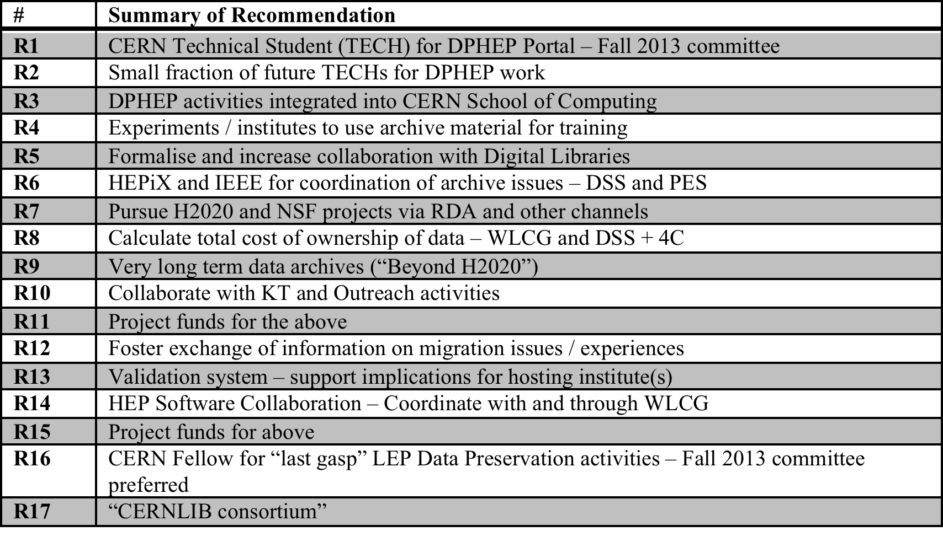
DPHEP-CERN Vision Document

Slide 24
Connections and opportunities
Mobilize resources through existing structures:
  Research Data Alliance:
    Funding / strong interest from EU, US, AU, others
    Part of roadmap to “Riding the Wave” 2030 Vision
    STFC and DCC personnel strongly involved in setup
  WLCG:
    Efforts on “software re-design” for new architectures
    Experiment efforts on Software Validation (to be coordinated via DPHEP), building on DESY & others
  DPHEP:
    Coordination within HEP and with other projects / disciplines
National & International Projects
  H2020 / NSF funding lines
  National projects also play an important role
    France, Italy, UK
    US/DASPOS

Slide 25
General comments
Computing is an very good shape
  pressure is less visible in the last weeks, but this can change over LS1
Resources
  provisioning relies on technological improvements, in particular for 2015
  Opportunistic may become routine , costs benefits to be followed, new ideas may emerge (HPC, private/industrial clouds etc.)
  Pledges versus real allocation and true usage need a better predictability: LHCC and CRSG should continue the good cooperation in order to ensure a robust and efficient resources provision
Work on improving the models started, with very good prospects for 2014
  Collaborations on methods/software across experiments
  New paradigms may emerge (virtuallisation, clouds etc.)
  Document expected before the next LHCC meeting: prediscussed with the referees?
Data Preservation is now also considered by the LHC experiments
  International Collaboration being build around DPHEP, with a strong potential for interdisciplinary

