Slide 1
gLExec deployment update
MB, 2013-06-18
Maarten Litmaath
CERN

Slide 2
Deployment status tracking
A deployment status tracking page has been set up:
  https://twiki.cern.ch/twiki/bin/view/LCG/GlexecDeploymentTracking
It currently shows the situation on June 16, per site, per VO
  Details on the following pages
If the situation for a site changes, its line needs to be updated
  The date should be adjusted at the same time
The page does not show if the latest test succeeded for a VO
  Click on the links in the VO’s cell to see the latest results
  The gLExec infrastructure can fail like any other grid service
    Admins should try keeping it in good shape
    Ops VO tests can help detecting problems early
The color cyan indicates the site passed the tests for the given VO on the given date

Slide 3
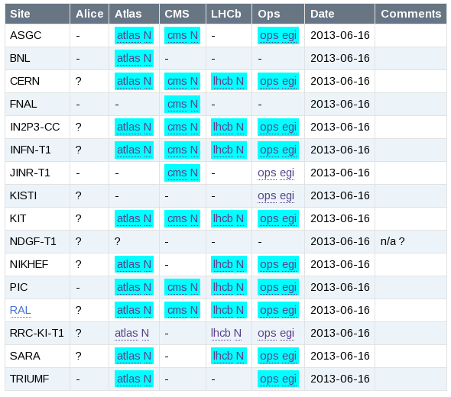
CERN and Tier-1 sites

Slide 4
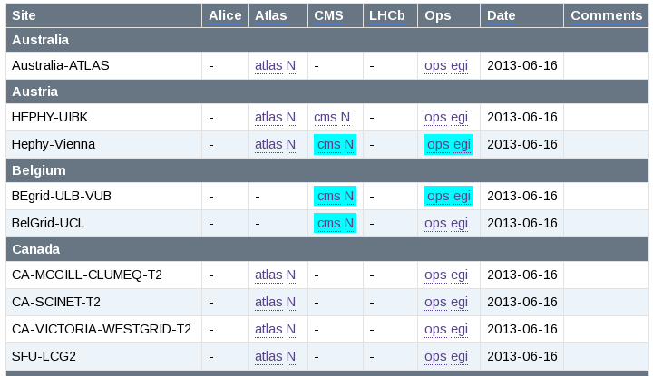
EGI Tier-2 sites (1)

Slide 5
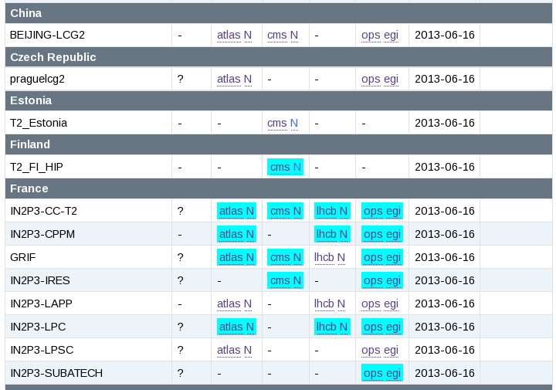
EGI Tier-2 sites (2)

Slide 6
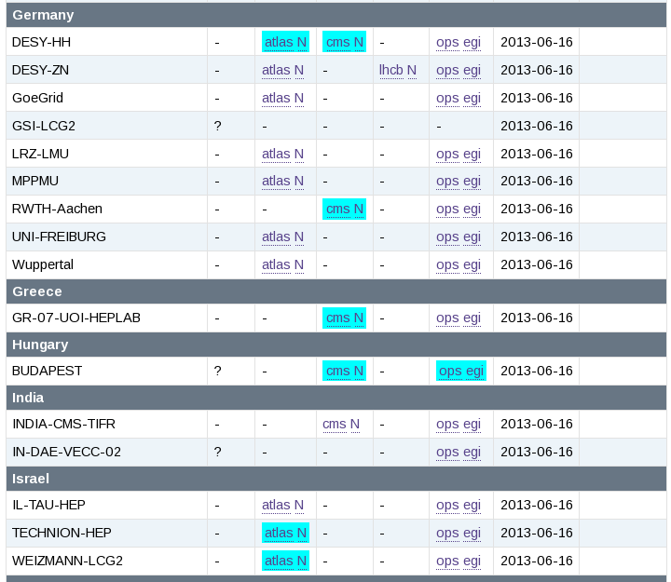
EGI Tier-2 sites (3)

Slide 7
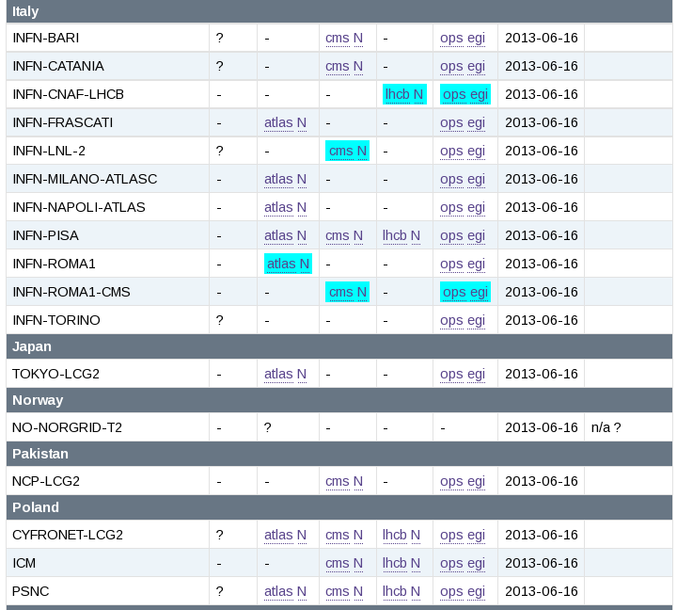
EGI Tier-2 sites (4)

Slide 8
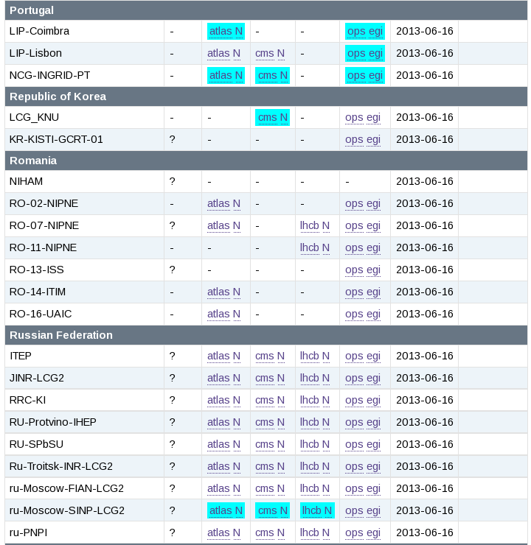
(5)

Slide 9
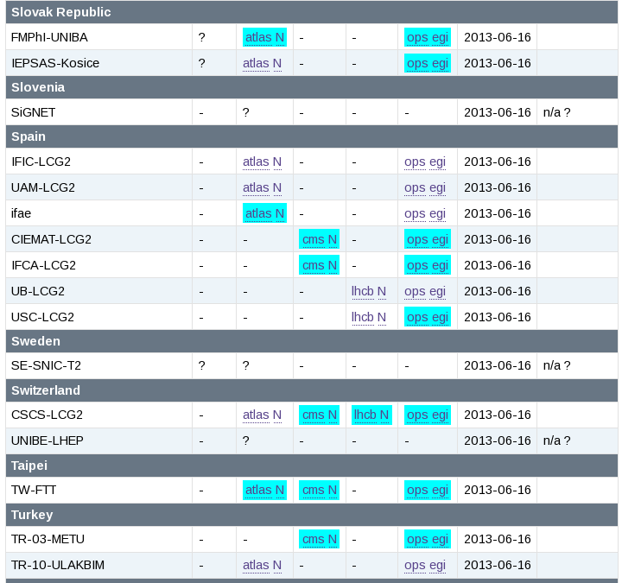
(6)

Slide 10
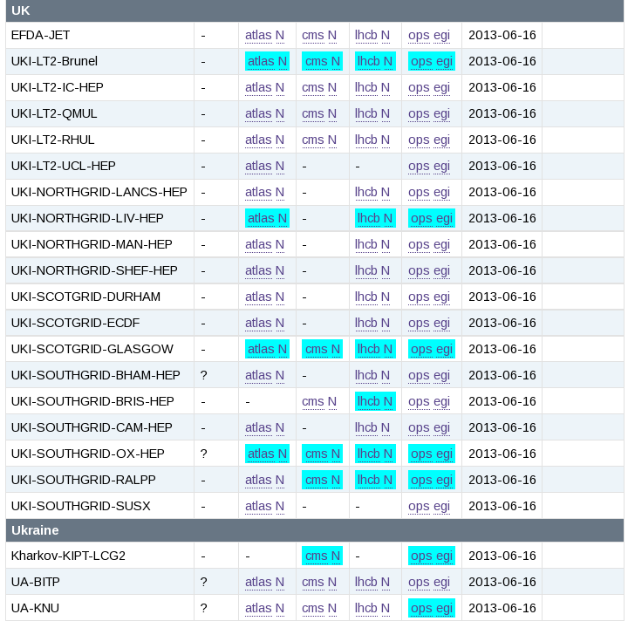
(7)

Slide 11
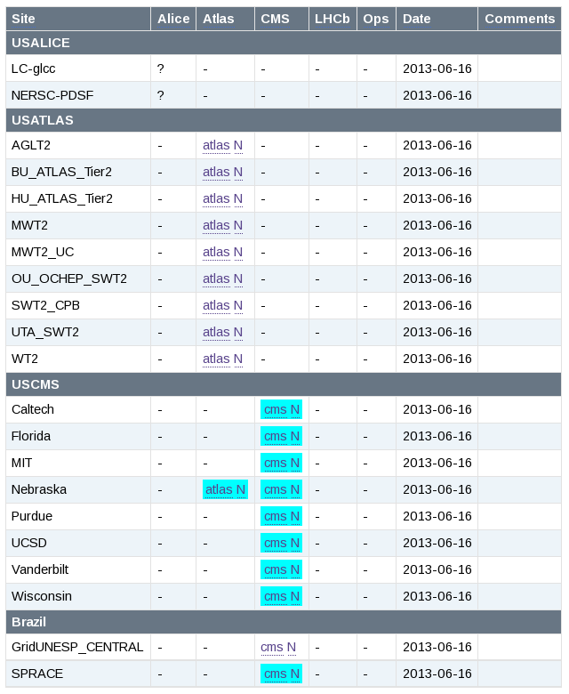
OSG T2

Slide 12
Discussion items
Tests and links for ALICE will be added in the coming days
Tests for other experiments often fail due to timeouts
  Timeouts can be increased (up to ~23h)
  Sites should give priority to pilot jobs
VO test results for some sites do not show up in MyWLCG
  Configuration?
Experiments do not test all their WLCG MoU sites
  Configuration?
Should ATLAS NorduGrid sites deploy gLExec?
  Or does the ARC Control Tower handle user traceability?
What about T3 sites?
  CMS have various included already

Slide 13
Plans
Final details to be discussed in Operations Coordination meeting this Thu
  Try spreading the tickets over a team
    Could some regions take care of their own “back yard”?
  Start ticketing sites next week?
Deadline
  Aim for making gLExec tests critical by Oct 1?

