Slide 1
Update on Status of Tier-1 candidate @ GSDC, KISTI
Sang-Un Ahn, for the GSDC Tier-1 Team
sahn@kisti.re.kr

Slide 2
News
2013 budget spending started from the end of June due to the delay of organization of MSIP
  Procurement has delayed:
    2013 pledges will be completed by the end of October
    2Gbps bandwidth upgrade will be contracted on 1st Oct.
p-Pb RAW replication complete: 16th Aug. 2013
Network upgrade plan for 10Gbps established
  2014 Budget for 10Gbps upgrade is secured
  Procurement for switches and equipment to prepare for 10Gbps is on-going
Preliminary on-call scheme and supporting system laid out

Slide 3
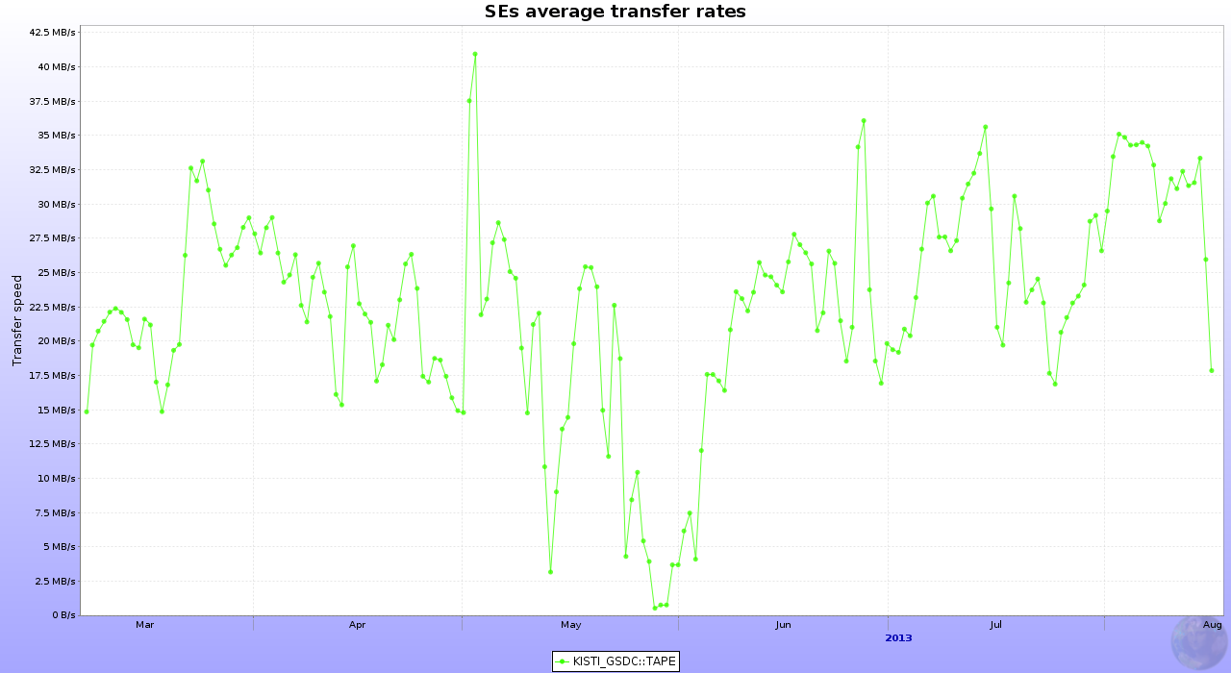
2013 p-Pb RAW replication
p-Pb data (taken in 2013) transfer started on 7th March and ended 16th August
  Total data size: 309.9 TB (400k files in queue)
  Transfer speed was 21.27 MB/s in average
  Few errors: 0.1% of Total (re-transfer requested)
Network incident:
Heavy traffic from workers to outside
Torrent ports communicating between workers closed accidently by puppet after SL security update

Slide 4
Network – 10G Network to Join OPN
Establishing 2Gbps link between CERN-KISTI is on the administrative process
  Contract with NLR(US) and SURFnet(NL) will be started on 1st Oct.
Budget to upgrade network up to 10Gbps is secured and will be performed in Mar. 2014
  Including 1Gbps backup link
Timescale for 10Gbps upgrade requires more than 6 months (connection/test is foreseen in Aug. 2014)
Plan revised:
Year | 2012 | 2013 | 2014 | 2015
Bandwidth (proposed) | 1Gbps | 1Gbps -> 2Gbps (Oct. 2013) | 2Gbps -> 10Gbps (Aug. 2014) | 10Gbps
 | (1Gbps) | (2Gbps) | (3Gbps) | -

Slide 5
Network – Internal Network Upgrade
  Top switch upgrade
    From 960G to 2.5T
    HA configuration in private network
    Remove bottleneck to NAS storage
  Full 20G configuration (Up/Down)
    Replacing all switches by 10G
    Addition of 10G ethernet cards to service nodes including workers
    Isolation of Tier1 service network from 1G network
  Accordingly, long (around 2 weeks) shutdown is required to re-structure internal network configuration
    Scheduled downtime from 23rd September to 6th October

Slide 6
On-call Service – Preliminary Plan
Alarm system
  Current: Nagios + e-mail notification
  Plan: Implementing SMS plugin + Night owl shift by private company
  For TAPE, any hardware/software malfunction reported to both of IBM and third-party company for 24/7, and any required action to be made within one day
  Evaluation on-going for monitoring framework: e.g. Icinga, Zabbix, etc.
On-call scheme
  One week shift cycle among 5-6 personnel
  Expecting 1 or 2 calls in a cycle (few alarms from PBS hanging or /home full by packages, mostly calm)
  Based on daily monitoring report, action list describing what to be done in which situation should be drawn out by the end of this year
Night owl shift
  Private company contract to hire some people who keep eyes on monitoring in order to cover in any case that notification fails during night: SMS, e-mail notification could fail wake up the person on duty
  Supercomputing division at KISTI has already run similar system for years

Slide 7
Conclusion
6 months delay of budget execution:
  2Gbps link, 2013 pledges, network equipment, …
Data transfer complete:
  Network issue - slow speed than expected, network incident
10G network upgrade plan presented and internal network re-structuring scheduled accordingly
  OPN joining could start after 2G link configured?
  A network expert (Dr. Cho) from KISTI network division will fully support us
A scheme of on-call service has been laid out

Slide 8
Milestones
Objective | Target
Nominate KISTI/GSDC representatives in the WLCG Management Board and the GDB | Jun. 2012
Establishment of a 1Gbps connectivity to CERN | Apr. 2012
Installation of tape system | Dec. 2012
High speed transfer of data from CERN to KISTI at the speed required to receive and archive 10% of the ALICE AA raw data foreseen for 2012 over a continuous period of 2 weeks | Apr. 2013
Provide a precise plan for 3Gbps (or higher) connectivity to CERN | Sep. 2013
Present a plan for providing on-call services/support according to the T1 specifications as laid out in the WLCG MoU | Sep. 2013
85% of the job capacity running for at least 2 months | Apr. 2013
90% Storage Element (DPM and/or XROOTD) availability (functional tests) for at least 2 months | Apr. 2013
Running of the reliability tests (both OPS and ALICE-specific) and publishing those to the new SAM infrastructure | Feb. 2013
Integration with the APEL accounting system and publishing accounting data | Jan. 2013
90% of the WLCG T1 service targets for at least 2 months | -
Integration in the WLCG OPN (with 2Gbps) | To be decided
Functional tests of the OPN (with 2Gbps) | To be decided
■ Done
■ To be done
■ Issue
Issue
Slow performance than expected
To be done
2Gbps connection to be established, 10Gbps upgrade planned (budget secured)
Preliminary on-call plan laid out, Implementation and testing should be done in this year
T1 service target
How to evaluation?

