Slide 1

WLCG Service Report
9 weeks Sep 16 – Nov 18
Maarten Litmaath
~~~
WLCG Management Board, 19th Nov 2013

Slide 2
Operations Coordination
New TF being set up to drive the deployment of multi-core resources in WLCG.
CVMFS client instabilities to be addressed at the site level (best practices).
Possible commissioning exercise (STEP'14) to be discussed during the Feb 2014 Operations Coordination F2F meeting.
SL6 migration TF concluded on Nov 1st (only 8% of the resources remain to be done).
  Many thanks to Alessandra Forti for coordinating this effort!
FTS-3 running stably at scale. Deployment scenario being discussed.
SHA-2 certificates successfully tested by all experiments. WLCG infrastructure readiness fairly advanced.

Slide 3
Incidents (1/2)
Sep 16: 94k ATLAS files lost at TRIUMF → SIR
Sep 16: Russian GEANT link again limited to 100 Mbps
  Most ALICE T2 were closed, some operational at a low cap
  CMS also affected
  Biggest sites back since Sep 29, a few ALICE sites still not 100%
Sep 18: CERN CC routers upgrade fallout → SIR
Sep 23: CVMFS failure on 1 WN at KIT (GGUS:97505)
  “I/O Error” → also seen at other sites at various other times
Oct 2: BNL VOMS server host certificate change
  Service needs to remain switched off until all ATLAS sites have adjusted their VOMS configurations (in progress)
Oct 7: lcg-voms.cern.ch host certs wrongly updated → SIR
Oct 7: alarm tickets do not work (GGUS:97817)

Slide 4
Incidents (2/2)
Oct 14: ASGC power cut
Oct 28: 2260 CMS files lost at KIT → SIR
Nov 2: LHCb dCache SEs at various sites fail for some Brazilian certs (GGUS:98570, GGUS:98571, …)
  dCache team provided a fix
Nov 4: FTS-2 proxy errors (GGUS:98586)
  Also seen at a few other sites in the last months
Nov 4: 1M ATLAS files (140 TB) lost at ASGC → SIR
Nov 7: 78k EOS-CMS files (15 TB) of 28 users accidentally deleted by 1 user → SIR
Nov 18: 28 CMS files lost at KIT → SIR

Slide 5
Progress
SL6 migration: vast majority done
  CERN: bad job efficiencies experienced by ALICE and others → to be clarified soon
KISTI
  Networks reorganized for 10 Gbps
  Alarm test OK with Oct 23 GGUS release
SE upgrades for SHA-2 support ongoing
FTS-3 handles all LHCb transfers since Oct 10
CVMFS also used by ALICE at most sites
Staging throughput for LHCb at KIT fixed

Slide 6
Service Incident Reports https://twiki.cern.ch/twiki/bin/view/LCG/WLCGServiceIncidents
Sep 16: 94k ATLAS files lost at TRIUMF
  SAN interruption damaged XFS superblocks
Sep 18: CERN CC routers upgrade fallout
  VOBOXes/LFC/FTS/DB/… unexpectedly impaired
Oct 7: lcg-voms.cern.ch host certs wrongly updated
  Proxy creation and renewal failures, large numbers of transfer and job failures
Oct 28: 2260 CMS files lost at KIT
  1 broken tape + dCache bug (fixed)
Nov 4: 1M ATLAS files (140 TB) lost at ASGC
  1 DPM disk server lost, SIR pending
Nov 7: 78k EOS-CMS files (15 TB) of 28 users accidentally deleted by 1 user
  SIR pending
Nov 18: 28 CMS files lost at KIT
  1 broken tape, SIR pending

Slide 7
GGUS summary (9 weeks 16/09 -17/11) by Pablo Saiz
VO | User | Team | Alarm | Total
ALICE | 11 | 4 | 1 | 16
ATLAS | 47 | 234 | 0 | 281
CMS | 66 | 0 | 0 | 66
LHCb | 17 | 68 | 1 | 86
Totals | 141 | 306 | 2 | 449

Slide 8
Supported related events
GGUS release on the 23/10
  Alarm tests to T0/T1 were successful
  Important items:
    Decommissioned SU: Condor Utils, Torque Utils, ETICS
    New SU: CVMFS
Next release scheduled for 27/11
Two alarms during the period covered (see details on following slides)

Slide 9
LHCb ALARM GGUS:97743
WRONG PROTOCOL RETURNED BY SRM
What time UTC | What happened
2013/10/03 15:55 | GGUS TEAM ticket opened, assigned to IN2P3-CC. Automatic notification to site admin Type of problem File Access
2013/10/03 15:58 | Site administrator replies that the problem has been fixed
2013/10/03 16:05 | New shifter changed ticket to ALARM (This should not have happened)
2013/10/03 16:13 | Submitter changed status to ‘Solved’ and ‘Verified’

Slide 10
ALICE ALARM GGUS:97815
Wrong certificates in lcg-voms.cern.ch
What time UTC | What happened
2013/10/07 12:13 | GGUS ALARM ticket opened, Automatic notification to alice-operator-alarm@cern.ch failed due to wrong mail configuration at GGUS side Automatic assignment to ROC_CERN Automatic SNOW ticket creation done. Type of Problem: Middleware
2013/10/07 12:41 | Fixed by VOMS 2nd line support. The certificate renewal procedure had not been followed correctly
2013/10/07 12:48 | Submitter acknowledges the solution
2013/10/11 14:28 | Failed notification understood and solved

Slide 11
Analysis of the reliability plots :
Week 16/09/2013
by Ivan Dzhunov
ALICE :
NTR
ATLAS :
2.1 Issue with dCache, new nodes were activated without certificates
2.2 WN-swspace CREAMCE test failing with error ' cannot access /cvmfs/atlas.cern.ch/repo/sw: Transport endpoint is not connected'
CMS:
3.1 CREAMCE-JobSubmit failing on cream-ge-5-kit.gridka.de GGUS
LHCB :
4.1 Configuration lost after upgrade of dCache

Slide 12
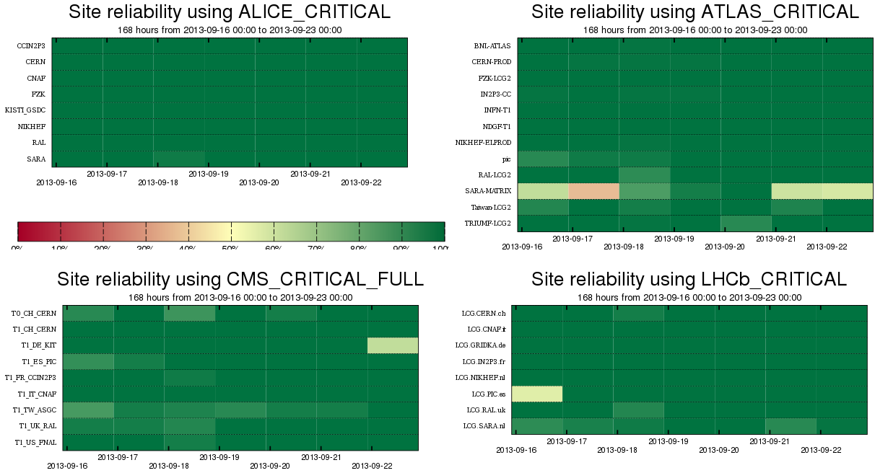
2.1
2.2
3.1
4.1

Slide 13
Analysis of the reliability plots :
Week 23/09/2013
by Ivan Dzhunov
Common:
0.1 Unknown test results due to site maintenance
ALICE :
1.1 Failures of CREAMCE-JobSubmit test
1.2 Unknown test results due to site maintenance
ATLAS :
2.1 WN-swspace CREAMCE test intermittently failing during the whole week with error ' cannot access /cvmfs/atlas.cern.ch/repo/sw: Transport endpoint is not connected'
CMS:
3.1 CVMFS problems GGUS & GGUS
3.2 Failures of CREAMCE-JobSubmit, probably due to GOCDB downtime
LHCB :
4.1 Problems with mass storage system, cannot read from or write to tape GOCDB

Slide 14
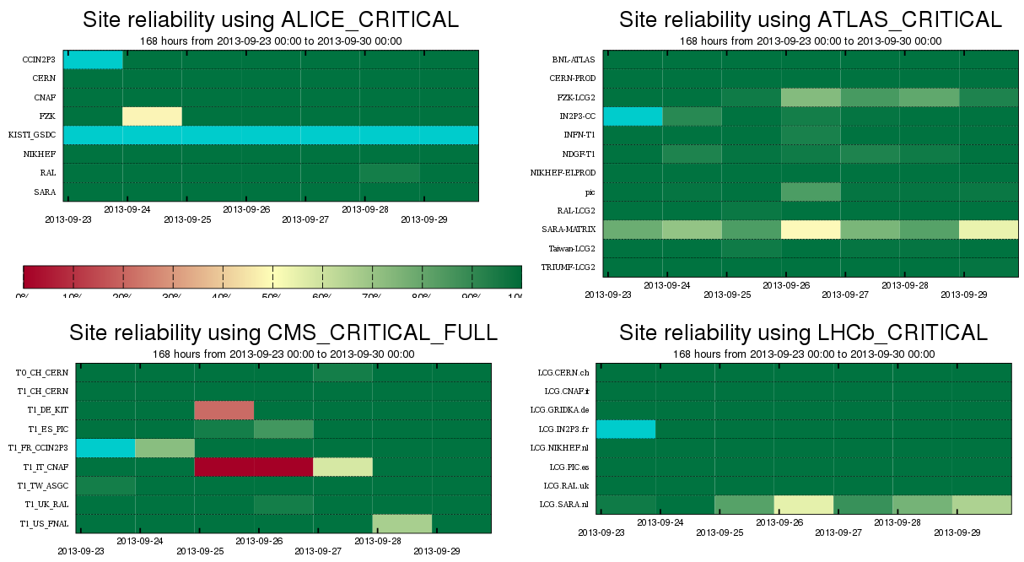
0.1
1.1
0.1
1.2
2.1
2.1
3.1
0.1
0.1
3.2
4.1
4.1

Slide 15
Analysis of the reliability plots :
Week 30/09/2013
by Ivan Dzhunov
ALICE :
1.1 Site is in maintenance for the whole week
ATLAS :
2.1 WN-swspace CREAMCE test failing with error ' cannot access /cvmfs/atlas.cern.ch/repo/sw: Transport endpoint is not connected'
2.2 failures for ~5h due to expired proxy on sam-atlas-prod machine
2.3 failures of CREAMCE-JobSubmit test
CMS: NTR
LHCB :
4.1 Problems with mass storage system, cannot read from or write to tape

Slide 16
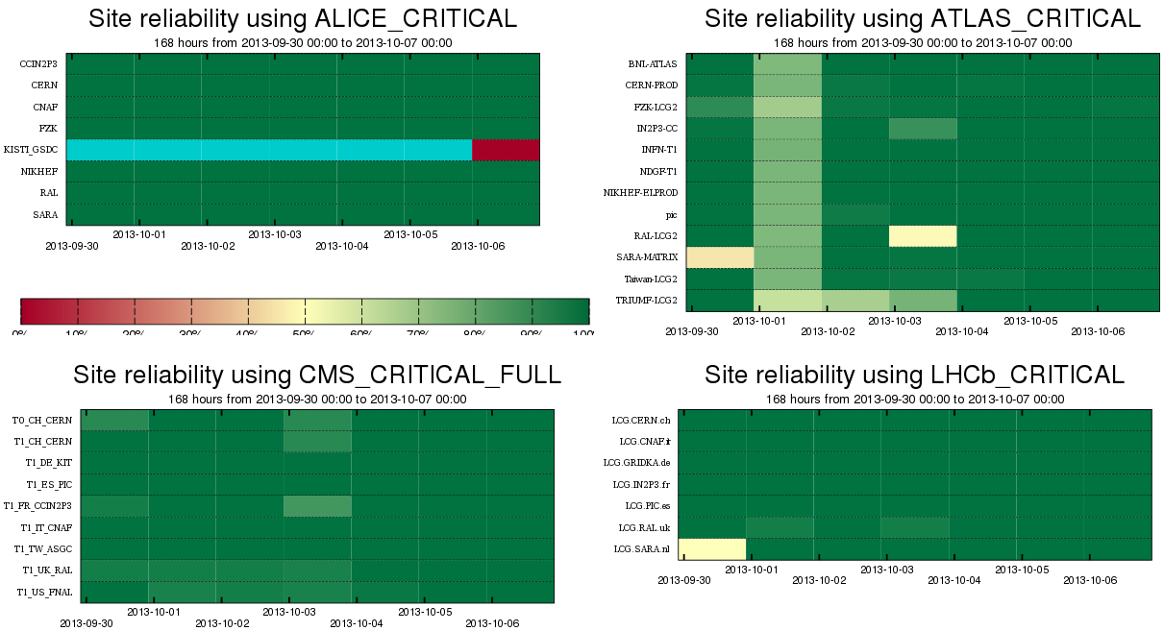
1.1
2.2
2.3
2.1
4.1

Slide 17
Analysis of the reliability plots:
Week 07/10/2013
by Jacobo Tarragón Cros
ALICE:
1.1 Unknown test results due to site maintenance
ATLAS:
2.1 CREAM-CE jobs aborted
emi.cream.CREAMCE-JobSubmit: CRITICAL: Job was aborted.
Failed to create a delegation id for job … FaultDetail=[Connection refused]
CREAM Register raised std::exception … FaultDetail=[Resolver internal error]
SRMv2 closed connections
org.atlas.SRM-VODel, SRM-VOGet, SRM-VOPut: Error reading token data
header: connection closed.
CMS:
3.1 SRMv2 tests failing due to database connection
org.cms.SRM-VOPut: [SE][GetSpaceTokens][SRM_INTERNAL_ERROR] …
ORA-12541: TNS:no listener

Slide 18
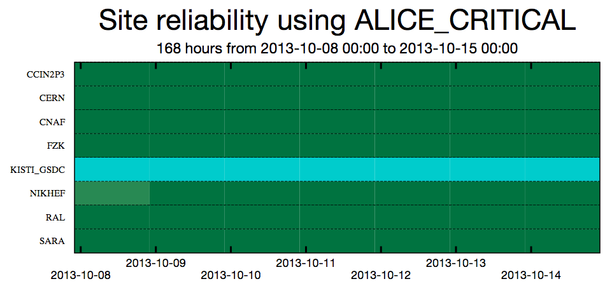
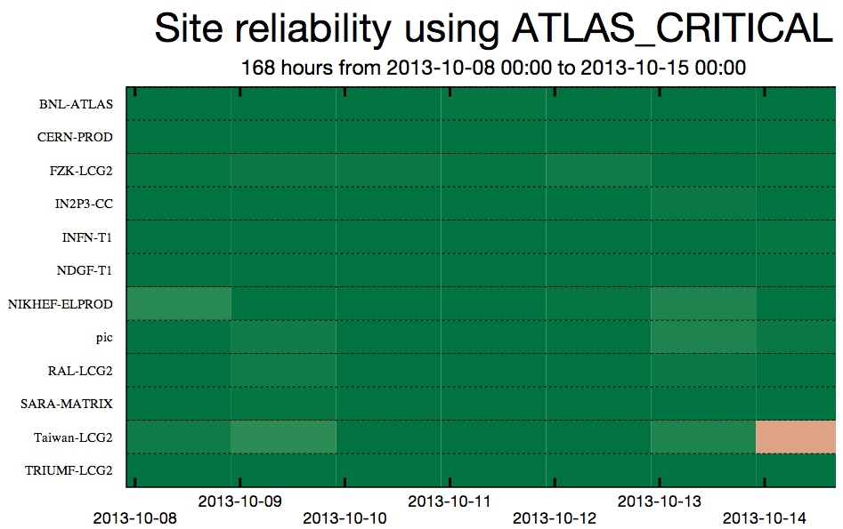
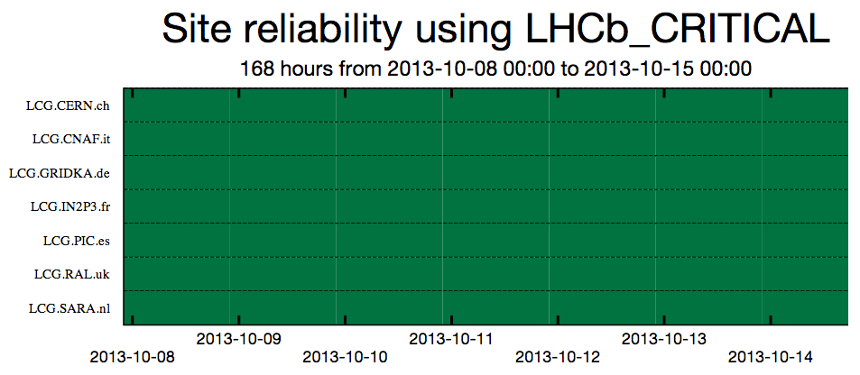
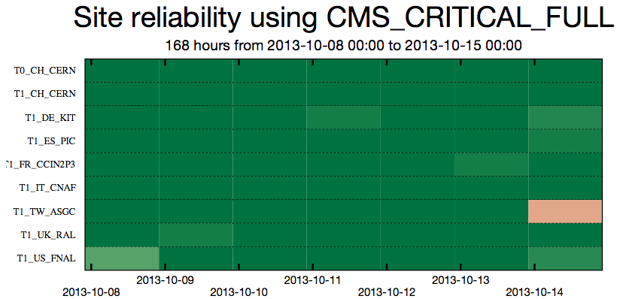
1.1
2.1
3.1

Slide 19
Analysis of the reliability plots :
Week 14/10/2013
by Edward Karavakis
Common:
0.1: Unscheduled Outage from 14-Oct-13 08:42 to 15-Oct-13 15:20: Power cut at ASGC DC
ALICE:
1.1: Scheduled Outage from 06-Oct-13 00:00 to 19-Oct-13 00:00: Downtime extension due to delayed delivery of CISCO switches
ATLAS: NTR
CMS:
3.1: SAM SRM & CE warnings at KIT – GGUS 98017
LHCb: NTR

Slide 20
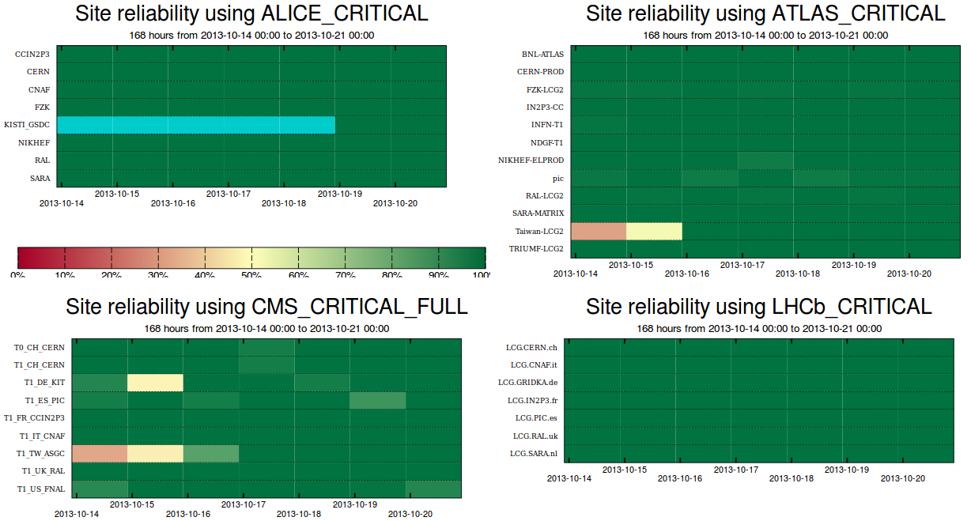
1.1
1.1
1.1
1.1
1.1
0.1
0.1
3.1
0.1
0.1

Slide 21
Analysis of the reliability plots :
Week 21/10/2013
by Ivan Dzhunov
ALICE : NTR
ATLAS : NTR
CMS: NTR
LHCB : NTR

Slide 22
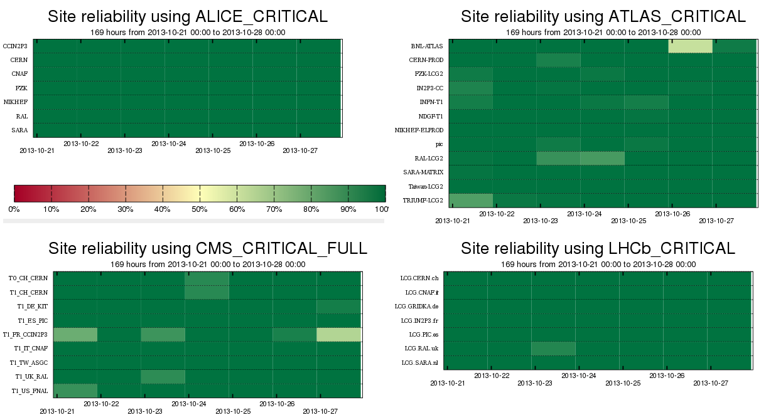

Slide 23
Analysis of the reliability plots :
Week 28/10/2013
by Robert Veznaver
ALICE:
1.1: CREAM-CE job submit on creamce.gina.sara.nl and creamce2.gina.sara.nl was failing
ATLAS :
2.1: All SRM probes on srm.grid.sara.nl were failing
CMS:
3.1: CREAM-CE job submit on all hosts was failing
3.2: WN-swinst test were failing on all CREAM-CE hosts

Slide 24
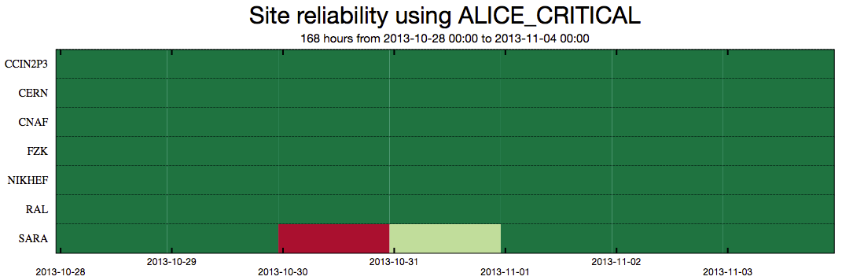
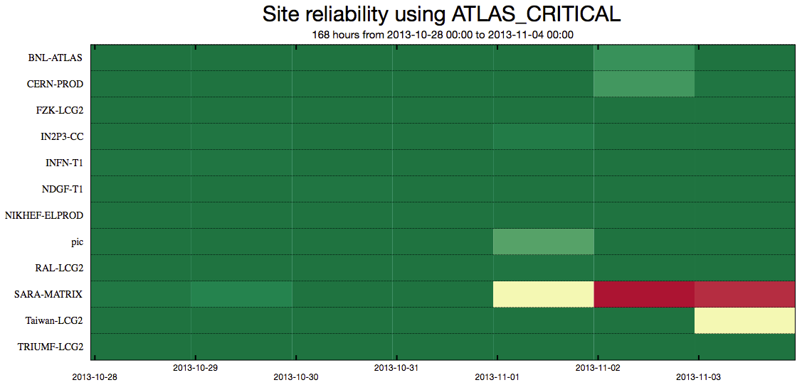
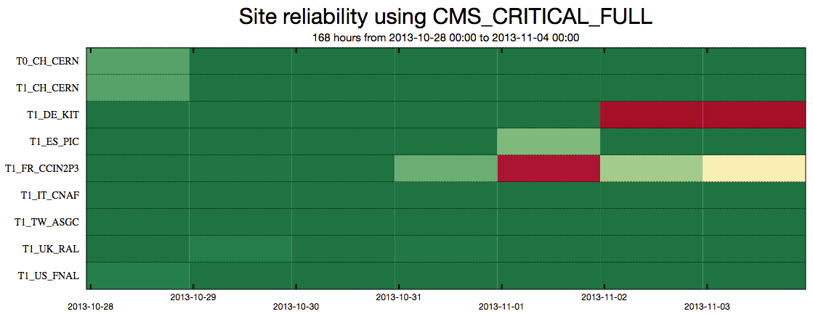
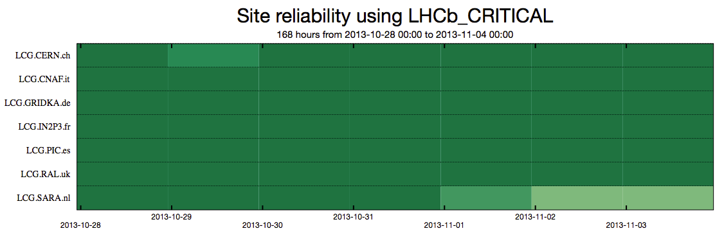
1.1
1.1
2.1
2.1
2.1
3.1
3.1
3.2

Slide 25
Analysis of the reliability plots: Week 04/11/2013 by Jacobo Tarragón Cros
Common
—0.0 RAL CREAMCE-JobSubmit tests aborted with JobSubmissionDisabledException
ALICE
—NTR
ATLAS
—2.0: SRM tests failed: File was not deleted from SRM / No such file or directory
—2.1: SRM tests failed: could not open connection
CMS
—3.0: WN-swinst failed: cannot stat … BrokerInfo
—3.1: VOPut failed: could not open connection
LHCB
—NTR

Slide 26
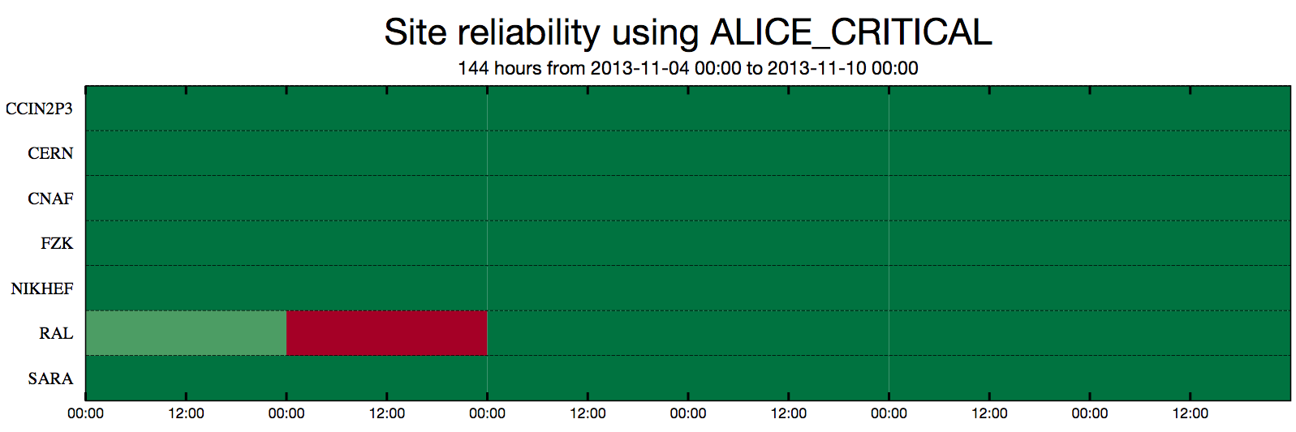
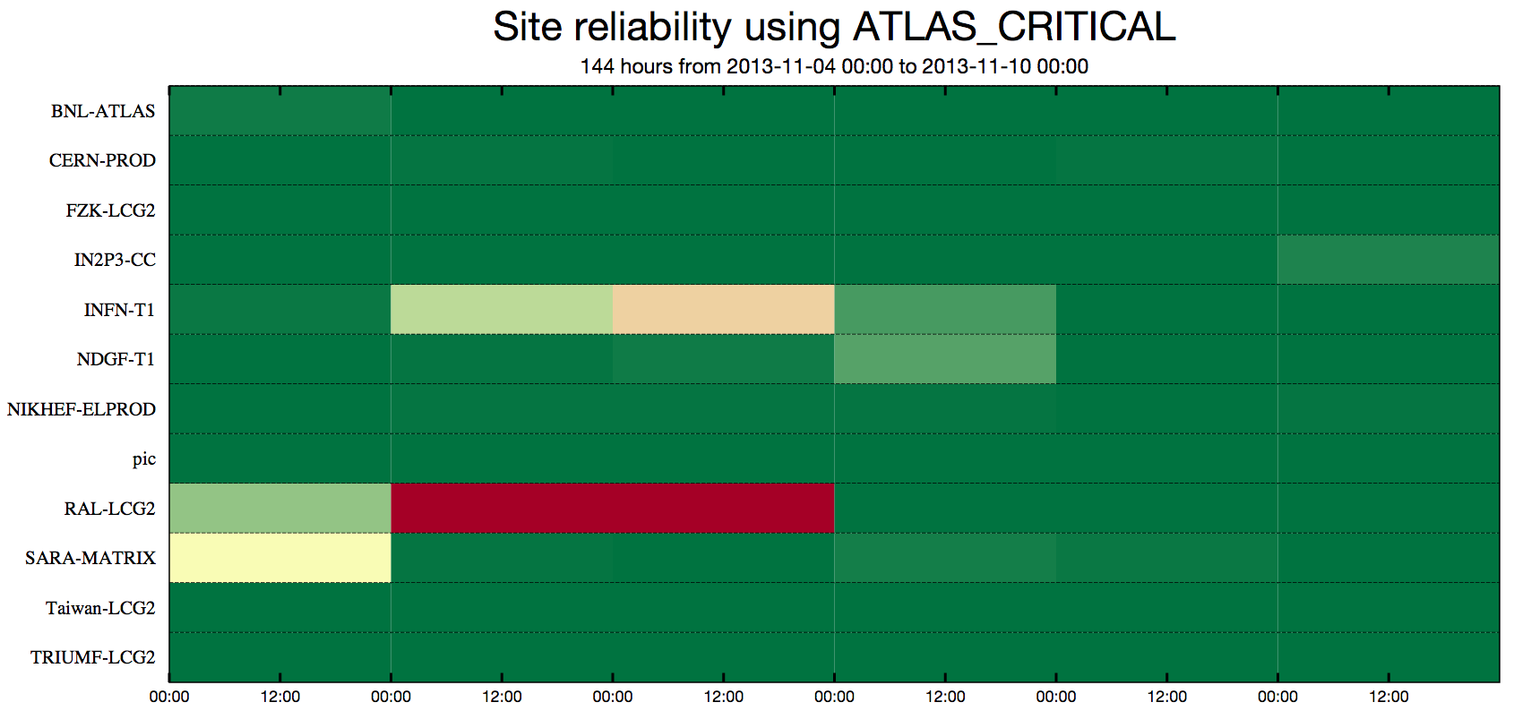
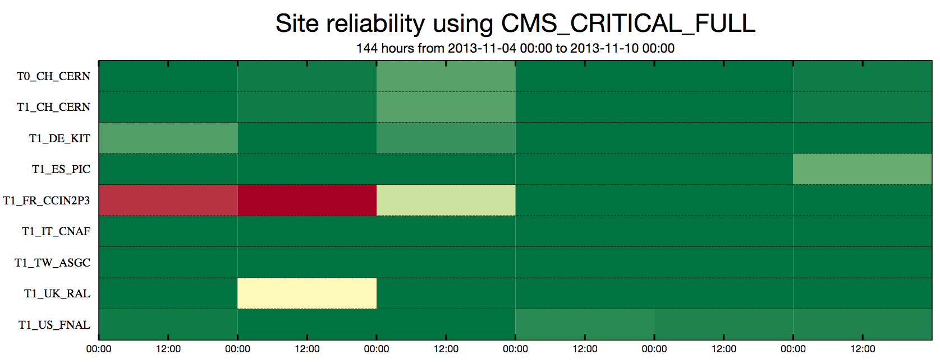
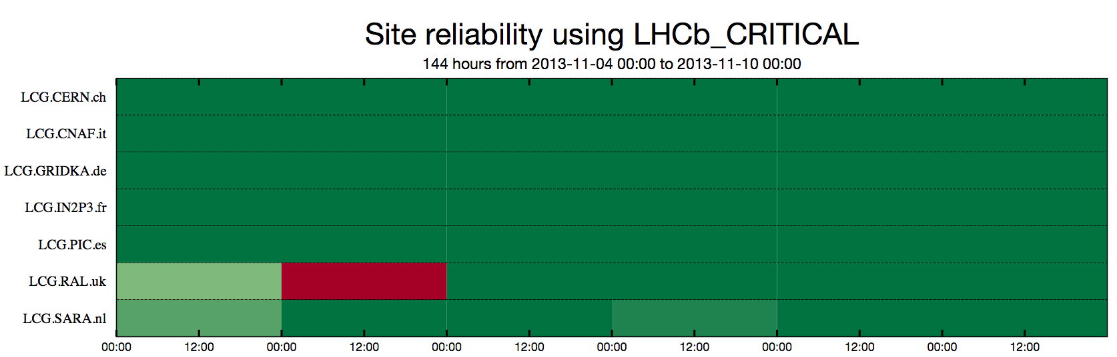
2.0
2.1
0.0
2.0
3.0
3.1
0.0

Slide 27
Analysis of the reliability plots :
Week 11/11/2013
by Edward Karavakis
COMMON:
0.1 IN2P3-CC: SRM tests were failing.
Scheduled Outages: 12-Nov-13 06:00 to 12-Nov-13 18:00: dCache migration to 2.6.10 version (SHA2 compliant) and on 12-Nov-13 08:00 to 25-Nov-13 17:00: Decommission of cream ce: cccreamceli02, cccreamceli03, cccreamceli11.
Unscheduled Outages: 12-Nov-13 18:00 to 13-Nov-13 11:00: dCache migration to 2.6.10 - Chimera database migration takes more time than planned.
ALICE: NTR
ATLAS: NTR
CMS:
3.1 PIC: SRM Put and Get tests were failing: PIC reported that lots of CMS jobs with heavy use of the SE caused SAM tests to time out.
LHCB : NTR

Slide 28
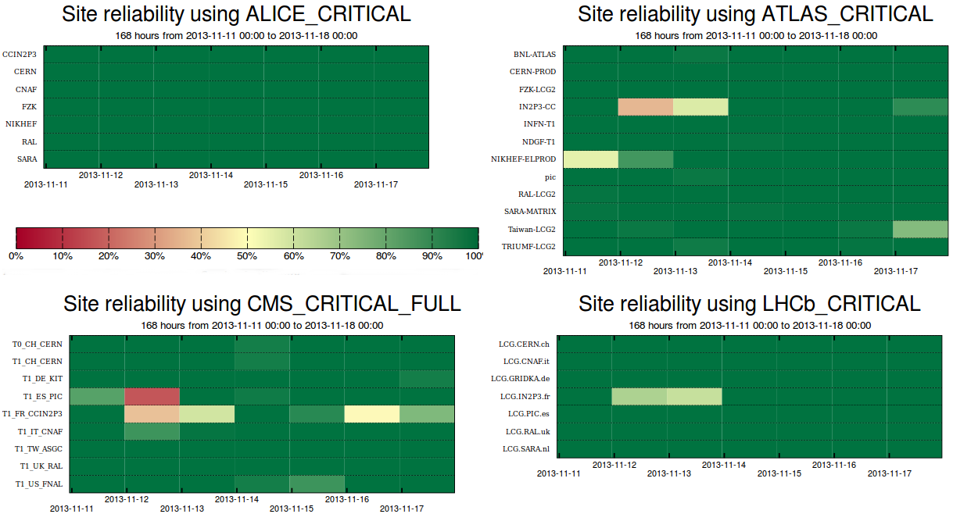
0.1
3.1
0.1

