Slide 1
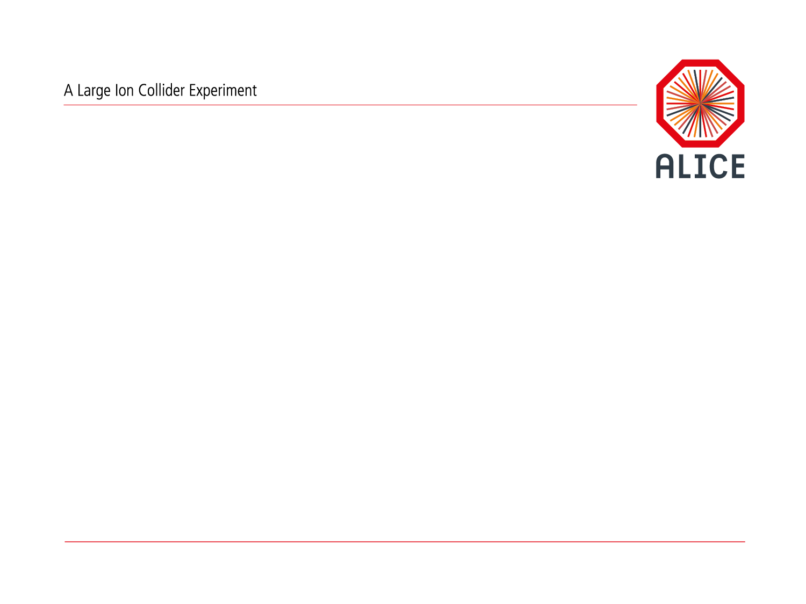
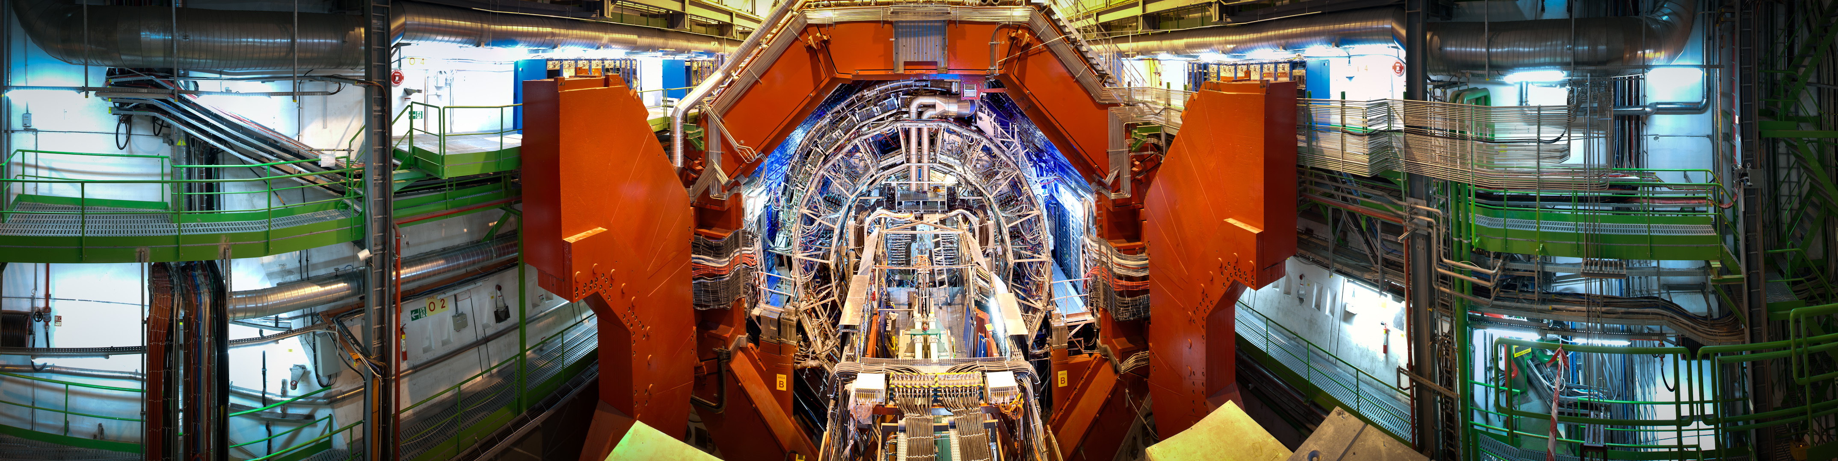
ALICE Collaboration Database
ALICE© | Collaboration between LHC experiments and Grey Book and foundation | 16 November 2012 | Catherine Decosse

Slide 2
Current Status of ALICE Collaboration Database(s)
The ALICE Collaboration is a large international collaboration with 1285 active members from 140 institutes and laboratories. The management and the administration of such a large number of people require reliable tools to manage as for example, membership records, funding agencies and institutes contributions, author’s lists, EGroups, shifts and service tasks accounting.
RECENT DECISION TO CHANGE SYSTEM because the tools we are currently using are no more corresponding to our needs. Two main DB: ACDB (Alice Collaboration DataBase) and SMS (Shift Management System) work independently and do not communicate, we had major crashes of our database with 50 users logged (people accessing the data at one time), and we regularly face problems when extracting data for the author’s list or for statistics (M&O list, Thesis). In addition, the systems are installed on local servers (not centrally managed by CERN-IT) and maintenance of the DBs is not guaranteed for the long term. Additional obligations for members of the Collaboration, as Service Tasks for PhD students increase our needs to have one single system, which can retrieve and insert/modify data on various databases.
ALICE© | Collaboration between LHC experiments and Grey Book and foundation | 16 November 2012 | Catherine Decosse

Slide 3
New Project: ALICE_GLANCE
We have assessed the ATLAS-Glance system and agreed to develop a comparable GLANCE search interface for ALICE, which will access various databases:
A test database has been already created (acdb@pdbr.cern.ch) on CERNDB1 and postgreSQL data imported with date 06.11.2012
Foundation
inSPIRE
And many more ….
The ALICE_Glance should include:
  Management of Collaboration Members and Institutes
  Creation of EGroups
  Authors’ list
  Management of Thesis
  Management of Service Tasks
  Management of Appointments
  Management of Shifts
ALICE© | Collaboration between LHC experiments and Grey Book and foundation | 16 November 2012 | Catherine Decosse

