Slide 1


Experimental review of sterile neutrino searches with very short baselines
David Lhuillier – CEA Saclay

Slide 2
Outline
Reactor anomaly
Testing the 4th ν hypothesis
Short baseline reactor experiments
Source experiments

Slide 3
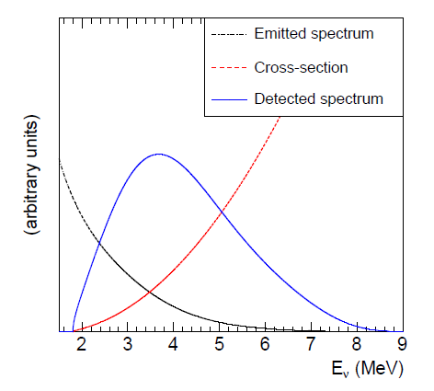
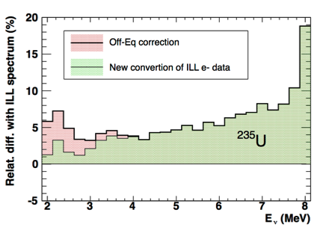
The Reactor ν_{e} Anomaly
New conversion of ILL beta spectra
Th. Mueller et al, Phys. Rev. C83,054615 (2011)
P. Huber, Phys. Rev. C84, 024617(2011)
New
Conversion
→ +4%
Accumulation of long lived isotopes
→ +1%

Slide 4

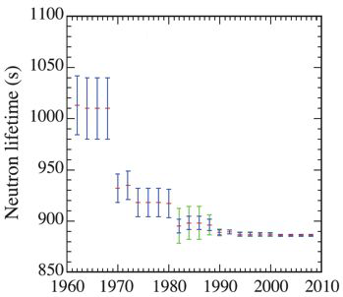
The Reactor ν_{e} Anomaly
Reevaluation of σ_{interaction}
New
Conversion
New τ_{n}
→ + 1.5%
PRD 83, 073006 (2011)

Slide 5
The Reactor ν_{e} Anomaly
Reanalysis of reactor short baselines experiments
Increased prediction of detected flux
G. Mention et al., Phys. Rev. D83, 073006 (2011)
New
Conv.
New τ_{n}
Significant increase of the prediction by 6.5%

Slide 6
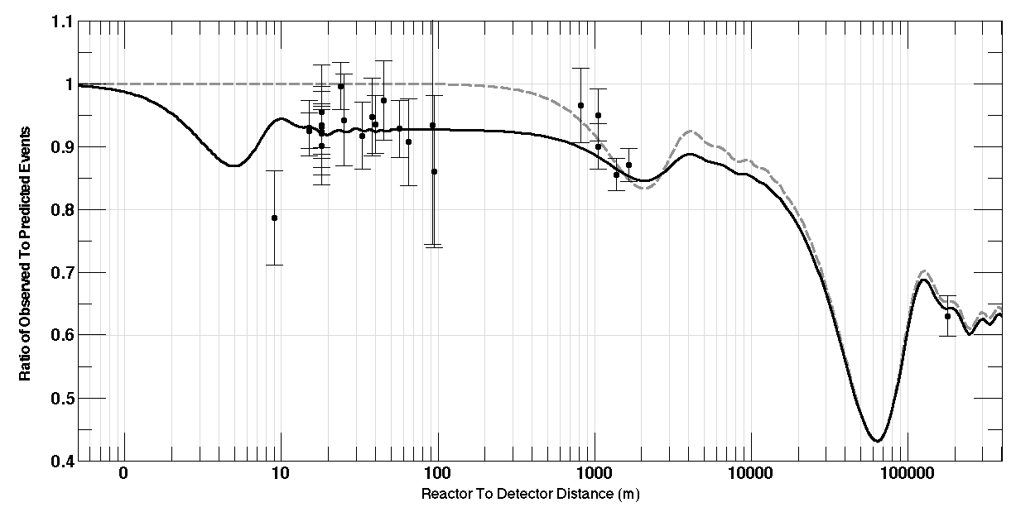
The Reactor ν_{e} Anomaly
Observed/predicted averaged event ratio: R=0.935±0.024 (2.7 σ)
No oscilation
New Oscilation to sterile ν?
Atmospheric Oscilation
Solar
Oscilation
Reactor anomaly

Slide 7
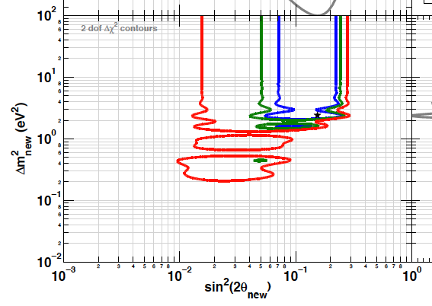
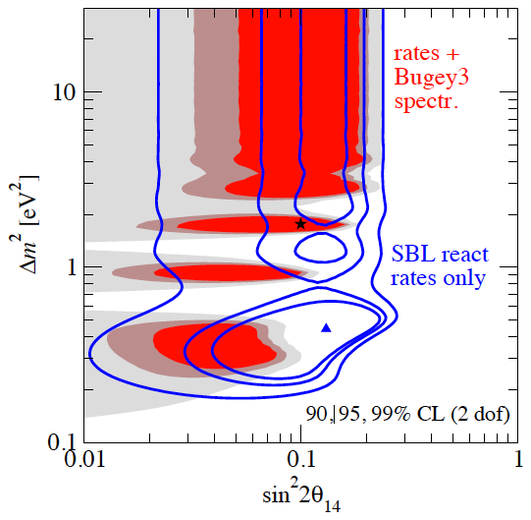
The Sterile Neutrino Hypothesis
J. Kopp et al., hep/ph:1303.3011
White paper, arXiv:1204.5379
90, 95, 99 % CL.
Δm²=0.2- 1 eV2 region very sensitive to the treatment of correlations.
Lowest Δm² spot driven by the lever arm of ILL and SRP points.

Slide 8
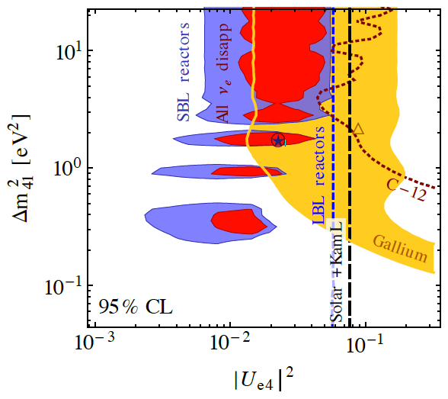
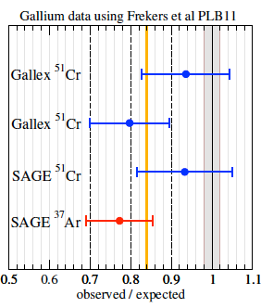
Consistent Picture in ν_{e} disappearance
Compatible with ν_{e} deficits observed in Gallium experiments
J. Kopp et al., hep/ph:1303.3011
Gallex: 51Cr source (750 keV)
Sage: 51Cr & 37Ar (810 keV)
Non-oscill hypothesis disfavored at 3.3 σ level.
Cancellation of the anomaly by a single syst effect requires a ≥4σ deviation from expectation
R_{obs/pred} = 0.86 ± 0.05 (σ_{Bahcall})
R_{obs/pred} = 0.76 ± 0.085 (σ_{Haxton})

Slide 9
Testing ν_{e} disappearance anomalies

Slide 10
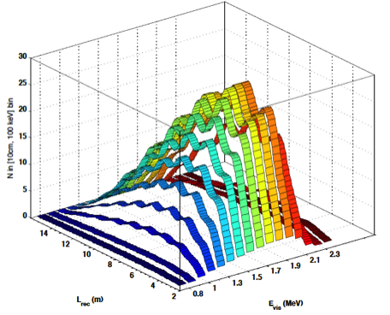
Experimental Strategy
Goal: direct test, beyond the current mean deviation from predicted rate
→ Search for a new oscillation pattern in E & L
Sensitivity to few m scale oscillations:
  Compact source
  Good position and energy resolutions
  High statistics
Few % stat + syst measurements to cover the anomaly contour
→ Measurement of relative shape distortion, completed by norm information.
L (m)
E (MeV)
L (m)
E (MeV)

Slide 11
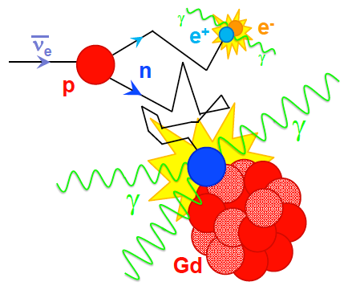
Neutrino Interaction
Inverse Beta Decay
Background rejection
Accidental γ-neutron coincidence
Shielding
Segmentation
Neutron discrimination
R&D on positron discrimination
Fast-n correlated background
Rejection of recoil protons with PSD
Cosmic rays induced:
  Reactor OFF
  Overburden
Reactor induced: must be negligible.
Selective coinc
e⁺ prompt signal & n-capture

Slide 12
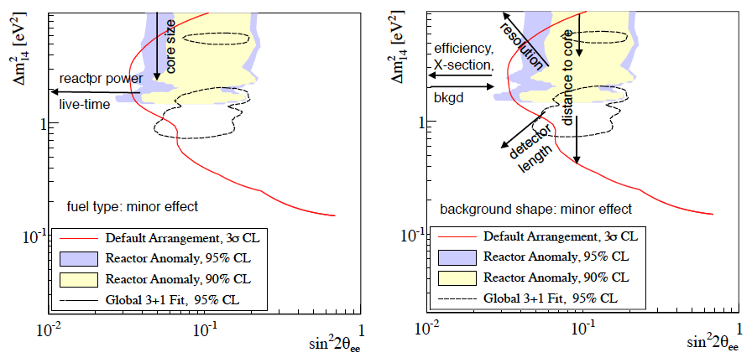
Specifications
Source
Detector
source activity
Year scale stability
K.M. Heeger et al., arXiv:1212.2182v1

Slide 13
Short Baseline
Reactor Experiments

Slide 14
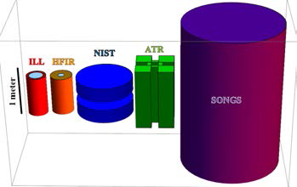
Research Reactors
Compact sources → no oscill. smearing.
Intense source and very short baselines available
→ high statistics, typically few 100 evts/day/t.
Short cycles with typical 30% reactor-off time → moderate overburden compensated by accurate measurement of the cosmogenic component.
Challenging reactor-induced backgrounds (γ and n) , depending on sites.
Highly enriched fuel → well known ²³⁵U fisison spectrum.

Slide 15
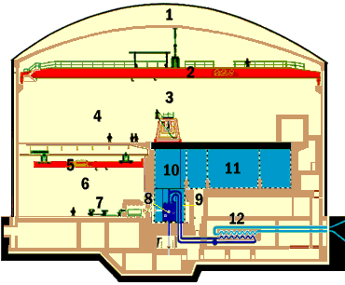
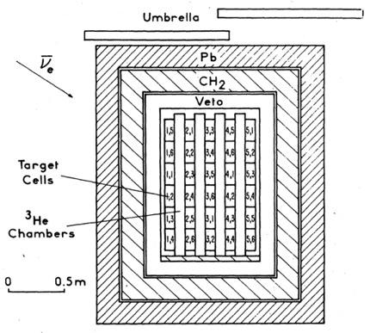
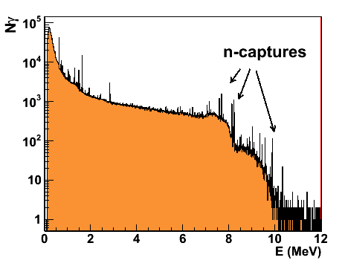
Benchmark of ILL experiment
20 cm lead shielding
30 cm neutron shielding
B42
377 l Liquid Scintillator target + ³He tubes
9 m away from the reactor core
~38 ν/d, 4890 ν total.
High energy γ’s from n-captures on metals

Slide 16
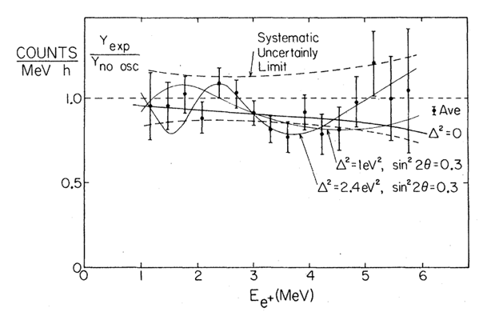
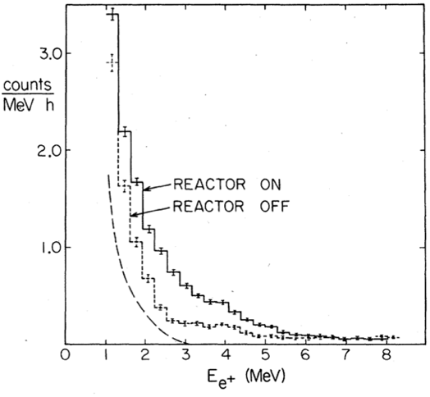
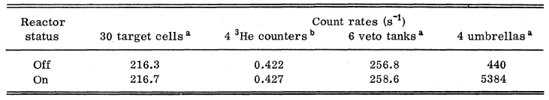
Benchmark of ILL experiment
1 MeV threshold
S/B = 1.5
A posteriori 9.5% correction of reactor power.
A. Hoummada et al., Appl. Radiat. Isot. 46 (1995)
No measurable reactor induced background in the prompt and delayed rates.
Stat. and cosmic background limited.

Slide 17
Synergy with Reactor Monitoring Experiments

Slide 18



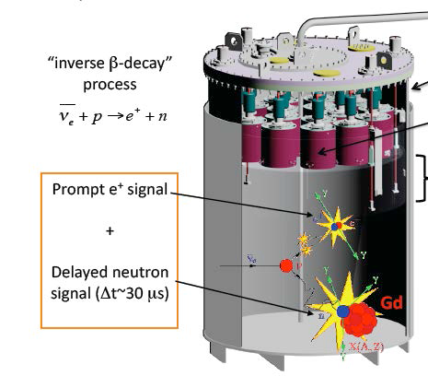
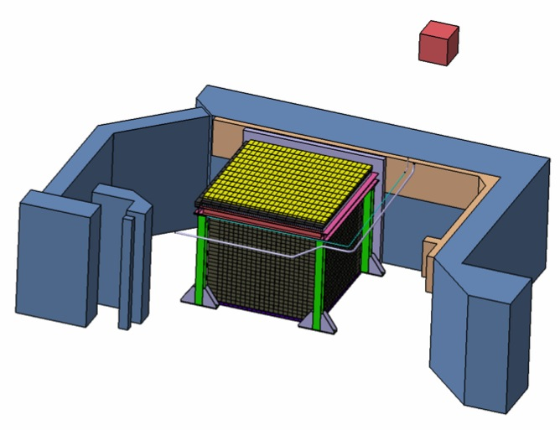
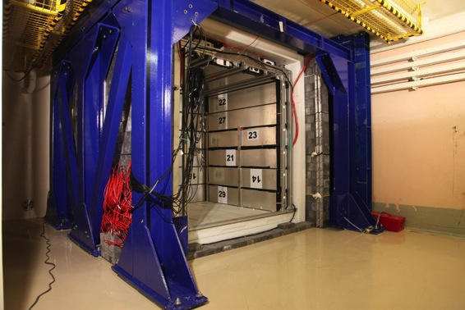
Nucifer @ OSIRIS
60 cm core size
70 MW
7 m
7m from 70 MW compact core
Very simple design based on Gd-loaded LS (Double Chooz R&D, see C. Buck’s talk)
High-E γ background (~1 MHz/m² above 2 MeV)
Heavy passive shielding 20 cm of lead in front main γ sources+ active μ-veto.
Reactor pool wall
Contact: T. Lasserre, CEA-Saclay

Slide 19
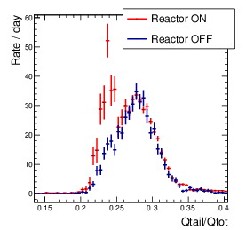
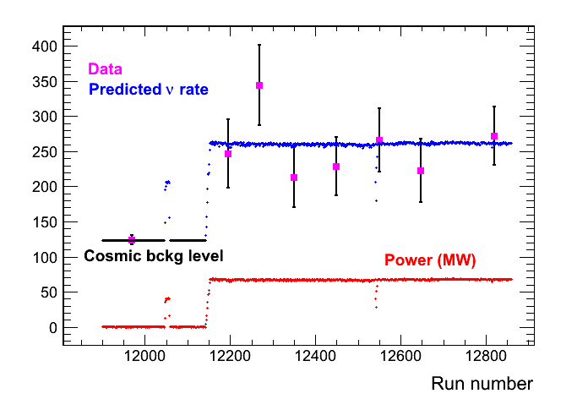
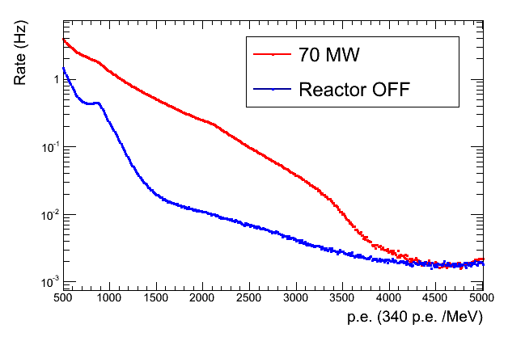
Nucifer @ OSIRIS
PSD
ν signal
(acc. subtracted)
No reactor induced fast n.
Efficient rejection of cosmic background.
Need further γ attenuation to reach S/B~1. Extra 3.75 cm of lead to be implemented this fall.
γ spectra
ν rate

Slide 20
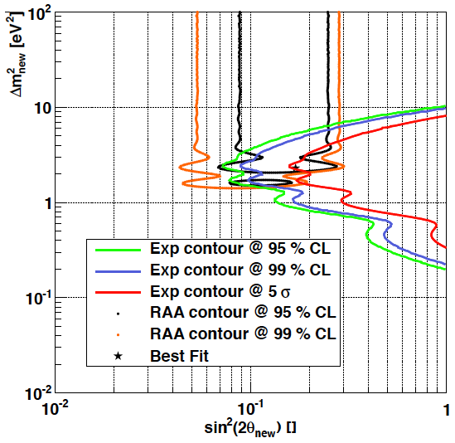
Nucifer @ OSIRIS
PSD
ν signal
(acc. subtracted)
No reactor induced fast n.
Efficient rejection of cosmic background.
Need further γ attenuation to reach S/B~1. Extra 3.75 cm of lead to be implemented this fall.
300 days
S/B=1
γ spectra
ν rate

Slide 21
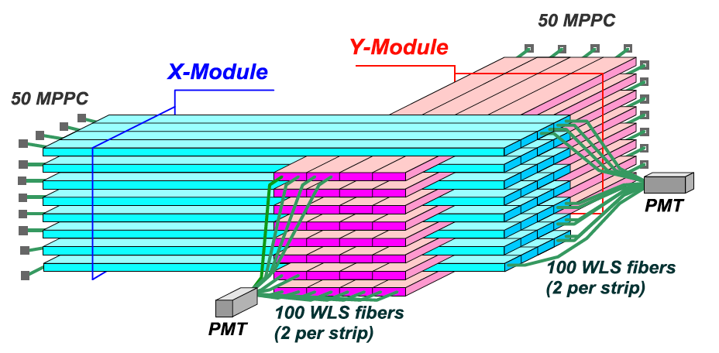
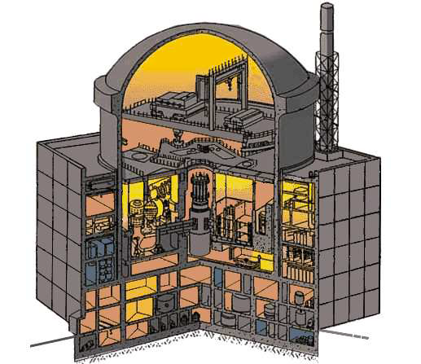
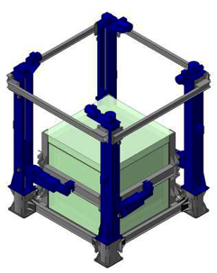
DANSS @ KNPP
See M. Danilov’s talk
Highly segmented detector for better background reduction.
Plastic strips with Gd-loaded interlayer, read out by WLS fibers.
E resol ~20% at 1 MeV.
Vertical motion of the detector from 9.7 to 12.2 m baseline.
10⁴ evt/day expected at 11m.
Good overburden from core structure. Extended source.
WWER-1000 reactor

Slide 22
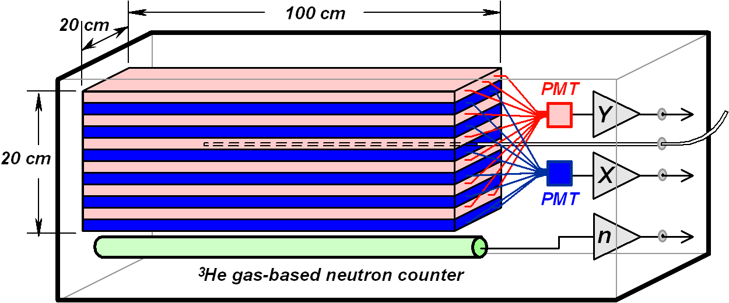
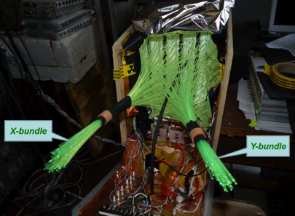
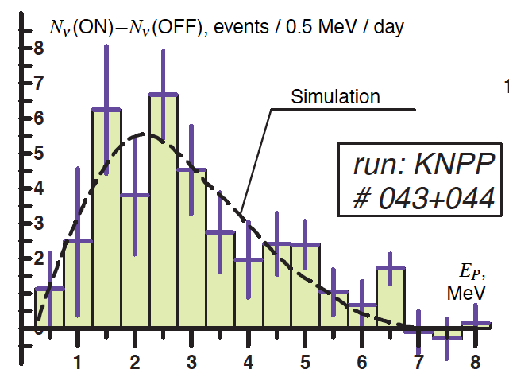
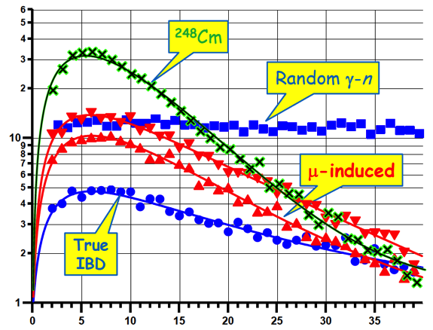
DANSSINO Prototype
1/25th of DANSS
Tested for ~20 days @ KNPP
10 cm Cu-Lead + 10 cm CH₂ shelding
Accidentals well suppressed
S/B~1, limited by cosmic fast neutrons.
Δt (μs)

Slide 23
New Short Baseline
Reactor Experiments

Slide 24

New Short Baseline Reactor Experiments
US Short Baseline Interest Group
Neutrino4 @ SM-3 Dimitrovgrad
SOLID @ BR2, Belgium
CARR site Beijing
Stereo @ ILL Grenoble
DANSS @ KNPP
Udolmya
Hanaro, Corea

Slide 25
New Short Baseline
Reactor Experiments
Segmented Liquid Scintillator Target

Slide 26

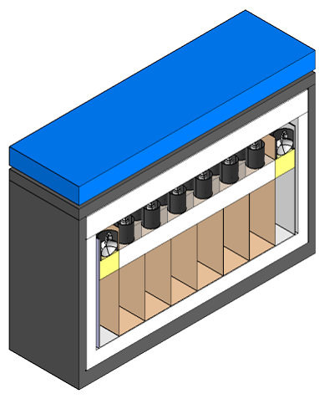
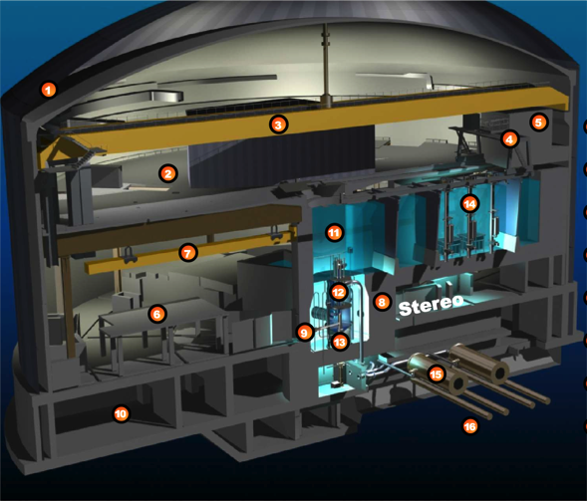

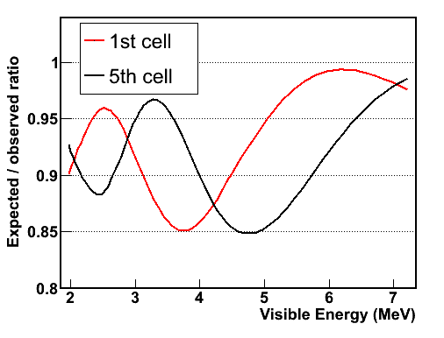
Stereo @ ILL
Contact: D. Lhuillier, CEA-Saclay
Outer crown for improved ε_{det} and veto of external background
Good overburden from water channel, factor 4 attenuation of vertical flux
μ veto
γ and n shielding
Relative measurement in 6 cells
50 MW core
h=80cm, Φ=40cm
Detector based on Double Chooz and Nucifer developments.
[8.5-11] m baseline range

Slide 27
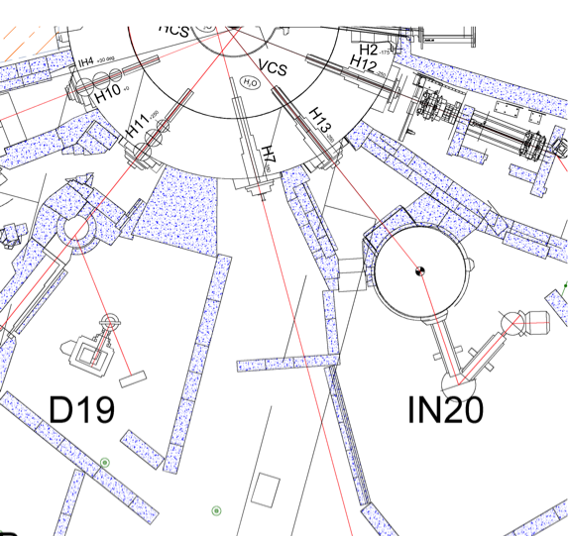

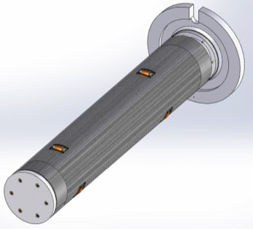
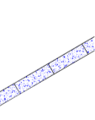

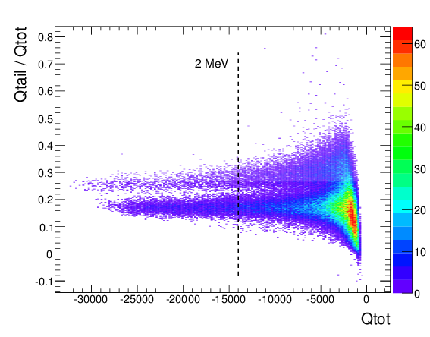
Background Rejection
Extensive on site measurements of muon, thermal n, fast n and γ background
Massive deployment of shielding during the upcoming long reactor shutdown. 30 cm of lead in front hot γ spots + hermetic B4C coating.
Dedicated plug of the neutron
line already designed.
Core
Stereo
Shadow of water channel
B4C
Lead
Liquid R&D for optimal light yield and PSD

Slide 28
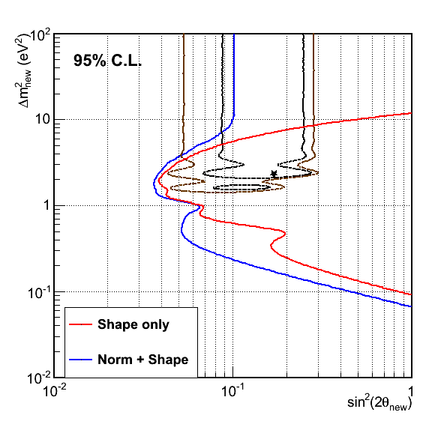
Stereo Sensitivity
6 ILL cycles (1.5 year running)
L₀ = 9.8 m
S/B = 1.5
E_{vis}>2 MeV, Neutron cut = 5 MeV
Complete det response
δL=20 cm, δE/E~10%@ 1MeV
δEscale = 2%
All syst. of ²³⁵U spectrum
3.5% total norm error
480 ν/day expected
Funded by ANR grant
Time schedule:
  2013-2014: design and construction
  Mid-late 2014: installation
  2015-2016: data taking

Slide 29
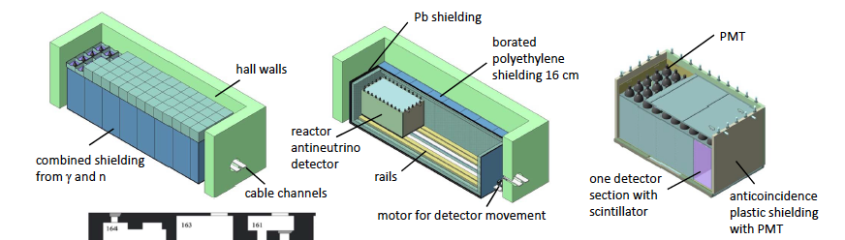
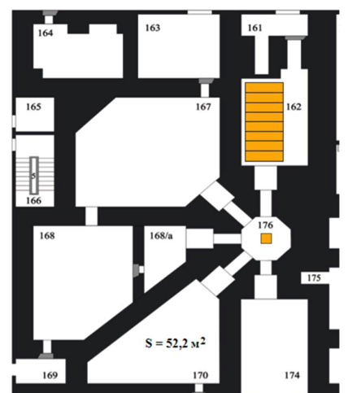
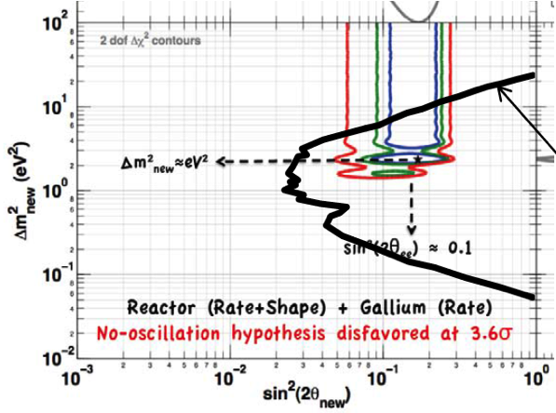
Neutrino-4 @ SM3
Contact: A. Sereborv, Gatchina
5 section movable detector [6-12] m, 2.5 m³ target
E_{prompt}>2.2 MeV, No background
Ongoing background meas. on site
100 MW
compact core
(35x42x42 cm³)

Slide 30
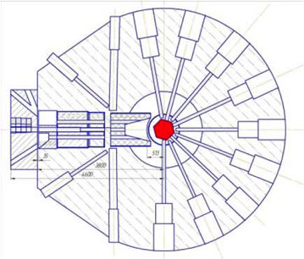
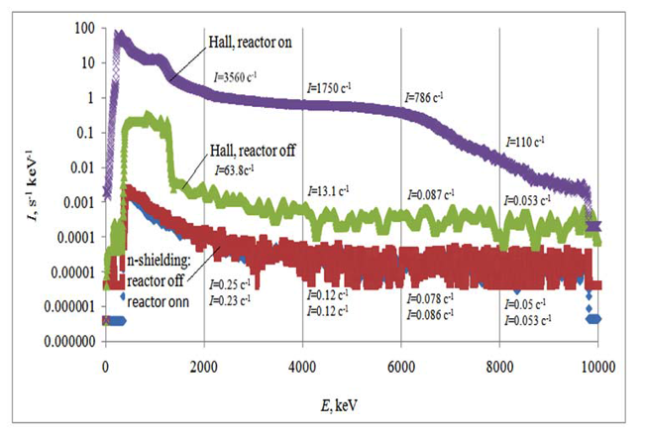
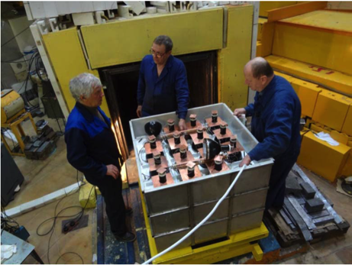
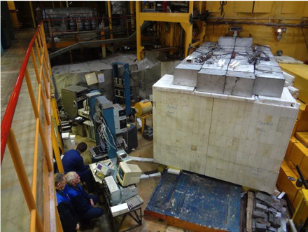
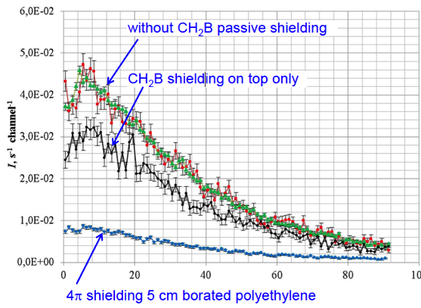
Neutrino-4 Prototype
Good suppression of γ background
Validation of a prototype detector at the WWR-M 17 MW reactor (Gatchina)
ON, no shield.
Off, no shield.
On, Off with shield.
Neutrino detection currently limited by cosmic rays induced fast neutrons.
Installation of shielding at the SM-3 site foreseen this fall.

Slide 31
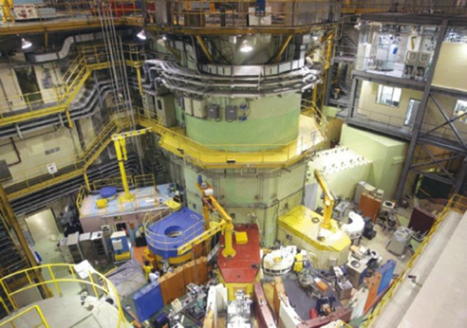
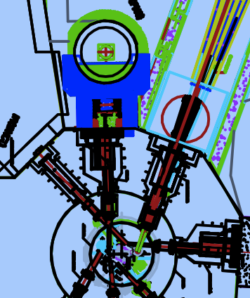


Hanaro, Korea
detector
- 30MW research Reactor
- Compact core ~ 20x40x60cm
- Modest overburden
- 500L Main Detector → ~ 100 events /day.
6m
Core
50L Prototype Detector built (2013)
Background study @ surface
Test of ⁶Li-loaded LS with segmentation
→ good n discrimination but low E_{visible}
Contact: K. Yeongduk, Sejong Univ.

Slide 32

Hanaro, Korea
Simulations about backgrounds
  Cosmic muon induced
  Cosmic neutron induced
  Accidentals
  Detector optimization.
Physics Run @ two places (2015)
  30MW research reactor.
  Tendon Gallery run @ 3GW commercial reactor.
500L detector design
Detector optimization :
  Include Gamma Catcher ?
  Include Pb shielding inside PE shielding ?
Stockholm, July 2013

Slide 33


Poseidon
Position-Sensitive Detector Of Neutrino
100 MW research Reactor PIK
is being built in Gatchina, (~2014 y)
LS(Gd) Detector
2.1x1.3x1.3 m³
MC simulation:
Energy resolution
σ = 7% at 1 MeV
Spatial resolution
σ_{x} = 15 cm at 1 MeV
Detector can be placed at 5-8 m
64 6” PMTs
15 cm
Veto+anti511
Compact core: h=50 cm, d=39 cm
E- and X-reconstruction of event is based on the charges collecting by PMTs
LAB+PPO+Gd
The region of sensitivity:
δm² = (0.3 - 6) eV² and Sin²(2θ)≥ 0.01
Petersburg Nuclear Physics Inst.,
NRC Kurchatov Inst. (arXiv:1204.2449)
Contact: A. Derbin, pnpi-Gatchina

Slide 34
New Short Baseline
Reactor Experiments
Near/Far Detector Concept

Slide 35

US Short-Baseline Reactor Experiment
Objectives
- short-baseline neutrino oscillation search with high sensitivity, probe of new physics
- test of the oscillation region suggested by reactor anomaly and νe disappearance channel
- precision measurement of reactor νe spectrum for physics and safeguards
- develop antineutrino-based reactor monitoring technology for safeguards
2-Detector Oscillation Experiment
reactor core
detector 1
~4m
Technically Limited Schedule:
FY13-14 - R&D
FY14-15 - design&construction
FY 2016 - first data?
detector 2
~15m
x10 det1 vol.
reactors under consideration:
NIST, ATR, HFIR
Contact: K.M. Heeger, Yale

Slide 36



A 2-Detector Oscillation Experiment
Discovery Potential
3σ in 1 year
5σ in 3 years
feasible at 3 US reactor sites
NIST, ATR, HFIR
Mumm, Littlejohn, K.M.Heeger, arXiv:1307.2859 (2013)

Slide 37









US Research Reactors
NBSR, NIST
ATR
HFIR, ORNL
Ongoing site characterization
Adapted from Lasserre et al 2012
NBSR, NIST

Slide 38





China Advanced Research Reactor
Detector concept:
GdLS (Daya Bay)
1-ton target/detector module
Teflon reflector on the inner wall
Two identical detector modules for relative measurement (rate+shape). Near detector @ 7 m, far flexible
Passive gamma/neutron shield + outer detector with liquid scintillator (anti-compton, fast neutron/muon veto).
CARR:
@CIAE in Beijing
Nearly operational
60 MW_{th}
5 m shielding wall
Contact: J. Liu, Shangai Univ.

Slide 39
Sensitivity Study
Near/far configuration
60MW_{th} × 1 year × near/far 1 ton × 100% efficiency
Detector-related systematics included
No background
Challenge: reactor-on background suppression
G. Guo et al., arXiv:1313.0607

Slide 40
New Short Baseline
Reactor Experiments
Highly Segmented Plastic Scintillators

Slide 41






SoLi∂
Search for Oscillations with ⁶Li Detector
BR2 REACTOR, Mol, Belgium
Core: 45-80 MW, ~ 50cm diameter
DETECTOR
2.88t fiducial volume
Novel type of composite solid scintillator detector (PVT + 6LiF:ZnS)
2x 20 planes 1.2m x 1.2m x 1m with 576 5cm x 5cm x 5cm cubes
Read out by WLS fibres and Geiger-mode APDs (MPPC), 1920 channels total
HDPE shielding
Lead Wall
SoLid detector
BR2 core
5.5m
HIGH SIGNAL TO BACKGROUND RATIO : S/B ~ 6
Soft Gamma-rays (< 3 MeV)
No reactor neutrons
Overburden ~10 m.w.e
contact : antonin.vacheret@physics.ox.ac.uk

Slide 42



SoLi∂ Antineutrino detection
Assembly of 5cm cubic cells
⁶Li
⁶Li
MC
-
⁶Li
ν_{e}
e⁺
e⁺
γ
γ
⁶Li
n
Δt ~ 1-200 us
n
Very discriminant neutron signal in ⁶LiF:ZnS. High neutron-γ rejection factor
3D reconstruction close to interaction point : high background rejection capability using topological information of IBD.
High light yield and good energy resolution (~17% at 1 MeV)
Data AmBe run
neutron
Gamma

Slide 43



SoLi∂ Sensitivity & status
Rate + shape
8kg Fiducial mass
20cm
20cm
5σ
95% CL
99% CL
Prototype under commissioning at Oxford
Deployment at BR2 for August 2013 reactor cycle (~25-30 days)
  study of background conditions
  antineutrinos measurement trial at 5m from reactor core
  expect 6 evts/day, S:B ~ 1:5
<Baseline>=6.8m, 2.88t fiducial mass
300 days (~ two years running)
45% IBD efficiency, 1200 n/day expected
L binning of 20 cm
Systematics : norm 4.1%, total ~5%
Physics run scheduled for start of 2016

Slide 44
Source Experiments

Slide 45


General Idea
Place an intense (0.5-10 MCi) source inside or close to a large size, already existing and well known neutrino detector.
The sources are very compact and can be accurately calibrated (~1%)
Neutrino source ⁵¹Cr
Antineutrino source ¹⁴⁴Ce
Mono-energetic
Elastic Scattering
Continuous β-spectrum
Discriminant IBD process
Proposed by Raghavan
Produced for Gallium experiments
ITEP N°90 1994
M. Cribier et al. PRL 107, 201801, 2011

Slide 46

CeLand Project
¹⁴⁴Ce Source @ the KamLAND detector
IBD: Eth = 1.8 MeV - (e+,n) coincidence
Virtually background free experiment!
Resolutions: 7.0%/√E - 15 cm
Funded by ERC and DOE grants.
Phase 1: 2015
  75 kCi source in outer detector
Phase 2: 2016 (if feasible)
  50 kCi source at center of LS
CeLAND Collaboration:
CEA: DSM-Irfu / DEN / SPR / LNHB / DRI
KamLAND Japanese Collaboration, Irfu (ERC), Hawaii U. (DOE funding), LBNL/UCB, Russia (Mephi)
Contact: T. Lasserre, CEA-Saclay

Slide 47





Source Production
Kola Nuclear Plant
Rosatom
Common SOX/CeLAND development for a 1% calorimeter at ~1kW thermal power.
PA Mayak
Reprocessing of few tons of spent nuclear fuel from the Kola reactor at the Mayak facility. Clean separation from other rare earth element by chromatography.
Samples to be delivered soon at CEA-Saclay
Final 75 kCi source to be delivered early 2015.
Transport issues under discussion.

Slide 48

CeLand Phase 1
Source @2.5 m away from LS.
75 kCi & 6-18 months of data taking.
L (m)
Shielding tungsten alloy
  47 cm diameter
  16 cm thickness
  ρ=18.5 g/cm³
scintillator
oil

Slide 49

CeLand Phase 1
0.5 year exposure
95% C.L.

Slide 50
CeLand Phase 1
1.5 year exposure
95% C.L.

Slide 51



CeLand Phase 2
Relocate the 144Ce source at the center of KAmLAND
75 kCi leads to 50 kCi after 6 months
95% C.L.

Slide 52

SOX Source Deployment in Borexino
SOX-A (2015)
10MCi ⁵¹Cr in Icarus pit
8.25 m from the center
3 months of data taking
SOX-B (end 2015)
75 kCi ¹⁴⁴Ce source in W.T.. PPO everywhere to enhance sensitivity
SOX-C (2016/2017)
50 kCi ¹⁴⁴Ce source in the center. Only after the end of solar program
CL-B
SOX-C
CL-A (2015)
75 kCi ¹⁴⁴Ce in the WT
6 months of data taking
CL-B (2016/2017)
50 kCi ¹⁴⁴Ce source in the center
1.5 y of data taking
CL-A
SOX-B
Funded by ERC grant.
SOX-A
See next talk by G. Ranucci

Slide 53
SOX sensitivities

Slide 54
Conclusions
Reactor and source experiments offer direct tests of the 4th neutrino hypothesis.
Sensitivities nicely cover the anomaly contour with complementary E and L coverage →unique discovery potential within the next 5 years.
High statistics experiments searching for few % deviations. The final sensitivity will be driven by detector systematics and background suppression
Reactors:
  Background mitigation is challenging. Site characterization is crucial.
  Nice combination of mature and new technologies; Synergies with reactor monitoring efforts.
Sources:
  Low background measurements using state of the art detectors.
  Challenge of the production and transportation of intense source

Slide 55
Backup Slides

Slide 56

Low Δm² Solution
sin²θ_{new}=0.15, Δm²=0.48 eV²

Slide 57

Stereo
10 reactor cycles
2 years data taking

Slide 58


DANSS
ВВЭР-1000
СМ-3 Small core
100MW Reactor

Slide 59

Li6-Doped Scintillator
N. Bowden, NANPino conference 2013.

Slide 60





SoLi∂
Search for Oscillations with ⁶Li Detector
contact : antonin.vacheret@physics.ox.ac.uk
RESEARCH REACTOR
SCK•CEN BR2 Mol, Belgium
Core: 45-80 MW, ~ 50cm diameter
DETECTOR
2.88t fiducial volume
Novel type of composite solid scintillator detector (PVT + 6LiF:ZnS)
2x 20 planes 1.2m x 1.2m x 1m with 576 5cm x 5cm x 5cm cubes
read out by WLS fibres and Geiger-mode APDs (MPPC), 1920 channels total
65MS/S dead timeless electronics
BACKGROUND
High signal to background ratio : S/B ~ 6
Soft Gamma-rays (< 3 MeV)
No reactor neutrons
Overburden ~10 m.w.e
HDPE shielding
Lead Wall
SoLid detector
BR2 core
5.5m
Front-end boards
Back-end FPGA based
Digital pulse processing boards
X-Y cube read out by BCF-91A
fibres
MPPC read out
3mm x 3mm

Slide 61




Source @ Daya Bay
¹⁴⁴Ce-¹⁴⁴Pr source can Probe baselines from 1.5-8 m with an source in the water pool of the Daya Bay Far Hall
Advantageous to place source outside detectors in water pool.
Multiple detectors allow for control of systematics.
500 kCi
source
source experiment feasible in Far Hall of the Daya Bay experiment after θ13 measurement.
Phys. Rev. D 87, 093002 (2013), Dwyer, Littlejohn, Vogel, Heeger

Slide 62




Icarus-Nessie @ CERN
• Using CERN-SPS new νμ
beam (Eν ~ 2 GeV)
• 2 LAr-TPC (from ICARUS):
near: 150 t, far: 600 t
• +magnetic spectrometers for
charge determination
• Should start (both beam and
detector data taking by end
of 2015).
-
-
ν_{μ} to ν_{e}
ν_{μ} to ν_{e}
ν_{e} to ν_{e}

Slide 63

ν_{μ} Sector

