Slide 1
BTY line @ 2 GeV
SGUI presentation
28/01/2013
J. Cole, K. Hanke, A. Newborough, S. Pittet, D. Voulot

Slide 2
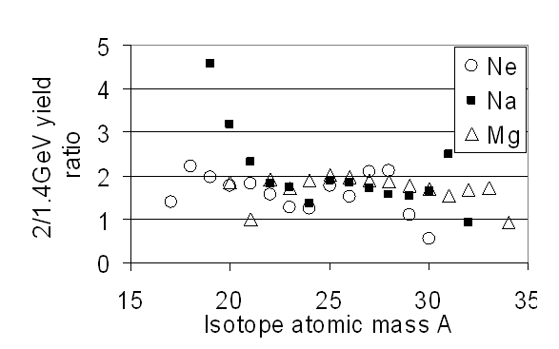
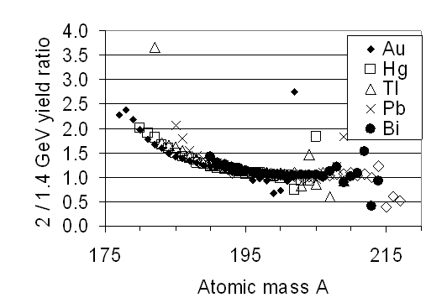
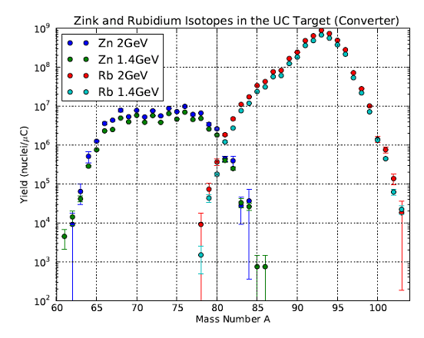
Motivation
Fragmentation
Several-fold increased yields for most beams especially exotic isotopes
2 GeV is the foreseen driver beam energy for EURISOL
Spallation
Fission
See: ‘Motivations to receive a 2 GeV proton beam at ISOLDE / HIE-ISOLDE:
Impact on radioisotope beam availability and physics program’, M. Kowalska, T. Stora (2011)

Slide 3
Assumptions
Keep beam optics and geometry unchanged
1.2 s repetition rate
Only 1.4 and 2 GeV beams available (no more 1.0 GeV beams !)
Only consider BTY line (BT and BTM part of LIU)

Slide 4
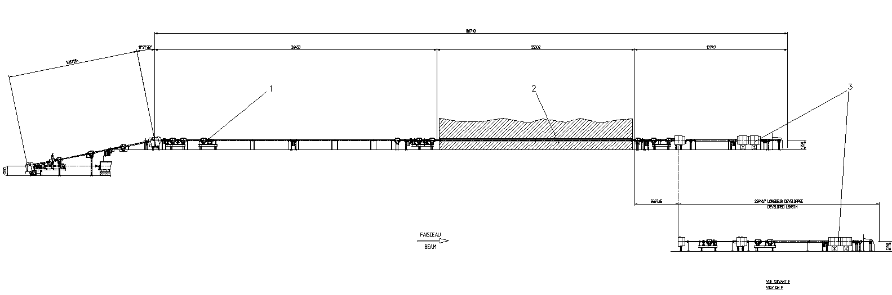
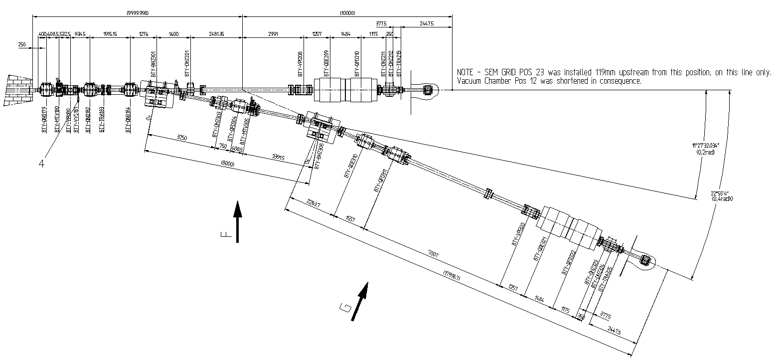
BTY line layout
BTY.BVT116
BTY.BVT101
Rte.
Democrite
GPS
BTM line
HRS
BT line
GPS
GPS + HRS lines inside target area
BTY.BHZ301
HRS
BTY.BHZ308

Slide 5
Magnet types
Quadrupoles
  Q100 Target focalization (4 units)
  Q130 beam transport (15 units)
Dipoles
  HB4 from former ISR transfer lines (4 units)
Correctors
  Type 1 H-V corrector magnets from PSB (14 units)
  Correctors have enough margin for 2 GeV

Slide 6
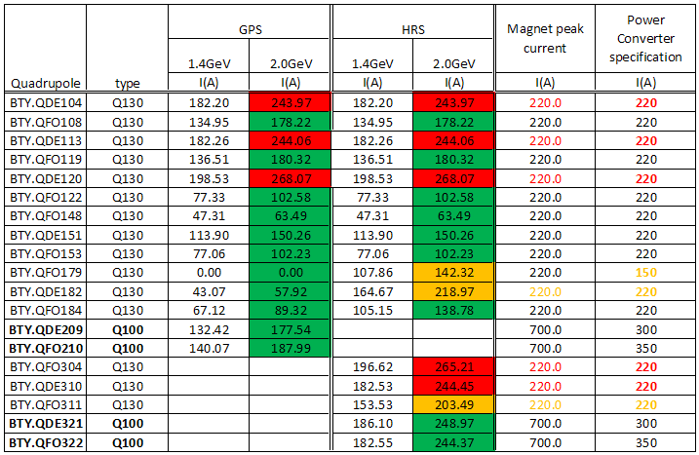
Quadrupole settings @ 2 GeV
5 quads exceed the limit (red) + 3 within 10% of limit (orange)
New converters required
Q130 magnets OK for 2 GeV assuming PPM operation with RMS < 220 A
No need for modification of the cooling circuits if PPM
No need for new cables
Q100 can be operated as today i.e. DC
Q100 have lots of radiation damages, replacement should be foreseen (spares available at CERN)
Theoretical settings from:
C. Carli, PS Booster Transfer Line setting for Operation with a lower vertical tune Qv = 4.23 (2003)

Slide 7
PPM mode
All magnets (except Q100*) and power converters are designed for PPM operation
Present situation: all quadrupoles operate in DC mode except BTY.QFO179, BTY.QDE182 and BTY.QFO184
PPM operation reduces RMS currents and hence cooling needs
Test of power converters in PPM mode in December 2011 between 1.0 and 1.4 GeV settings
OK for all but three converters:
  BTY.QDE120 (Q130, should be replaced anyway)
  BTY.QDE209 and BTY.QDE321 (Q100 will remain DC)
Need to test field stability with beam (end of LS1?)
* Q100 are solid yoke magnets (no lamination)

Slide 8
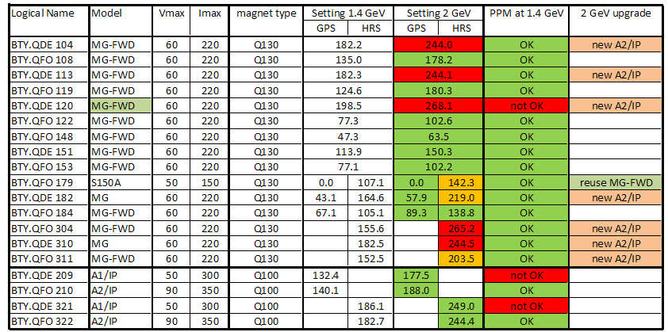
Power converters (Quads)
Need 7 new power converters and reassign 1
Cost estimation 7 * 160 kCHF = 1.12 MCHF (spares already available at CERN)

Slide 9
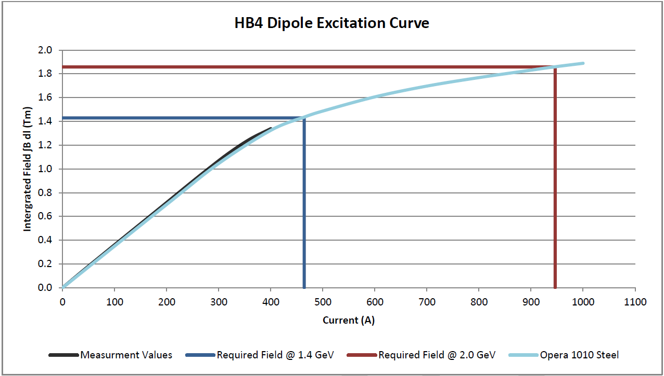
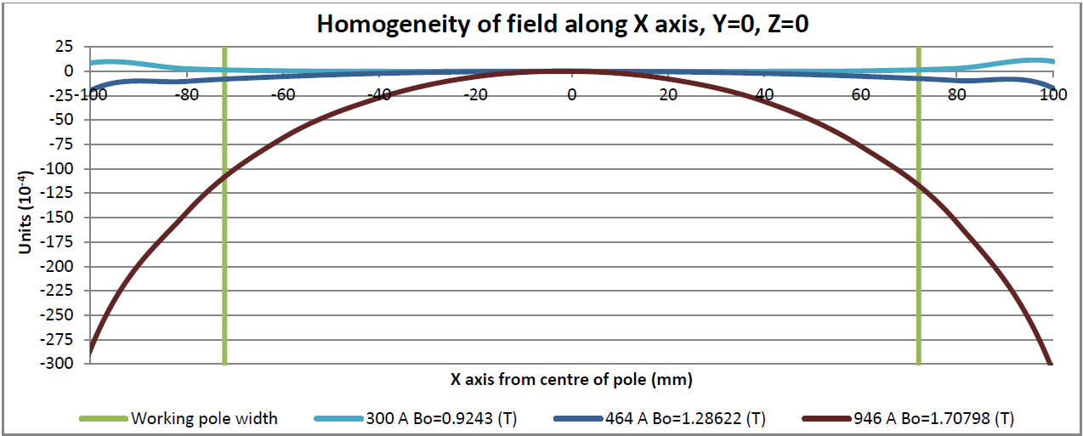
HB4 dipoles
Need 946 A @ 2 GeV (464 A @ 1.4 GeV)
Magnets highly saturated
Cooling requirement too high
Homogeneity problems
High cost of new PC ~500 kCHF/pc
HB4 magnets cannot operate at 2 GeV
J. Cole, Operation of the Booster to ISOLDE (BTY) magnets at 2 GeV (2012) EDMS: 1250294 v.2

Slide 10
Proposed Scenario
Replace the 4 HB4 dipoles with new dipoles designed to match the existing power converters specifications
Advantage
No need for new converters (save 2 MCHF) + no need for new building to house the converters
No need for re-cabling
But longer magnets
Need to adapt beamlines around the magnets
Restricted access to BTY line (2.5m * 2m access shaft) and ISOLDE target area

Slide 11
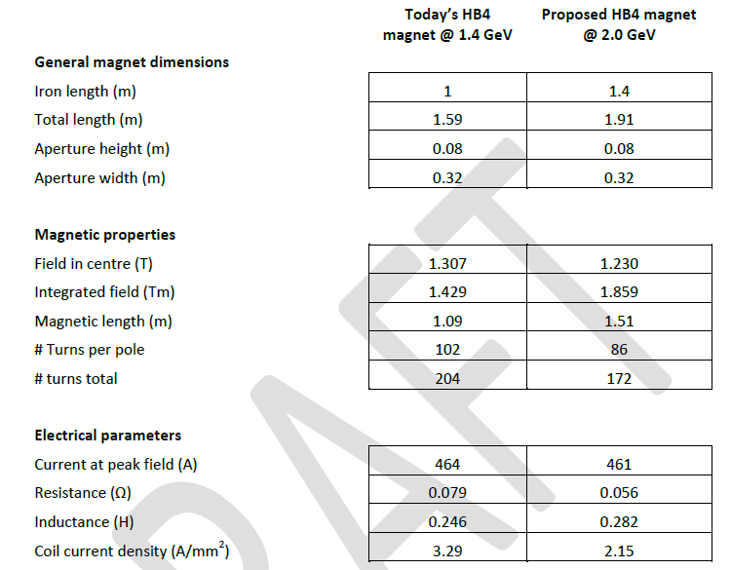
Preliminary magnet specifications
J. Cole, Operation of the Booster to ISOLDE (BTY) magnets at 2 GeV (2012) EDMS: 1250294 v.2

Slide 12
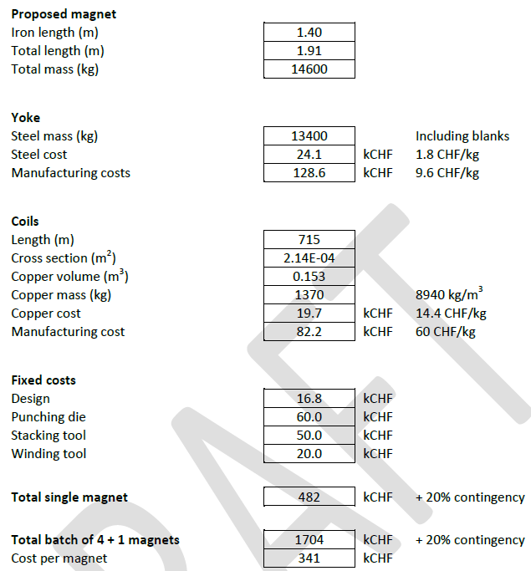
Preliminary cost estimate
J. Cole, Operation of the Booster to ISOLDE (BTY) magnets at 2 GeV (2012) EDMS: 1250294 v.2

Slide 13
RP and shielding
Radiation will scale with power (no significant change in cross sections between 1.4 and 2 GeV)
BTY shielding design was very conservative (Sullivan 1993)
  assuming: ‘1% of the maximum beam, or 0.2% per meter of beam path, could be lost anywhere continuously along the beamline’
  and ‘maximum losses for which hand-on maintenance of the accelerator component would be possible due to the high residual dose rate (several mSv/h near the beam line)’
In reality losses and residual dose rates are many orders of magnitude lower (uSv/h)
Shielding is not expected to be an issue even for a four fold increase of the beam power (2.8 ->10 kW)
Need more detailed analysis plus RP survey after power upgrade
Sullivan, A H. Radiation safety at ISOLDE. s.l. : CERN, 1993. CERN/TIS/RP/93-13

Slide 14
Beam intercepting device
Main concern: beam stopper
Not water cooled
Designed for lower beam power
Replacement of all beam stoppers foreseen as part of the PS complex consolidation
Other beam intercepting devices: SEM-grids, MTVs
Standard diagnostics used elsewhere in the PS complex
Should stand the power increase

Slide 15
Conclusion
OK for all magnets except dipoles assuming RMS operation for Q130
Initial test in December show PPM operation is possible (need to confirm with beam test)
Need new dipoles matching existing PC and space constraints (seem to be possible)
Need beam optics and integration study
Estimated cost 2.8 MCHF (replacement of power converters1.12 + new dipoles 1.7)
Vacuum, support, transport, civil engineering(?)... not included
Little concern with shielding and beam intercepting devices (need more detailed analysis)
Not approved for the moment, should be discussed at next IEFC

