Slide 1
Thread-Safe Histogram Service
Concurrency Forum
Beat Jost
Cern / PH
22 November 2012

Slide 2
Why?…
Two methods to explore many-core architectures for “identical” tasks without making memory requirements explode
  Forking, i.e. configure one copy and fork N copies
    Read-only pages are shared and only copied when being written
    Histograms exist in several copies
  Threading, i.e. create N threads running the algorithms, maybe after configuring the basic infrastructure.
    All (heap) memory is shared, especially also histograms
    HOWEVER, Root is (not yet) thread-safe, i.e. filling is not thread-safe

Slide 3
Making Histogram Filling thread-safe
Three approaches
  Adapt root to protect critical code sections with mutexes
  Protect the filling algorithm with a mutex
  Dispatch the filling to a separate thread and communicate with it via a queue (containing the filling parameters)
Discussion
  - Prob. The most efficient way, unless operations tend to take long (lock-out of other threads)
  - fine-grain locking possible
  - have to go through entire root code
  Similar to a). Obviously no fine-grain locking possible. No in-depth knowledge of root needed.
  Most flexibility. Works efficiently if processing is ‘rare’ and ‘long’ (not the case for histogram filling)
  →Not very easy to return results of calculations, etc.
  (could have a queue per source thread to receive results and de-queue when needed)

Slide 4
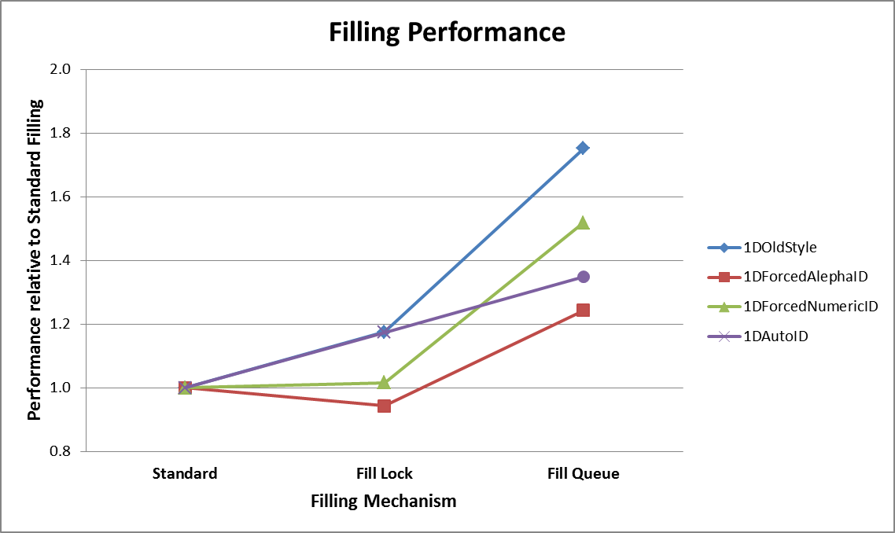
Implementation and Performance
Solutions b (pthread mutex) and c (TBB concurrent queue) have been implemented in a prototype of the histogram service
  Choice between old functionality and b) or c) via job options
  Tested with histogram test option file from Gaudi Examples
The test delivers also some sort of performance summary

Slide 5
Outlook
Depending on the usage of the histogram service, maybe other functions have to be protected
  E.g. add, to get a consistent sum?
I think queues are an adequate tool to implement service-like constructs, such as
  reading events from files and feeding them to algorithms to prevent worked threads from waiting
  Collecting results from several threads and e.g. write to disk
  (remember root/IO is prob. also not thread safe)

Slide 6
Mutex Performance
N Threads locking/unlocking single Mutex

Slide 7
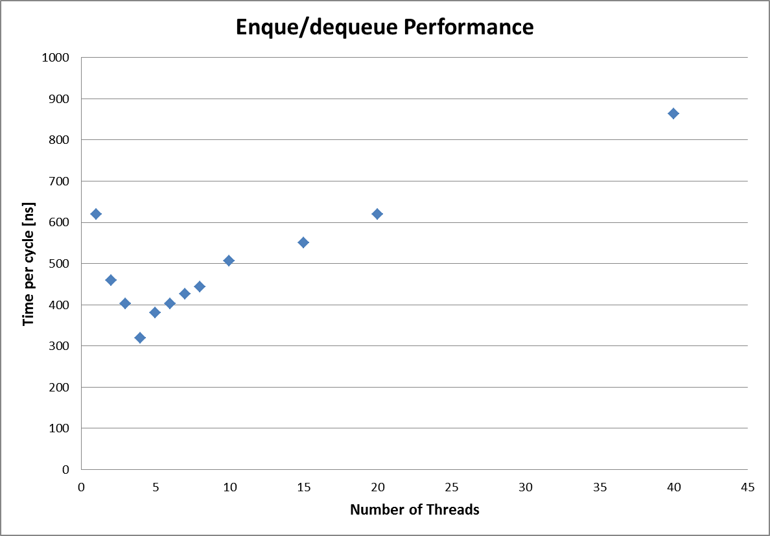
Queue Performance
N threads inserting and N threads removing from single queue

