Slide 1
large GEM test beam November 2012
C. Armaingaud, J. Merlin, S. Colafranceschi, A. Marinov
Y. Maghrbi, P. Barria, S. Salva

Slide 2
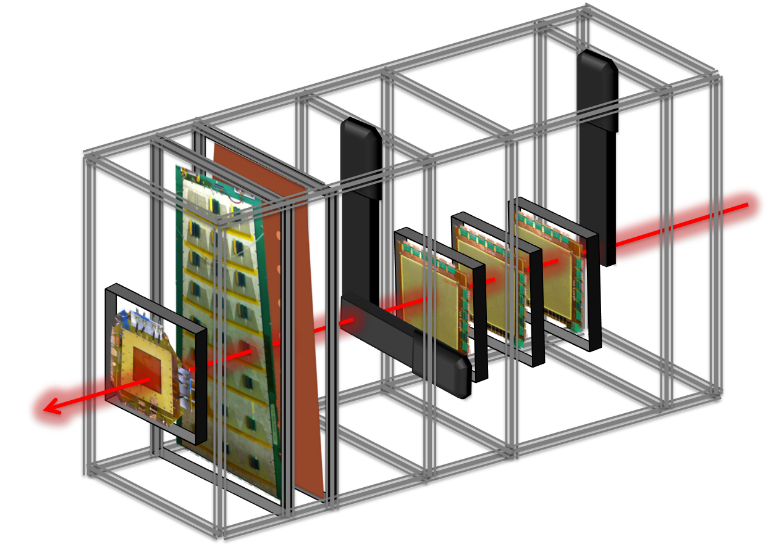
SET UP
Muons or pions beam 150Gev
Tracker: three triple GEM 10x10Cm
Trigger signal: three scintillators
2 large chambers to test
1 Timing GEM

Slide 3
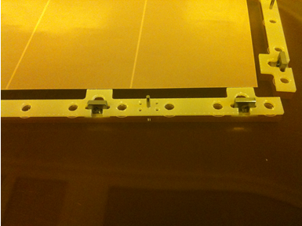
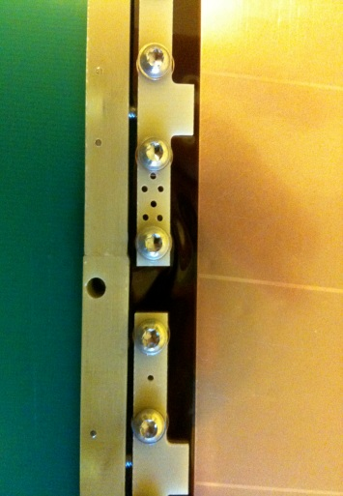
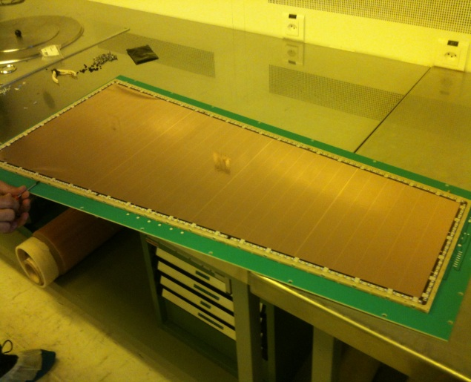
Detectors tested
2 large chamber (NS2 technic) No spacers in active area.
3-1-2-1 gap configuration
E-fields at High efficiency :
drift : 3KV/cm
transfert 1 and 2 : 3.5KV/cm
induction : 5KV/cm
2 Sectors tested with pitch 0.83 and 0.88.
Data taken with VFAT system and SRS system.

Slide 4
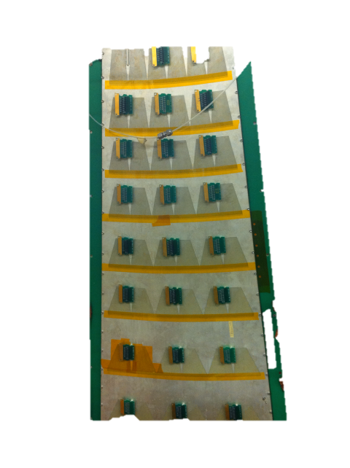
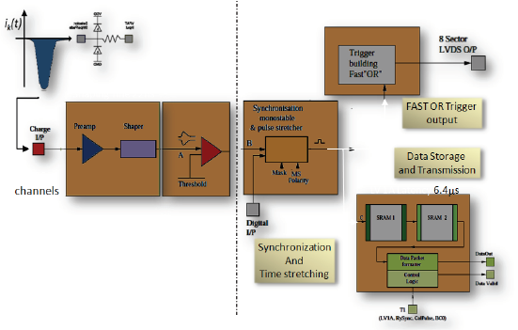

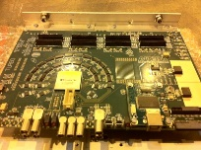
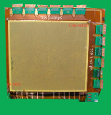
VFAT
ANALOG AND
ASYNCRONOUS
DIGITAL AND
SYNCRONOUS
Analogic signal
scintillators
data
Tracker1
Turbo0
discriminateur
Tracker2
Trigger information
Turbo1
coïncidence
Tracker3
Turbo2

Slide 5
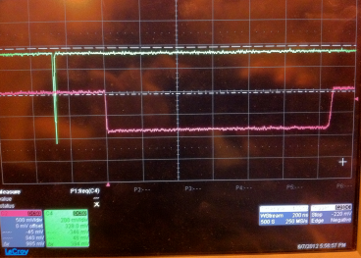
Time measurement with TDC
TDC
Analogic signal
scintillators
delay~ 100ns
Tracker1
SBIT
Turbo0
discriminateur
Tracker2
Turbo1
coïncidence
Tracker3
Trigger
Turbo2

Slide 6
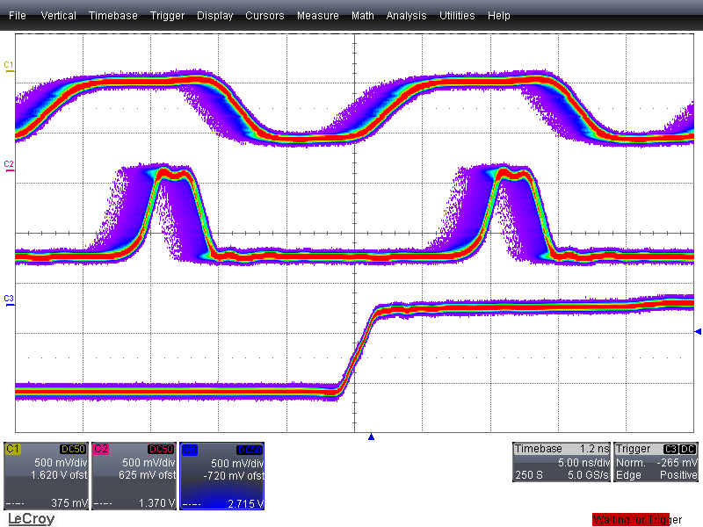
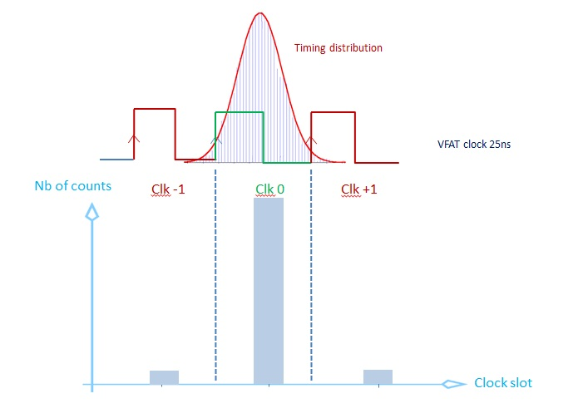
TDC with synchronized clocks
Goal: Which purcentage of event is recorded in one clock cycle?
New trigger: coincidence between scintillators (previous trigger) and turbo’s clocks.
Event recorded per clock cycle.

Slide 7
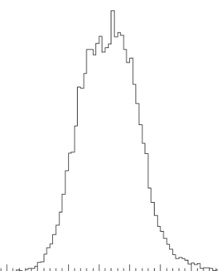
We need to position the time distribution in the middle of one clock cycle.
Clk -1
Clk 0
Clk +1

Slide 8
VFAT TURBO TDC
TDCRun 000 to 013 :
Ar/CO2/CF4-45/15/40 ------ Sectors 3/4 and 1/4
Icomp Scan from 40 to 140 at 4250 V // 800 uA
Delay 12 ns // Ishaper=200
Pions 150 GeV
TDCRun 014 to 020 :
Ar/CO2/CF4-45/15/40 ------ Sectors 3/4 and 1/4
HV Scan from 3650 V // 687 uA to 4250 V // 800 uA
Icomp=76 // Delay 12 ns // Ishaper=200
Muons 150 GeV
TDCRun 021 to 028 :
Ar/CO2/CF4-45/15/40 ------ Sectors 3/4 and 1/4
Ishaper Scan from 175 to 225 at 4250 V // 800 uA
Icomp=76 // Delay 12 ns
Muons 150 GeV
TDCRun 029 to 051 :
Ar/CO2/CF4-45/15/40 ------ Sectors 3/4 and 1/4
Icomp Scan from 40 to 140 at 4250 V // 800 uA
Delay 23.5 ns // Ishaper=200
Pions 150 GeV
TDCRun 054 to 059 :
Ar/CO2/CF4-45/15/40 ------ Sectors 3/4 and 1/4
HV Scan from 3650 V // 687 uA to 4250 V // 800 uA
Icomp=100 // Delay 23.5 ns // Ishaper=150
Pions 150 GeV MSPL 4
TDCRun 060 to 066 :
Ar/CO2/CF4-45/15/40 ------ Sectors 3/4 and 1/4
HV Scan from 3650 V // 687 uA to 4250 V // 800 uA
Icomp=100 // Delay 23.5 ns // Ishaper=150
Muons 150 GeV MSPL 1

Slide 9
APV+SRS
Run01 :
Ar/CO2-70/30 ------ Sectors 3/5 and 1/5
HV Scan from 3000 V // 562 uA to 3600 V // 675 uA
Muons 150 GeV
Run02 :
Ar/CO2-70/30 ------ Sectors 3/4 and 1/4
HV Scan from 3000 V // 562 uA to 3600 V // 675 uA
Muons 150 GeV
Run03 :
Ar/CO2/CF4-45/15/40 ------ Sectors 3/4 and 1/4
HV Scan from 4050 V // 762 uA to 4250 V // 800 uA
Muons 150 GeV
Run04 :
Ar/CO2/CF4-45/15/40 ------ Sectors 3/4 and 1/4
HV Scan from 3950 V // 744 uA to 4250 V // 800 uA
Pions 150 GeV
Run05 :
Ar/CO2/CF4-45/15/40 ------ Sectors 3/4 and 1/4
HV Scan from 3750 V // 706 uA to 4250 V // 800 uA
Pions 150 GeV
Run06 :
Ar/CO2/CF4-45/15/40 ------ Sectors 3/4 and 1/4
HV Scan from 3750 V // 706 uA to 4250 V // 800 uA
Muons 150 GeV
Run07 :
Ar/CO2/CF4-45/15/40 ------ Sectors 3/4 and 1/4
HV Scan from 3850 V // 725 uA to 4250 V // 800 uA
Pions 150 GeV
Run08 :
Ar/CO2/CF4-45/15/40 ------ Sectors 3/4 and 1/4
HV Scan from 3750 V // 706 uA to 4250 V // 800 uA
Muons 150 GeV
+ Some long runs (muons/pions)
+ Pedestal runs

Slide 10
Conclusion
Data analysis in progress.
Data taken with both SRS and VFAT systems. It will be interesting to compare results given by two different electronic readout from one common run.
Timing measurement done in two different ways (synchronised clock, or « online » time distribution).
We learned SRS system, THANK YOU ERALDO. Very powerful system, it will be used in the future.

