Slide 1
SRS electronics 2012 overview
RD51 Miniweek
3-5 September - CERN
Working Group 5-electronics for MPGD’s

Slide 2
SRS status
SRS 19” now standard
SRS-ATCA coming

Slide 3
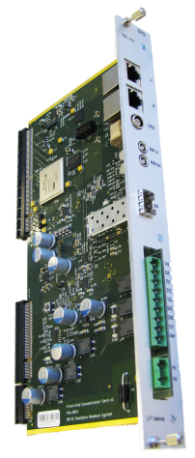
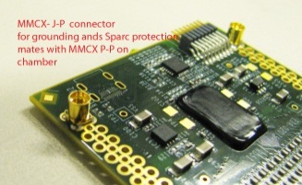
SRS frontends
SRS system cards
APV25 (128 ch, analog) (CERN store )
VFAT (128 ch, digital) CMS/Totem
Beetle (128 ch,a+d) Focal, WIS
VMMx (64 ch, digital ZS ) ATLAS NSW
Timepix R&D proto for ILC TPC Bonn
analogue adapter (16 x ADC 12 bit) ( CERN store)
digital adapter ( 16 x HDMI->FPGA) (VFAT CMS)
CTF clock-trigger fanout (INFN Napels)
Timepix adapter 3U ( Bonn )
HV card 3U ( RD51)
Optocard VFAT 6U (Totem)
FEC ( CERN store)
SRU (common, RD51 & EMCal)
FEC-ATCA (new, dual FEC)
ADC-ATCA mezzanine
octal SFP optical ATCA mezzanine (UPV)
SRS Online via UDP
Slow controls via IP
DATE (default)
MMDAQ (ATLAS MM)
RCDAQ ( RHIC)
Labview SRS ( testing)
SDC (standard )
scripts via Linux/DATE
Labview (testing)

Slide 4
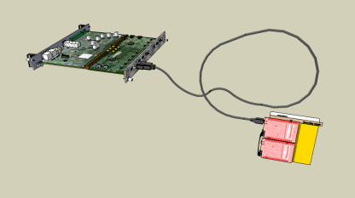
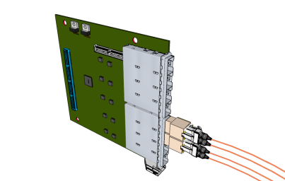
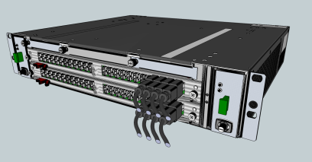
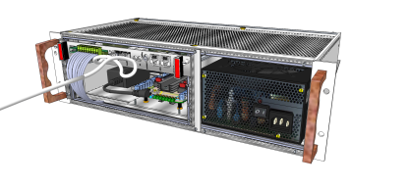
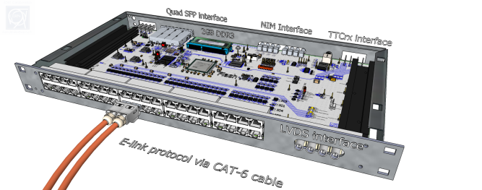
frontend links
Crate environment
HDMI cables ( CERN store)
optical SFP ( in prep@ UPV)
E-link via kapton (proposal)
Minicrate 19” 3U (CERN store)
Eurocrate 19” 6U (CERN store)
ATCA Minicrate (ELMA )
ATCA 14 slot full crate (ELMA)
Readout Units
SRS firmware
Network switch ( NETGear)
SRU ( default, large systems)
SRU-ATCA (slot 1, 40-100 GB planned)
SRU-e ( e-link <-> 10 GBE emulation )
Common FEC ( SRS resource repository)
core 1 GBE Virtex5
analogue module APV readout
common mode/pedestal correction
Zero Suppression APV
10 Gbit core Virtex6 XAUI ( SRU)
DDL core ALICE
Slink core ATLAS
TTC rx module Virtex-6 (SRU)
TTC rx emulator SFP Virtex6 (SRU)

Slide 5
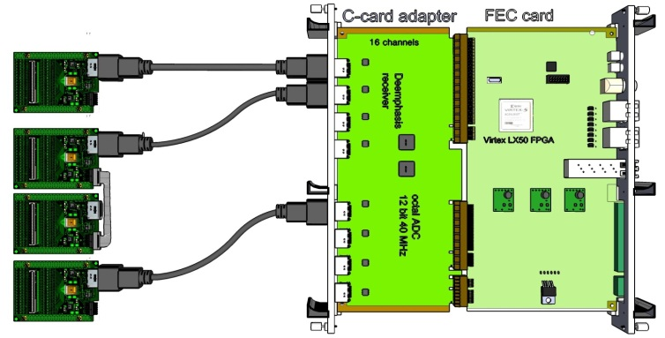

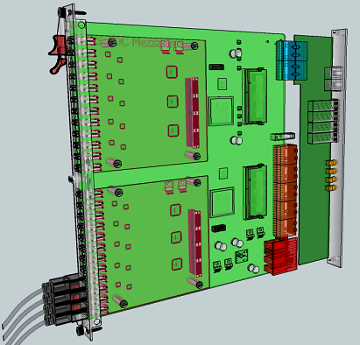
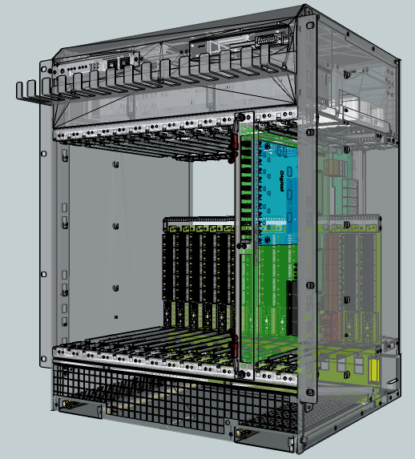
Coming: ATCA-SRS* for LHC experiments
ATCA-FEC blade:
2 x FEC
upgraded FPGA
RTM:
Ethernet
SFP
DTC
(for stand-alone applications)
Mezzanines:
HDMI ADC
HDMI Digital (HS)
Optical interface
1.) higher channel integration => reduce cost/channel for large systems
2.) certified crate standard 3.) replace DTCC cables by ATCA backplane
4.) start with 2-slot ATCA crate that can be read out via SRU box through DTCC on RTM
Commercial production for NEXT, EMCaL, ATLAS NSW : EicSys GmbH
(ATCA = AdvancedTCA = Adcanced Telecommunication Computing Architecture)

Slide 6
SRS inhouse purchase
Final procedures

Slide 7
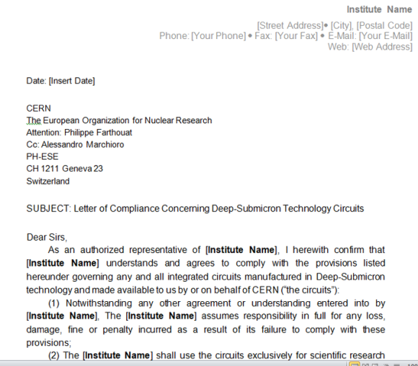
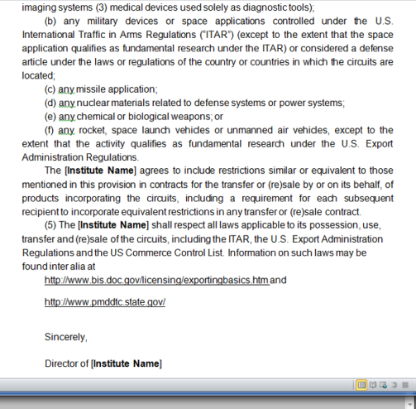
Export restrictions radhard electronics
SRS hybrids contain radhard ASICs , hence purchase is subject to:
a.) your institute must have signed the “letter of compliance” available by RD51
b.) Special export permit is needed for a number of countries
http://www.ecfr.gov/cgi-bin/text-idx?c=ecfr&sid=59ee1d5eeb8f1d444ba88927fa1eaaff&rgn=
div9&view=text&node=15:2.1.3.4.24.0.1.5.27&idno=15
ESE group has exclusive
distribution right
Director of Institution
needs to sign for use and conditions

Slide 8
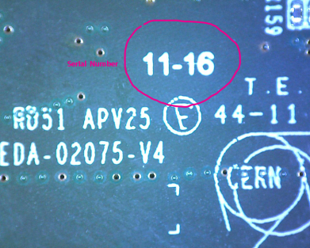
Procedure SRS orders
For all SRS items, before placing the order, check with CERN store if the material is available
use CERN EDH purchase system: edh.cern.ch ( CERN computer account needed !)
go to material request (STORE) and click on CERN Stores icon
Enter keyword “SRS” to opens a list of SRS items with SCEM numbers
Click on “BUY” to create an EDH Material request in your Browser
You need a budget code and CERN delivery location
Normally the budget code is a CERN Team account code *
When Material request is complete and saved, check total cost in CHF & click SEND
Delivery of standard material to CERN address
Hybrids require pickup: contact ESE group Alessandro.Marchioro
Serial numbers ( see photo) will be registered under your name
RD51 membership authorizes opening of a CERN team account
https://espace.cern.ch/team-accounting/Procedures/Pages/Opening.aspx

Slide 9
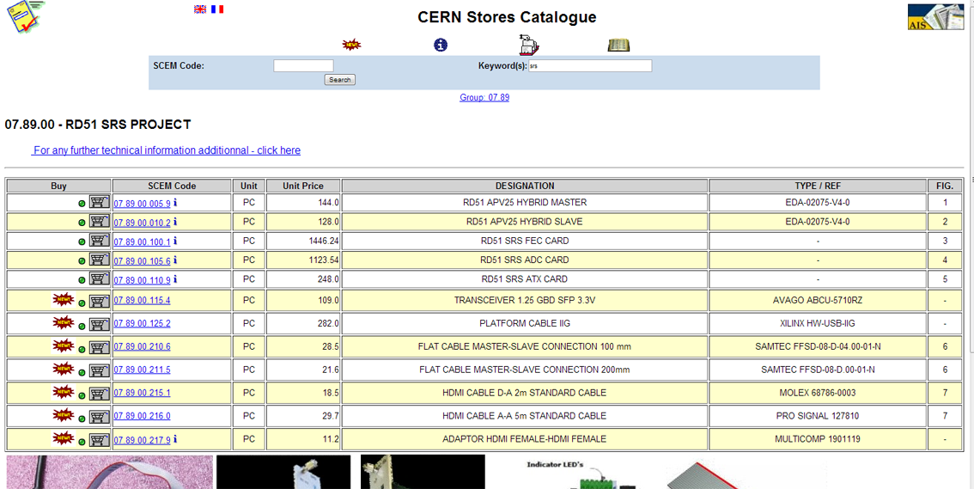
SRS SCEMs
Minicrate A SCEM 07.89.00.020.0
Eurocrate HP SCEM 07.89.00.030.8
MMCX on detector SCEM 07.89.00.200.8
MMCX on hybrid SCEM 07.89.00.205.3
1 Gbit PCI card for PC SCEM 80.02.08.007.1
130 pin connector for hybrid SCEM 09.55.42.400.3
130 pin connector for detector SCEM 09.55.42.410.6
NUP4114 quad protection diode SCEM 07.89.00.999.3

Slide 10
SRS standard 19”
What you can buy now

Slide 11

FEC card V3 (standard)
FEC V3 | Revision 3 | Revision V6 planned
applies to: | all 19” SRS systems | Euro + Minicrate
Design | finished 2010, Mentor G | UPV Valencia, J.Toledo
PCB routing | Gerbers available | UPV Valencia, J.Toledo
PCB production | 12- layer NELCO 4000 | Lab Circuits
Material list | available | Contact us
Prototyping | finished | CERN RD51
Firmware | downloadable | SRS repository
Production | ongoing | Prisma Electronics
Availability | YES, SCEM 07.89.00.100.1 | CERN store
Serial No | > 50 | Mac address derived
Online Software | DATE, MMDAQ, RCDAQ | See RD51 talks
Test Software | Labview | See RD51 talks
Documentation | DATE for SRS, SRS-Labview, writeups | Contact us

Slide 12
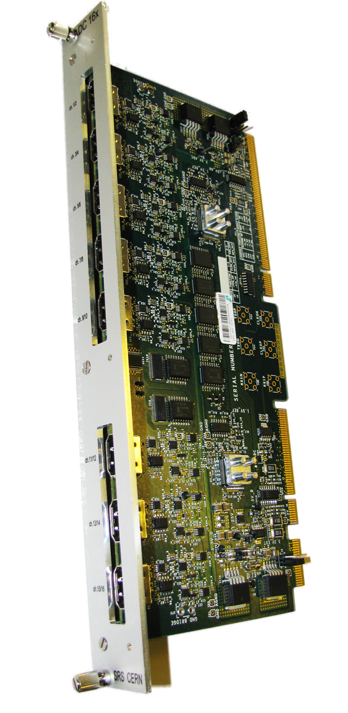
ADC digitizer card (standard)
ADC | Revision 1.1 | Revision 2 planned
applies to | Analogue ASICs | APV25, Beetle, ..
Design | finished 2010 | RD51 CERN, S.Martoiu
PCB routing | Finished 2010 | Intrasys Design Ltd
PCB production | 10 layer FR4 | ELTOS, Beta Layout
Material list | available | Contact us
Prototyping | finished | CERN RD51
Firmware | See FEC | SRS repository
Production | ongoing | Prisma Electronics
Availability | YES, SCEM 07.89.00.105.6 | CERN store
Serial No | > 50
 | DATE, MMDAQ, RCDAQ | See RD51 talks
Test Software | SRTCS Labview | V.Gezer
Documentation | DATE for SRS, SRS-Labview, writeups | Contact us
updates | 3V3-> 5V power HDMI | Contact us

Slide 13
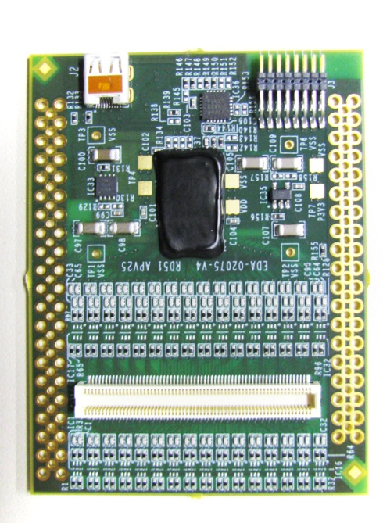
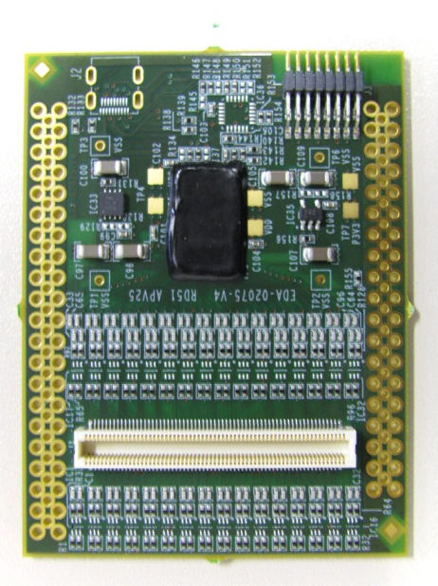
APV hybrid (standard)
Master
AVP hybrid, 128 ch | Revision 4 | final
applies to | MPGD detectors | analogue , 250 kHz max
Design | finished 2010 | RD51 CERN, S.Martoiu
PCB routing | finished 2010 | CERN DEM
PCB | 4 layer ENIG, microvia | ELTOS
Material list | available | EDA-02075-V4
Prototyping | finished | CERN RD51
Firmware | See FEC | SRS repository
Production, bonding | ongoing | Hybrid S.A
Availability | YES, SCEM 07.89.00.005.9 (M) 07.89.00.010.2 (S) | CERN store purchase Distribution via ESE
Serial No | > 500 Format (XX-YY) | on serigrafie backside
Client s | All RD51 teams | R&D on MPGS detectors
Software | DATE, MMDAQ, RCDAQ | Contact users
Test Software | apv-srs (Labview) | INFN Naples R. de Asmundis
Documentation | CMS APV documentation | Contact us
Connection & power | Micro HDMI | SCEM 07.89.00.215.1
Slave

Slide 14
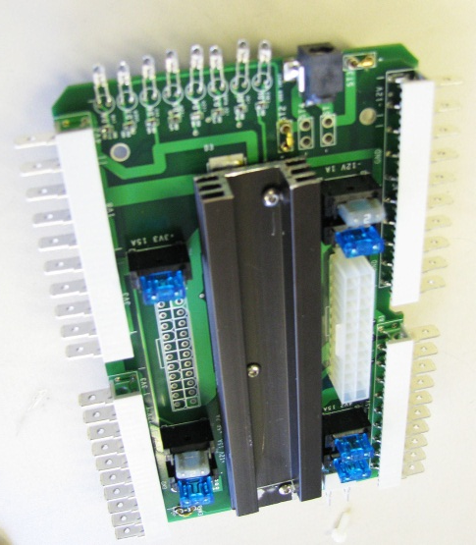
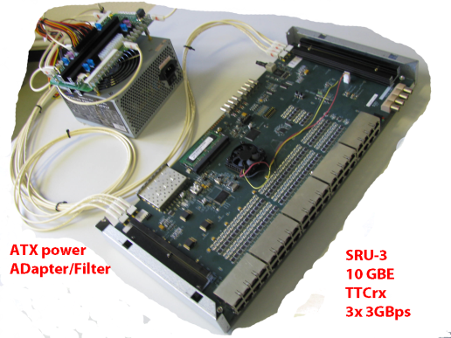
ATX adapter (standard)
ATX power for SRS | Revision 2 | final
applies to | Minicrate, Eurocrate Desktop power SRU | FEC SRU ADC Hybrid
Design | finished 2010 | RD51 CERN, H.Muller,
PCB routing | finished 2010 | RD51 CERN, V.Gezer
PCB | 2 layer FR4 | BETA layout
Material list | available | Contact us
Production | ongoing | Prisma Electronics
Availability | YES, SCEM 07.89.00.110.9 | CERN store self made possible
Test Software | apv-SRS (Labview) | INFN Naples R. de Asmundis
Documentation | Mechanical | Contact us
Connection & power | 15 A Car plugs | Mini car fuses 10A, 2 A
part of SRS crates

Slide 15
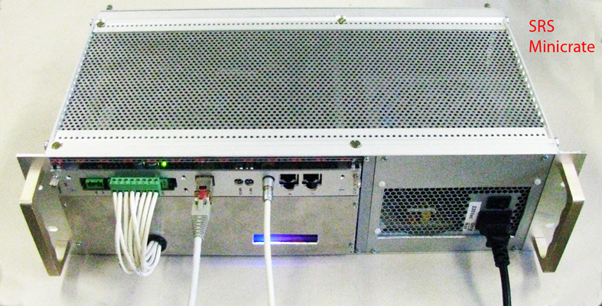
Minicrate A (standard)
So far used with APV frontend up 2048 ch
Minicrate | Revision A | Rev B planned (2 FECs)
applies to | 1 FEC/ADC Combo | 2048 APV channels max
Design | finished 2010 | RD51 CERN, H.Muller
Mechanics | 19 “ 3U x 220 crate kit | CERN store
Part and mechanical design document | Dxf and pdf available | Contact us
Prototyping | finished | CERN RD51
Production | ongoing | Prisma Electronics
Availability | YES, SCEM 07.89.00.020.0 | CERN store Check availability
Serial No | > 25
ATX adapter included | 9-way power cable | 5 kg
Separate orders needed for
1 FEC V3
1 ADC V1.1
Accessories:
1 SFP plugin 1000Base-T
( SCEM 07.89.00.115.4 )
Up to 8 HDMI A-Micro cables
(SCEM 07.89.00.215.1)

Slide 16
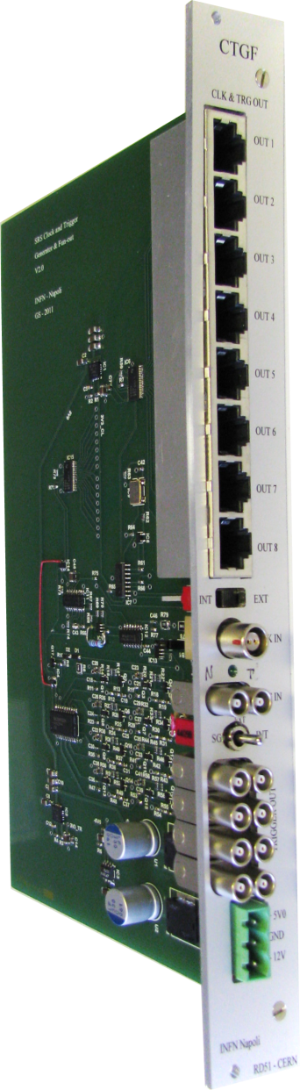
CTF (Clock Trigger Fanout)
CTF | Prototypes | Commercal version planned
applies to | Eurocrates slot 9 | Clock and trigger
Design | finished 2010 | INFN Naples , G.Sekhniaidze
PCB | 10 layer FR4 | Beta Layout
PCB layout | Altium | G.Sekhniaidze
Material list | available | Contact us
Prototyping | finished | INFN Naples
Production | Planned 2013 | Prisma Electronics
Availability | Prototypes | SRS lab
Serial No | > 5
Test Software | CTF required for SRCTS | Labview
Documentation | Connectivity | Contact us
updates | Pinout RJ45 = DTCC link | Contact us
Slot 9 in Eurocrates

Slide 17
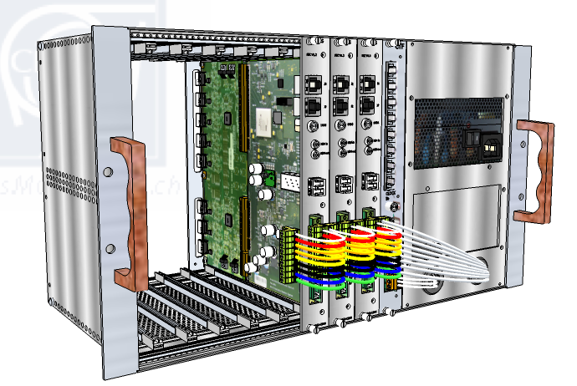
Eurocrate HP (standard)
Half Power = 500 W
With APV frontend up 8192 ch
Other frontends and adapters can be used
CTF card recommended in Slot 9
Network switch needed to combine FEC-networks -> Online
Minicrate | Revision HP | Upgradable to FP
applies to | 4 FEC/ADC Combos 1 CTF card slot | 8 FEC /ADC Combos 1 CTF card slot
Design | finished 2011 | RD51 CERN, H.Muller
Mechanics | 19 “ 6U x 220 crate | CERN store
Part and mechanical design document | dxf, and pdf available | Contact us
Production | ongoing | Prisma Electronics
Availability | YES, SCEM 07.89.00.030.8 | CERN store Check availability
Serial No | > 25
ATX adapter included | 9-way power cable Daisy chained x4 | 10 kg
Separate orders needed for
Up to 4 x (FEC V3+ADC V1.1)
Accessories:
1 SFP plugin 1000Base-T
per FEC card
( SCEM 07.89.00.115.4 )
Up to 8 HDMI A-Micro cables
per ADC card
(SCEM 07.89.00.215.1)

Slide 18
Special versions
prototypes

Slide 19
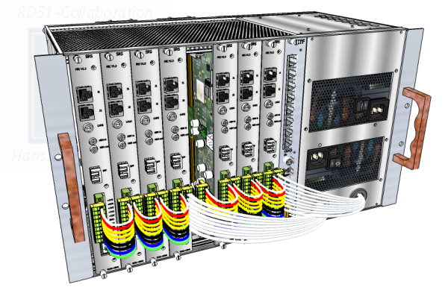
Eurocrate FP (proto only)
Full Power = 2 x 500 W
With APV frontend up 16384 ch
Open for other frontends
CTF card needed in Slot 9
SRU recommended DTCC FEC links -> 10 GBE Online
Minicrate | Revision HP | Upgradable to FP
applies to | 4 FEC/ADC Combos 1 CTF card slot | 8 FEC /ADC Combos 1 CTF card slot
Design | finished 2011 | RD51 CERN, H.Muller
Mechanics | 19 “ 6U x 220 crate | CERN store
Part and mechanical design document | pdf available | Contact us
Production | Planned as upgrade of HP | Prisma Electronics
Availability | Prototype | RD51 SRS lab
Serial No | 1
2 ATX adapters included | 9-way power cable Daisy chained x8 | 15 kg
Separate orders needed for
Up to 4 x (FEC V3+ADC V1.1)
Accessories:
1 SFP plugin 1000Base-T
per FEC card
( SCEM 07.89.00.115.4 )
Up to 8 HDMI A-Micro cables
per ADC card
(SCEM 07.89.00.215.1)

Slide 20
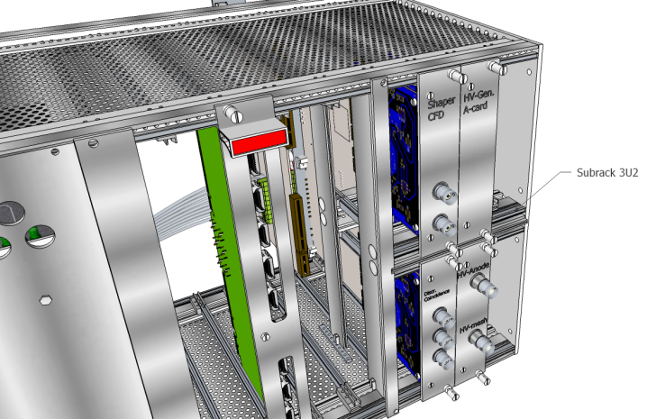
Eurocrate HP-SR (Proto)
Half Power with Subrack 3U , 500 W
Under prototyping
Like Eurocrate- HP but
3U subrack for 3U SRS utility cards added
3U Subrack SCEM 06.61.61.737.6
Minicrate | Revision HP | Not upgradable
applies to | 4 FEC/ADC Combos 1 CTF card slot | Subrack in slots 1-4 awaiting FEC V6
Design | finished 2011 | RD51 CERN, H.Muller
Mechanics | 19 “ 6U x 220 crate | CERN store
Part and mechanical design document | available | Contact us
Production | Planned with FEC V6 | Proto can be used with FEC V3
Availability | Proto | SRS lab
Serial No | 2
ATX adapter included | 9-way power cable Daisy chained x4 | 10 kg
Separate orders needed for
Up to 4 x (FEC V3+ADC V1.1)
Accessories:
1 SFP plugin 1000Base-T
per FEC card
( SCEM 07.89.00.115.4 )
Up to 8 HDMI A-Micro cables
per ADC card
(SCEM 07.89.00.215.1)

Slide 21
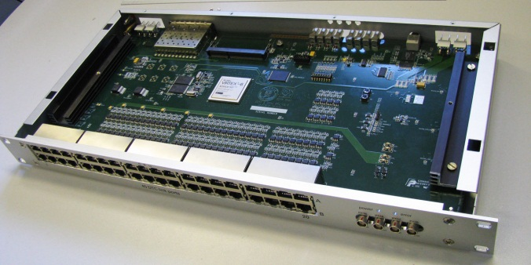
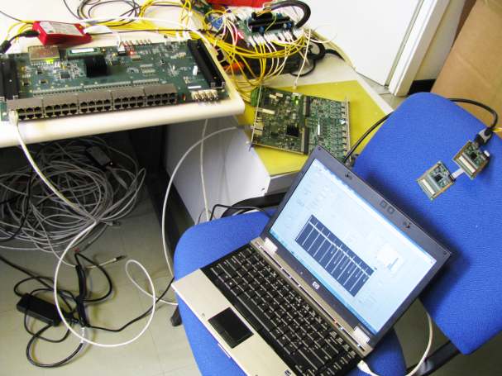
SRU (becoming standard)
=> Talk by A.Tarazona
SRU | Revision 3 | Revision V7 planned
applies to: | Eurocrate with >4 FEC cards | Upgrade Virtex7 in 2013
Design | finished 2011, Cadence | RD51 CERN, S.Martoiu
PCB | 12- layer NELCO 4000 | Beta Layout
PCB routing | 12 layer, 430x215 | Intrasys design LTD
Material list | available | Contact us
Prototyping | finished | CERN RD51
Firmware | Downloadable 10 Gbit, TTCrx, DTCC | SRS repository
Production | Yes | TELSA electronics
Availability | 10 Prototypes | SRS lab, contact us
Serial No | 34 | + 20 planned via CERN store
Online Software | Tested with DATE, MMDAQ | See RD51 talks A.Tarazona, A.Zibell, M.Byszewski
Documentation | writeups | Contact us
SRU in 1 U ALU box
SRS
readout & Slow controls
& TTC via SRU working

Slide 22
SRS accessories
For MPGD detectors

Slide 23
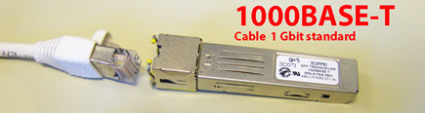
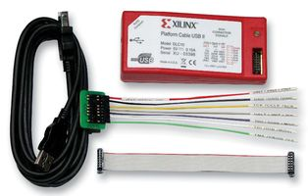
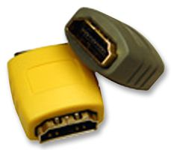
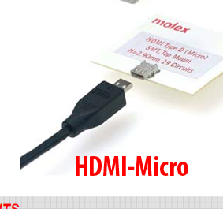
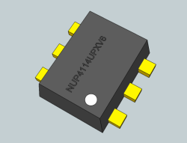
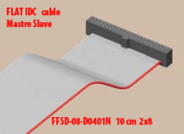
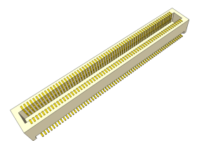
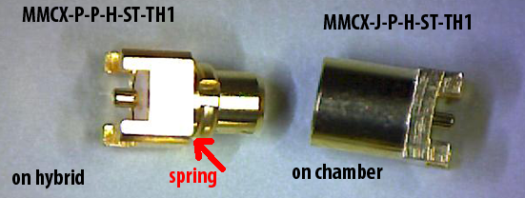
Available in CERN store
1 Gbit SFP Ethernet Cable adapter
SCEM 07.89.00.115.4
Xilinx FPGA rogrammer USB
SCEM 07.89.00.125.2
Quad Protection diode
NUP4114
SCEM 07.89.00.999.3
HDMI-AA
Prolongator
SCEM 07.89.00.217.9
1.5 m HDMI-A->Micro
SCEM 07.89.00.215.1
Panasonic connector 130 pin
Female on hybrid
SCEM 09.55.42.400.3
Male on detector
SCEM09.55.42.410.6
Master Slave IDT cable
10 cm SCEM 07.89.00.210.6
20 cm SCEM 07.89.00.211.5
SCEM 07.89.00.205.3
SCEM 07.89.00.200.8

Slide 24
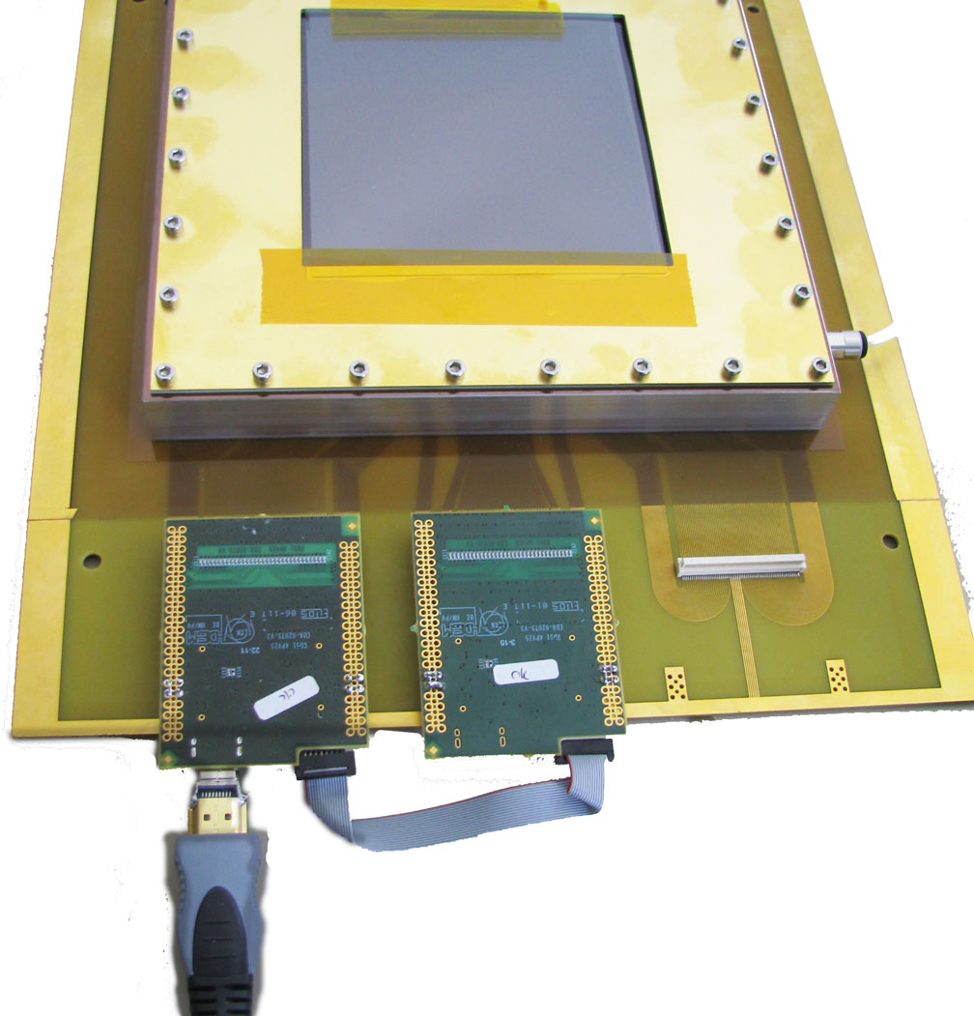
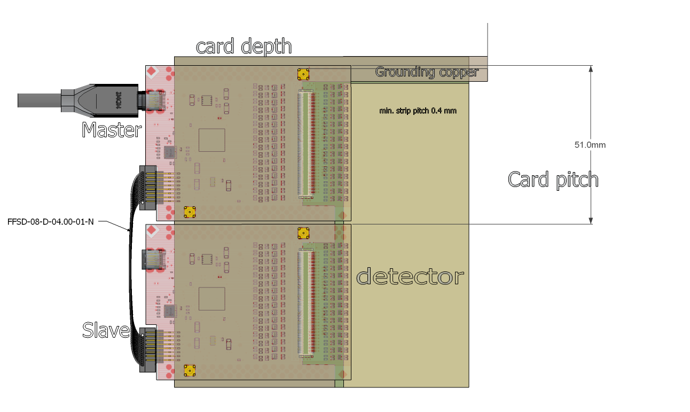
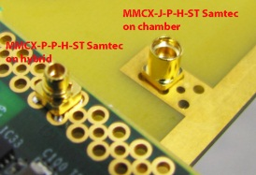
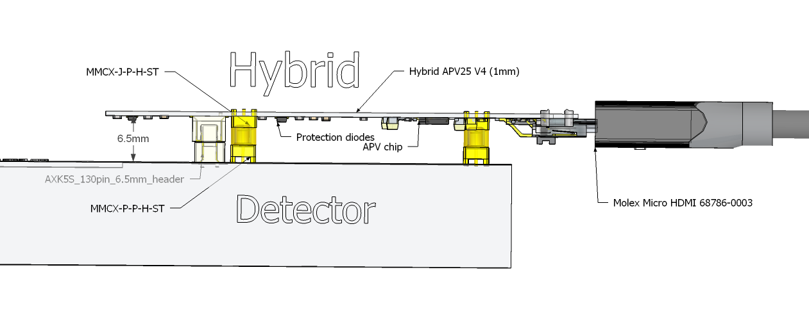
SRS hybrids and accessoirs for MPGD detectors
128 channels for 0.4 mm
continuous pitch
Typical desktop
MPGD detector*
Panasonic 130-pin socket on detector
SCEM 09.55.42.410.6
header on hybrid
SCEM 09.55.42.410.6
Gas connector
careful, may break !
Master
(has HDMI)
SCEM 07.89.00.005.9
Slave
no HDMI
07.89.00.010.2
9 mm above detector
detector plane
Master-Slave = 256 channels
per HDMI A-D readout cable
SCEM 07.89.00.215.1
power via HDMI
M-S flat cable
10 cm: 07.89.00.210.6
SAMTEC FFSD-08-D0401N
20 cm: 07.89.00.211.5
SAMTEC FFSD-08-D0801N
MMCX click-in Grounding system
SCEM 07.89.00.200.8, 07.89.00.200.8
on detector and hybrid, stackheight 6.5 mm
*Gas bottles and gas mixture system is another story

Slide 25
More SRS projects waiting for completion
manpower and contributions are welcome

Slide 26
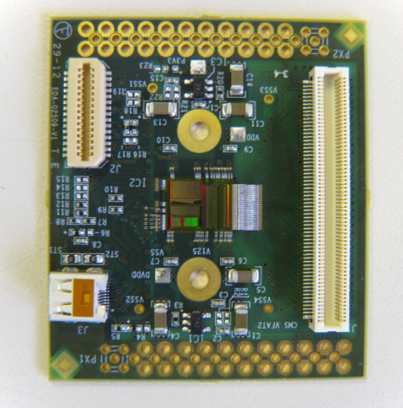
VFAT hybrid
=> revision, commissioning, firmware
VFAT hybrid, 128 ch | prototype | started
applies to: | MPGD detectors | digital peak readout
Design | started 2011 | RD51 CERN, S.Martoiu
PCB | 4 layer ENIG, microvia | ELTOS
Material list | available | EDMS EDA-02509-V1
VFAT -2ASICS | Available | Contact P.Aspell
Prototyping | started | CERN RD51, CMS GEM
Firmware | to be started | For SRS repository
Production, Bonding | Prototypes OK | Hybrid S.A
Availability | 4 pre-prototypes | Later: CERN store Distribution via ESE
Client experiment | CMS GEM, Totem, RD51
Software | TBD
Test Software | TBD
Documentation | VFAT chip manual
Connection & power | Micro HDMI, Panasonic
Photo Version 1
without protection diodes
longer version with
protection diodes
exists

Slide 27
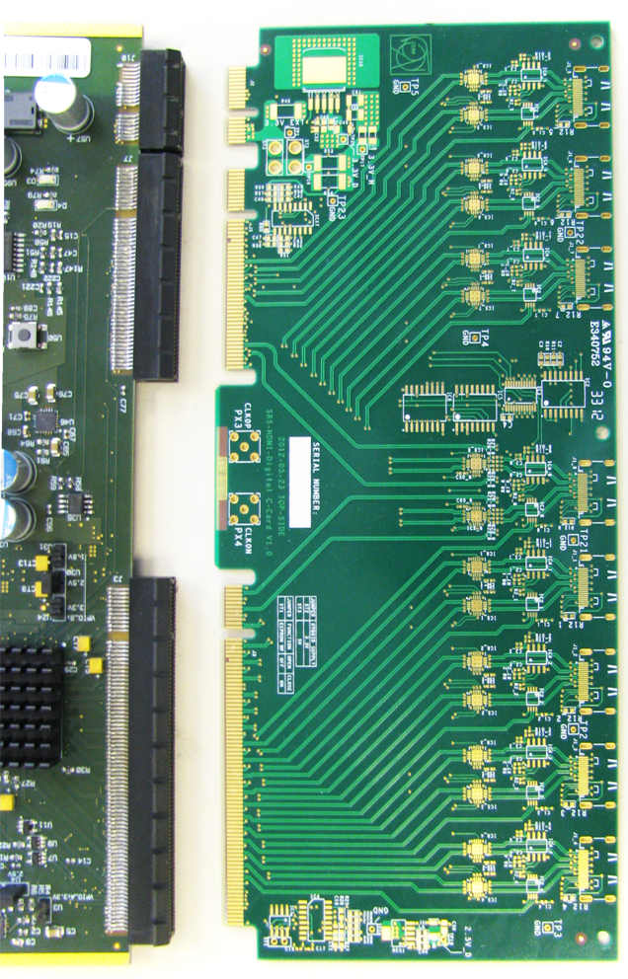
Digital card
=> component mounting, test, finalization
FEC
Digital card
Digital | Rev. 0
applies to | Digital ASICs | VFAT2, VMM1, ..
Design | started 2011 | RD51 CERN, S.Martoiu
PCB | 4 layer FR4 | Beta Layout
Material list | available | Contact us
Prototyping | Up to PCB | CERN RD51
Firmware | For FEC, to be developed | for SRS repository
Availability | PCB only | SRS lab
Serial No | 10 (PCB only)
Test Software | Labview
Documentation | To be started

Slide 28
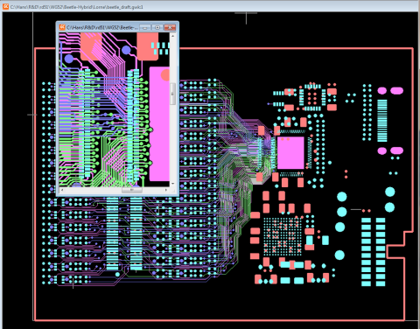
Beetle hybrid
=> 1st test , revision and firmware
VFAT hybrid, 128 ch | prototype | started
applies to: | MPGD detectors | Analogue or digital Trigger generation
Design | started 2010 | WIS L. Levinson
PCB | 6 layer ENIG, microvia 32 card ordered | ELTOS
BEETLE ASICs | 1000 available | Export restriction as for APV
Material list | Available | Contact L. Levinson, WIS
Prototyping |  | CERN RD51, CMS GEM
Firmware | to be started | for SRS repository
Production, Bonding | Planned , offer exists | Hybrid S.A
Clients | ALICE FOCAL pads, RD51 | 1 MHz readout and Trigger
Documentation | Beetle Thesis
Connection & power | Micro HDMI
Gerber plot of WIS design
Contains CPLD for trigger

Slide 29
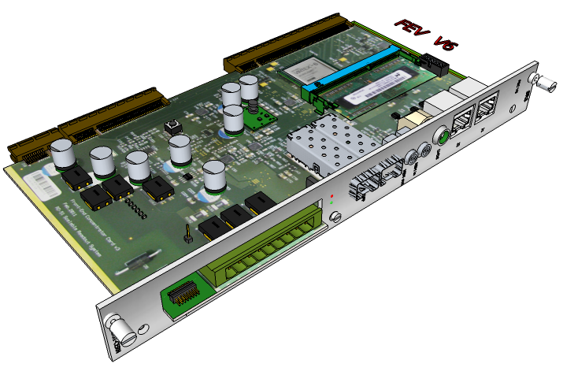
FEC card V6 (planned)
=> 20 KFs needed for routing and 4 protos
FEC V6 | Revision 6 | Virtex-6 FPGA
applies to: | all 19” SRS systems | Euro + Minicrate
Design | finished 2011, Cadence | UPV Valencia, J.Toledo
PCB routing | Offer exists | Intrasys Design LTD
PCB (planned) | 12- layer NELCO 4000 | Lab Circuits
Firmware | Upgrade from V3 tbd | SRS repository
Production | Planned by | Prisma Electronics
Availability | YES, SCEM 07.89.00.100.1 | CERN store
Serial No | > 50 | Mac address derived
Online Software | DATE, MMDAQ, RCDAQ | See RD51 talks
Test Software | Labview | See RD51 talks
Documentation | DATE for SRS, SRS-Labview, writeups | Contact us
More FPGA resources
higher speed
Dual SFP ethernet
DDR memory plugin
I/O connector for 3 U
Subrack cards

Slide 30
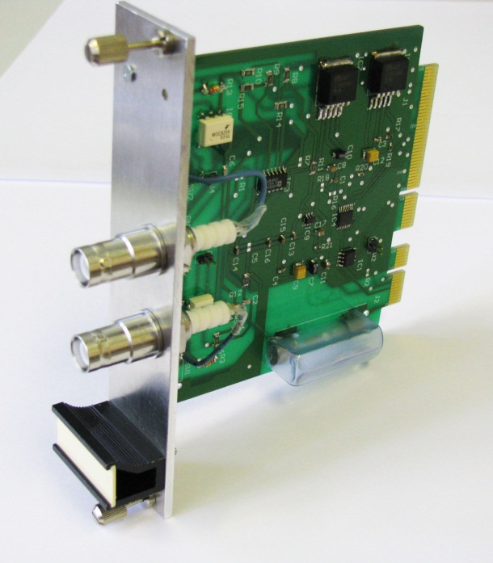
HV card ( 3U) Prototype
HV-B | Prototype
applies to | Eurocrates HP-SR | Clock and trigger
Design | 2011, Altium | RD51, H.Muller
PCB | 2 layer FR4 | Beta Layout
PCB layout | Altium | N. Weingartz
Material list | available | Contact us
Prototyping | Waiting for manpower
Production | after revision
Availability | 1 prototype | SRS lab
Programmable via FEC Slow controls
2 channels 200-600 V in 10 bit steps ( MicroMega only )
Project:
Revised 2000V generator modules (draft available)
increase linear control to 2000V
Add current monitoring in range 1mA-1 pA

Slide 31
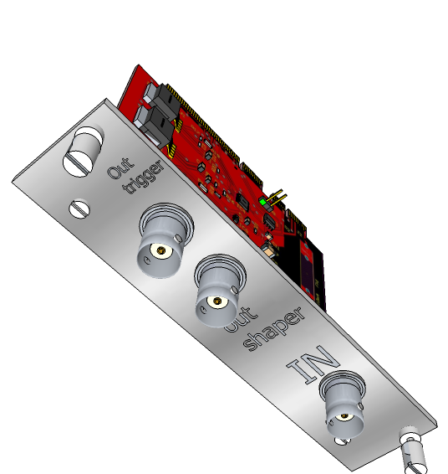
Shaper card ( 3U) open project
shaper | planned
applies to | Trigger pickup + Trigger generation within SRS | GEM, MM
Design | 3U SRS card, tbd | tbd
PCB layout | Based on HV-B Altium
Prototyping | manpower needed
Input from Pickup preamplifier box
Programmable shaping times and gains
Programmable trigger threshold
Project:
Design shaper according existing 2nd order shaper principle
Design peak trigger with programmable threshold
Card layout in ALTIUM
Configuration via SRS slow control

Slide 32
SRS -ATCA
Just starting…

Slide 33
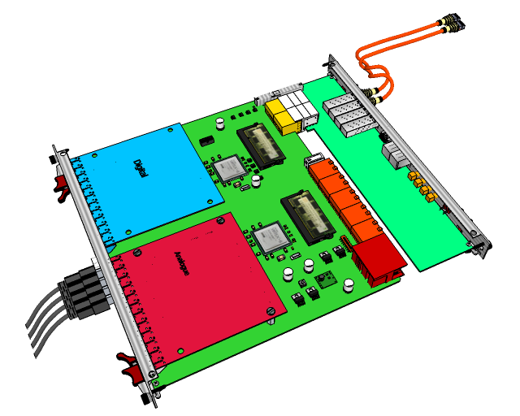
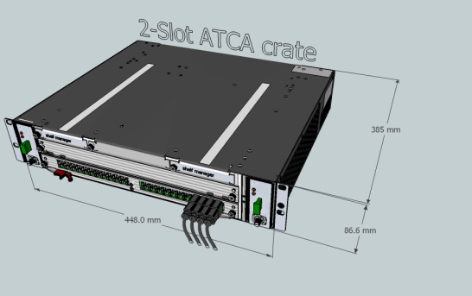
SRS -ATCA standard (New)
=> See talk by EicSys
ATCA blade
SRS mezzanines RTM card
SRS-ATCA blade | Revision 1
applies to: | ATCA readout systems | LHC experiments
Design | on-going by EiCSYS GmBH | J.Toledo , S.Martoiu, H.Muller as reviewers
Client Experiments | NEXT, MAMMA, FOCAL | CERN SRS team
Firmware | Derived from SRS firmware | SRS repository
Production | expected Q1, 2013 | EICSYS GmbH
Online Software | DATE, MMDAQ, RCDAQ | planned
Test Software | Labview ?
Documentation | To be started
ATCA Minicrate (ELMA)

Slide 34
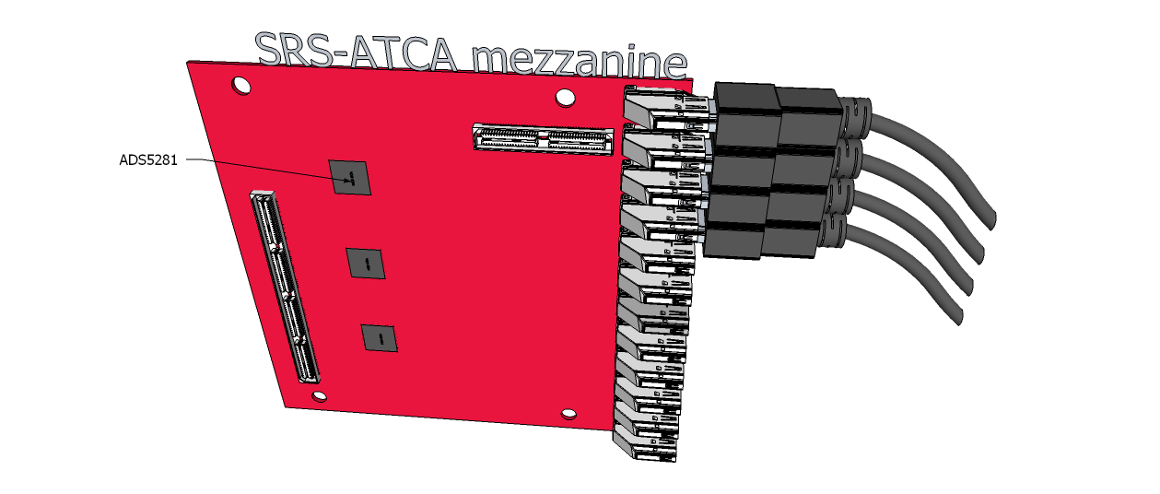
Analogue SRS-ATCA mezzanine
SRS-AADC- TCA | under design
applies to: | Analogue ASICS | APV, Beetle, ..
Design | planned 2012/13 | EicSys , S.Martoiu
Client Experiments | NEXT, NSW, ALICE, CMS
Firmware | Upgrade existing FW | S.Martoiu
Production | 2013 | EICSYS GmbH
Test Software | Labview | planned
Documentation | tbd
SRS-ATCA mezzanine
with 12 HDMI ports

Slide 35

Optical SRS-ATCA mezzanine
Optical SRS-ATCA | planned
applies to: | Optical Frontend readout Data, Trigger, Clock, Control | LHC experiments
Design | planned 2012/13 Cadence | UPV Valencia J.Toledo
Client Experiments | NEXT, NSW ? , ALICE | CERN SRS team
Firmware | to be developed | Based on DTCC for SRU
Production | 2013 | EICSYS GmbH
Test Software | Labview | planned
Documentation | N.A.
SRS-ATCA mezzanine
with 8 SFP ports for optical transceivers

Slide 36
Other electronics
for R&D on MPGD

Slide 37
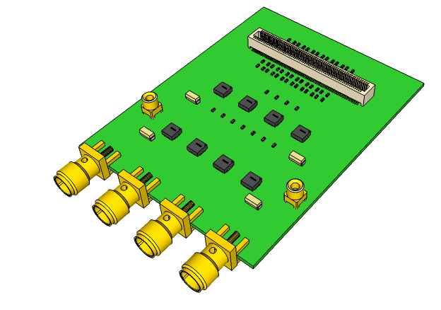
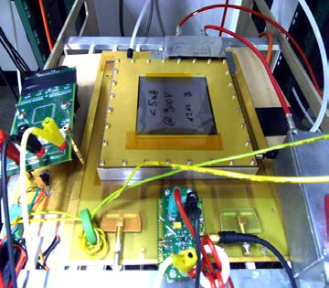
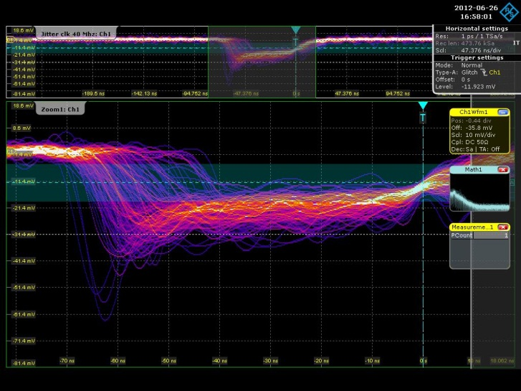

A. Quad Signal amplifier
plugs on MM or GEM
like a hybrid
4 x 50 OHM
signal output
Wideband
amplifiers
Signal from MM with
1 Channel -14 db amplifier prototype
( Manik Aima, Summer 2012)
Nov 2012, Altium design started by A.Rusu
2 pF input, 10MHz->2.4 GHz BW, 28 dB ( factor 25 V/V)
Simulation dual Amplifier
by A.Tarazona
Electrons -ions

Slide 38



Quad pickup application target
1 GHz , low cost option
4 GHz, high cost option
DRS-4 , 4 x 1 GHz via USB
R&S RTO1044
C++ software for display of pickup signal in 3 time domains in prep (A.Manik)
Shaper ( A_{max} ~ Q _{tot})
CSA ( V = $\int{dQ dt}$)
Q(t) (raw)

Slide 39


B. Trigger Pickup box
Preamplifier
CSP –out
4 boxes under test
feedback by users being evaluated

Slide 40



C. Flexible copper links for frontend ASICs
ASICs in radiation environment => FPGA readout
at several m distance
Length required
2-4 m
-Kapton
-Micro-coax
--
Future Readout Unit emulation via SRU-e
( working on SEU mitigation of FPGA )

Slide 41
Summary
SRS electronics at the end of 2012 looks (finally) stable
Purchase rules for SRS have been clarified
Letter of compliance and Export restrictions for SRS hybrids
Complete set of SCEM numbers for SRS now in CERN store
Basic SRS and Accessories now considered standard
Some versions of modules and crate versions to be completed
Several open projects ( hybrids, system cards ) require more manpower / money
SRS-ATCA on the way for LHC experiments
Electronics for R&D on MPGDs
Participation in all levels welcome

