Slide 1
R&D and simulations on gain stability and IBF for the ALICE GEM-TPC upgrade
Taku Gunji
Center for Nuclear Study
The University of Tokyo
For the ALICE TPC Upgrade Collaboration
RD51 mini week at CERN, Dec. 3-5, 2012

Slide 2
Outline
ALICE GEM-TPC upgrade
R&D Status of gain stability
R&D Status of Ion back Flow
Simulation study of Ion Back Flow
Summary and Outlook

Slide 3
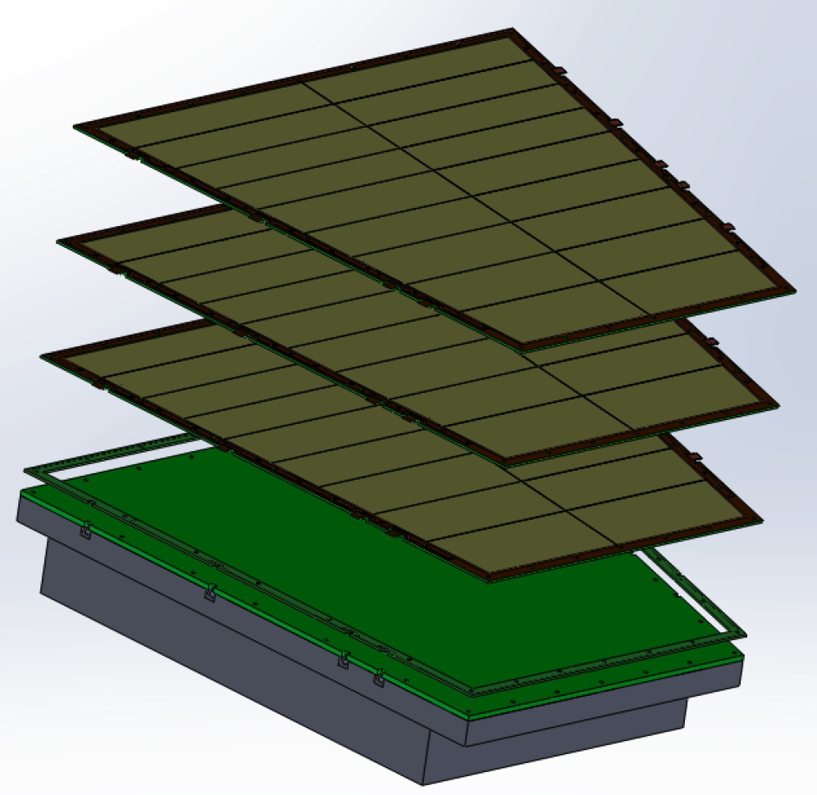
ALICE GEM-TPC Upgrade
LoI of the ALICE upgrade
  https://cdsweb.cern.ch/record/1475243/files/LHCC-I-022.pdf
  Endorsed by the LHCC
High rate capability
  Target: 2MHz in p-p and 50kHz in Pb-Pb collisions
Plan for the ALICE-TPC upgrade
  No gating grid and continuous readout
    Inherited the idea from PANDA GEM-TPC [arXiv:1207.0013]
  MWPC readout will be
  replaced with GEM.
  Ne(90)/CO₂(10)
  E_{d}=0.4kV/cm

Slide 4
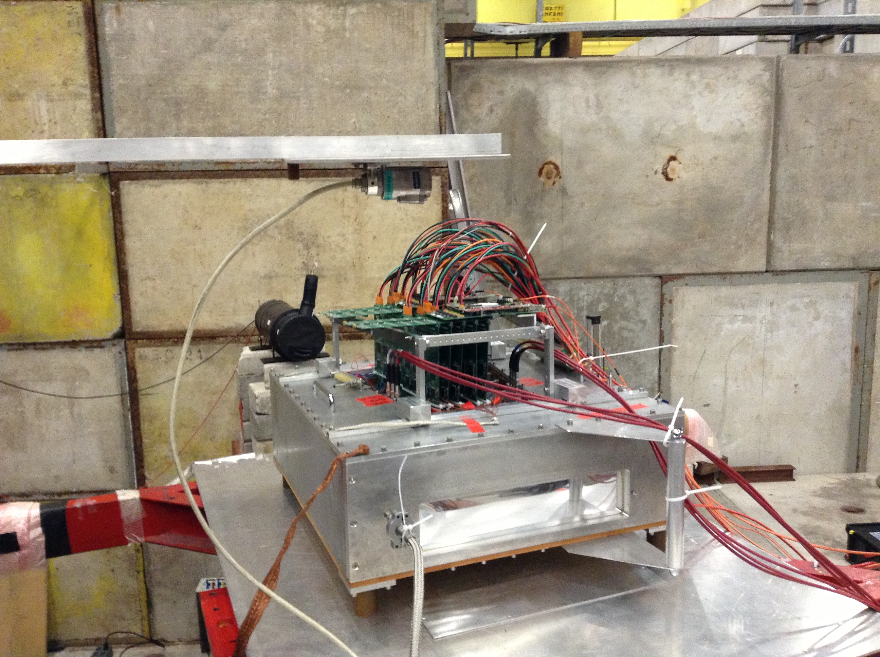
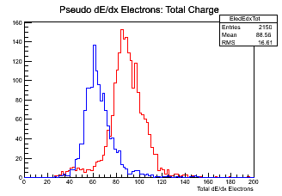
ALICE GEM-TPC Upgrade
Major issues for the GEM-TPC upgrade
  dE/dx resolution for the particle identification
    ~5% for Kr by PANDA GEM-TPC.
    Beamtest of prototype GEM-TPC at CERN PS-T10
      Detailed presentation by P. Gasik
Electronics (PCA16+ALTRO: loan from
the LCTPC. Thanks!!) & RCU
TPC Gas Vessel & GEM-Stack
very preliminary
of dE/dx for π/e
(no calibration,
no tracking)

Slide 5
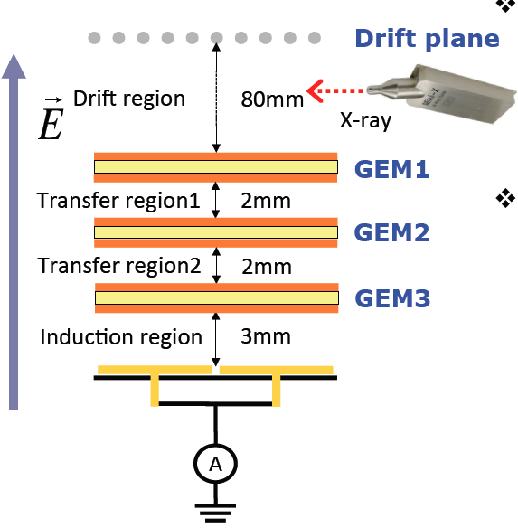
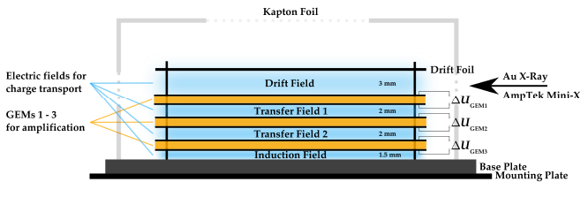
ALICE GEM-TPC Upgrade
Major issues for the GEM-TPC upgrade
  Stability of GEM (gain, charge up, discharge, P/T)
    Measurements in the lab.
    Test with the prototype at ALICE cavern in 2013. (p-Pb)
  Ion back flow to avoid space-charge distortion
    Requirement < 0.25%
    Test bench in CERN, Munich, and Tokyo
    Simulations to search for the optimal solutions

Slide 6
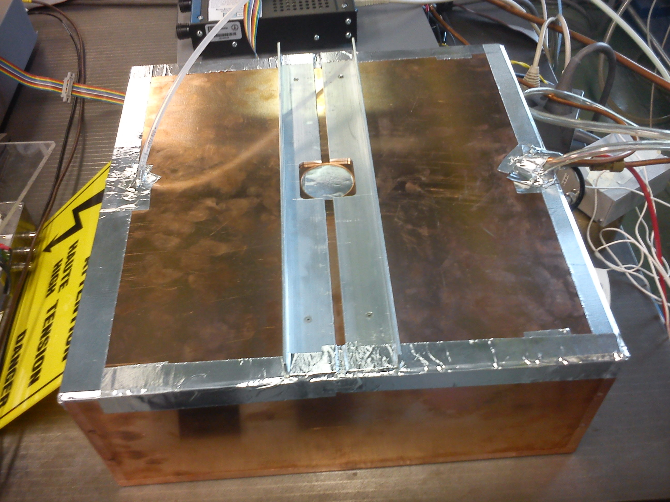
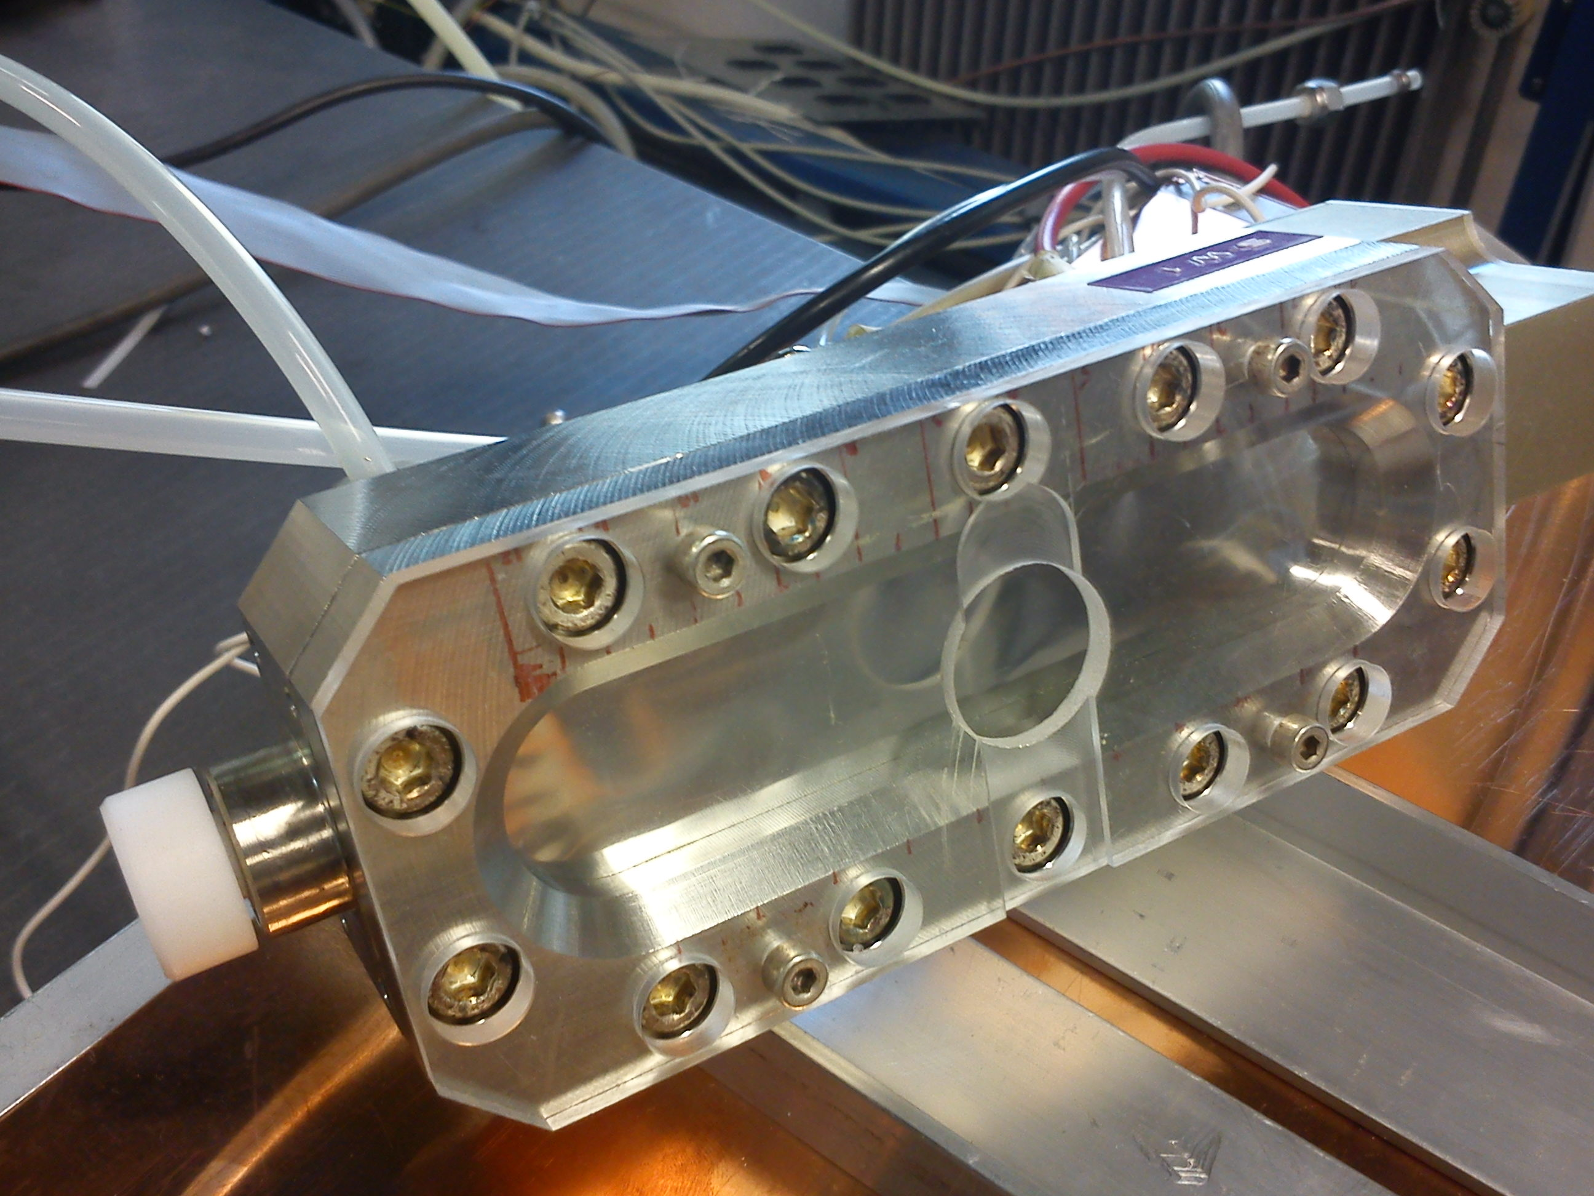
R&D of gain stability
Measurement setup
  Single wire chamber as reference
  Monitor humidity
V. Peskov
J. Reinink
Single/double GEM
gain~900-2000
Current density ~ 2-7nA/cm²
Sealed shielding box flushed with N₂, containing GEM
Single wire chamber used as reference
Mass flow
meters
GEM
Single-wire
chamber
Hygro-
meter
PC
NIM
CAMAC
PC

Slide 7
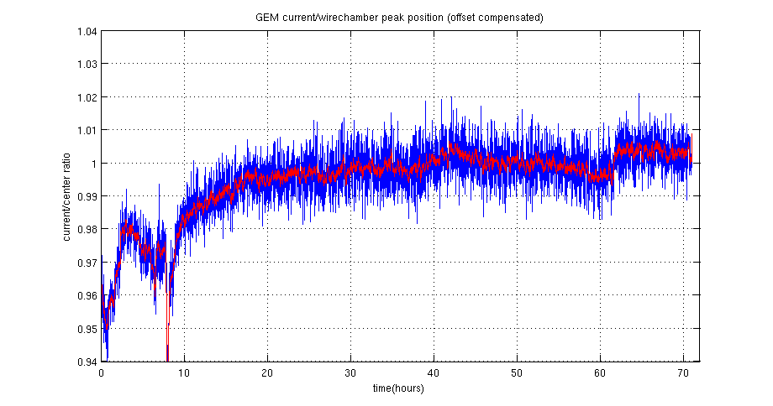
Gain stability
2 GEMs (cylindrical holes) in Ar/CO₂(10). Sr⁹⁰ source
  4-5% variation of GEM and wire chamber current
    4-5% variation was compatible with temperature variation (T=23~24.5).
  Gain stays stable to within 1% after a few hours
  Humidity: 56-73 ppm. Gain~900 & current density~1.8nA/cm²
GEM current/Wire chamber current

Slide 8
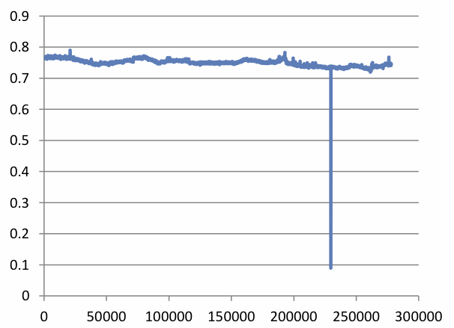
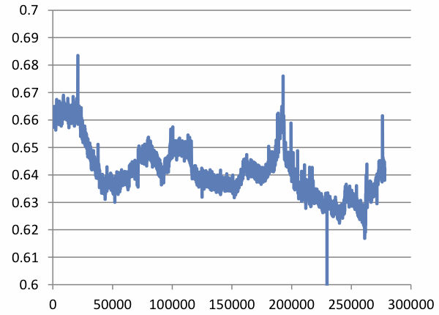
Gain stability
Gain~2000 & current density ~ 7nA/cm²
  Stability is ~3%
Next is to measure stability with 3 GEMs under Ne/CO₂

Slide 9
Ion back Flow
High rate operation (50kHz), continuous readout (no gating grid), and online calibration/clustering
  Need to minimize field distortion by back drifting ions
  Target: IBF ~ 0.25% at gain 1000-2000
Direction of IBF R&D
  Use standard GEMs and optimize by asymmetric electric field
  Use exotic GEMs (Flower GEM, Cobra GEM, MHSP)
  Simulations to search for optimal solutions

Slide 10
Measurement at CERN/TUM/CNS
Systematic measurement of IBF
  Using 3 layers of standard GEMs
  Rate and gain dependence under various field configurations
Setup at CERN (RD51-Lab.), TUM, and CNS
  Various rate of X-ray gun
  Simultaneous measurement of IBF/energy resolution (TUM/CNS)
  Readout currents from all electrodes (TUM)
TUM: Technical University Munchen
CNS: Center for Nuclear Study, Univ. of Tokyo

Slide 11
Rate dependence of IBF
Changing X-ray tube current and absorber filter
  Covering charge density= 1000-40000nA/(10cm²)
Clear rate dependence on IBF (0.1%~1%)
  Absorption of ions at GEM3 gets larger for higher rate
Due to space charge?
Y. Yamaguchi
C. Garabatos
Ar(70)/CO₂(30)

Slide 12
X-ray position dependence
Changing X-ray position from top of GEM1
  Different local charge density due to diffusion
IBF gets better for smaller distance between X-ray and GEM1 top (→larger local charge density).
Due to space charge?
Ar(70)/CO₂(30)
Rate dependence
for 4cm case

Slide 13
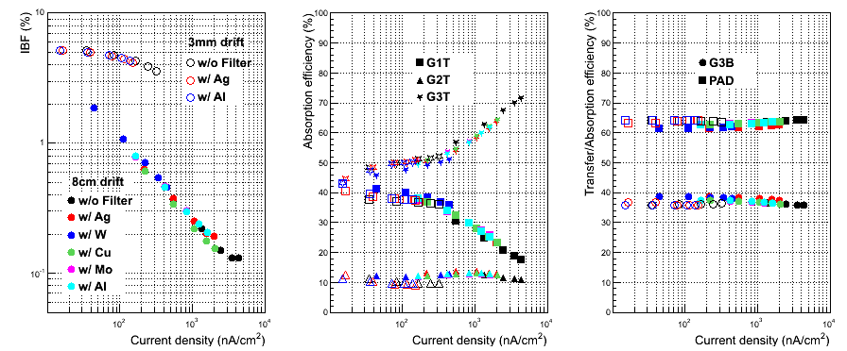
Drift space dependence
Changing drift space from 80mm to 3mm.
  Different interaction rate
Clear difference in IBF due to different interaction rate.
  IBF gets better for larger interaction rate.
  IBF=2~5% for lower rate (not so much dependeing on rate).
Ar(70)/CO₂(30)

Slide 14
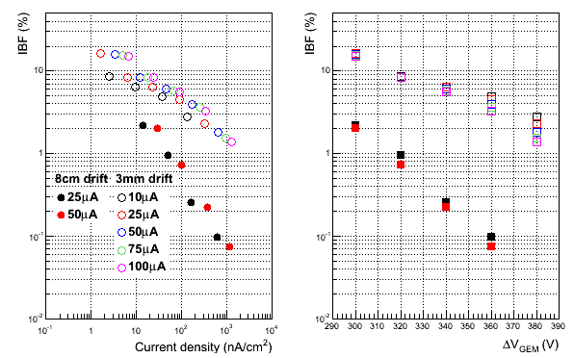
V_{GEM} dependence
V_{GEM} dependence for different drift space
IBF depends on V_{GEM}.
  Steeper dependence for 80mm case.
  (even if rate dependence is small for 3mm, V_{GEM} dependence is visible..)
Due to space charge?
Ar(70)/CO₂(30)

Slide 15
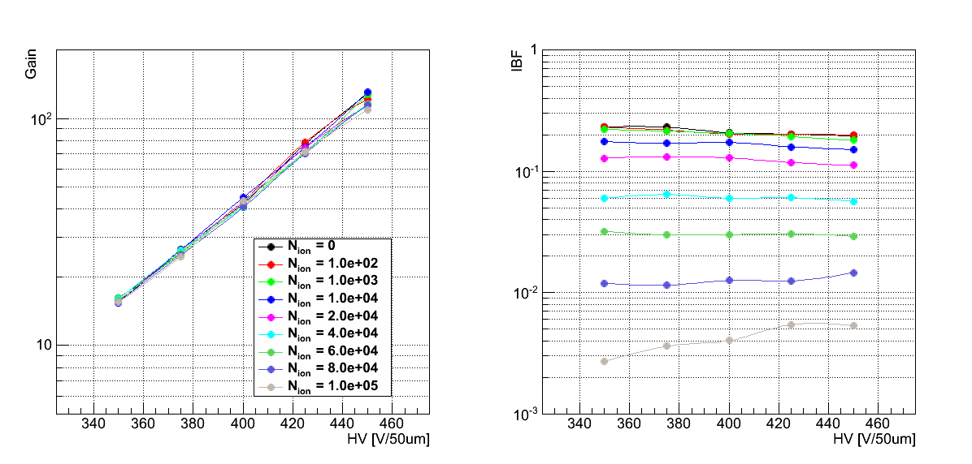
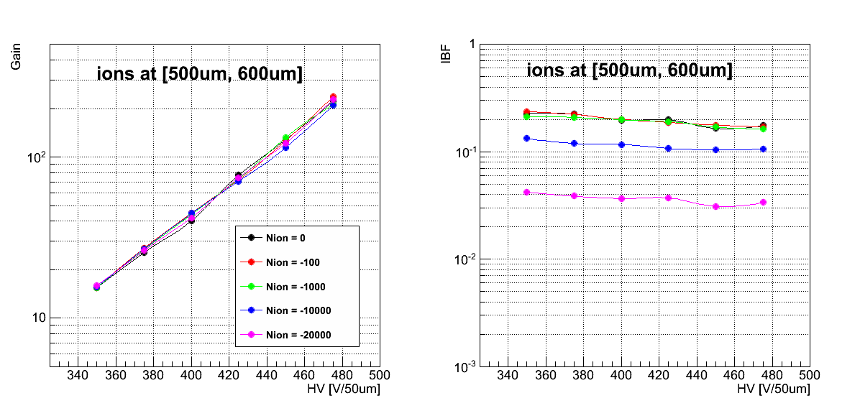
Space charge and IBF
Simulation study by garfield simulation.
  Presented at the last RD51 meeting on Oct. 2012.
Put many Ions above GEM1 (Ed=0.4kV/cm)
IBF strongly depends on N_{ions} (>10⁴). Space charge may play an important role for IBF.
T. Gunji
Ions at [0, 100um]
above GEM1
N_{ions}=10⁴
N_{ions}=0, 10², 10³,
10⁴, 2x10⁴
N_{ions}=10⁵

Slide 16
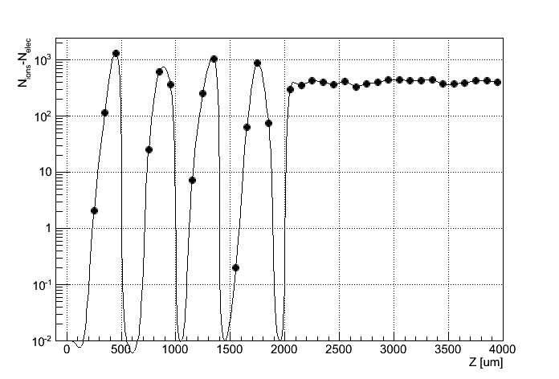
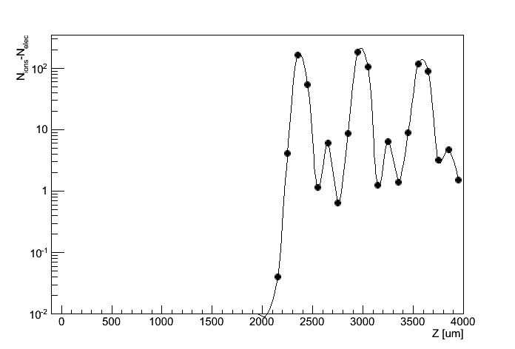
Space charge and IBF
More dynamical simulations by garfield (2 GEMs).
  Presented at the last RD51 meeting on Oct. 2012.
Make spatial profiles of ions created by avalanches for 10usec (100kHz) and 100usec (10kHz) separated seeds.
Ion profile per one seed (Ar/CO₂=70/30, Gain~1000)
Et = 3kV/cm
Ed = 0.4kV/cm
Et = 3kV/cm
Ed = 0.4kV/cm
10usec spacing
for avalanches
100usec spacing
for avalanches
electron
electron

Slide 17
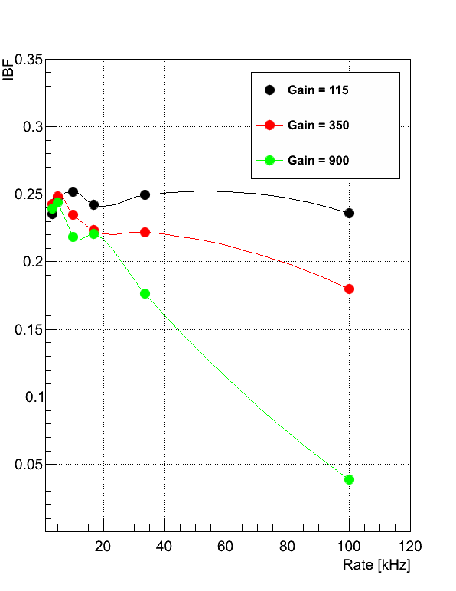
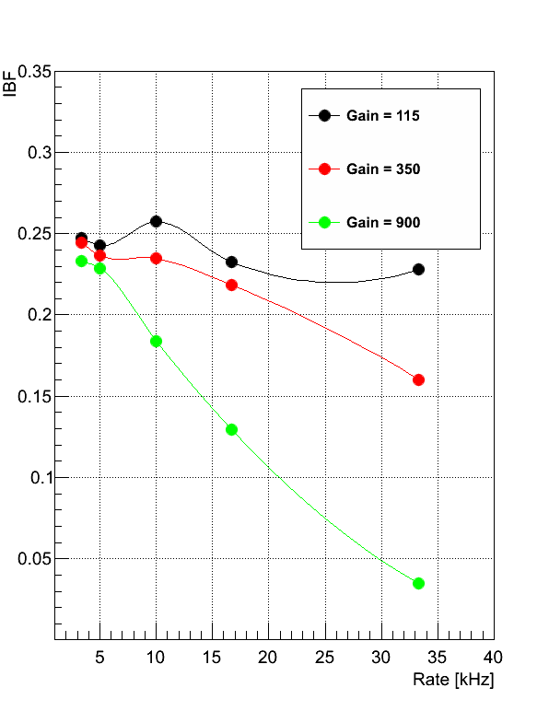
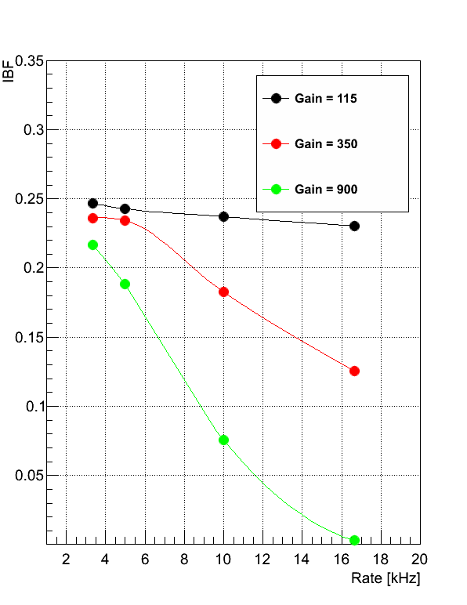
Space charge and IBF
IBF vs. rate (time separation between 2 coming seeds)
  Rate/hole=10-50kHz in the lab. and less than 1kHz for LHC Pb-Pb 50kHz collisions
IBF strongly depends on rate, gain, and # of seeds/hole in case of high rate operations.
  Qualitatively consistent with the measurements.
Seed/hole=3
Seed/hole=10
Seed/hole=25

Slide 18
IBF from TUM (lower rate)
Reading currents from all electrodes.
3mm as drift space. X-ray tube with 2mm collimator.
Pad current ~ 5uA(<< current at CERN measurements.)
No strong rate dependence (may be due
to low rate and less space charge). IBF = 2-4%
A, Honle
K. Eckstein
M. Ball
S. Dorheim
B. Ketzer
Ar(70)/CO₂(30)

Slide 19
IBF from TUM (lower rate)
Reading currents from all electrodes.
3mm as drift space. No collimator.
No strong rate dependence (might be due to lower rate, much less space-charge).
IBF = 7%
Ar(70)/CO₂(30)

Slide 20
Different field configurations
Lowering E_{T2} and high E_{T1}
  0.8% of IBF in Ar/CO₂ with E_{T2}=0.16kV/cm and E_{T1} = 6kV/cm (E_{d}=0.25kV/cm)
IBF=3-5% for Ne/CO₂
  E_{T1} cannot be so high.
    Adding N₂ to achieve
    high E_{T1}?
Scale=1.0
Scale=1.07
gain=600~2000
gain=2000~6000

Slide 21
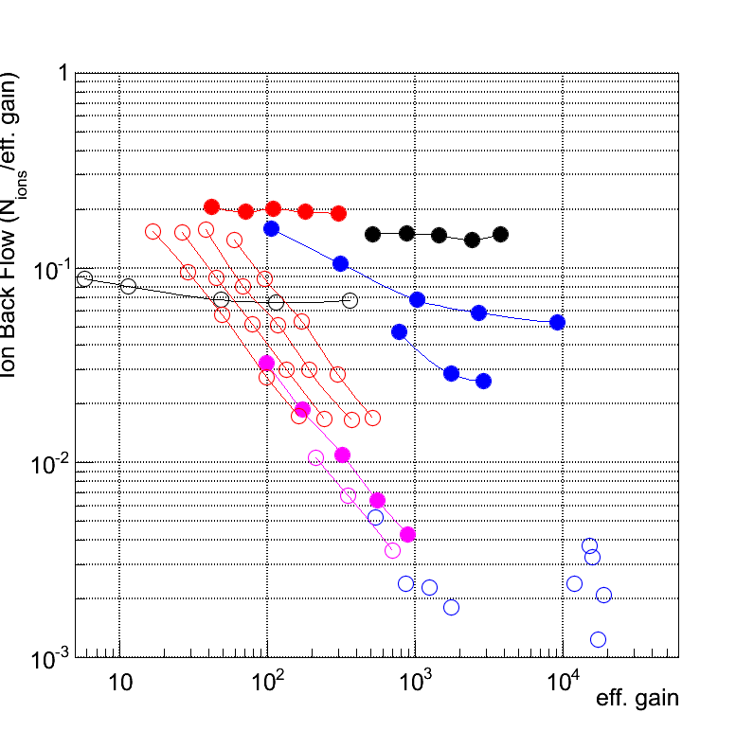
IBF for various GEM configurations
T. Gunji
Search for optimal solutions for IBF by simulations
2GEM standard (same GEMs)
3GEM standard
2GEM, low Et (50V/cm)
3GEM, low Et2 (50V/cm)&V_{GEM2}
(for various V_{GEM1}/V_{GEM3})
Large pitch GEM1 + standard
GEM2 (Flower GEM structure)
Large pitch GEM1 + standard
GEM2 & GEM3
2 layers of cobra GEMs
3 layers of cobra GEMs
More studies are on going.
(higher gain, combination
of different geometry, etc…)

Slide 22
Summary and Outlook
R&D of gain stability and ion back flow are on-going.
Gain stability <3% (2 GEMs, higher gain and rate)
  Stability of 3 GEMs will be studied under Ne/CO₂.
IBF depends on rate of X-ray, spread of seed electrons (diffusion), and gain of GEM under high rate conditions.
  Space charge plays an important role for IBF under high rate.
  This is (partially) confirmed by garfield simulations.
Under low rate, IBF is 2-5% with 3 standard GEMs.
Try to reduce IBF further:
  More study on asymmetric field configurations
  Use standard GEMs with different geometry (hole size, pitch)
  Use exotic GEMs (Thick COBRA GEM, Flower GEM)
Simulation studies are on-going.

Slide 23
Backup slides

Slide 24
R&D of gain stability

