Slide 1
Thin and high-pitch laser-etched mesh manufacturing and bulking"
RD51 Common Projects
WG 1 – New techniques
(INFN Bari, CEA Saclay, CERN)
V. Berardi, P. Colas, Rui de Oliveira
With help from D. Attié, M. Kebbiri, O. Pizzirusso, W. Wang, and A.Ancona, T. Sibillano, F. Di Niso (CNR)

Slide 2
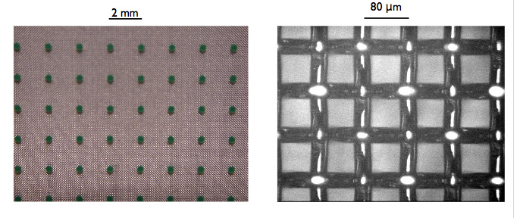
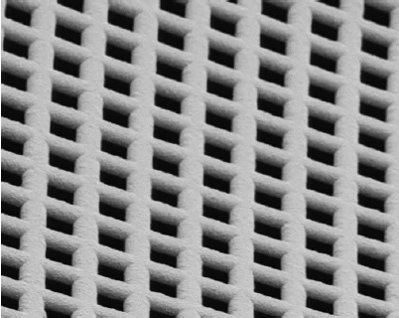
Project started Feb. 15, 2012 for an initial duration of one year.
Sharing of the tasks :
  Bari : improve laser punching technique
  CEA Saclay : test of meshes, gain, ion back-flow
  CERN: bulking with various meshes
Funding : 19 000 CHF (8 000 Bari, 5000 Saclay, 6000 CERN)
Motivation : extend the bulk process (so far using only woven meshes) to thinner and higher-pitch meshes, to optimize ion back-flow, electron collection, and resolution. Favor non-magnetic materials
Two paths : laser punching and bulking of new electroformed meshes

Slide 3
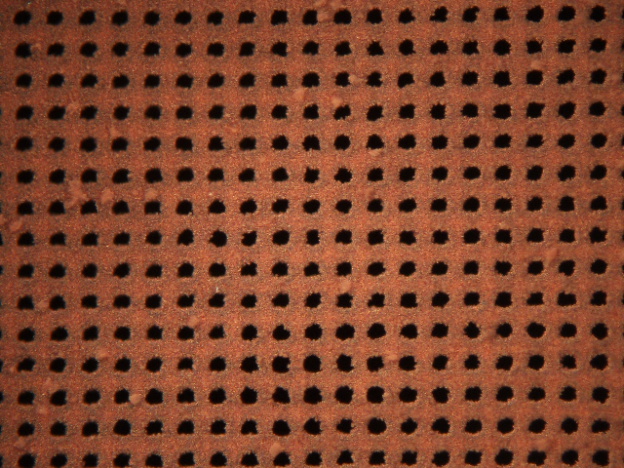
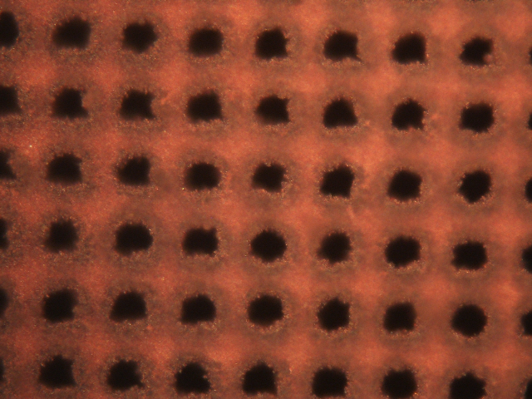
Progress in laser-etched meshes
First attempt in February using double-layer of copper -> no signal. The holes were not open. Very difficult to ‘peal’ the mesh.
Second attempt (10x10 mm² meshes received in Saclay after Stony Brook) : transparency OK. To be tested in gas.
With the present laser: 10 holes/s.
A factor of 5 could be gained.

Slide 4
Cost for 8 6’’ x 6’’ copper meshes : 2529 euro wo tax. Payed half-half by Saclay and RD51.
Woven meshes are typically 380-450 lpi

Slide 5
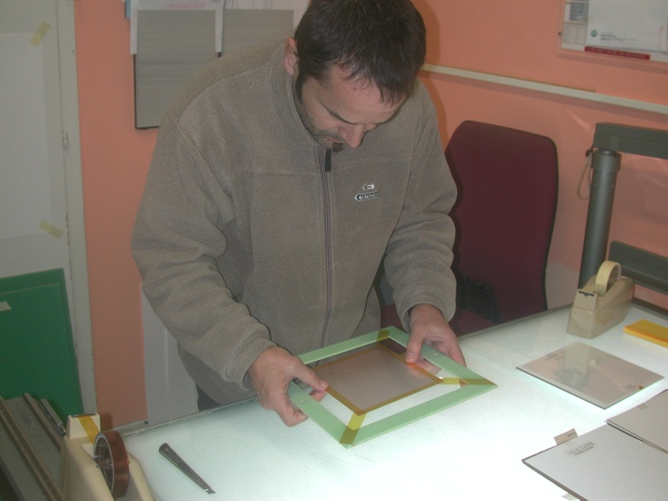
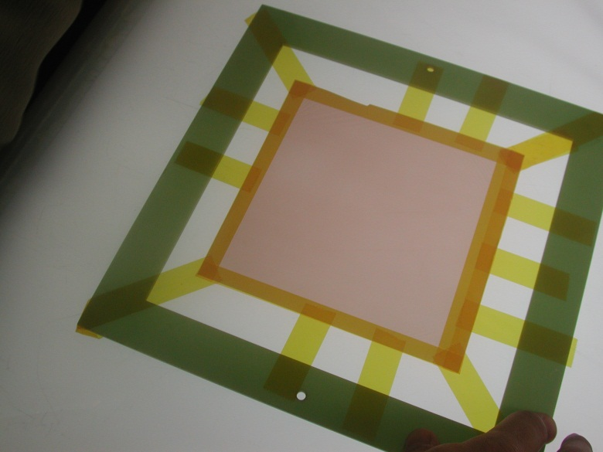
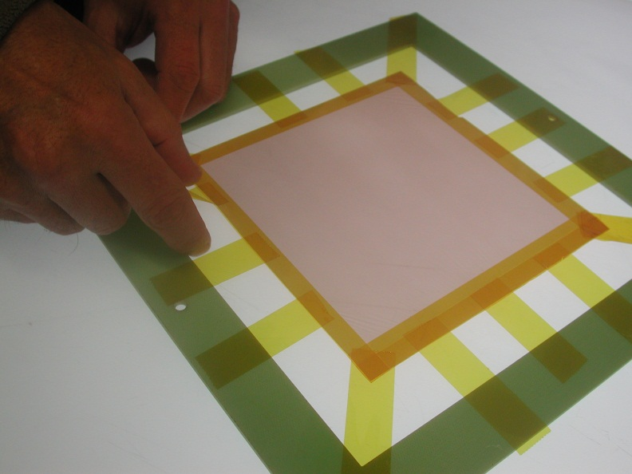
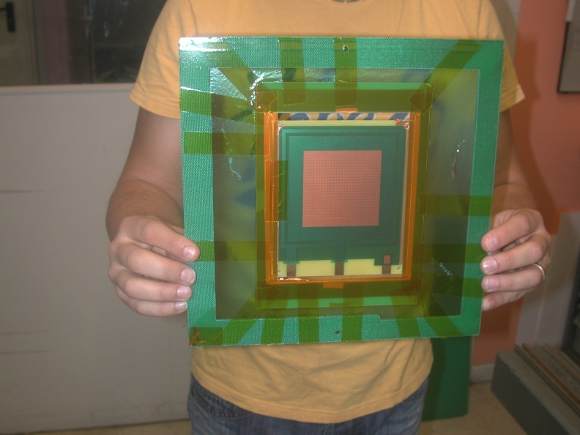

Slide 6
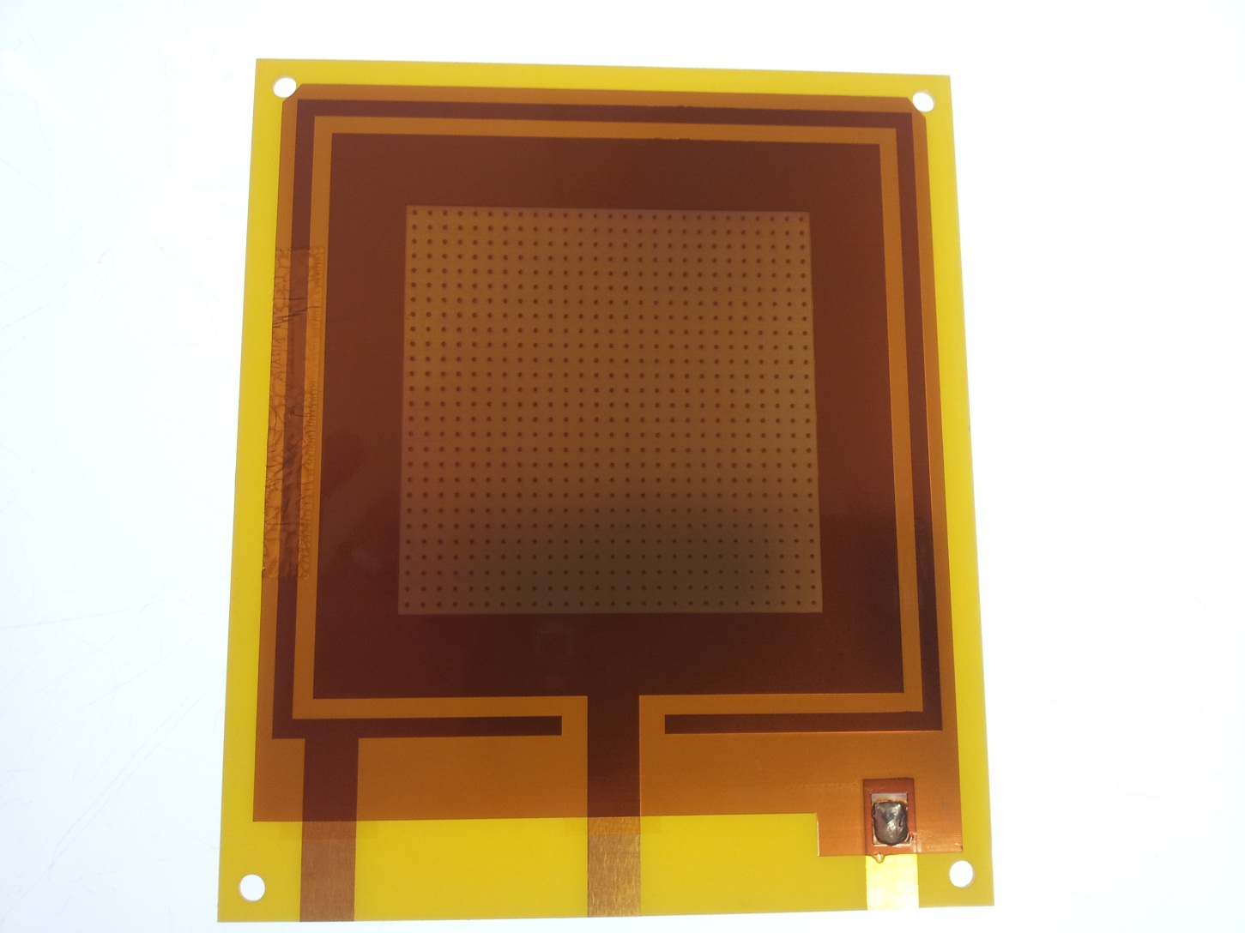
First thin-mesh bulk

Slide 7
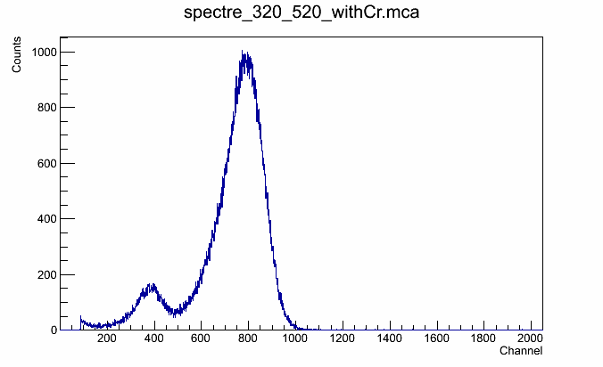
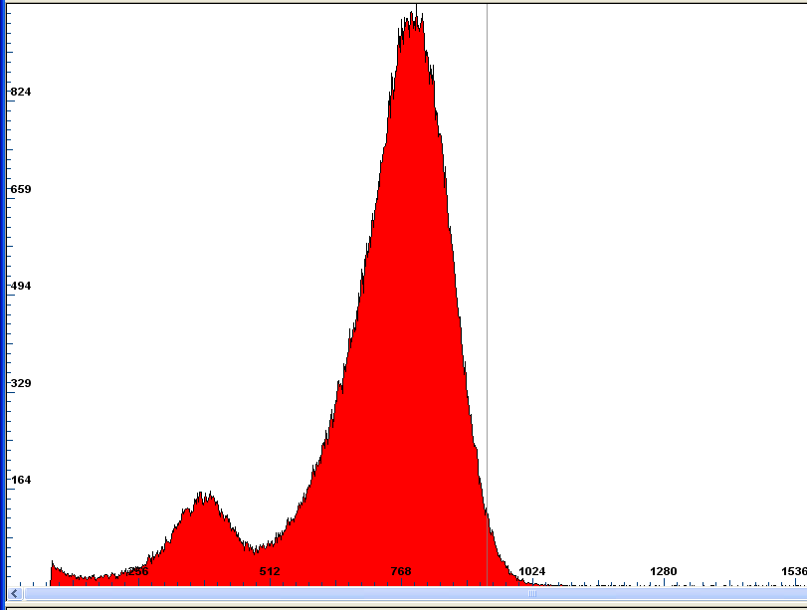
Performances tested at Saclay

Slide 8
Financial report
Currency: CHF | Bari | CEA Saclay | CERN
Available (Own) | 4000 | 2500 | 3000
Available (RD51) | 4000 | 2500 | 3000
Spent (Own) | 0 | 750 (meshes)+500 (test, gas, box…) | 750(meshes)+500 (bulking)
Spent (RD51) | 0 | 750 | 750
In total, only 4 kCHF were spent out of 19. Bari benefited from a huge investment (500 K€ from EU) in the CNR laser lab.

Slide 9
Conclusions
Recently the common project on meshes made good progress: First thin-mesh bulk made at CERN.
New laser-etched meshes ready to be tested
Main goals will be attained within initial schedule (before February 15, 2013)

