Slide 1
Quantum efficiency enhancement of CsI-TGEM/RETGEM -based RICH prototype
M. Adhikari, A. Di Mauro, P. Martinengo
V. Peskov

Slide 2
Earlier at RD-51 meetings we already presented some results obtained with large-area TGEM/RETGEM-based RICH prototypes

Slide 3
PC
Acquisition
Electronics
Pad plain
(each pad 8x8mm)
3
3
TGEMs
3
CsI
Cherenkov
light
~60
Drift mesh
11
C₆F₁₄ radiator
Beam particles

Slide 4
The top view of the RICH prototype (from the electronics side)
135
TGEMs
3
4
1
5
2
6
Cherenkov
ring
Feethroughts
RETGEM supporting flame

Slide 5
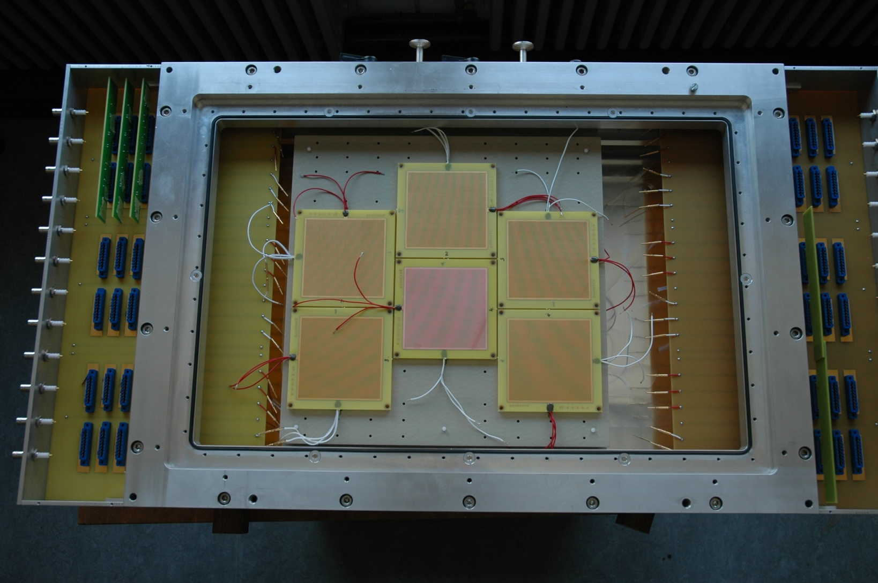
View from the back plane

Slide 6
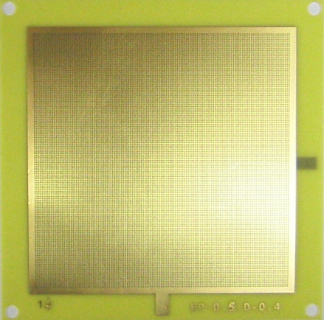
TGEM
TGEM is a hole-type gaseous multiplier based on standard printed circuit boards
featuring a combination of mechanical drilling (by a CNC drilling machine) and etching techniques.
Thickness: 0.45 mm
Hole d: 0.4 mm
Rims: 10 μm
Pitch: 0.8 mm
Active area: 77%
100mm
Notes:
6

Slide 7
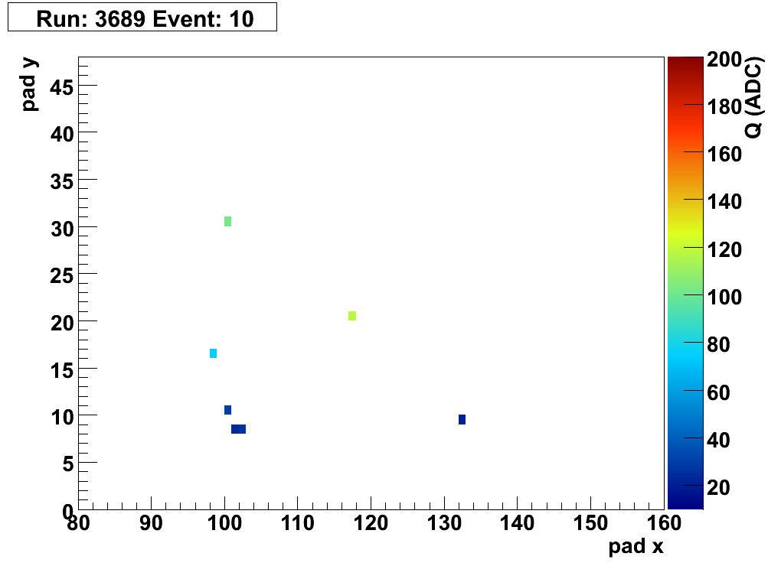
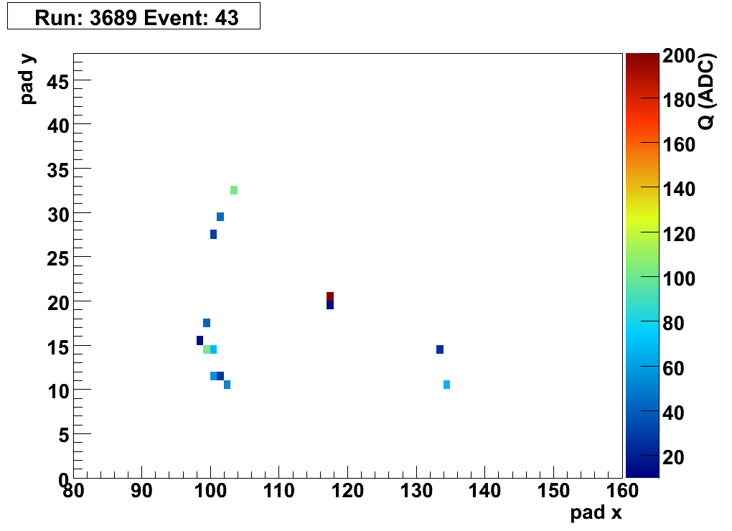
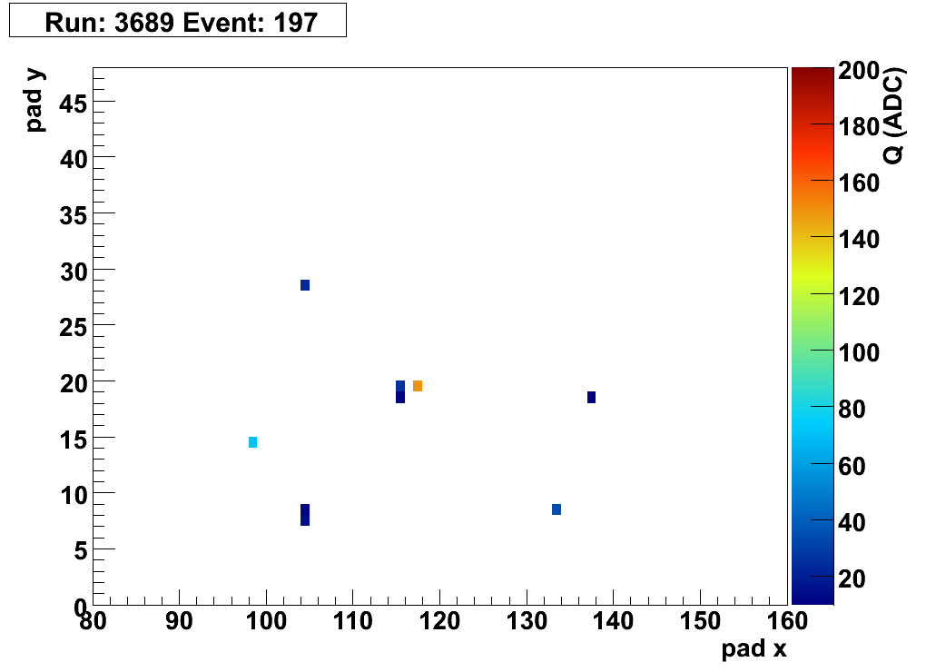
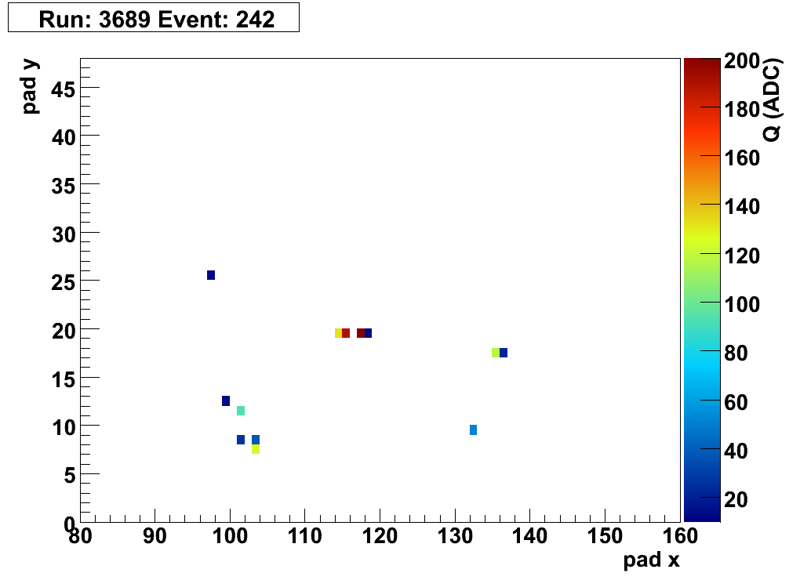
Single events display
MIP

Slide 8
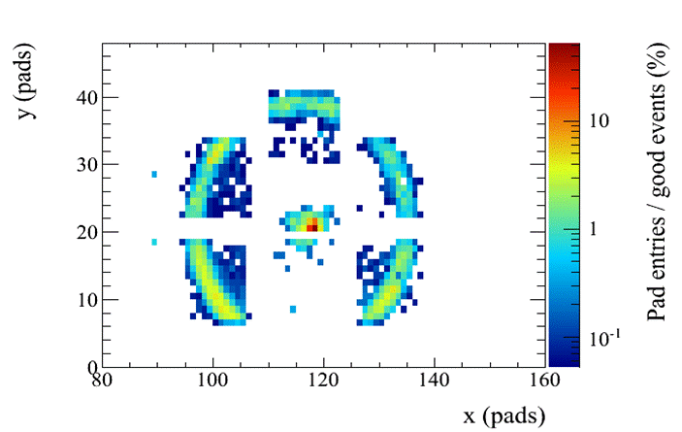
Ne+10%CH₄
(overlapping events, radiator thickness 10mm)
November 2010 beam test. Noise was removed offline

Slide 9
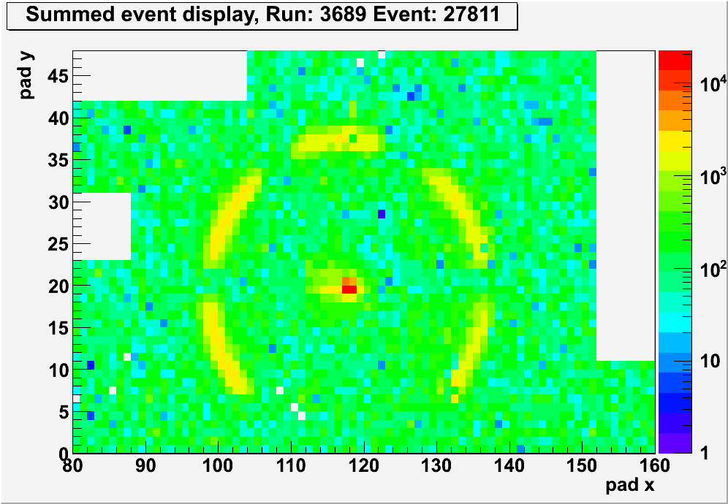
Ne+10%CF₄ (overlapping events, rad. thickness 15 mm)
May 2011 beam test. Raw data, no noise removal

Slide 10
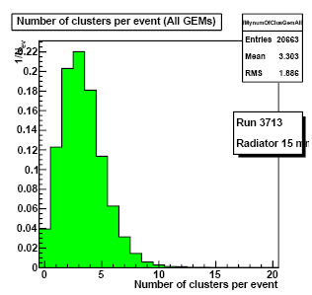
Four triple TGEMs together
After corrections on geometry and nonuniformity of the detector response the
estimated mean total number of photoelectrons per event is about 10.2

Slide 11
How much p.e one can expect in “ideal conditions”: full surface (without holes) and CH₄ gas:
Corrections: 0.9 (extraction)x0.75=0.68
10p.e/0.68~ 15pe

Slide 12
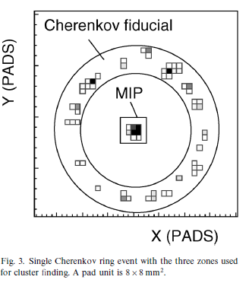
What was achieved in the past with the CsI-MWPC (radiator 15mm)?
F. Piuz et al., NIM A433,1999, 178

Slide 13
There are several possible ways to increase the efficiency of CsI-TGEM/TEGEM-based RICH detectors:
Gas
Geometry optimization
Double CsI (?)
CsI QE enchantment (?)

Slide 14
Gas
Potential for
5-7%
improvement

Slide 15
Optimization of TGEM/RETGEM geometry
Geometry optimization
Calculations on the way by
R.Veenhof+UNAM students.
Not ready yet, but probably another 5-7%?
G. Hamar et al., NIM A694(2012)16

Slide 16
Double CsI with misaligned holes?
CsI
TGEMs

Slide 17
Schematics of measurements
UV
Drift mesh
10 mm
pA
Voltages
V
3 mm
gaps
RETGEMs

Slide 18
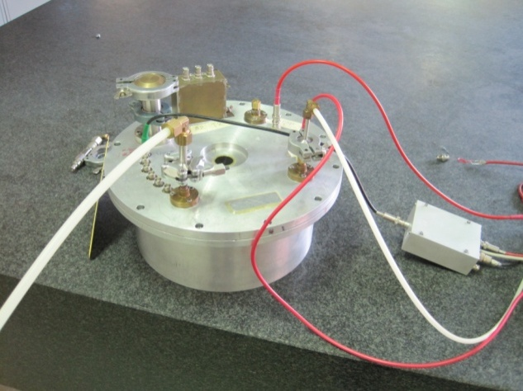
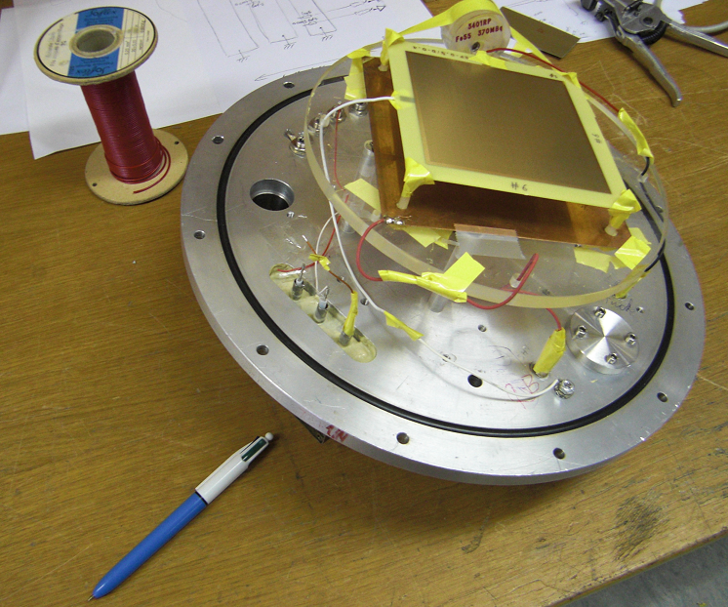
Test chamber

Slide 19
Low photocurrent measurements. Light at 90°
The effect, of exists, is inside the errors
TGEM2b
TGEM1b
Zoom
TGEM1t+TGEN2t
TGEM1t
Gas Ne+10%CH4.
Extraction fields 200-250v
(not very sensitive to exact value).
Across the GEM in collection mode:
250-300V to make
it transparent for photoelectrons

Slide 20
High photocurrent (to increase the sensitivity)
Is this an effect or systematic?
TGEM1t+TGEM2t
TGEM1t
??

Slide 21
Light at 45°
The effect partially disappear?
No conclusions, except that effect,
if exist, is not easy to catch with
this method.
Moreover, in the case of RICH one
have to deal with inclined UV beams..

Slide 22
Adsorbed layer

Slide 23
Enhancement with adsorbed layer
Important note:
TMAE vapors
were introduced, but
not in a flushed mode
D. Anderson et al.,
NIM A323 (1992) 626

Slide 24
Similar effect was observed with EF

Slide 25
For studies a simplified RICH prototype containing one triple TGEM/RETGEM was used

Slide 26
Pulsed UV lamp
Ar
4 mm CaF₂ window
Ne/CH₄ 90/10
40mm
Drift mesh
CsI layer
Drift gap 10mm
3mm
3mm
4.5mm
R/O pads 8x8 mm²
Front end electronics
(Gassiplex + ALICE HMPID R/O + DATE + AMORE)

Slide 27
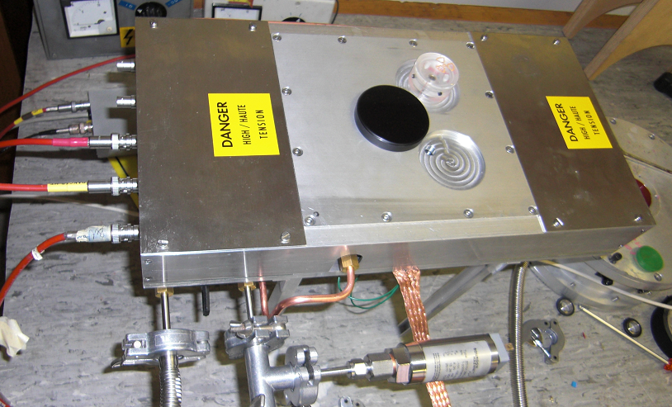
Photograph
Notes:
27

Slide 28
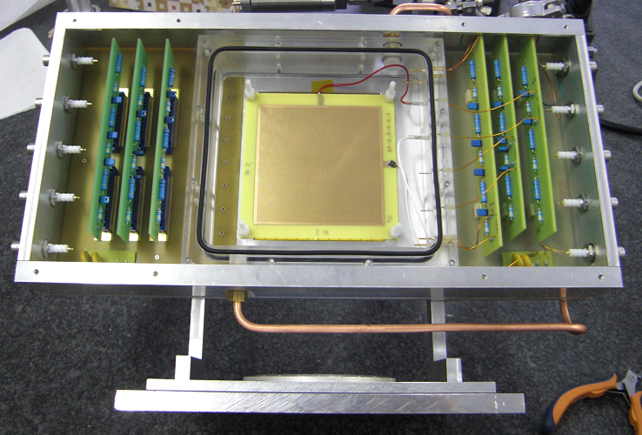
Notes:
28

Slide 29
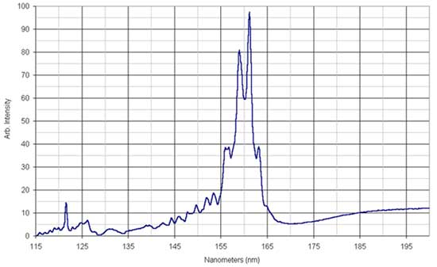
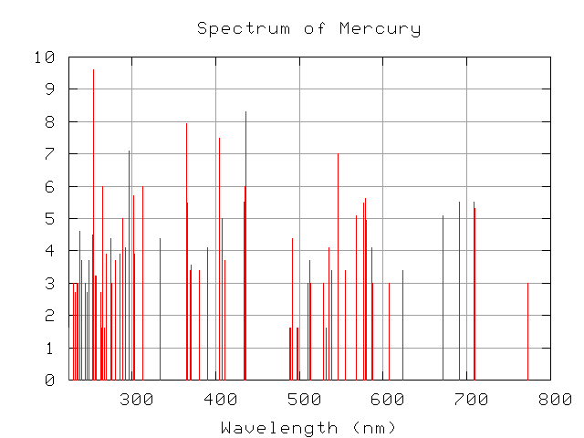
D2 lamp spectrum
Do not use Hg lamp!

Slide 30
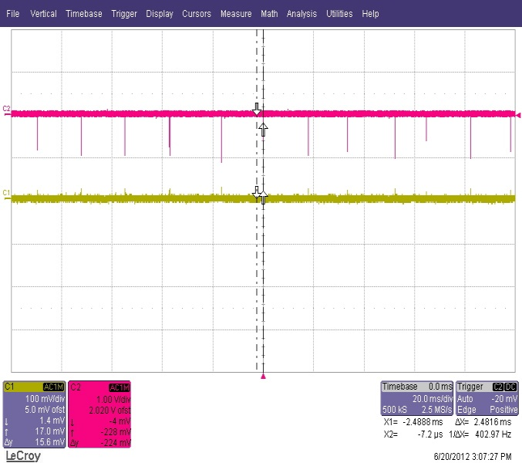
After shaper
Direct
From
Ortec142pc

Slide 31
Room temperature (~30°), continuous flushing
Preliminary
Flushing without EF(recovering)
Inject EF
Close EF, but
keep flushing the gas
When corrected on adsorption effect is
almost 40%

Slide 32
Tests with sealed gas chamber
Ist day
2d day
Preliminary
Inject EF and sealed when the signal was close to maximum
QE enhansement (after correction) is about 50%

Slide 33
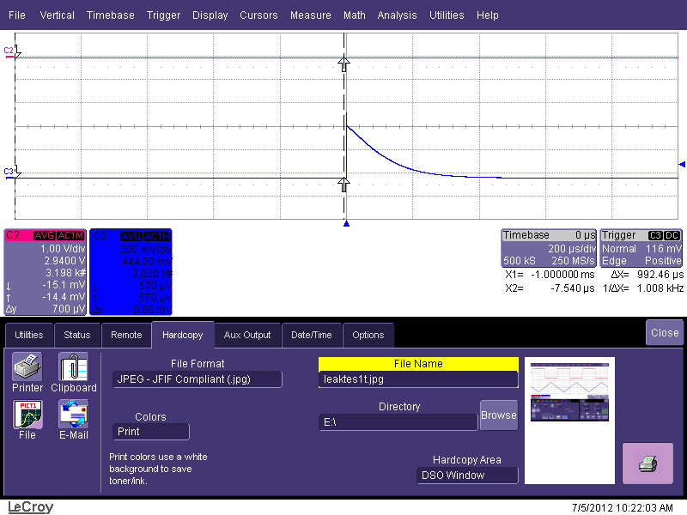
Cross –check with heating: CsI QE should drop, EF signal should increase

Slide 34
Elevated temperatures (60°C)
Negative Voltage applied on | Signal level
Drift/mesh | .5 x 20mV/div
TOP 1 | 2.5 x 200mV/div
Signal is 50 times less for EF
compared to CsI,
Which well fit expectations

Slide 35
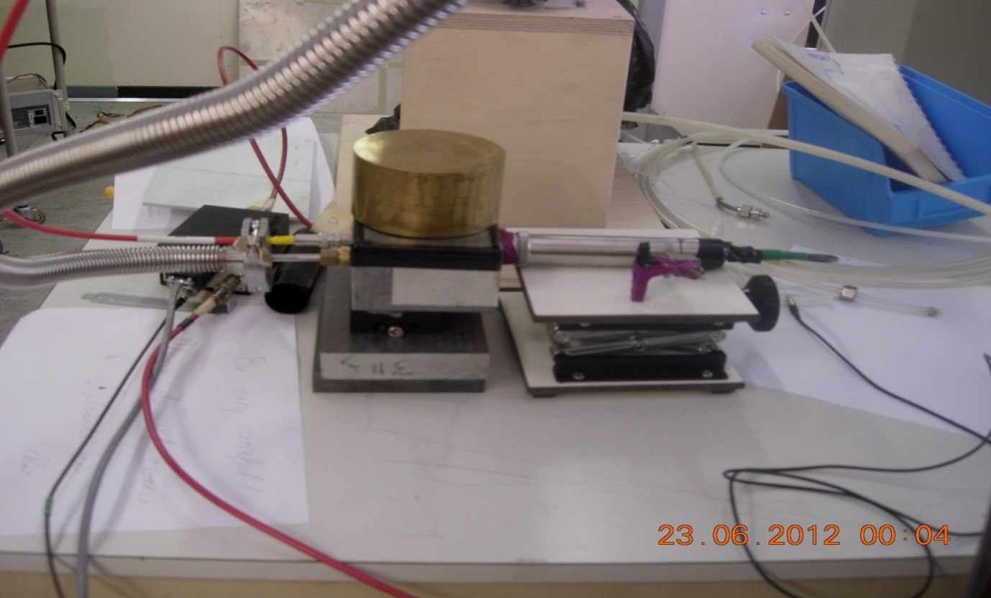
Cross-checks with othe detectors

Slide 36
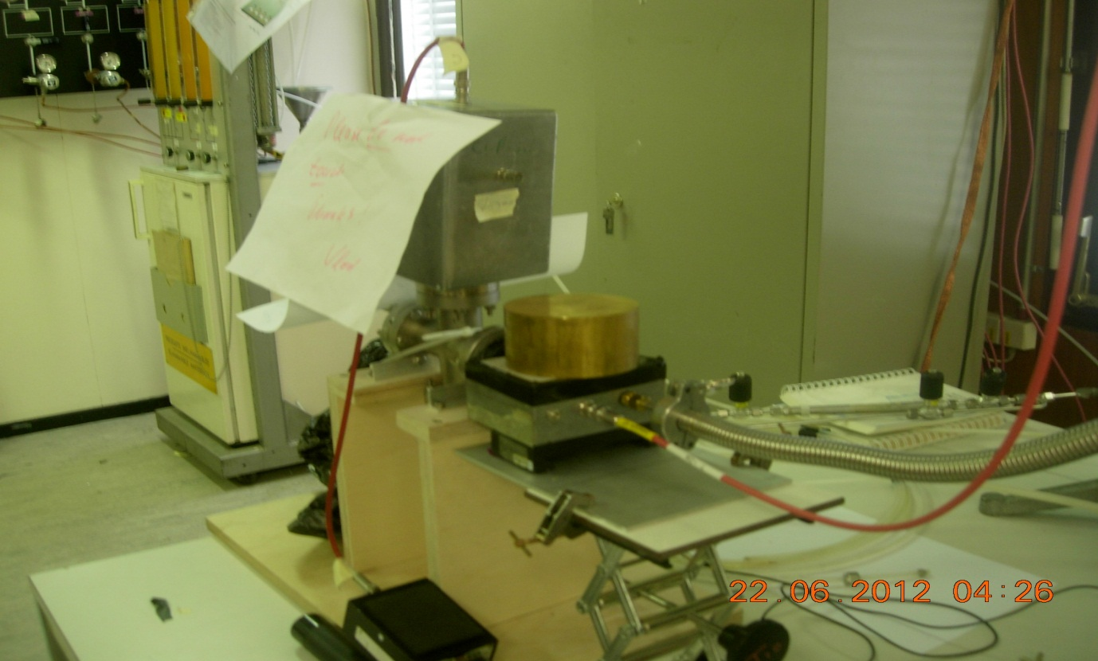
TMAE filled detector
Signal 1.3 V which corresponds the expected QE of the CsI

Slide 37
Potentials:
Gas optimization-5%
Geometry- probably 5 %
Double CsI??? (more studies are needed)
Absorbed layer 20-30% (a 50% after corrections). Not clear how to handle.
More efforts should be done

Slide 38
Can this enhancement be applied to the CsI-MWPC?
Should be carefully considered for each particular case:
feedback, contribution from the volume ionization, aging?

Slide 39
Conclusions:
• Some very preliminary measurements indicate that adding EF vapors increase CsI QE
• However one should find a way of stabilize the enhancement, because CsI act as a getter
• Some stability can be achieved with a sealed detector, however the gas gain changes with time
• More work is needed to master this effect in flush mode
• In the case of the success the efficiency of CsI-TGEM/TRETGEM may approach that of CsI-MWPC

Slide 40
Back up slides

Slide 41
Scintillators
Scintillators
Liquid radiator
Our proximity focusing TGEM-based RICH prototype installed at CERN T10 beam test facility
(mostly ~6 GeV/c pions)

Slide 42
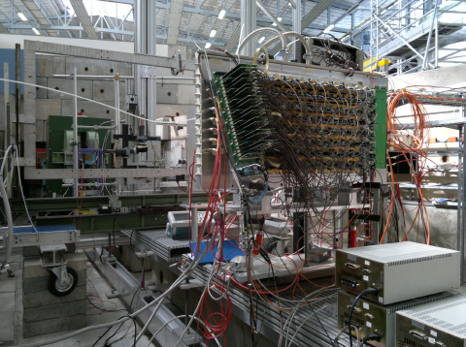
Electronics side

Slide 43
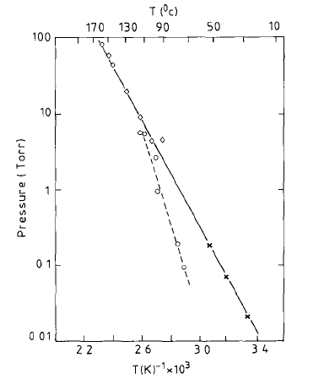

Slide 44
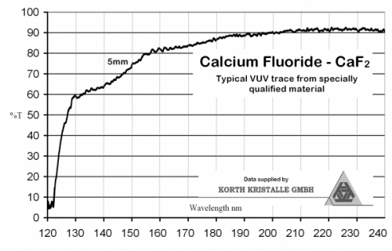

Slide 45
Gain degradation in a seled detector

