Slide 1



Status of the Micromegas industrialization activity with CIREA
Alan PEYAUD
December 2012 – RD51 MINIWEEK @ cern

Slide 2
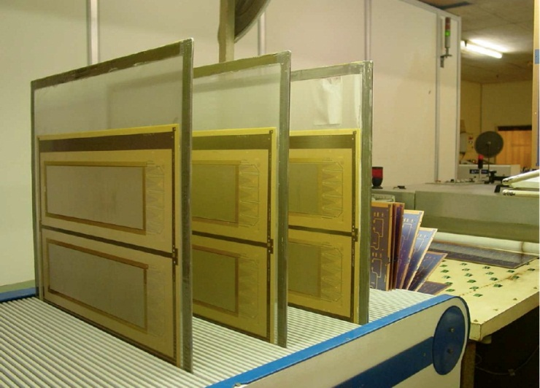
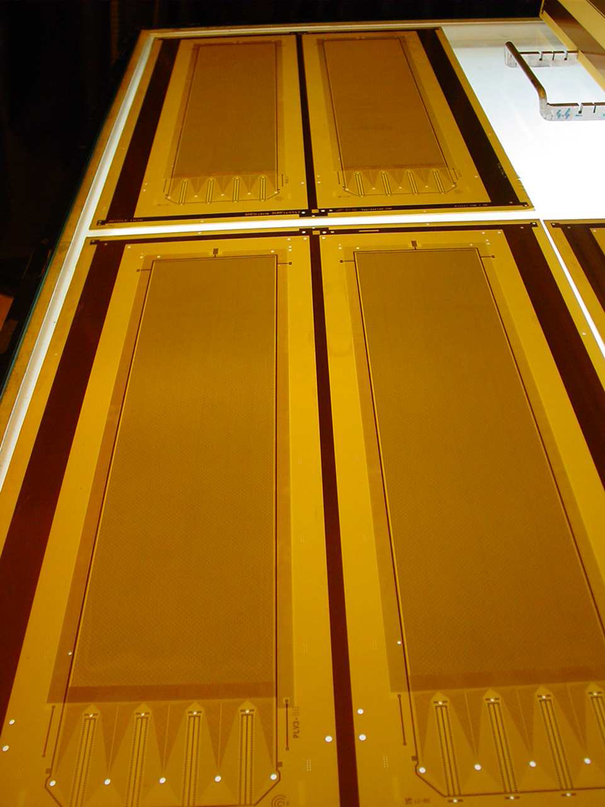
Elvia / cea partnership
Common fundings since one year (ANR)
develop large area detectors protected against sparks (SPLAM)
Main Bulk Tech. Transfer developments:
COMPASS: large pixel MM detector with buried resistors
CLAS12: large bulk on thin PCB (resistive solution also studied for the forward)
          …..few slides at the end of this talk
HL-LHC NSW program @ CEA Saclay

Slide 3

Industrialisation for the HL LHC - nsw
GOAL
end 2012/ early 2013 - Large resistive prototype detectors (0.5x1 m² ?)
2013 - Technical R&D (investment in machines) to achieve areas of 1 x 2 m²
2014/2016 - Production
ROAD MAP (NSW milestones)
Nov 2012: delivery of 3 BXY 10x10 cm² detectors (CERN/Saclay)
End 2012: towards large areas (0,5x1 m²)
  → Geoazur project (P. Salin) – to be redefined
2013/2014: towards nominal areas (1 x 2 m²) …… TO BE DISCUSSED
INDUSTRIAL PARTNERS
ELVIA / CIREA (France), ELTOS (Italy), Triangle Labs (Nevada, US)

Slide 4
first step: small bulk XY
Use of an existing layout
Resistive bulk (50 to 100 MΩ along the strips)
X-Y readout
Active area: 10 x 10 cm²
Geometry:
      strip pitch 250 µm
      strip width 150 µm
Bulk Mesh
128 um
Coverlay
Y readout
FR-4
X readout

Slide 5
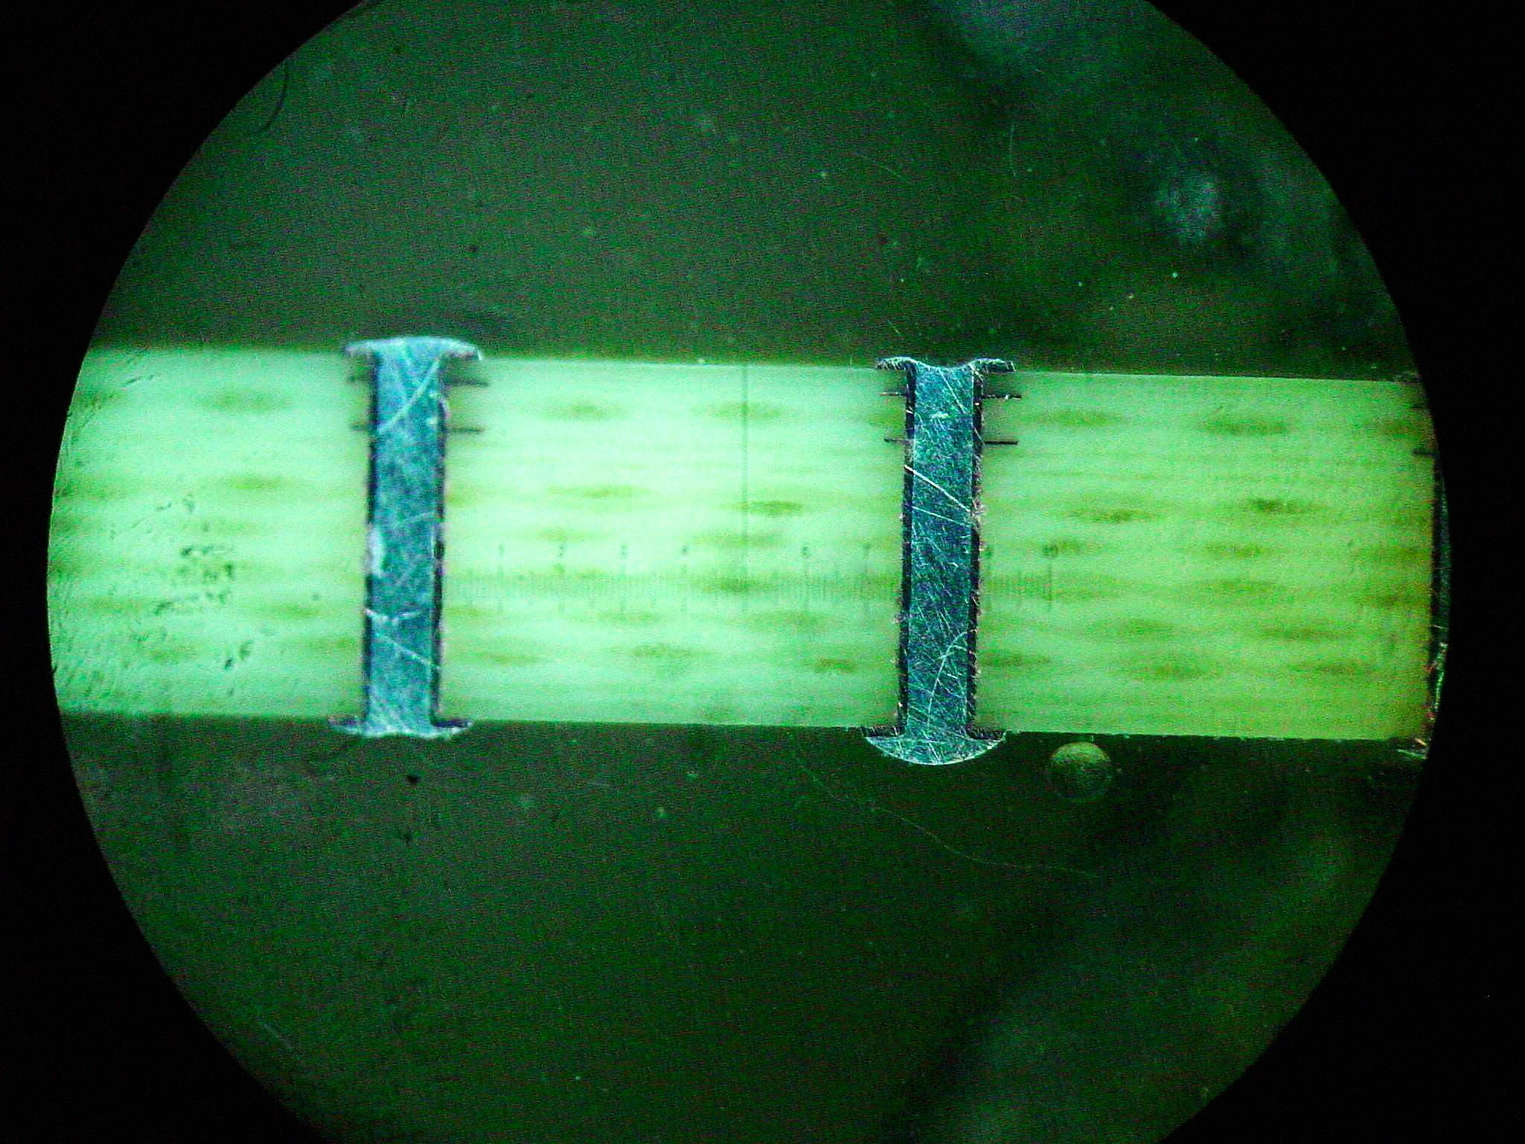
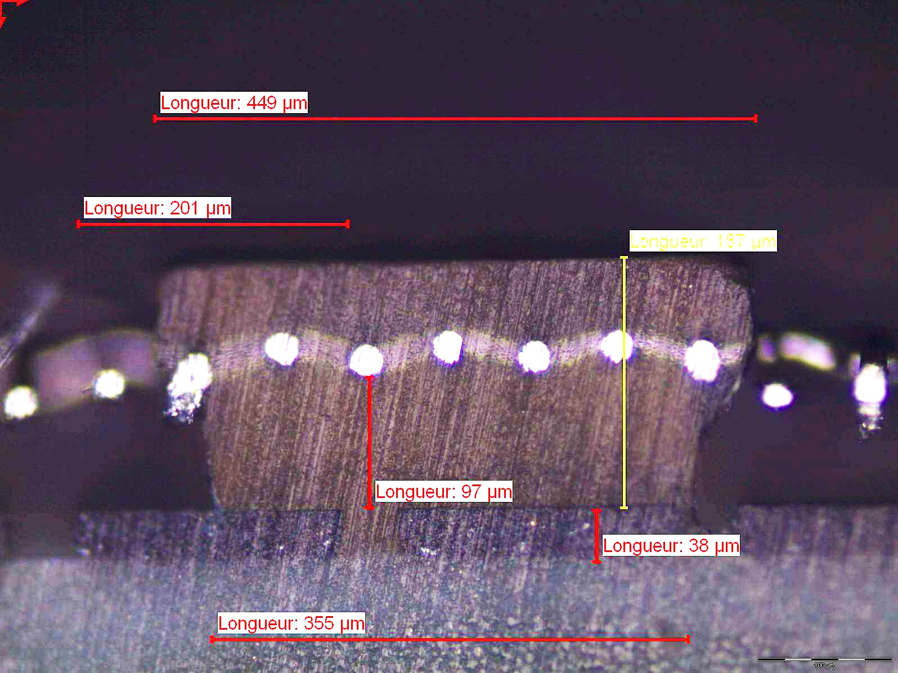
Elvia / cirea detector CROSS section
Resistive bulk XY cross section: pillar
PCB multi-layer
449 µm
201 µm
wires
187µm
Nominal figures
Coverlay: 64 µm
Amp gap: 128 µm
Pillar above mesh: 64 µm
Total pillar height: 192 µm
Resist. thickness: 35 µm
Mesh : 45/18 µm (30 µm)
97µm
resistive strip
38 µm
355 µm

Slide 6
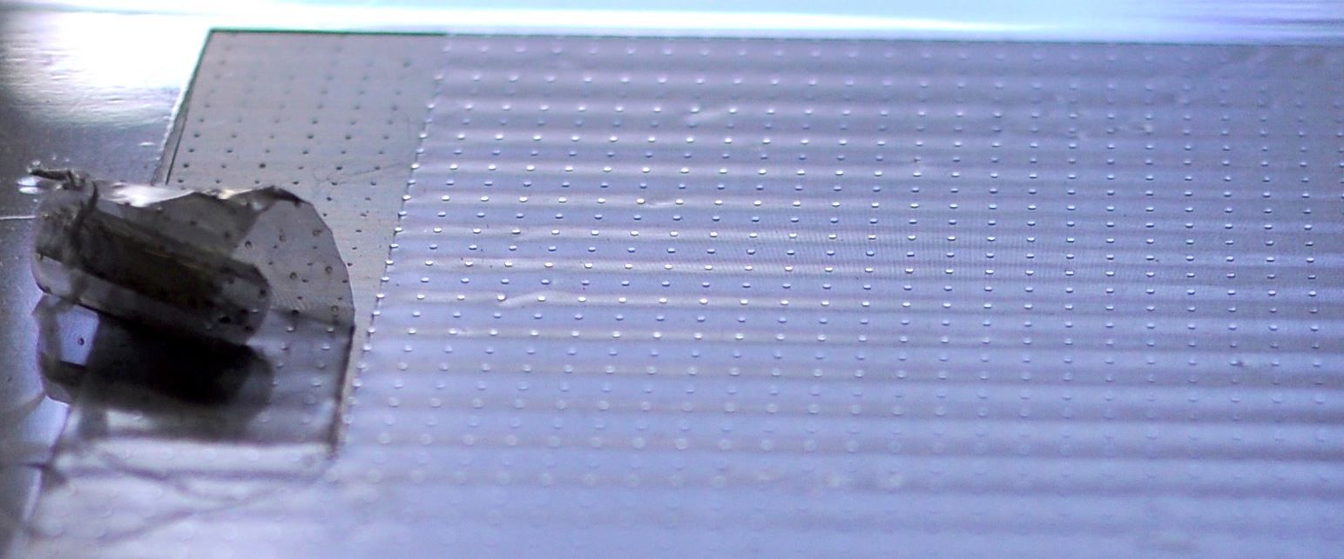
BXY1 : First batch (july 2012)
3 detectors are delivered beginning of July
Resistivity meas. ~50 MΩ per strip (decent homogeneity)
…But visual inspection show waves on the mesh
Diagnostic: the mesh has not been stretched correctly
Measurements in gas give ⁵⁵Fe spectrum with low energy resolution and evidence of an inhomogeneous amplification gap (lack of correct stretching)

Slide 7
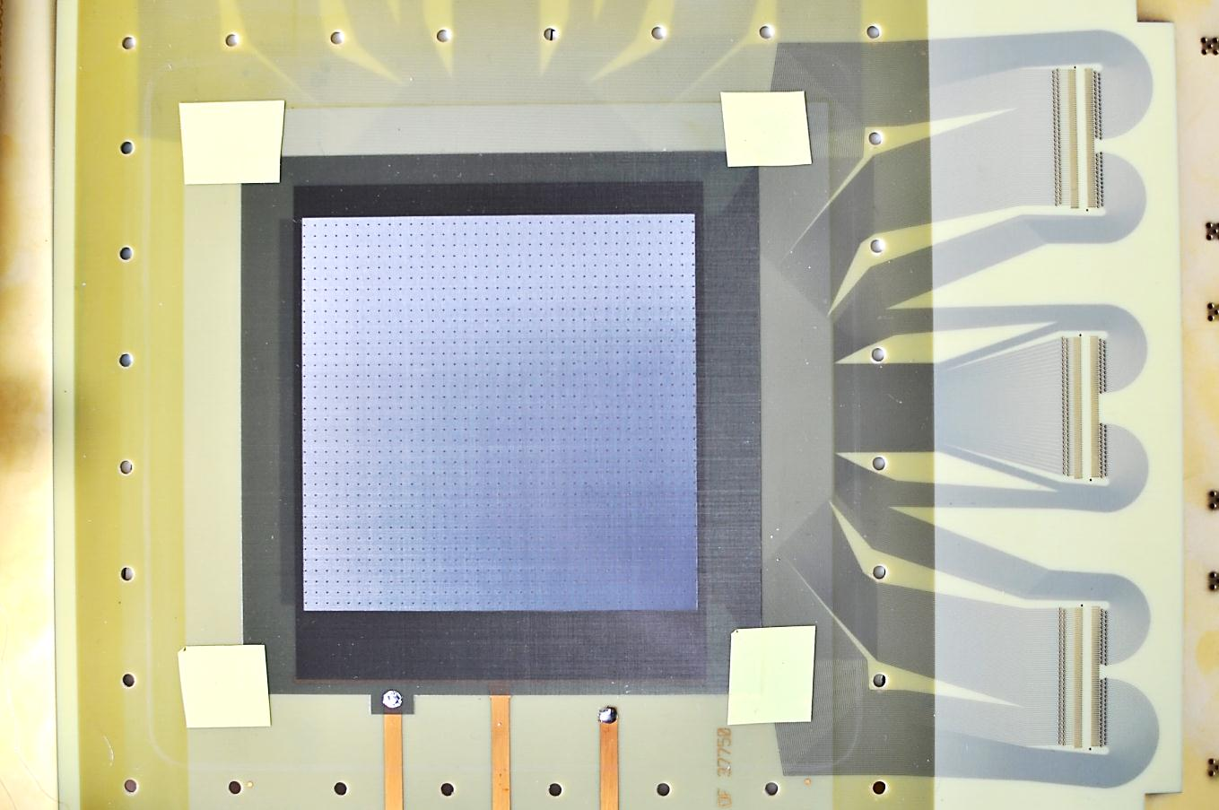
Bxy2 : Second batch (september 2012)
Grid manufactured by SERITEC (Switzerland) – stretch @ 15 N.cm
X
X
X
X
X
X
X
X
X
➔ 3 detectors delivered at Saclay at the beginning of september

Slide 8
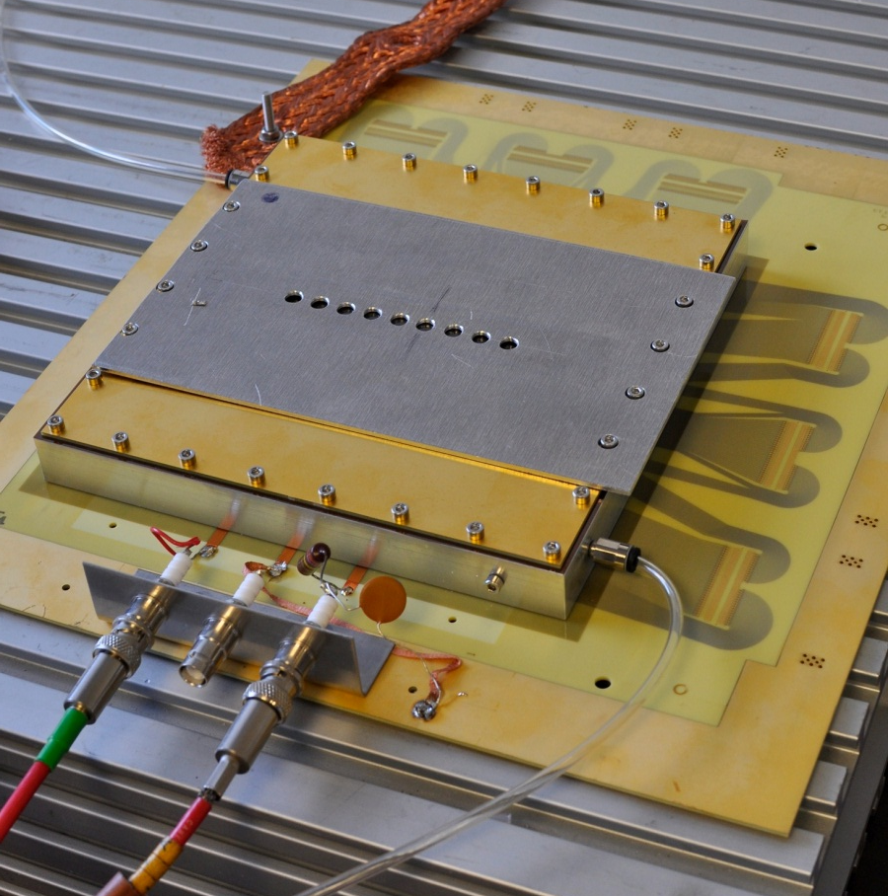
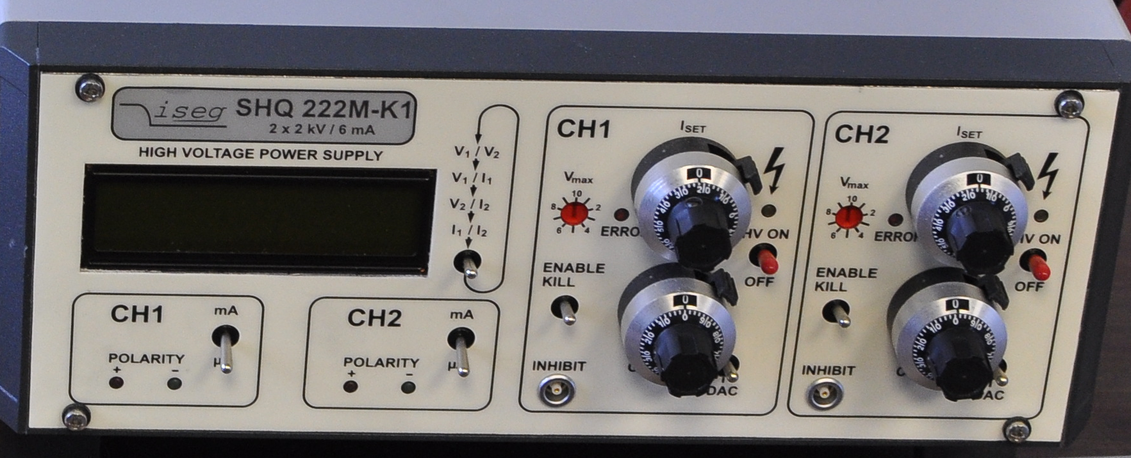
Bxy2 : ⁵⁵Fe calibration
Setup
Gas: Ar+10% CO₂
Preamp: Ortec 142B
Amp: Ortec 472A
MCA
HV mesh: 520 V
HV drift: 750 V

Slide 9
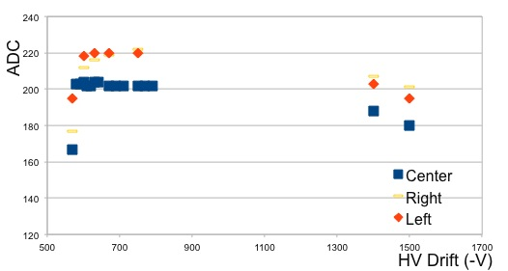
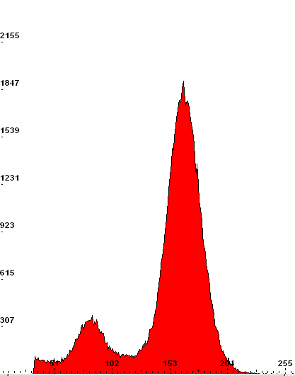
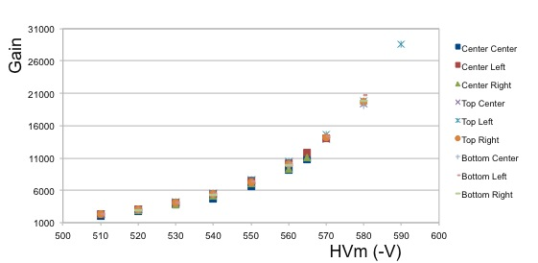
F4 after washing
Washed in demineralized water
Nitrogen drying
Oven curing (50°C) overnight
Transparency
HVm: 550
HVd: 650
Gain: 7500
dE/E ~ 18%

Slide 10
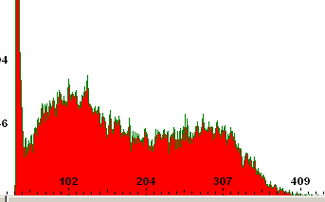
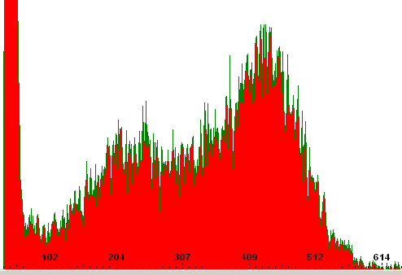
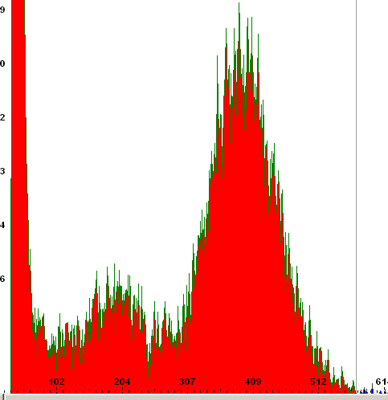
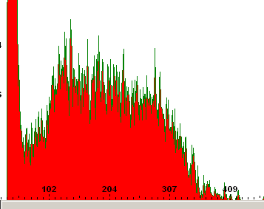
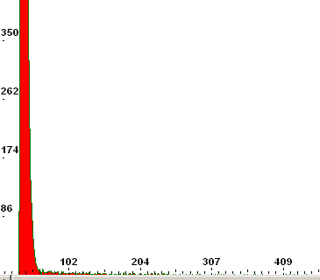
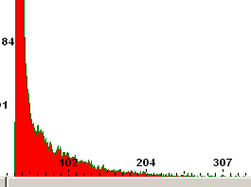
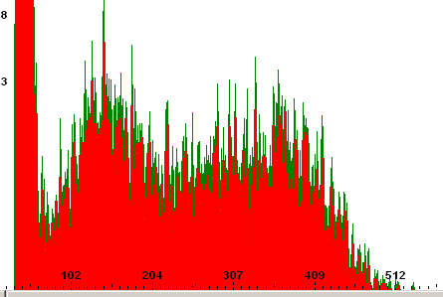
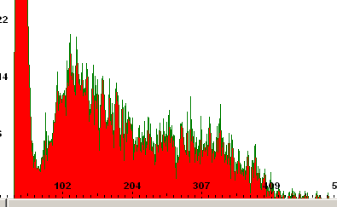
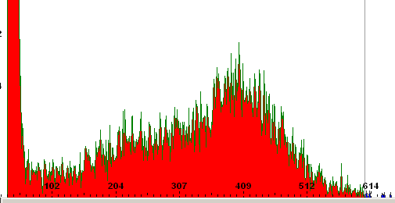
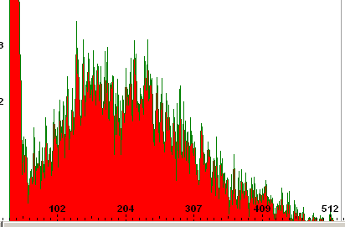
The other detectors…
Same washing program than for F4 but no improvement - the issues:
the polymerisation was not long enough and unsufficient mesh bonding through the pillars
Visually the mesh seems not to be attached to the pillars except in the corners
F1
F3

Slide 11
BXY2 3rd Batch – November 2012
2 new detectors were delivered early November
What has been done:
          Proper stretch from SERITEC
          Doubled the insulation time
          Proper curing time
Measurements in Ar + 7% CO2 with the ⁵⁵Fe gives some very good result

Slide 12
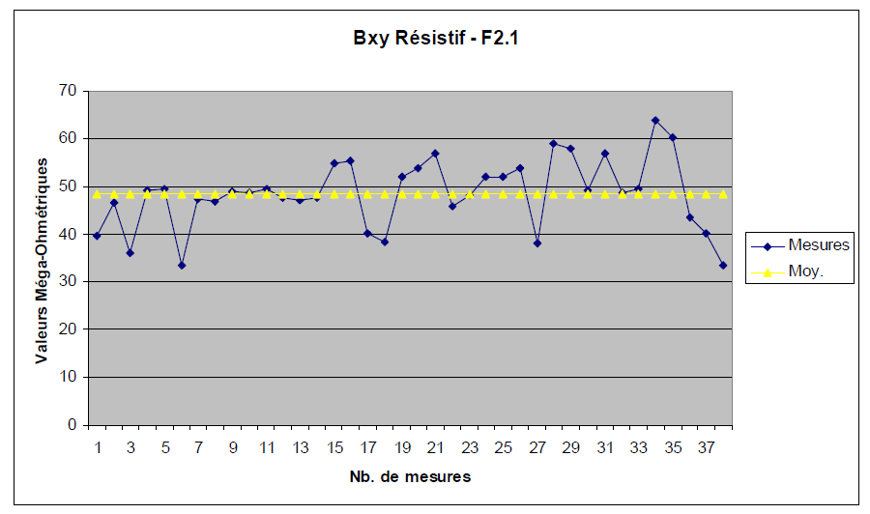
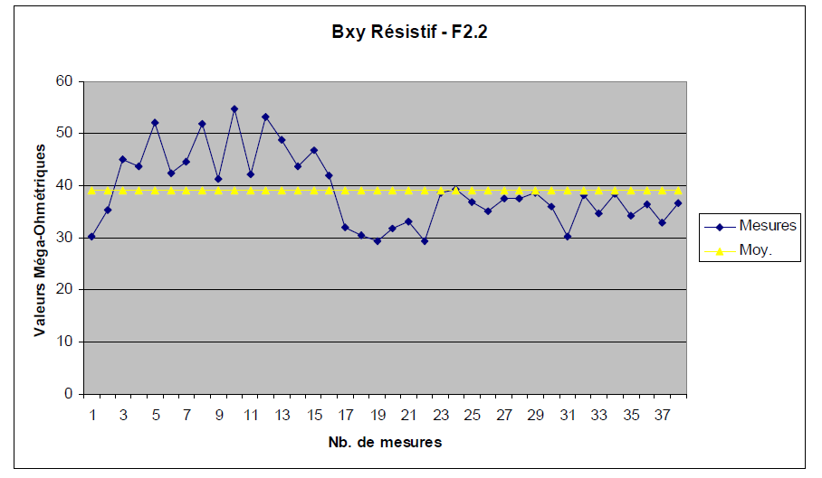
Synthesis of CIREA measurements on Bxy 3rd batch – received 24/10/12
Measurement made from the « comb » side to the extremity of each strip (1 meas. every 10 strips) with a Megger MIT 420 - calibre M 500V
MΩ
MΩ

Slide 13
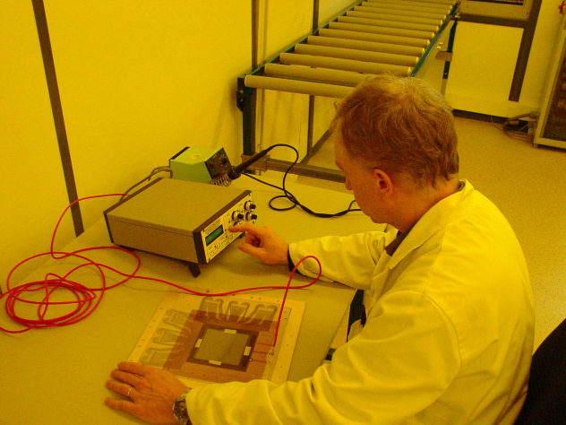
meas. On BXY 3rd batch

Slide 14
Transparency F2.1 & F2.2

Slide 15
GAIN F2.1 & F2.2

Slide 16
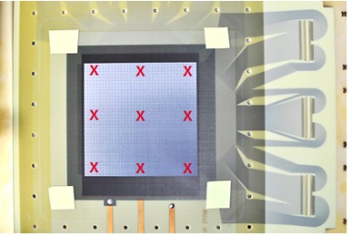
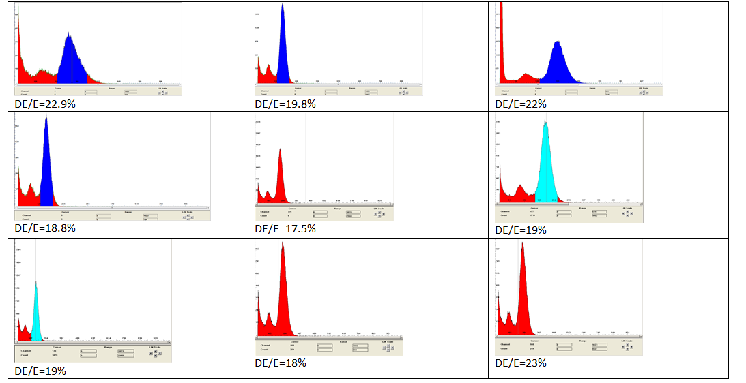
Homogeneity of BXY 2nd batch
F2.1 @ HV_{mesh} 540 V & HV_{drift} 790 V
<ΔE/E> ≈ 20% but some spread in peak position due to the position of the source on the edge of the drift

Slide 17
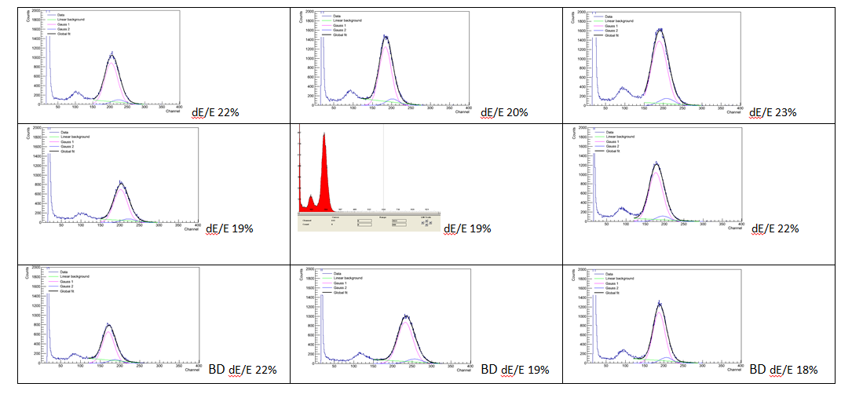
Homogeneity of BXY 2nd batch
F2.2 @ HV_{mesh} 540 V & HV_{drift} 790 V
<ΔE/E> ≈ 20% and peak position more uniform
1
2
3
4
peak offset
5
6
7
8
9

Slide 18
SUMMARY for BXY & NSW studies
Success!
Detectors F4, F2.1 & F2.2 are fully functioning➔ goal reached 3 detectors to RD51 collaboration by the end of 2012
Mesh stretching problem is solved
Resistivity is homogenous
Fine tuning to improve the process (insulation time and coverlay curing)
What’s next?
Large PCB (1 and 2 x 0.6 m²) have been ordered for strips precision meas.
REDISCUSS the roadmap for the industrialisation process
              Now a few slides from Damien Neyret & David Attie

Slide 19
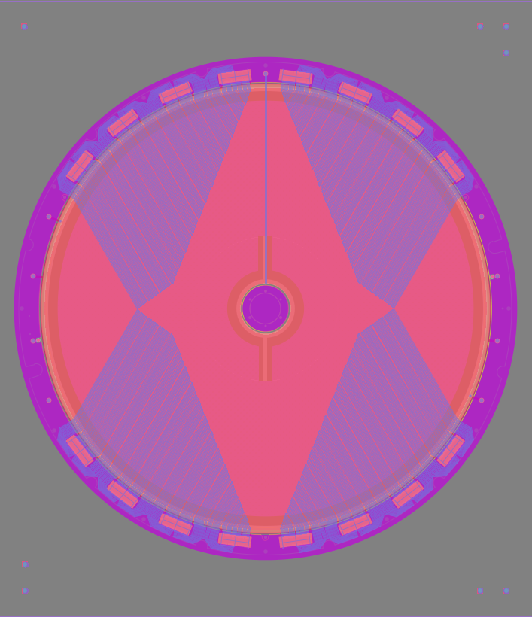
Prototype of the CLAS12-Forward Tracker
Bulk on active area: ∅410 mm
Layout design made by CERN/Saclay:
  scale 1 of the final design
  960 resistive strips of 500 µm pitch
  100 µm double sided epoxy
  glued on a 4 mm-thick Rohacell
  copper layers: 35 µm
  « classical » manufacture of the resistive strips
Status of the prototype production:
  ELTOS (PCB) + CERN (resistive strips + bulk) × 2 (+1)
  CIREA (PCB + resistive strips + bulk) × 3
    quotation of CIREA: 11 k€ in 5 weeks delay
    order sent 2 weeks ago in ELTOS and CIREA
Final design production (end of 2013):
  8 detectors: 6 + 2 spares
    layout adjustments
    copper layers: 5 µm
  manufacturing of resistive strips using serigraphy?
  produced by CIREA if prototypes are qualified
∅ 480 mm

Slide 20
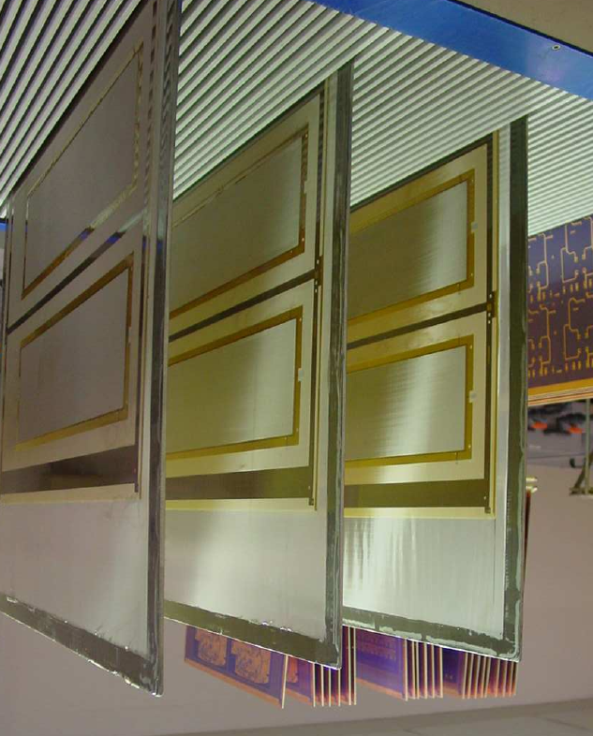
R&D on production at CIREA company
For COMPASS
First large size bulk Micromegas produced at CIREA
Damien Neyret - CEA Saclay IRFU/SPhN
RD51 3-5/12/2012
Activities on bulk production
A few small prototypes (6x10cm²) produced during 2011
➔1 with good gain performances
Several larger PLV3 prototypes (12x50cm²) batches produced since end of 2011 on thick boards
Also PLV3 on thin boards glued on Rohacell sandwich
Several problems at the beginning: bubbles in coverlay, pillars unstuck off board, low pillar thickness, waves on mesh
Quality has been improved with the time, almost good now
| PAGE 20

Slide 21
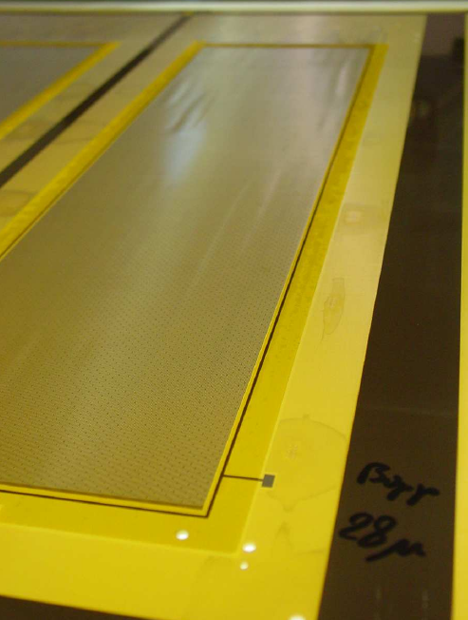
PLV3 boards from CIREA
Gain measured on April batch
Ar+5%iC₄H₁₀ gas
Very inhomogeneous gain
Some areas with nominal gain
Explained by bad pillar thickness
Finally solved by higher UV insulation
Batch produced in June with nominal thickness
First large size bulk Micromegas produced at CIREA early 2012

Slide 22
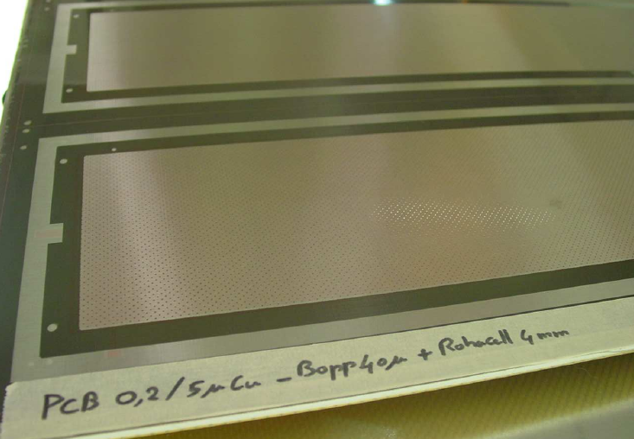
PLV3 boards from CIREA

Slide 23
PLV3 boards from CIREA
Present status of R&D on PLV3 prototypes
Last batch sparks at >750V in air
Pillar thickness nominal
Remaining problem: waves on mesh
New batch under production with more stretched mesh to get rid of waves
Part of next batch with thin board on Rohacell sandwich

Slide 24
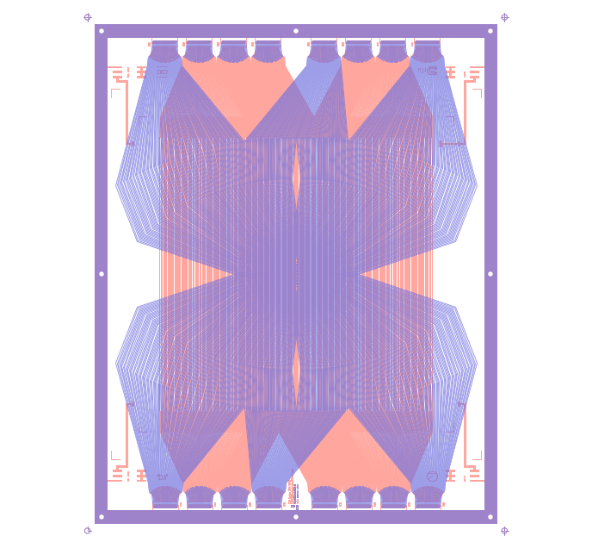
Production of large size prototypes at CIREA
Large size COMPASS prototypes
New rectangular design with active area 40x40cm²
Simplified design for first prototypes
Thin board on Rohacell sandwich to lower material budget
2 proto produced end of October
Installed in beam at Compass Thursday 29/11
In parallel discussions on production of buried resistors MM…
59cm
59cm
73cm
73cm

Slide 25
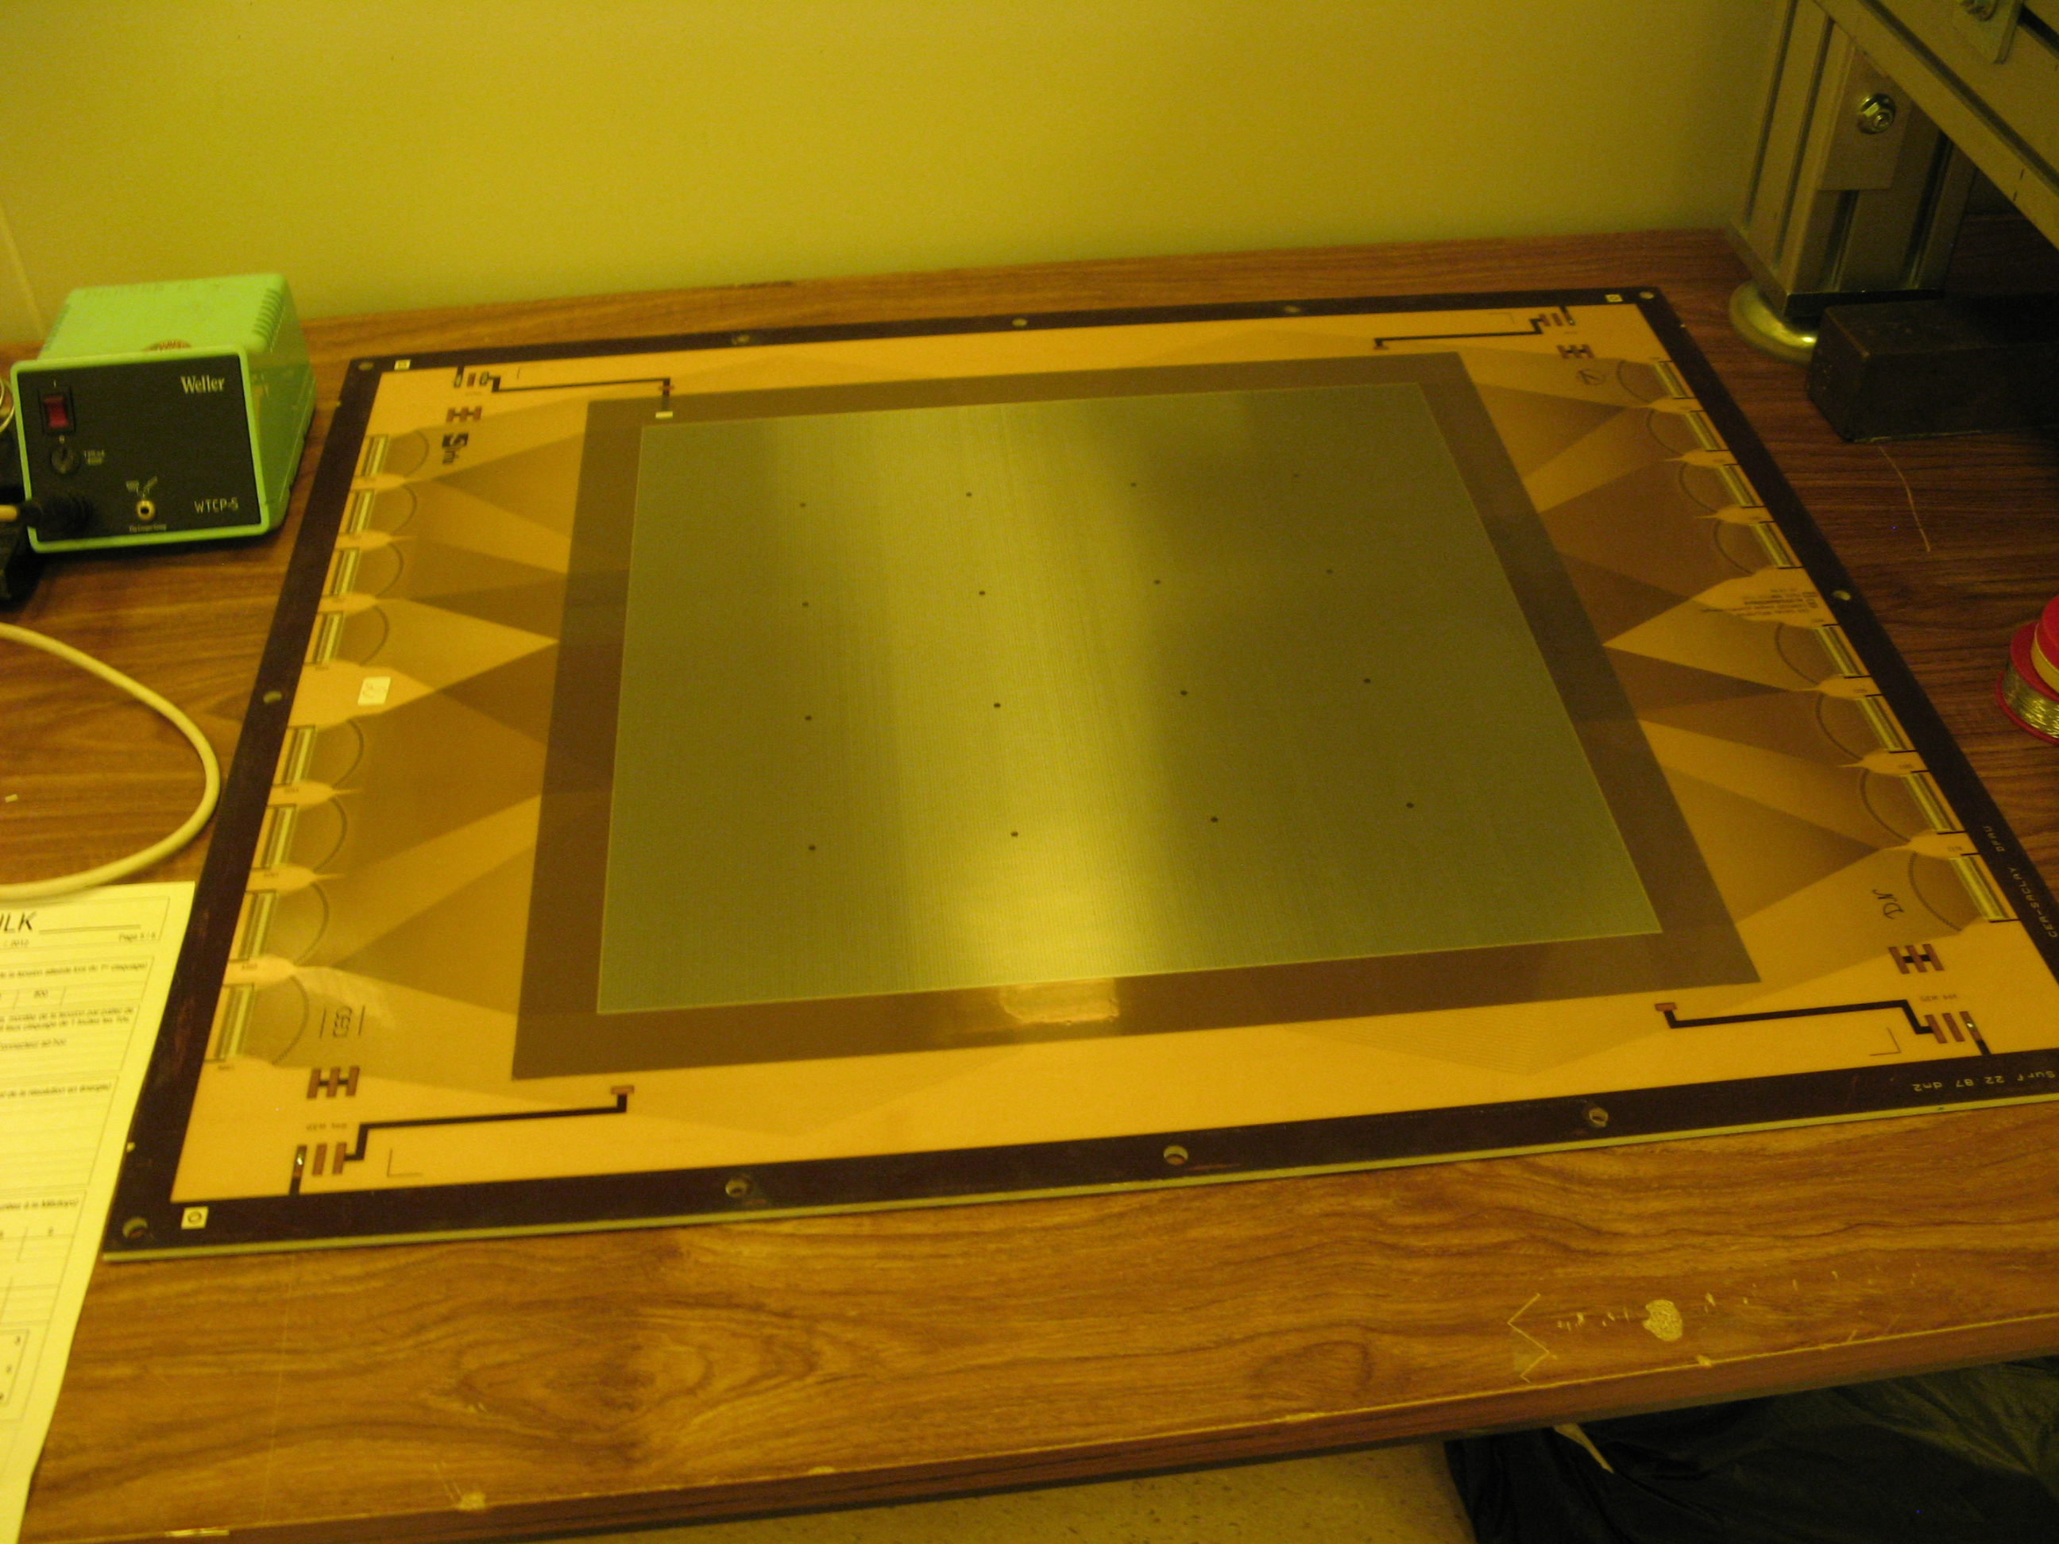
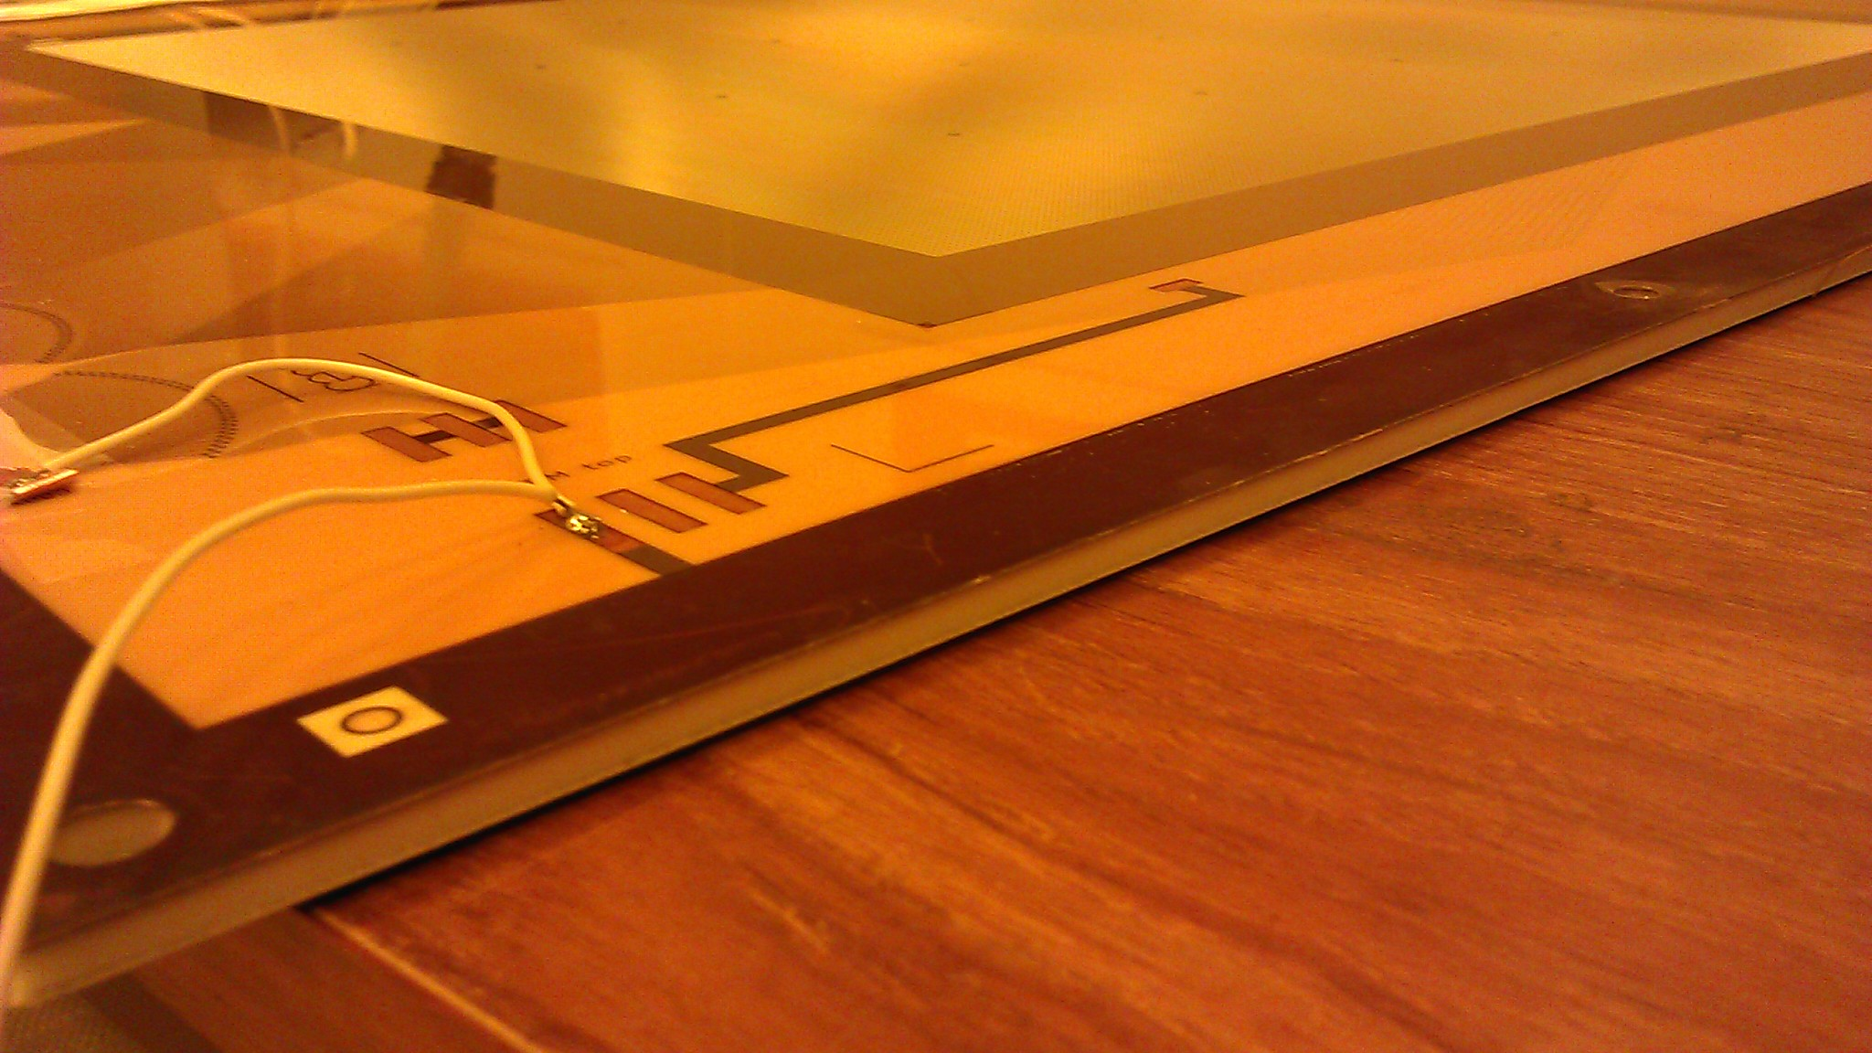
Compass pixel MM board built at CIREA
16 large pillars to support
additional GEM foil
Rohacell sandwich

Slide 26
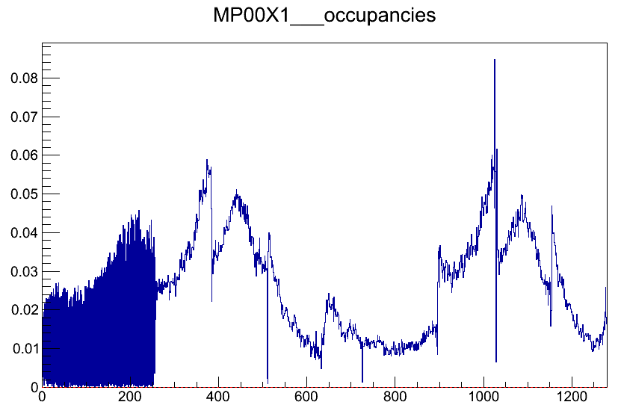
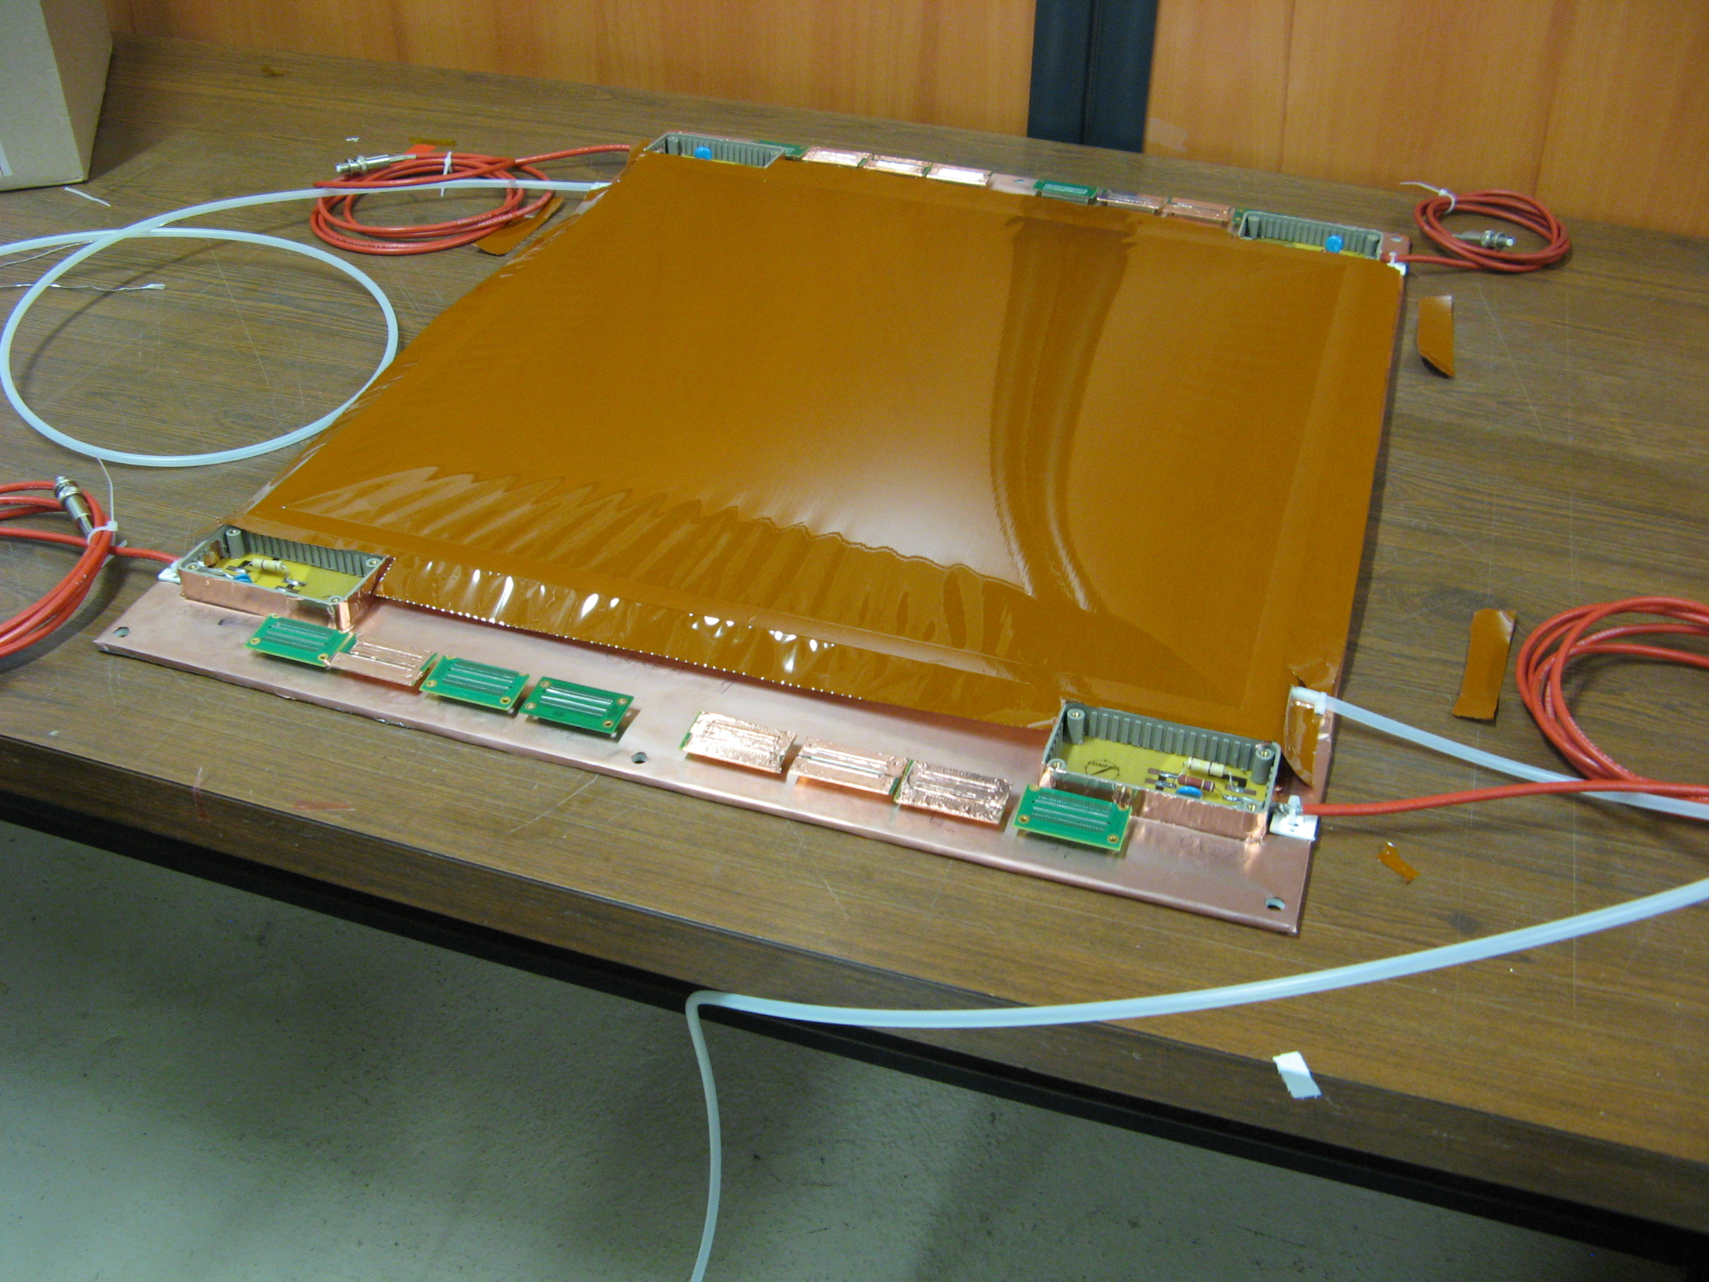
CIREA pixelMM installed at COMPASS
Bad APV card
1st prototype almost ready to be installed at COMPASS
First profile taken with beam

