Slide 1
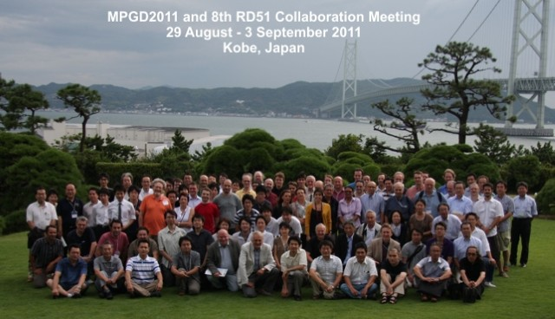
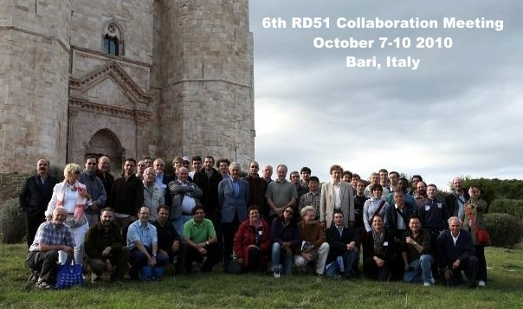
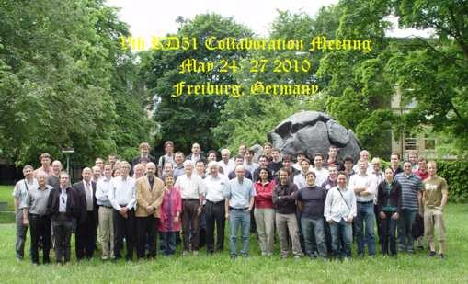
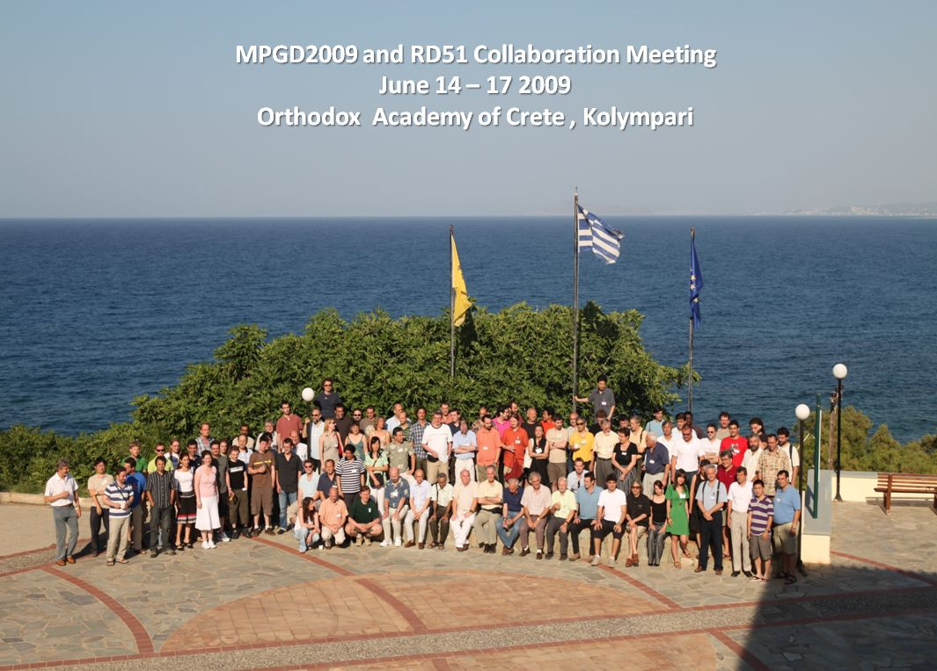
RD 51 Collaboration News
Leszek Ropelewski (CERN), Maxim Titov (CEA Saclay)
80 RD51 Member Institutes; ~ 450 Participants
RD51 Collaboration Mini-Week, CERN Geneva, December 3-5, 2012

Slide 2
RD51 Collaboration Mini-Week (CERN, December 3-5, 2012):
https://indico.cern.ch/conferenceOtherViews.py?confId=218341
Monday, December 3
10:30 - 12:00 Plenary session
    10:30 RD51 Collaboration news
    11:00 A novel Silicon device incorporating MicroMegas technology for picosecond Charged particle measurement at high rates (S. White, Center for Studies in Physics and Biology, The Rockefeller University,NY )
14:00 - 18:00 WG5 - Electronics
Tuesday, December 4
09:00 – 12:30 WG1 MPGD Technologies and New Structures
14:00 - 18:00 WG2 – Physics Issues
Wednesday, December 5
09:00 - 11:00 WG7- Test Beams
11:00 – 12:30 WG6 - Production
14:00-18:30 WG4 - Simulation & software

Slide 3
RD51 Collaboration Meetings in 2013 and Communications:
30 January – 1 February: RD51 Mini-Week (CERN)
22 – 24 April: RD51 Mini-Week (CERN)
5 - 6 July: RD51 Collaboration Meeting (Saragoza, Spain) –
together with MPGD 2013 (1-4 July)
14 – 16 October: RD51 Collaboration Meeting (CERN)
RD51 Official Communications:
RD51 Collaboration Meetings Agenda:
http://rd51-public.web.cern.ch/RD51-Public/Meetings/CollaborationMeetings.html
CB minutes:
https://espace.cern.ch/test-RD51/CB%20meeting%20minutes/Forms/AllItems.aspx
MB minutes:
https://espace.cern.ch/test-RD51/MB%20meetings/Forms/AllItems.aspx

Slide 4
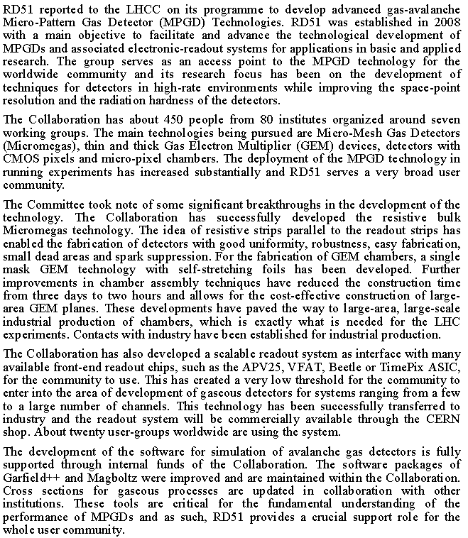
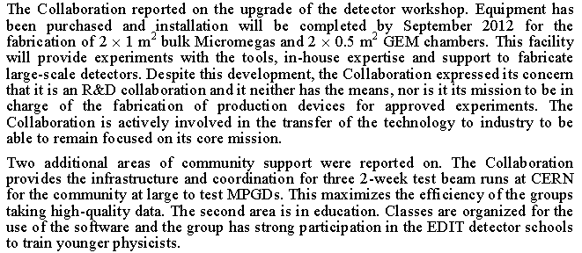
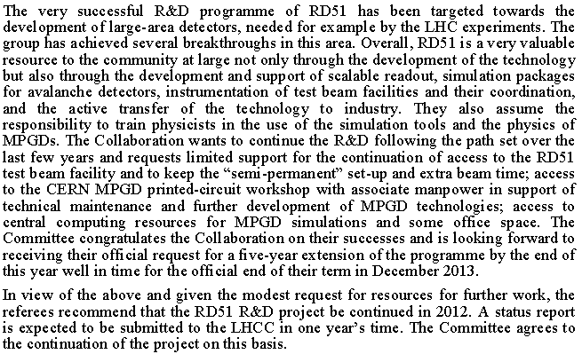
RD51 LHCC Review
LHCC Committee,
Draft Minutes
(CERN/LHCC-2012/008)
RD51 Report in the LHCC Open Session on June 13, 2012
http://indico.cern.ch/conferenceDisplay.py?confId=194183

Slide 5
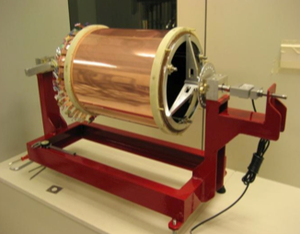
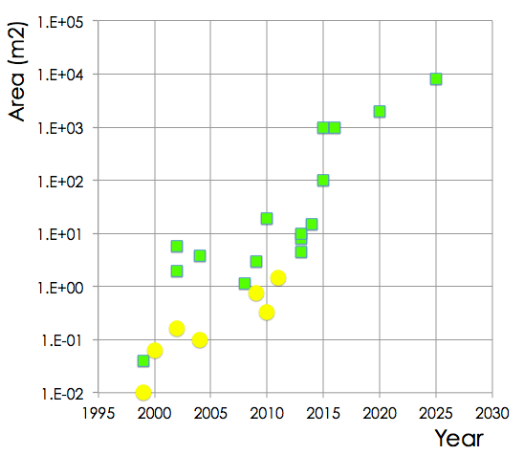
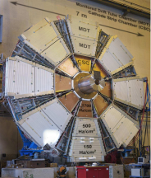
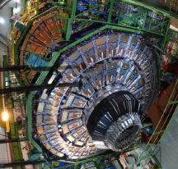
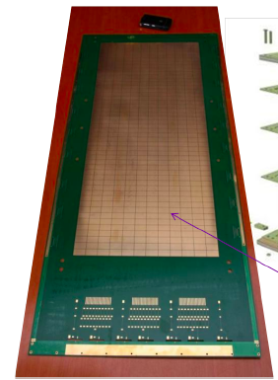
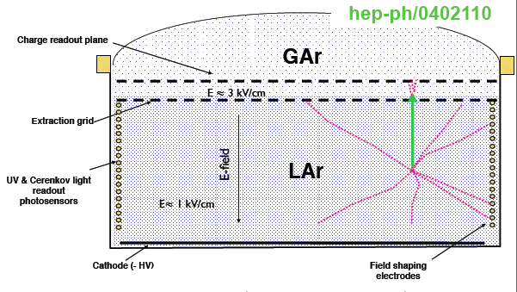

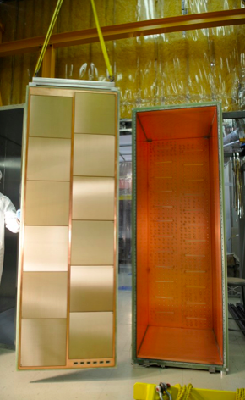
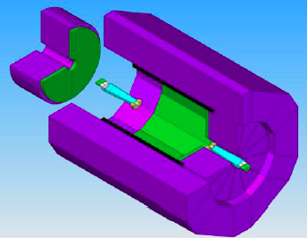
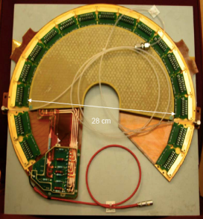
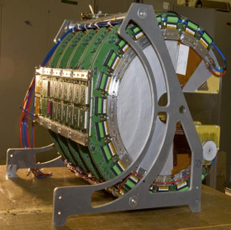
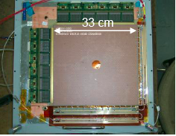
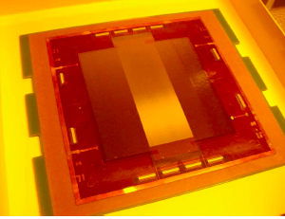
European Strategy Meeting in Cracow: Detector R&D for Discovery Science
A. Cattai, Detector R&D Talk
Kloe
total area
produced
GLACIER
T2K
size of the single
GEM/μM foil
SiD
HCAL
TOTEM
COMPASS
a
foster industrial
large scale production
A

Slide 6
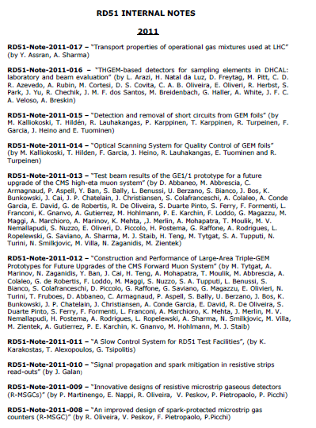
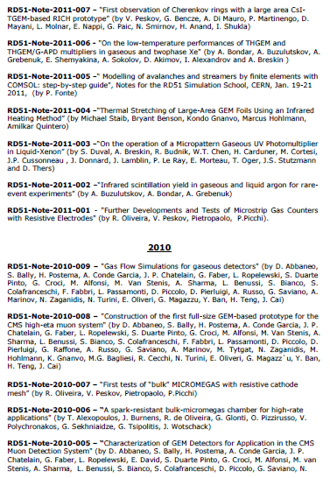
RD51 Collaboration Notes
https://espace.cern.ch/test-RD51/RD51%20internal%20notes/Forms/AllItems.aspx
RD51 Notes: 12 in 2012
17 in 2011;
9 in 2010;
7 in 2009
We encourage everybody to submit results of your work (before journal publication)
and internal documentation as RD51 internal notes

Slide 7
WG2: RD51 Common Projects in 2011 and 2012
2012: 4 Projects has been submitted for evaluation
R&D on large area GEMs for the ALICE TPC upgrade (GSI/ Tokyo / UNAM)
2D-MHSP and 2D-THMHSP for medical applications (Aveiro/Coimbra)
High resolution UV scanner for MPGD applications (Wigner FCP/INFN Trieste/ INFN Bari )
Large-area THGEM detector evaluation with SRS electronics (Weizmann/Coimbra/Aveiro)
MB will meet this week to discuss proposal selection
2011: Ongoing Common Projects:
Thin and high-pitch laser-etched mesh manufacturing and bulking (Saclay / CERN / Bari)
Development of innovative resistive GEM alpha detectors for earthquakes prediction
and homeland security (INFN Bari / UNAM, Mexico / INFN Padova / INFN Frascati)
MPGDs technology laboratory for training, development, fabrication, applications
and innovation (Universidad Antonio Nariño, Columbia / Brookhaven National Laboratory/
Helsinki Institute of Physics / HEPTech / GSI Helmholtzzentrum)
A low mass microbulk with real XY strips structure (NCSR Demokritos / Saclay/ Laboratorio
de Física Nuclear y Astropartículas, Universidad de Zaragoza / CERN )

Slide 8
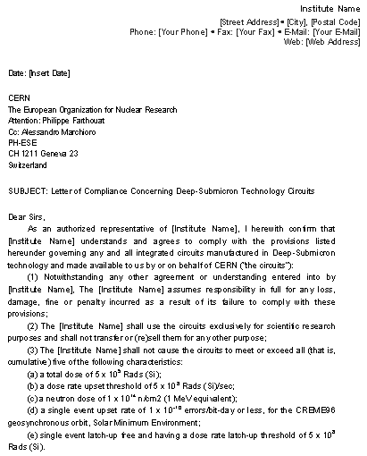
WG5 – Electronics & Scalable Readout Systems
Legal documents required for SRS distribution to the RD51 institutes are finalized
Caveat: situation only resolved for countries, which does not require license, based on “Commerce Control List” (cat. NS2) – mostly Europe, Switzerland & few others
SRS Distribution Procedure;
Every institute has to sign “Letter of Compliance” with RD51 spokes
Order your SRS systems/hybrids from CERN Store
Pick-up hybrids from A. Marchioro office
(PH-ESE-ME, 77319)

Slide 9
WG6 – MPGD Technology & Industrial Partners
NEW FLEX company send us a letter – because of the overload they are not be able to
continue with GEM industrialization
Good news from Micromegas industrialization → WG6 talks
Fabio Formenti resigned as a WG6 Convener because of the new project at CERN →
THANK YOU FABIO FOR ALL YOUR EFFORTS !!!
THGEM Technology – ELTOS S.p.A. (Italy)
PRINT ELECTRONICS (Israel)
GEM Technology
Tech-ETCH (USA, Boston)
Techtra (Wroclaw, Poland)
Scienergy (Japan, Tokyo)
Keerthi Industries (India)
MicroMetal GmbN (Germany, Muellheim)
Micromegas Technology
TRIANGLE LABS (USA, Nevada)
ELTOS S.p.A. (Italy)
SOMACIS (Italy, Castelfidarco)
CIREA (France, CHOLET)

Slide 10
CERN MPGD Technology & Workshop
Special 1-day meeting to discuss future of the TE-MPE-EM workshop took place on Nov. 29:
to discuss current situation and to define workshop structure and future activities
Significant increase in production volume and number of people employed for MPGD activities:
Number of people working on GEM/
Micromegas production has
significantly increased since this summer:
GEM: 2 → 4
Micromegas: 2 → 3
Was ~70/30 (PCB/MPGD)
few years ago
Two major important items were brought by the RD51 management:
Keep MPGD R&D at a similar level for the next 5 years, independently of any large volume
MPGD Production in the workshop
MPGD Technology Industrialization

Slide 11
WG7 – Test-Beams
From: Eraldo Oliveri [eoliveri@cern.ch]
Sent: Friday, November 30, 2012 9:40 AM
To: rd51-wg7@cern.ch
Subject: FW: Call for Test beam Requests DESY 2013
Dear All,
There will be no beam in the SPS/North Area for almost two years. The beam is planned
to come back only after October 2014.
Below you will find some information about the possibility of having beam test in DESY
for the 2013. You have been probably already informed.
The dead line for DESY is next week (if you were not informed, sorry for the short advice):
“If you are planning to use the DESY test beam facility in 2013 please send before
December 5th 2012”. More details are below.
We cannot provide support to user "on beam". However, everything needed from
the lab (detectors for tracking, electronics,..) could be provided.
Kind Regards.
Yorgos and Eraldo

Slide 12
RD51 Future (beyond 2013):
The initial validity of the present RD51 MoU covers the period
until the 31st of December 2013
If RD51 would like to continue beyond 2013 → need to ask for
extension LHCC and CERN Research Board (RB);
Preliminary discussions with LHCC → will not need to write new
RD51 proposal →prepare executive summary (10-15 pages) to
describe future RD51 program
Received a lot of contributions from individual groups and RD51
WG conveners – THANK YOU FOR ALL YOUR INPUTS !
Document to be submitted to the LHCC in the beginning of 2013 →
extension discussed/(approved) by LHCC/RB in March/June 2013

Slide 13
Future RD51 Collaboration Activites (beyond 2013):
Generic R&D (new structures, ideas, detector physics) – RD51 Common Projects (WG2)
Applications – new proposal: organization of series of specialized workshops
disseminating MPGD applications beyond fundamental physics – RD51, potential users and industry (e.g. dosimetry, neutron detection, medical physics, …) (WG3)
Development and Maintenance of Software & Simulation Tools; basic studies &
software support for the RD51 community (WG4)
Development and Maintenance of the SRS Electronics (WG5)
MPGD Industrialization - GEM, Microgemas, Thick GEM (WG6)
Maintenance of the RD51 Test-Beam Infrastructure (WG7)
MPGD Education and Training – new proposal: organization of schools for
students and newcomers & academic training outside CERN, covering specific
areas of the RD51/MPGD activities
Circulate Draft Executive Summary – before end of the this year

Slide 14
Backup Slides:

Slide 15
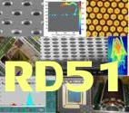
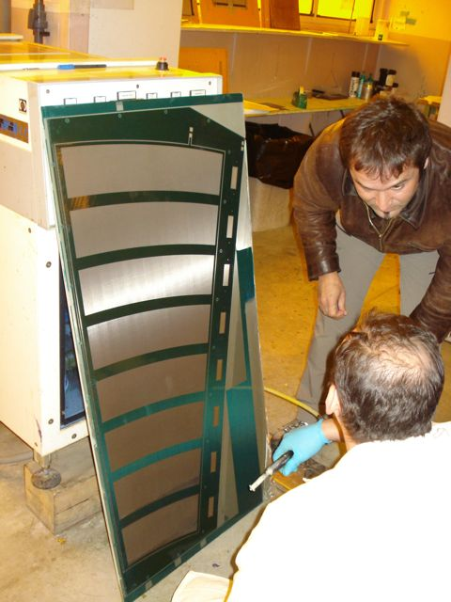
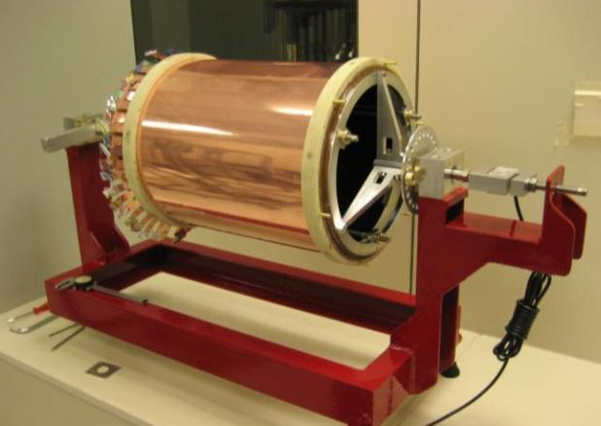
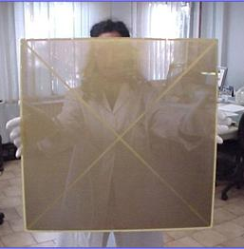
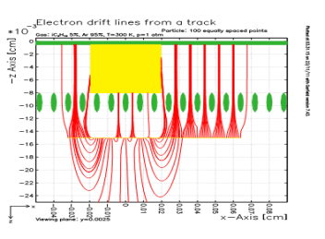
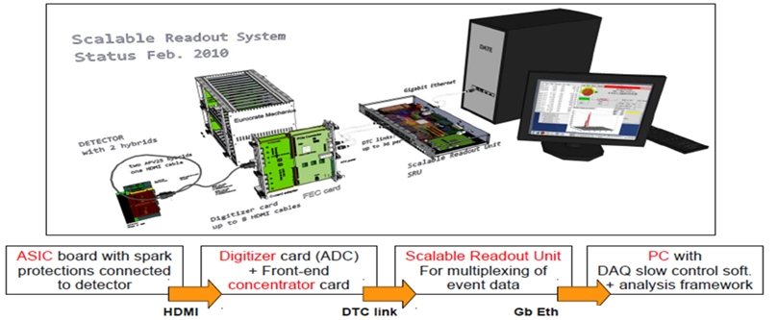
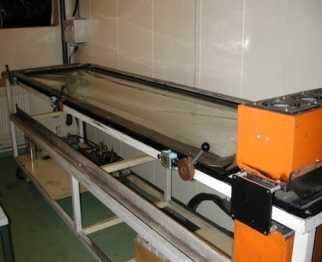
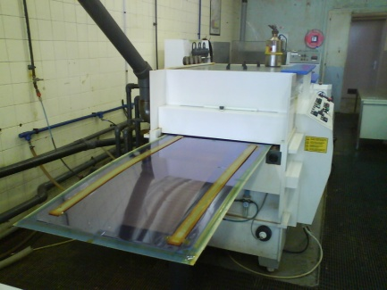
RD 51 Collaboration Organization
Consolidation around common projects: large area MPGD R&D, CERN/MPGD
production facility, common electronics developments, software tools, beam tests
Large area (MM, GEM, THGEM)
Design optimization
(e.g. THGEM, Resistive MM)
“RD51 Common Projects”
(Generic R&D)
WG2:
WG1:
MPGD SRS
Electronics
WG5:
Software and
Simulation
RD51
WG4:
WG7:
WG6:
RD51 Common
Test Beam Facility
CERN MPGD Workshop
& Industrialization

Slide 16
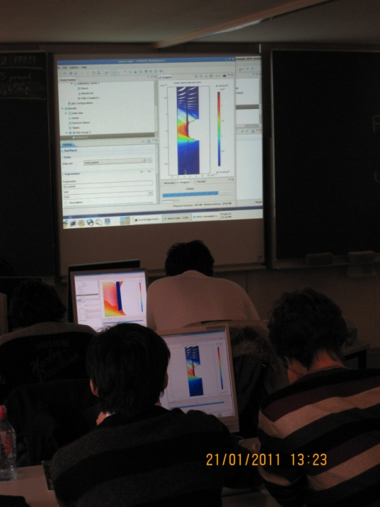
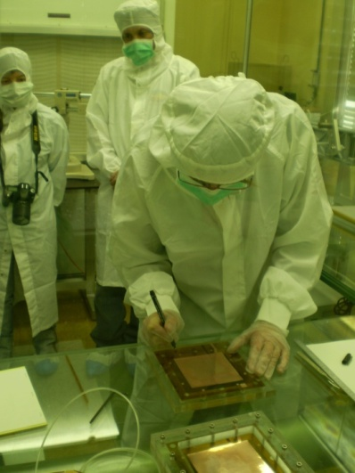
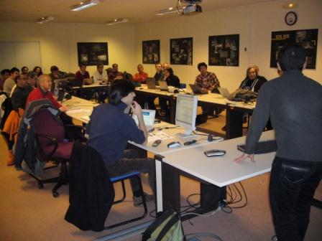
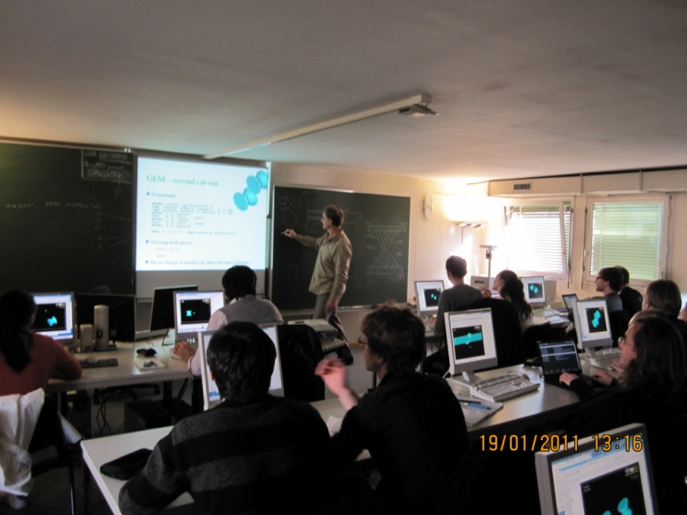

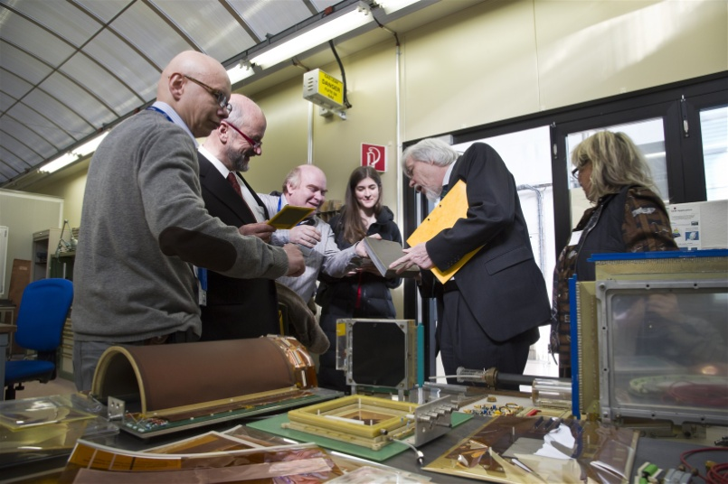
MPGD Training and Education Events
Feb. 2009 @ CERN: RD51 GEM & Micromegas & assembly and training
Jan. 2010 @
RD51 Simulation School
Contributions to the
EDIT School:
2011 @ CERN; 2012 @ Fermilab
RD51

