Slide 1


Six modules Micromegas TPC beam test & Test bench
D. Attié, P. Colas, M. Dixit, P. Hayman, W. Wang

Slide 2
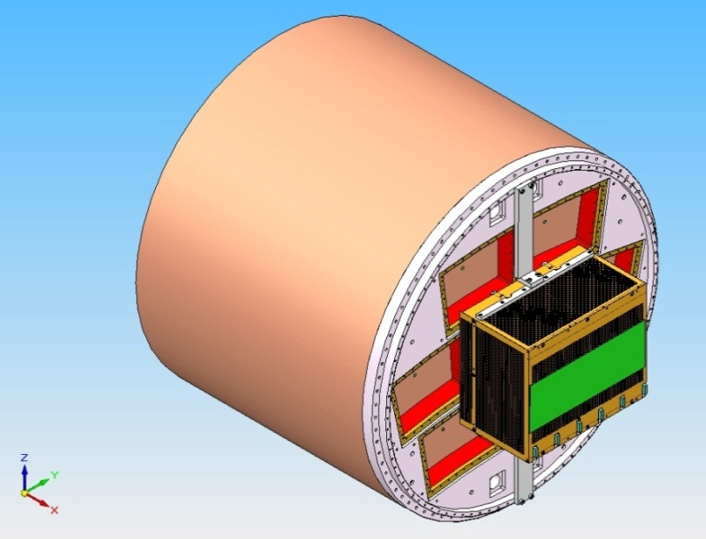
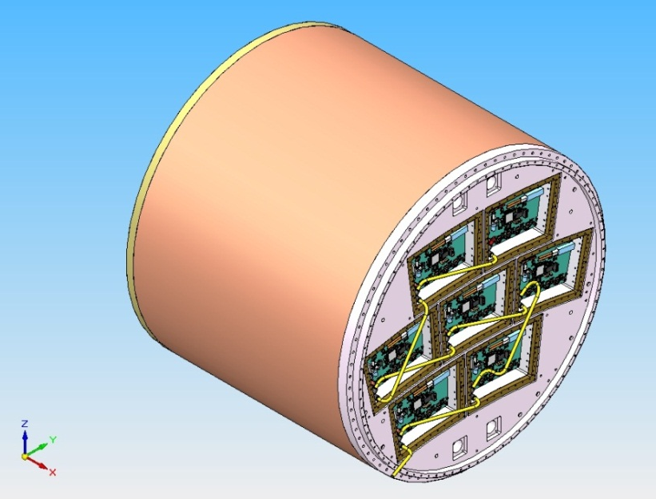
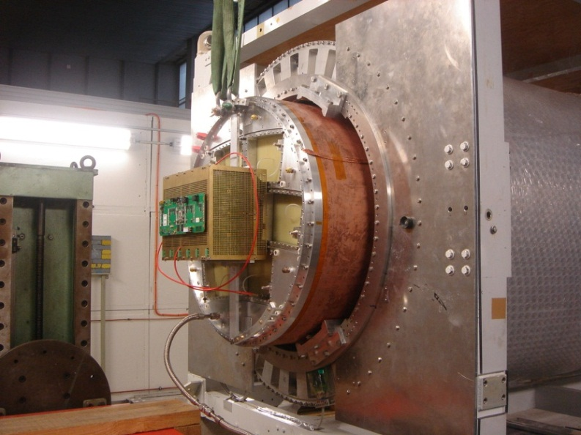
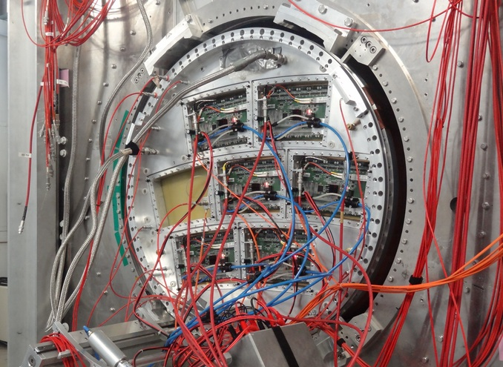
7 Micromegas modules with integration of electronics
2008-2011
2012-

Slide 3
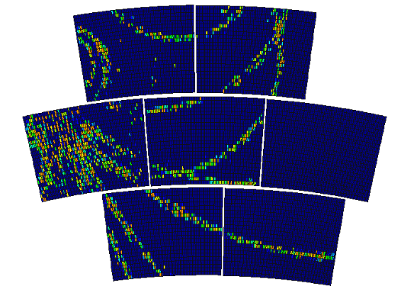

6 Modules Test
In July 2012, 6 modules were installed on the endplate of LP-TPC at DESY and tested at the same time. Data were taken with cosmic rays and 5 GeV e- beam.
Cosmic event
Notes:
33

Slide 4
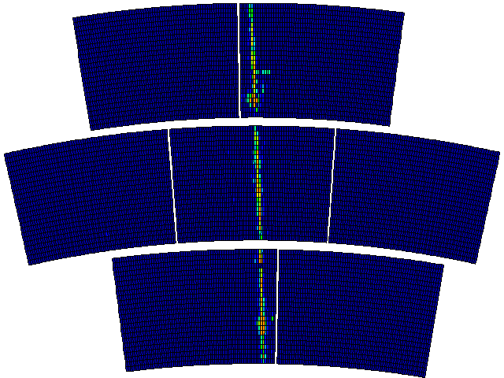
Event display (the first 100 triggers of a good run)
Each module has 1726 pads
(24 rows x72 columns)

Slide 5
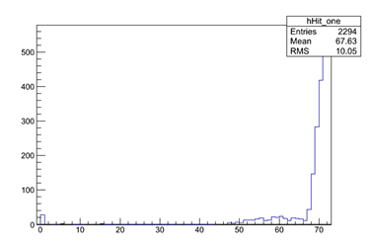
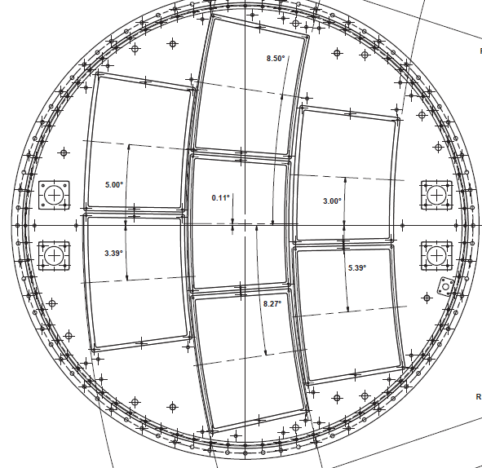
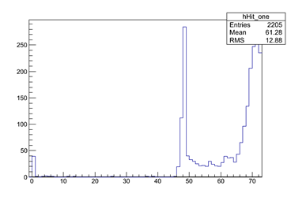
Crack scan
Outside crack
x
5 GeV
e- Beam
In crack
Upper crack
Lower crack
Padrow number (3x24=72)

Slide 6
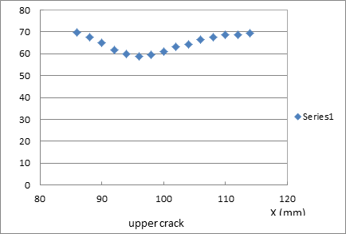
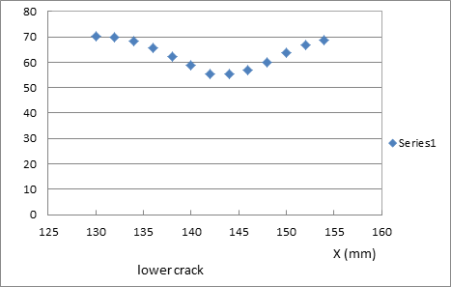
Crack scan
Number of hits vs x (72 pad-rows)
Study the hit reconstruction efficiency at or near the crack: take data with beam, moving by steps of 2mm

Slide 7
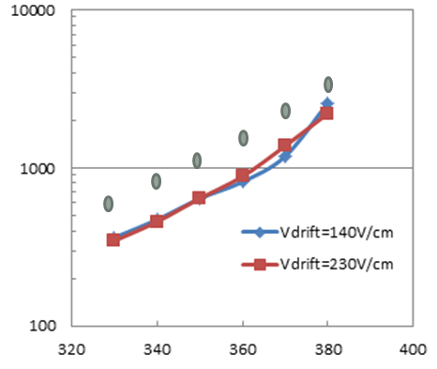
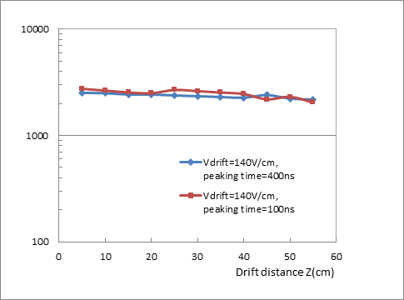
Gain study
Using the fitted MPV of the (Landau) distribution of the measured charge
Effective gain vs mesh voltage
(compared with the direct gain measurements using ⁵⁵Fe source on a bulk detector without resistive foil)
Effective gain vs drift distance
(Vmesh=380V, Vdrift=140V/cm, peaking time 100 ns and 400 ns)

Slide 8
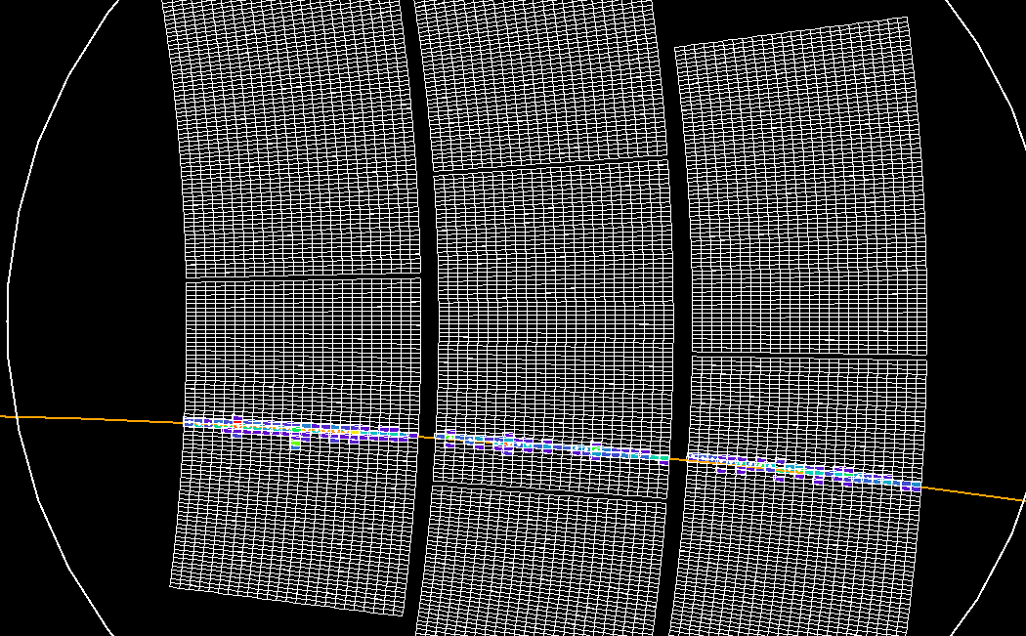
Track fit

Slide 9
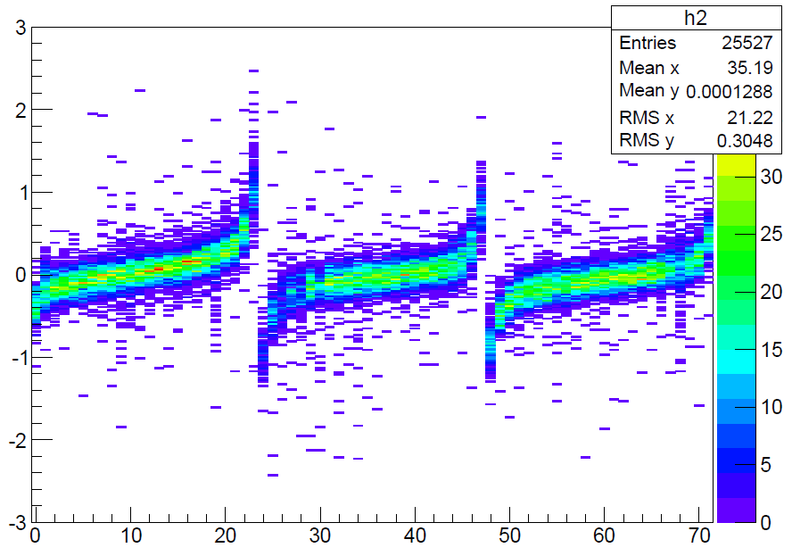
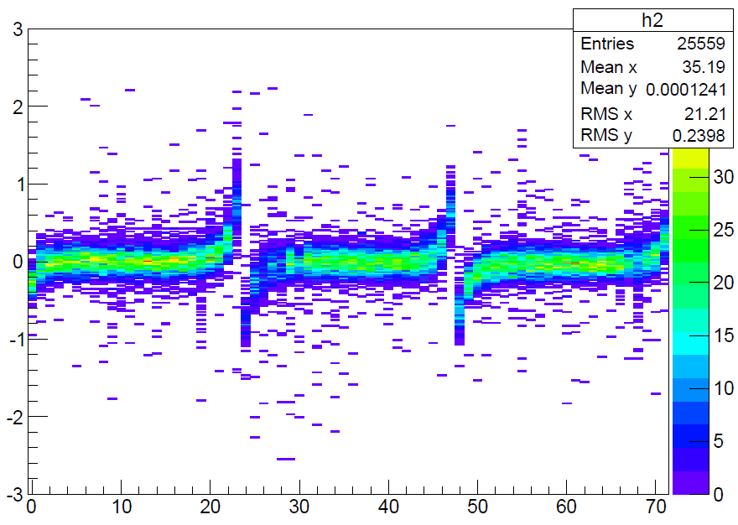
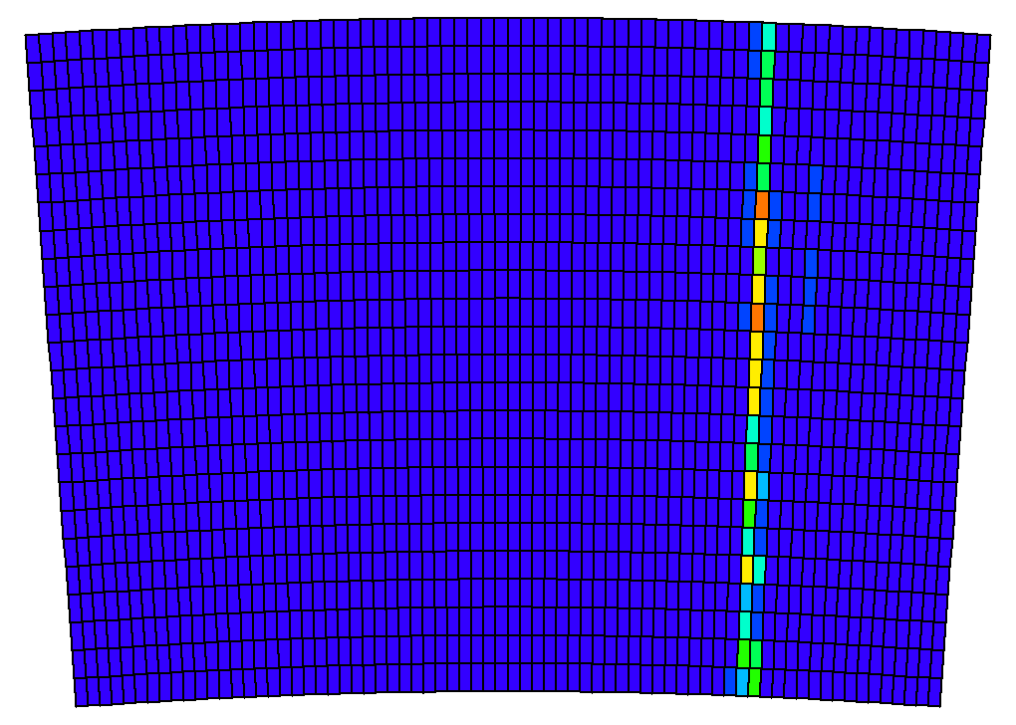
Residuals by padrow
Row Number: 3 x 24 = 72 Displacement in mm
(b): After alignment
δφ= 2.9 , 2.1 and 2.2 mrad
δx = 47 µm, -43 µm and -52 µm
(a): Before alignment
One module has 1726 pads
(24 rows x72 columns)

Slide 10
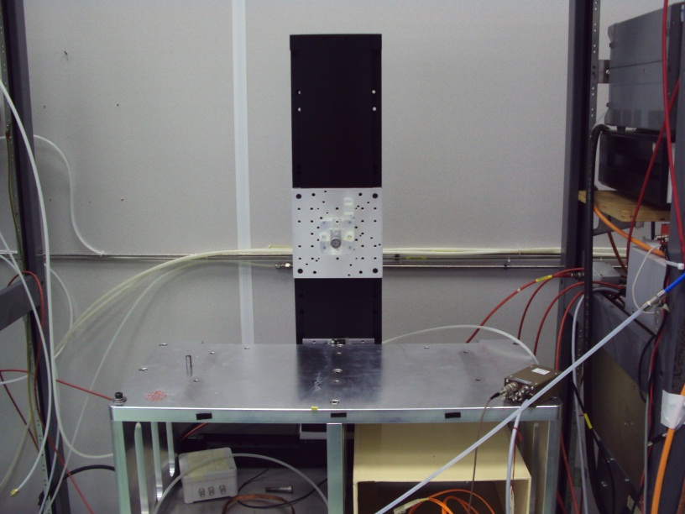
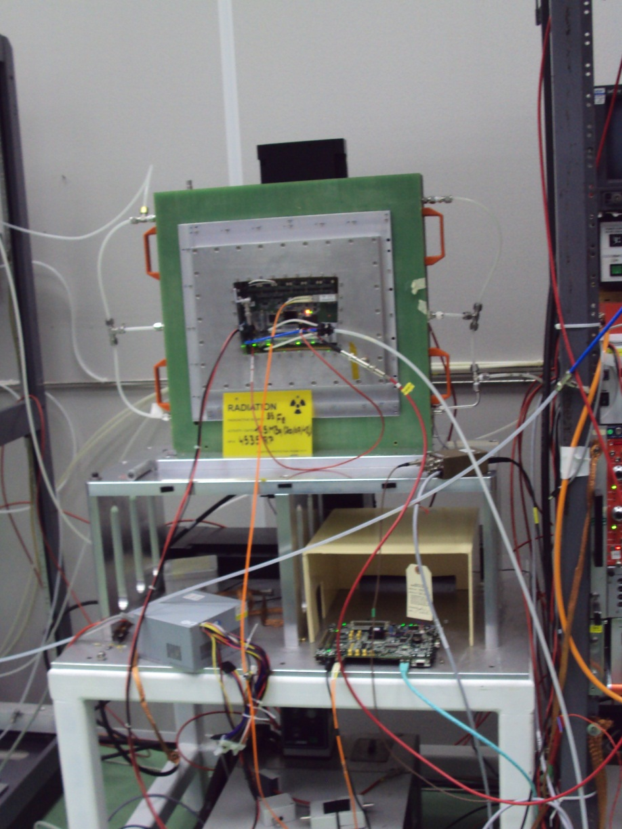
Test Bench
The 55Fe source is put in an aluminum collimation tube and fixed on a set of two mechanical arms (X-Y).

Slide 11
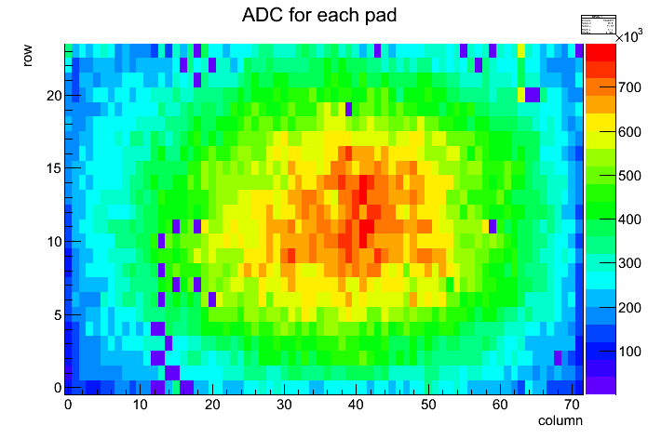
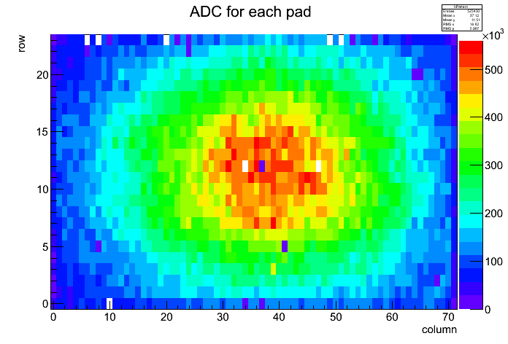
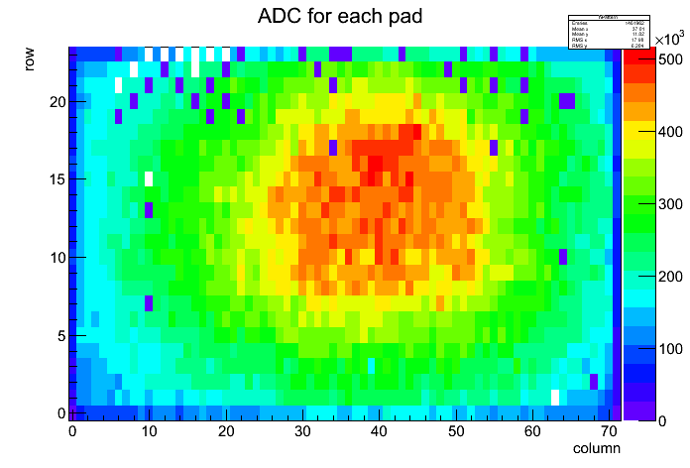
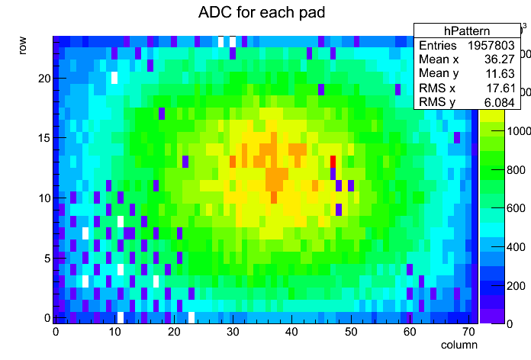
Test Bench
Module S1D - ~30 disconnected pads
Module S7H - ~5 disconnected pads + some at the boarder
Module S8G - ~30 disconnected pads
Module S4E - ~100 disconnected pads

Slide 12
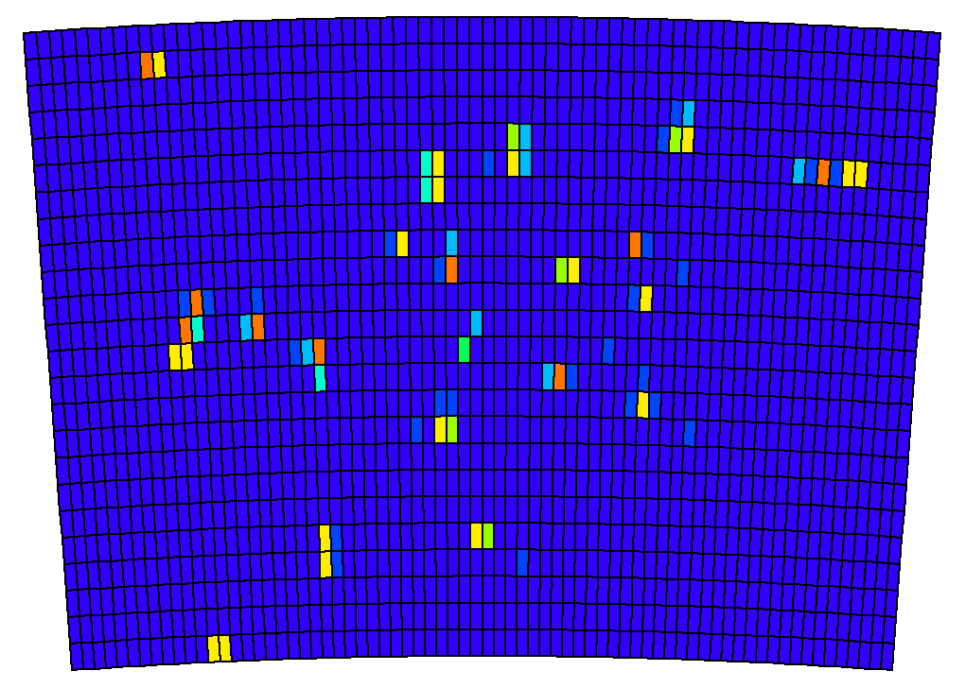
Evt with uncollimated source
(each cluster is an X-ray photon)

Slide 13
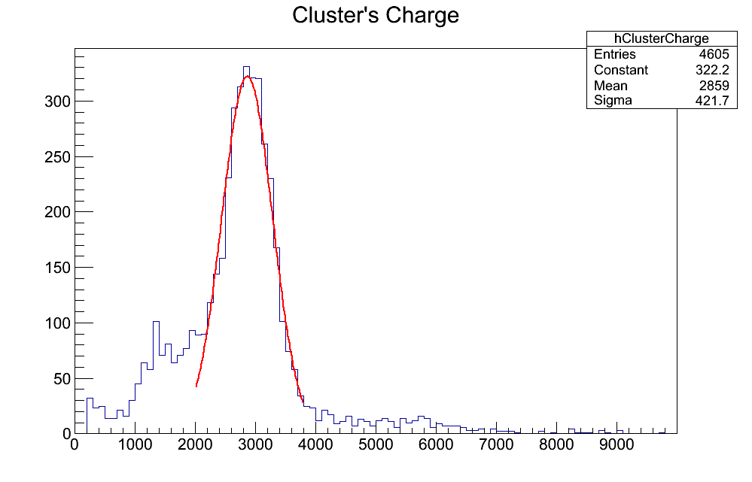
Test Bench
Energy Resolution (preliminary) :
~15% rms

Slide 14
Summary
Successful test of 6 modules simultaneously with full integration of the electronics flat behind the panels. The analysis work is on-going.
Test bench is on-going to study the modules one by one: energy resolution, calibration, cross-talk…
Next step: 7 modules high quality test at the end of January 2013

Slide 15
Thank you!

