Slide 1
wg7
Sharing of common infrastructure for detector characterization
Test Beam Facility
RD51-GDD laboratory
Yorgos - Eraldo

Slide 2
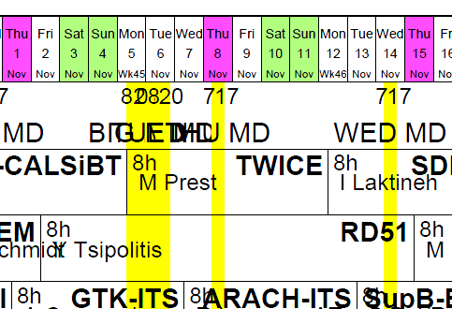
Test Beam Facility
November (2-15) Test Beam
150GeV Pions/Muons Beam
GEM for CMS (*)
CALICE-LAPP
NIKHEF
WIS/AVEIRO/COIMBRA (*)
WIS/LAPP
(* RD51 Trackers/SRS)

Slide 3
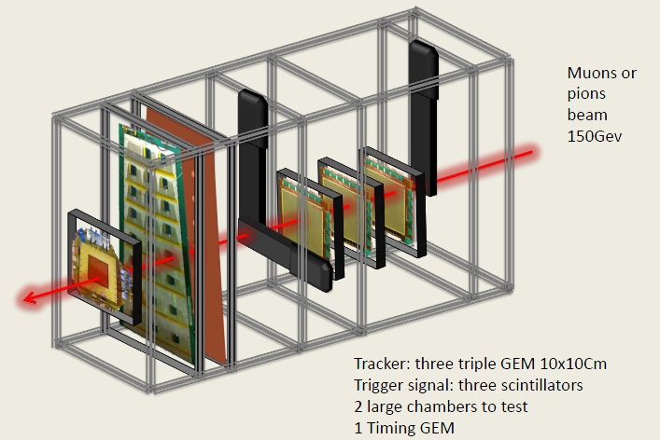
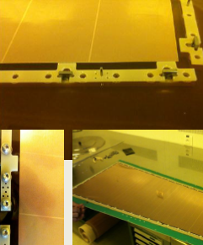
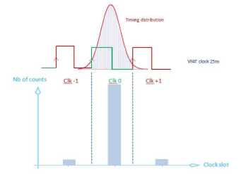
GEM for CMS Upgrade
Large Triple GEM
(NS2 technic)
No Spacers
No Glue(*)
(*) Still present in the actual prototypes
APV/SRS & VFAT/TURBO readout
Test beam focused on FE optimization for 25ns-efficiency
“Latest large GEM test beam results ”
    Christopher Armaingaud (Institut Pluridisciplinaire Hubert Curien (FR))
    http://indico.cern.ch/getFile.py/access?contribId=21&sessionId=4&resId=0&materialId=slides&confId=218341
    RD51 mini week - Tuesday, December 4, 2012 - WG2 - Physics issues

Slide 4
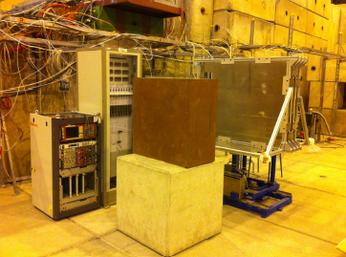
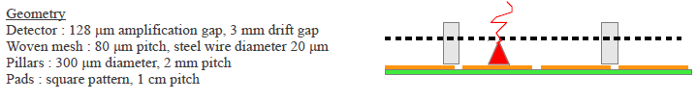
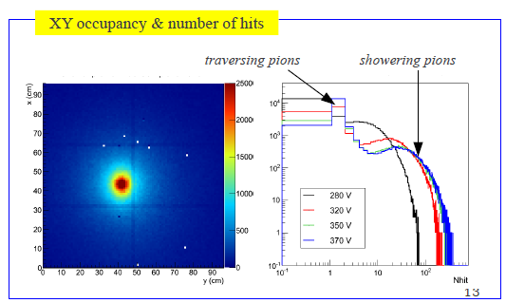
Pion calorimetry with 1x1 m2 Micromegas chambers [CALICE/LAPP]
“Pion calorimetry with 1x1 m2 Micromegas chambers (latest testbeam results)”
M. Chefdeville (LAPP, Annecy)
http://indico.cern.ch/getFile.py/access?contribId=13&sessionId=4&resId=0&materialId=slides&confId=218341
RD51 mini week - Tuesday, December 4, 2012 - WG2 - Physics issues

Slide 5
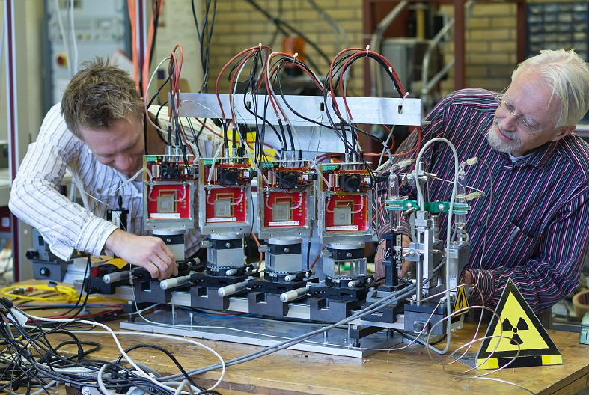
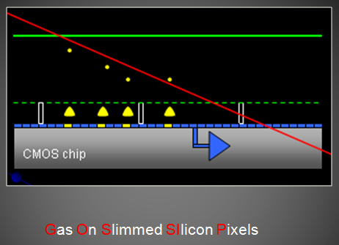
Gossip telescope [NIKHEF]
Harry van der Graaf, http://www.google.fr/url?sa=t&rct=j&q=gridpix%20detector%20gossip&source=web&cd=1&ved=0CC4QFjAA&url=http%3A%2F%2Fwww-ppd.fnal.gov%2FEPPOffice-W%2FResearch_Techniques_Seminar%2FTalks%2Fvdgraaf_USASeminarFermi.ppt&ei=qoi-ULqZHeLb0QW_joEI&usg=AFQjCNGo1WWrOlVdXIZhS29ux_KdD02nvQ&cad=rja
The GridPix detector is one of those new prototypes, a pixelated readout chip with a gas amplification grid on top. Its thin version, the Gossip (Gas On Slimmed SIlicon Pixels), has a 1 mm gas layer over the GridPix structure. This family of detectors allows a 3-D track reconstruction of ionising radiation. The X-Y position is given by the chip's fine pixel structure and the Z position is calculated with the time of arrival of the drifting ionisation charge.
http://www.nikhef.nl/pub/departments/mt/projects/detectorR_D/GossipTelescope/slides/IMG_6939.html

Slide 6
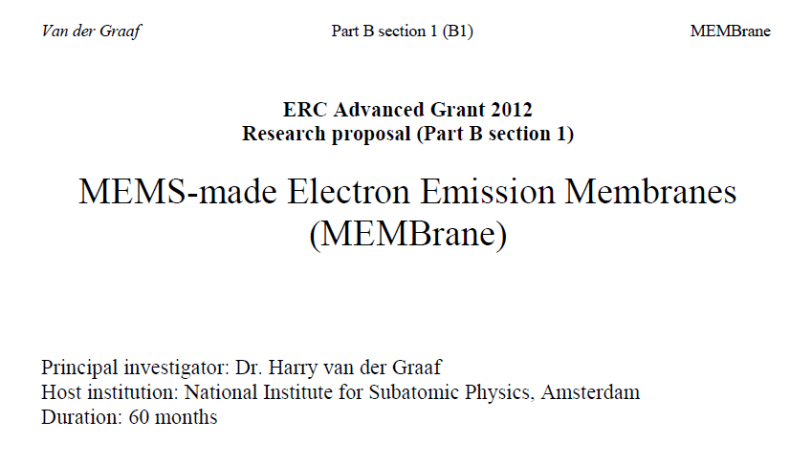
PM photocathode electron emission [NIKHEF/Harry van der Graaf(*)]
We will first measure the intrinsic (flat surface) yield of well-known low escape potential materials: a simple but interesting experiment is to put a photomultiplier, without scintillator, in a low-momentum MIP beam.
Single-electron events must be due to electrons emitted from the photocathode, which has a very low work function. Some MIPs will generate Cherenkov radiation in the glass window: the generated photons may dominate the single electron event. These Cherenkov photons would not be generated if the beam enters from the opposite side (of the electrical connection). The difference between these two yields is a measure for the rate of Cherenkov events, and the electron yield could be corrected for, although the yield could be different of an incoming MIP or exiting MIP. This experiment should be a good indication for the highest possible level of the intrinsic emission yield.
http://www.google.ch/url?sa=t&rct=j&q=mems%20made%20electron%20emission%20membranes&source=web&cd=1&ved=0CDUQFjAA&url=http%3A%2F%2Fwww.nikhef.nl%2Fpub%2Fdepartments%2Fmt%2Fprojects%2FdetectorR_D%2FTiPC%2FPublications%2FB1NCVB2.pdf&ei=MGO-UJfKEvLb4QT384DADw&usg=AFQjCNGrKG5empufFkRQuskPQvHpw0ruiQ&cad=rja

Slide 7
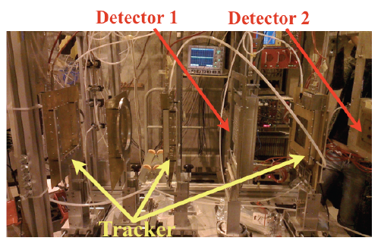
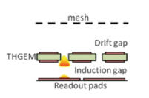
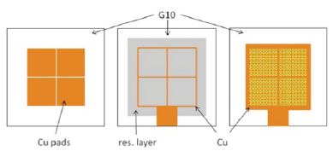
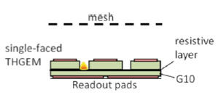
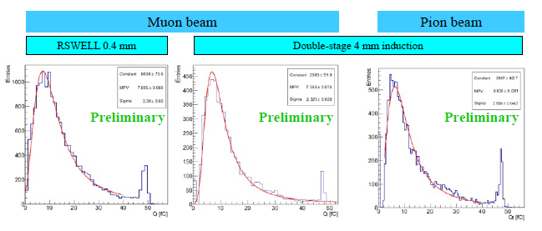
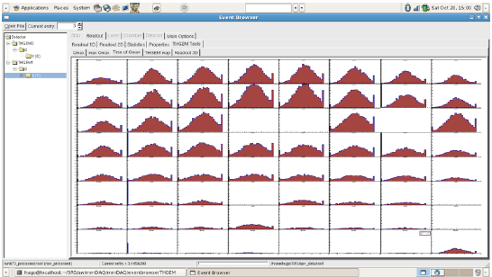
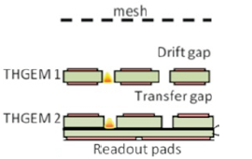
THGEM/APV-SRS [Weizmann/Aveiro/Coimbra]
Single stage with 1 mm induction gap
Resistive segmented WELL
Resistive Layer
Double-stage RSWELL+THGEM
“THGEM/SRS test-beam operation & analysis tools”
S. Bressler (Weizmann Institute of Science (IL))
http://indico.cern.ch/getFile.py/access?contribId=26&sessionId=1&resId=0&materialId=slides&confId=218341
RD51 mini week - Monday, December 3, 2012 - WG5 – Electronics

Slide 8
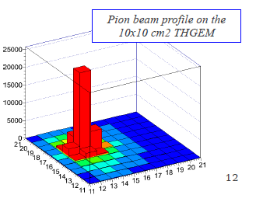
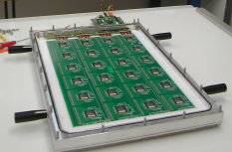
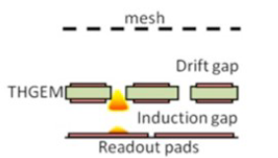
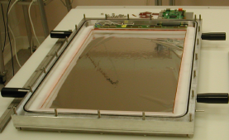
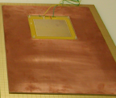
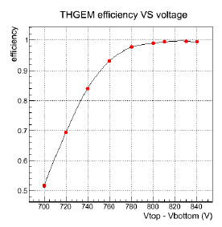
THGEM and a MICROROC readout [LAPP/Weizmann]
LAPP ASU
Active Sensor Unit, Basic building block of LAPP large area Micromegas chamber: 8 layer PCB of 32x48 cm2 with 24 ASICs, 1536 pads and a Bulk mesh
+ WIS THGEM
“First results on the combination of a THGEM and a MICROROC readout”
Maximilien Chefdeville (LAPP, Annecy)
http://indico.cern.ch/getFile.py/access?contribId=13&sessionId=4&resId=0&materialId=slides&confId=218341

Slide 9
Useful/Essential Supports
DCS (Konstantinos Karakostas)
SRS/APV (Sorin Martoiu, Hans Muller, Francisco Garcia Fuentes - HIP)
Trackers & DUT DAQ and Analysis
  ATLAS/MAMMA group (sorry, the list is too long.. Everybody knows you…) for mmDAQ/recomm/tracking
  Filippo Costa, Kondo Gnanvo, Michael Staib for DATE/AMORE

Slide 10
A special sorry…
To GEM-Jlab (Evaristo & Co.)
Really sorry that you didn’t fix the foils for the beam and many thanks for your efforts on providing us in time (appreciated) everything was needed (but unfortunately not used) and requested to prepare the test.

Slide 11
LS1 & Beams

Slide 12
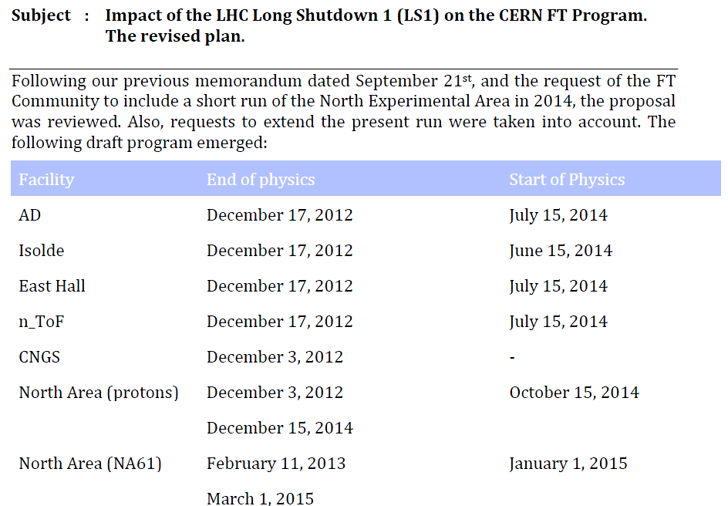
LS1 and Beams
CERN RESEARCH BOARD - MINUTES OF THE 201stMEETING OF THE RESEARCH BOARD -
HELD ON MONDAY 24 SEPTEMBER 2012 http://cdsweb.cern.ch/record/1481530/files/M-201.pdf
?
H4

Slide 13
Next two years…

Slide 14
Outside…one example:Desy
From: Ingrid Gregor <ingrid.gregor@desy.de>
Reply-To: "testbeam-2013@desy.de" <testbeam-2013@desy.de>
Subject: Call for Test beam Requests DESY 2013
Dear colleagues,
we would like to prepare the test beam schedule for the DESY test beam facility in 2013. The DESY test beam will
be running in 2013 from end of January till end of June and a further period from mid of October to the end of the year.
It will also run throughout 2014 (with shorter machine development breaks). This schedule is preliminary and will
be confirmed soon.
Most of you already told us their preliminary test beam needs for the next year(s). With this mail we would like
to ask that you please confirm your request for test beam at DESY.
If you are planning to use the DESY test beam facility in 2013 please send before December 5th 2012
following information to testbeam-2013@desy.de:
- project name
- number of requested weeks
- preferred month(s)
- preferred infrastructure (beam telescope, magnetic field, …)
You can find information of the DESY test beam on testbeam.desy.de.
Groups from European institutions can apply for funding via AIDA (http://aida.web.cern.ch).
Best regards
Marcel Stanitzki, Norbert Meyners and Ingrid-Maria Gregor
DESY Test beam coordinators
PS: Please apologize if you receive this mail multiple times, we had to create an ad-hoc e-mail list to make
sure we reach the whole community.
=========================================
Dr. Ingrid-Maria Gregor
DESY ingrid.gregor@desy.de
Notkestr. 85 Office: +49-40-8998-3032
Mobile: +49-151-1170-1082
D-22607 Hamburg FAX: +49-40-8998-3092
DEAD LINE … TODAY!?!
User has been informed, but
just in case you have not received it…

Slide 15
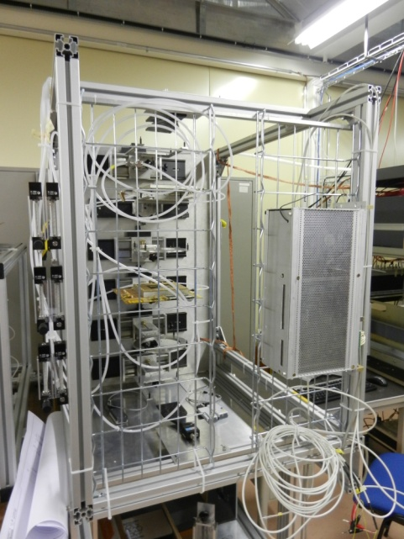
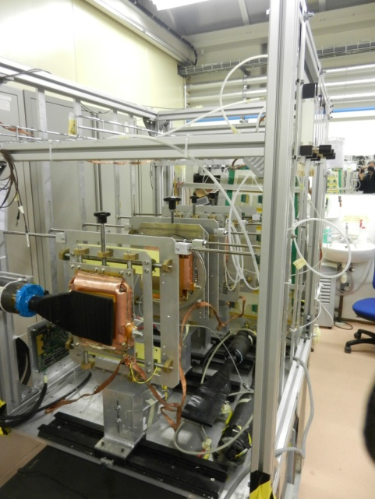
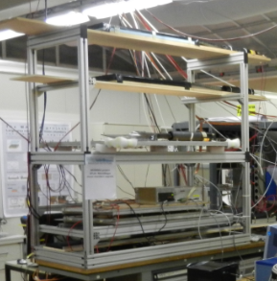
Cosmics (as everywhere) @GDD/RD51Lab:
mm tarcker
[Small Area]
GEM tarcker
[Small Area]
Or something as the
ATLAS/MAMMA Cosmic Set up
[Large Area]

Slide 16
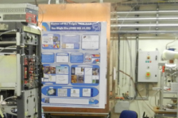
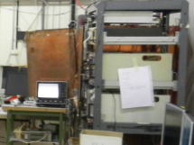
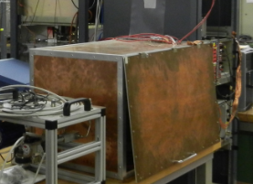
X-Ray@GDD/RD51Lab:
Cu Anode PANalytical
Cu Anode PANalytical
Ag Anode Amptek

Slide 17
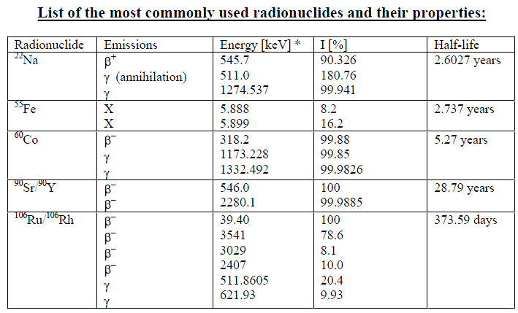
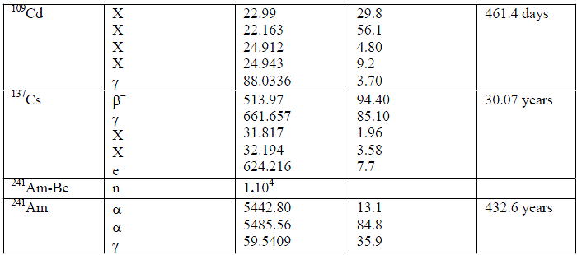
Sources@GDD/RD51Lab:
Available in the lab (sources from H4 will be moved to lab when beams stop)
Source Id | Isotope | Activity | Location
3392RP | Fe-55 | 3.01 MBq on 07.08.2012 | PREV 887/R-K47
3506RP | Fe-55 | 1.98 MBq on 07.08.2012 | MEYR 154/R-007
3509RP | Sr-90 | 24.03 MBq on 07.08.2012 | MEYR 154/R-007
3592RP | Sr-90 | 24.52 MBq on 07.08.2012 | PREV 887/R-K47
3597RP | Fe-55 | 2.45 MBq on 07.08.2012 | MEYR 154/R-007
3771RP | Na-22 | 7.15 kBq on 07.08.2012 | MEYR 154/R-007
3874RP | Cd-109 | 17.85 kBq on 07.08.2012 | MEYR 154/R-007
4148RP | Am-241 | 39.55 kBq on 07.08.2012 | MEYR 154/R-007
Available from RP (not all of them and not all the activity that you would like to have)

Slide 18
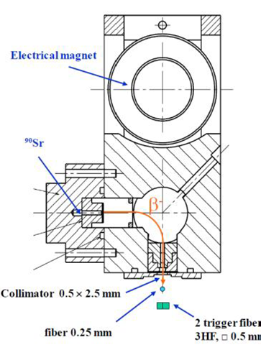
Sources@GDD/RD51Lab:
An appealing source… (probably available in CERN/DT)
Sr90+electron Spectrometer
The source allows to produce a quasi mono-energetic electron beam of about 2 MeV which are practically MIPs

Slide 19
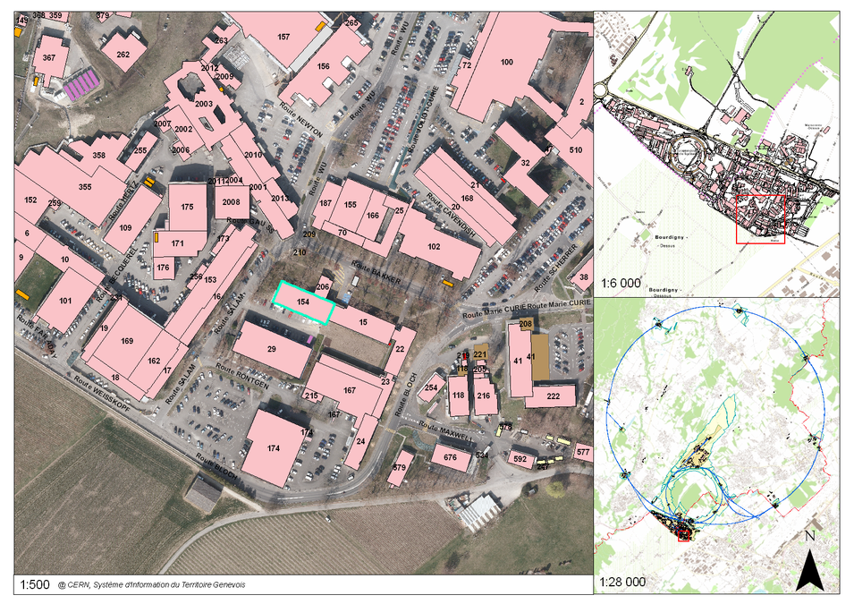
RD51-GDD lab, Building 154

Slide 20
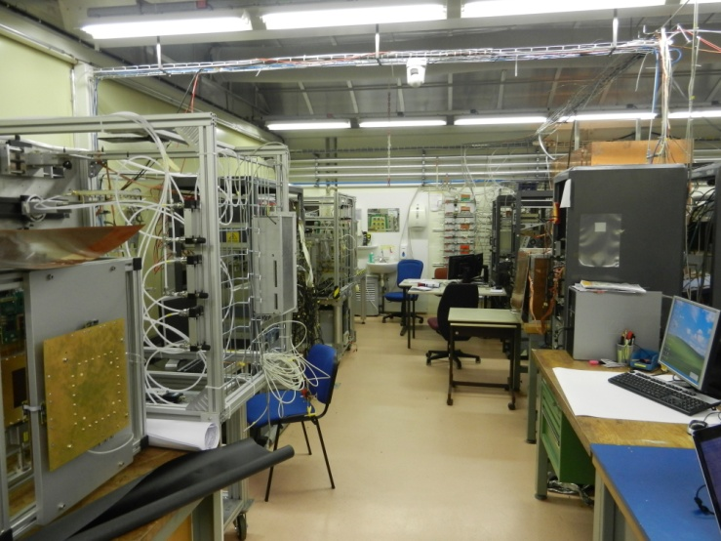
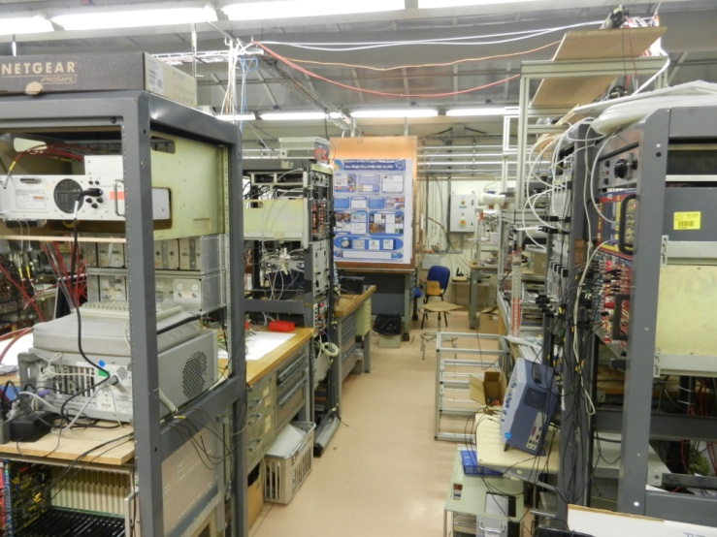
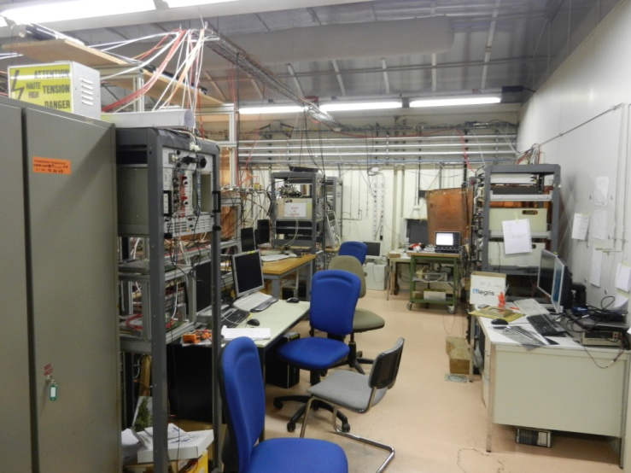
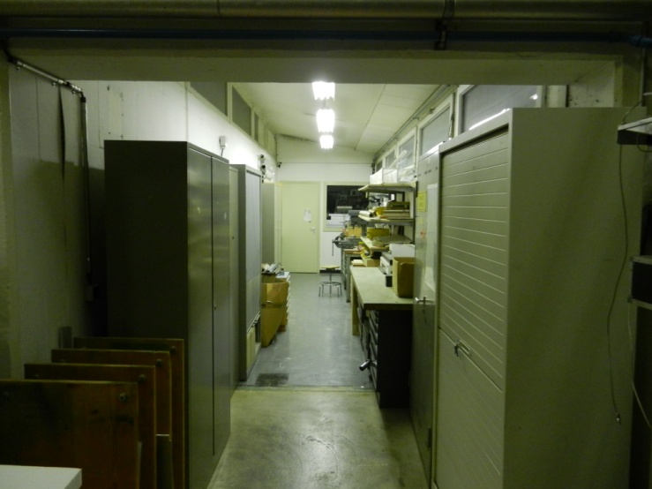
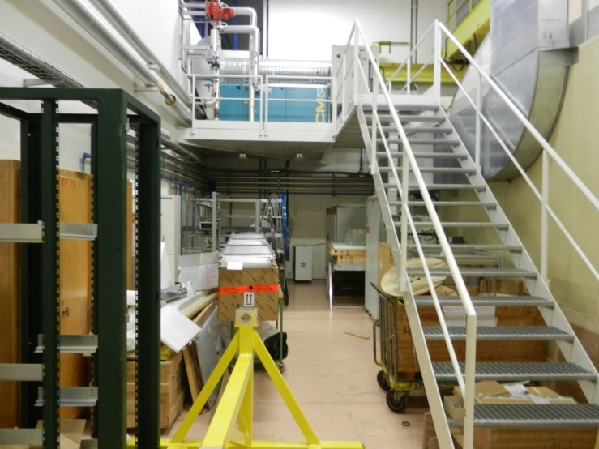
Renovation Bâtiment 154… (GDD/RD51 lab)
+

Slide 21
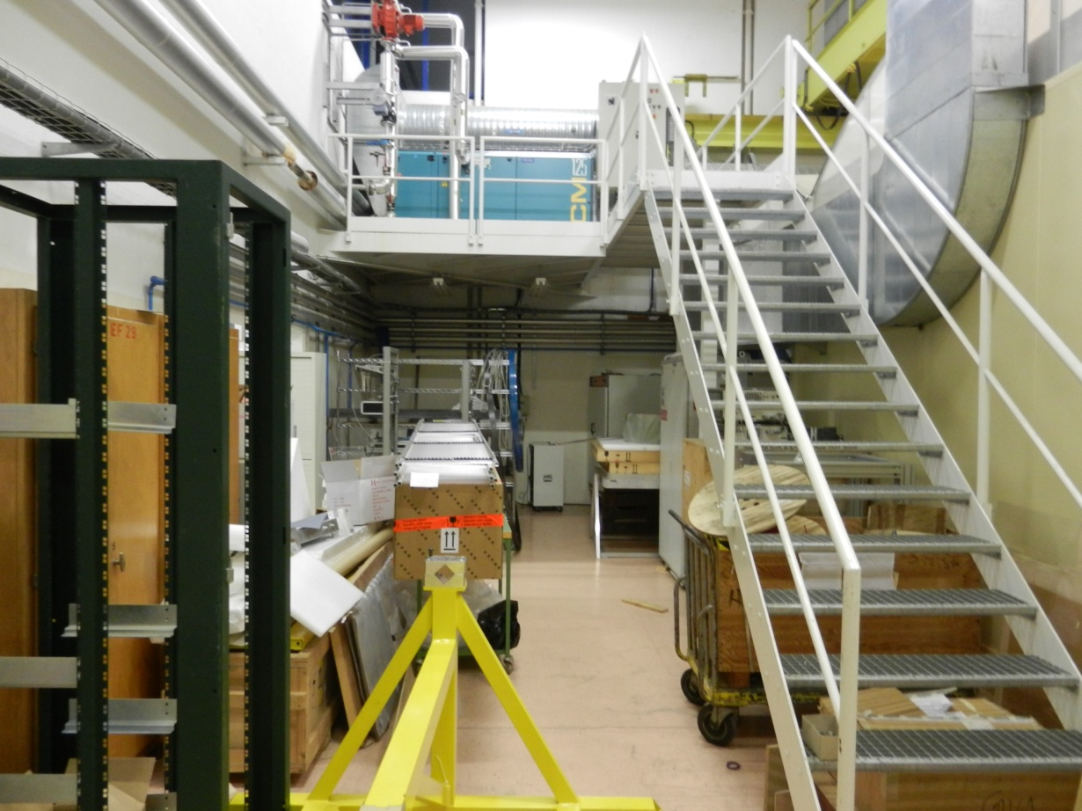
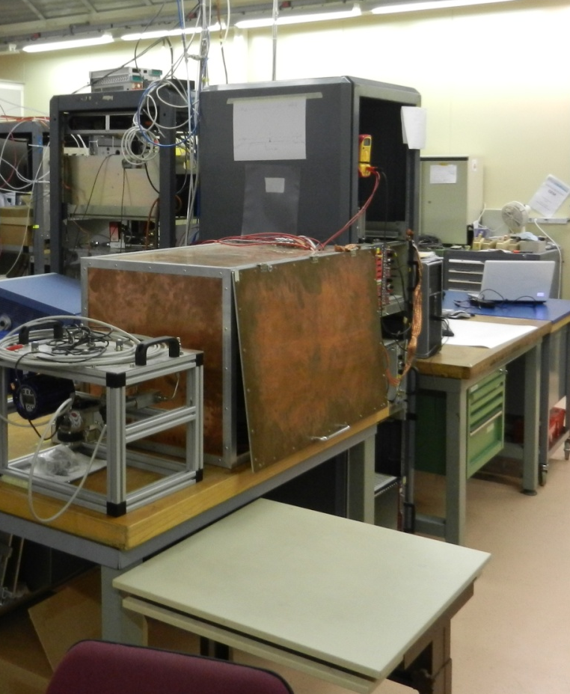
Renovation Bâtiment 154… (GDD/RD51 lab)
(*) ALICE Set up (?)
very limited in space as it is now
. More space for “Permanent” Users(*).
. More Working Places for Temporary Users.
. Specific Set Up [Services/Measurements/Sources] (requests from users are welcome)
. More space for Large Area Detector.

Slide 22
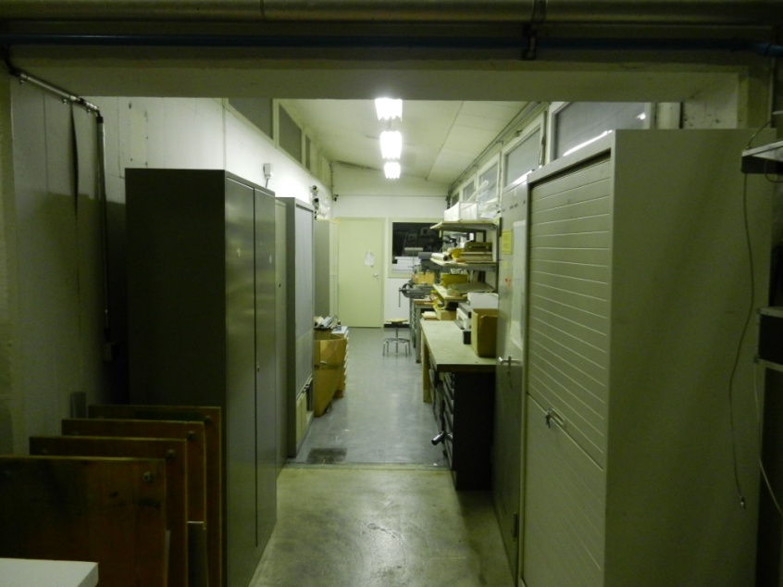
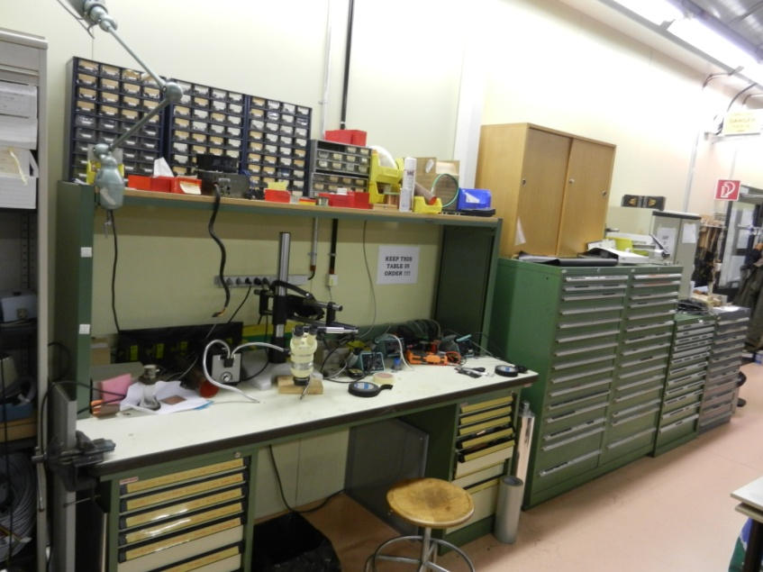
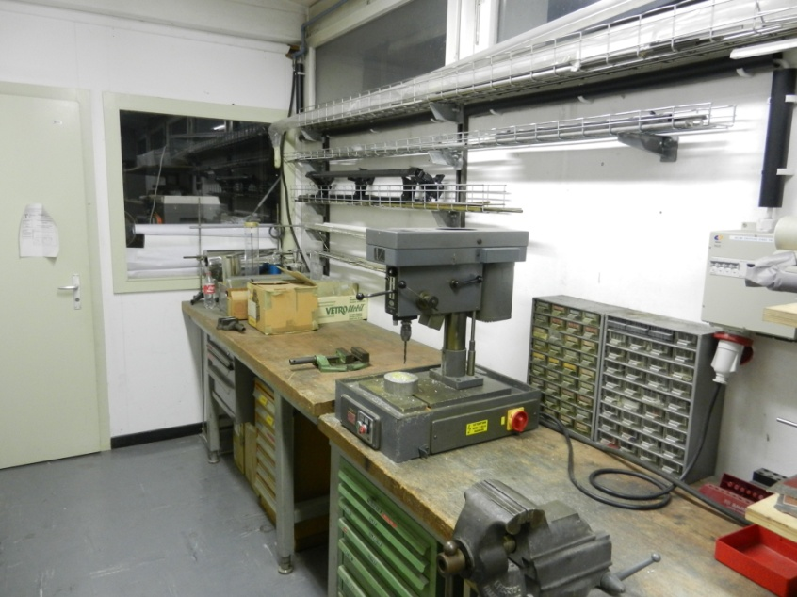
Renovation Bâtiment 154… (GDD/RD51 lab)
Working Place for soldering, cabling…
Mechanical Workshop
- “Dirty” activity isolated from the detectors
- More space in the lab

Slide 23
conclusions
November Test Beam
  Beams: not perfect, but enough
  Services: ok
  Trackers: ok
  DAQ: ok
  Users: ok
LS1
  No beams for two years
GDD/RD51 lab
  Users can profit of the incoming lab extension.
GIF++
  See R.Guida (previous) Talk

Slide 24
