Slide 1



Puffin
L.T. Campbell & B.W.J. McNeil
University of Strathclyde

Slide 2
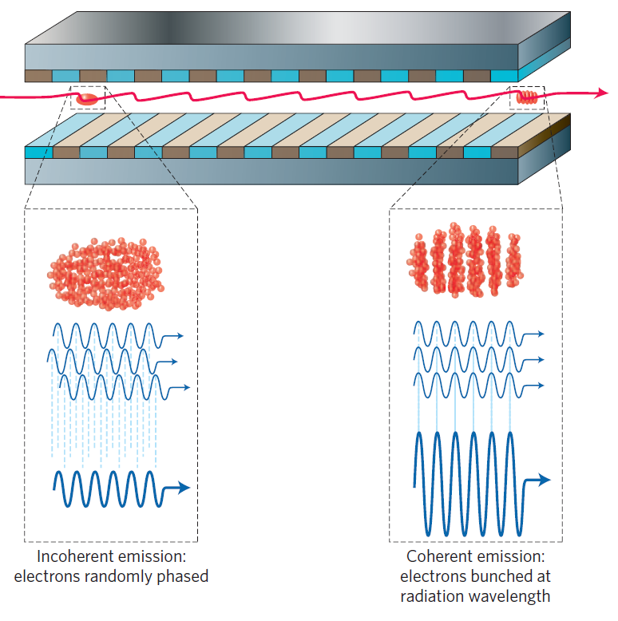
What is an FEL?
In a Free Electron Laser (FEL), a beam of relativistic electrons and a radiation field co-propagate an undulator or wiggler
An undulator or wiggler is a periodic array of alternating magnetic poles
This forces the electrons to oscillate in the direction transverse to propagation
This oscillating component of velocity allows an energy transfer between electrons and radiation field
The interaction causes the electrons to bunch spatially, and they begin to coherently amplify the radiation field, giving an exponential growth in intensity
McNeil, Thompson, nature photonics | VOL 4 | DECEMBER 2010 |

Slide 3
What is an FEL?
Electrons amplify field at a certain resonant frequency
“slow” amplification process (w.r.t. the FEL resonant wavelength)
Use Slowly Varying Envelope Approximation (SVEA), and use averaged quantities to drive radiation field
Call this ‘averaged model’
McNeil, Thompson, nature photonics | VOL 4 | DECEMBER 2010 |

Slide 4
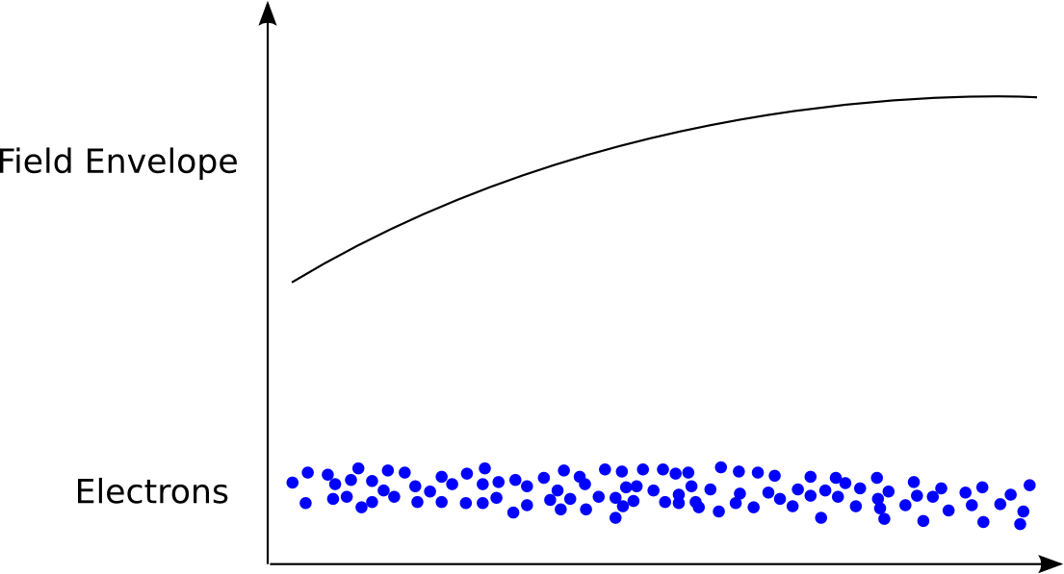
FEL Averaged Code - Basic
Radiation field and electrons co-propagate an undulator

Slide 5
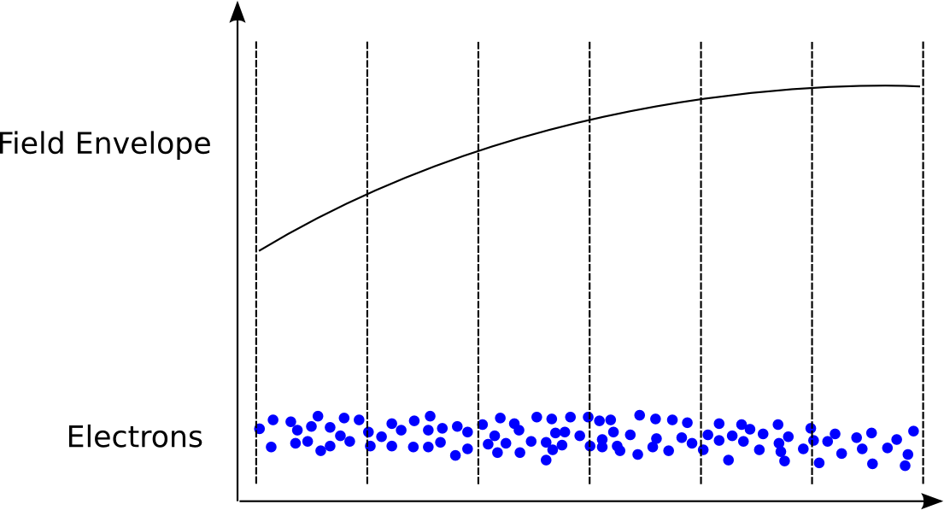
FEL Averaged Code - Basic
Use Slowly Varying Envelope Approximation (SVEA), and use averaged quantities to drive field

Slide 6
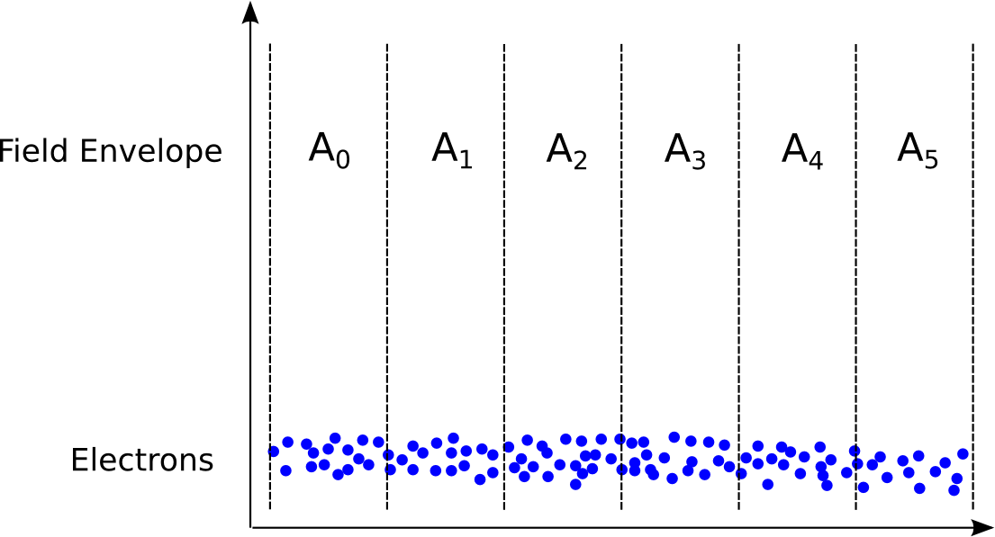
FEL Averaged Code - Basic
Use Slowly Varying Envelope Approximation (SVEA), and use averaged quantities to drive field

Slide 7
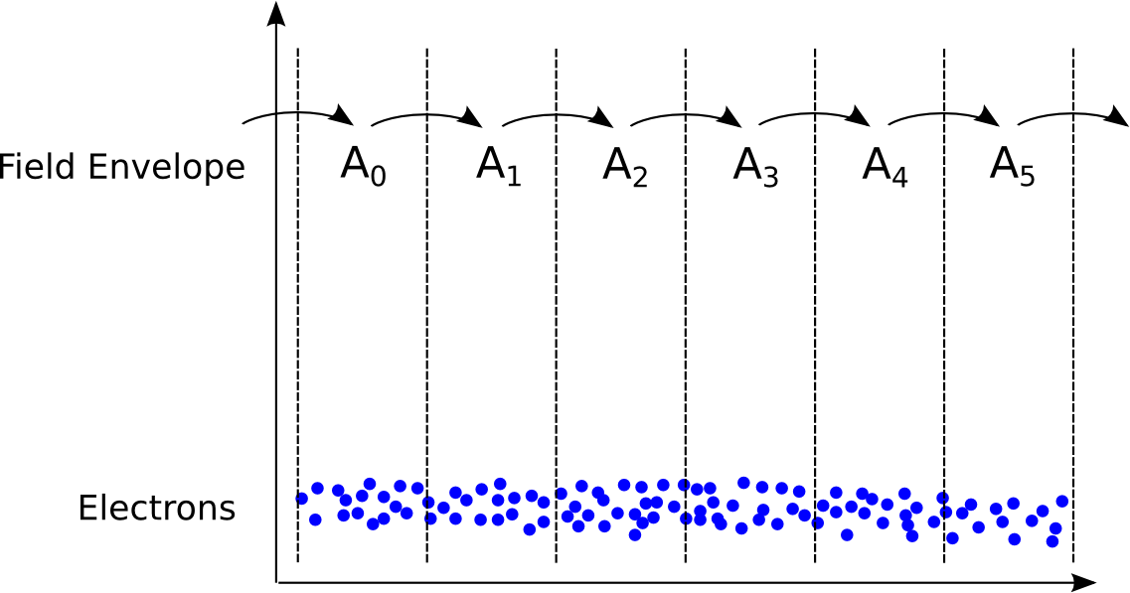
FEL Averaged Code - Basic
Electron velocity < c
To simulate relative electron-radiation ‘slippage,’ pass field on to next slice

Slide 8
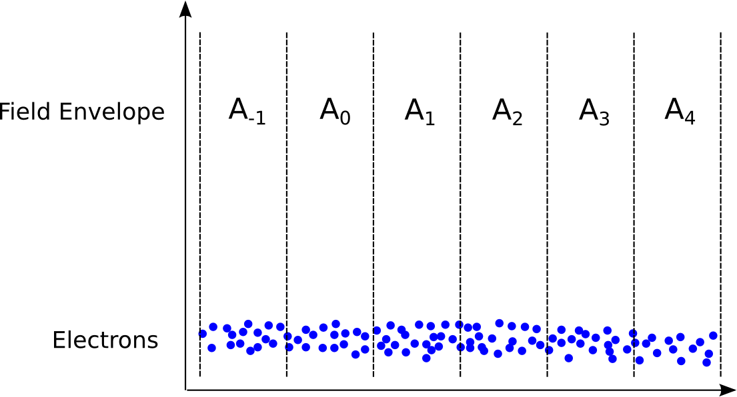
FEL Averaged Code - Basic
Electron velocity < c
To simulate relative electron-radiation ‘slippage,’ pass field on to next slice

Slide 9
FEL Averaged Code - Basic
In this model, electrons are confined to each slice, within periodic BC’s in phase space i.e. over a slice:
Current assumed constant in each ‘slice’

Slide 10
FEL Unaveraged Code
In an unaveraged code, we do not perform the SVEA or averaging process, and the radiation field is sampled on a much finer grid – a Particle In Cell (PIC) model

Slide 11
Unaveraged FEL codes
In an unaveraged code, the radiation field envelope can vary quickly, and so can model the full radiation spectrum self consistently (limited by the Nyquist frequency) – so can model coherent emission arising from current gradients in the beam
Electrons are not confined to slices – can model current redistribution during propagation

Slide 12
Motivation
FEL’s now operating in hard x-ray (around 1Å) with pulse lengths of 10’s of fs and peak powers of ~10¹⁰W, to probe ultrafast, ultrasmall phenomena. Evolves from noise – process known as SASE – and SVEA can model this
Cannot model coherent spontaneous emission arising from current gradients in the beam
Cannot model electron transport fully

Slide 13
Motivation II
Hard to model different frequencies with SVEA, can only model resonant frequency
New techniques to improve temporal output and shot-to-shot stability may violate SVEA
e.g. EEHG involves violent changes in electron position to prepare the beam
Laser Plasma Accelerators produce short electron pulses which may exhibit a large degree of coherent emission, which averaged codes cannot model
Such short electron pulses could involve large changes in relative electron positions – averaged codes cannot model this

Slide 14
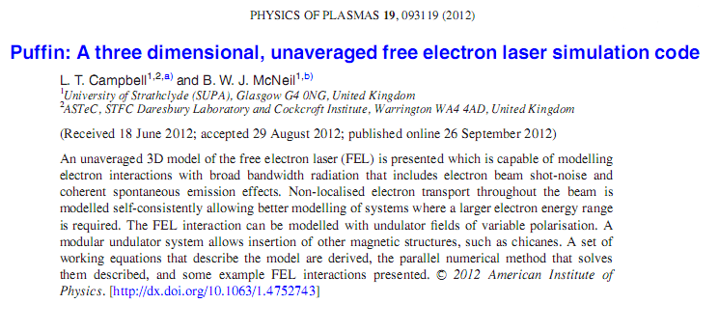
Puffin
Parallel Unaveraged Fel Integrator
  Unaveraged Free Electron Laser (FEL) code
Puffin is first unaveraged FEL code in 3D
Written in Fortran 90 using MPI
Models a variably polarised undulator FEL
Intended for probing new FEL schemes and ideas

Slide 15
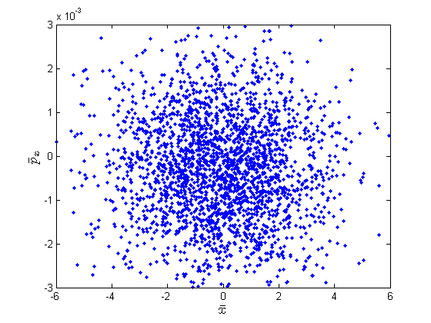
Numerical Solution - Electrons
Electron beam is discretised into electron macroparticles by method of [1]
Sampling an electron beam with a gaussian current distribution
[1] – B.W.J. McNeil and G.R.M. Robb, Phys Rev E 65, 046503

Slide 16
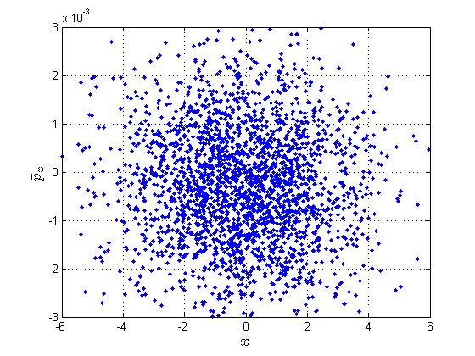
Numerical Solution - Electrons
Electron beam is discretised into electron macroparticles by method of [1]
Sampling an electron beam with a gaussian current distribution
Create a grid...
[1] – B.W.J. McNeil and G.R.M. Robb, Phys Rev E 65, 046503

Slide 17
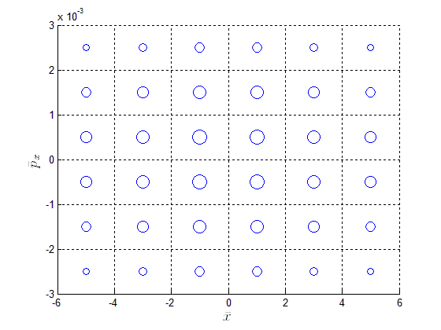
Numerical Solution - Electrons
Electron beam is discretised into electron macroparticles by method of [1]
Sampling an electron beam with a gaussian current distribution
Create a grid, and into each grid element we assign a macroparticle with charge weight determined by the current distribution
[1] – B.W.J. McNeil and G.R.M. Robb, Phys Rev E 65, 046503

Slide 18
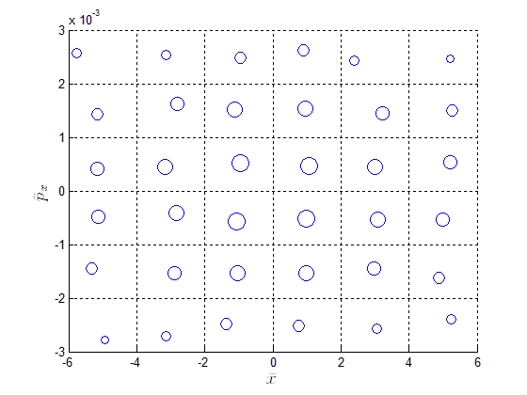
Numerical Solution - Electrons
Electron beam is discretised into electron macroparticles by method of [1]
Sampling an electron beam with a gaussian current distribution
Create a grid, and into each element we assign a macroparticle with charge weight determined by the current distribution
To simulate noise assign random Poisson deviate to each macroparticle charge weight & position
[1] – B.W.J. McNeil and G.R.M. Robb, Phys Rev E 65, 046503

Slide 19
Numerical Solution - Field
Solve field with split step Fourier method [1]
  1st half step: Field diffraction solved with Fourier Transforms
  2nd half step: Field source (amplification and absorption by electron macroparticles) and electron propagation
Field Source solved with Finite Element (Galerkin) Method [2]
Involves solution of sparse linear system
  [1] - R.H. Hardin and F.D. Tappert, SIAM Rev. 15, 453 (1973)
  [2] - K.H. Huebner, E.A. Thornton and T.G. Byrom, The Finite Element Method for Engineers

Slide 20
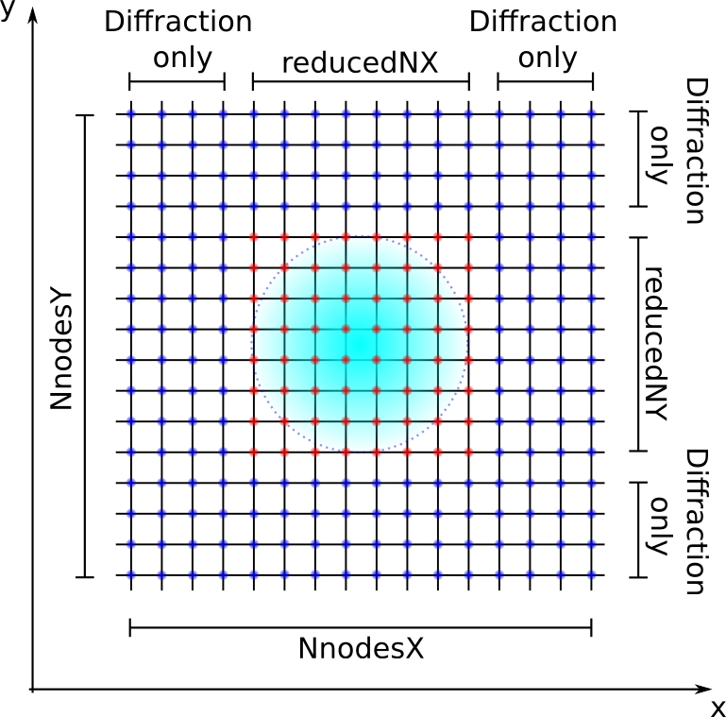
Matched Electron Beam
Radiation field is modelled with a grid of nodes with linear interpolant, macroparticles move freely throughout field elements
Electron beam is matched to undulator, meaning in transverse space it is focussed such that the beam has a constant radius

Slide 21
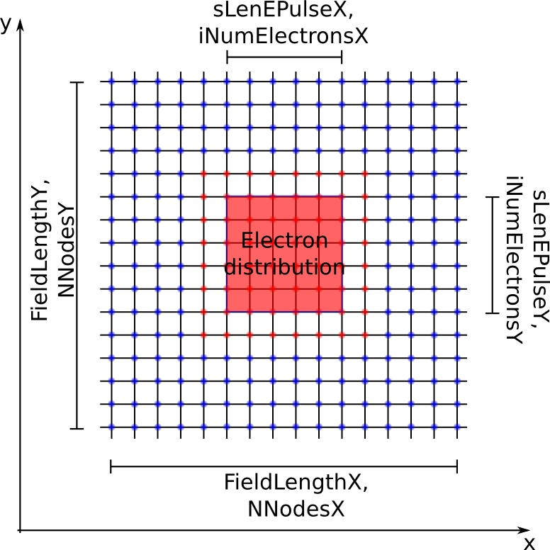
Matched Electron Beam
Electrons will therefore remain confined to an inner set of nodes. Outer field nodes are then used only for diffraction
Low frequency components diffract very quickly out the system. This causes an unphysical low frequency background signal to emerge which may interfere with the FEL interaction. Currently filter out low frequencies during propagation.

Slide 22
Parallelism
Large data sets
Num of macroparticles ~10⁹ – would like to go orders of magnitude larger, need to distribute large electron arrays
MPI
Parallel Fourier Transforms
Parallel Linear Solver for Sparse Systems
We use:-
  FFTW 2.1.5 for Fourier Transforms
  MUMPS for Linear Solver - Possible change to Hiper for linear solver in future

Slide 23
Memory Distribution
Not immediately intuitive how to maintain a consistent memory distribution with minimum processor communication
- field
- electron beam
P_{N}
- Nth Processor
P₀
P₁
P₂
P₃
P₄
P₅
P₆
P₇
(ct-z)

Slide 24
Memory Distribution
Not immediately intuitive how to maintain a consistent memory distribution with minimum processor communication
- field
- electron beam
P₀
P₁
P₂
P₃
P₄
P₅
P₆
P₇
(ct-z)

Slide 25
Parallelism
Electrons propagate freely through radiation field elements at v < c
Store full field array on each processor
Electrons are distributed evenly amongst processors
Since num macroparticles >> num field nodes (6D beam vs 3D field)

Slide 26
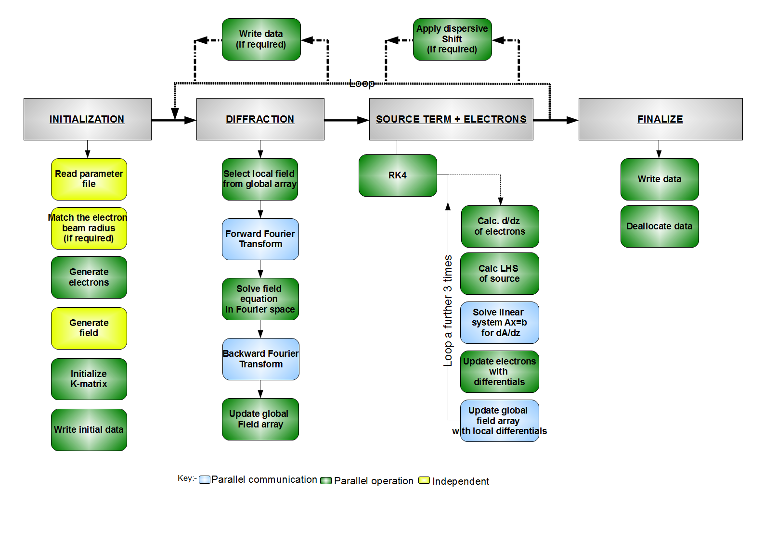
Code

Slide 27
Machines Used
In house Sun x4600 server
  16 cores
DL1 on NW grid at Daresbury
  30-40 cores
ARCHIE at University of Strathclyde
  200-300 cores
Hartree?
  ???

Slide 28
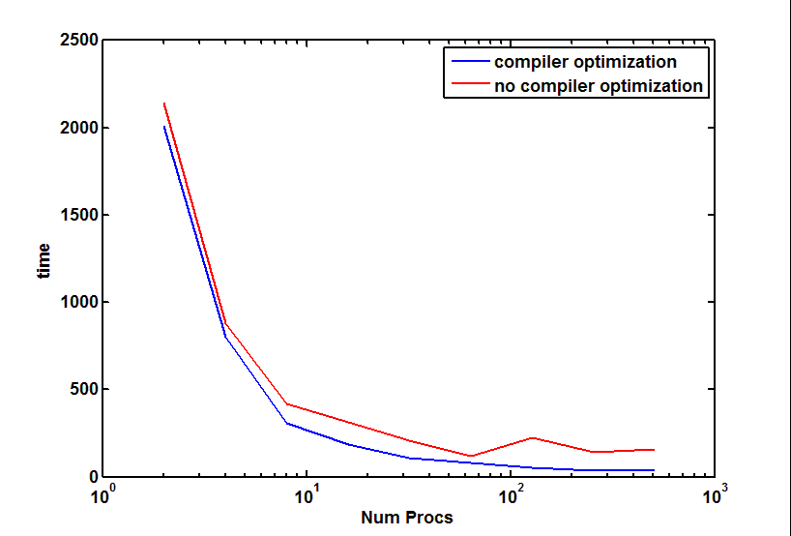
Current
Benchmarking performed by Lucian Anton at Hartree

Slide 29
Need for more processors/parallelism
Currently using around 10⁹ macroparticles
For larger systems would like to increase to at least 10¹¹ – 10¹²
Linear solver can be replaced to be more efficient, currently it appears to take the most time in each integration step

Slide 30
Ongoing Work
Output and post-processing
  Previously using custom Matlab interface
  Now using scripts, need to link these into the Matlab GUI
  Data files too large, inconvenient for storage and transport

Slide 31
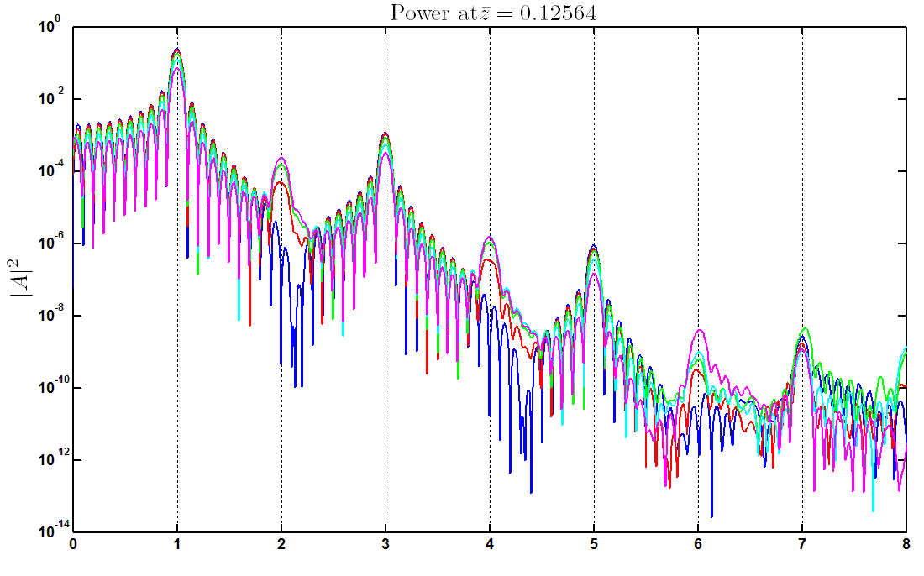
Broadband Field - variation with observation angle
- on-axis spectra, then in order of increasing arbitrary angle:
Avg. code range
ω/ω_{r}

Slide 32
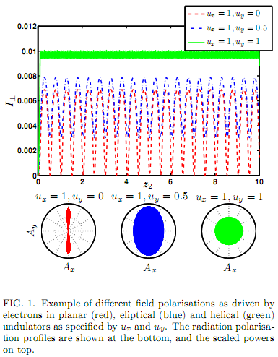
Ongoing Work
Models variably polarized undulator
Radiation field polarization solved self-consistently – electrons only interact with correct polarization
May be useful investigating FEL concepts with variable polarization and multifrequency model

Slide 33
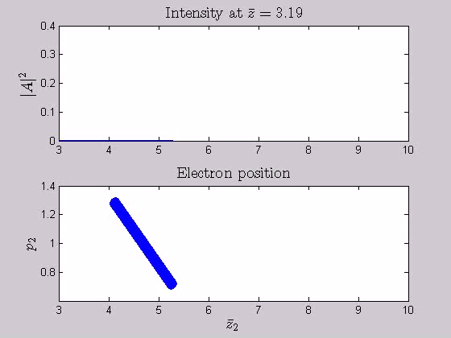
Ongoing Work

Slide 34
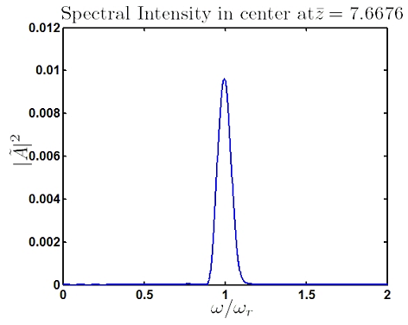
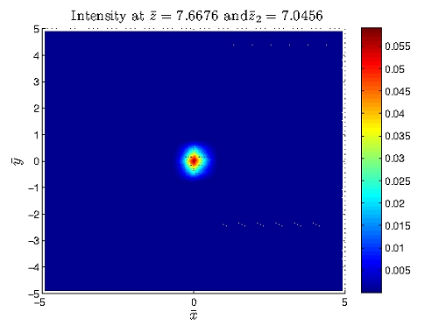
Ongoing Work

Slide 35
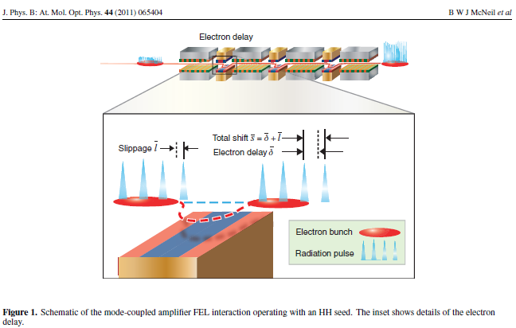
Ongoing Work
Mode locked FEL
HHG seeding

Slide 36
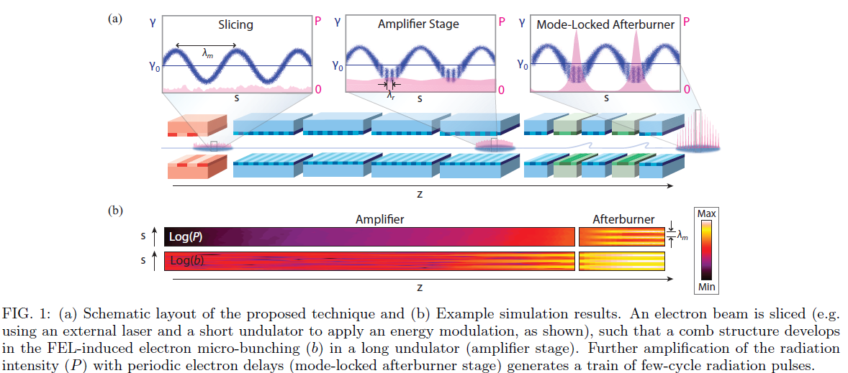
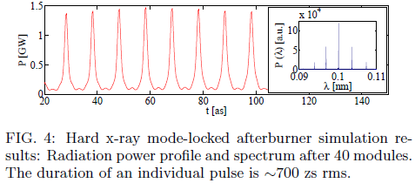
Ongoing Work
D. J. Dunning, B. W. J. McNeil, N. R. Thompson, arXiv:1212.2047v1

Slide 37
End
Thank you

