Slide 1
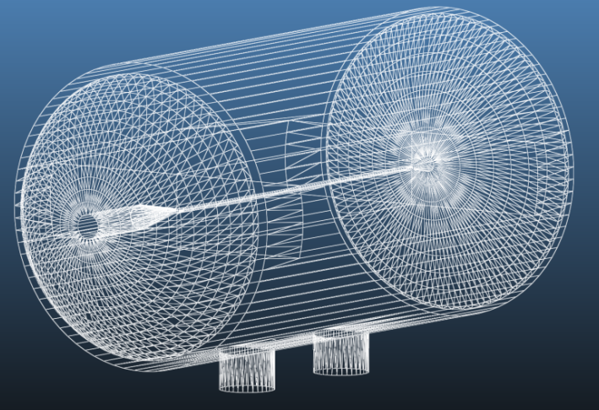
VELO aperture reduction for LS2 and Beam Vacuum Stability
Preliminary Vacuum Stability Code simulations indicates a potential impact of the aperture reduction on the critical current value. Iterations with the mechanical design teams are required to assess the critical current and optimise the VELO design.
The value of the critical current can be upgraded by :
a full bake out of the entire system
a full NEG coating of the vacuum system (e.g. RF foil included)
an activation of the NEG coating at temperature equal or better higher than 180°
an improvement of the VELO tank pumping speed
a possible recovery of the vacuum performances when required

