Slide 1
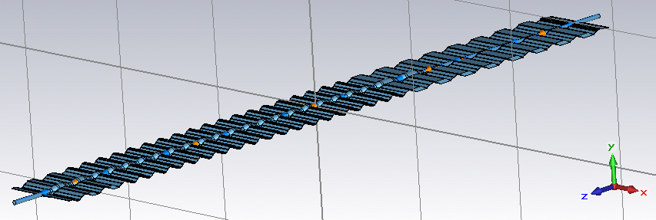
Preliminary results for the LHCb VELO radius reduction
(5.5 mm to 3.5 mm)
Final geometry not known → current geometry roughly scaled by 2/3 in both transverse directions.
Very twisted shape → difficult to import 3D model, low accuracy of simulations, convergence issues,
far from analytical models
 | Im(Zlong/n) | Im(Zeff vertical) | Im(Zeff horizontal)
Current RF box | ~ 1.2 mΩ | ~0.08 MΩ/m | ~0.06 MΩ/m
“New” RF box | ~ 1 mΩ | ~0.26 MΩ/m | ~0.22 MΩ/m
Total LHC (in stable beams) | 90 mΩ | 25 MΩ/m | 25 MΩ/m
With the current model, the radius decrease is expected to lead to an increase of the transverse impedance estimated to be up to 0.5% of the total transverse LHC impedance, despite the low beta function at the VELO location (up to 15 m). Unexpectedly, the longitudinal impedance in fact decreases with this smaller radius. Actual impedance and power loss with post-LS1 and HL-LHC parameters need to be checked and optimized when the final geometry is known.

