Slide 1
Wide Area Network Data Access Requirements in Analysis
Doug Benjamin
Duke University

Slide 2
Setting the stage
Since the beginning of the year, how much analysis was done?
Why Jan 1 to May 1?
  has analysis ramp up ahead of major Winter conferences (Moriond series)
  Post conference activity perhaps indicative of steady state activity well into LS1 period
What data do analyzers use?

Slide 3
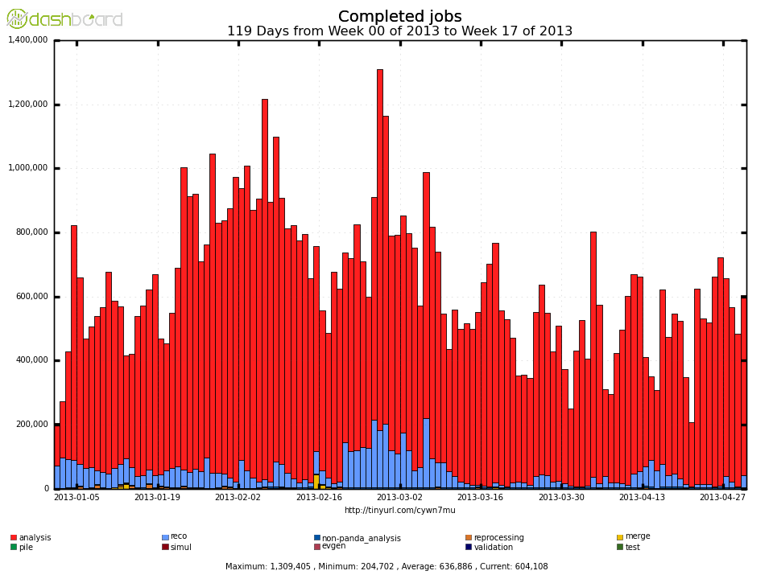
Completed Jobs (1-Jan to 1 May 2013)
1 million/day
analysis
Reco
Job Type - Group Analysis, Group production, User analysis

Slide 4
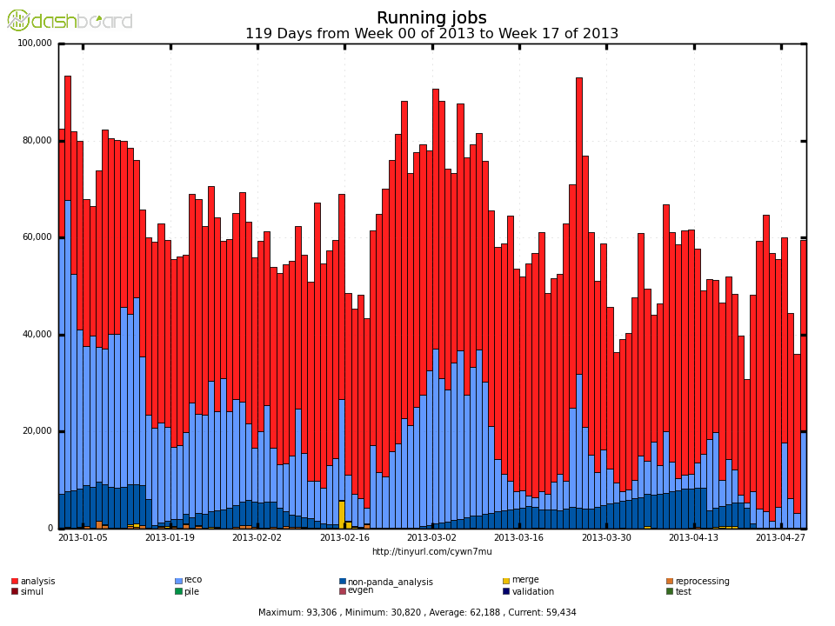
User Analysis jobs 1-Jan – 1-May 2013
80K
analysis
Reco (groupD3PD’s)
Non-Panda analysis
Job Type - Group Analysis, Group production, User analysis

Slide 5
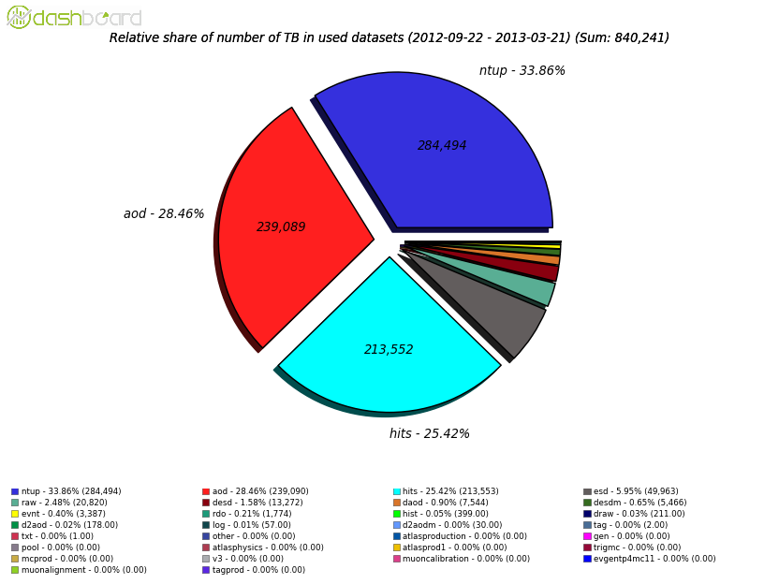
Data popularity
(used datasets 2012-09-22 to 2013-03-21)
AOD
239,089 TB
NTUP
284,494 TB
AOD’s used to make NTUP’s

Slide 6
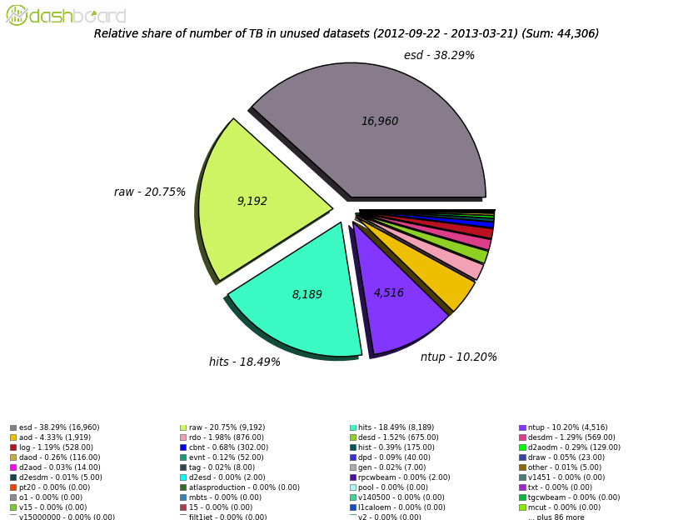
Data unpopularity
(Unused datasets)
AOD (1,919 TB)
NTUP (4,516 TB)

Slide 7
Interim summary
1-Jan to 1-May 2013 – peak of over 1M analysis jobs per day
Prior to Moriond ~800 K jobs/day
Post Moriond ~ 400 – 600 K jobs/day
Jobs are typically short (most < 4 hours)
In 6 month period End – Sep 2012 to end March 2013, NTUP’s most popular data type 284 PB used (~ 67 PB/month)
In same period - 4.5 PB NTUP’s unused (~ 1.5%)

Slide 8
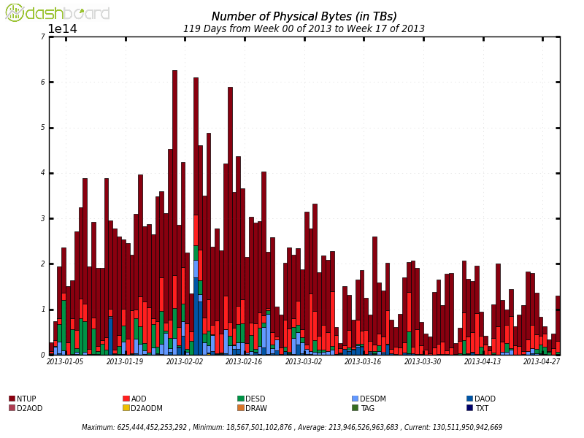
Analysis triggered data motion (PD2P)
NTUP – largest data typed moved
Drop in amount data moved post Moriond
500 TB
0 TB

Slide 9
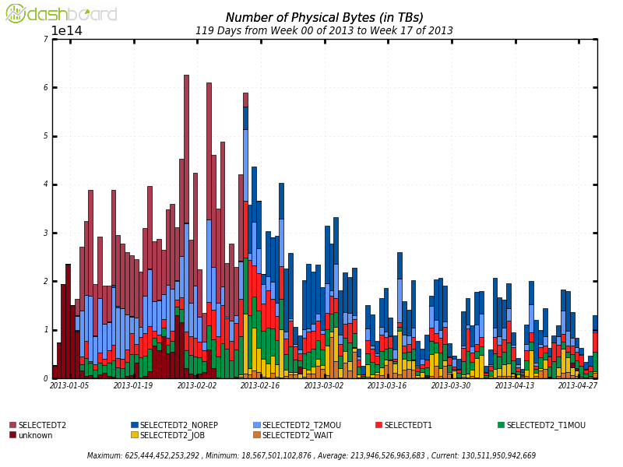
PD2P by Algorithm
By design most data sent to Tier 2’s
See twiki page for meaning of
Algorithms –
https://twiki.cern.ch/twiki/bin/viewauth/Atlas/PandaDynamicDataPlacement
500 TB
0 TB

Slide 10
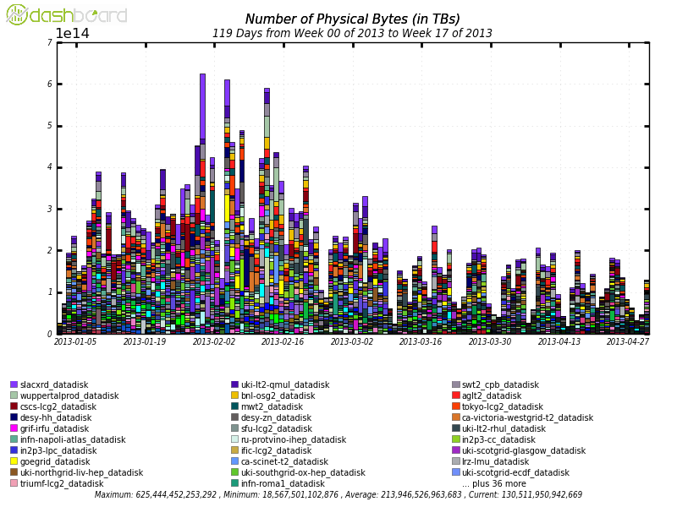
PD2P sends data everywhere
No obvious hot spots
Data being sent to many sites – 65 sites in this plot

Slide 11
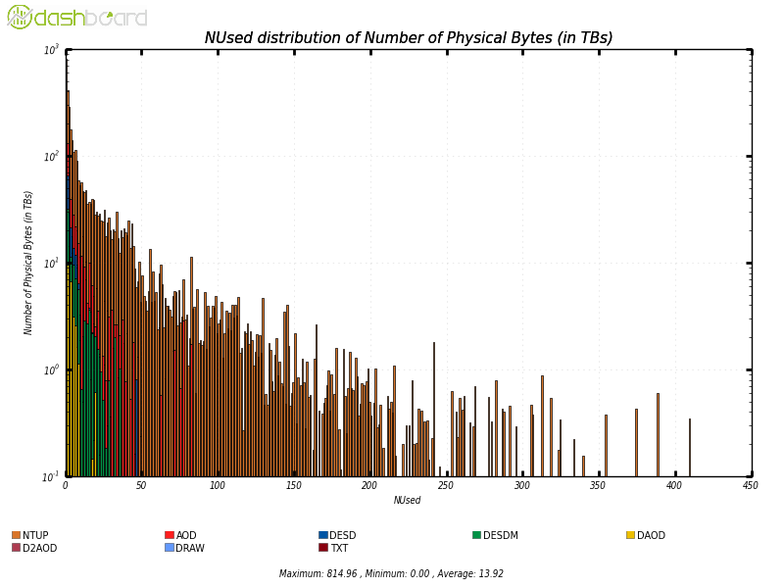
Dataset reuse

Slide 12
Fraction of Data volume reused
Using Nused quantity to determine reuse
NTUP – 90 % of data volume 50 times or less
AOD - 90% of data volume 24 times or less

Slide 13
PD2P interim summary
Jan-Apr 2013 – PD2P moved at peak ~ 600 TB/day
NTUP most popular data type to move
  Not a surprise given the popularity plots
Most data moved to Tier 2 sites
Data moved to a wide variety of sites (> 67 sites)
… something about dataset reuse….

Slide 14
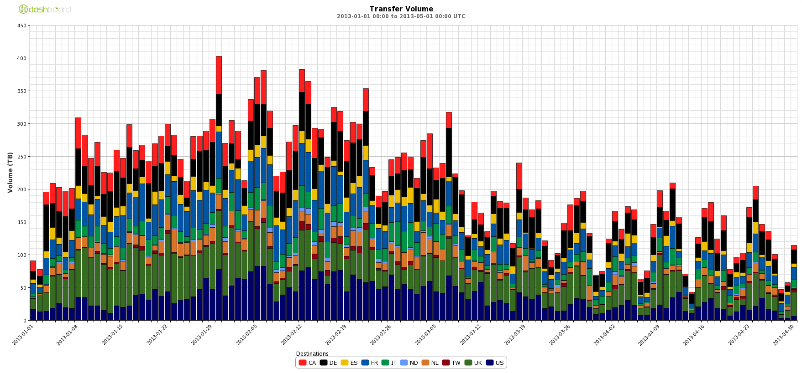
Planned data replication
400 TB
0
DDM – Daily Data Brokering data Volume (1-Jan to 1-May 2013)

Slide 15
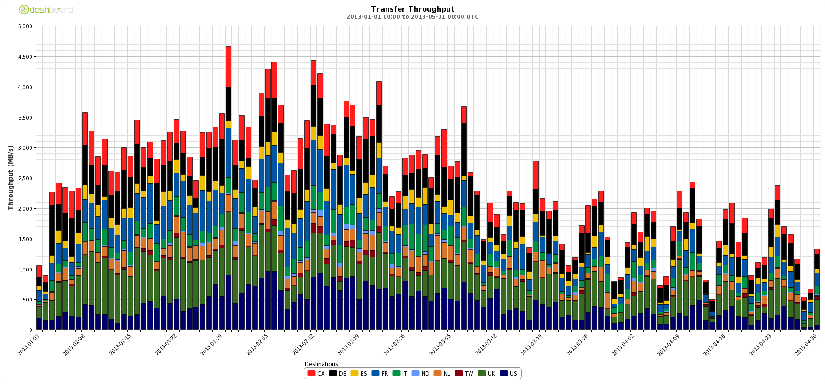
Data Brokering transfer Rate
4.5 GB/s
0
Transfer Throughput (averaged over a day) 1-Jan to 1-May 2013

Slide 16
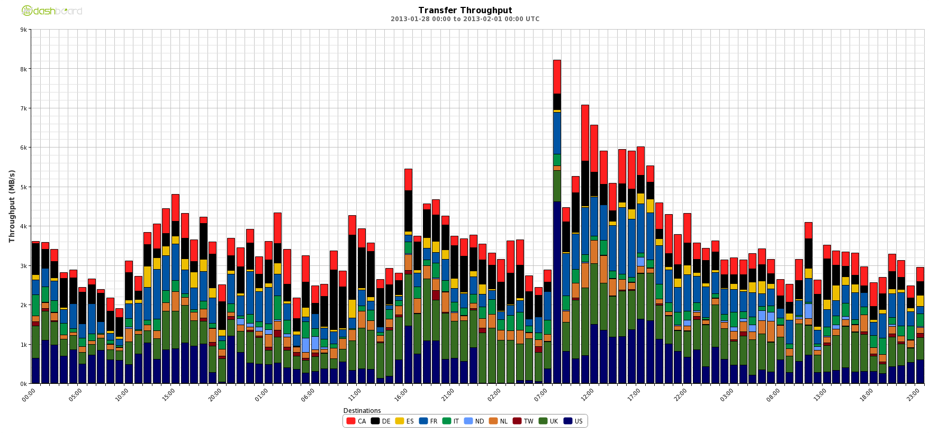
Data Brokerage transfer rate
28-Jan – 31-Jan (48 hrs)
7 GB/s
Transfer Throughput (one hour bins) 28-Jan to 1-Feb 2013

Slide 17
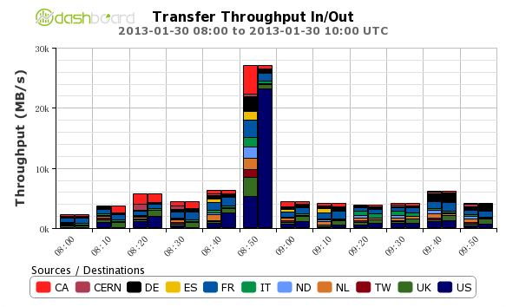
Transfer rate zoom in further
30 GB/s
in
out
20 GB/s
10 GB/s

Slide 18
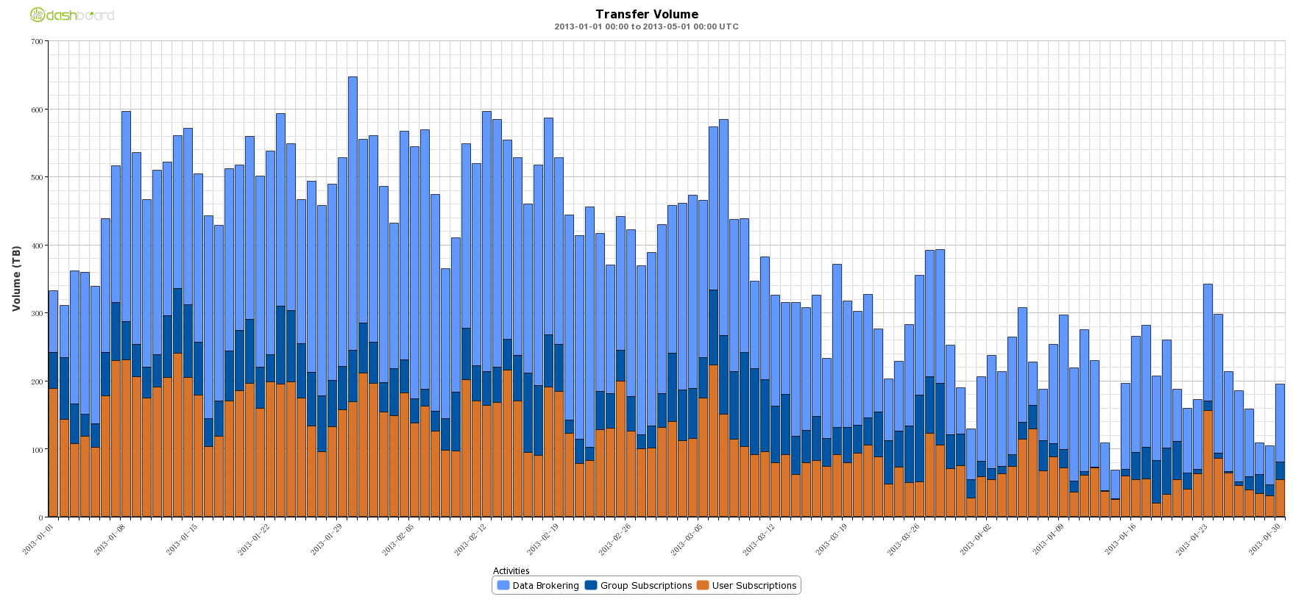
Planned transfers
Data Brokering, Group Subscriptions, User subscriptions
600 TB
Data Brokering
400
200 TB
User
0 TB

Slide 19
Planned Data Brokerage summary
Peak 400 TB/day and ~ 200 TB/day post Moriond
Transfer rates
  Peak 4.5 GB/s (day resolution)
  During busiest few days 28-Jan through 31-Jan-13 (48 hrs)
  7 GB/s (one hour resolution)
  Jan 30, 2013 (08:00 – 10:00) peak time, in Peak 10 minute period
  30 GB/s - reading mostly from US Cloud to rest of ATLAS
  ~ 5 GB/s other 10 minute periods
User data subscriptions
150-200 TB/day pre Moriond
50-100 TB/day post Moriond
All networking plans should include accounting for User Output

Slide 20
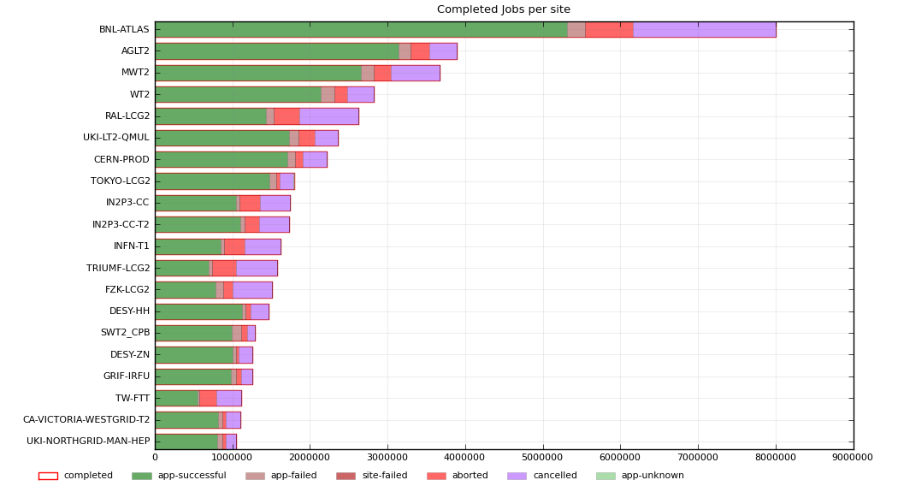
Analysis Sites
Jan 1 to April 30 2013 - MWT2 – direct read site

Slide 21
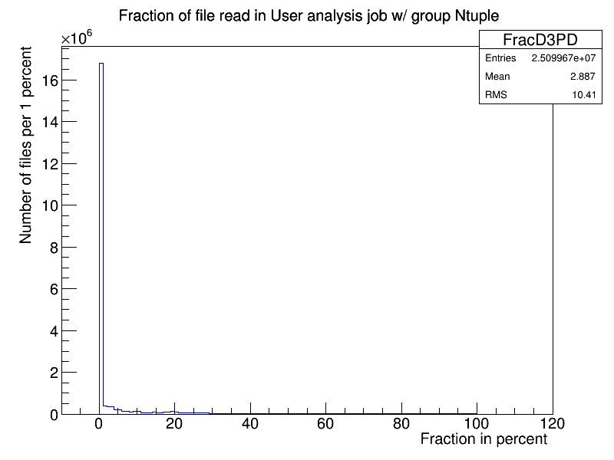
How much of D3PD do users read?
Many small reads of Physics group D3PD files

Slide 22
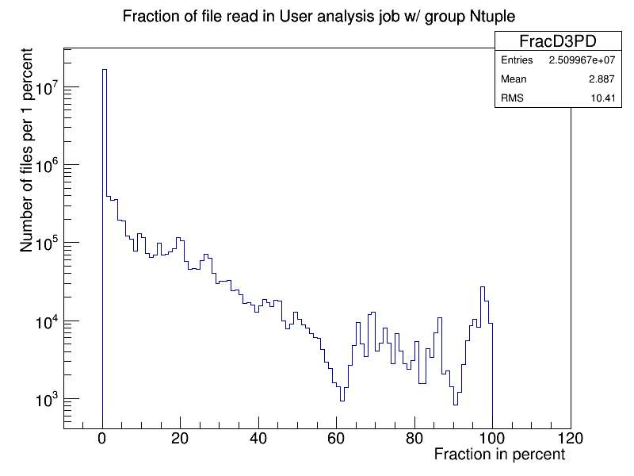
How much of D3PD do users read?
Semi-log version of previous plot

Slide 23
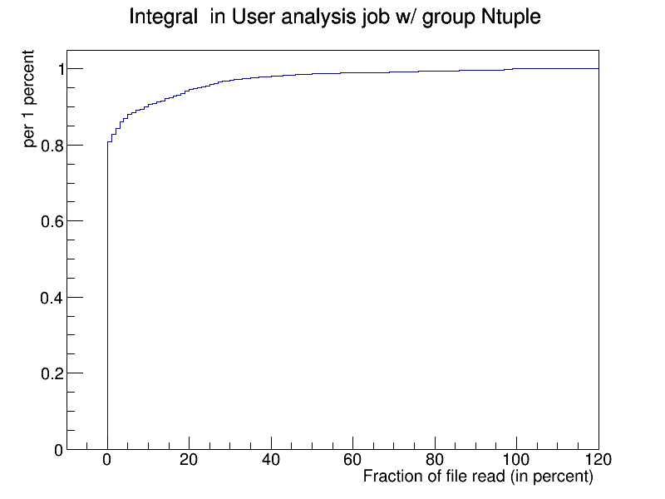
How much of D3PD do users read?
90% of all access read 10% or less of file.
Implies if users are reading mostly the same variables – we more a lot of data never read.

Slide 24
Interim summary user access of D3PD’s
Current D3PD’s from the Physics groups typically very large
They contain more Branches than the users typically use
New analysis model is working to merge AOD and D3PD’s
  Implication – input files will contain much more information that the users actually read
  Efficient Skim/Slim centralized service will be crucial
Need some mechanism for capturing what variables the users are really using and then provide them files with mostly those variables.

Slide 25
Open questions needing further study
How much PD2D data is read only once or twice after it has been replicated via PD2P?
How long does a file stay popular (ie read frequently)?
  We want to replicate the popular files and not the other ones?
Can we reduce the amount of data in the Analysis files that is rarely read?
Should we have caches for data files at the Tier 1 and Tier 2 sites ?
  Do for analysis data what was done for database data and software releases (frontier/squid and cvmfs/squid).
  What will it take to have partial event caches?
Can we estimate the network growth needs when jobs and input data are in separate locations (WAN access from jobs)

Slide 26
Conclusions
During busy times – 1 Million user analysis and D3PD production jobs per day, user analysis jobs are short duration.
PD2P moves at peak ~ 600 TB/day and planned replication of similar files ~ 400 TB/day, User subscriptions ~ 200 TB/day
90% of NTUP datasets (by volume) are read 50 times or less. (according to PD2P values)
Users still read a small fraction of the centrally produced D3PD’s (NTUP’s). Implies much of the data moved is not read
What network issues will be seen w/ factor of 3 increase in Trigger Rate in 2015-2016?

