Slide 1
LHC Open Network environment
Status update
Artur Barczyk/Caltech
Tokyo, May 2013

Slide 2
LHCONE Introduction
In a nutshell, LHCONE was born to address two main issues:
  ensure that the services to the science community maintain their quality and reliability
  protect existing R&E infrastructures against potential “threats” of very large data flows
LHCONE is expected to
  Provide some guarantees of performance
    Large data flows across managed bandwidth that would provide better determinism than shared IP networks
    Segregation from competing traffic flows
    Manage capacity as # sites x Max flow/site x # Flows increases
  Provide ways for better utilization of resources
    Use all available resources
    Provide Traffic Engineering and flow management capability
    Leverage investments being made in advanced networking

Slide 3
LHCONE Overview
Current activities split in several areas:
Multipoint connectivity through L3VPN
Point-to-point dynamic circuits
  R&D, targetting demonstration this year
Common to both is logical separation of LHC traffic from the General Purpose Network (GPN)
  Avoids interference effects
  Allows trusted connection and firewall bypass
More R&D in SDN/Openflow for LHC traffic
  for tasks which cannot be done with traditional methods

Slide 4
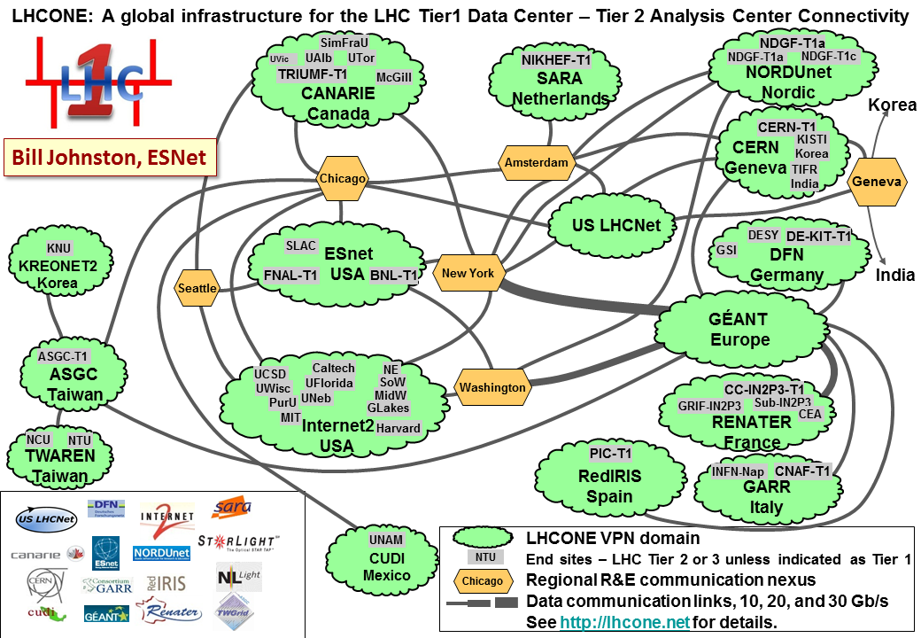
Routed L3VPN Service, VRF
Based on Virtual Routing and Forwarding
BGP peerings between the VRF domains
Currently serving 44 LHC computing sites

Slide 5
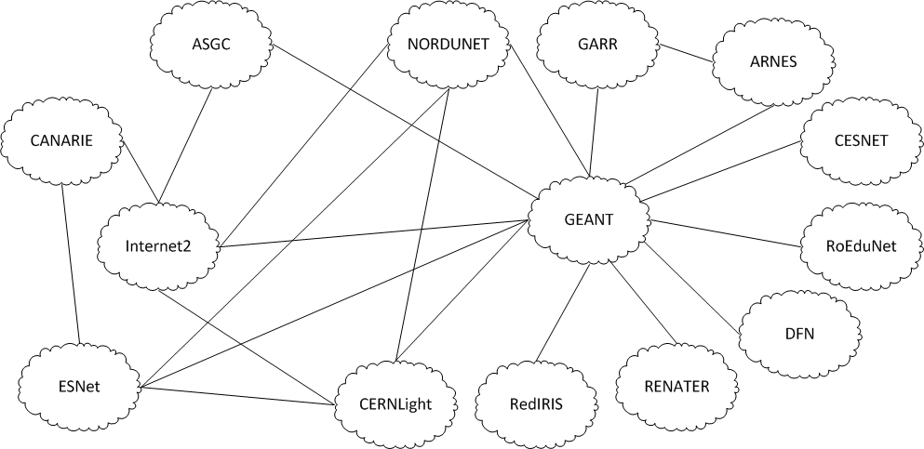
Routed L3VPN Service, VRF, cont.
Current logical connectivity diagram:
From Mian Usman (DANTE)

Slide 6
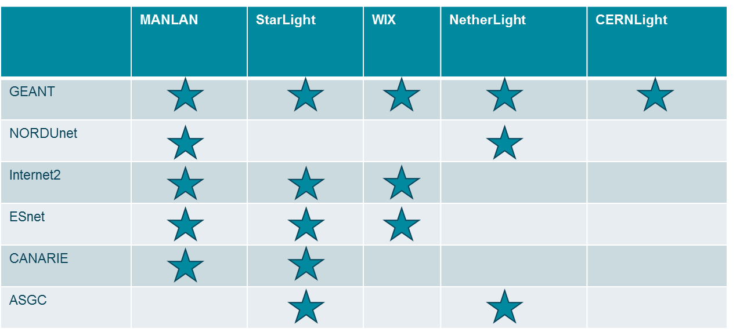
Inter-domain connectivity
Many of the inter-domain peerings are established at Open Lightpath Exchanges
Any R&E Network or End-site can peer with the LHCONE domains at any of the Exchange Points (or directly)

Slide 7
For LHCONE L3VPN Service Providers
Please see information on wiki:
  https://twiki.cern.ch/twiki/bin/view/LHCONE/LhcOneVRF
List of BGP communities on the wiki
Implementation recommendations:
  Do not filter by prefix length. Any prefix length must be accepted
  Apply maximum-prefix checks. Ad-hocs for TierXs, 3000 between VRFs
  Do not allow private AS Numbers

Slide 8
Computing Site Connection HOWTO
Wiki instructions:
https://twiki.cern.ch/twiki/bin/view/LHCONE/LhcOneHowToConnect
Any LHC computing site can connect to the LHCONE infrastructure
  Connect to one of the VRF domains
  directly or at exchange point
  see Wiki for list of active VRF domains
The site needs to have
  public IP addresses
  a public AS Number
  a BGP capable router
LHCONE transports LHC data traffic only
  Announce only LCG IP prefixes
  Make sure traffic is symmetric, to avoid problems with stateful firewalls

Slide 9
LHCONE Operational Aspects
The Operational Model is broadly based on the LHCOPN experience
  Basic principle: A sites experiencing problems contacts its first LHCONE upstream provider
Still in the process of being worked out
Current operational handbook draft: https://twiki.cern.ch/twiki/pub/LHCONE/LhcOneVRF/LHCONE_VRF_Operational_Handbook-v0.5.pptx

Slide 10
Point-to-point service
PATH TO A DEMONSTRATION SYSTEM

Slide 11
Dynamic Point-to-Point Service
Provide reserved bandwidth between a pair of end-points.
Several provisioning systems developped by R&E community: OSCARS (ESnet), OpenDRAC (SURFnet), G-Lambda-A (AIST), G-Lambda-K (KDDI), AutoBAHN (GEANT)
Inter-domain: need accepted standard
OGF NSI: The standards Network Services Interface
Connection Service (NSI CS):
  v1 ‘done’ and demonstrated e.g. at GLIF and SC’12
  Currently standardizing v2

Slide 12
GLIF and Dynamic Point-to-Point Circuits
GLIF is performing regular demonstrations and plugfests of NSI-based systems
Automated-GOLE Working Group actively developing the notion of exchange points automated through NSI
  GOLE = GLIF Open Lightpath Exchange
This is a R&D and demonstration infrastructure!
Some elements could potentially be used for a demonstration in LHCONE context

Slide 13
Point-to-Point Service in LHCONE
Intended to support bulk data transfers at high rate
Separation from GPN-style infrastructure to avoid interferences between flows
Conducted 2 workshops:
  1st LHCONE P2P workshop was held in December 2012
    https://indico.cern.ch/conferenceDisplay.py?confId=215393
  2nd workshop held May 2013 in Geneva
    https://indico.cern.ch/conferenceDisplay.py?confId=241490
(Some) Challenges:
  multi-domain system
  edge connectivity – to and within end-sites
  how to use the system from LHC experiments’ perspective
    e.g. ANSE project in the US
  manage expectations

Slide 14
Point-to-point Demo/Testbed
Demo proposed and led by Inder Monga (Esnet)
  Choose a few interested sites
  Build static mesh of P2P circuits with small but permanent bandwidth
  Use NSI 2.0 mechanisms to
    Dynamically increase and reduce bandwidth
    Based on Job placement or transfer queue
    Based or dynamic allocation of resources
Define adequate metrics!
  for meaningful comparison with GPN or/and VRF
Include both CMS and ATLAS
Time scale: TDB (“this year”)
Participation: TDB (“any site/domain interested”)
More discussion at the next LHCONE/LHCOPN meeting in Paris (June 2013)

Slide 15
SDN/Openflow
OTHER R&D ACTIVITIES

Slide 16
Meeting on SDN in LHCONE, May 3rd, 2013
Discussed the potential use case: SDN/Openflow could enable solutions to problems where no commercial solution exists
Identify possible issues/problems Openflow could solve, for which no other solution currently exists?
Multitude of transatlantic circuits makes flow management difficult
  Impacts the LHCONE VRF, but also the GPN
  No satisfactory commercial solution has been found at layers 1-3
  Problem can be easily addressed at Layer2 using Openflow
  Caltech has a DOE funded project running, developing multipath switching capability (OLiMPS)
  We’ll examine this for use in LHCONE
Second use case: ATLAS is experimenting with OpenStack at several sites.
  Openflow is the natural virtualisation technology in the network. Could be used to bridge the data centers.
  Needs some more thought, interest in the ATLAS experiment

Slide 17
Summary
The LHCONE is currently operating a L3VPN (aka VRF) service
  44 LHC computing sites connected
The Point-to-point circuit service will be first shown in a demonstration
  Based on NSI
  Interested Networks and Sites are welcome to join
We are also investigating ideas in the SDN/Openflow space
  Useful to LHCONE participating networks?
  Any direct benefit to the LHC computing model?

Slide 18
Information exchange
http://lhcone.net
Weekly audio conference, 14.30 UTC, alternating every second week:
  architecture discussion
  operations
mailing lists:
  lhcone-operations@cern.ch
  lhcone-architecture@cern.ch
LHCONE wiki: https://twiki.cern.ch/twiki/bin/view/LHCONE/WebHome
Next LHCONE/LHCOPN meeting: Paris, June 17/18, 2013
  http://indico.cern.ch/conferenceDisplay.py?confId=236955

Slide 19
Thank you! Questions?
http://lhcone.net

