Slide 1

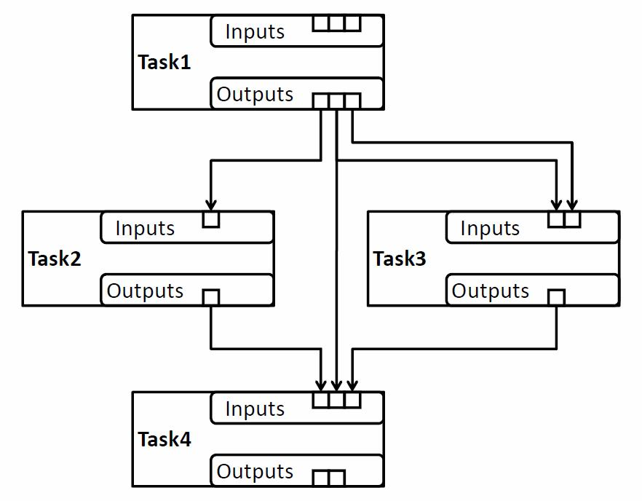
DEFT: status, near term and 2014 plans
Maxim Potekhin
BNL
ATLAS Distributed Computing
Technical Interchange Meeting
May 16, 2013

Slide 2
About this presentation
General plans for the ATLAS Production System evolution and upgrade (ProdSys2) have been worked out about a year ago. Design of its components (DEFT+JEDI) took place in late 2012 – early 2013.
”JEDI” will be covered in a separate presentation. The focus of this talk is DEFT, its current status and plans for further development.
Initial DEFT prototype was ready before the S&C week in March, progress made since then. The crucial DEFT functionality has been tested.
Important but a subject of a separate presentation:
  A test version of JEDI (codename JEDI-α) has been tested with appropriate interfaces built to the existing Production System database.
Substantial effort has been invested in documenting this project
  https://twiki.cern.ch/twiki/bin/viewauth/Atlas/ProdSys (and its many links!)
  https://twiki.cern.ch/twiki/bin/viewauth/Atlas/PandaJEDI
  http://prodsys.blogspot.com
  Also, ATLAS S&C Workshop: https://indico.cern.ch/conferenceDisplay.py?confId=210656
Important: The ProdSys2 Technical Design Report (TDR) has been created, and will be presented in this meeting – see that document for more detail.

Slide 3
Overview of the context: ProdSys2 = DEFT + JEDI
The new Production System (ProdSys2) is a tandem of two subsystems, which play complementary roles and represent two different levels in managing the overall workflow in PanDA :
DEFT: Database Engine For Tasks:
  DEFT is responsible for formulating the Meta-Tasks and the underlying tasks (collections of jobs). Meta-Tasks can include chains of tasks, bags of tasks and other types of task groupings, complete with all necessary parameters. DEFT keeps track of the state of the Meta-Tasks under its management, and their constituent tasks, by using a database as its persistence mechanism. It accounts for data dependencies among the tasks by maintaining records of datasets and their states. It provides the interface for each Meta-Task definition, management and monitoring throughout its lifecycle.
JEDI: Job Execution and Definition Interface
  JEDI is using the task definitions formulated in DEFT to define and submit individual jobs to PanDA, keep track of their progress and handle re-tries of failed jobs, job redirection etc. In addition, JEDI interfaces data management services in order to properly aggregate and account for data generated by individual jobs (i.e. general dataset management)

Slide 4

DEFT and JEDI working in tandem
DEFT
JEDI
Job 1-1-1
Task 1-1
Job 1-1-2
Meta-Task 1
Task 1-2
Job 1-1-3
PanDA Sites
Task 1-3
Job 1-1-4
Task 1-4
Front End and User Interface – Meta-Task Editor
Job 2-1-1
Meta-Task 2
Task 2-1
Job 2-1-2
Task 2-2
…
Meta-Task 3
…
…
Task 2-N
…
Meta-Task 4
Job 2-1-N
...
Meta-Task N
…
…

Slide 5
DEFT and JEDI as an assembly line
Job 1-1-1
Job 2-1-1
Job 1-1-2
Job 2-1-2
Job 1-1-3
Job 2-1-3
Job 1-1-4
Job 2-1-4
JEDI
JEDI
JEDI
DEFT
Task 1 (t₀)
Task 1 (t₁)
Task 2 (t₂)
Meta-Task 1
Meta-Task 1
DEFT
DEFT
DEFT
T

Slide 6

ProdSys2: Motivations from the DEFT perspective
We need to address the following:
The concept of Meta-Task as a group of logically related tasks, required to complete a specific physics project or sub-project. Absent in the original product (ProdSys), it emerged based on operational experience with PanDA and its workflow. It effectively became the central object in the high-level workflow management, but…
…it is currently modeled in spreadsheets, which act as surrogate database and GUI, require active maintenance and limit the scalability of the overall Production System.
Meta-Tasks must be properly modeled, introduced and integrated into the system to guarantee that it delivers adequate scalability and performance going forward, as well as a productive environment for the Production Managers and users involved in the physics analysis.
Analysis tasks are currently handled outside the Production System, however they also have workflow characteristics. Having a universal system supporting the management of workflows across production and analysis will bring benefits to the ATLAS community.

Slide 7
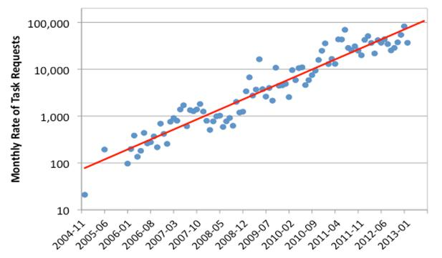
The Meta-Task
Why Meta-Task?
The initial PanDA design parameters contained an assumption that a relatively small number of tasks will be maintained in the system, while each task would be translated into a large number of job definitions, to be submitted for execution.
As we gained more operational experience with PanDA, it became obvious that physics groups and production managers have learned to use the system in more sophisticated ways, formulating the workload in a fine-grained fashion, i.e. multiple tasks of smaller size, often logically connected with each other. This resulted in the exponential growth of the rate of PanDA Task Request submissions:

Slide 8
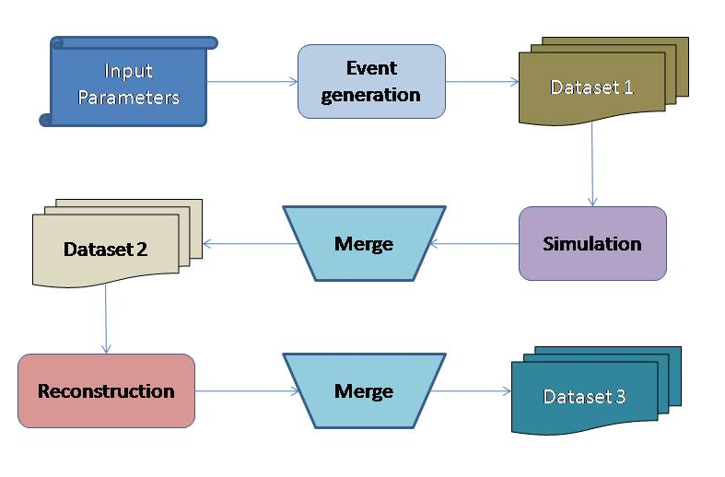
Meta-Task as a way to manage complexity of the workflow
As shown in the previous page, there is a real need to manage the scale and complexity of the PanDA workflow in order to accommodate the explosive growth of the task requests and complexity of their relationship. For example, the following highly simplified diagram illustrates a chain of PanDA tasks and the data that defines their relationship:

Slide 9

ProdSys2: Requirements from the DEFT perspective
Automation: we need the capability to process Meta-Tasks with minimal human intervention beyond task definition. Right now it is a labor intensive semi-manual process.
Automatic recovery from simple failure modes
But we also need the capability to have operator intervention and Meta-Task recovery: there must be adequate tools for the operators and managers to direct the Meta-Task processing
Dynamic job definition (e.g. making it dynamic as opposed to static once the task is created) – functionality to be implemented in JEDI
Maintainability: the code of the existing Production System was written "organically", in order to actively support emerging requests from the users, and it starts showing its age
Scalability: in general, given the dramatic rise in the number of tasks defined and executed, we must ensure a lot of headroom going forward.
Ease of use: there is currently a great amount of detail that the end user (Physics Coordination) must define in order to achieve a valid task request. We must automate and facilitate the task creation process, whereby cumbersome logic is handled within the application, and the user interface is more transparent and friendly.

Slide 10
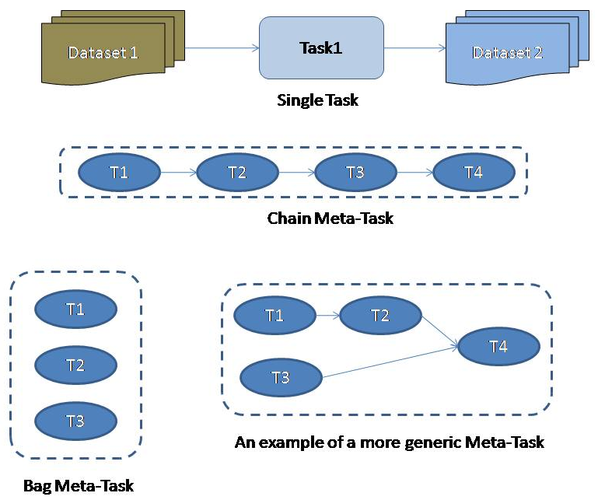
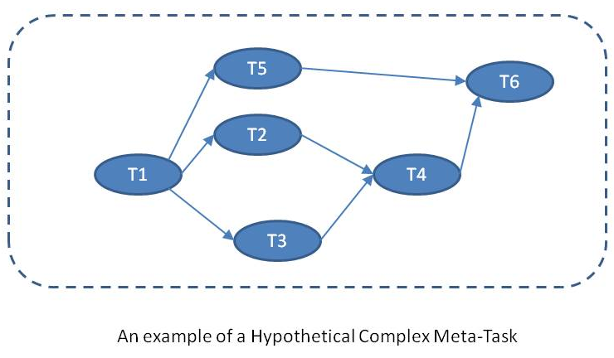
DEFT: Meta-Task as a Graph Model
Graph model is commonly used to describe workflow:
It allows implementation of the “chain”, “bag” and “bag of chains” topologies
Liberates the designers of the workflow from limitations of the current “spreadsheet” model
In the following, we will generally use the concept of tasks as a group of jobs using one or more datasets as input, and one or more datasets is output:

Slide 11
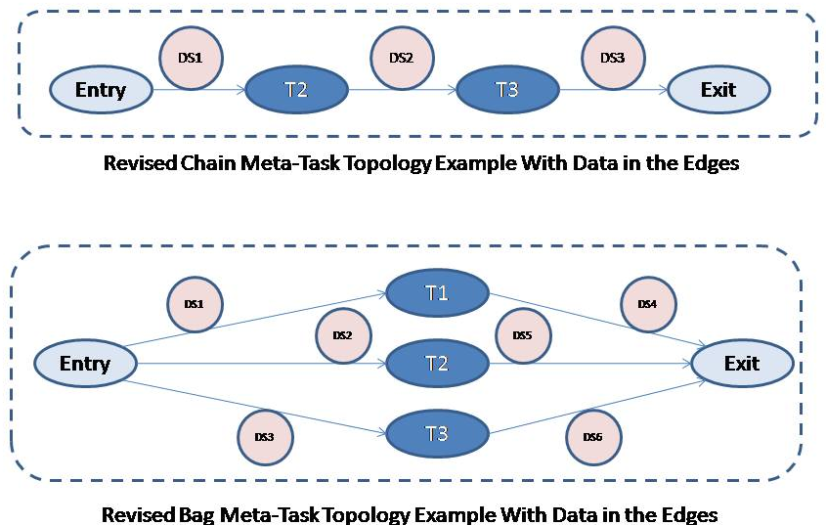
The Graph Model
Crucial features of the DEFT Meta-Task Model
In accordance with operational practice in ATLAS, the dependencies between two adjacent tasks, which we model as nodes of a graph, are best conceptualized as datasets, which then become the edges of the graph
In order to handle “bag” and other complex topologies, we introduce “pseudo-tasks” representing the entry and exit points. It is actually an established technique in handling workflows.

Slide 12
The DEFT Equation
We model tasks as workflow elements acting on an array of input datasets, while producing a number of output datasets. The tasks have states, and undergo state transitions based on their inputs and applicable rules. Each task in a Meta-Task can be represented as a vector of variables describing its internal state and state of each input and output. The role of DEFT is to apply rules to transform this vector. Importantly, some of the parameters will be modified by JEDI.
y₁
y₂
y₃
…
y_{N}
x₁
x₂
x₃
…
x_{N}
= D

Slide 13
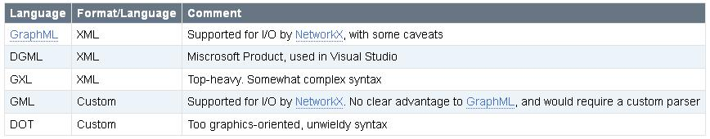
Meta-Task: the Language
How do we represent and document the objects created according to the Graph Model, in human-readable format?
The need to represent Meta-Tasks and their components in a way amenable to reading, editing and archival by humans was realized early on in the project
Do we need to build this format from scratch? Probably not,
It’s the model!
Since we consider the Graph Model as the optimal way to represent the workflow in its various states, it is a reasonable approach to try and identify a natural way to represent the graph
This leads to realization that there are already standard languages and schemas that do exactly that. Some are XML-based, some are not.

Slide 14
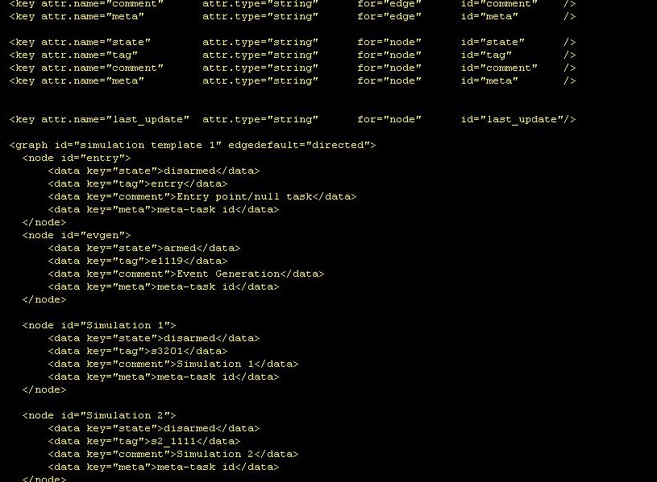
DEFT: example of a workflow template in GraphML

Slide 15

DEFT: Status and Summary of Progress in the past 6 months
Analyzed initial project requirements (with Wolfgang Ehrenfeld et al)
Developed an object model for the DEFT component of ProdSys2
Created (and updated as development progressed) the database schemas for object and graph persistence in RDBMS
Investigated multiple existing solutions for workflow management and identified software components to be used in the project
Applied an appropriate (industry-standard) format for describing, modeling and version control of the PanDA workflow
Developed a prototype DEFT application –
  CLI driver with an extensive set of command-line options to enable realistic testing and bookkeeping of the task database
  A suite of reusable Python classes and modules
  Efficient logging mechanism based on a standard Python package
Code actively maintained in SVN
Maintained documentation on every aspect of the development effort, from design to JEDI interface, in TWiki and a specially created ProdSys2 blog.
Documented important use cases
Started addressing the issues of DEFT performance and scalability by running simulated sweeps over a large group of test Meta-Tasks.

Slide 16
The DEFT Prototype
DEFT exists as a functioning, proof-of-integration prototype (CLI utility)
Integration of NetworkX, GraphML, PyUtilib and DB Oracle schemas
Capability to import and export workflows in GraphML format, as well as to persist data in RDBMS, and access and modify data transparently across these containers
Change of the Meta-Task State
Template
Change of the Meta-Task State
GraphML
Document
input
Oracle DB
read and update
DEFT
GraphML
Document
output

Slide 17
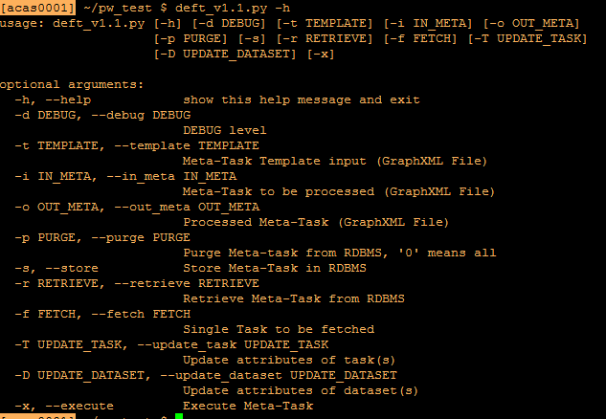
The DEFT Prototype
Capability to support workflows described by DAG of any complexity, not just “chains” and “bags”
Straightforward template capability, cloning and copying of tasks
Implementation of rules for state transition of tasks

Slide 18
Near-term Plans (0-3 months)
Initial stages of DEFT/JEDI Integration
In a parallel development, not covered in this presentation (credits: T.Maeno, D.Golubkov et al) an interface was developed between the “old” task definition interface and the new JEDI modules. This part of the project has been given the codename “JEDI-alpha”.
With JEDI-alpha operational and providing valuable testing platform for JEDI, the next step is to inject tasks from DEFT into JEDI and thus create an instance of ProdSys2.
Test of functionality while emulating various operational and failure conditions
Basic “vanilla” use cases as the starting point.
Data Management Integration
Handling transient datasets needs to be addressed
Some of the basic functionality such as dataset naming module is yet to be implemented (will follow shortly)
Initial design of the graphic user interface
The user interface is an important feature of the overall system and must be properly implemented
Need to evaluate existing packages for graph and other data manipulation

Slide 19
Medium-term Plans (3-6 months)
DEFT/JEDI Integration: covering more use cases
Will follow the list of use cases beyond the basic one, and implement necessary logic for handling these (incremental task execution, lost files etc)
Further iteration of the database schemas as necessary
User Interface prototype
Will have the initial working prototype of the DEFT UI.
Finalizing DEFT/JEDI integration
To test the complete DEFT/JEDI functionality throughout the lifecycle of a Meta-Task
Developing use cases for ProdSys2 application to analysis workflow
This hasn’t been done yet, remains an important objective.

Slide 20
Long-term Plans (6-12 months)
End of 2013
ProdSys32 in pre-production (a limited number of production Meta-Tasks executed under close supervision and QA)
Functioning UI
Early 2014 – rollout!
Introduction of ProdSys2 into the ATLAS production cycle
Mid-2014 – UI and Monitoring Integration
The objective is to provide capable monitoring and management tools to the groups production managers and operations staff. This implies a level of integration of the DEFT UI and various monitoring components in ATLAS.
While not the core part of the project, this component will play a major role in its success.
Late 2014 – analysis workflow
Using ProdSys2 to handle the analysis workflow.

Slide 21
Backup slides

Slide 22
Meta-Task: GraphML, NetworkX and RDBMS
Choice of Schema
There is an obvious advantage in choosing the schema that’s is standardized, enjoys support and has parsers already written to handle its specifics.
GraphML appears to be very simple, human-readable and enjoys parser support in many existing visualization and analysis software products
It allows us to standardize on the workflow description, visualization, editing, documentation and versioning with essentially zero effort.
Capable graphic editors, such as GePhi, already exist and can be used immediately to create, visualize and edit Meta-Task templates (see backup slides).
NetworkX
“NetworkX is a Python language software package for the creation, manipulation, and study of the structure, dynamics, and functions of complex networks.”
While its functionality is quite rich, and allows all sorts of graph analysis and exploration, the minimal subset of methods is quite easy to learn and use immediately
Reads GraphML, JSON, and other documents and creates an in-memory model of the graph automatically. Likewise, serializes graphs into a variety of formats, like GraphML, JSON etc
Visualization can be implemented by a few supported Python packages which need to be installed separately, such as matplotlib etc.
Persistence in RDBMS
Persisting graphs in RDBMS had been addressed before; we revisited existing approached and chose the “Adjacency Table” approach as the most scalable and easy to implement. Two tables are created, one for nodes and another for edges. See Twiki for details: https://twiki.cern.ch/twiki/bin/viewauth/Atlas/TaskModel#Graphs_in_RDBMS

Slide 23
DEFT/JEDI Communication
A few features of the DEfT/JEDI tandem design: in managing the workflow in DEFT, it’s unnecessary (and in fact undesirable) to implement subprocesses and/or multi-threaded execution such as one in products like PaPy etc. That is because DEFT is NOT a processing engine, or even a resource provisioning engine, as is the case in some Python-based workflow engines. It's a state machine that does not necessarily need to work in real time (or even near time). Near-time state transitions and resource provisioning is done in PanDA
There are a few ways to establish communication between Deft and Jedi, which are not mutually exclusive. For example, there may be callbacks, and database token updates, which may in fact co-exist. If a message is missed for some reason, the information can be picked up during a periodic sweep of the database. In summary, DEFT and JEDI will work asynchronously.
Essentially, both components perform a database sweep
Since there are no in-memory processes keeping track of all Panda tasks and jobs at any given time, this provides us with better scalability going forward, compared to some other workflow management solutions

Slide 24
Backup slides: notes on visualization
Task visualization, editing and monitoring
Basic visualization tools are already available, such as GePhi and matplotlib add-on to NetworkX (cumbersome installation though). Editing is available in GePhi complete with a GUI interface, and of course GraphML files can also be edited using any text editor.
For more polished look and more dynamic and better user experience, we can develop a browser-based frontend utilizing jsPlumb, WireIt, Raphael etc – but we need to budget manpower for that, since the considerable power of these graphics systems comes with significant complexity of logic and API

Slide 25
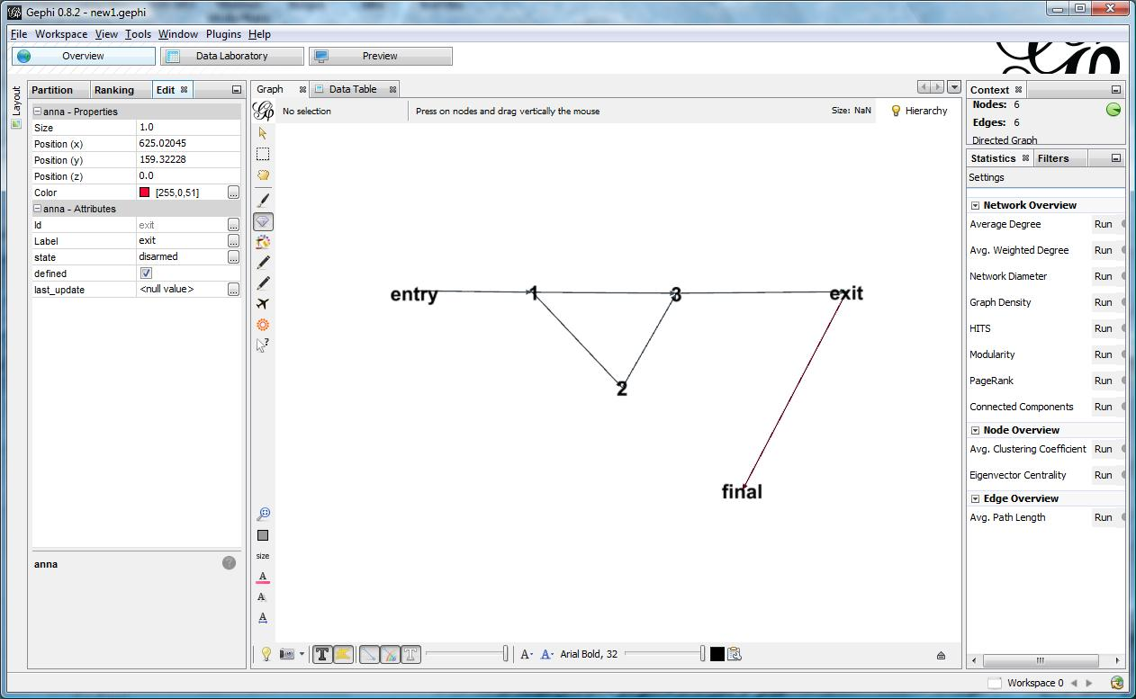
Backup slides: examples of workflow visualization and editing in GePhi

Slide 26
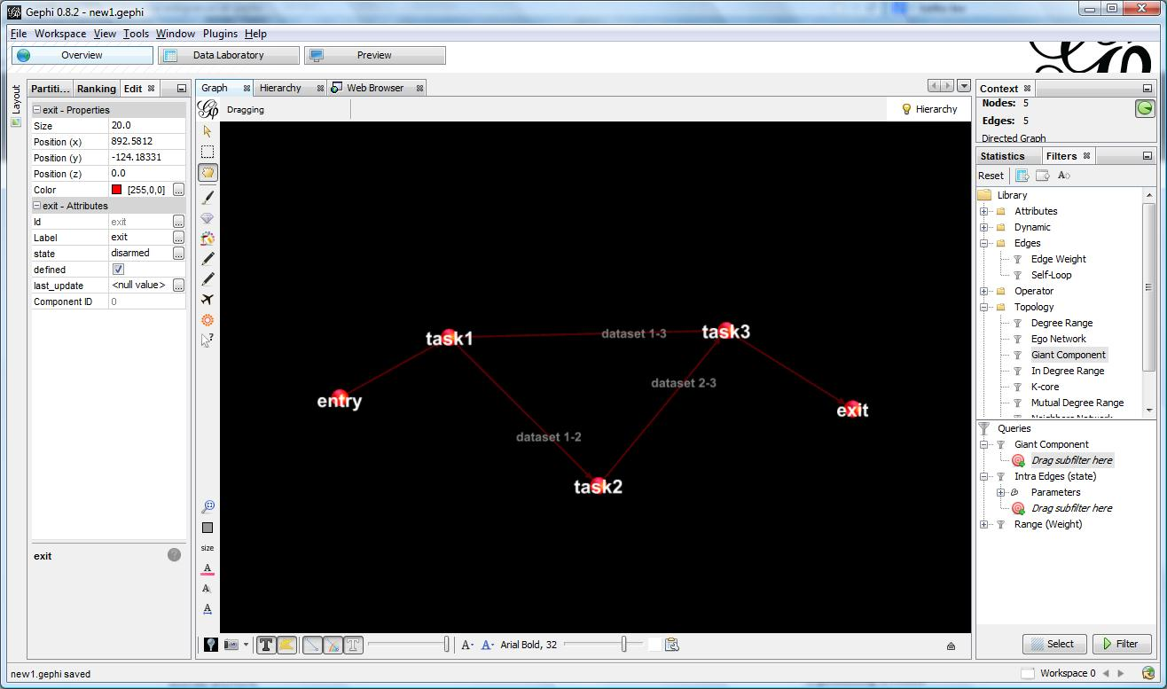
Backup slides: examples of workflow visualization and editing in GePhi

Slide 27
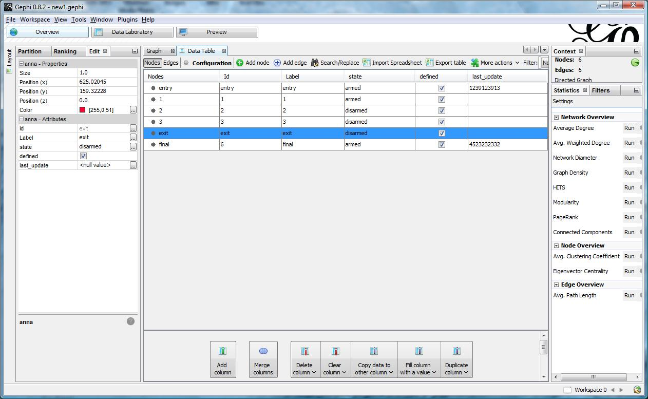
Backup slides: examples of workflow visualization and editing in GePhi

Slide 28
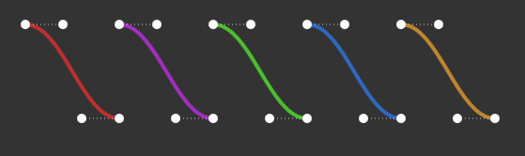
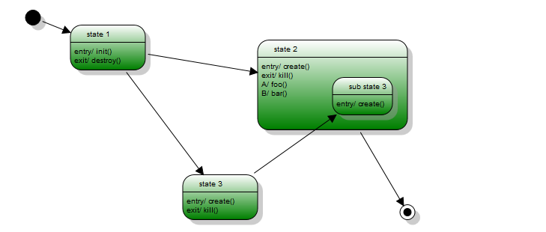
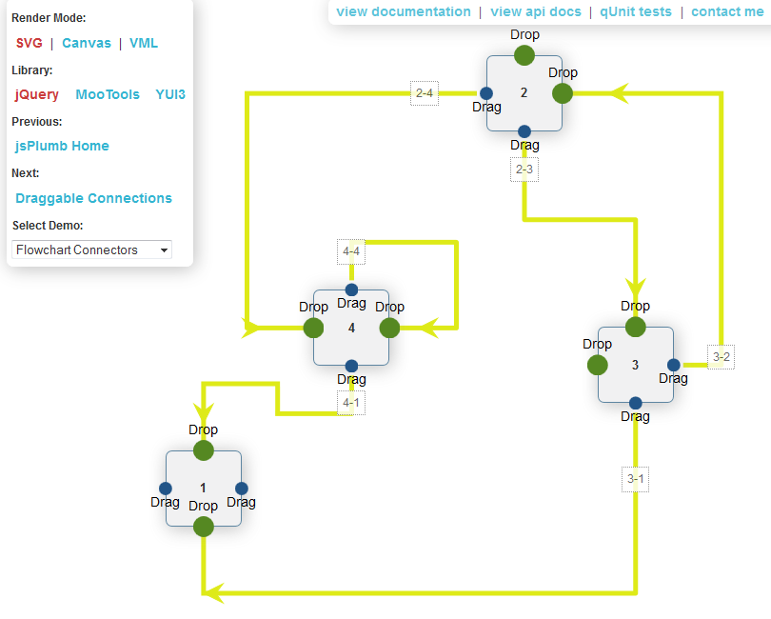
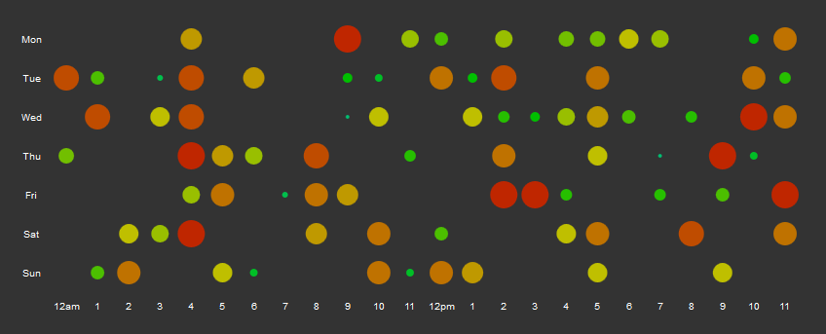
Backup slides: examples of Javascript tools to aid in building Meta-Task GUI in DEFT

