Slide 1
Event Service
Torre Wenaus, BNL
Thanks to K. De, P. Calafiura, T. Maeno, D. Malon, P. Nilsson, V. Tsulaia, P. Van Gemmeren, R. Vitillo et al for input
ADC TEG Meeting, Tokyo
May 16, 2013

Slide 2
Opportunistic resources: an important means of expanding our computing throughput
HLT during LS1, and opportunistically after LS1
Allocations on supercomputers (HPC)
  Over-engineered for us but we can soak up free cycles opportunistically
    In the US for example our funding agencies are insistent that we do so – we are high-profile science
  Free research clouds, commercial clouds
    More/cheaper resources available if we can be highly opportunistic (e.g. Amazon spot market)
Others we haven’t explored yet
  e.g. ‘ATLAS@Home’ via BOINC?
  By one estimate, BOINC = ~500k volunteer computers, ~7 Petaflops, ~$5M/hour in ‘Amazon EC2 dollars’
    (from Eric Lancon heard at a FR-cloud meeting in Beijing)

Slide 3
Leveraging opportunistic resources
Common characteristic to these opportunistic resources: we have to be agile in how we use them
  Quick onto them (software, data and workloads) when they become available
  Quick off them when they’re about to disappear
  Robust against their disappearing under us with no notice
  Use them until they disappear – don’t allow holes with unused cycles, fill them with fine grained workloads
Means of enabling agile use of opportunistic resources: an event service

Slide 4
Event Service
JEDI brings event-level workflow management
  Event server support is part of the JEDI design
Tasks and jobs are managed in terms of events processed/to be processed
Invites allocating work to pilots that way, rather than allocating work in bulk (input files or big chunks of input files)
Serve pilots/payloads a steady stream of events, and send outputs back in a steady stream
  Well suited to opportunistic resources: no heavy data prestaging, and we can make a hasty exit, losing almost nothing
Predicated on workable event streaming: effective WAN data access is essential, preferably buffered by async caching

Slide 5
Event Service and Core Software
Just as JEDI is an enabler for the event server scheme on the grid side, athenaMP and associated I/O developments and optimizations are enablers on the core sw side
  Queueing and streaming events to be consumed by workers
  I/O optimizations making event reading over WAN practical
  Asynchronous pre-fetch to remove network latencies from processing workflow
Event server support being actively worked by core services/event I/O experts

Slide 6
Other event service advantages
Avoid idle cores in athenaMP processing – if parallel threads process events in large chunks (files), cores can sit idle while the slowest one completes
DDM simplification – no DDM involvement on input or output
Output merging flexible and simple: file size is tunable, aggregation of outputs to merge site proceeds concurrently with processing, JEDI knows when to trigger merge
A crash doesn’t lose the job, only a few events which will be re-dispatched

Slide 7
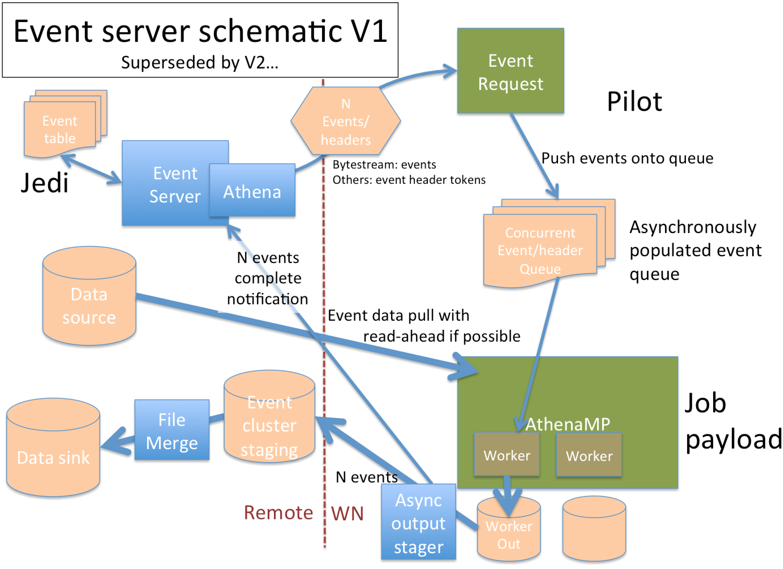
Developing the scheme
Initial scheme from Borut and Andrej, 6/2011
Agreed to be integral to Prodsys2 design at Ljubljana meeting 6/2012
Informal discussions in subsequent months: ADC, core framework, event I/O
Design V1 sketched out at 3/13 S&C week
Subsequently elaborated, latest discussion last week

Slide 8
Event server schematic V2
May 2013
Event list
Request
Pilot
Event
list
JEDI
Event table
JEDI
Event list
Dispatcher
Pass event list for header/data fetch
http/get to dispatcher
Event header/data
Fetch
Event index
N Events/
headers
http/get to event server
Returns:
Bytestream: events
Other: event header tokens
Push events
onto queue
Event
Server
Athena
evReader
N events
complete
notification
yampl
Data sources
SE
Data sources
Data sources
SE
Event data pull with
read-ahead if possible
Asynchronous event queue
JEDI creates
merge job
AthenaMP
Job
payload
Data sink
SE
File Merge
PanDA
job
Event cluster
staging
WebDav?
Async
output
stager
Worker
Worker
Worker Out
Output aggregation site
N events
Remote
WN

Slide 9
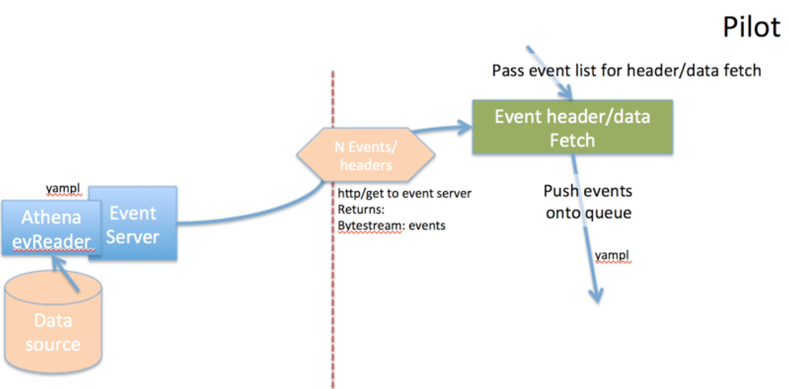
Prototype Status (reported last week)
V. Tsulaia, R. Vitillo, P. Van Gemmeren

Slide 10
Prototype Status
Prototype of the event reader and the event server web service
Event reader reads (currently) bytestream events
Web server is stateless Apache python/WSGI service with RESTful API
At startup the event reader creates a YAMPL (message passing) channel to the event server web service, listening for requests
When request is received from web service, it reads the requested event data from file and constructs a buffer sent over YAMPL to the web service, and thence to the requestor (pilot)
Pilot client is emulated by curl
V. Tsulaia, R. Vitillo, P. Van Gemmeren

Slide 11
Issues – How to send events
Send full events (as in prototype) or just event addresses (headers/tokens) from the event server?
  Full events makes for fewer client/server interactions. But…
  Increases substantially the scaling requirements for the event server (moving MBs instead of kB)
  Loses opportunity for dispersing data retrieval for scalability, and leveraging direct access (FAX)
For now at least, agreed to send event addresses; events will be retrieved from the client (pilot+athena) in a subsequent step

Slide 12
Issues – Scope/scale/role of event server
Event reader has to resolve an event ID from JEDI into headers/tokens rendering the event retrievable
Obvious (current) way is for event reader to read the actual file (so should be colocated with the data or will expose WAN latencies in ID->token resolution)
Colocation is rather a big demerit – would be preferable to have many fewer event service instances than there are data repository Ses
Colocation & file open unnecessary if we have an Event Index
  Direct, remote, fast ID->token resolution
  Lookup could even be done by the pilot, eliminating need for event reader service?

Slide 13
Issues – Managing outputs
Outputs must be managed in a near real time, granular way just as inputs are, in order to reap full benefits
  Minimal losses in case of sudden eviction from or disappearance of opportunistic resource
  Output aggregation and monitoring can proceed concurrently with task processing
Present concept:
  athenaMP workers write few-event files to WN output directory
  Watching monitor thread picks up event files and sends them to (webDAV?) aggregation point associated with the WN’s CE (may not be local; e.g. may be at T1). On successful transfer, notifies JEDI that those events are processed; JEDI so records in the bookkeeping
  JEDI knows state of completion and decides when to submit PanDA job for merging of event files

Slide 14
Issues – Pilot aspects
Adapt present ‘job dispatch’ stage to retrieve the job configuration to be used (determining what sort of event processing athenaMP is to be configured for)
  A given pilot+payload will not be reconfigurable for a different processing type, at least initially
New ‘event dispatch’ stage to iteratively request events
  A runEvent module analogous to existing runJob
Adapt RunJob to new event consumer role
Output watcher/completion reporter as a new ‘monitoring’ thread parallel to payload execution
Need testing scheme – HC jobs + dev pilot?

Slide 15
Prototype next steps (Vakho, Roberto)
Agree on message content, format between JEDI, event server for communicating event IDs, e.g. include file ID in the request
Start implementing a new AthenaMP tool, which will work with events received from the pilot and pass the events to the workers
  NB! Presently we cannot run Athena job with no input file. This would require serious cleanup/modifications in various places.
  So, for the time being the AthenaMP job will be given some input RAW file only to start, initialize and then switch to the "waiting” mode for events from the pilot
Look at some scalability aspects of the event server/reader
  Currently the Apache server dynamically tunes the number of processes, which encapsulate the web service, based on the number of pending requests. We need to see how this scales for hundreds or thousands of requests
  Will need to see how many reader applications we can afford running simultaneously. Just one reader serving thousands of services will clearly create a bottleneck, running thousands of readers accessing disk simultaneously is not going to work either. [Considerations that make using Event Index attractive.]

Slide 16
Conclusion
Prodsys2 is designed to enable efficient & flexible resource usage in the (even more) heterogeneous computing environment we’re entering – multicore, serial, opportunistic, HPC, …
Together with concurrency-directed core software work, it enables event servers for efficient use of these resources
Leverages existing work in athenaMP, event I/O optimization, and FAX
Effective WAN direct access to data is an enabler and a prerequisite
Prototyping and development under way (as other priorities permit)
Plenty of issues to address (only a subset discussed here)

Slide 17
More Information
“ADC issues in concurrent processing and maximizing computing throughput”, T. Wenaus, March 2013 S&C Week

Slide 18
Supplemental

Slide 19
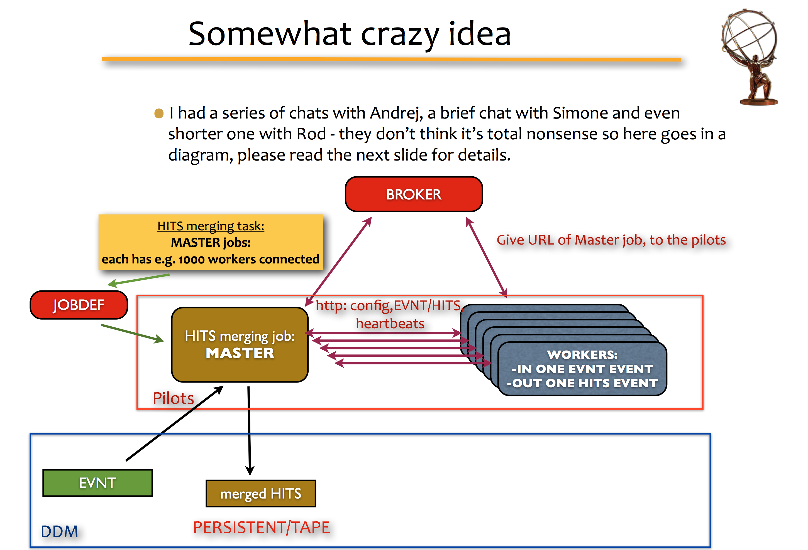
Genesis 6/2011
Borut, Andrej 6/2011

Slide 20
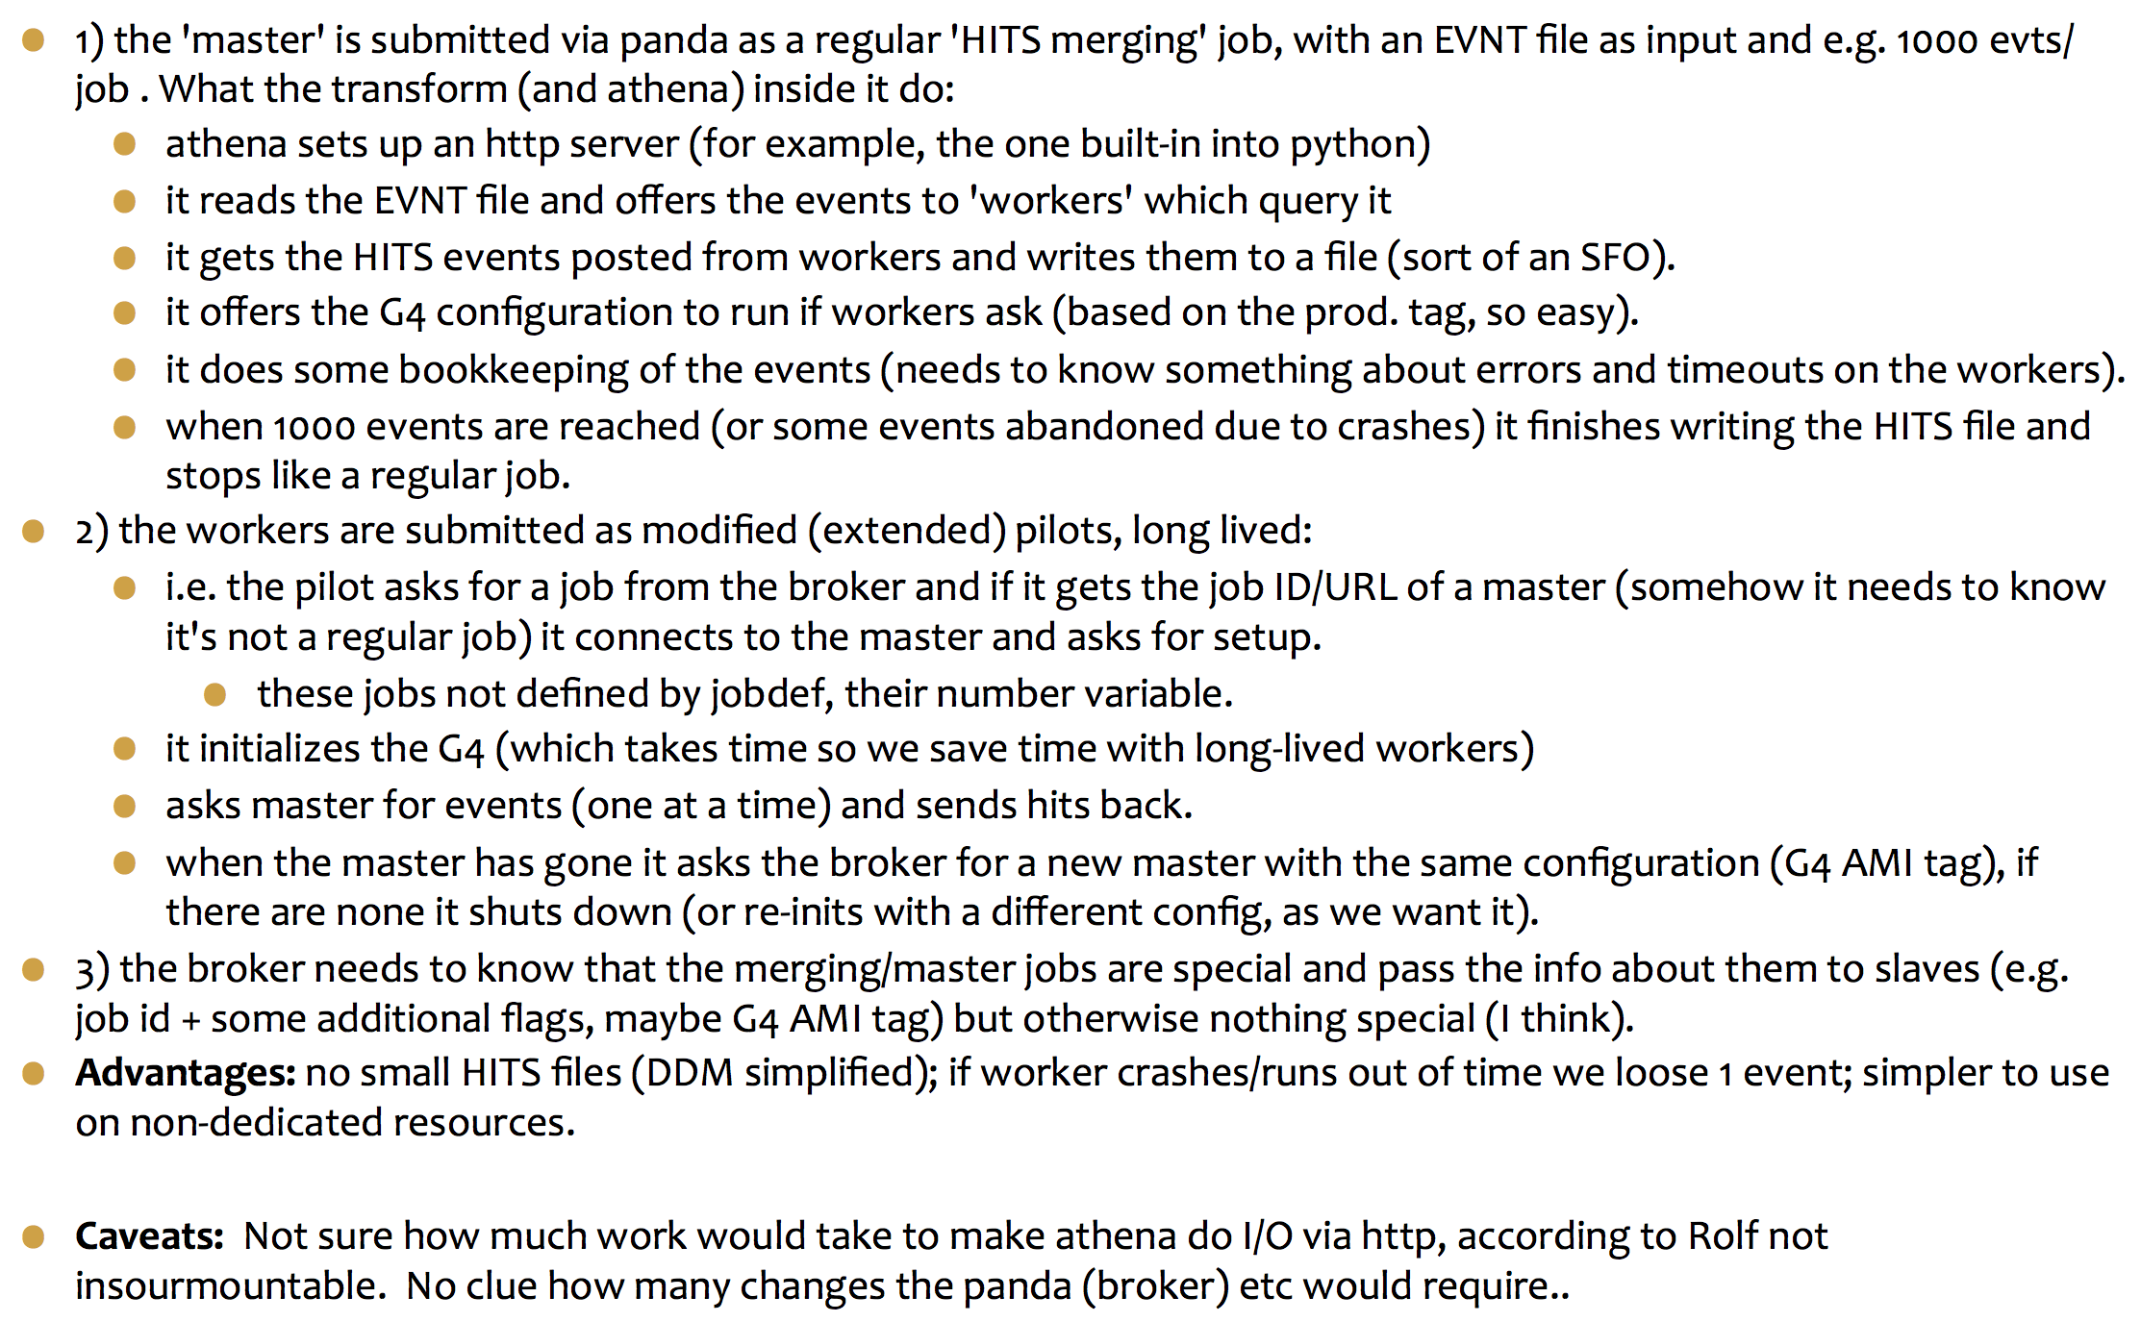
Somewhat crazy idea (2)
Genesis 6/2011
Borut, Andrej 6/2011

