Slide 1
ATLAS Network Use Cases
Simone Campana, CERN IT-SDC
ATLAS Technical Interchange Meeting, Tokyo 2013

Slide 2
Network Session at TIM
We discussed network related topics at TIM several times
Here we have the opportunity to go in the details of ATLAS network use cases and plans
TIM has a focus on the mid and long term evolution of ATLAS computing

Slide 3
ATLAS Network Use Cases
The rough picture
Planned replication
Replication on demand
WAN data access

Slide 4
Use Case I: planned replication
Consolidation of ATLAS data at T1s and T2s
  T0 data distribution to T1s and T2s
  Reprocessed data distribution from T1s to other T1s and T2s
Specs:
  Normally big files (order of GB), could be large data volume (up to PB)
  Can be predicted/scheduled/throttled
  Benefits of high bandwidth connections, latency irrelevant
  Totally asynchronous: acceptable time of completion within days, as long as data gets there within system timeouts

Slide 5
Use Case II: replication on demand
Data replicated upon request from user or system
  Transfers of prodsys input/output
  PD2P when Nwaiting for a site is large
  DaTRI requests (analysis outputs, selected data replication)
Specs:
  Large spectrum of file sizes (from MB to GB), generally limited data volume (TB). Could be very bursty.
  Difficult to predict (on demand), in some cases can be steered/adapted to network topology.
  Need sufficient bandwidth, latency could be relevant
  Semi-(a)synchronous: acceptable time of completion within hours

Slide 6
WAN data access
Data access over the WAN at job runtime
  Today tightly coupled with Federated Data Access
Specs
  Normally large files (GB), small to large data volume depending on the scenario
  Impossible to predict by construction
  Not necessarily WAN bandwidth is the main concern. Watch out for hotspots, campus network congestion, storage congestion, latency
  Totally synchronous: acceptable time of completion within minutes/seconds (or less)

Slide 7
Dynamic Data Placement
PD2P is the perfect example to illustrate what I just described
  Should we reduce planned replication and favor more dynamic replication?
    PB scale but predictable vs TB scale but less predictable
  Should we reduce PD2P replication if jobs are waiting and simply fill free CPUs accessing data over the WAN?
    some delays, but more under control vs prompt CPU, chaotic data access)
Where we put the boundaries strongly depends on what we can get from the network

Slide 8
Adaptive vs Proactive
Which attitude should we have toward the network?
Adaptive: the network is what it is, we should simply use it
  Adapt the use case to the network
  Measure and complain if you do not get what you are supposed to get
Proactive: the use case is what it is
  We should be able to adapt the network to it (even on short timescale demand)

Slide 9
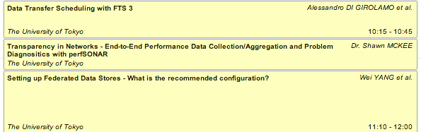
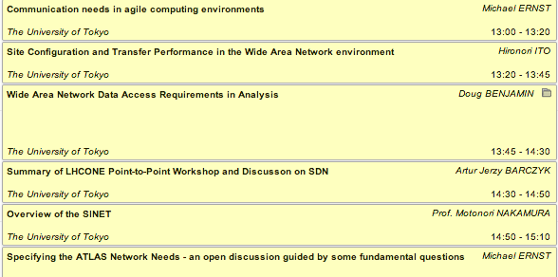
Today’s agenda

