Slide 1
FAX – infrastructure configuration and performance
Wahid Bhimji, University of Edinburgh
A couple of illustrative configuration examples from the UK
Mining monitoring data to see what things look like from the server side….

Slide 2
DPM sites
DPM sites all have their site and federation redirector on the “headnode” along with other services (e.g. SRM)
Data transfer requests (local or remote) are redirected to disk server itself so transfers benefit from full bandwidth
Several sites in UK using xrootd for local atlas traffic (initially copy – now some direct access)
External WN traffic often goes through NAT
Most UK sites have 10Gig links to WAN and disk servers
Some also have 10 Gig to WNs – e.g. Glasgow:
80 Gbs
10 Gbs
multi
1 Gbs
multi
WAN
Glasgow Locals: Sam Skipsey, David Crooks

Slide 3
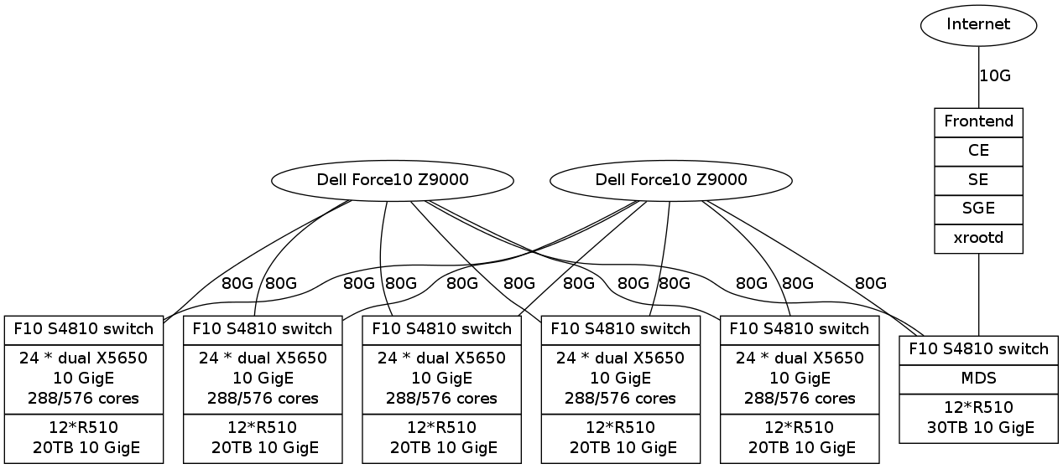
QMUL – Lustre and Storm
Highly optimized local access via Lustre will outperform xrootd access in current setup
Local jobs reading from Lustre filesystem get the benefit of 10gig connections for WNs and the 100 disk servers
Single xrootd server can only get 1/100 of this bandwidth to the servers.
Xrootd not integrated with StoRM – r/o access for xrootd in atlas group.
Traffic to WAN goes through a NAT.
QMUL Local: Chris Walker

Slide 4
Performance measurement data mining…
Source: see, for example, this GDB talk. Comes from UDP stream from every xrootd server at every site.
Monitoring FAX traffic, and also local traffic if xrootd is used (e.g. ECDF (Edinburgh), Glasgow and CERN)
Lots of plots obtainable from dashboard
Here we do some analysis on the raw data
  Provided from db by Domenico Giordano and Alexandre Beche
  Will have an interface to dump such raw data from dashboard
Metrics used along the lines described in: “Metrics for I/O pattern studies” talk in WLCG I/O and Benchmarking WG…. (and subsequent EOS (log file based studies): e.g. Throughput; Read Ratio, Read operations, Vector reads…

Slide 5
General observations
Tests are a significant part of current FAX data
  So “spikes” can be these rather than user activity.
  Can provide an extra angle on Ilija and HC tests .
Non-EOS non-Fax traffic has a lot of xrdcp – though some DPM sites recently moving to direct access for Analy queues
Missing data mid-Apr; Some sites not sending all info (e.g. Glasgow). No detailed info on reads for EOS
  Will get more stable – but means for now I have no good comparison of server side for the Johannes/Simone HC tests.
  Client_domain same as server one for dpm hosts and other minor bugs

Slide 6
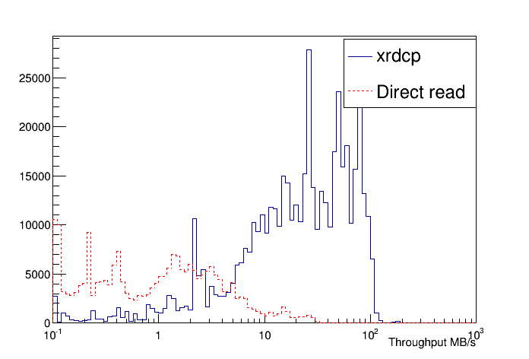
Throughput : Edinburgh (DPM) : (Direct and copy traffic)
“xrdcp” are those where read exactly equals filesize – probably copies

Slide 7
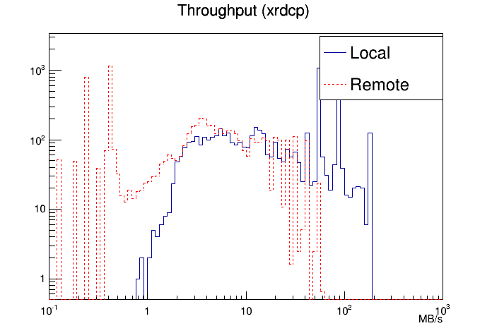
Throughput: QMUL (Lustre and Storm): Local and Remote
(xrdcp)

Slide 8
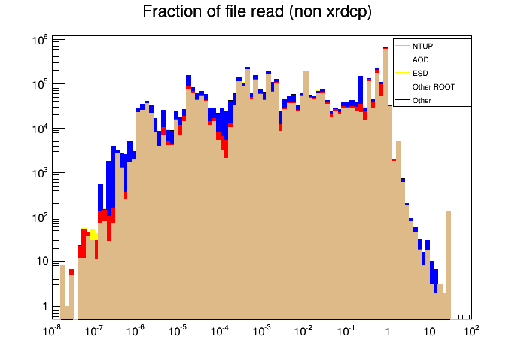
All sites except CERN

Slide 9
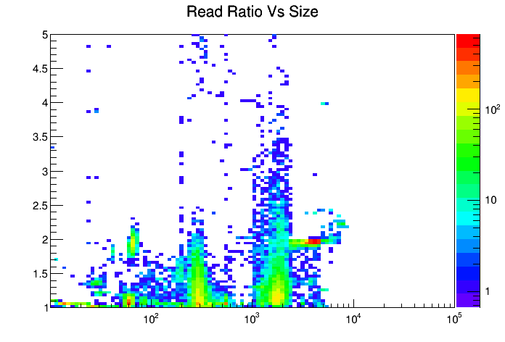
File Size / MB

Slide 10
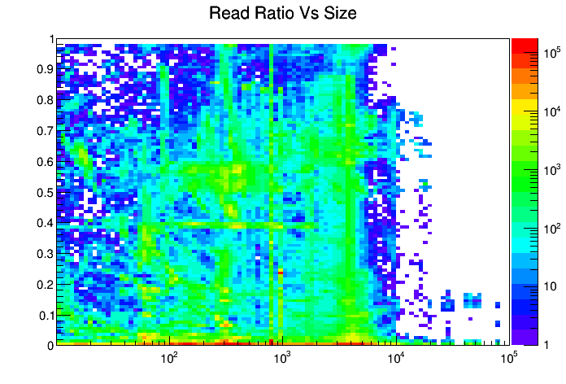
ReadRatio < 1
File Size / MB
Reading small fractions not a bad thing.
Reading 10% events with TTreeCache (e.g. Ilija’s tests) gives a read ratio near 100%:

Slide 11
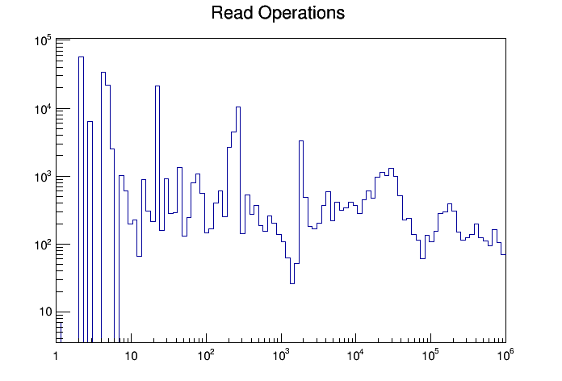
ECDF
Jobs with up to a million read operations

Slide 12
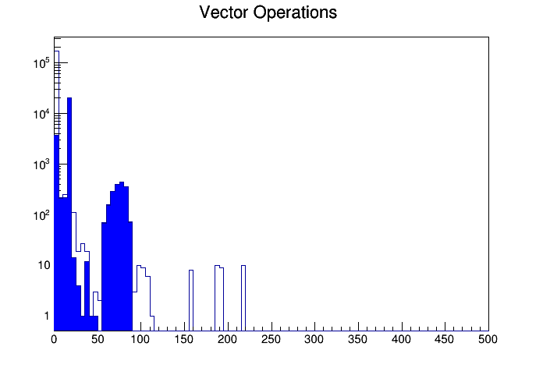
ECDF
Most jobs have 0 vector operations (so not using TTC)
Some jobs do use it (but these mostly tests (shaded blue))

Slide 13
Conclusions
Having this performance data is awesome ;-)
Many sites currently configured for local access rather than remote.
Throughput numbers appear low (may not be related). Current jobs are doing OKish though ….
Large no. of jobs with low read ratios suggest more direct access would conserve bandwidth
Jobs which read files multiple times, have high no. of read operations (and low bandwidth) are concerning:
  If we can force bulk of traffic to well behaved applications: (e.g central skim/slim service or app., athena, proot) then we will be better off.
Todo:
  Analysis of HC workloads;
  Suggestions for standard monitoring to add to dashboard
  User profiling (and contacting !) if user use grows.

