Slide 1
Transparency in Networks - End-to-End Performance Data Collection/Aggregation and Problem Diagnostics with perfSONAR-PS
Shawn McKee/University of Michigan
ATLAS Technical Interchange Meeting
Tokyo Japan
May 15th, 2013

Slide 2
Motivations and Considerations
I want to cover the broad topic of network monitoring, debugging. See my HEPiX talk for details at:
http://indico.cern.ch/getFile.py/access?contribId=45&sessionId=2&resId=0&materialId=slides&confId=220443
SUMMARY: ATLAS (and all distributed, data-intensive projects) critically depends upon the network
Network problems can be hard to diagnose and slow to fix
Standardizing on specific tools and methods allows larger groups to focus resources more effectively and better self-support (as well as benefiting from others work)
Performance issues involving the network are complicated by the number of components involved end-to-end. We need the ability to better isolate performance bottlenecks

Slide 3
Network Monitoring for ATLAS: Goals/Purpose
Goals:
  Find and isolate “network” problems; alerting in a timely way
  Characterize network use (base-lining)
  Provide a source of network metrics for higher level services
First step: get monitoring in place to create a baseline of the current situation between sites (see details later)
Next: continuing measurements to track the network, alerting on problems as they develop
Choice of a standard “tool/framework”: perfSONAR
perfSONAR’s main purpose is to aid in network diagnosis by quickly allowing users to isolate the location of problems. In addition it can provide a standard measurement of various network performance related metrics over time as well as “on-demand” tests.

Slide 4
Plans for WLCG Operations
Simone Campana and I are leading a WLCG (Worldwide LHC Computing Grid) operations task-force for perfSONAR:
  Encouraging all sites to deploy and register two instances
  All sites to use the “mesh” configuration (central configs)
  One set of test parameters to be used everywhere
  Site instructions (draft) at https://twiki.cern.ch/twiki/bin/view/LCG/PerfsonarDeployment
The current dashboard is being used as a central source for network information. This will continue but we need to make sure we are gathering the right metrics and making them easily accessible for our applications and infrastructure
  We need to encourage discussion about the types of metrics our frameworks and applications would like concerning the network

Slide 5
Current Status
Waiting on final release of perfSONAR-PS v3.3 which has numerous resiliency fixes and the ability to leverage central configurations for tests and test-sets (meshes).
  Originally targeted for release beginning of March 2013
  Now looks like the end of this month (May 2013)
ATLAS sites should be either already instrumented with prior versions of perfSONAR-PS or will be asked to do so as part of OSG and WLCG efforts.
We don’t yet have consistent, regular network metric gathering in place but we are very close

Slide 6
High Level perfSONAR-PS Issues
If we want to rely upon network metrics we need to be sure we understand what we are collecting and how we are collecting it.
  All sites should co-locate perfSONAR-PS instances with their storage resources (same subnet and switches)
  If some sites are not doing this we need to flag them appropriately
The complete set of metrics: latency/packet-loss, bandwidth and traceroute need to be collected on “important” paths
  Some test-sets (meshes) may end up with subsets depending upon impact
We know there are potential anomalous readings when testing between 10g and 1g instances. Need to flag those.
  perfSONAR-PS developers are aware of this issue but there is not yet a solution provided within the toolkit

Slide 7
Network Monitoring Deliverables
What does a perfSONAR deployment provide for us?
  We get measurements of the network behavior along relevant paths
  The system schedules non-conflicting tests between sites
The latency measurements provide one-way latency via NTP-synced clocks (74 byte packets at 10Hz; 5.9 kbits/s)
  More interesting is the measurement of packet-loss it provides. With 600 packets/minute we can see marginal paths via their loss metric
  Are latency measurements feasible amongst all WLCG sites?
The bandwidth measurements deliver an estimate of achievable bandwidth along paths
  Useful to set expectations and indicate problematic paths
  Tracking versus time provides a way to identify when problems start
  Comparison with ATLAS Dashboard can differentiate networks vs end-site problems
The traceroute measurements track routing changes

Slide 8
Configuration of Network Testing
One of the lessons learned from LHC use of perfSONAR-PS was that setting up and maintaining scheduled tests for the perfSONAR-PS toolkit instances was a challenge.
As sites changed, joined or left, every other site needed to update their configuration to change, add or remove tests.
  Labor intensive, slow to get all updates in place and gets worse as we increase the size of the deployments!
Aaron Brown/Internet2 provided a solution: the “mesh” configuration which allows sites to track a central configuration and update themselves when it changes.
http://www.usatlas.bnl.gov/twiki/bin/view/Projects/PerfSONAR_PS_Mesh
For current perfSONAR-PS deployments a set of patches and new RPMS needs to be installed to enable the mesh-config
V3.3 will have all functionality for the mesh built-in

Slide 9
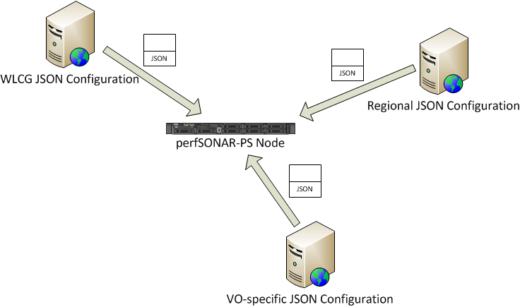
perfSONAR-PS Mesh Use Example
perfSONAR-PS toolkit instances can get their configuration information from a URL hosting an suitable JSON file
An agent_configuration.conf file on the PS node defines one or more URLs
The perfSONAR-PS instances can participate in more than one configuration (WLCG, Tier-1 cloud, VO-based, etc.)
The WLCG mesh configurations are hosted in AFS/HTTP at
/afs/cern.ch/project/gd/wlcg-ops/perfsonar/conf/
https://grid-deployment.web.cern.ch/grid-deployment/wlcg-ops/perfsonar/conf/

Slide 10
Network Test Details
Assuming we successfully deploy PS instances at all sites
  What tests do we want to run?
  How often and at what scale?
  Assuming we want different testing between ATLAS sites we will need to define which sites and test frequencies
WLCG planning:
  First priority scenario: intra-region tests
    One mesh per region, Bandwidth, Traceroute and Latency
    Plus the mesh of OPN sites
  Second priority scenario: T2s to T1s tests
    Each regional mesh against the OPN mesh
  Third priority scenario: inter-region tests
    The WLCG mesh: Each T2 against each T2

Slide 11
Gathering Network Metrics
As noted we intend to have perfSONAR-PS toolkit installations at ALL ATLAS/WLCG Tier-2 (and Tier-1) sites.
Each will gather the following network metrics:
  Latency (one-way delay) and packet loss (# lost / 600 packets/min)
  Achievable bandwidth (MB/sec) between source-destination
  Routing: using traceroute between host and all partners every 10 min
CHALLENGES:
  Need upcoming v3.3 of perfSONAR-PS installed at each site
  Need policy and configuration in place to define/coordinate tests
  Need centralized data gathering/display/alerting setup
  Must refine the system to optimize problem identification/isolation

Slide 12
perfSONAR-PS Policy and Configuration
The WLCG perfSONAR-PS TF is developing policy:
  Standard site naming
  Defining test parameters (duration, frequency)
  “Matrix” (mesh) configurations
    What coverage for what tests? WLCG-wide vs VO specific vs Geographical
We are documenting things on a Twiki so far:
https://twiki.cern.ch/twiki/bin/view/LCG/PerfsonarDeployment
ATLAS should provide any needed feedback on what is done (we have representatives on the task-force)
  Concerns or suggestions can be gathered during this talk and via email

Slide 13
ATLAS Specific Meshes?
Should ATLAS request some more detailed tests for “ATLAS” sites, regionally or inter-cloud?
Network testing frequency along specific paths should be correlated with “use” and “importance”. Certainly an ATLAS-only site would put higher priority on testing to another ATLAS site vs a CMS-only site and vice-versa
The mesh-configs planned will include all of WLCG (at low frequency), inter-cloud tests and “regional” tests
  Is “regional” of more than one flavor? E.g., USATLAS and USCMS as opposed to US-WLCG? Do we want to micro-manage by VO?

Slide 14
Debugging Network Problems
Using perfSONAR-PS we identify network problems by observing degradation in regular metrics for a particular “path”
  Packet-loss appearance in Latency tests
  Significant and persistent decrease in bandwidth
  Currently requires a “human” to trigger.
Next check for correlation with other metric changes between sites at either end and other sites (is the problem likely at one of the ends or in the middle?)
Correlate with paths and traceroute information. Something changed in the routing?

Slide 15
Modular Dashboard: Centralized Info
Having a large number of perfSONAR deployments is great for instrumenting our networks, but all these instances are not easy to track, summarize or use to better understand the overall network performance and status.
The current modular dashboard (developed by Tom Wlodek at BNL) is being used to track a large number of LHC perfSONAR-PS installations:
http://perfsonar.racf.bnl.gov:8080/exda/
The dashboard provides a highly configurable interface to monitor a set of perfSONAR-PS instances via simple plug-in test modules. Users can be authorized based upon their grid credentials. Sites, clouds, services, tests, alarms and hosts can be quickly added and controlled.
Very good for the user community but needed recoding…

Slide 16
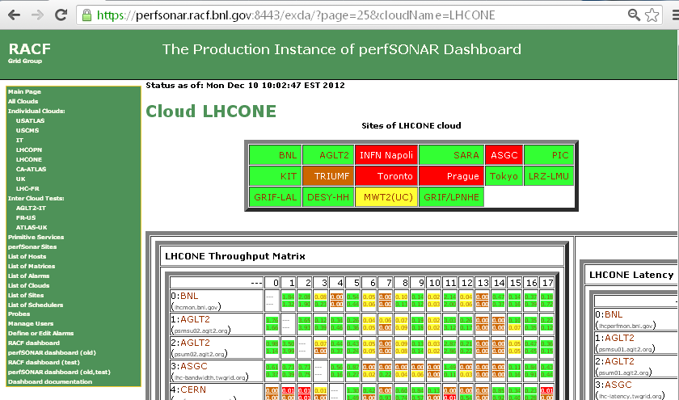
Example of Dashboard showing LHCONE
See https://perfsonar.racf.bnl.gov:8443/exda/?page=25&cloudName=LHCONE

Slide 17
perfSONAR Modular Dashboard Efforts
There is an ongoing effort to produce the next generation of the dashboard which is scalable and preserves the existing functionality of the current dashboard
  We have setup a new organization in GitHub: ‘PerfModDash’
  Code is now in GitHub under a modified BSD license:
  https://github.com/PerfModDash/PerfModDash
  Everyone interested is encouraged to participate
We need to discuss how to leverage this project for WLCG. OSG (as a subset of WLCG) plans to deploy this as a service to gather and provide network metrics for OSG sites
  Should WLCG also bring up such a service? (I think we need to)
  Can OSG host the complete WLCG service? (under discussion)

Slide 18
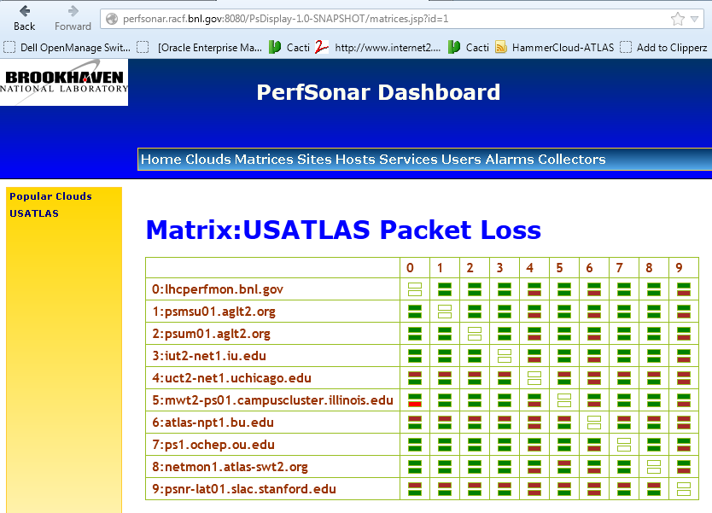
Example of New Dashboard
http://perfsonar.racf.bnl.gov:8080/PsDisplay-1.0-SNAPSHOT/matrices.jsp?id=1

Slide 19
Network Monitoring Challenges Ahead
Getting hardware/software platform installed at all sites
Dashboard development: Need additional effort to produce something suitable quickly and ensure it meets our needs…
Managing site and test configurations
  Testing and improving “centralized” (VO-based?) configurations
  Determining the right level of scheduled tests for a site, e.g., Tier-2s test to other same-cloud Tier-2s (and Tier-1)?
  Address 10G vs 1G tests that give misleading results
Improve path monitoring (traceroute) access within the tool
Alerting: A high-priority need but complicated:
  Alert who? Network issues could arise in any part of end-to-end path
  Alert when? Defining criteria for alert threshold. Primitive services are easier. Network test results more complicated to decide
Integration with VO infrastructures and applications

Slide 20
Improving perfSONAR-PS Deployments
Based upon the issues we have encountered we setup a Wiki to gather best practices and solutions to issues we have identified: http://www.usatlas.bnl.gov/twiki/bin/view/Projects/LHCperfSONAR
This page is shared with the perfSONAR-PS developers and we expect many of the “fixes” will be incorporated into future releases (most are in v3.3 already)
Improving resiliency (set-it-and-forget-it) a high priority. Instances should self-maintain and the infrastructure should be able to alert when services fail (OIM/GOCDB tests)
Please feel free to add to the Wiki (either directly or by emailing me updates/changes/additions).

Slide 21
Facility Use of Network Metrics
Once we have a source of network metrics being acquired we need to understand how best to incorporate those metrics into our facility operations.
Some possibilities:
  Characterizing paths with “costs” to better optimize decisions in workflow and data management (underway in ANSE)
  Noting when paths change and providing appropriate notification
  Optimizing data-access (FAX) or data-distribution (DDM) based upon a better understanding of the network between sites
  Identifying structural bottlenecks in need of remediation
  Aiding network problem diagnosis and speeding repairs
  In general, incorporating knowledge of the network into our processes
We will require testing and iteration to better understand when and where the network metrics are useful.

Slide 22
Summary
During 2012 we converged on getting a ‘standard’ network monitoring framework in place globally for WLCG sites
Both WLCG and OSG are focusing on getting robust installations of perfSONAR-PS in place to provide a single source of network metrics for their use.
There have been significant improvements in the perfSONAR-PS toolkit in response to issues noted during ATLAS and CMS use. Centralized management is now possible. Further improvements coming in v3.3
Modular dashboard critical for “visibility” into networks
Interesting times ahead as we complete deployments: How best to utilize the network metrics we gather? How best to debug network issues with this new framework in place?

Slide 23
Some Questions To Discuss
Alerting on services should be straightforward (service responds or not). Metrics are trickier. Can we identify effort to work on the task of alerting based upon PS metrics?
  Alerting is not only about “when” but about “who” to alert…
Centralized visualization is critical for making PS instances easily usable. Are there experts in GUIs who can work on the dashboard project to deliver a more effective interface? Are there existing interfaces we should integrate with?
How best to identify appropriate meshes to configure in WLCG? USATLAS and USCMS exist currently. What about LHCb or ALICE? What sub-meshes are needed in Tier-1 (or regional) clouds?

Slide 24
Discussion/Questions
Questions or Comments?

Slide 25
Relevant URLs
perfSONAR-PS site http://psps.perfsonar.net/
Install/configuration guide: http://code.google.com/p/perfsonar-ps/wiki/pSPerformanceToolkit33
Modular Dashboard: https://perfsonar.racf.bnl.gov:8443/exda/ or http://perfsonar.racf.bnl.gov:8080/exda/
Tools, tips and maintenance: http://www.usatlas.bnl.gov/twiki/bin/view/Projects/LHCperfSONAR
OSG networking pages https://www.opensciencegrid.org/bin/view/Documentation/NetworkingInOSG
GitHub perfSONAR Modular Dashboard: https://github.com/PerfModDash/PerfModDash
http://perfsonar.racf.bnl.gov:8080/PsDisplay-1.0-SNAPSHOT/matrices.jsp?id=1
WLCG Installs http://twiki.cern.ch/twiki/bin/view/LCG/PerfsonarDeployment

