Slide 1
Site Configuration and Transfer Performance in the Wide Area Network
Hironori Ito
Brookhaven National Laboratory

Slide 2
Current Transferring System
FTS : Transfer agent
  Transfer group by pre-determined channel
    Good
      Each dedicated channel is independent from other channel
    Bad
      Slow transfer from one of group channel site can prevent transfer to other sites.
        Particularly problematic for T1S-to-T2D transfer
          Increase in “transferring” backlog
            Sites get drained due to lack of assigned jobs
            Jobs failed due to timeout in transferring state
  Efficient
    Can easily fill the network pipe.

Slide 3
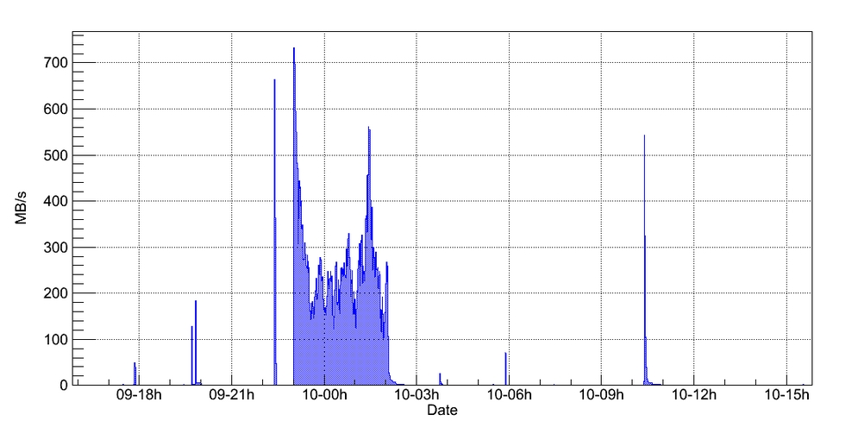
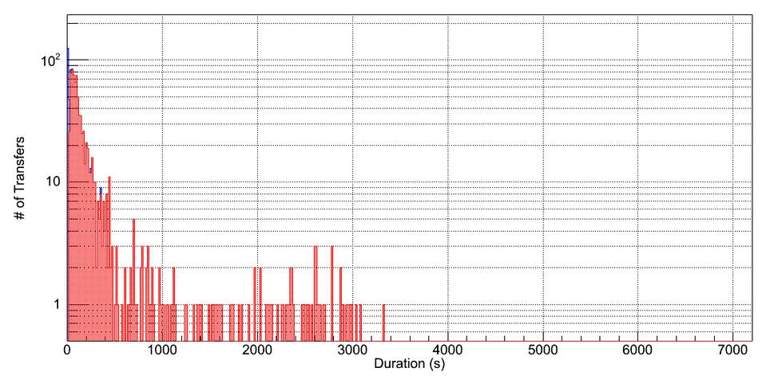
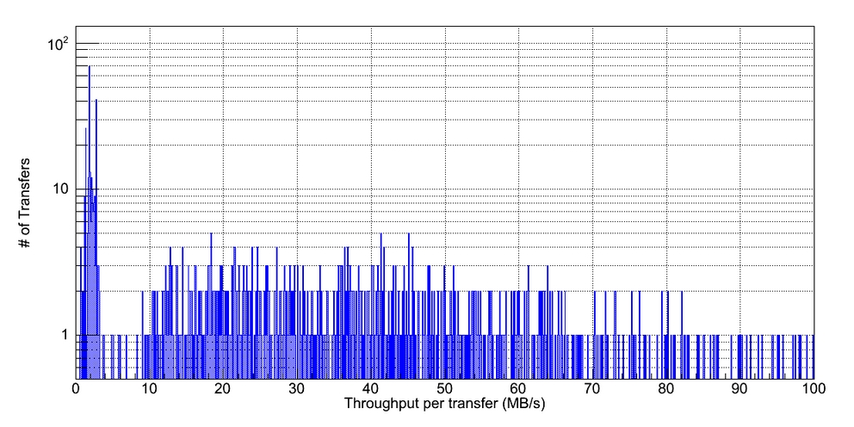
Good Case
Example: BNL to AGLT2
Over 700MB/s
Not many slow transfers
-- Sharp peaks
Reaching 100MB/s per individual file

Slide 4
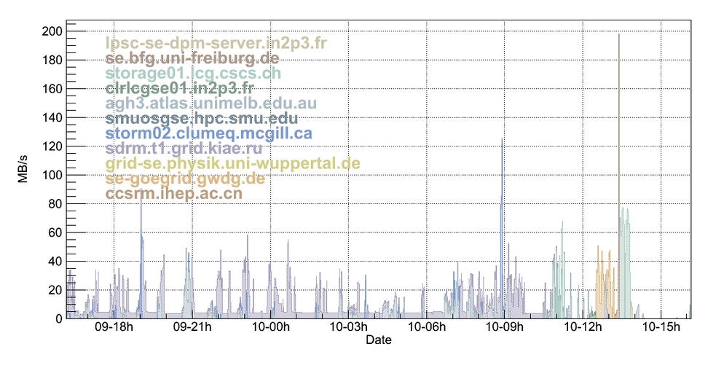
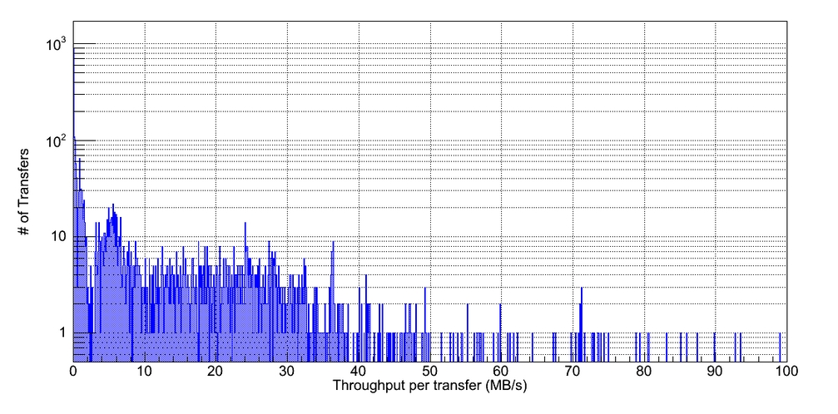
Bad Case
Example: STAR-BNL
Some very slow transfers using all available slots for long time.
Slow transfers
Slow transfers

Slide 5
Painful to identify the true cause of slow transfers
Identify slow transfers
Adjust FTS parameters
  Eg., FTS has rate based rejection
Identify if the cause is on disk-IO or network-IO
  Check memory-to-memory transfers by PerfSonar
  Check disk-to-disk transfer
  Visual aid could be really helpful

Slide 6
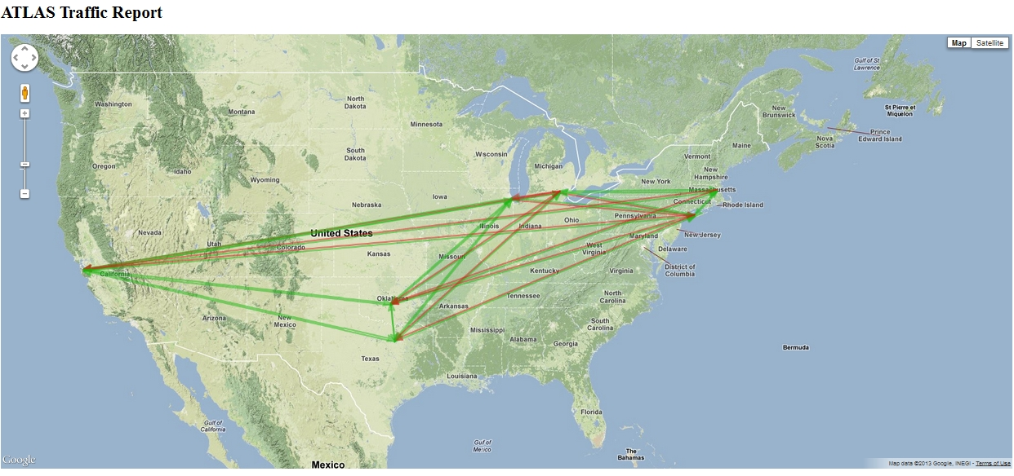
Idea of visual aid
http://www.usatlas.bnl.gov/dq2/perfthroughputs/currentStatus
Eastern sites: BNL, AGLT2 and NET2 have problems with SWT2
The problem is asymmetric
MWT2 does not have the problem.
Data is not current

Slide 7
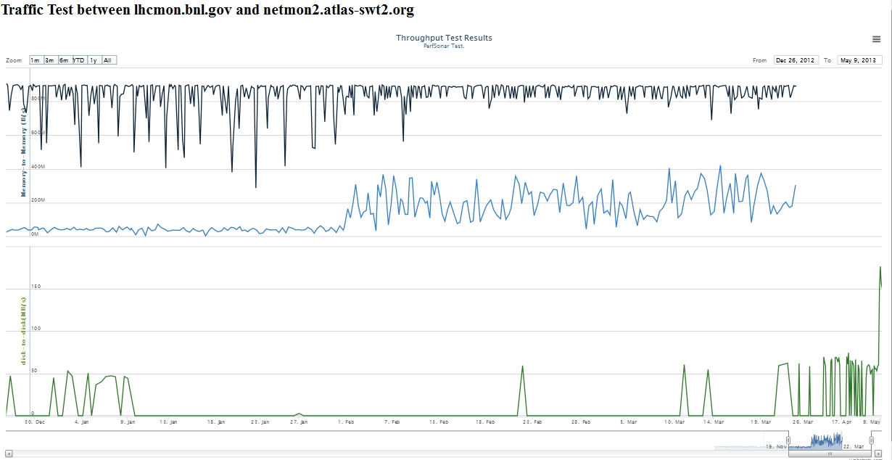
Disk-to-disk and M-to-M traffic test
Fixed
Asymmetric network path
Bad switches

Slide 8
Latency vs CPU Efficiency in analysis jobs
With FAX, the access to data by jobs becomes more transparent.
Jobs can use files from remote sites explicitly (via prun’s runlist) or unknowingly (via global/regional redirector).
In the case of jobs that sparsely read input data, the latency to the data has big impact.

Slide 9
Latency vs CPU Efficiency
A test with a job.
  Obtained from Doug as an example of codes used in top group.
  Run a job at BNL with input ntuple data located at various sites using xrootd interface
Input location | RTT | CPU Efficiency
RAM on WN | --- | 100%
DISK on WN | --- | 45%
RAM on site storage | 0.5ms | 75%
Site storage | 0.5ms | 35%
MWT2 storage | 29ms | 3.8%
AGLT2 storage | 34ms | 3.3%

Slide 10
Latency
Latency (network and disk-IO) kills CPU efficiency in sparse-read-IO jobs for even between sites with great throughput.
  Test was done with xRootd. If one uses http, it will be probably worse due to even more overhead. But, a test will be done.
Cache (if made) must be as close to a client location as possible to be effective.
Can data be less sparse for analysis jobs?

