Slide 1
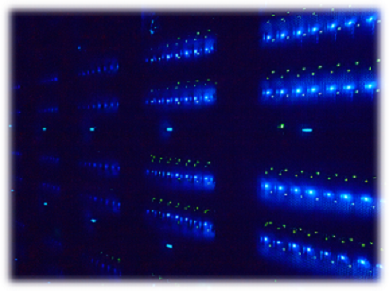

ICEPP regional analysis center
(TOKYO-LCG2)
ICEPP, The University of Tokyo

Slide 2
History of ICEPP regional analysis center
Discussion in the ATLAS-Japan group on the possibility of having a regional computing center in Japan.
1999: ICEPP, University of Tokyo decided to take the responsibility.
2001~2005: R&D work.
2005: Preparation of a computer room and an UPS room in School of Science Bldg. 1.
2006: Deployment of the first computer system (3-year lease for 2007-2009).
2009: Upgrade to the second system (3 year lease for 2010-2012).
Dec. 2012: Upgrade to the third system (3 year lease for 2013-2015).
Member
Tetsuro Mashimo (physicist): Local resource, CASTOR, Procurement, LSF
Nagataka Matsui (technical staff): Local resource, AFS, GPFS, LSF
Tomoaki Nakamura (physicist): Tier2 services, ATLAS analysis environment
Hiroshi Sakamoto (physicist): ADCoS leader for AP region
Ikuo Ueda (physicist): ADC operation
System engineers, 2FTEs by 3 persons (from company)

Slide 3
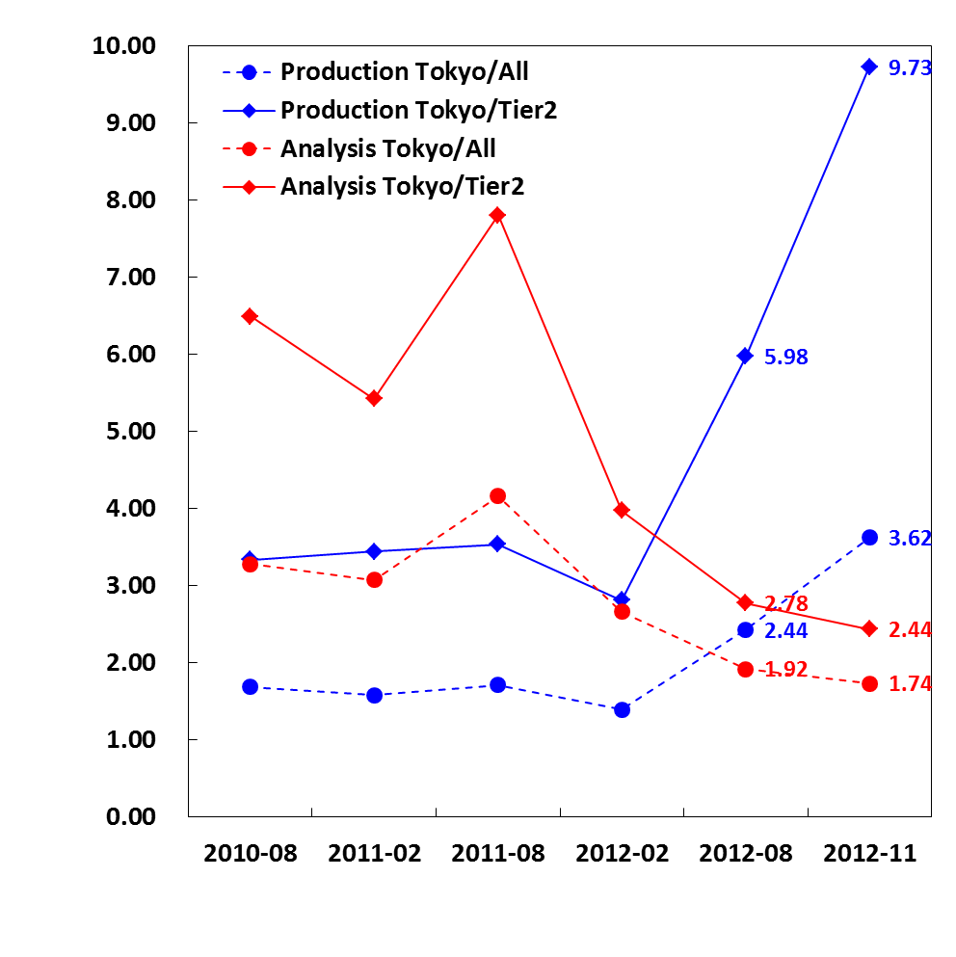
Contribution to ATLAS jobs
50 million ATLAS jobs have been completed per 6 months in WLCG for each production and analysis.
ATLAS collaboration: ~3000
ATLAS-Japan: ~110
Contribution target: 3~4%
The last bins indicates effect of extra contribution (2560 cores) only for the production jobs.
This is manly for the rush period for ICHEP2012.
Total 3712 cores were deployed by the end of 2012.
Fraction of completed jobs [%]
from Jun to Dec
[per 6 months]

Slide 4
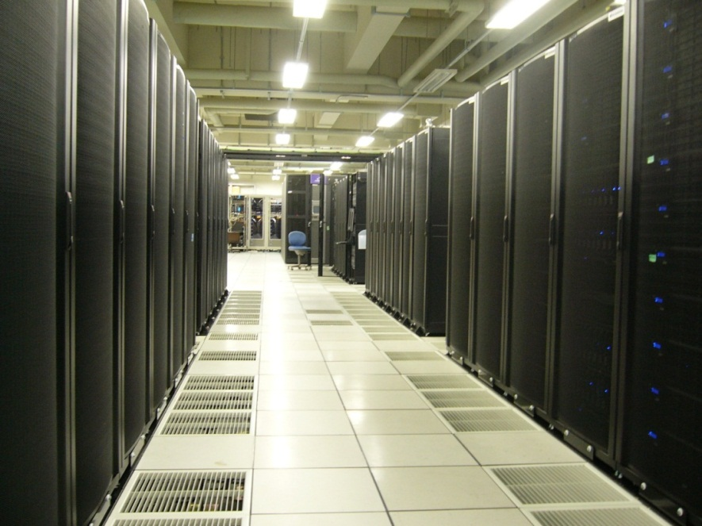
2nd system (2010 - 2012)
WNs
Disk Arrays
Disk Arrays
~270 m²

Slide 5
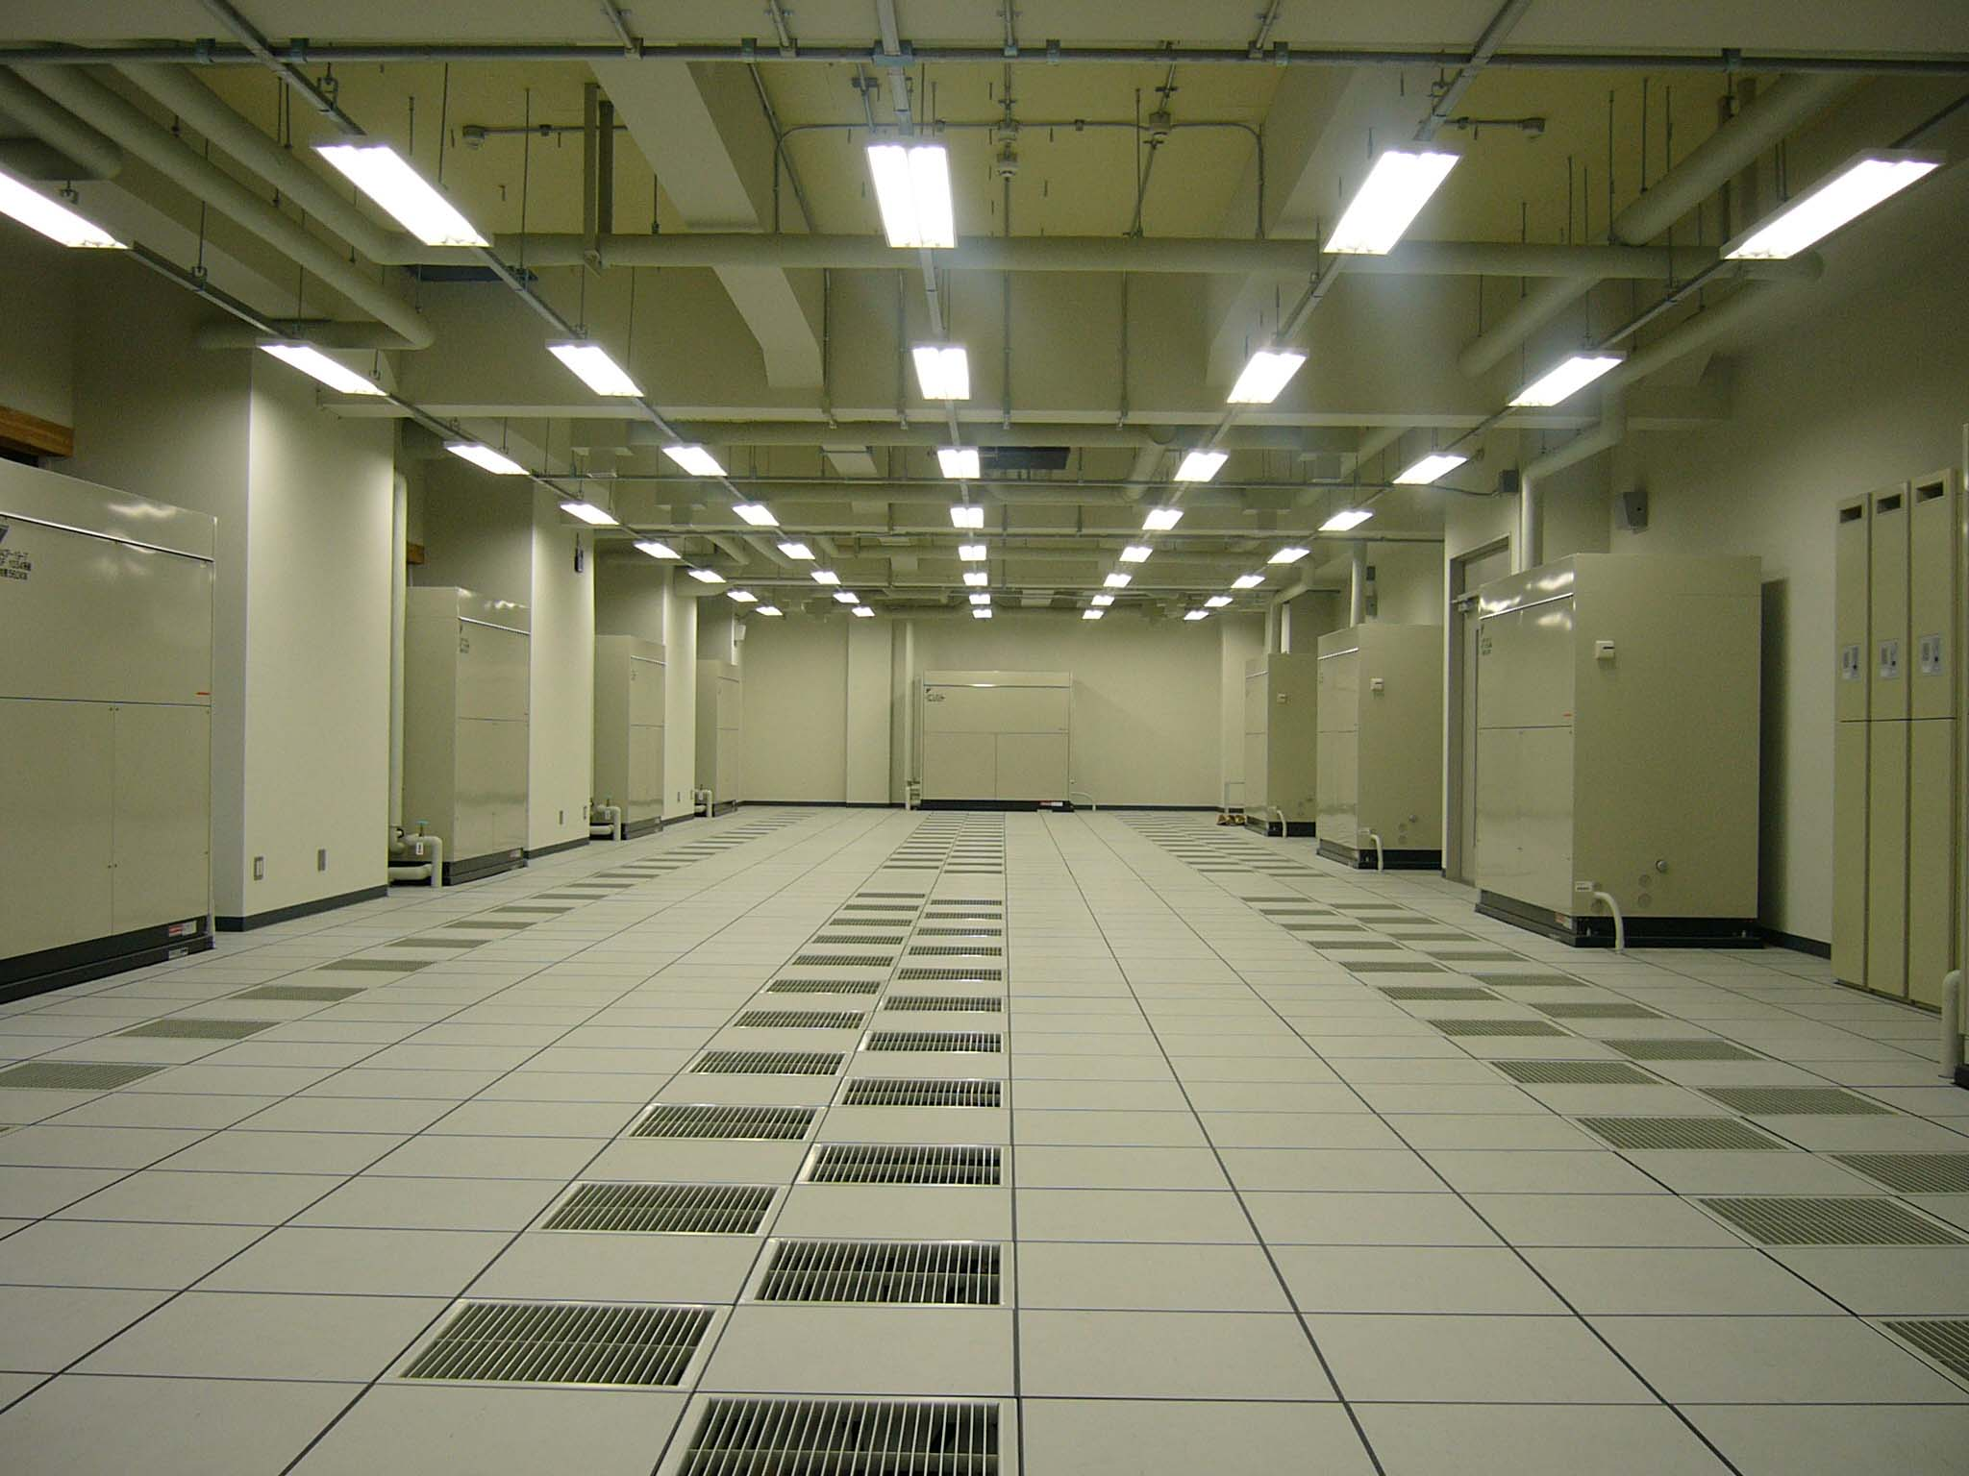
Removing almost all HWs in two days

Slide 6
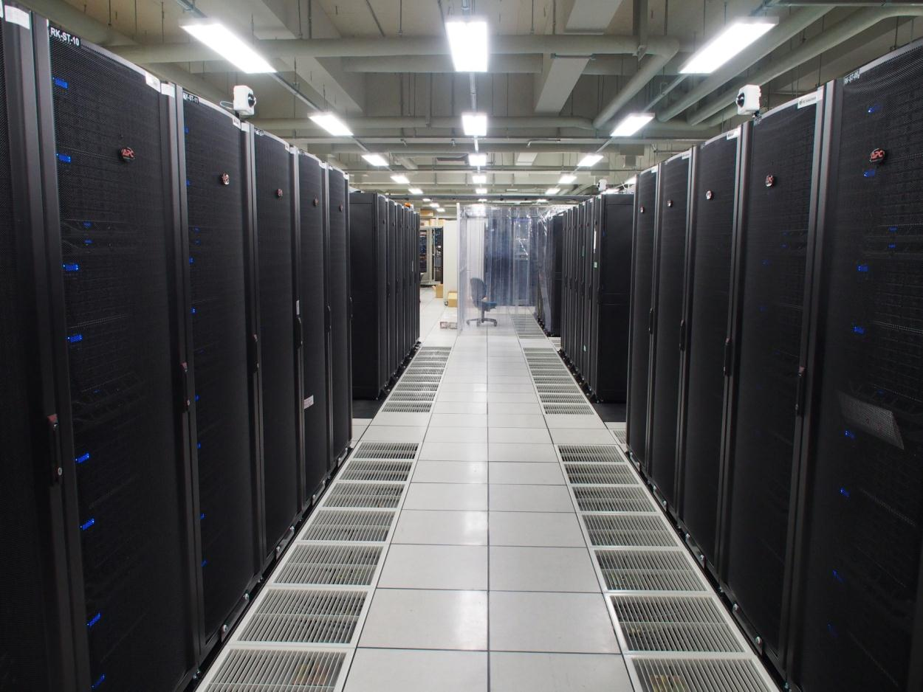
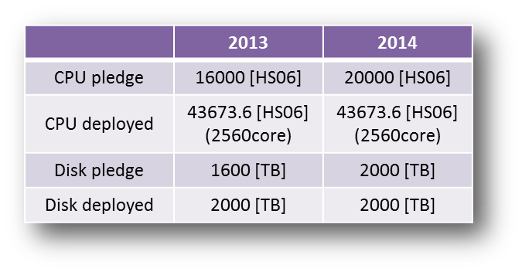
3rd system (2013 - 2015)

Slide 7
2nd system vs. 3rd system
 |  | 2nd system (2010-2012) | 3rd system (2013-2015)
Computing node | Total | Node: 720 nodes, 5720 cores (including service nodes) CPU: Intel Xeon X5560 (Nehalem 2.8GHz, 4 cores/CPU) | Node: 624 nodes, 9984 cores (including service nodes) CPU: Intel Xeon E5-2680 (Sandy Bridge 2.7GHz, 8cores/CPU)
 | Non-grid | Node: 96 (496) nodes, 768 (3968) cores Memory: 16GB/node NIC: 1Gbps/node Network BW: 20Gbps/16 nodes Disk: 300GB SAS x 2 | Node: 416-α nodes, 6656-α cores Memory: 16GB/node (to be upgraded) NIC: 10Gbps/node Network BW: 40Gbps/16 nodes Disk: 600GB SAS x 2
 | Tier2 | Node: 464 (144) nodes, 3712 (1152) cores Memory: 24GB/node NIC: 10Gbps/node Network BW: 30Gbps/16 nodes Disk: 300GB SAS x 2 | Node: 160+α nodes, 2560+α cores Memory: 32GB/node (to be upgraded) NIC: 10Gbps/node Network BW: 80Gbps/16 nodes Disk: 600GB SAS x 2
Disk storage | Total | Capacity: 5280TB (RAID6) Disk Array: 120 units (HDD: 2TB x 24) File Server: 64 nodes (blade) FC: 4Gbps/Disk, 8Gbps/FS | Capacity: 6732TB (RAID6) + additional disk Disk Array: 102 (3TB x 24) File Server: 102 nodes (1U) FC: 8Gbps/Disk, 8Gbps/FS
 | Non-grid | Mainly NFS | Mainly GPFS
 | Tier2 | DPM: 1.36PB (pledge 2012) | DPM: 2.64+α PB (pledge 2013/2014)
Network bandwidth | LAN | 10GE ports in switch: 192 Switch inter link: 80Gbps | 10GE ports in switch: 352 Switch inter link : 160Gbps
 | WAN | ICEPP-UTnet: 10Gbps (+10Gbps) SINIET-USA: 10Gbps x 2 ICEPP-EU: 10Gbps | ICEPP-UTNET: 10Gbps (+10Gbps) SINET-USA: 10Gbps x 3 ICEPP-EU: 10Gbps (+10Gbps) LHCONE

Slide 8
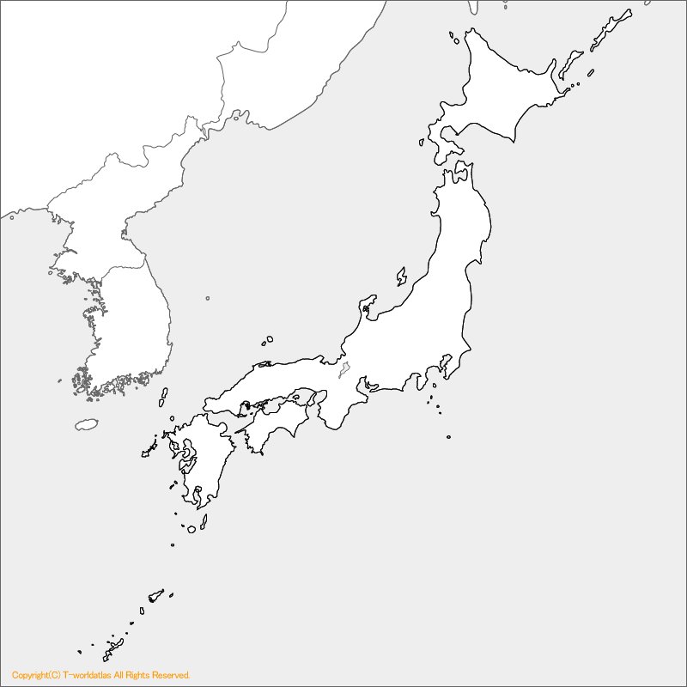
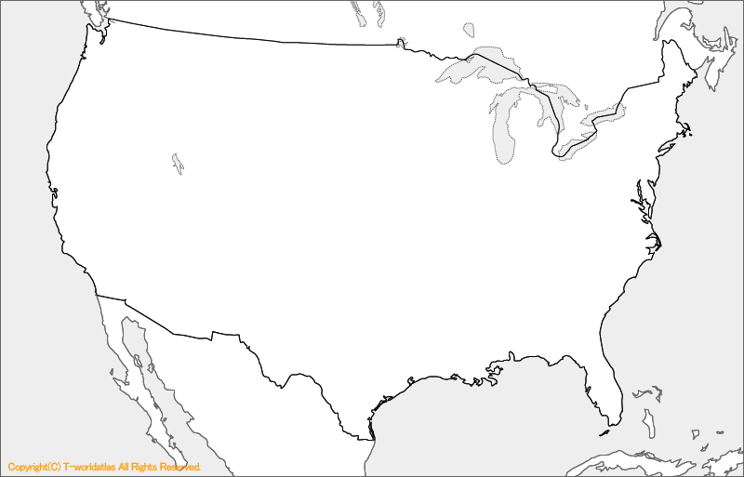




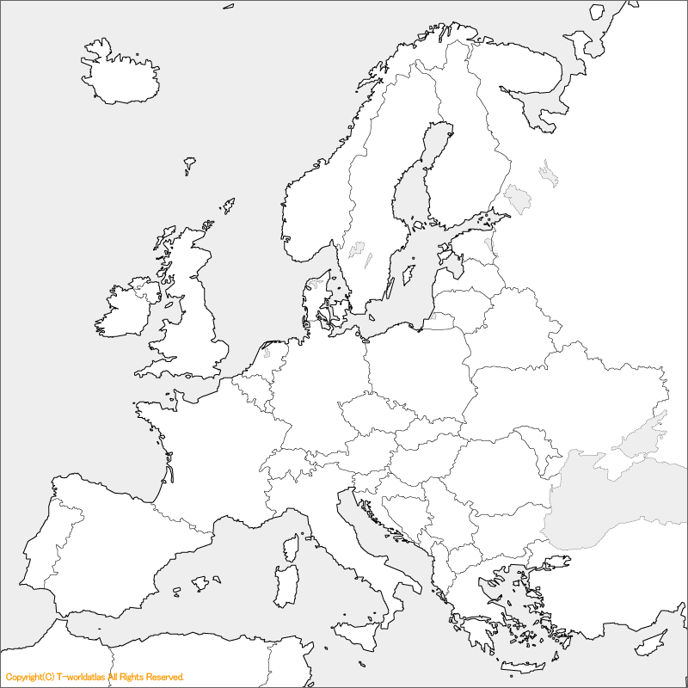

WAN for TOKYO
ASGC
Pacific
Atlantic
TOKYO
10Gbps
TRIUMF
40Gbps
NDGF
OSAKA
10Gbps
LA
SARA
NIKEF
WIX
BNL
40Gbps
Amsterdam
14:50 Overview of the SINET 20'
14:50 Overview of the SINET 20'
Additional new line (10Gbps)
from the end of March 2013
20 Gbps
Geneva
RAL
CCIN2P3
CERN
CANF
PIC
10 Gbps
14:50 Overview of the SINET 20'
Speaker: Prof. Motonori Nakamura (NII)
Dedicated line

