Slide 1
Logistics

Slide 2
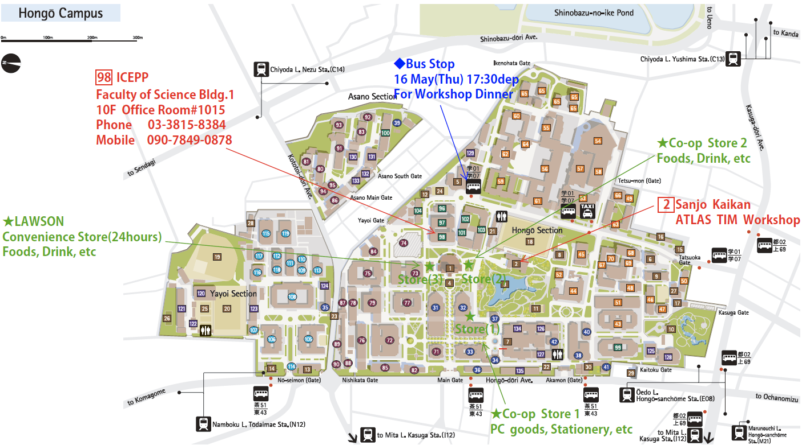

Slide 3
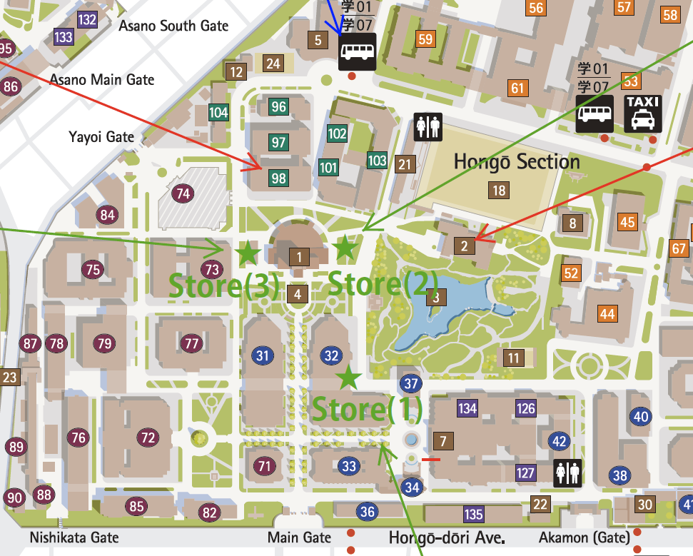
ICEPP, Sci Bld #1
Sanjo Kaikan
Smoking area

Slide 4
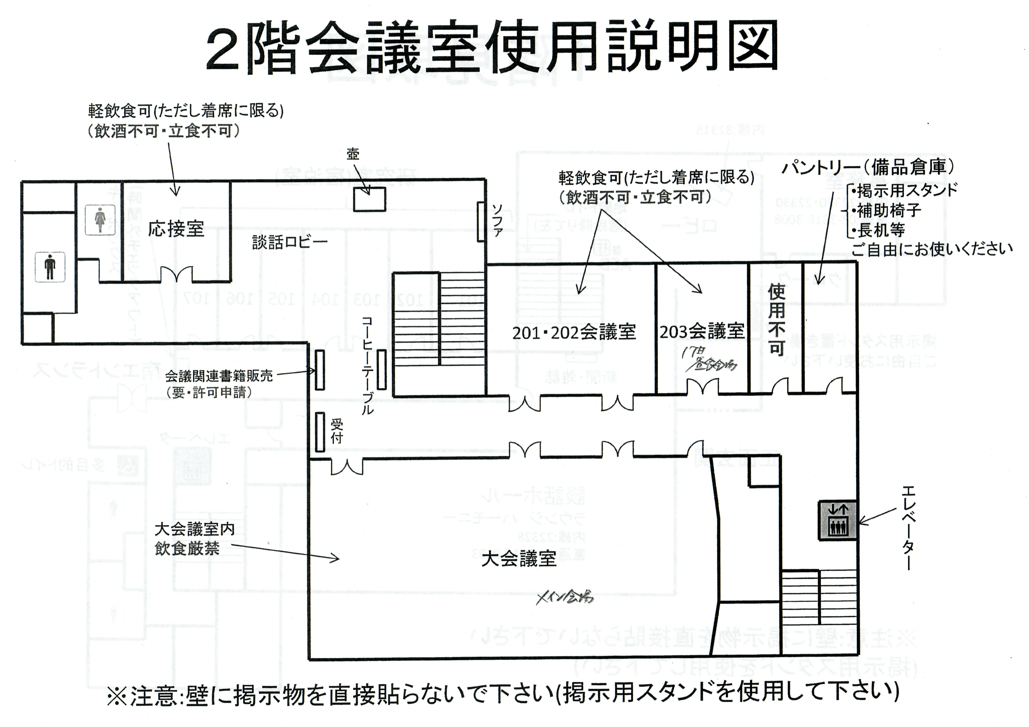
2nd Floor
Lunch room #1 (May 17th)
Coffee/Tea
Conference Room
No food, no drink please

Slide 5
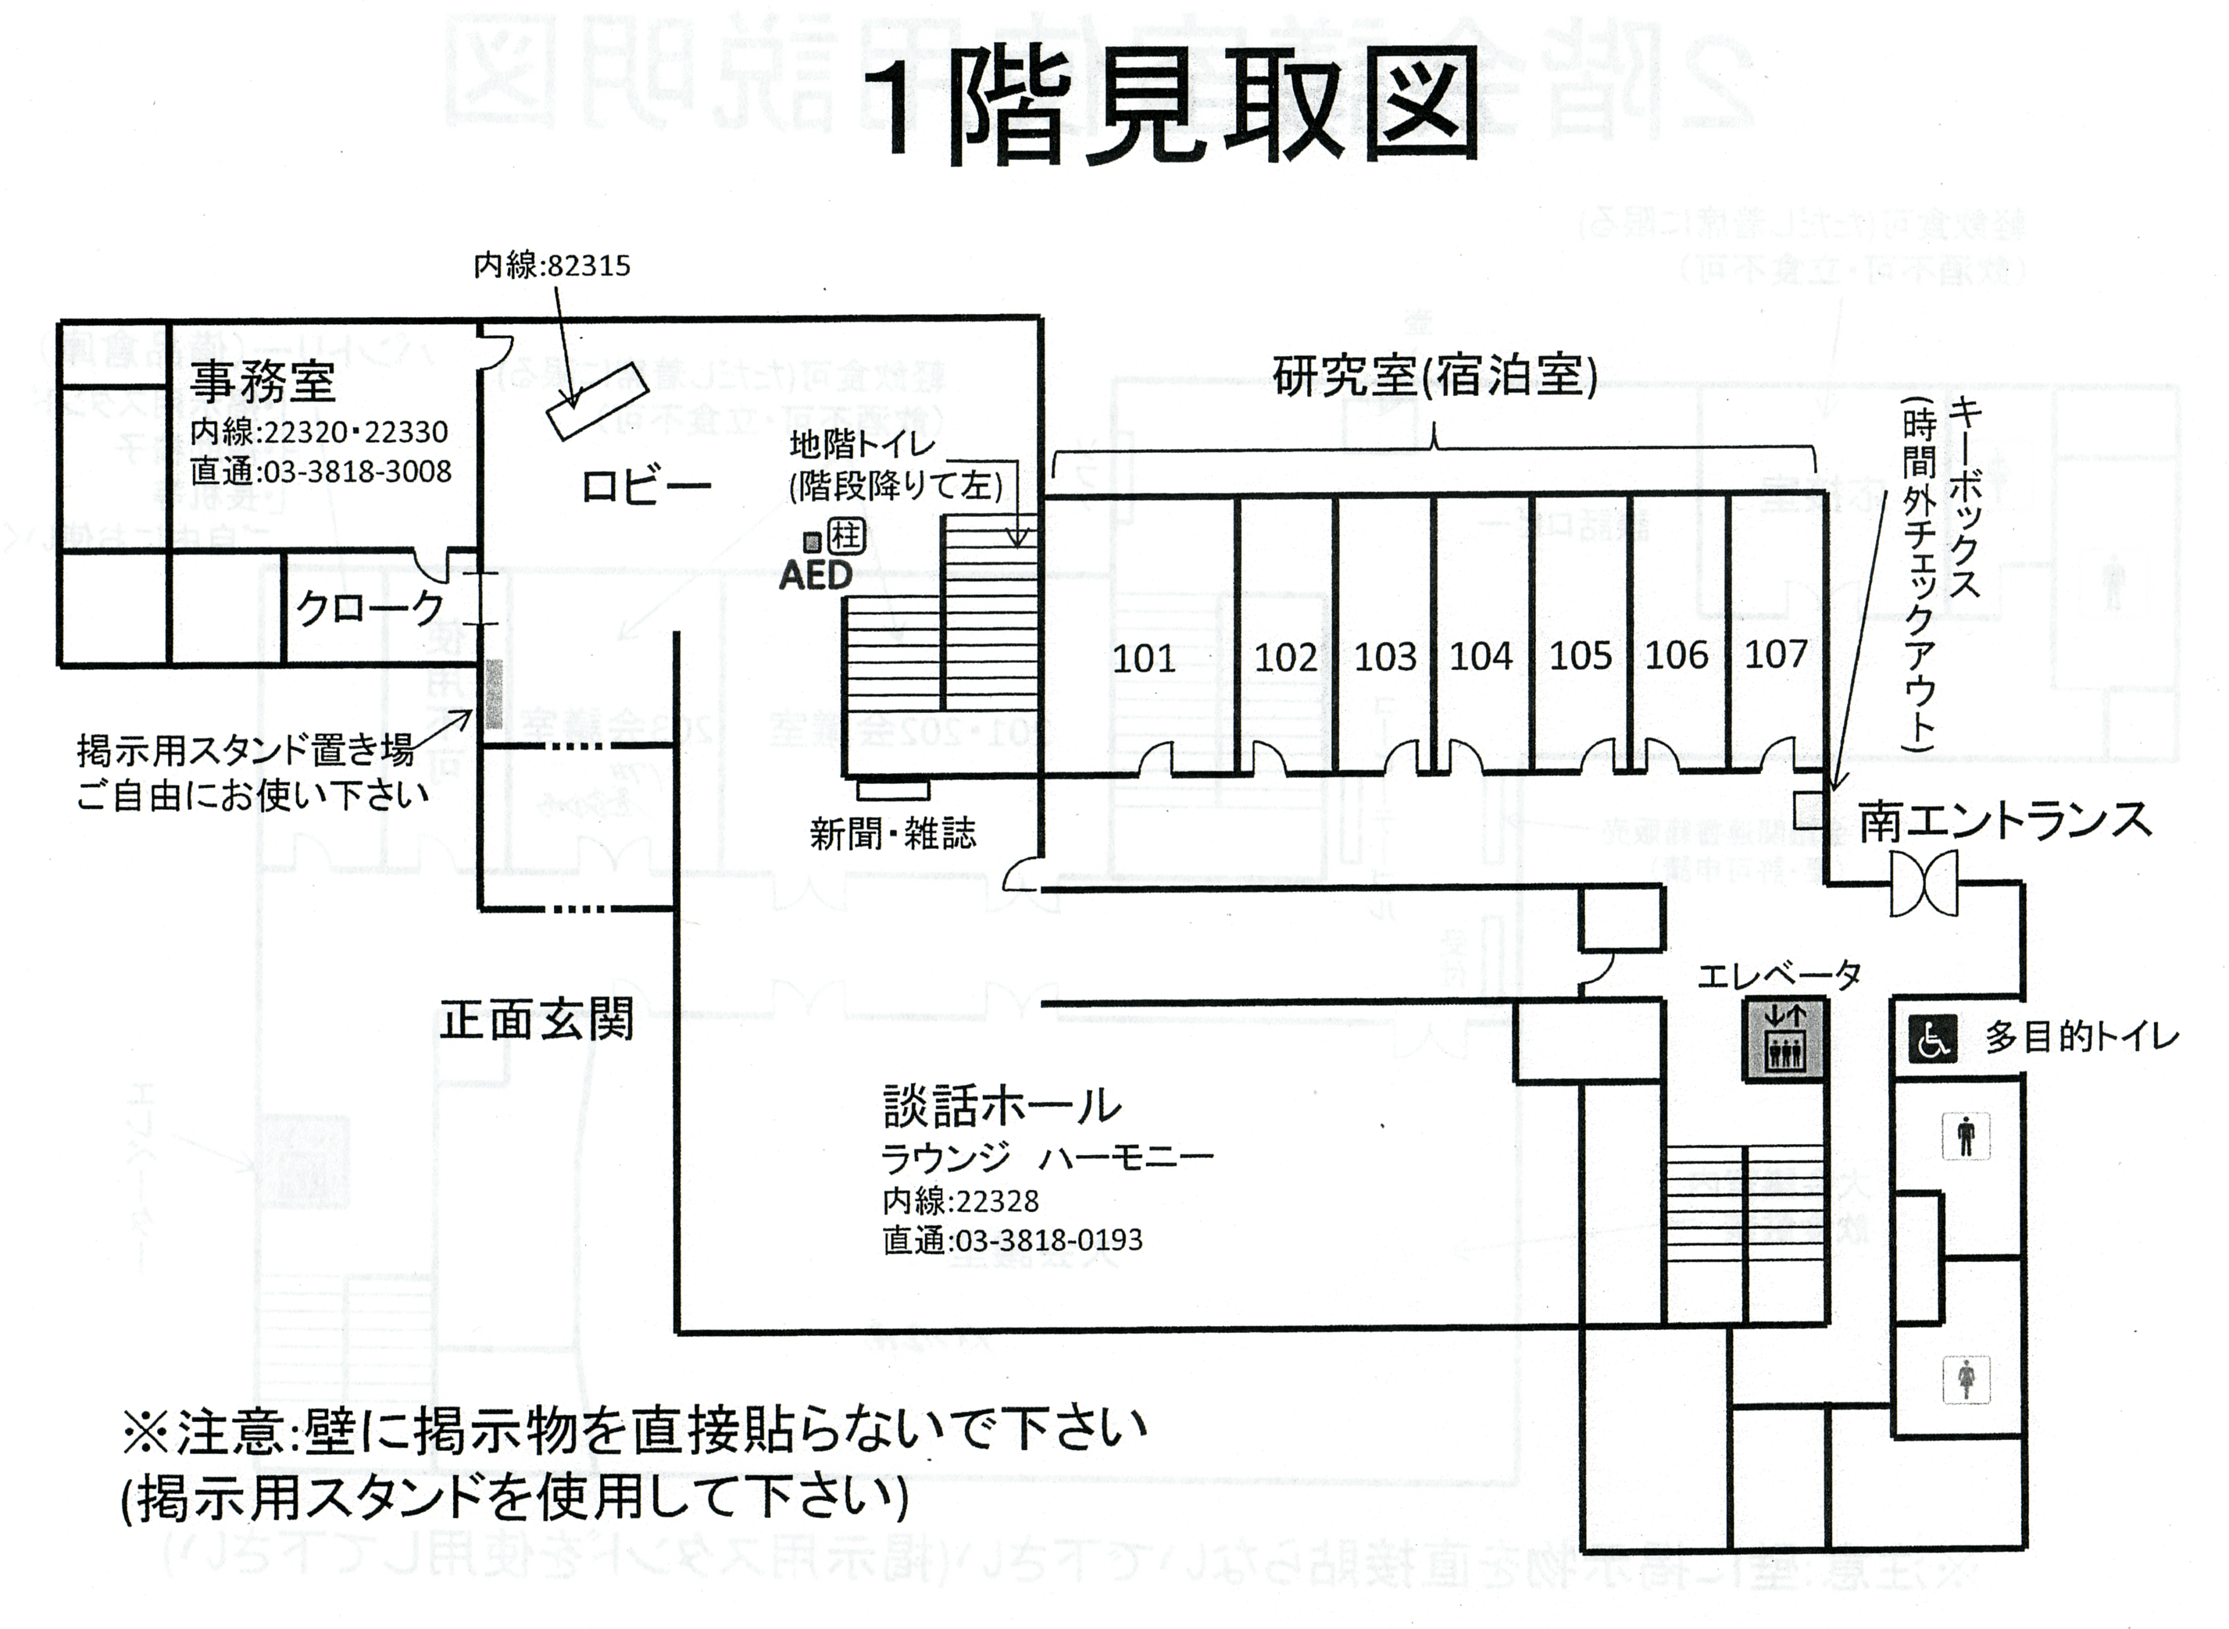
1st Floor
Entrance
Lounge

Slide 6
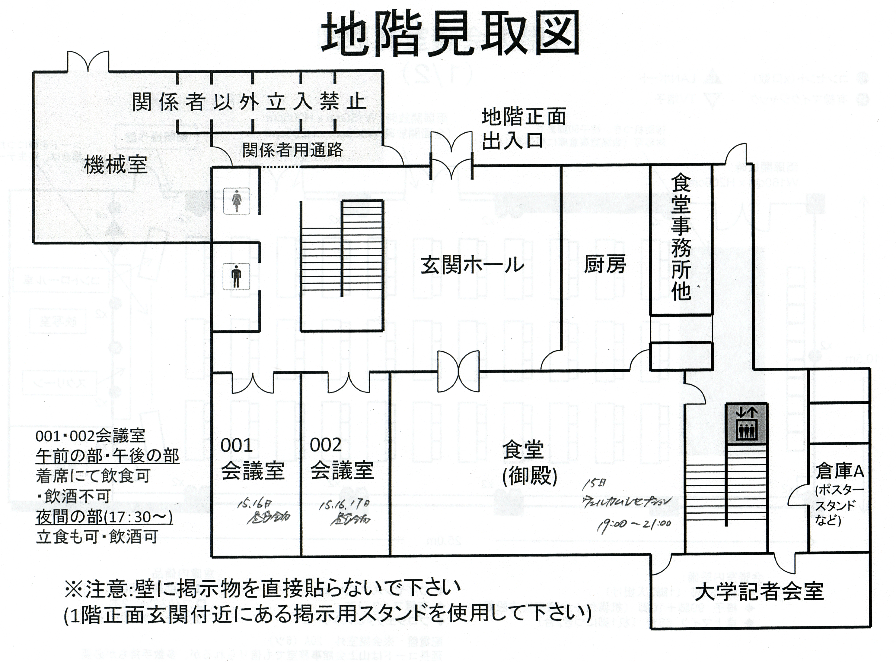
Basement Floor
Lunch room #1 (May 15th, 16th)
Lunch room #2
Reception Party
May 15th

Slide 7
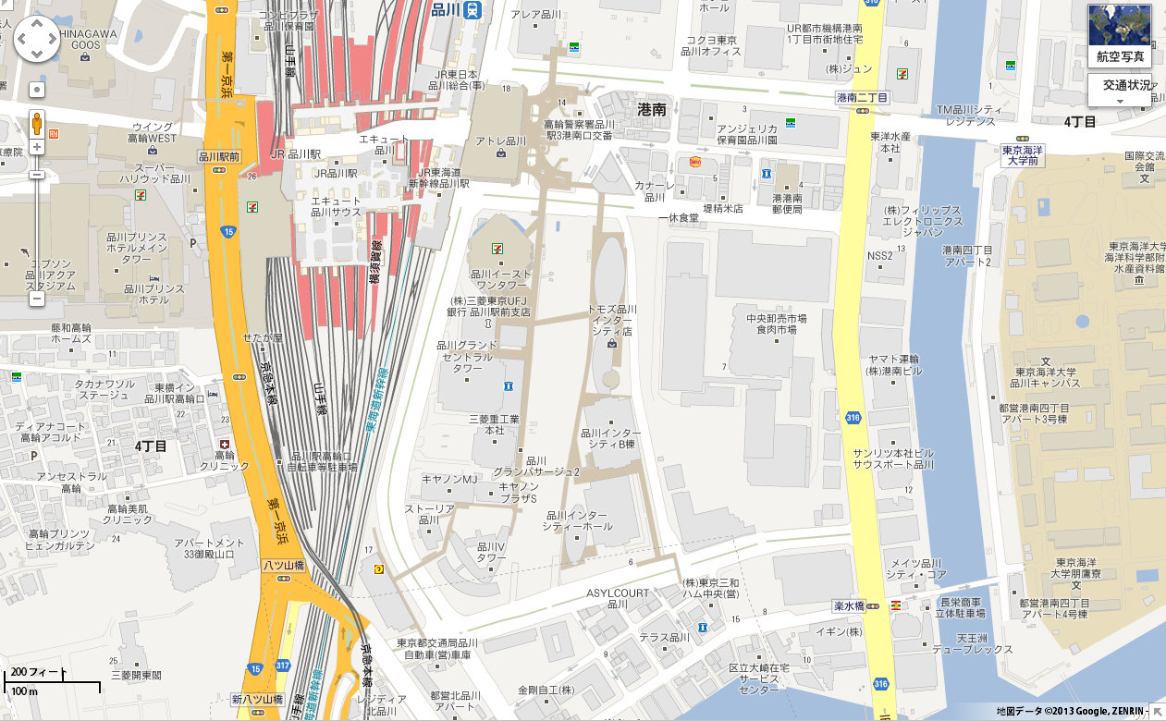
Workshop Dinner: Boat Cruise “Funasei”
+81-3-5479-2731
JR Shinagawa St.
Shinagawa Grand Commons
Funasei

Slide 8
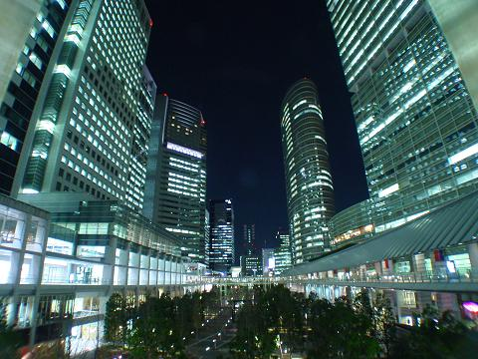
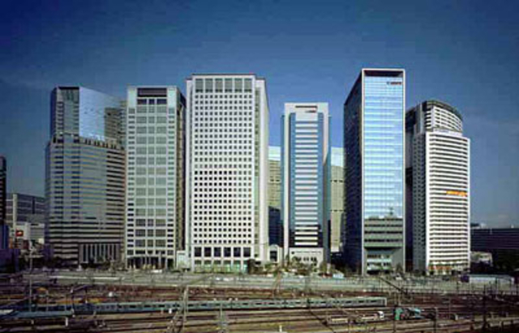
Shinagawa Grand Commons

Slide 9
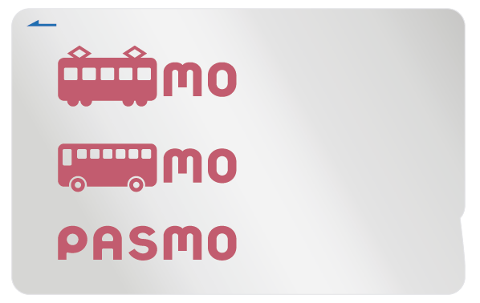
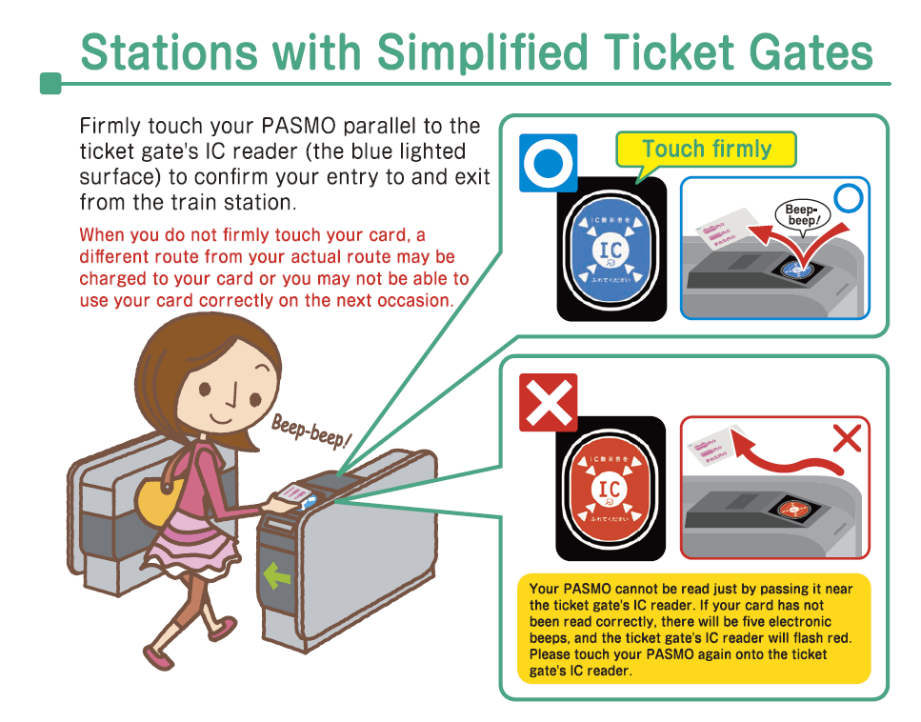
About ‘PASMO’
Public transportation IC card system which can be used for metro, JR trains, buses etc.
http://www.pasmo.co.jp/en/index.html

Slide 10
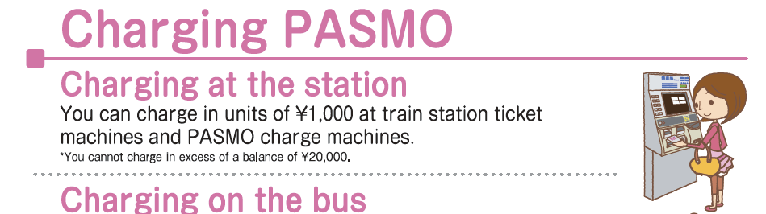
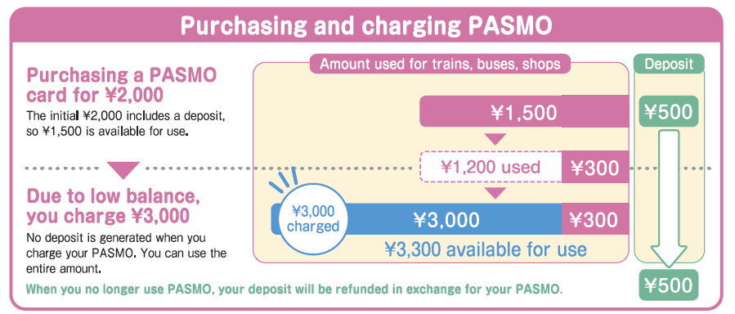

Slide 11
High Energy Physcis Activities in Japan

Slide 12
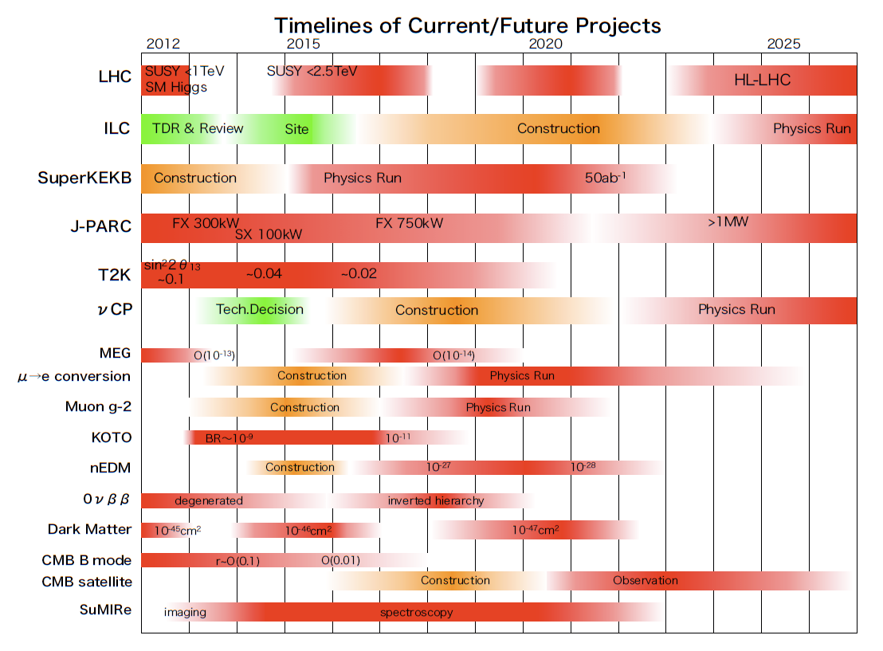

Slide 13
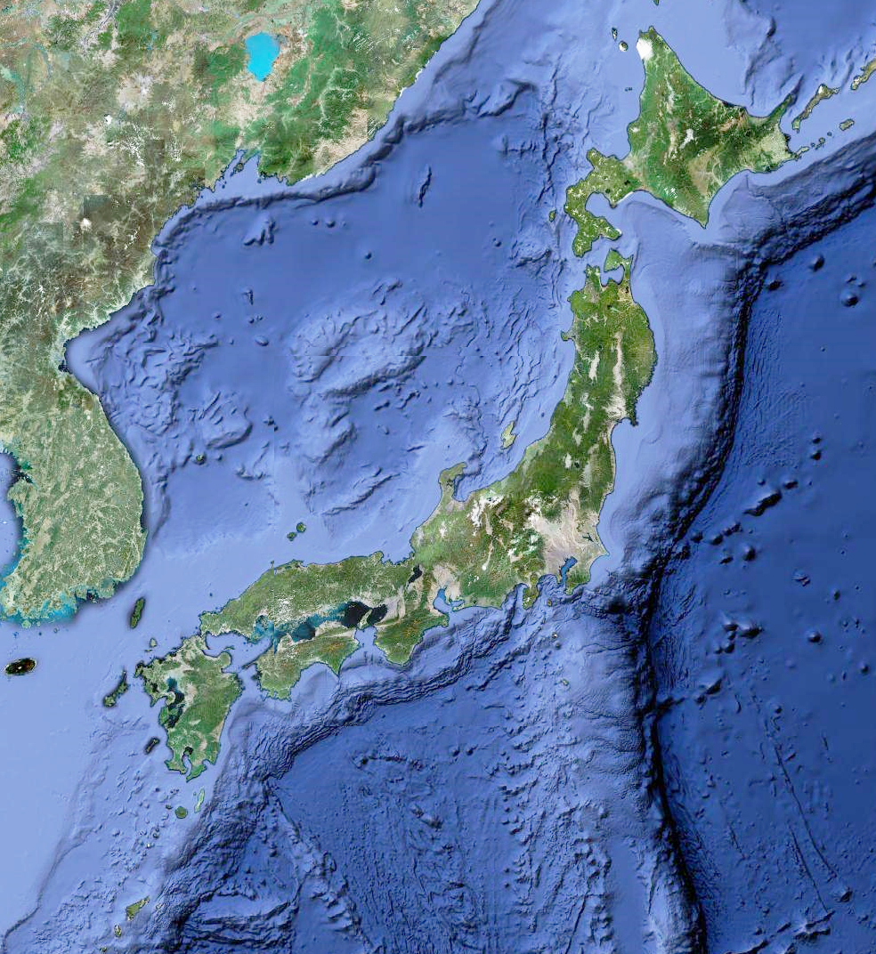
Rokkasho
ITER
Kitakami
ILC candidate
Kamioka
(SK, ν, KAGRA)
KEK Tokai
(J-PARC, T2K)
Oki νCP candidate
KEK Tsukuba
(Belle2, ATLAS)
U. Tokyo (ATLAS)
Seburi
ILC candidate
0
1,000km

Slide 14
ATLAS Japan Collaboration
17 Institutes,
~110 Collaborators
KEK
Univ. Tsukuba
Univ. Tokyo
Tokyo Metro. Univ.
Tokyo Inst. Tech.
Waseda Univ.
Ochanomizu Univ.
Shinshu Univ.
Nagoya Univ.
Kyoto Univ.
Kyoto Univ. Edu.
Osaka Univ.
Kobe Univ.
Okayama Univ.
Hiroshima Inst. Tech.
Kyushu Univ.
Nagasaki Inst. Appl. Sci.
Notes:
現在の日本の参加機関。15機関あり、広島と立命が抜けて代わりに早稲田と東工大が参加。正式には10月バルセロナでのATLAS Collaboration Boardで承認。参加人数は現在のオーサーリストから。

Slide 15
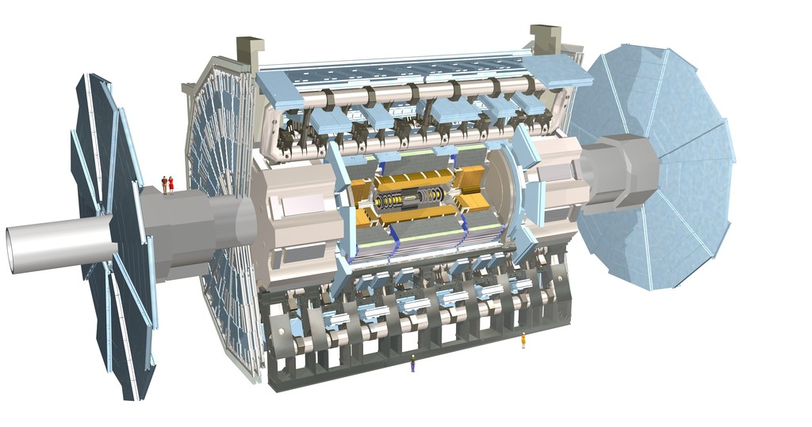
Japanese Contribution to Sub-Detectors
TGC: KEK, Tokyo, TMU, Shinshu, Nagoya, Osaka, Kobe
Solenoid: KEK
Muon TDC: KEK
SCT:
KEK, Tsukuba, Osaka, Kyoto Edu., Okayama
DAQ: KEK, Shinshu, Hiroshima IT, Nagasaki IAS
HLT: KEK, Kobe
Notes:
日本が建設に参加したサブシステム。DAQとHLTを含め従来の参加機関が表示してある。

Slide 16
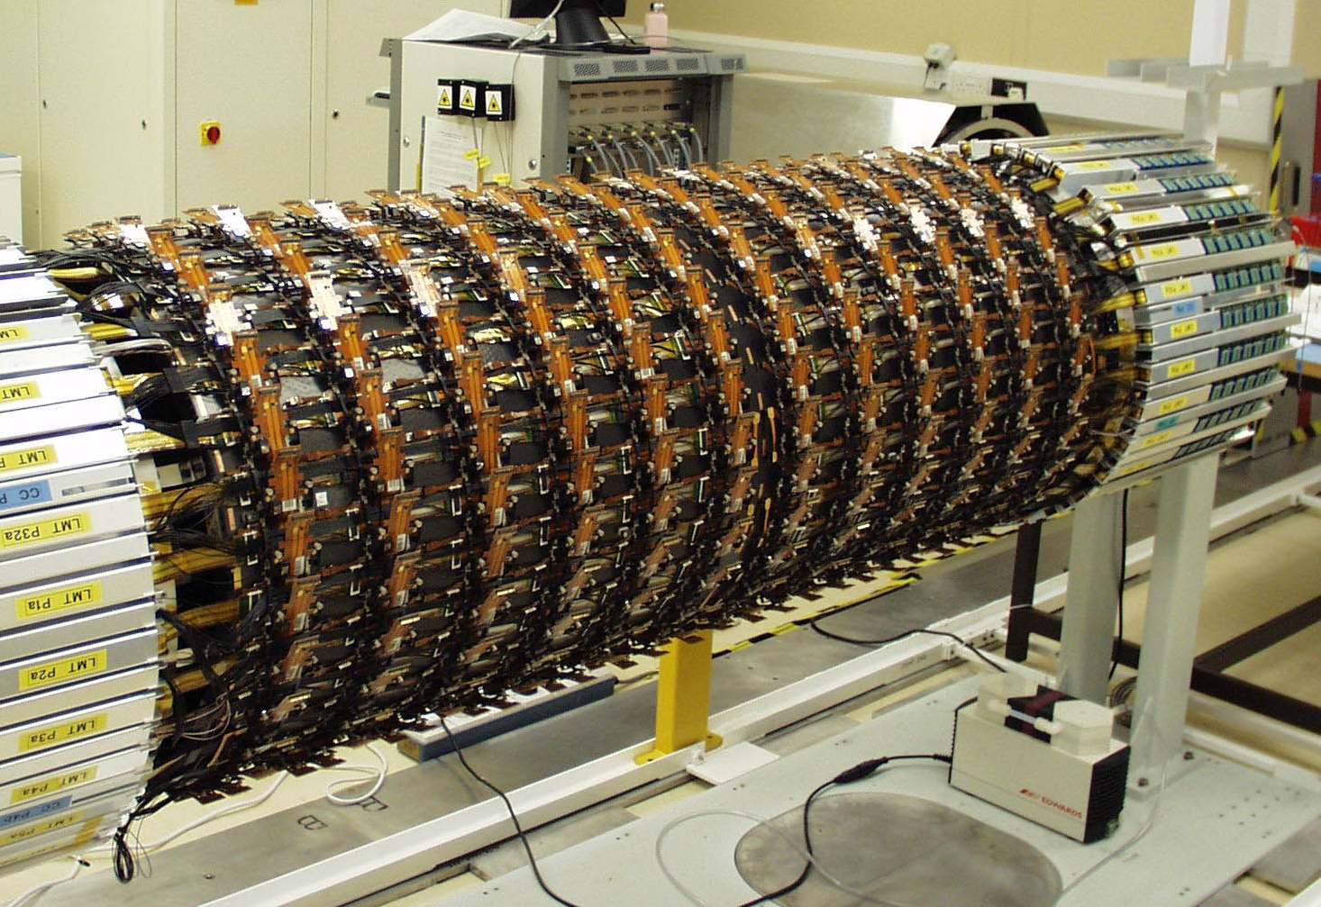
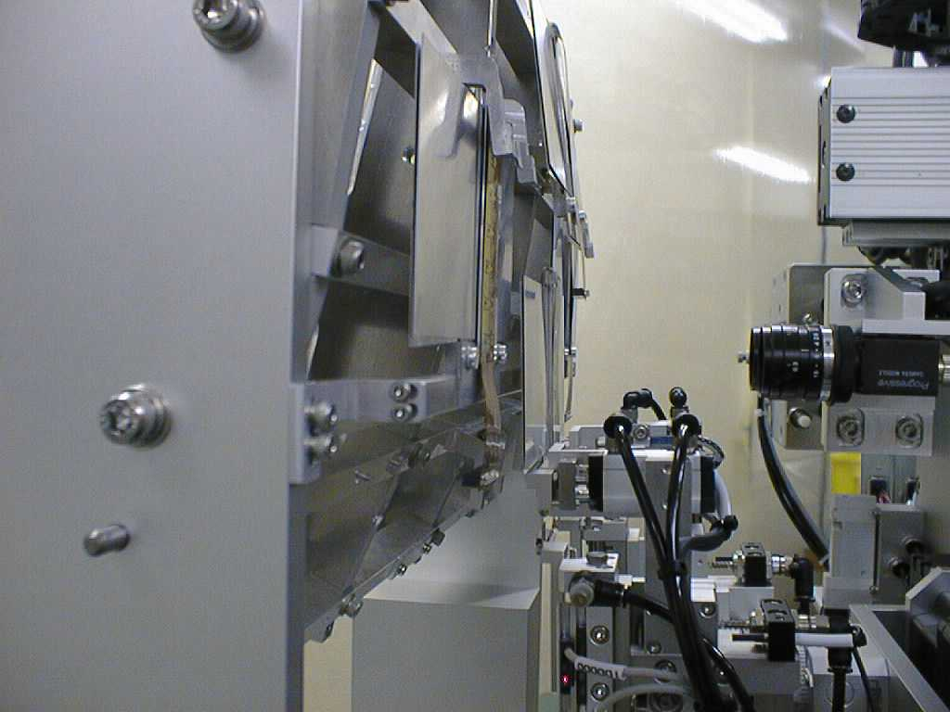
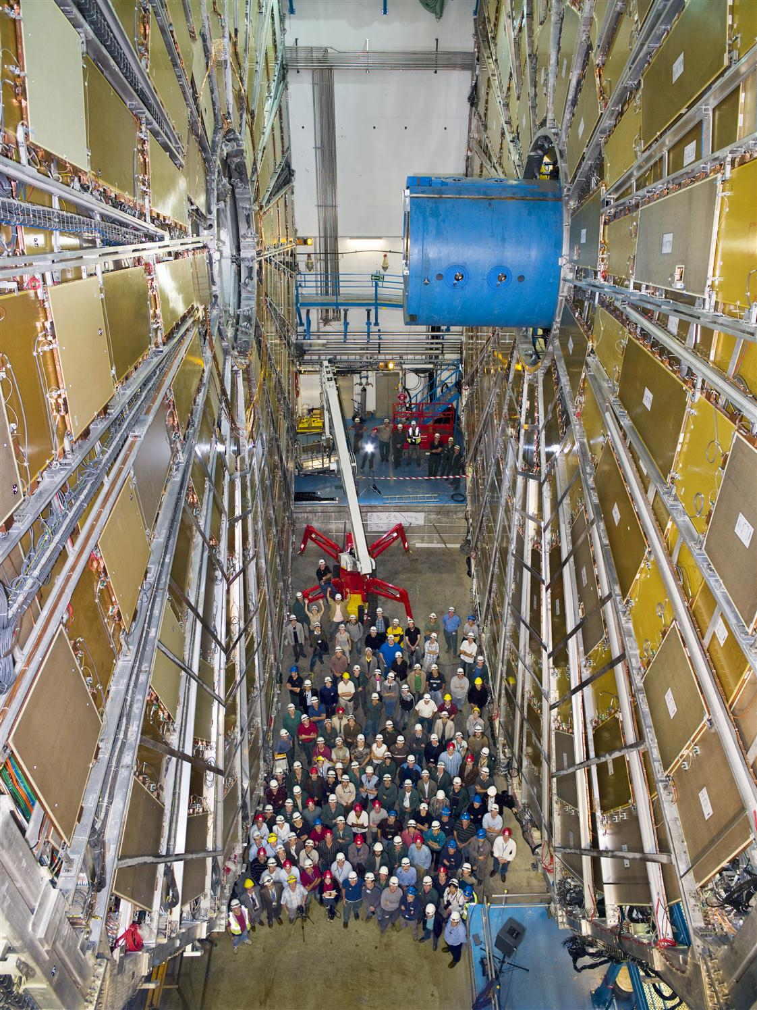
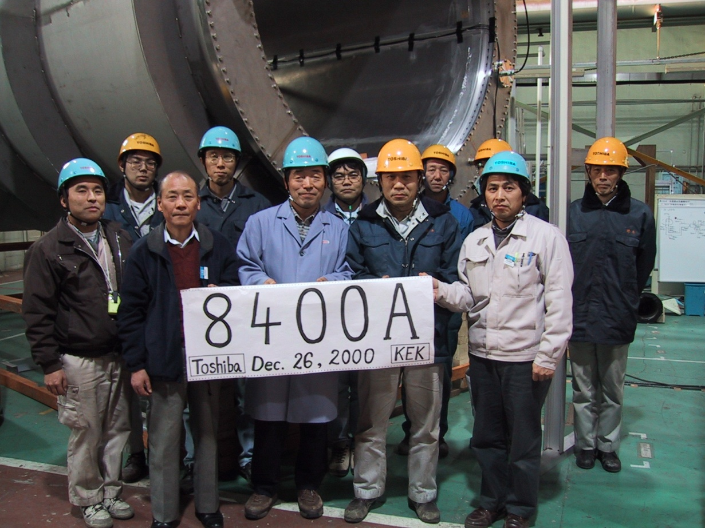

Slide 17
ATLAS Computing
TOKYO-LCG2 : Tomoaki’s talk
Network Connectivity : Motonori’s talk

